Slide 1

redisGraph分享
——吴浩杰

Slide 2
redisGraph图关系创建
公司结点：company{"companyName":"公司名称","companySize":"公司规模","companyType":"公司类型","companyAddress1":"公司地址所在市","companyAddress2":"公司地址所在区","companyAddress3":"公司地址所在街道"}
职位结点：position{"positionName":"职位名称","positionPriceLower":"薪资最小值","positionPriceTop":"薪资最大值","positionPriceAvg":"薪资平均值","positionEducation":"学历要求","postitionWorktype":"工作类型","positionBackground":"工作经验要求","positionFringe":"福利待遇","positionSource":"招聘信息来源","positionSplit":"行业一级分类","positionAddress1":"工作所在市","positionAddress2":"工作所在区","positionAddress3":"工作所在街道","provinceAddress":"工作所在省","cityTier":"所属城市类别","industryLevel":"行业二级分类"}
图构建：
(company)-[:have]->(position) ：公司有哪些职位招聘信息
(position)-[:belong]->(company) ：职位招聘信息属于哪些公司

Slide 3
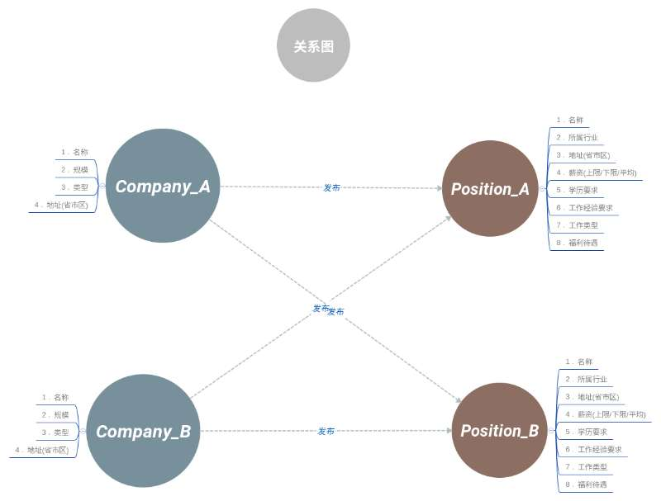
redisGraph图关系创建

Slide 4
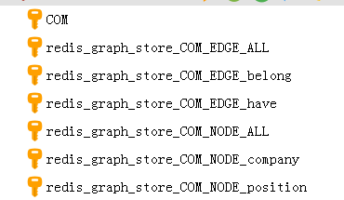
redisGraph存储结构
Com：表名称
Redis_greaph_store_com_NODE_[X]：结点名称
Redis_greaph_store_com_EDGE_[X]：关系名称

Slide 5
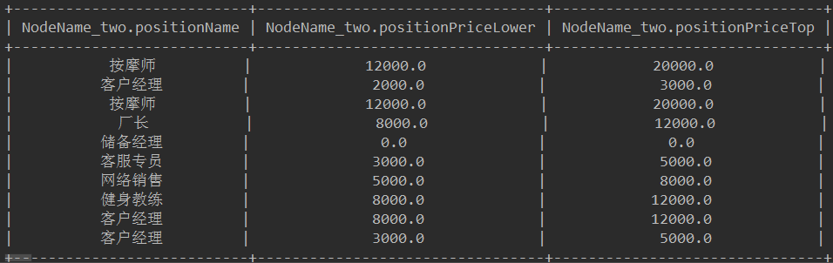
存储数据展示
由于redisgraph官方提供的API对数据返回类型支持不足，需要对返回值进行字符串自定义处理，以满足多类型数据返回值的需求。

Slide 6
Match
基础查询语句
MATCH (alias_node_source:Node_Source)-[:Relationship]->(alias_node_target:Node_Target)
Node_Source:源节点
Relationship：关系
Node_Target:目标节点
alias_node_source:源节点别名
alias_node_target:目标节点别名

Slide 7
Match
1）查找节点：
a.通过标签：match(com:Company)
b.通过标签及属性：match(com:Company {CompanyName:’百度’})
2）通过节点及关系查找
match (com:Company)-[:have]->(pos:Position)
match (pos:Position )-[:belong]->(com:Company)

Slide 8
例一
MATCH (pos:position {positionName:’客户经理’})
"message":[ { "positionName":"客户经理", "positionPriceLower":"2000.0", "positionPriceTop":"3000.0", "positionPriceAvg":"2500.000000", "positionEducation":"专科及以上", "positionBackground":"经验不限", "positionFringe":"餐补交通补助话补", "positionSource":"赶集网", "positionSplit":"销售/人力/行政/客服/财务", "positionAddress1":"贺州市", "positionAddress2":"八步区", "positionAddress3":"贺州/远东国际城C405", "postitionWorktype":"全职", "provinceAddress":"广西壮族自治区", "cityTier":"五线城市", "industryLevel":"销售业务", "companyName":"内蒙古鸿茅药业有限公司", "companySize":"NULL", "companySource":"赶集网", "companyType":"NULL", "companyAddress1":"贺州市", "companyAddress2":"八步区", "companyAddress3":"贺州/远东国际城C405" }, Object{...}, Object{...}, Object{...} ]

Slide 9
Match
3) 带返回结果查询：
MATCH (alias_node_source:Node_Source)-
[alias_edge:Relationship]->(alias_node_target:Node_Target)
WHERE alias_node_[name]. attribute [condition],
alias_edge_[name]. attribute [condition],
RETURN alias_node_source, alias_node_target，
alias_node_[name]: 节点别名
alias_edge_[name]: 边别名
attribute：标签的属性名称
Condition:条件
RETURN ：返回结果集
支持的方法：
MAX 最大值
MIN 最小值
SUM 求和
AVG 平均值

Slide 10
例二：
MATCH (com:company)-[:have]->(pos:position) RETURN pos.cityTier,avg(pos.positionPriceAvg)
查询不同城市类型的平均薪资排行
结果返回：
[ { "cityTier":"一线城市", "AVG":5740.690909 }, { "cityTier":"二线城市", "AVG":5577.291891 }, { "cityTier":"三线城市", "AVG":4531.494687 }, { "cityTier":"五线城市", "AVG":2738.095238 }, { "cityTier":"四线城市", "AVG":1893.518519 } ]

Slide 11
通用查询1：
全部结果集查询
condition={"position": {"positionName": "“},company": {"companyName": ""}}
MATCH (com:company)-[:have]->(pos:position)
WHERE condition
RETURN com,pos
需要查询的内容通过动态传参，传入json串便可实现。查询那个字段，就相应传入那个字段

Slide 12
例三：
condition={"position":{"positionEducation":"专科及以上"}}
MATCH (com:company)-[:have]->(pos:position)
WHERE condition
RETURN com,pos
查询学历要求为“专科及以上”的公司信息与职位信息
只有节点名称固定，其他条件动态传入。

Slide 13
通用查询2
返回固定条件结果集
查询语句：condition={"position": {"positionName":""}
MATCH (NodeName_one:company)-[:have]
->(NodeName_two:position)
WHERE Condition RETURN NodeName_two. attribute,
count(NodeName_two. attribute)
avg(NodeName_two. attribute)……
Condition：条件
Attribute:标签属性名称

Slide 14
例四
condition={“position”: {“positionName”: “服务业","industryLevel": "","province_address":
"","cityTire": "","positionEducation":""},"company": {"companyName": ""}}
MATCH (com:company)-[:have]->(pos:position)
WHERE condition
RETURN com,pos
查询“服务业”的公司信息与职位信息

Slide 15
例四：结果
"message":{ "positionName": { }, "industryLevel":Object{...}, "provinceAddress":Object{...}, "cityTire":Object{...}, "positionEducation":Object{...}, "companyName":{ "招聘项目部":8000, "苏州市相城区阳澄湖镇秋日渔大闸蟹养殖有限公司":9000, "悟明堂":15000, "复兴时代国际传媒":6750, "融屹金融":16000 } }
查询“服务业”的公司信息与职位信息，返回所有查询字段，过滤查询的条件字段

Slide 16
例五
“message”:[ { “positionName”:“客户经理”, “positionPriceLower”:“2000.0”, “positionPriceTop”:“3000.0”, “positionPriceAvg”:“2500.000000”, “positionEducation”:“专科及以上”, “positionBackground”:“经验不限”, " positionFringe":"餐补交通补助话补", "positionSource":"赶集网", "positionSplit":"销售/人力/行政/客服/财务", "positionAddress1":"贺州市", "positionAddress2":"八步区", "positionAddress3":"贺州/远东国际城C405", "postitionWorktype":"全职", "provinceAddress":"广西壮族自治区", "cityTier":"五线城市", "industryLevel":"销售业务", }, Object{...}, Object{...}, Object{...} ]
任意查询—条件可追加
{“position”: {“cityTier”:“五线城市”,
“positionName”:“客户经理”}…}
如查询“五线城市”的“客户经理”的职位信息

Slide 17

Thank you !

