Slide 1
Decision Analytics
Week 7
Optimization in Industry
Introduction to OPL

Slide 2
Introduction to IBM Optimization Studio
We have used Excel’s Solver capabilities to solve our optimization problems
Large problems need more robust capabilities both to model the problem and to solve them
IBM ILOG CPLEX Optimization Studio is an optimization software package.
OPL provides for a modelling framework
CPLEX is the underlying solver
Other key industrial solvers exist as well (e.g. Gurobi)

Slide 3
General Template
dvar (type of variable)
minimize (or) maximize …
subject to {
…
…
…
}
Decision variables
Objective function
Constraints

Slide 4
Types of decision variable functions
dvar float - Real number
dvar float+ - Non-negative real number
dvar int - Integer variable
dvar int+ - Non-negative integer variable
dvar boolean - Binary variable

Slide 5
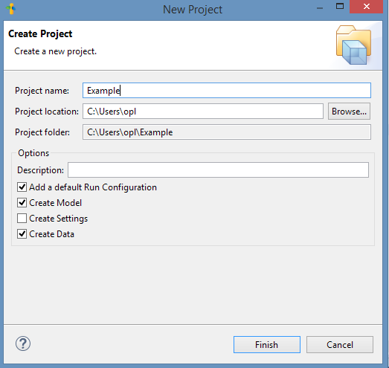
Opening a new project
File
New
OPL Project

Slide 6
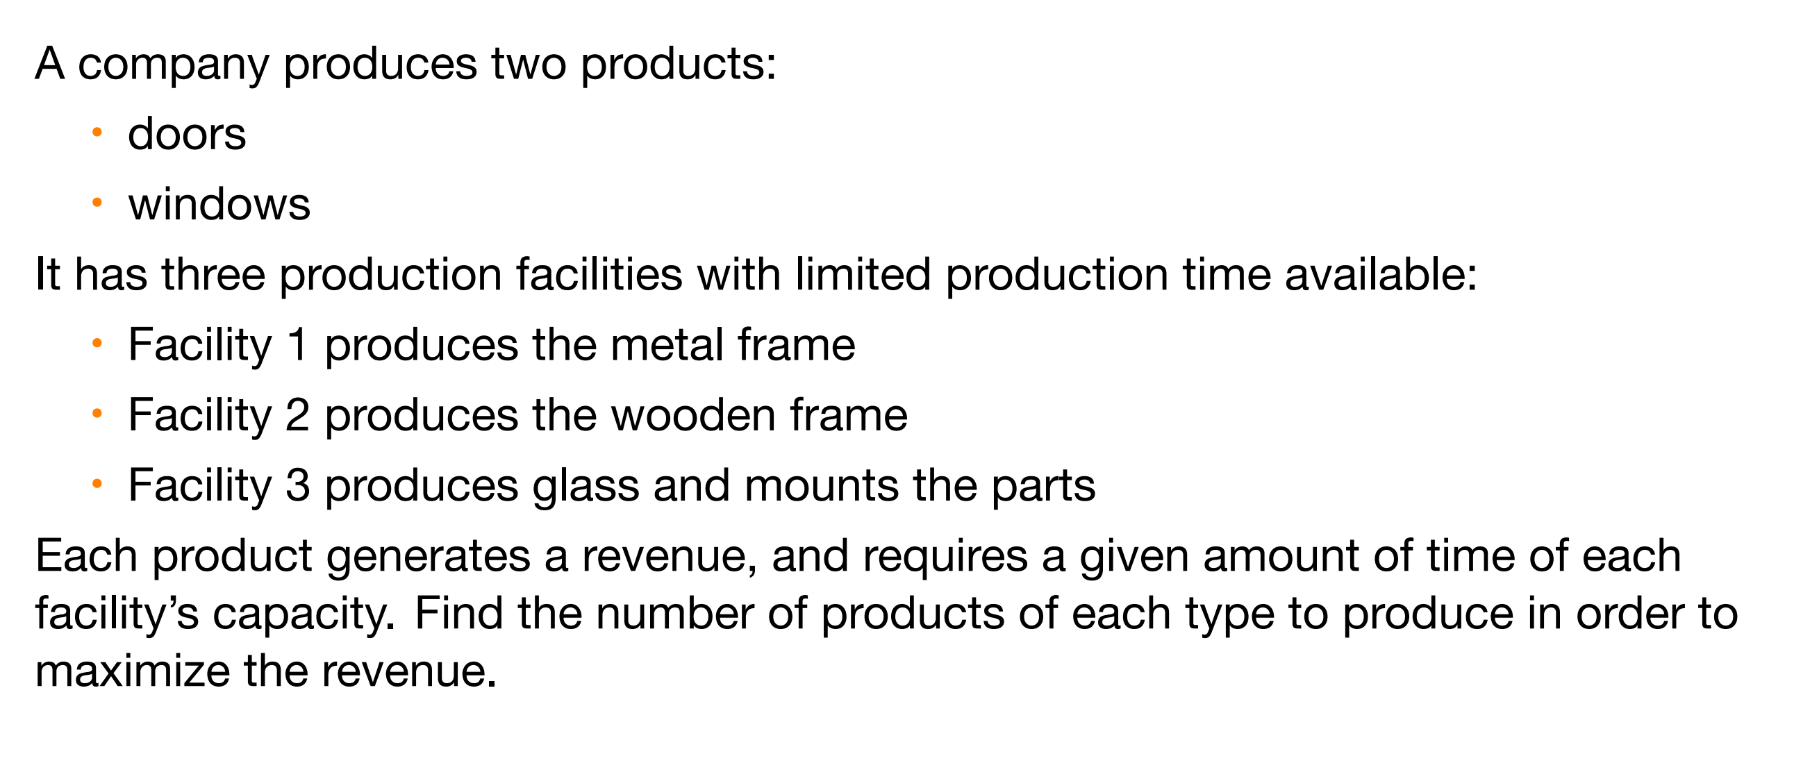
Small Example

Slide 7
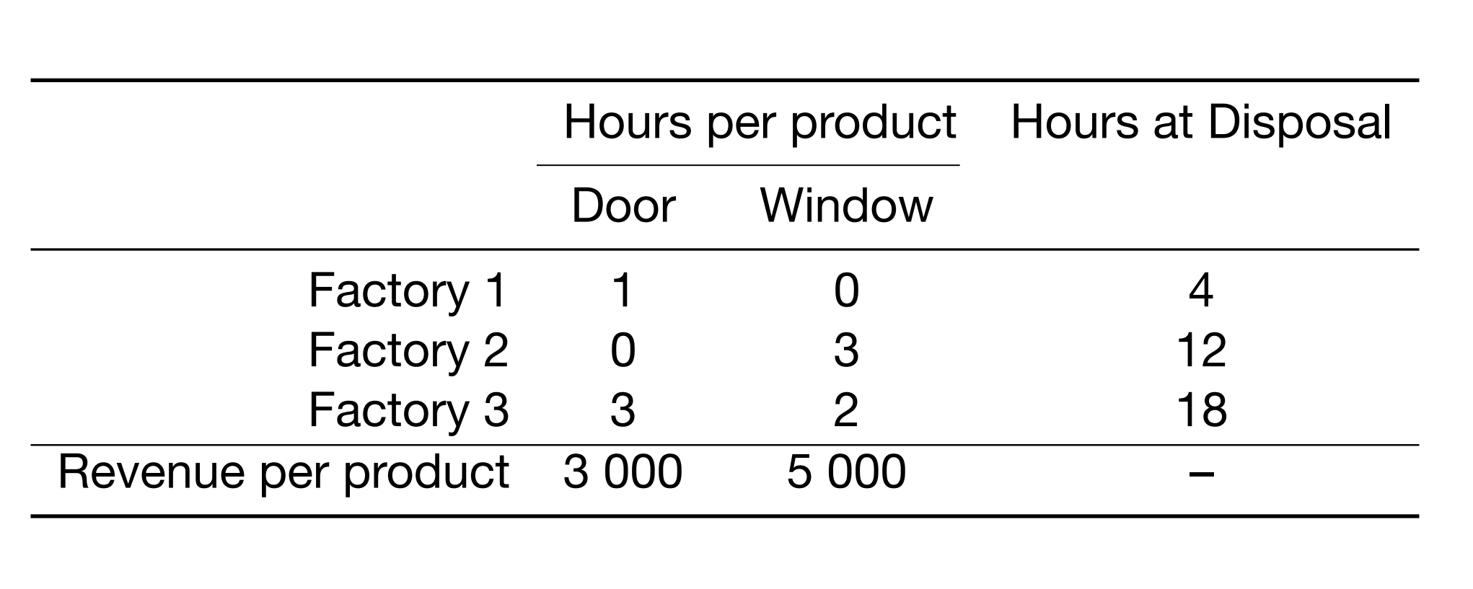
Small Example
2

Slide 8

Small Example: Formulation
Decision variable
Xi: units of product i to produce
Objective Function
Max $\sum_{i}{R_{i}X_{i}}$
Subject to
$\sum_{i}{a_{ij}X_{i}≤}h_{j}$ for all j
$X_{i}≥0$ and integer for all i

Slide 9
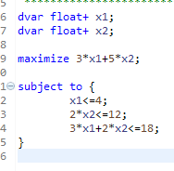
Defining a model
Decision variables
Objective function
Constraints

Slide 10
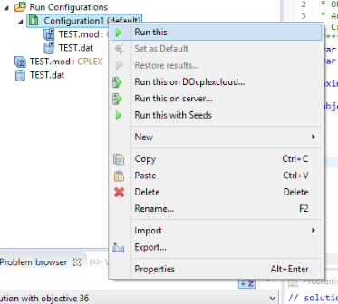
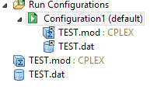
Model Execution
Drop the mod and dat file in Configuration1
Right click → Run this

Slide 11
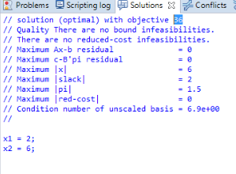
Reviewing the Solution
# of batches of product 1 produced per week, x₁ = 2
# of batches of product 2 produced per week, x₂ = 6
Total profit per week from producing these two products, Z = $ 36,000

Slide 12
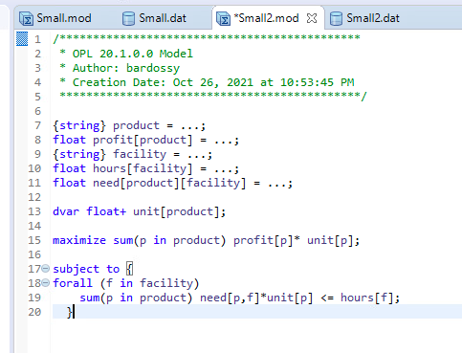
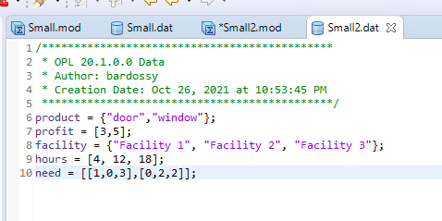
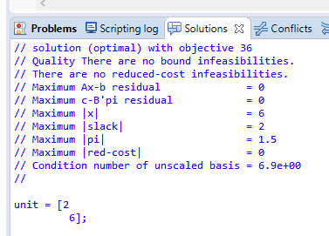
Separating the Data from the Model

Slide 13
Questions?

