Slide 1
Decision Analytics
Heuristic Methods in Optimization
Metaheuristics
Content for this presentation was derived from Introduction to Operations Research, 9th Edition, Chapter 13, by Hillier and Lieberman

Slide 2
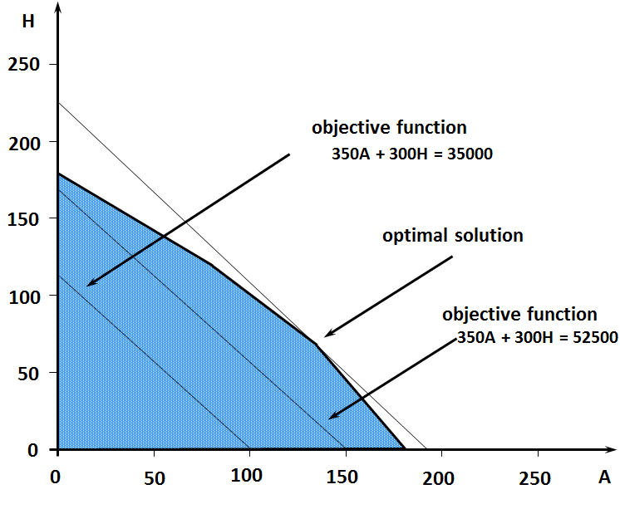
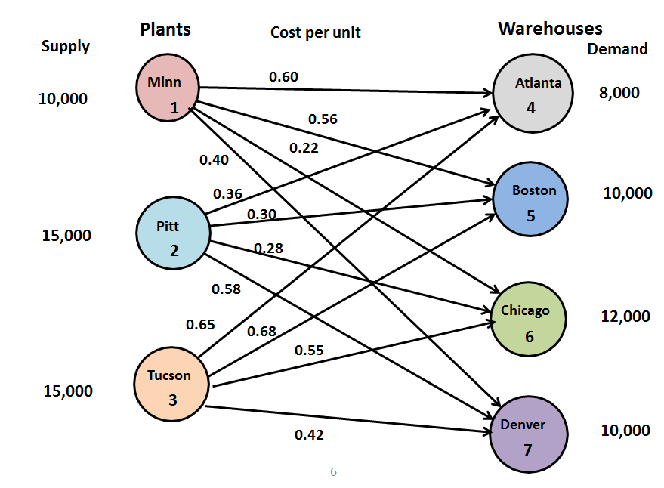
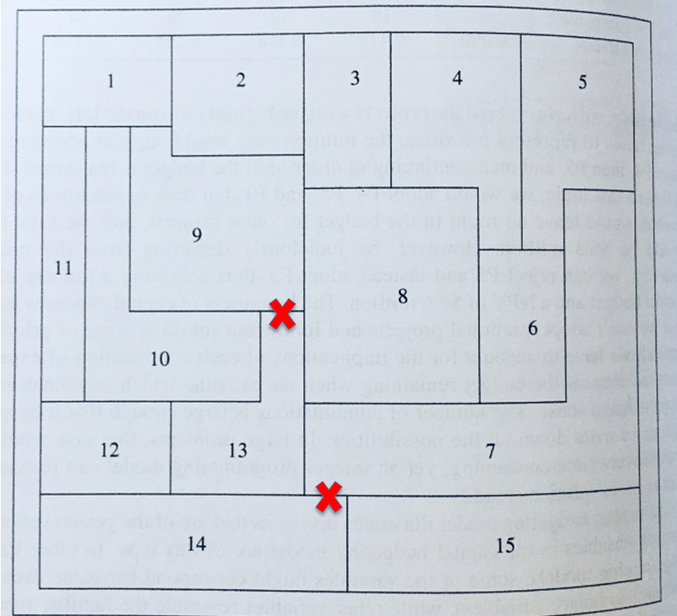
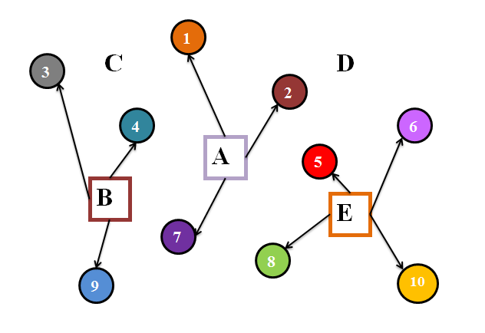
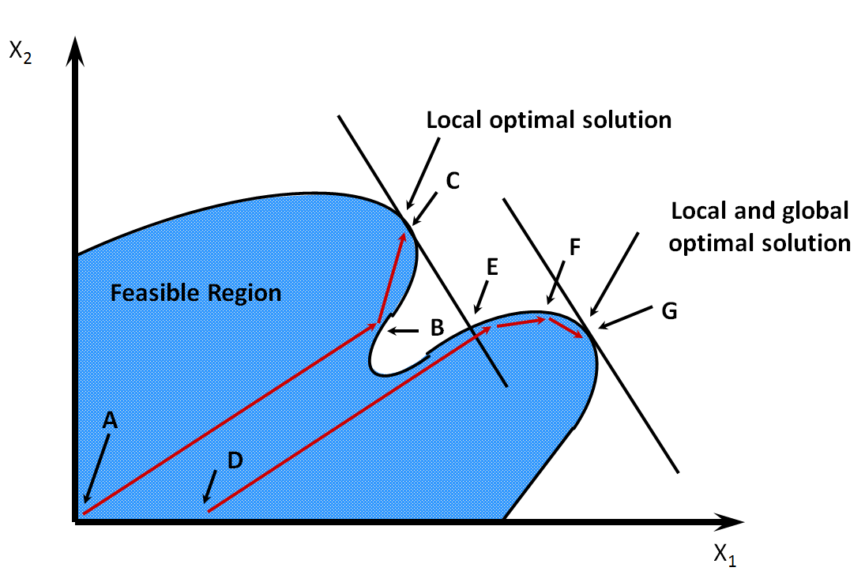

Recap
Network Flows
Linear Programming
Mixed-Integer Programming
Non-Linear Programming
Integer Programming

Slide 3
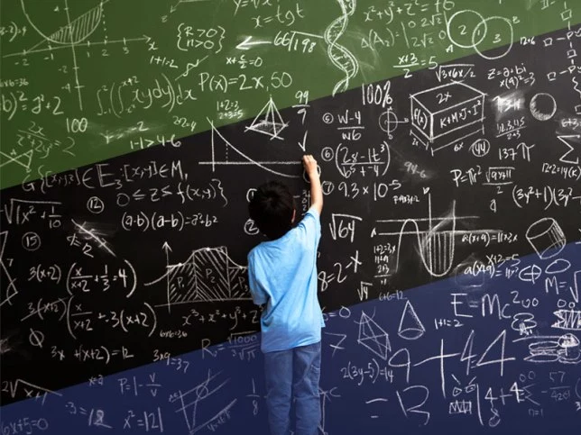
Motivation
Some optimization problems are so complicated that it may not be possible to solve for an optimal solution
We still want to find a good feasible solution
Formulation may exist but it may be very hard to solve
Many combinatorial problems fall in this category
Traveling Salesman Problem, Vehicle Routing Problem, Sequencing
Heuristic methods are commonly used for these problems
Often iterative
Each iteration focuses on finding a better solution than the one found previously

Slide 4

Heuristic Algorithms
Exact algorithms
Guaranteed to find a global optimal solution
The run times are unreasonably high for large scale problems
Heuristic algorithms
Finds a good solution fast
Chosen method depends on the specific problem
No guarantee on the quality of the solution in general
Metaheuristics
Provides a general structure and strategy guidelines to develop a heuristic method to fit a particular type of problem

Slide 5
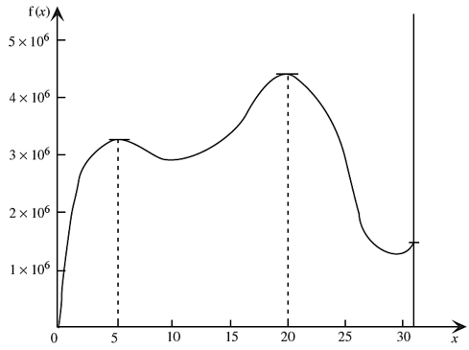
Metaheuristics – an example
Example: a nonlinear programming problem with multiple local optima
Maximize : f(x) = 12x⁵ – 975x⁴ – 345,000x³ + 1800,000x
subject to 0 ≤ x ≤ 31
Simple heuristic solution approach
Hill-climbing approach
Gradient search procedure
Procedure stops when a local optimum is reached
Which optimum is found depends on where procedure begins the search
Metaheuristics can escape from a local optimum
Trial solutions that immediately follow a local optimum are allowed to be inferior

Slide 6
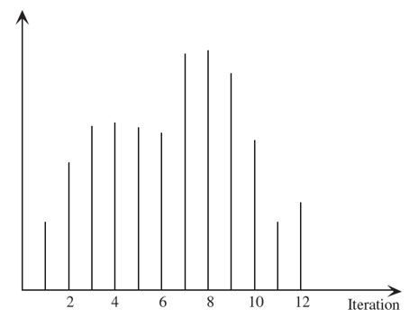
The Nature of Metaheuristics
A typical sequence of objective function values for the solutions obtained by a metaheuristic as it first converges to a local optimum (iteration 4) and then escapes to converge to the global optimum (iteration 8) of a maximization problem before concluding its search (iteration 12)

Slide 7
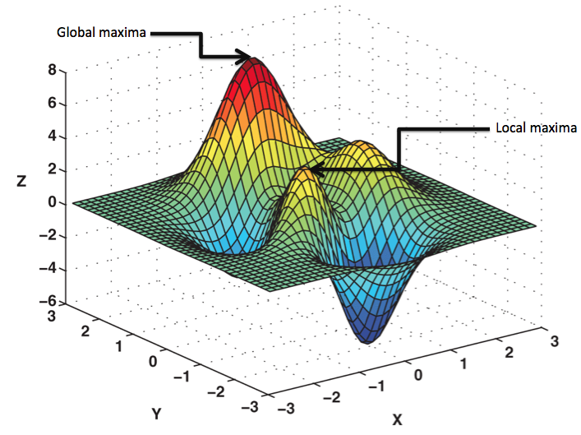
Examples of Metaheuristics
Tabu Search
Simulated Annealing
Genetic Algorithms

Slide 8

Tabu Search
Basic concepts of Tabu search
Subroutine: a local search procedure
Uses the steepest ascent-mildest descent approach (using analogy of hill-climbing)
Danger with this approach: after moving away from a local optimum, the process will cycle back to the same local optimum
Solution
Tabu search temporarily forbids moves that would take it back to the last optimum
Tabu moves are saved in a tabu list

Slide 9
Tabu Search
Initialization: start with a feasible trial solution
Iteration
Use local search procedure to define feasible moves into the neighborhood of the current solution
Use tabu list to eliminate certain moves
Stopping rule
Fixed number of iterations, CPU time, or other criterion

Slide 10
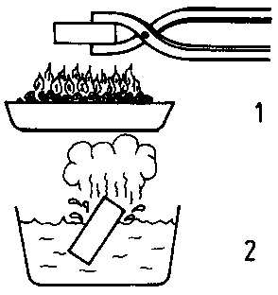
Simulated Annealing
Basic concepts of simulated annealing
Models the physical process of heating a material and gradually lowering the temperature to decrease defects
Focuses on searching for the tallest hill
Early emphasis on taking steps in random directions
Gradually moves the emphasis on climbing upward by rejecting more moves that go in a downward direction
Approach for selecting the next trial solution
If the candidate under consideration is better than the current trial solution, it is selected
If it is worse, a certain acceptance probability is applied
Probability depends on how much worse it is

Slide 11
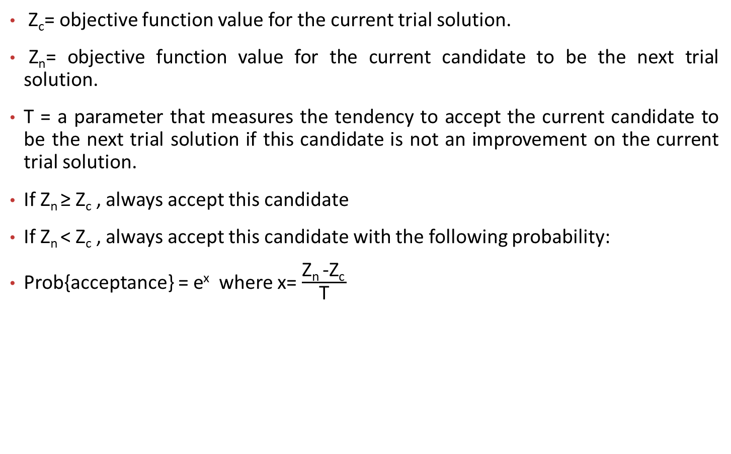
Simulated Annealing – probability determination
Z_{c}= objective function value for the current trial solution.
Z_{n}= objective function value for the current candidate to be the next trial solution.
T = a parameter that measures the tendency to accept the current candidate to be the next trial solution if this candidate is not an improvement on the current trial solution.
If Z_{n} ≥ Z_{c} , always accept this candidate
If Z_{n} < Z_{c} , always accept this candidate with the following probability:
Prob{acceptance} = e^{x} where x= $\frac{\text{Z}\text{n}\text{ −}\text{Zc} }{\text{T}}$

Slide 12
Simulated Annealing - Outline
Initialization
Start with a feasible initial trial solution
Iteration
Use the move selection rule to select the next trial solution.
(If none of the immediate neighbors of the current trial solution are accepted, the algorithm is terminated)
Check the temperature schedule
When the desired number of iterations have been performed at the current value of T, decrease T to the next value in the temperature (or annealing) schedule and resume performing iterations at this next value
Stopping rule
When the desired number of iterations have been performed at the smallest value of T in the temperature schedule, stop.
Accept the best trial solution found at any iteration (including for larger values of T) as the final solution.

Slide 13

Genetic Algorithms
Basic concepts of genetic algorithms
Analogous to Darwin’s theory of evolution, “survival of the fittest,” and natural selection
Concerned with populations of solutions
Rather than dealing with one trial solution at a time
Generate improving populations of trial solutions as they proceed
Mutations can occur

Slide 14
Genetic Algorithms - Outline
Initialization
Start with an initial population of feasible trial solution, perhaps by generating them randomly.
Iteration
Use a random process that is biased toward the more fit members of the current population to select some of the members to become parents.
Pair up the parents randomly and then have each pair of parents give birth to 2 children.
Stopping rule
Use some stopping rule, such as fixed number of iterations, a fixed amount of CPU time, or a fixed number of consecutive iterations without any improvements in the best trial solution found so far.
The best trial solution on any iteration is the final solution.

Slide 15
Conclusion
For complex optimization problems
May not be possible to solve with exact algorithms presented in previous weeks
Metaheuristics provide structure and strategy
Goal is to arrive at a very good solution in a very reasonable amount of time!

Slide 16
Questions?

