Slide 1
Topic 3: Integer Optimization
BUDT 732: Decision Analytics
Gisela Bardossy,

Slide 2
Objectives
Motivation for Integer LP Models
Solving Method: Branch-and-Bound
Examples of Integer LP Models
  Investment selection, scheduling, allocation
  Binary variables & Logical conditions
  Min-max or max-min objectives

Slide 3
Objectives
Motivation for Integer LP Models
Solving Method: Branch-and-Bound
Examples of Integer LP Models
  Investment selection, scheduling, allocation
  Binary variables & Logical conditions
  Min-max or max-min objectives

Slide 4
Introduction
Often, fractional solutions are just not useful
  Personnel scheduling
  R&D project selection
  Planning locations for new factories, call centers etc.
  Production planning (if we are making airplanes or optic fibers)
Many business decisions are “yes/no” in nature (e.g. sign this contract or not)
Integer programming ensures that we get an optimal solution that makes sense
Sometimes this is easy, but the costs can be quite high
.

Slide 5
Example
The owner of the machine shop is planning to expand by purchasing some new machines- presses and lathes. The owner has estimated that each press purchased will increase profit by $100 per day and each lathe will increase profit by $150 daily. The number of machines the owner can purchase is limited by the cost of the machines and the available floor space in the shop. The machine purchase prices and space requirements are as follows:
The owner has a budget of $40,000 for purchasing machines and 200 square feet of available floor space. The owner wants to know how many of each type of machine to purchase to maximize the daily increase in profit.
Machine | Required Floor Space (sq ft) | Purchase Price
Press | 15 | $8,000
Lathe | 30 | 4,000

Slide 6
Integer Conditions
MAX: 100X₁ + 150X₂ } profit
S.T.:
15X₁ + 20X₂ <= 200 } space
8X₁ + 4X₂ <= 40 } budget
X₁, X₂>= 0 } nonnegativity
X₁, X₂ must be integers } integrality
Integer (or integrality) conditions are easy to state but make the problem much more difficult to solve.
.

Slide 7
Relaxation (generic LP)
Original ILP
    MAX: 100X₁ + 150X₂
    S.T.:
    15X₁ + 20X₂ <= 200
    8X₁ + 4X₂ <= 40
    X₁, X₂>= 0
    X₁, X₂ must be integers
LP Relaxation
    MAX: 100X₁ + 150X₂
    S.T.:
    15X₁ + 20X₂ <= 200
    8X₁ + 4X₂ <= 40
    X₁, X₂>= 0
.

Slide 8
Integer Feasible vs. LP Feasible Region
X₂
Integer Feasible Solutions
3
2
1
0
0
1
2
3
4
X₁
.

Slide 9
Observations
The feasible region is a collection of disconnected points.
Unlike a linear optimization model, the feasible region is not shaped at all like a polygon.
The feasible region has no corner points.
The border points of the feasible region do not necessarily correspond to where two constraints meet.
This is all very different from what we observed with linear optimization models.
.

Slide 10
Solving Integer Optimization Problems
First, try and solve the LP relaxation: same problem, but without the integer constraints
If Excel gives you an integer solution, this solution must also be optimal for the original IP (why?)
This can happen – see the original Pirelli Optics problem or network problems with integer inputs
.

Slide 11
Rounding does not work
It is tempting to simply round a fractional solution (i.e., non-integer) to the closest integer solution.
In general, this may not work reliably:
  The rounded solution may not be feasible.
  The rounded solution may not be optimal.
.

Slide 12
Bounds
The optimal solution to an LP relaxation of an ILP problem gives us a bound on the optimal objective function value.
For maximization problems, the optimal relaxed objective function values is an upper bound on the optimal integer value. (why?)
For minimization problems, the optimal relaxed objective function values is a lower bound on the optimal integer value. (why?)
.

Slide 13
Objectives
Motivation for Integer LP Models
Solving Method: Branch-and-Bound
Examples of Integer LP Models
  Investment selection, scheduling, allocation
  Binary variables & Logical conditions
  Min-max or max-min objectives

Slide 14
Branch-and-Bound
This is how Excel actually solves IPs. You do not need to ever do this yourself, but just keep in mind that IPs are much harder than LPs
First, solve the problem without integer constraints. If the answer is integer, great! If not, say Type A fibers = 116.94. Then we solve two new problems. One with the constraint that number of type A fibers is <=116, and one with number of type A fibers is >=117. (Hence the term “branch”).
Keep doing this until we find the best integer solution (we may have to solve many, many new problems in doing this).
In practice, it often takes LOTS of computational effort (i.e., time).
.

Slide 15
The Branch-And-Bound Algorithm
MAX: 2X₁ + 3X₂
S.T. X₁ + 3X₂ <= 8.25
2.5X₁ + X₂ <= 8.75
X₁, X₂ >= 0 and integer
© 2017 Cengage Learning. All Rights Reserved. May not be scanned, copied or duplicated, or posted to a publicly accessible website, in whole or in part.

Slide 16
Solution to LP Relaxation
X₂
3
Feasible Integer Solutions
Optimal Relaxed Solution
X₁ = 2.769, X₂=1.826
Obj = 11.019
2
1
0
0
1
2
3
4
X₁
© 2017 Cengage Learning. All Rights Reserved. May not be scanned, copied or duplicated, or posted to a publicly accessible website, in whole or in part.

Slide 17
The Branch-And-Bound Algorithm
Problem I
MAX: 2X₁ + 3X₂
S.T. X₁ + 3X₂ <= 8.25
2.5X₁ + X₂ <= 8.75
X₁ <= 2
X₁, X₂ >= 0 and integer
Problem II
MAX: 2X₁ + 3X₂
S.T. X₁ + 3X₂ <= 8.25
2.5X₁ + X₂ <= 8.75
X₁ >= 3
X₁, X₂ >= 0 and integer
© 2017 Cengage Learning. All Rights Reserved. May not be scanned, copied or duplicated, or posted to a publicly accessible website, in whole or in part.

Slide 18
Solution to LP Relaxation
X₂
3
Problem I
X₁=2, X₂=2.083, Obj = 10.25
2
Problem II
1
0
0
1
2
3
4
X₁
© 2017 Cengage Learning. All Rights Reserved. May not be scanned, copied or duplicated, or posted to a publicly accessible website, in whole or in part.

Slide 19
The Branch-And-Bound Algorithm
Problem III
MAX: 2X₁ + 3X₂
S.T. X₁ + 3X₂ <= 8.25
2.5X₁ + X₂ <= 8.75
X₁ <= 2
X₂ <= 2
X₁, X₂ >= 0 and integer
Problem IV
MAX: 2X₁ + 3X₂
S.T. X₁ + 3X₂ <= 8.25
2.5X₁ + X₂ <= 8.75
X₁ <= 2
X₂ >= 3
X₁, X₂ >= 0 and integer
© 2017 Cengage Learning. All Rights Reserved. May not be scanned, copied or duplicated, or posted to a publicly accessible website, in whole or in part.

Slide 20
Solution to LP Relaxation
X₂
3
Problem III
X₁=2, X₂=2, Obj = 10
2
Problem II
X₁=3, X₂=1.25, Obj = 9.75
1
0
0
1
2
3
4
X₁
© 2017 Cengage Learning. All Rights Reserved. May not be scanned, copied or duplicated, or posted to a publicly accessible website, in whole or in part.

Slide 21
B&B Summary
Original Problem
X₁=2.769
X₂=1.826
Obj = 11.019
X₁>=3
X₁<=2
Problem II
Problem I
X₁=2
X₂=2.083
Obj = 10.25
X₁=3
X₂=1.25
Obj = 9.75
X₂<=2
X₂>=3
Problem III
Problem IV
X₁=2
X₂=2
Obj = 10
infeasible
© 2017 Cengage Learning. All Rights Reserved. May not be scanned, copied or duplicated, or posted to a publicly accessible website, in whole or in part.

Slide 22
Branch and Bound
Systematic
General optimization
Partitions the feasible solution space
In practice, it can take a lot of computation effort.

Slide 23
Solver Options
  Integer Optimality Percent: Setting it to 0 guarantees the optimal solution. Other values give you an integer solution that is guaranteed to be within the tolerance factor.
  Max Time: Time after which solver will stop and ask you if it should continue (if it has not found an answer).
  Iterations: Iterations of B&B after which solver will stop and ask you if it should continue (if it has not found an answer).
.

Slide 24
More on the Integer Optimality Percentage
We do not know the optimal solution (or the optimal value), but we can prove whether or not a certain integer solution is within some % of optimal
Because B&B can take a while, most optimization packages allow you to specify a tolerance factor
Bounds obtained from LP relaxations are helpful here.
  Example (maximization problem)
    LP relaxation has an optimal obj. value of $64,306.
    95% of $64,306 is $61,090.
    Thus, an integer solution with obj. value of $61,090 or better must be within 5% of the optimal solution.
.

Slide 25
Objectives
Motivation for Integer LP Models
Solving Method: Branch-and-Bound
Examples of Integer LP Models
  Investment selection, scheduling, allocation
  Binary variables & Logical conditions
  Min-max or max-min objectives

Slide 26
Problems Involving Integer Decision Variables
Capital Budgeting
  Should we allocate capital for one investment over another?
Fixed-Cost (Fixed Charge) Models
  There is fixed cost associated with operations
Facility/Resource Location Models
  Determine the number and location of facilities (eg. Warehouses, call centers, lockboxes etc.)
.

Slide 27
R&D Budgeting: Telenor Technologies
The company currently has $250,000 available to invest in new projects.
It has budgeted $75,000 for continued support for these projects in year 2 and $50,000 per year for years 3, 4, and 5.
Based on forecasts of returns, which project(s) should the company invest in?

Slide 28
R&D Budgeting: Telenor Technologies
Capital (in $000s) Required in
Expected Profit
Project (in $000s) Year 1 Year 2 Year 3 Year 4 Year 5
1 $141 $75 $25 $20 $15 $10
2 $187 $90 $35 $0 $0 $30
3 $121 $60 $15 $15 $15 $15
4 $83 $30 $20 $10 $5 $5
5 $265 $100 $25 $20 $20 $20
6 $127 $50 $20 $10 $30 $40
.

Slide 29
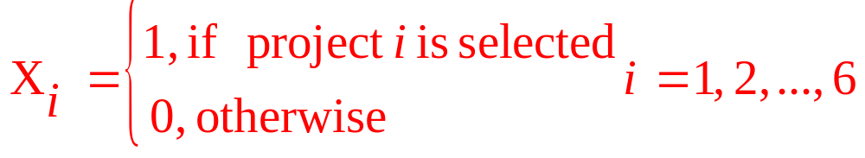
Defining the Decision Variables
Defining the objective: Maximize the total Profit of selected projects.
MAX: 141X₁ + 187X₂ + 121X₃ + 83X₄ + 265X₅ + 127X₆
.

Slide 30
Defining the Constraints
Capital Constraints
  75X₁ + 90X₂ + 60X₃ + 30X₄ + 100X₅ + 50X₆ <= 250 } year 1
  25X₁ + 35x₂ + 15X₃ + 20X₄ + 25X₅ + 20X₆ <= 75 } year 2
  20X₁ + 0x₂ + 15X₃ + 10X₄ + 20X₅ + 10X₆ <= 50 } year 3
  15X₁ + 0X₂ + 15X₃ + 5X₄ + 20X₅ + 30X₆ <= 50 } year 4
  10X₁ + 30X₂ + 15X₃ + 5X₄ + 20X₅ + 40X₆ <= 50 } year 5
Binary Constraints
  All X_{i} must be binary
Implementing the model: See file telenor.xlsx
.

Slide 31
Objectives
Motivation for Integer LP Models
Solving Method: Branch-and-Bound
Examples of Integer LP Models
  Investment selection, scheduling, allocation
  Binary variables & Logical conditions
  Min-max or max-min objectives

Slide 32
Binary Variables & Logical Conditions
Binary variables are also useful in modeling a number of logical conditions.
  Of projects 1, 3 & 6, no more than one may be selected
    X₁ + X₃ + X₆ <= 1
  Of projects 1, 3 & 6, exactly one must be selected
    X₁ + X₃ + X₆ = 1
  Project 4 cannot be selected unless project 5 is also selected
    X₄ <= X₅
.

Slide 33
More on binary modeling
Globex Investment Capital Corp. owns six companies with the following estimated returns if sold during the next 3 years:
Company | Year 1 | Year 2 | Year 3
1 | $14M | $18M | $23M
2 | $9M | $11M | $15M
3 | $18M | $23M | $27M
4 | $16M | $21M | $25M
5 | $12M | $16M | $22M
6 | $21M | $23M | $28M

Slide 34
More on binary modeling
To obtain the needed operating funds, Globex must sell at least $20M of assets in year 1, $25M in year 2, and $35 in year 3
What is the decision? What is the objective? What are the constraints?

Slide 35

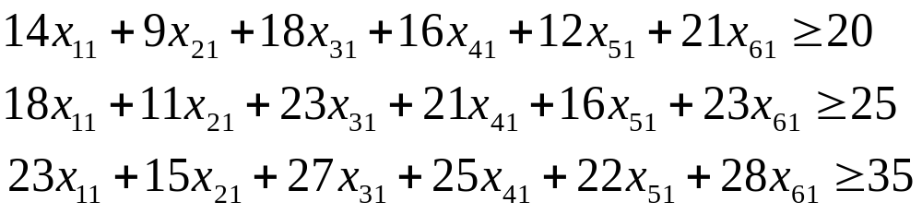
Modeling with binary variables
Define to be a 0-1 variable indicating whether or not to sell company i in year j
Objective for maximizing return:
Constraints for needed funds:

Slide 36
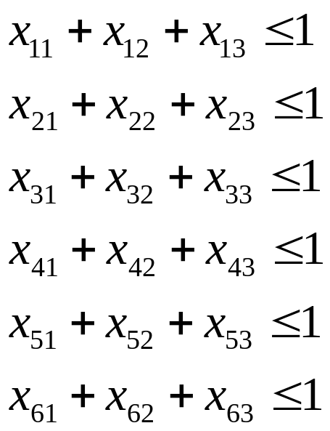
Modeling with binary variables
You cannot sell a company more than once:
Easy to code in a spreadsheet if the variables are arranged in a table

Slide 37
Objectives
Motivation for Integer LP Models
Solving Method: Branch-and-Bound
Examples of Integer LP Models
  Investment selection, scheduling, allocation
  Binary variables & Logical conditions
  Min-max or max-min objectives

Slide 38
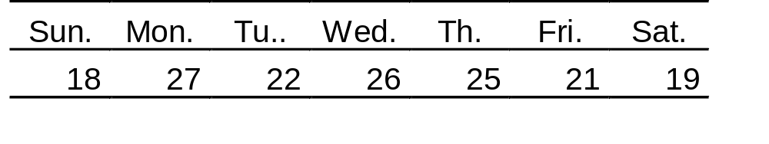
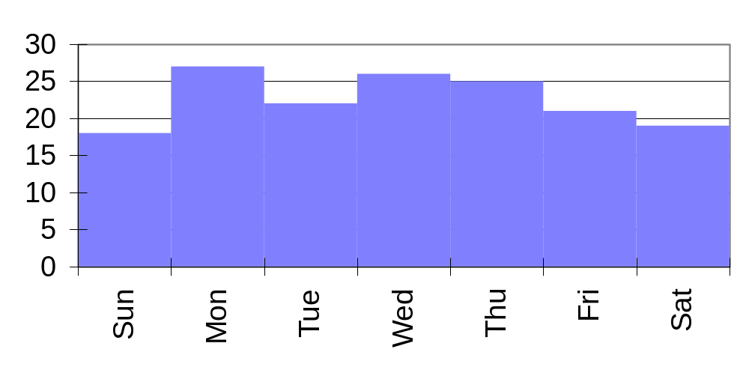
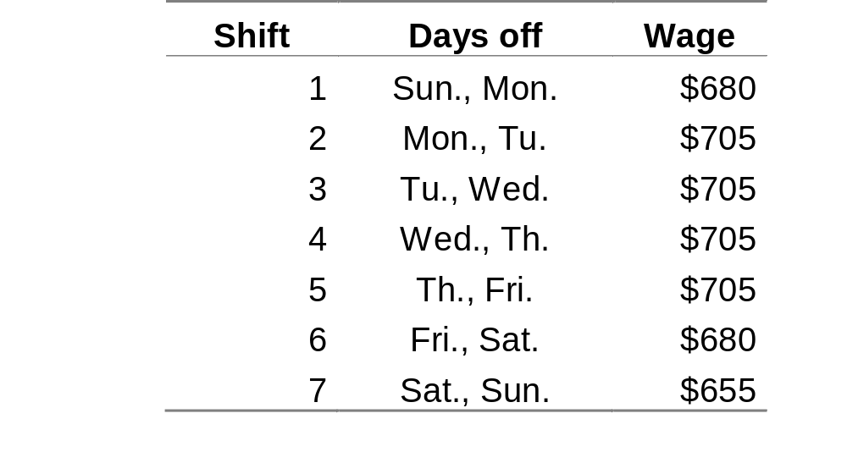
Call Center Agent Scheduling
.

Slide 39
Call Center Agent scheduling
The call center agents are unionized and are guaranteed a five-day work week with two consecutive days off. The base wage for the agents is $655 per week. Because most workers prefer to have Saturday or Sunday off, the union has negotiated bonuses of $25 for its members who work on these days.
Thus, working either Saturday or Sunday, but not both, will yield $680 per week, while working both will yield $705.
.

Slide 40
Agent Scheduling
Demand profile is a forecast of how many agents are needed on each day of the week.
The problem is to “fill up” the profile by adding agent-shifts.
      Objective: Minimize total labor cost.
      Decisions: How many agents to schedule for each shift.
      Constraints: Satisfy demand and satisfy contract with union (two consecutive days off).
.

Slide 41
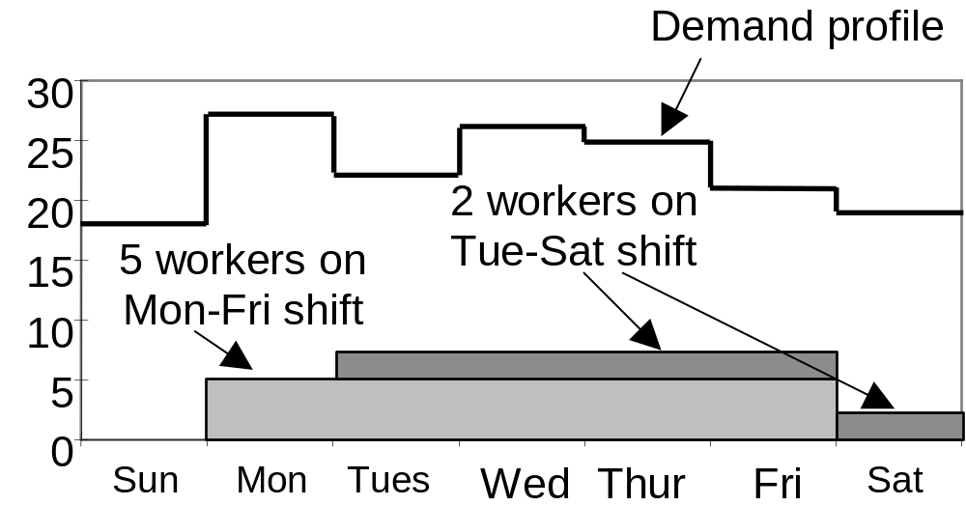
Workforce Scheduling
.

Slide 42
Defining the Decision Variables
X₁ = the number of workers assigned to shift 1
X₂ = the number of workers assigned to shift 2
X₃ = the number of workers assigned to shift 3
X₄ = the number of workers assigned to shift 4
X₅ = the number of workers assigned to shift 5
X₆ = the number of workers assigned to shift 6
X₇ = the number of workers assigned to shift 7
.

Slide 43
Defining the Objective Function
Minimize the total wage expense:
MIN: 680X₁ +705X₂ +705X₃ +705X₄ +705X₅ +680X₆ +655X₇
.

Slide 44
Defining the Constraints
Workers required each day
  0X₁ + 1X₂ + 1X₃ + 1X₄ + 1X₅ + 1X₆ + 0X₇ >= 18 } Sunday
  0X₁ + 0X₂ + 1X₃ + 1X₄ + 1X₅ + 1X₆ + 1X₇ >= 27 } Monday
  1X₁ + 0X₂ + 0X₃ + 1X₄ + 1X₅ + 1X₆ + 1X₇ >= 22 }Tuesday
  1X₁ + 1X₂ + 0X₃ + 0X₄ + 1X₅ + 1X₆ + 1X₇ >= 26 } Weds.
  1X₁ + 1X₂ + 1X₃ + 0X₄ + 0X₅ + 1X₆ + 1X₇ >= 25 } Thurs.
  1X₁ + 1X₂ + 1X₃ + 1X₄ + 0X₅ + 0X₆ + 1X₇ >= 21 } Friday
  1X₁ + 1X₂ + 1X₃ + 1X₄ + 1X₅ + 0X₆ + 0X₇ >= 19 } Saturday
Nonnegativity & integer conditions
  X_{i} >= 0 and integer for all i
.

Slide 45
More on scheduling
Downtown Cab Co. has 70 drivers to schedule in three 8-hour shifts
Demand for cabs varies greatly according to the time of day
The company must provide a certain level of service at all times, but revenues will fluctuate

Slide 46
Demand profile
Time block | Average revenue over 8 hrs. | Drivers needed
Midnight – 4 AM | 80 | 10
4 AM – 8 AM | 500 | 12
8 AM – Noon | 420 | 20
Noon – 4 PM | 300 | 25
4 PM – 8 PM | 270 | 32
8 PM - Midnight | 210 | 18

Slide 47

IP Formulation
Decision variables
  Let be the number of drivers starting in block i
Objective function:

Slide 48
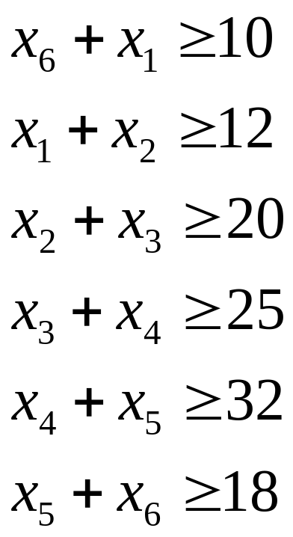
IP Formulation
Constraints: need to satisfy demand
Don’t forget the integrality constraints!

Slide 49
Additional constraints
Suppose that only 15 drivers are willing to work the late shift from midnight to 8 AM. How does the formulation change?
All the drivers like to work from 8 AM to noon, so you have decided to limit the number of drivers working this block to 20.

Slide 50
Objectives
Motivation for Integer LP Models
Solving Method: Branch-and-Bound
Examples of Integer LP Models
  Investment selection, scheduling, allocation
  Binary variables & Logical conditions
  Min-max or max-min objectives

Slide 51
The Fixed-Charge Problem
Many decisions result in a fixed or lump-sum cost being incurred:
The cost to lease, rent, or purchase a piece of equipment or a vehicle that will be required if a particular action is taken.
The setup cost required to prepare a machine or to produce a different type of product.
The cost to construct a new production line that will be required if a particular decision is made.
The cost of hiring additional personnel that will be required if a particular decision is made.

Slide 52
Remington Manufacturing
How much of each product should be produced to maximize net profit?
Hours Required By:
Operation Prod. 1 Prod. 2 Prod. 3 Hours Available
Machining 2 3 6 600
Grinding 6 3 4 300
Assembly 5 6 2 400
Unit Profit $48 $55 $50
Setup Cost $1000 $800 $900

Slide 53
Big M constraints
Linking Constraints (with “Big M”)
X1 <= M1Y1 or X1 - M1Y1 <= 0
X2 <= M2Y2 or X2 - M2Y2 <= 0
X3 <= M3Y3 or X3 - M3Y3 <= 0
If Xi > 0 these constraints force the associated Yi to equal 1.
If Xi = 0 these constraints allow Yi to equal 0 or 1, but the objective will cause Solver to choose 0.
Note that Mi imposes an upper bounds on Xi.
It helps to find reasonable values for the Mi.

Slide 54
Minimum Order Size Restrictions
Suppose Remington doesn’t want to manufacture any units of product 3 unless it produces at least 40 units...

Slide 55
A Contract Award Problem
B&G Construction has 4 building projects and can purchase cement from 3 companies for the following costs:
Cost per Delivered Ton of Cement
Max.
Project 1 Project 2 Project 3 Project 4 Supply
Co. 1 $120 $115 $130 $125 525
Co. 2 $100 $150 $110 $105 450
Co. 3 $140 $95 $145 $165 550
Needs 450 275 300 350
(tons)

Slide 56
A Contract Award Problem
Side constraints:
  Co. 1 will not supply orders of less than 150 tons for any project
  Co. 2 can supply more than 200 tons to no more than one of the projects
  Co. 3 will accept only orders that total 200, 400, or 550 tons

Slide 57
Objectives
Motivation for Integer LP Models
Solving Method: Branch-and-Bound
Examples of Integer LP Models
  Investment selection, scheduling, allocation
  Binary variables & Logical conditions
  Min-max or max-min objectives

Slide 58
Scheduling tasks
Work orders arrive at a factory, where they are completed using different machines
Suppose that there are five machines that can be used to complete ten jobs
Any machine can do any job, but the completion times will vary

Slide 59

Objective(s)
Let be a binary variable set to 1 if we assign job j to machine i
Several objectives are possible:
  Minimize total machine time used (each job is completed as efficiently as possible)
  Minimize the maximum time that any machine is busy
  Maximize the minimum number of jobs completed by any machine

Slide 60

Problem inputs
Let be the running time needed to finish job j using machine i
This is a pre-specified number, not a decision variable
M\J | 1 | 2 | 3 | 4 | 5 | 6 | 7 | 8 | 9 | 10
A | 2 | 4 | 1 | 7 | 3 | 4 | 1 | 2 | 6 | 3
B | 3 | 3 | 4 | 5 | 2 | 5 | 1 | 4 | 4 | 7
C | 4 | 1 | 2 | 3 | 5 | 3 | 2 | 6 | 5 | 1
D | 7 | 5 | 3 | 6 | 3 | 5 | 4 | 6 | 2 | 5
E | 4 | 2 | 1 | 5 | 6 | 2 | 3 | 6 | 3 | 4

Slide 61
Objective(s)
Minimize total machine time used
  Essentially a transportation problem
  What are the supply/demand nodes?
  What are the supply/demand quantities?
  What are the “transportation” costs?
This model may overwork a machine that may be more efficient than others

Slide 62
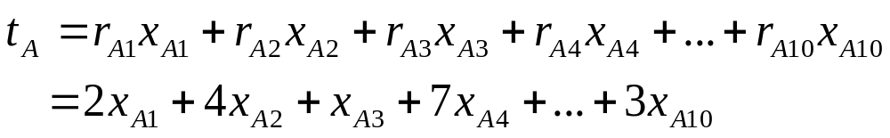
Objective(s)
Minimize the maximum time that any machine is busy
If the machines all run concurrently, this is the time needed to complete all jobs
Total running time of machine A:

Slide 63

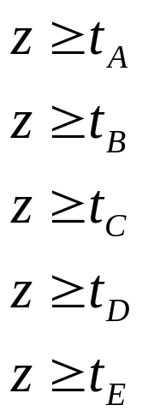
Minimizing the maximum
Our objective should be
However, this is not linear!
Solution: define another variable z with constraints

Slide 64

Final objective function
The final form of the objective is just
The inequality constraints on z ensure that this variable is larger than all the running times
But, since we minimize z, the optimal solution will set it exactly equal to the largest running time

Slide 65

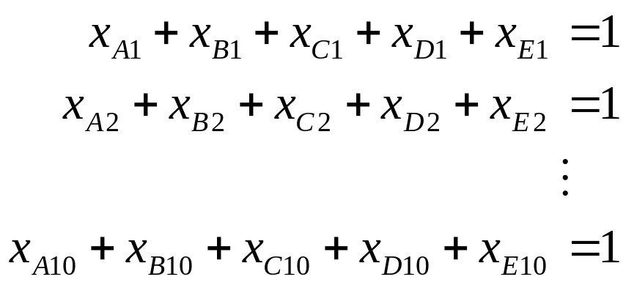
Other constraints
Add equality constraints to make sure that is equal to the running time of machine i
Make sure each job is completed by exactly one machine:

Slide 66
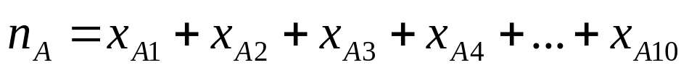
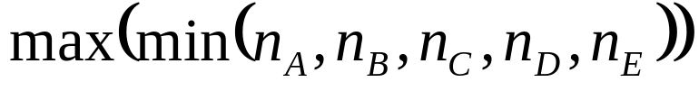
Objective(s)
Maximize the minimum number of jobs completed by any machine
The number of jobs completed by machine i is
The objective can be written as

Slide 67

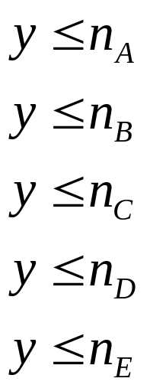
Objective(s)
Again, this is not linear, so add a new decision variable y and write
Don’t forget to add new constraints

Slide 68
Max-min and min-max
The max-min and min-max objectives are easy to convert into a linear form by adding more variables and constraints
This allows us to use LPs/IPs to solve “worst-case” problems
Many other applications, e.g. finance (maximize worst-case performance)

Slide 69
Multiple objectives
In reality, a decision-maker may want to accommodate all three of these objectives
We can use an aggregated objective function:
Minimize: (1/3) x (total machine time)
+ (1/3) x (maximum running time)
- (1/3) x (minimum number of jobs)

Slide 70
Multiple objectives
There is still a single set of decision variables, so this objective will produce a single decision
However, this decision will consider all three objectives to some degree
If one objective is more important than others, it can be weighted more heavily

Slide 71

Objectives
Motivation for Integer LP Models
Solving Method: Branch-and-Bound
Examples of Integer LP Models
  Investment selection, scheduling, allocation
  Binary variables & Logical conditions
  Min-max or max-min objectives

