Slide 1
Topic 1: Linear Programming
BUDT 732: Decision Analytics
Gisela Bardossy

Slide 2
Objectives
Motivation for Optimization
Linear Programming Properties and Components
Modeling and Solving LP Problems
  Graphical Method
  Excel Solver
Sensitivity Analysis
Modeling Techniques

Slide 3
Objectives
Motivation for Optimization
Linear Programming Properties and Components
Modeling and Solving LP Problems
  Graphical Method
  Excel Solver
Sensitivity Analysis
Modeling Techniques

Slide 4
Introduction
We all face decisions about how to use limited resources such as time, money, workers, and bandwidth.
Optimization finds the most efficient way of using limited resources to achieve business objectives.
85% of the Fortune 500 companies use Linear Optimization in their planning process:
  Scheduling of workers
  Network design
  Production planning
  Logistics and supply chain management
  Financial investment strategies
  Marketing on social media
  Ad optimization
.

Slide 5
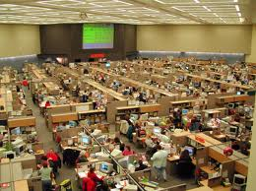

Schneider National
Fleet size management
Choosing where and how many jobs to offer
Real-time dispatch decisions

Slide 6

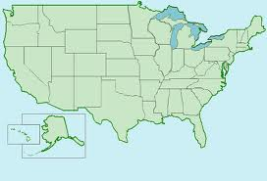

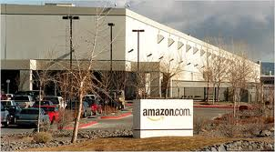
Amazon.com
Which fulfillment center should be used for a particular order?

Slide 7



TNT Express
Network routing and scheduling
Tactical route planning for pickups/deliveries
Supply chain optimization

Slide 8

Hewlett-Packard
Product variety management (assortment planning)
ROI evaluation for proposed new products

Slide 9



Memorial Sloan-Kettering
Managing real-time prostate cancer treatment
Optimized radiation therapy plans require 15% fewer needles, 20% fewer radioactive “seeds”

Slide 10
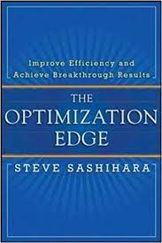
Other examples
Sashihara in The Optimization Edge gives a few:
  Walmart: routing, supply decisions; dynamic decision-making (e.g. supply air conditioners based on heat wave information)
  McDonalds: rules for supplying and storing food based on “local” factors (time of day, season, etc.)
  UPS: increasing fuel efficiency of delivery trucks through optimization routing software
  Marriott: dynamic pricing and revenue management

Slide 11
Classes of business problems
Investment problems
  Select financial portfolios to invest in
  Maximize the return
Production planning problems
  Schedule a list of operations on available machines
  Minimize total production cost (or time)
Marketing problems
  Select appropriate media to advertise products
  Maximize the coverage

Slide 12
Summary
Overall, optimization matches real-world problems to broad classes of flexible quantitative models
Routing trucks and buying energy supply contracts is very similar mathematically
However, a great deal of domain knowledge goes into each individual model

Slide 13
OM for business problems
Optimization
BUDT 732
Business Problems (Applications)
Probability
& Statistics
Probability/Statistics: how to gather data (or avoid doing so)
Optimization: how to make decisions using the data

Slide 14
Objectives
Motivation for Optimization
LP Problems, Properties and Components
Modeling and Solving LP Problems
  Graphical Method
  Excel Solver
Sensitivity Analysis
Modeling Techniques

Slide 15
Linear Programming
Linear programming (LP, also called linear optimization) is a method to achieve the best outcome (such as maximum profit or lowest cost) in a mathematical model whose requirements are represented by linear relationships. Linear programming is a special case of mathematical programming (also known as mathematical optimization).

Slide 16
Properties
Proportionality
Additivity
Divisibility
Certainty
LINEAR RELATIONSHIP BETWEEN VARIABLES

Slide 17
Components
Decision variables
  What is the decision that needs to be made?
Objective function
  What is the criteria to rank alternative decisions?
  What is the decision-maker goal or driver?
Constraints
  What are the limitations or requirements for the decision?

Slide 18
Objectives
Motivation for Optimization
LP Problems Properties and Components
Modeling and Solving LP Problems
  Graphical Method
  Excel Solver
Sensitivity Analysis
Modeling Techniques

Slide 19
Example: Linear Optimization
Pirelli Glass produces two types of fiber optic strands: A-type & H-type (a higher speed variety).
A-type H-type
Fiber 1 1
Labor 9 hours 6 hours
Glass 12 lbs 16 lbs
Unit Revenue $350K $300K
Due to “pulling” restrictions they are only allowed to produce 200 fibers. There are 1566 hours of labor and 2880 lbs. of glass available.
How many A-type and H-type fibers should be produced?
.

Slide 20
Thinking about optimization
“What is the decision?”
  What does the decision-maker have direct, immediate control over?
  In this case, production quantity (not revenue)
“What is the goal?”
  How can you tell a good decision from a bad one?
“What are the limitations?”
  Why can’t you just have infinite revenues?

Slide 21
Quantitative Formulation (5 steps)
1. Understand the problem.
2. Identify the decision variables.
A=number of A-type fibers to produce
H=number of H-type fibers to produce
3. State the objective function as a linear combination of the decision variables.
MAX: 350A + 300H
4. State the constraints as linear combinations of the decision variables.
1A + 1H <= 200 } fibers
9A + 6H <= 1566 } labor
12A + 16H <= 2880 } glass
5. Identify any upper or lower bounds on the decision variables.
A >= 0
H >= 0
.

Slide 22
Final LP Formulation:
MAX: 350A + 300H
S.T.: 1A + 1H <= 200
9A + 6H <= 1566
12A + 16H <= 2880
A >= 0
H >= 0
.

Slide 23
Objectives
Motivation for Optimization
Linear Programming Properties and Components
Modeling and Solving LP Problems
  Graphical Method
  Excel Solver
Sensitivity Analysis
Modeling Techniques

Slide 24
Graphical Solution
Because this problem only has two decisions (type-A/type-H), it can be viewed on a graph
We can visualize all possible solutions to the problem, and identify the optimal solution
Not an effective solution method, but gives insight into LPs and why they are preferable
A real LP problem would typically have 1000s of variables and constraints

Slide 25
H
250
(0, 200)
200
boundary line of fiber constraint
A + H = 200
150
100
50
(200, 0)
0
0
50
100
150
200
250
A
.

Slide 26
H
(0, 261)
250
boundary line of labor constraint
200
9A + 6H = 1566
150
100
50
(174, 0)
0
0
50
100
150
200
250
A
.

Slide 27
H
250
(0, 180)
200
150
boundary line of glass constraint
12A + 16H = 2880
100
Feasible Region
50
(240, 0)
0
0
50
100
150
200
250
A
.

Slide 28
H
250
200
(0, 116.67)
objective function
150
350A + 300H = 35000
100
50
(100, 0)
0
0
50
100
150
200
250
A
.

Slide 29
H
250
(0, 175)
objective function
200
350A + 300H = 35000
objective function
150
350A + 300H = 52500
100
50
(150, 0)
0
0
50
100
150
200
250
A
.

Slide 30
H
250
objective function
200
350A + 300H = 35000
150
optimal solution
100
objective function
350A + 300H = 52500
50
0
0
50
100
150
200
250
A
.

Slide 31
Calculating the Optimal Solution
The optimal solution occurs where the “fiber” and “labor” constraints intersect.
This occurs where:
  A + H = 200 (1)
  and 9A + 6H = 1566 (2)
From (1) we have,
  H = 200 - A (3)
Substituting (3) for H in (2) we have,
  9A + 6 (200 - A) = 1566
  which reduces to A = 122
So the optimal solution is,
  A=122, H=200-A=78
  Total Profit = $350*122 + $300*78 = $66,100K
.

Slide 32
Why LPs are “easy” to solve
Notice that the feasible region looks like a polygon (lines and corners)
Also, the optimal solution is located at a corner point
This is always true for any linear program, but not for nonlinear problems
Although there are uncountably many feasible solutions, only 5 are actually worth examining

Slide 33
H
250
obj. value = $54M
200
(0, 180)
obj. value = $64M
150
(80, 120)
obj. value = $66.1M
100
(122, 78)
50
obj. value = $0
obj. value = $60.9M
(0, 0)
(174, 0)
0
0
50
100
150
200
250
A
.

Slide 34
Objectives
Motivation for Optimization
Linear Programming Properties and Components
Modeling and Solving LP
  Graphical Method
  Excel Solver
Sensitivity Analysis
Modeling Techniques

Slide 35
Spreadsheet Modeling
Organize the data for the model on the spreadsheet.
Reserve separate cells in the spreadsheet to represent each decision variable in the model.
Create a formula in a cell in the spreadsheet that corresponds to the objective function.
For each constraint, create a formula in a separate cell in the spreadsheet that corresponds to the left-hand side (LHS) of the constraint.
If you are not very comfortable with Excel, you may want to keep 1, 2, 3, and 4 separate. In that case also create a cell with the right-hand side (RHS) of the constraint.
.

Slide 36
Solver
Data/Solver menu
Functions
  Set Objective – define the cell in the spreadsheet that represents the objective function
  Equal To – “Max” or “Min”
  By Changing Variables – define the cells in the spreadsheet representing the decision variables
  Subject to the Constraints – use “Add” to set up the cells in the spreadsheet representing the resource restrictions
  Select a Solving Method – Tells Solver which method to use to solve the problem (“Simplex LP” for linear problems!)
  Make Unconstrained Variables Nonnegative – Tells Solver variables are greater than or equal to 0.
  Options – define a number of additional options, some method specific.
.

Slide 37
How Solver Views a Model
Set Objective cell - the cell in the spreadsheet that represents the objective function
Changing variable cells - the cells in the spreadsheet representing the decision variables
Constraint cells - the cells in the spreadsheet representing the resource restrictions
Excel comes with Solver. If you don’t see it (under the Data tab) you may have to do additional work to install it.
  Go to the Office→Excel Options Menu
  Click on Add-ins
  If Solver does not show up as an installed add-in, click on it and the “Go” button on the bottom next to the “Manage Excel Add-ins” option.
  Check the add-ins you want installed or uninstalled. Click OK and Excel will install these add-ins.
.

Slide 38
The Answer Report
Final (optimal) value for the objective function
Final (optimal) values for the decision variables (adjustable cells).
Tells you how much of each resource is used up.
Tells you which constraints are binding (have used up all of the resource), and which ones are non-binding.
  Binding constraints are those constraints that are satisfied at equality at the optimal solution.
  Non-binding constraints are the constraints that are not satisfied at equality (it is satisfied with strict inequality at the optimal solution).
  Why is this concept important?
.

Slide 39


Why “linear” optimization?
“Linear program” means that all constraints, as well as the objective function, express linear relationships
  “ ” is linear
  “ ” is not linear
When this occurs, there is a special method called the simplex method that quickly finds the exact solution to the problem
If the model is not linear, other methods must be used
  Generally run much slower
  May even produce inaccurate results!
Sometimes non-linear problems can be “reformulated” in a linear way
.

Slide 40
Limitations with linear optimization
Linearity means that selling one more type-A fiber will always add $350K in revenue
There are ways to adapt a linear model to apparent non-linearities…
Divisibility: the LP model allows fractional solutions, e.g. 100.5 type-A fibers
Integer programming can solve this problem, but is not always strictly necessary

Slide 41
Special Situations
H
250
objective function level curve
200
450A + 300H = 78300
150
100
Alternate/multiple optimal solutions
50
0
0
50
100
150
200
250
A
There may be multiple optimal solutions, but at least one will be at a corner point.
.

Slide 42
Special Situations
Infeasibility: there is no way to satisfy every constraint at the same time
What happens if we require A >= 175?
Constraints can be used to represent performance requirements, targets, etc.
An infeasible LP means that our expectations are unrealistic – consider relaxing them

Slide 43
Special Situations
Unboundedness: it is possible to achieve an infinitely large objective value
MAX: 350A + 300H
S.T.: A >= 0, H >= 0
An unbounded LP suggests that the model is too optimistic, and some key limiting factors have been omitted

Slide 44
Another Example
Producing Frames at Monet
Production of 4 types of picture frames
  Max Potential sales = (1000, 2000, 500, 1000)
Data
Question: What is the Optimal Production Schedule?
 | Skilled Labor | Metal | Glass | Selling Price
Frame 1 requirements | 2 | 4 | 6 | $28.50
Frame 2 requirements | 1 | 2 | 2 | $12.50
Frame 3 requirements | 3 | 1 | 1 | $29.25
Frame 4 requirements | 2 | 2 | 2 | $21.50
Available | 4000 hours | 6000 ounces | 10,000 ounces
Cost | $8.00/hr | $0.50/oz | $0.75/oz
.

Slide 45
Producing Frames at Monet
 | Selling Price | Production Cost | Unit Profit
Frame 1 | $28.50 | $22.50 | $6.00
Frame 2 | $12.50 | $10.50 | $2.00
Frame 3 | $29.25 | $25.25 | $4.00
Frame 4 | $21.50 | $18.50 | $3.00
.

Slide 46
Algebraic Formulation
Decision variables
F₁= # of Frames of Type 1 produced.
F₂= # of Frames of Type 2 produced.
F₃= # of Frames of Type 3 produced.
F₄= # of Frames of Type 4 produced.
 | Selling Price | Production Cost | Unit Profit
Frame 1 requirements | $28.50 | $22.50 | $6.00
Frame 2 requirements | $12.50 | $10.50 | $2.00
Frame 3 requirements | $29.25 | $25.25 | $4.00
Frame 4 requirements | $21.50 | $18.50 | $3.00
Maximize: 6F₁ + 2F₂ + 4F₃ + 3F₄
Subject to:
2F₁ + 1F₂ + 3F₃ + 2F₄ <= 4000 (labor constraint)
4F₁ + 2F₂ + 1F₃ + 2F₄ <= 6000 (metal constraint)
6F₁ + 2F₂ + 1F₃ + 2F₄ <= 10,000 (glass constraint)
F₁ <= 1000, F₂ <= 2000, F₃ <= 500, F₄ <= 1000, (production constraint)
F1, F2, F3, F4 >= 0 (non-negativity)
.

Slide 47
Objectives
Motivation for Optimization
Linear Programming Properties and Components
Modeling and Solving LP Problems
  Graphical Method
  Excel Solver
Sensitivity Analysis
Modeling Techniques

Slide 48
Sensitivity Analysis
Key question: Would a manager be interested in knowing more than just the optimal solution?
LP sensitivity analysis:
  Which resources (e.g., glass, labor) are the most valuable for increasing our revenue?
  Does the solution change if e.g. the objective function changes?
Why are these useful to us?
  The numbers in the problem may be based on estimates. How important is it for these estimates to be accurate?
  In a dynamic world, prices and resource availability may change. How should our solution change in response?
  Contract negotiations: how much should one be willing to pay for an extra 300 hours of labor or 500 tons of glass?
.

Slide 49
Approaches to Sensitivity Analysis
Integer or nonlinear programming:
  Change the numbers in the spreadsheet and resolve the problem!
Excel’s LP solver provides “free” information on the following:
  Amounts by which objective function coefficients can change without changing the solution.
  The impact on the optimal objective function value of changes in various constrained resources.
  The impact on the optimal objective function value of forced changes in certain decision variables.
The sensitivity report is generated without having to resolve multiple versions of the problem
.

Slide 50

Objective Function
The sensitivity report in Excel provides the following information:
All else being equal, as long as the revenue for type-A fibers is between $300K and $450K, the solution (122,78) will remain optimal.

Slide 51
Implications
How robust is the solution? It depends on how certain we are of our revenue figures.
If future revenue is $340K, the performance of our decision will be different, but the decision itself will be the same
If future revenue is likely to fall below $300K, we should consider a backup plan

Slide 52
Constraints
Recall that our constraints in the Pirelli problem are:
The optimal solution is (122,78). The first two constraints are binding, while the last is non-binding.
1A + 1H <= 200 (fibers)
9A + 6H <= 1566 (labor)
12A + 16H <= 2880 (glass)

Slide 53
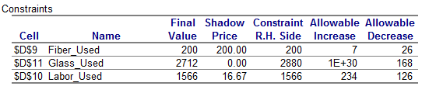
Constraints
Excel tells us how much of each resource is used by the optimal solution:
Compare this with “Constraint R.H. Side” to see which constraints are binding/non-binding.

Slide 54
Constraints
“Fiber_Used” will remain binding as long as the production capacity is between 174 and 207.
“Labor_Used” will remain binding as long as we have between 1440 and 1800 hours of labor.
“Glass_Used” will remain non-binding as long as we have over 2712 lbs. of glass.

Slide 55
Implications
If the glass constraint is non-binding, that means we have leftover glass.
So, if we had even more glass, the constraint would continue to be non-binding.
Production capacity and labor are the main bottlenecks limiting our revenue.
If we add more labor, production will improve, but only for so long.

Slide 56
Shadow prices
What is more valuable, an hour of labor or an extra unit of capacity?
For binding constraints, the shadow price is the value of one more unit of the resource.
If we could produce 201 fibers, our optimal revenue would go up by $200K. (Why only $200?)

Slide 57
Shadow prices
Likewise, 1 hour of labor is valuated at $16.67K.
It takes 9 hrs. to make another type-A fiber, but the shadow price valuates a single unit
The value of labor “scales linearly,” so 10 hrs. are valuated at $166.7K.
This calculation is only valid if the proposed changes are within the allowable range!

Slide 58
Shadow prices: recap
Example 1. Pirelli is considering improvements to its equipment that will increase production capacity by 5, for a price of $0.9M. Is it worth it? What if the price is $1.2M?
Example 2. The proposed improvements will increase production capacity by 10, for a price of $1.5M. Is it worth it?

Slide 59
More on shadow prices
The shadow price of glass is zero. We already have leftover glass – we do not need more.
Any non-binding constraint always has a zero shadow price.
In production problems, the shadow price represents a fair price for a resource.
In general, the shadow price can be viewed as a valuation of a constraint, although the exact meaning of this is up to interpretation…

Slide 60
Reduced costs
The reduced costs can be viewed as shadow prices for the non-negativity constraints:
We are producing both types of fibers, so the non-negativity constraints are non-binding.

Slide 61
Reduced costs
Let’s introduce a new fiber (Type-L, a low speed variety) with these specifications:
  Revenue: $320K
  Labor required: 8 hours
  Glass required: 13 lbs.
See the spreadsheet “pirelli(newfiber).xlsx” for the new model

Slide 62
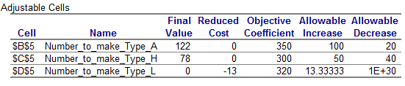
Reduced costs
Excel produces the following sensitivity analysis:
The optimal solution didn’t change – we still produce 122 fibers of type A, 78 of type B, and none of type L.

Slide 63
Interpretations
The type-L fiber has a reduced cost of -13:
  If we forced ourselves to produce at least one type-L fiber, our revenue would be reduced by $13K
  In order for type-L to be profitable (i.e. in order for us to make it), its revenue should be at least $333.33K

Slide 64
Reduced costs
In fact, we can decide not to produce type-L fibers without the new spreadsheet
In the original model, the resources needed for one type-L fiber are valuated at
(1 x 200) + (8 x 16.67) + (13 x 0) = $333.33K
However, the revenue of the type-L fiber is $320K, so it is not profitable
What if the fiber only needed 7 hrs. of labor?

Slide 65
Summary
Sensitivity analysis can measure:
  The robustness of the optimal solution to changes in the problem
  The value of changes to the constraints (e.g. the value of one more unit of a resource)
But be careful – the analysis is always conducted “all else being equal”
If we change more than one number at a time, the allowable ranges might be different

Slide 66
Other forms of analysis
To examine the effects of changing more than one number, we need to resolve the problem
The add-in “SolverTable” can do this for us: just click the SolverTable tab
  One-way table: Single input cell and any number of output cells. Allows us to understand the effect of a single input.
  Two-way table: Effect of two input cells and one or more outputs. Creates a separate table for each output of interest.

Slide 67
Sensitivity Analysis Using Excel
Examples using Solver Table for Monet Frames Example.
  Sensitivity of optimal product mix to to Labor Hours.
  Sensitivity of product mix to Metal Cost.
  Sensitivity of optimal profit to simultaneous changes in labor cost and labor hours availability.
.

Slide 68
Objectives
Motivation for Optimization
Linear Programming Properties and Components
Modeling and Solving LP Problems
  Graphical Method
  Excel Solver
Sensitivity Analysis
Modeling Techniques

Slide 69
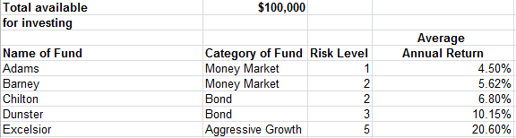
An investor’s problem
Maximize avg. annual return
Avg. risk level should be below 2.5
At least 30% in money market
At most $20,000 in aggressive growth

Slide 70
An Investor’s Problem
See handout for problem description.
Decision variables
A= proportion invested in Adams.
B= proportion invested in Barney.
C = proportion invested in Chilton.
D = proportion invested in Dunster.
E = proportion invested in Excelsior.
Constraints:
A+B+C+D+E = 1
1A+2B+2C+3D+5E <= 2.5
A+B >= 0.3
E <= (20,000/100,000)
A,B,C,D,E >=0
Objective:
Maximize average annual return =
(0.045A + 0.0562B + 0.068C + 0.1015D + 0.2060E)*100,000
.

Slide 71
Example: Herrick Foods Company
Create a trail mix to meet nutritional requirement at cheapest cost.
Data:
 | Seeds | Raisins | Flakes | Pecans | Walnuts | Nutritional Requirement
Vitamins | 10 | 20 | 10 | 30 | 20 | 16
Minerals | 5 | 7 | 4 | 9 | 2 | 10
Protein | 1 | 4 | 10 | 2 | 1 | 15
Calories | 500 | 450 | 160 | 300 | 500 | 600
Cost/Pound | $4 | $5 | $3 | $7 | $6
.

Slide 72
Formulation: Herrick Foods Company
Decision variables
S = # of pounds of seeds in package.
R = # of pounds of raisins in package.
F = # of pounds of flakes in package.
P = # of pounds of pecans in package.
W = # of pounds of walnuts in package
Minimize: 4S + 5R + 3F + 7P + 6W
Subject to:
10S + 20R + 10F + 30P + 20W >= 16 (vitamin floor)
5S + 7R + 4F + 9P + 2W >= 10 (mineral floor)
1S + 4R + 10F + 2P + 1W >= 15 (protein floor)
500S + 450R + 160F + 300P + 500W >= 600 (calorie floor)
S, R, F, P, W >= 0 (non-negativity)
.

Slide 73
Solution Using Solver
Problems with the solution? The optimized mix does not use pecans or walnuts, which may not be appealing.
Based on domain knowledge of customer preferences/choices, may want to add a constraint on minimum amount (lower bound) of each ingredient in the mix.
Add S, R, F, P, W >= 0.15
.

Slide 74
Blending problems
Blending models arise in practice when various inputs (raw materials) must be blended together to produce desired products with slightly different characteristics.

Slide 75
Blending at Chandler Oil
Chandler Oil has 5000 barrels of crude oil 1 and 10,000 barrels of crude oil 2 available. Chandler sells gasoline and heating oil. These products are produced by blending together the two crude oils. Each barrel of crude oil 1 has a “quality level” of 10 and each barrel of crude oil 2 has a quality level of 5. Gasoline must have an average quality level of at least 8, whereas heating oil must have an average quality level of at least 6. Gasoline sells for $25 per barrel and heating oil sells for $20 per barrel. The advertising cost to sell one barrel of gasoline is $0.20 and the advertising cost to sell one barrel of heating oil is $0.10. We assume the demand for heating oil and gasoline is unlimited, so that all of Chandler’s production can be sold. Chandler wants to maximize profit.
.

Slide 76
Blending at Chandler Oil
Sell gasoline and heating oil
By blending two types of crude
 | Gasoline | Heating Oil
Sale Price | $25/bbl | $20/bbl
Advertising Cost | $0.20/bbl | $0.10/bbl
Required Quality | 8/bbl | 6/bbl
 | Crude 1 | Crude 2
Availability | 5000 bbl | 10,000 bbl
Quality | 10/bbl | 5/bbl
.

Slide 77
The Model
What is the Objective?
Maximize Profit
What are the Constraints?
Cannot Use More Crude Oil of Each Type than Available
Have to ensure that minimum quality of gasoline and heating oil is met
Other?
.

Slide 78
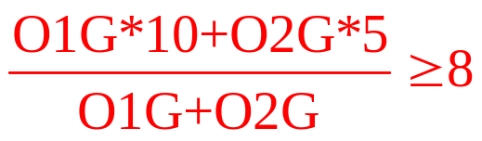
Mathematical Model (Constraints)
Let O1G represent barrels of crude oil 1 in Gasoline, and O2G represent barrels of crude oil 2 in gasoline.
Let O1H represent barrels of crude oil 1 in heating oil, and O2G represent barrels of crude oil 2 in heating oil.
Constraints:
O1G + O1H <= 5000
O2G + O2H <= 10000
Blending requirement:
Non-linear constraint. How to linearize?
.

Slide 79

Blending problems in industry
Oil Companies
  Use Linear Programming to optimize refinery operations
  Texaco
    Nonlinear optimization models for blending
      Blend volatilities, Octanes react
Chemical & Metallurgical industries
  Similar blending problems arise.
    E.g. Huntsman, Salt Lake City Based Petrochemicals company. Core Competence Blending raw materials to produce petrochemicals to match market demand.
Financial Services, Insurance, etc.
  Similar blending problems to create portfolios or derivative products arise.
.

Slide 80
Project management
A certain software project consists of 9 activities, which must be completed in a certain order:
Activity | Description | Predecessor | Time
A | Develop program | None | 12
B | Design usability tests | None | 3
C | Recruit testing subjects | B | 4
D | Test/refine | A, C | 5
E | Write user’s manual | D | 5
F | Produce | D | 3
G | Design package artwork | D | 3
H | Manufacture package | G | 4
I | Distribute | E, F, H | 1

Slide 81
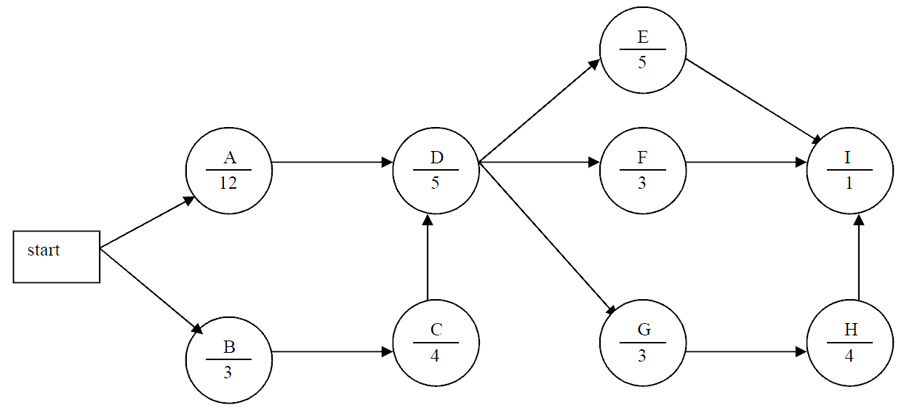
Project management
To visualize the flow of events, we can draw a diagram (standard in project management):

Slide 82




Project management
As the project manager, you want to know the earliest time that the project can be completed.
Define
-- start time of project
-- start time for activity
-- completion time of project

Slide 83
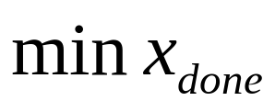
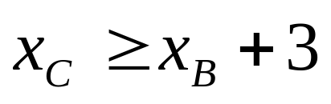
Project management
Objective: finish the project ASAP!
Constraints: precedence relationships
Activity B is a pre-requisite for C, so C can only be started after B is finished

Slide 84
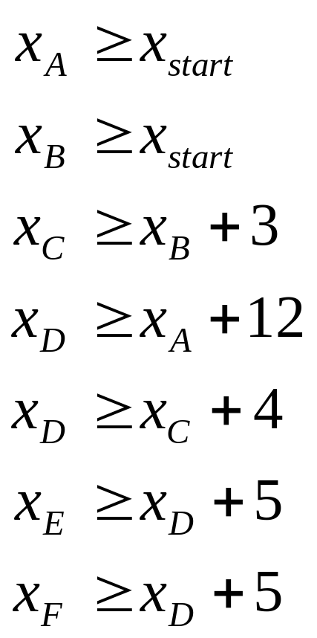
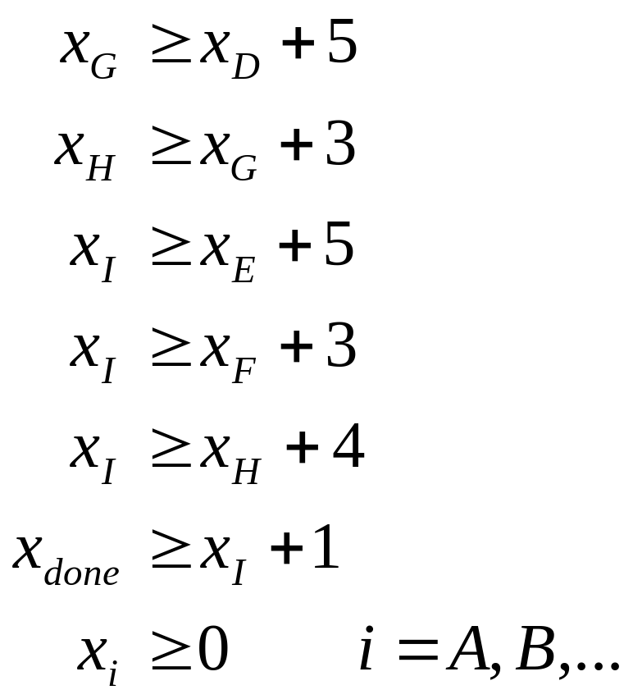
Constraints:

Slide 85
Diminishing returns
Suppose that, in the Pirelli Glass problem, only the first 100 type-A fibers can sell for $350K. Any fibers after that will sell for $250K.
This is an example of diminishing returns, which arise in many applications
By defining some more decision variables, we can stretch the LP framework to fit this problem

Slide 86
Diminishing returns
Let AF be the number of type-A fibers made “up to the first 100,” and let AS be the number of additional or surplus type-A fibers.
MAX: 350AF + 250AS + 300H
S.T.: 1AF + 1AS + 1H <= 200
9AF + 9AS + 6H <= 1566
12AF + 12AS + 16H <= 2880
AF <= 100
AF >= 0, AS >= 0, H >= 0

Slide 87
Discussion
This model allows some strange solutions: for example,
AF = 0, AS = 50, H = 10
is a feasible solution
Nonetheless, the optimal solution will make sense: we will only have AS > 0 if AF = 100
The art of LP modeling: some nonsensical solutions are possible, but the optimal solution solves the real problem

Slide 88
Deviational variables
In a production problem, the resource constraints may be “flexible”
For example, in the Pirelli problem, we may be able to purchase additional labor (above the 1566 hours currently available)
There may also be penalties for unused resources (such as glass)

Slide 89
Deviational variables
Suppose that we can purchase additional capacity for $275K/unit
Each unused pound of glass incurs costs of $50K/unit (maintenance, utilization, etc.)
Additional labour can be purchased for $15K/hour (running equipment overtime)

Slide 90
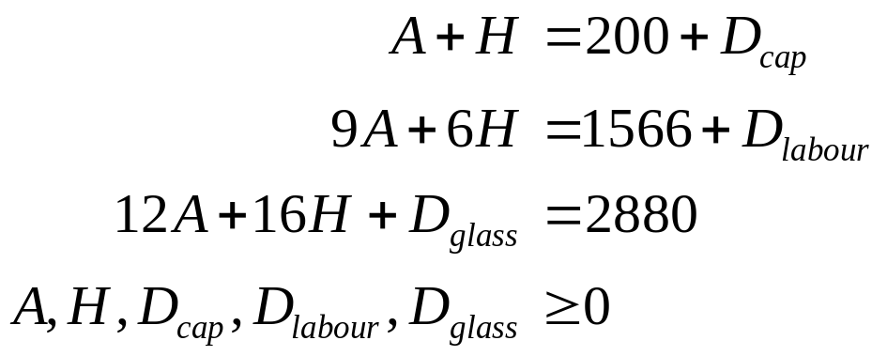
Deviational variables
New objective:
New constraints:

Slide 91

Discussion
The deviational variables are all positive
Thus, by definition,
is the glass that was unused (possibly zero)
The resource availability is augmented by however much was purchased
Need to be careful about putting the variables on the correct side of the equation!

Slide 92

Objectives
Motivation for Optimization
Linear Programming Properties and Components
Modeling and Solving LP
  Graphical Method
  Excel Solver
Sensitivity Analysis
Modeling Techniques
This Photo by Unknown Author is licensed under CC BY-NC-ND

