Slide 1

Py.Smith UM
ALUMNI ASSOCIATION
Group 2
Prince Nwankwoala, Liangrui Lu, Jiashu Wang, Nicholas Claud

Slide 2
BACKGROUND
Client: UMD Alumni Association
Data Sources:
2013-2019 Event data provided by Alumni Association
Event Name, Activity Code, Activity Description, Location Code, Location Description, Group Code, Group Description, Event Date, Participated, Average Age, First Time Attendees, Percentage of First Time Attendees, Major Prospects, Percentage of Major Prospects

Slide 3


INTRODUCTION
Objective 1 : Based on the data determine how the Alumni Association can attract more for first time attendees
Mission: To identify variables that are highly correlated with higher event attendance of first time attendees, and major gift prospect attendees so the Alumni Association can better engage these groups
Objective 2 : Based on the data determine how the Alumni Association can attract more major prospects

Slide 4

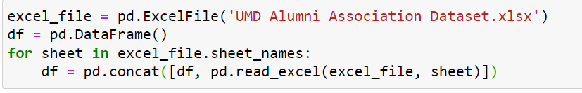

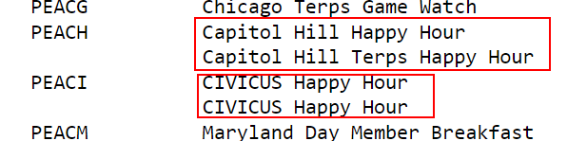
Preparing Data
Step 1.
Step 2.
These text must be normalized

Slide 5
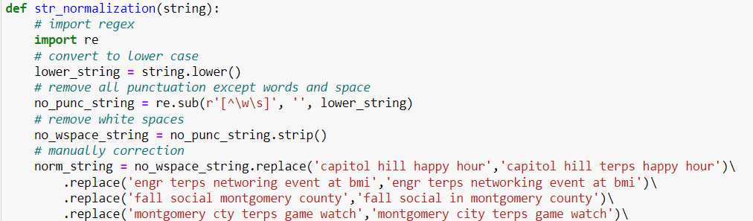
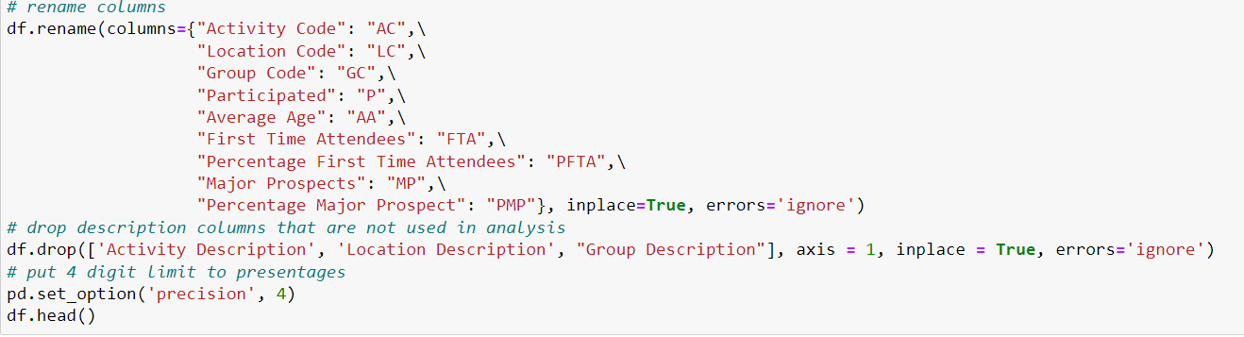
Write a function to remove all space, punctuation, uppercase letter and manually operate Event Name.
Step 3.
Rename & Drop columns

Slide 6
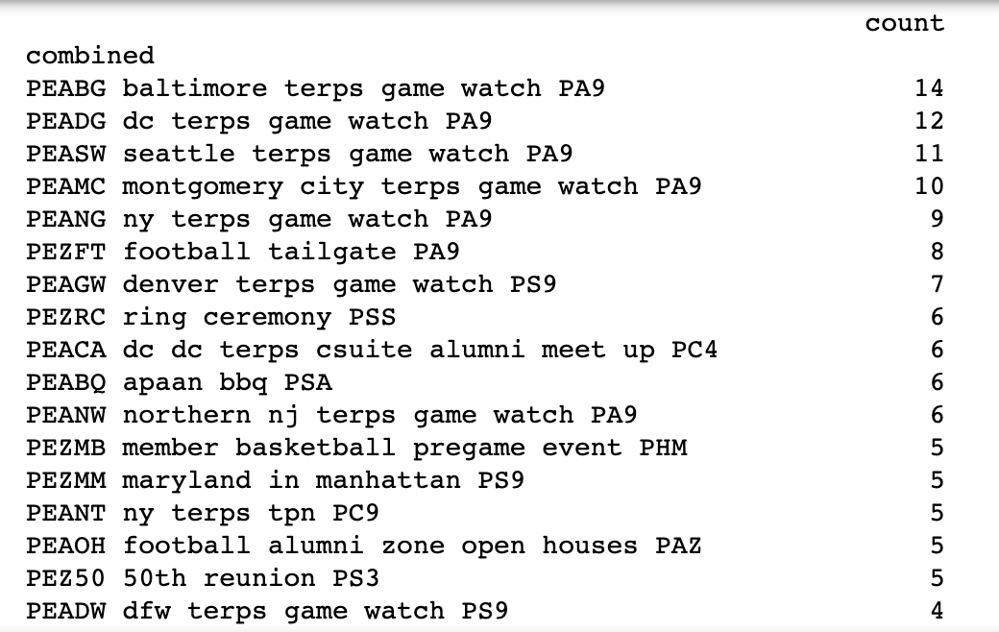
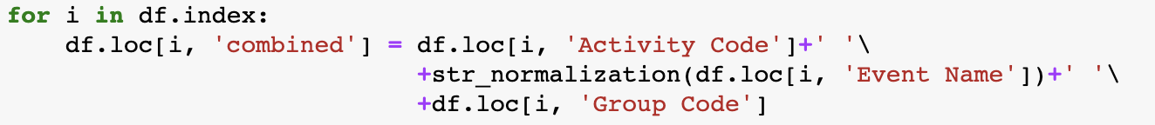
Individual Event Grouping
Why Grouping?
Improve our strategy for both new and existing events.
Take same events as a unit.
How Grouping?
According to Event Name
According to Activity Code
According to Group Code
Combine all three as identifier, as column Combined

Slide 7
Calculated Field Creation
“C”: Count
“APFTA”: Average Percentage First Time Attendees
“APMP”: Average Percentage Major Prospects
“combined”: Identifier for Event
“EM”: Event Month
factors: DataFrame Variable for factor caparison

Slide 8
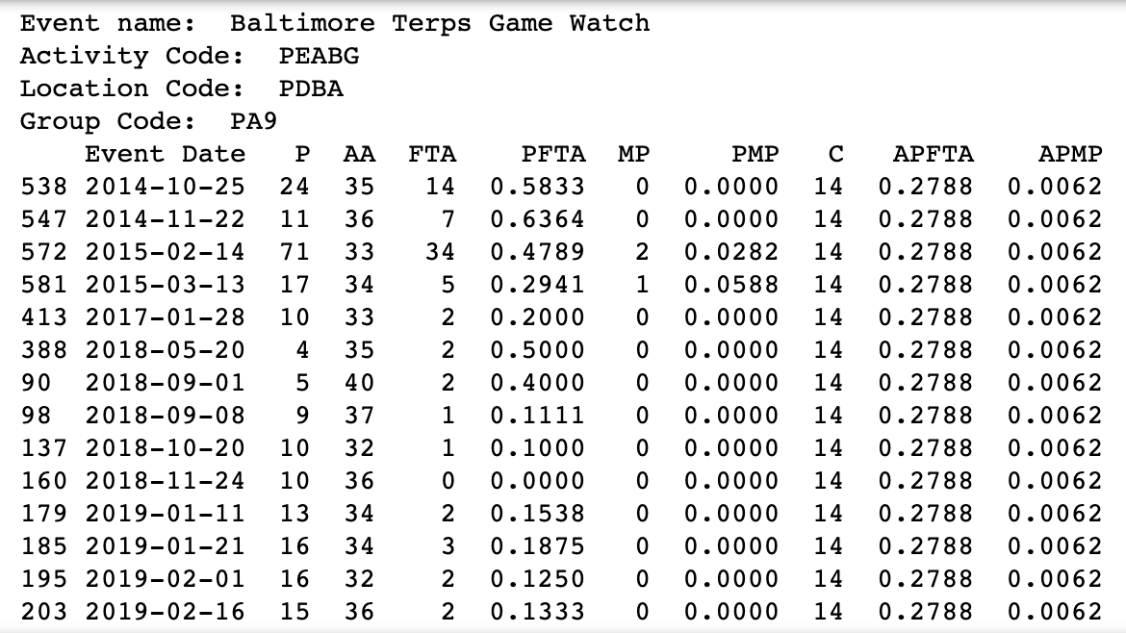
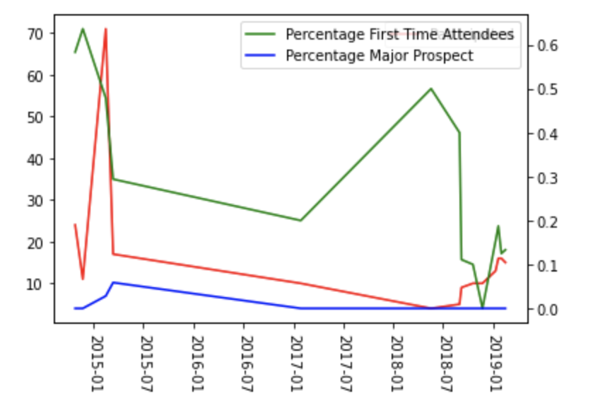
Look-Back Grouping

Slide 9
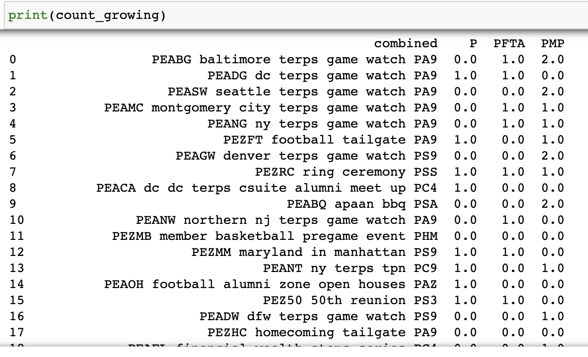
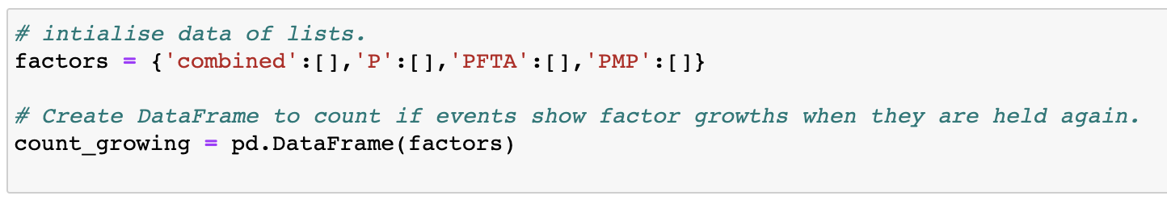
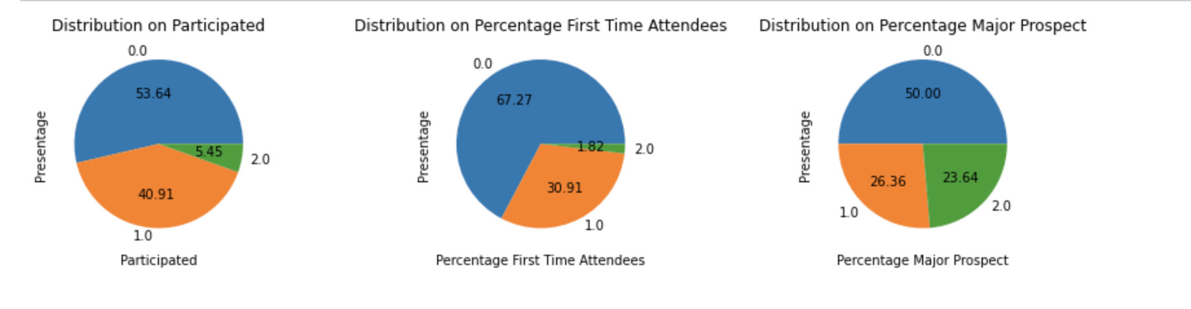
Factor Comparison
Factor Comparison between event’s first-time stage and second-time stage, for events holden repeatedly

Slide 10
Filtering
Events that had little participants provide huge negative impact on both PFTA and PMP.
Filter standard:
Participant <= 5.
Just hold once.
Filter Result: 622 -> 596

Slide 11
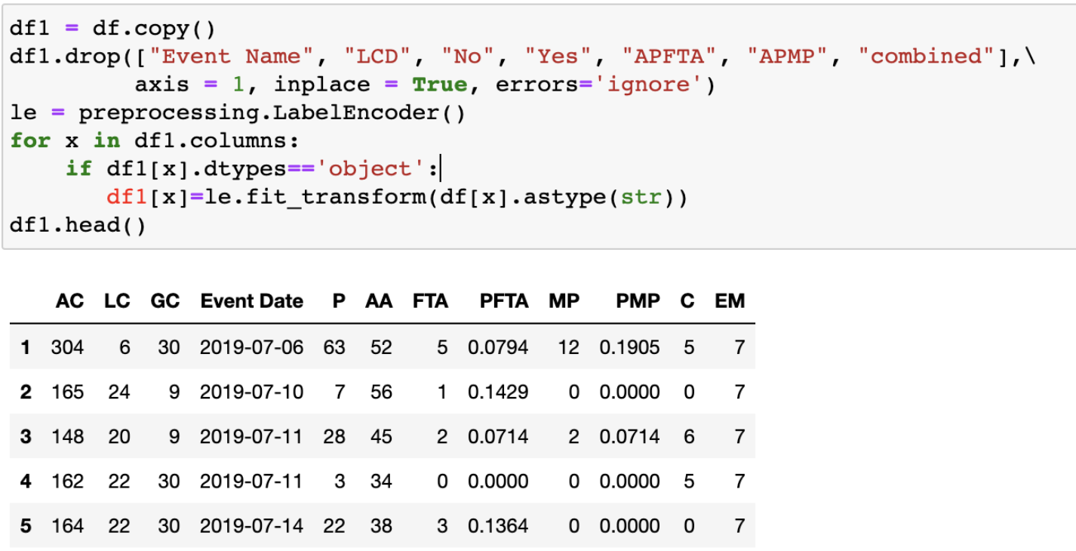
Label Encoder

Slide 12
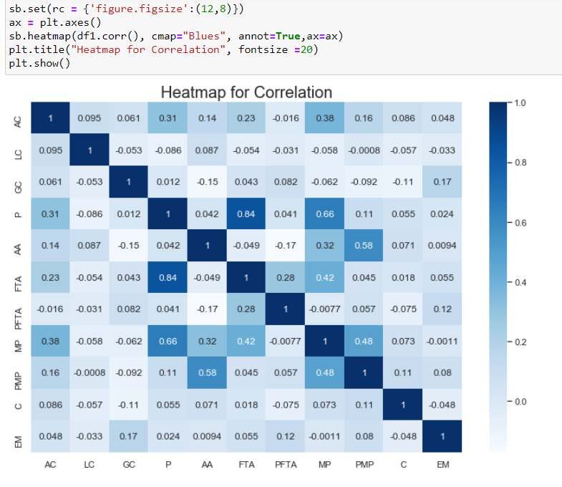
Correlation Matrix
FTA(First time attendees):
Positive linear relationship with MP(Major prospects)
Maybe the more attractive an event is, the more likely to attract new man and more alumni to donate.
PMP(Percentage Major Prospect): quite large positive linear relationship with AA(Average Age)
Maybe elder alumni have more money and willingness to make a donation.

Slide 13
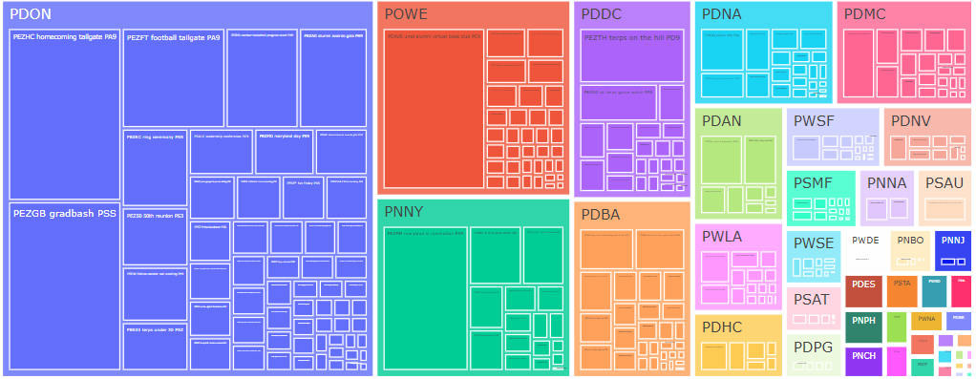
Treemap Operation
PDON: Holding Online Activity

Slide 14
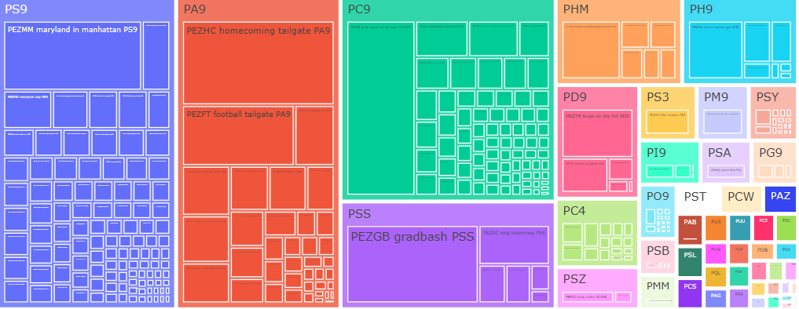
Treemap Operation
Holding more events for PS9, PA9, PC9

Slide 15
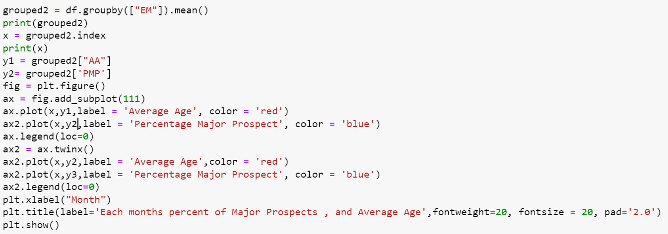
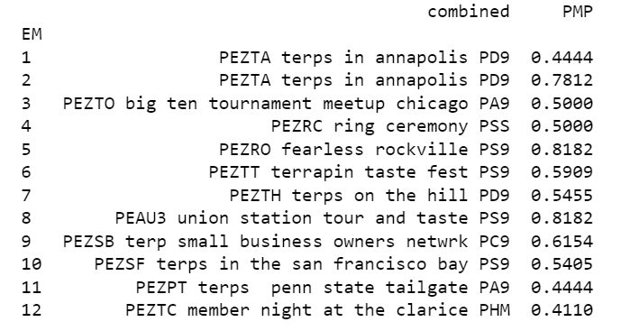
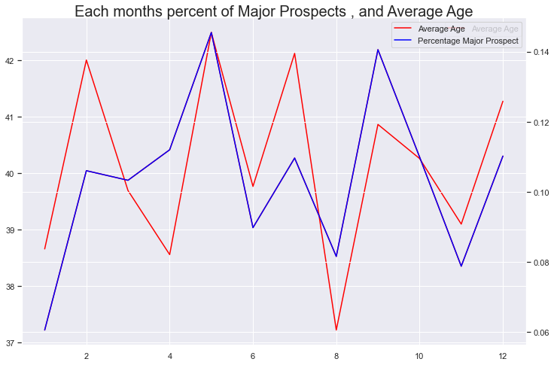
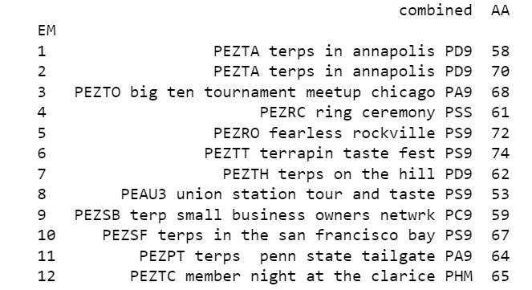
Findings

Slide 16
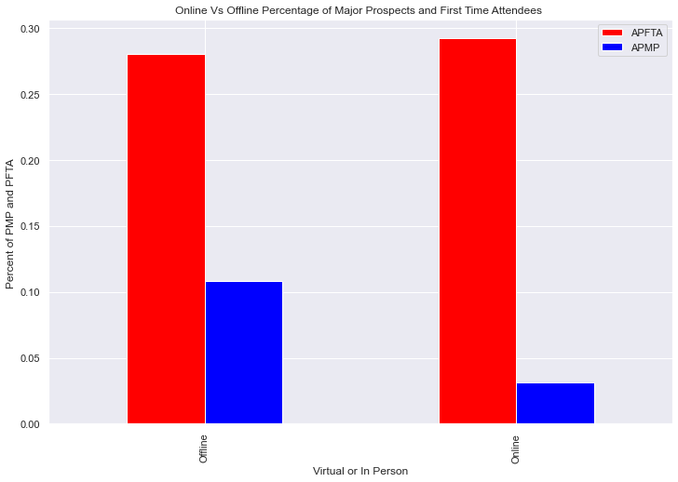
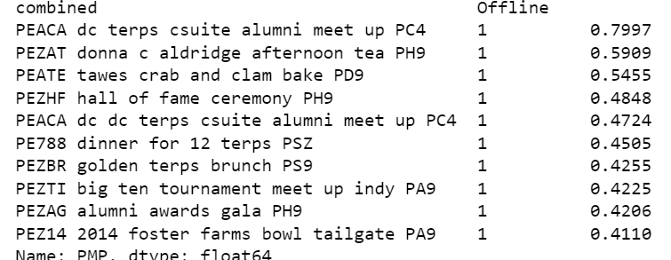
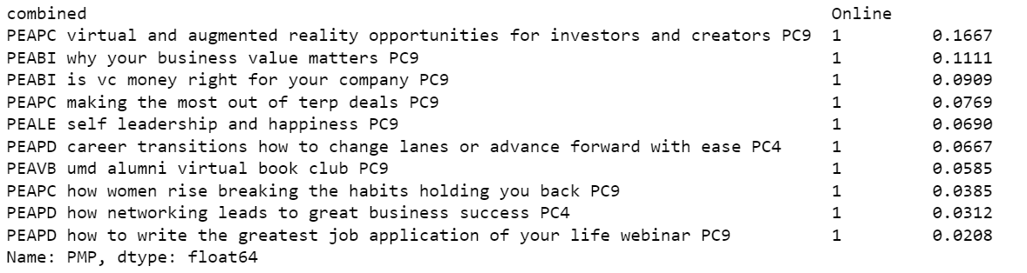
Findings
Online events had a much lower Percentage of Major Prospects as compared to Offline
Offline
dd
Online

Slide 17

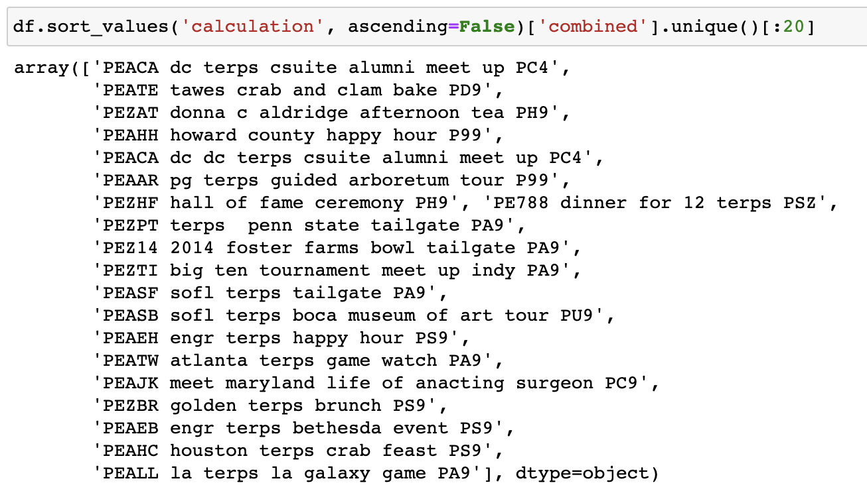
Excellent Events
Focus on creating new events
Make Online events as engaging as In-person Events

Slide 18

Future Works
Improving criteria for event evaluation in ‘calculation’, e.g., involving ‘count’ into factors.
Gather more instances of events to keep building the model, e.g., changes from offline to online.

Slide 19

QUESTIONS?

