Slide 1
Topic 2: Network Models
BUDT 732: Decision Analytics
Gisela Bardossy

Slide 2
Objectives
Motivation for Network Models
Examples of Network Models
  Supply chain and logistics problems
    Transportation, Transshipment and Assignment
  Shortest path problems
  Maximal flow problems

Slide 3
Objectives
Motivation for Network Models
Examples of Network Models
  Supply chain and logistics problems
    Transportation, Transshipment and Assignment
  Shortest path problems
  Maximal flow problems

Slide 4
Introduction
Many problems are naturally posed on networks, particularly supply chain and logistics problems
Such problems often involve “matching” of e.g. supply and demand (or jobs and staff, etc.)
The characteristics of “transportation problems” are:
  Some locations supply the product, some locations have a demand for it, and other locations may be “intermediate”
  We have to match all the demand to supply from different locations
  There is a cost to transport the product from a supply node to a demand node
.

Slide 5
Objectives
Motivation for Network Models
Examples of Network Models
  Supply chain and logistics problems
    Transportation, Transshipment and Assignment
  Shortest path problems
  Maximal flow problems

Slide 6
Example: Goodwin Manufacturing
You are the logistics manager for Goodwin. You have three plants that produce a product. You have four warehouses where you can stock the product. Each week we need to transport boxes/cartons of the product to the warehouses.
Diagram on next slide provides next week’s supplies and demands.
Determine a transportation plan (you will use your contracted company Roadway) to minimize your weekly transportation costs.
.

Slide 7
A Transportation Network
Plants
Cost per unit
Warehouses
Supply
Demand
Minn
0.60
Atlanta
10,000
8,000
1
4
0.56
0.22
0.40
0.36
Boston
10,000
Pitt
0.30
5
15,000
2
0.28
0.58
Chicago
12,000
0.65
0.68
6
0.55
Tucson
15,000
3
0.42
Denver
10,000
7
.

Slide 8
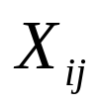
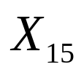
Decision Variables
Define the following:
= # of boxes of product shipped from node i to node j
That is, is the number of boxes sent from Minneapolis to Boston.
We will formulate an LP, so fractional decisions (e.g. “3.5 boxes”) are technically allowed for now.
.

Slide 9

Other notation
Also let be the cost of transporting a single box of product from node i to node j.
This cost is calculated offline, and may depend on factors such as distance (truckers’ tariffs).
However, we assume that cost scales linearly, so sending 3 boxes from Minneapolis to Boston costs 3x as much as one box.

Slide 10
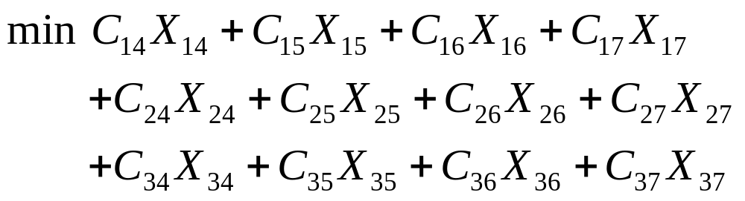
Defining the Objective Function
Minimize the total transportation cost.
.

Slide 11
Defining the Constraints
Demand constraints
  X₁₄ + X₂₄ + X₃₄ = 8,000 } Atlanta
  X₁₅ + X₂₅ + X₃₅ = 10,000 } Boston
  X₁₆ + X₂₆ + X₃₆ = 12,000 } Chicago
  X₁₇ + X₂₇ + X₃₇ = 10,000 } Denver
Supply constraints
  X₁₄ + X₁₅ + X₁₆ + X₁₇ = 10,000 } Minn
  X₂₄ + X₂₅ + X₂₆ + X₂₇ = 15,000 } Pittsburgh
  X₃₄ + X₃₅ + X₃₆ + X₃₇ = 15,000 } Tucson
Nonnegativity conditions
  X_{ij} >= 0 for all i and j
.

Slide 12
Optimal solution:
Plants
Cost per unit
Warehouses
Supply
Demand
Minn
Atlanta
8,000
10,000
1
4
10000
5000
Boston
10,000
Pitt
5
15,000
10000
2
Chicago
12,000
3000
6
2000
Tucson
15,000
3
10000
Denver
10,000
7
.

Slide 13
Transportation Problems
The transportation modeling framework:
  A list of supply/demand nodes, along with supply/demand amounts
  A list of unit transportation costs
  The decision is how much to ship along each “edge”
  The objective is to minimize total costs
  Total amount shipped from supply node equals total supply at that node
  Total amount shipped to demand node equals total demand at that node

Slide 14
Transportation Problems
Possible conditions:
Total Supply = Total Demand -> Balanced
  Total supply is used
Total Supply > Total Demand -> Unbalanced
  There is a surplus of supply
Total Supply < Total Demand -> Unbalanced
  There is a shortage of supply
  It is infeasible to satisfy all demand

Slide 15
Transportation Problems
When total supply equals total demand:
  Supply constraints can be <= and demand constraints can be >=
  Or both types of constraints can use = signs
  Or, one type can use = signs, and the other can use <= (for supply) or >= (for demand)
.

Slide 16
Transportation Problems
What if the total supply is greater than the total demand?
Represents a “snapshot” of demand at a moment in time
Two options:
  Write supply constraints as <= and demand constraints as >= or =
  Create a new “demand” node representing unused supply (demand at this location = total supply – total demand), and solve as a regular transportation problem
  Cost of new edges is zero
.

Slide 17
Transportation Problems
What if the total demand is greater than the total supply?
  Write supply constraints as = or >= and demand constraints as <=
  Or, create a new “supply” node representing unsatisfied demand (supply at this location = total demand – total supply), and solve as a regular transportation problem
  Cost of new edges?
.

Slide 18
Another example
A company sells computers to universities and colleges on the East Coast and ships them from three distribution warehouses in Richmond, Atlanta, and Washington DC.
The next slide shows supply and demand figures, as well as shipping and installation costs for the company’s four main clients.

Slide 19
Transportation network
Warehouses
Cost per unit
Clients
Demand
Supply
Rich.
22
Tech
400
550
1
4
17
30
18
15
A&M
250
Atlanta
35
5
610
2
20
25
State
400
28
21
6
16
DC
340
3
14
Central
500
7

Slide 20
Shortage costs
When the company is unable to meet demand at a university, that client will tend to purchase from other companies in the future
The firm has estimated a shortage (or opportunity) cost for each computer that is demanded but not supplied, reflecting the loss of future sales and goodwill:
  Tech: $40/unit
  A&M: $65/unit
  State: $25/unit
  Central: $50/unit

Slide 21
Modified network
Warehouses
Cost per unit
Clients
Demand
Supply
Rich.
22
Tech
400
550
1
4
17
30
18
15
A&M
250
Atlanta
35
5
610
2
20
25
State
400
28
21
6
16
DC
340
3
40
14
Central
500
65
7
“Very Large”
Shortage
25
50

Slide 22
Modifying networks
A supply/demand node does not need to represent an actual physical location
In this case, “Shortage” is a dummy node used to supply any leftover demand
The supply is “Very Large” (e.g. 10,000) because demand can always be satisfied by competitors
Solve this as an unbalanced problem to see exactly which clients are the most important

Slide 23
Excel modeling
Use a “table” of cells to represent shipping quantities (rows for supply nodes, columns for demand nodes)
Supply/demand constraints can be coded by adding up rows/columns
As long as all the problem data (costs, supplies, demands) are integers, the optimal solution will also be integer-valued

Slide 24
Shadow prices
In this problem, the constraints do not correspond to resources
We have one constraint for each supply/demand node
Excel calculates a shadow price for each constraint…what could this mean?

Slide 25

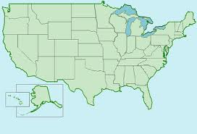
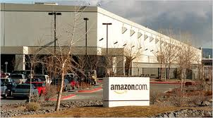
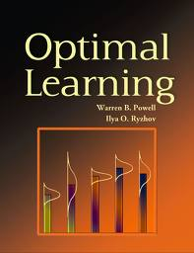
Amazon.com
Which fulfillment center should be used for a particular order?

Slide 26
Amazon.com problem
Suppose that we only consider the problem of shipping a single commodity (e.g. my book)
At any given moment, supply probably exceeds demand
If we compute a transportation problem, the shadow prices for supply constraints will be negative

Slide 27
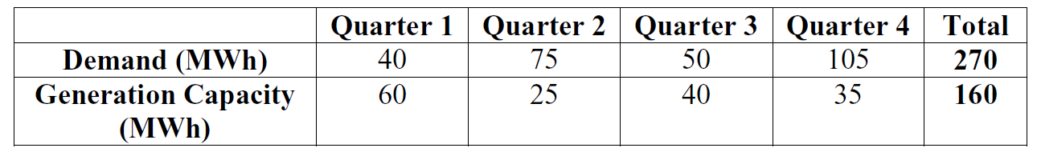
More on modeling
A small electricity producer and storage operator has signed forward contracts to satisfy a certain amount of demand (in MWh) every quarter:

Slide 28
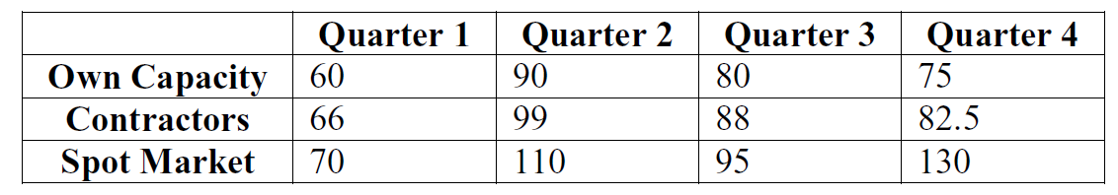
More on modeling
An additional 15 MWh per quarter can be obtained by purchasing from other operators. Any remaining demand must be satisfied by purchasing directly from the spot market, which is typically very expensive:

Slide 29
More on modeling
We can choose to hold electricity in storage (e.g. in a battery) and sell it at a later date. The cost of storage is $10 per quarter for one MWh.
Although this problem has nothing to do with transportation, it can still be solved using the “transportation” model. We just need to think carefully about the supply/demand nodes.

Slide 30
More on modeling
Demand nodes clearly should correspond to the four quarters
However, it is not enough to have three supply nodes (one for each source of energy)
The supply nodes should differentiate between when the energy was supplied
The “shipping” costs have to include generation and storage

Slide 31
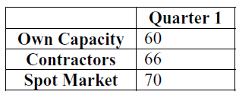
More on modeling
Cost of generating 1 MWh in Q1: $60
Cost of storage for one quarter: $10
Demand
Demand
(Q1)
40
Supply
60
Own
Capacity
(Q1)
70
Demand
(Q2)
75
60
80
90
Demand
(Q3)
50
Demand
(Q4)
105

Slide 32
More on modeling
Cost of buying 1 MWh from operators in Q1: $66
Cost of storage for one quarter: $10
Demand
Demand
(Q1)
40
Supply
66
Other
Operators
(Q1)
76
Demand
(Q2)
75
15
86
96
Demand
(Q3)
50
Demand
(Q4)
105

Slide 33
More on modeling
Cost of buying 1 MWh from market in Q1: $70
Cost of storage for one quarter: $10
Demand
Demand
(Q1)
40
Supply
70
Spot
Market
(Q1)
80
Demand
(Q2)
75
“Very Large”
90
100
Demand
(Q3)
50
Demand
(Q4)
105

Slide 34
More on modeling
Cost of generating 1 MWh in Q2: $90
Cost of storage for one quarter: $10
Demand
Demand
(Q1)
40
Supply
“Very Large”
Own
Capacity
(Q2)
90
Demand
(Q2)
75
25
100
110
Demand
(Q3)
50
If we buy or generate energy in Q2, we cannot use it to satisfy demand in Q1!
Demand
(Q4)
105

Slide 35
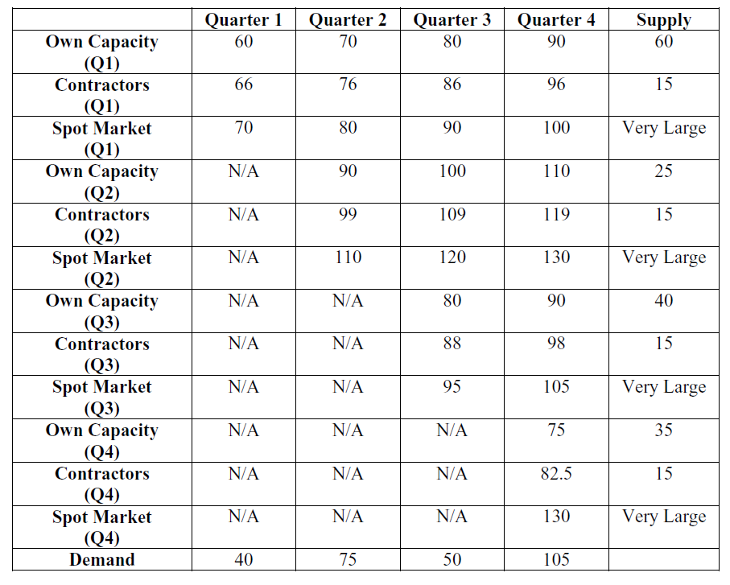
Final transportation model

Slide 36
Objectives
Motivation for Network Models
Examples of Network Models
  Supply chain and logistics problems
    Transportation, Transshipment and Assignment
  Shortest path problems
  Maximal flow problems

Slide 37
Transshipment problems
Consider the Goodwin Manufacturing Company’s problem again (3 plants, 4 warehouses)
Now, suppose that there are two distribution centers in Nashville and St. Louis
The product first goes from the plants to the DCs, then to regional warehouses

Slide 38
Transshipment network
Plants
Warehouses
Supply
Demand
Minn
0.40
Atlanta
10,000
1
8,000
4
0.18
0.32
Nash.
0.34
8
0.16
Boston
10,000
0.22
5
15,000
Pitt
0.36
2
0.24
0.24
0.48
0.58
St. L.
0.14
Chicago
0.52
9
12,000
6
0.30
Tucson
15,000
3
0.36
Denver
10,000
7

Slide 39
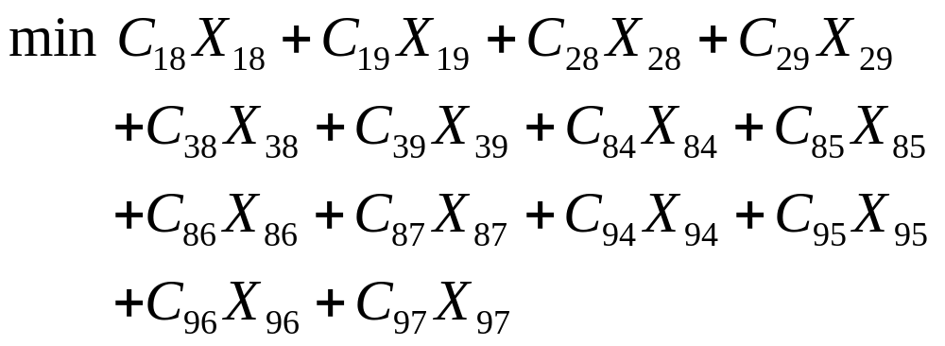
Defining the Objective Function
Minimize the total transportation cost.
.

Slide 40
Defining the Constraints
Demand constraints
  X₈₄ + X₉₄ = 8,000 } Atlanta
  X₈₅ + X₉₅ = 10,000 } Boston
  X₈₆ + X₉₆ = 12,000 } Chicago
  X₉₇ + X₉₇ = 10,000 } Denver
Supply constraints
  X₁₈ + X₁₉ = 10,000 } Minn
  X₂₈ + X₂₉ = 15,000 } Pittsburgh
  X₃₈ + X₃₉ = 15,000 } Tucson
.

Slide 41
Defining the Constraints
Transshipment constraints
  X₁₈ + X₂₈ + X₃₈ = X₈₄ + X₈₅ + X₈₆ + X₈₇ } Nashville
  X₁₉ + X₂₉ + X₃₉ = X₉₄ + X₉₅ + X₉₆ + X₉₇ } St. Louis
Non-negativity constraints:
X_{ij} >= 0
The transshipment constraints represent flow conservation: total product going in = total product going out.
.

Slide 42
Objectives
Motivation for Network Models
Examples of Network Models
  Supply chain and logistics problems
    Transportation, Transshipment and Assignment
  Shortest path problems
  Maximal flow problems

Slide 43
Assignment problems
An assignment problem is a transportation problem where every supply/demand node has 1 unit of supply/demand
“Demand nodes” can represent tasks or projects
“Supply nodes” represent workers, teams, machines, etc.

Slide 44
Assignment Problem
Special form of linear programming model.
A transportation problem where every supply/demand node has 1 unit of supply/demand.
“Demand nodes” can represent tasks or projects
“Supply nodes” represent workers, teams, machines, etc.
Machine
Time (to complete job)
Job
“Supply”
“Demand”
Mach 1
6
Job 1
1
1
1
4
5
4
5
1
Mach 2
Job 2
1
2
4
5
3
12
10
Job 3
1
1
Mach 3
6
3
8

Slide 45
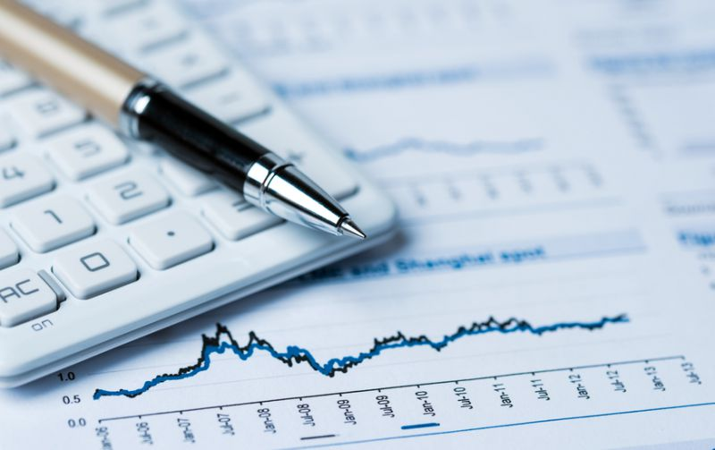
Example: Accounting Firm
An accounting firm has five new clients in the North Carolina area.
As part of their consulting process, one representative of the company needs to meet with the client at its site.
Your job is to decide who to send to meet with each client.
Any representative is equally qualified to meet with any client.
The main concern at this time is total distance traveled.
You have been given the approximate location as latitude and longitude of each representative and client.

Slide 46
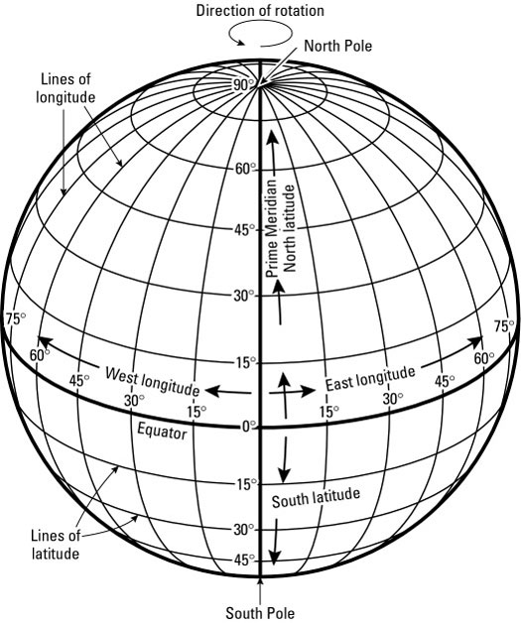
Example
Representative | Latitude | Longitude
Meghan | 34.2104 | -77.8868
Tamela | 36.0726 | -79.7920
Leo | 35.0527 | -78.8784
Melonie | 35.9132 | -79.0558
Jorge | 35.7915 | -78.7811
Titus | 36.2168 | -81.6746
Client | Latitude | Longitude
Client 1 | 35.2271 | -80.8431
Client 2 | 35.7796 | -78.6382
Client 3 | 35.5951 | -82.5515
Client 4 | 35.9940 | -78.8986
Client 5 | 34.0352 | -77.8936

Slide 47
Example
Representative
Distance (in miles)
Client
“Supply”
“Demand”
Decision Variables
Who meets with Client j?
Xij: whether representative i meets Client j
Objective Function
Total Distance Traveled
Constraints
Each Client needs to meet with one representative.
Each Representative can meet with at most one Client.
1
1
1
1
1
1
1
1
1
1
1

Slide 48
Example
Representative | Latitude | Longitude
Meghan | 34.2104 | -77.8868
Tamela | 36.0726 | -79.7920
Leo | 35.0527 | -78.8784
Melonie | 35.9132 | -79.0558
Jorge | 35.7915 | -78.7811
Titus | 36.2168 | -81.6746
Location A
Location B
Client | Latitude | Longitude
Client 1 | 35.2271 | -80.8431
Client 2 | 35.7796 | -78.6382
Client 3 | 35.5951 | -82.5515
Client 4 | 35.9940 | -78.8986
Client 5 | 34.0352 | -77.8936

Slide 49
Example
Steps followed in the spreadsheet model:
Build model to calculate distance between a Representative and a Client
  Use VLOOKUP function to pull information about location.
Use two-way table to build matrix of distances
Change Calculation Options to “Automatic Except for Data Tables”
Build optimization model: decision variables, objective function and constraints
  Use SUMPRODUCT and SUM functions.
Load model into Solver and Select a Solving Method: Simplex LP.
Use Conditional Formatting to highlight optimal assignment.
Analyze solution and its robustness (scenario cases, Sensitivity Analysis, SolverTable.)

Slide 50
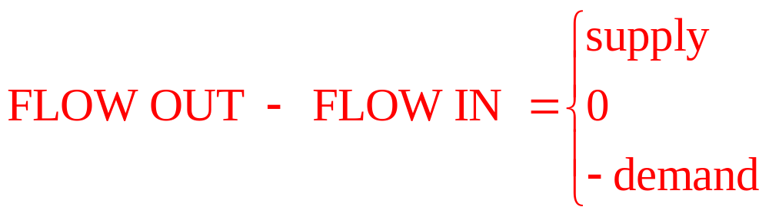
Network Flow Models
Transportation, Assignment, and Transshipment Problems are special cases of Network Flow problems
In these problems, “supply” (broadly defined) is matched with “demand” in a way that minimizes total cost
If the inputs are all integer-valued, Excel will produce an integer solution “for free”
To build a model from a given network diagram:
  Define a VARIABLE for each edge in the network diagram
  Define a CONSTRAINT for each node in the network diagram
  Express the BALANCE EQUATION
.

Slide 51
Generalized Network Flow Problems
In some problems, a gain or loss occurs in flows over arcs.
  Examples
    Oil or gas shipped through a leaky pipeline
    Imperfections in raw materials entering a production process
    Spoilage of food items during transit
    Theft during transit
    Interest or dividends on investments
These problems require some modeling changes.

Slide 52
Goodwin Co. with Yield Loss
Plants
% age of item lost
Warehouses
Supply
Demand
Minn
0.24
Atlanta
16,000
8,000
1
4
0.19
0.07
0.11
0.10
Boston
10,000
Pitt
0.05
5
16,000
2
0.04
0.15
Chicago
12,000
0.26
0.41
6
0.32
Tucson
16,000
3
0.27
Denver
10,000
7
.

Slide 53
Flow Balance Constraint Sign
When we have Yield Losses or Gains it is not always possible to tell if the problem has excess supply, excess demand, or if the supply and demand constraints will be met at equality.
In this case one safe route is to
  assume no excess supply or demand and write model with equality constraints.
  If that does not work (you get an infeasible solution), assume excess supply and use <= constraints
  If that does not work (you get an infeasible solution) Assume excess demand and use >= constraints.

Slide 54
Yield Losses in Constraints
Demand constraints
  0.76 X₁₄ + 0.90 X₂₄ + 0.74 X₃₄ >= 8,000 } Atlanta
  0.81 X₁₅ + 0.95 X₂₅ + 0.59 X₃₅ >= 10,000} Boston
  0.93 X₁₆ + 0.96 X₂₆ + 0.68 X₃₆ >= 12,000} Chicago
  0.89 X₁₇ + 0.85 X₂₇ + 0.73 X₃₇ >= 10,000} Denver
Supply constraints
  X₁₄ + X₁₅ + X₁₆ + X₁₇ <= 16,000 } Minn
  X₂₄ + X₂₅ + X₂₆ + X₂₇ <= 16,000 } Pittsburgh
  X₃₄ + X₃₅ + X₃₆ + X₃₇ <= 16,000 } Tucson
Nonnegativity conditions
  X_{ij} >= 0 for all i and j
.

Slide 55
Financial Network Problems
Many Investment Problems have a natural network structure to them
Consider the problem of saving for a child’s education, starting 4 years from now
Need to have $24K for 1st year, and $26K, $28K, $30K for 2nd, 3rd, and 4th year respectively
Investment options are:
Investment | Available | Matures | Return at maturity
A | Every year | 1 year | 6%
B | 1, 3, 5, 7 | 2 years | 14%
C | 1,4 | 3 years | 18%
D | 1 | 7 years | 65%
.

Slide 56
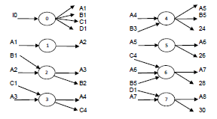
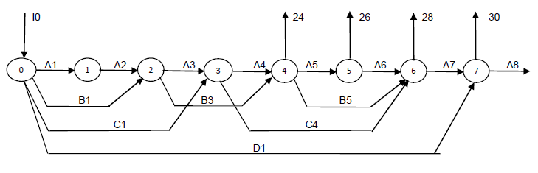
Monthly Fund Flows
.

Slide 57
Model
Minimize I0
Subject to:
A1+B1+C1+D1-I0=0 (end of year 0)
A2-1.06A1 = 0 (end of year 1)
A3+B3-1.06A2-1.14B1=0 (end year 2)
A4+C4-1.06A3-1.18C1=0 (end year 3)
A5+B5 + 24000 – 1.06A4 -1.14B3 = 0 (end year 4)
A6+26000-1.06A5 = 0 (end year 5)
A7+28000-1.06A6-1.14B5-1.18C4= (end year 6)
A8+30000-1.06A7-1.65D1=0 (end year 7)
All amounts non-negative
.

Slide 58
Rewritten slightly differently
Minimize I0
Subject to:
A1+B1+C1+D1 = I0 (end of year 0)
A2-1.06A1 = 0 (end of year 1)
A3+B3-1.06A2-1.14B1= 0 (end year 2)
A4+C4-1.06A3-1.18C1= 0 (end year 3)
A5+B5 – 1.06A4 -1.14B3 = -24000 (end year 4)
A6 -1.06A5 = -26000 (end year 5)
A7-1.06A6-1.14B5-1.18C4 = -28000 (end year 6)
1.06A7-1.65D1= -30000 (end year 7)
All amounts non-negative
.

Slide 59
Objectives
Motivation for Network Models
Examples of Network Models
  Supply chain and logistics problems
    Transportation, Transshipment and Assignment
  Shortest path problems
  Maximal flow problems

Slide 60
Shortest Path Problem: AAA
+0
L'burg
3.3 hrs
5 pts
9
Va Bch
11
-1
5.0 hrs
9 pts
2.0 hrs
4 pts
+0
4.7 hrs
2.7 hrs
9 pts
+0
4 pts
K'ville
1.1 hrs
G'boro
3 pts
5
2.0 hrs
3.0 hrs
Raleigh
9 pts
4 pts
8
10
+0
1.7 hrs
5 pts
A'ville
6
+0
1.5 hrs
+0
3 pts
2.3 hrs
Chatt.
3 pts
2.8 hrs
3
7 pts
2.0 hrs
Charl.
8 pts
7
+0
3.0 hrs
1.7 hrs
4 pts
4 pts
G'ville
1.5 hrs
2 pts
4
Atlanta
+0
B'ham
2
2.5 hrs
+1
1
2.5 hrs
3 pts
3 pts
+0

Slide 61
Shortest path problems
This is essentially a transshipment problem with one supply node and one demand node
There is exactly 1 unit of supply/demand (corresponding to the traveler)
Solving the problem for a given objective function will produce a meaningful route from the origin to the destination

Slide 62
Solving the Problem
There are two possible objectives for this problem
  Finding the quickest route (minimizing travel time)
  Finding the most scenic route (maximizing the scenic rating points)
  Spreadsheet shortestpath.xlsx solves the quickest route problem. Modify appropriately to find most scenic route.

Slide 63
Flow Balance Rules
For Minimum Cost Network Apply This Balance-of-Flow
Flow Problems Where: Rule At Each Node:
Total Supply > Total Demand Outflow-Inflow <= Supply or - Demand
Total Supply < Total Demand Outflow-Inflow >=Supply or - Demand
Total Supply = Total Demand Outflow-Inflow = Supply or - Demand

Slide 64
Objectives
Motivation for Network Models
Examples of Network Models
  Supply chain and logistics problems
    Transportation, Transshipment and Assignment
  Shortest path problems
  Maximal flow problems

Slide 65
The Maximal Flow Problem
In some network problems, the objective is to determine the maximum amount of flow that can occur through a network.
The arcs in these problems have upper and lower flow limits.
Examples
  How much water can flow through a network of pipes?
  How many cars can travel through a network of streets?

Slide 66
The Northwest Petroleum Company
Pumping
Pumping
Station 1
Station 3
3
4
2
2
6
6
1
Oil Field
Refinery
6
4
2
4
3
5
5
Pumping
Pumping
Station 2
Station 4
© 2017 Cengage Learning. All Rights Reserved. May not be scanned, copied or duplicated, or posted to a publicly accessible website, in whole or in part.

Slide 67
The Northwest Petroleum Company
Pumping
Pumping
Station 1
Station 3
3
4
2
2
6
6
1
Oil Field
Refinery
6
4
2
4
3
5
5
Pumping
Pumping
Station 2
Station 4

Slide 68
Formulation
MAX: X₆₁
Subject to: +X₆₁ - X₁₂ - X₁₃ = 0
+X₁₂ - X₂₄ - X₂₅ = 0
+X₁₃ - X₃₄ - X₃₅ = 0
+X₂₄ + X₃₄ - X₄₆ = 0
+X₂₅ + X₃₅ - X₅₆ = 0
+X₄₆ + X₅₆ - X₆₁ = 0
with the following bounds on the decision variables:
0 <= X₁₂ <= 6 0 <= X₂₅ <= 2 0 <= X₄₆ <= 6
0 <= X₁₃ <= 4 0 <= X₃₄ <= 2 0 <= X₅₆ <= 4
0 <= X₂₄ <= 3 0 <= X₃₅ <= 5 0 <= X₆₁ <= inf
© 2017 Cengage Learning. All Rights Reserved. May not be scanned, copied or duplicated, or posted to a publicly accessible website, in whole or in part.

Slide 69

Objectives
Motivation for Network Models
Examples of Network Models
  Supply chain and logistics problems
    Transportation, Transshipment and Assignment
  Shortest path problems
  Maximal flow problems

