Slide 1
Word Embedding
電機三劉記良
Notes:
Preparing the demo
Extra topic:
maybe I can talk about relation extraction
Rest:
Paragraph vector
Introducing document vector
convolutional DSSM or parsing tree
Introducing the whole representation
Topic covered:
Motivation: meaning representation
Meaning of one word:
predict the next word
structure
How to train 1
why? What we get (done)
other structure 1
Meaning of a sentence:
Deep Semantic 1
+ convolution 1
Paragraph Vector 1
Outlook: parsing, composition

Slide 2
1-of-N Encoding
Word Embedding
apple = [ 1 0 0 0 0]
dog
bag = [ 0 1 0 0 0]
rabbit
run
cat = [ 0 0 1 0 0]
jump
cat
dog = [ 0 0 0 1 0]
tree
flower
elephant = [ 0 0 0 0 1]
Word Class
class 1
Class 2
Class 3
dog
ran
flower
cat
jumped
bird
walk
tree
apple
Notes:
1 of N encoding: 維數大
Word class : 分類方法很多，不同class 間沒關聯。
Word embedding : 維數低，可表示字之間的關聯，可以讓機器自己學習。

Slide 3
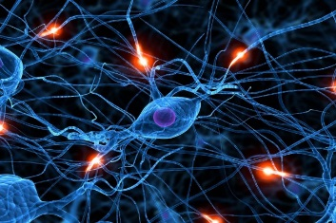

Word Embedding
Machine learns the meaning of words from reading a lot of documents without supervision
Word Embedding
tree
flower
dog
rabbit
run
jump
cat
Notes:
閱讀大量文章

Slide 4
Word Embedding
Machine learns the meaning of words from reading a lot of documents without supervision
A word can be understood by its context
You shall know a word by the company it keeps
蔡英文、馬英九 are something very similar
馬英九 520宣誓就職
蔡英文 520宣誓就職
Notes:
要怎麼解？
靠相鄰的字

Slide 5
How to exploit the context?
Count based
If two words w_{i} and w_{j} frequently co-occur, V(w_{i}) and V(w_{j}) would be close to each other
E.g. Glove Vector: http://nlp.stanford.edu/projects/glove/
Perdition based
V(w_{i}) . V(w_{j})
N_{i,j}
Inner product
Number of times w_{i} and w_{j} in the same document

Slide 6
Prediction-based – Training
潮水
Neural
Network
就
Collect data:
退了
潮水 退了 就 知道 誰 …
不爽 不要 買 …
公道價 八萬 一 …
………
退了
Neural
Network
知道
就
Minimizing cross entropy
就
Neural
Network
誰
知道
Notes:
What can it do? Application?

Slide 7
Prediction-based - 推文接話
推 louisee :話說十幾年前我念公立國中時,老師也曾做過這種事,但
推 pttnowash :後來老師被我們出草了
→ louisee :沒有送這麼多次,而且老師沒發通知單。另外，家長送
→ pttnowash :老師上彩虹橋 血祭祖靈
https://www.ptt.cc/bbs/Teacher/M.1317226791.A.558.html
推 AO56789: 我同學才扯好不好，他有一次要交家政料理報告
→ AO56789:其中一個是要寫一樣水煮料理的食譜，他居然給我寫
→ linger:溫水煮青蛙
→ AO56789:溫水煮青蛙，還附上完整實驗步驟，老師直接給他打0
→ linger:幹還真的是溫水煮青蛙
著名簽名檔 (出處不詳)
Notes:
故意接樓上推文來裱樓上

Slide 8
Prediction-based – Language Modeling
P(“wreck a nice beach”)
=P(wreck|START)P(a|wreck)P(nice|a)P(beach|nice)
P(b|a): the probability of NN predicting the next word.
P(next word is “wreck”)
P(next word is “a”)
P(next word is “nice”)
P(next word is “beach”)
Neural
Network
Neural
Network
Neural
Network
Neural
Network
1-of-N encoding of “START”
1-of-N encoding of “wreck”
1-of-N encoding of “a”
1-of-N encoding of “nice”

Slide 9
Prediction-based
w_{i}
…… w_{i-2} w_{i-1} ___
0
z₁
1-of-N encoding
of the word w_{i-1}
1
z₂
The probability for each word as the next word w_{i}
0
……
……
…
……
Take out the input of the neurons in the first layer
z₂
tree
flower
Use it to represent a word w
dog
rabbit
run
jump
cat
Word vector, word embedding feature: V(w)
z₁
Notes:
Note that we only consider one input word, we only consider wi-1
We will consider multiple word
The structured is a little different

Slide 10
Prediction-based
You shall know a word by the company it keeps
0
z₁
1
z₂
The probability for each word as the next word w_{i}
0
……
……
蔡英文
or
馬英九
…
……
“宣誓就職” should have large probability
Training text:
z₂
…… 蔡英文 宣誓就職 ……
蔡英文
w_{i-1}
w_{i}
馬英九
…… 馬英九 宣誓就職 ……
w_{i-1}
w_{i}
z₁
Notes:
A man is known by the company he keeps.
觀其友知其人
Why the word vectors can probably capture the meaning of the words

Slide 11
Prediction-based – Various Architectures
Continuous bag of word (CBOW) model
Skip-gram
w_{i-1}
Neural
Network
…… w_{i-1} ____ w_{i+1} ……
w_{i}
w_{i+1}
predicting the word given its context
…… ____ w_{i} ____ ……
Neural
Network
w_{i-1}
w_{i}
w_{i+1}
predicting the context given a word

Slide 12
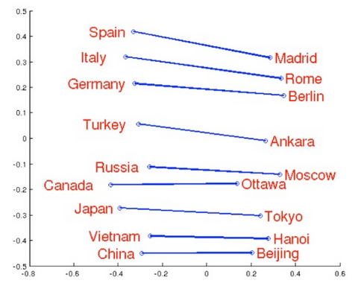
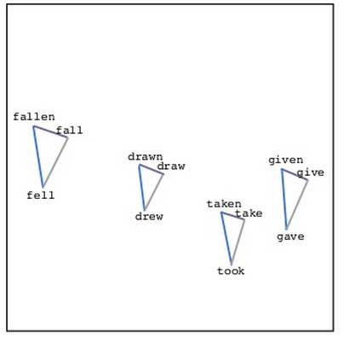
Word Embedding
Source: http://www.slideshare.net/hustwj/cikm-keynotenov2014
Notes:
Why can it happen
How to explain it

Slide 13
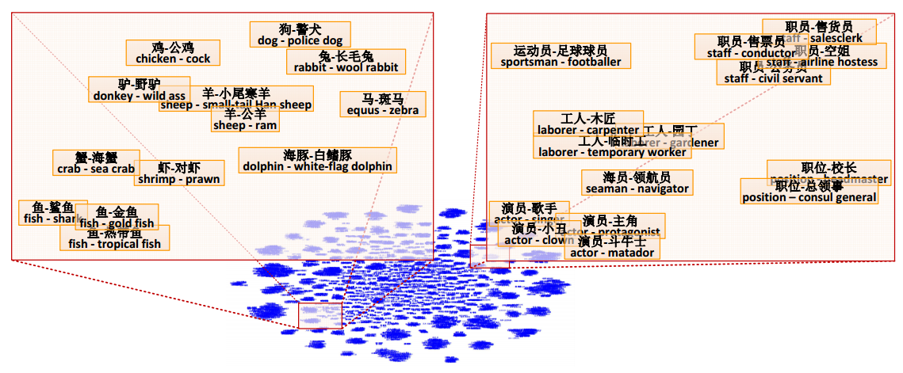
Word Embedding
Fu, Ruiji, et al. "Learning semantic hierarchies via word embeddings."Proceedings of the 52th Annual Meeting of the Association for Computational Linguistics: Long Papers. Vol. 1. 2014.

Slide 14
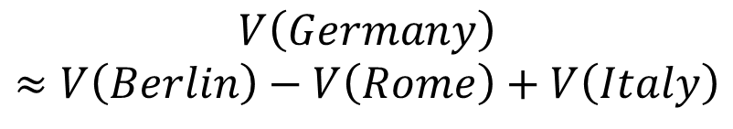
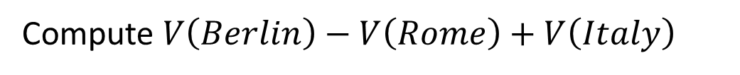
Word Embedding
$$V\left(Germany\right)$$
$$≈V\left(Berlin\right)−V\left(Rome\right)+V\left(Italy\right)$$
Characteristics
Solving analogies
$$V\left(hotter\right)−V\left(hot\right)≈V\left(bigger\right)−V\left(big\right)$$
$$V\left(Rome\right)−V\left(Italy\right)≈V\left(Berlin\right)−V\left(Germany\right)$$
$$V\left(king\right)−V\left(queen\right)≈V\left(uncle\right)−V\left(aunt\right)$$
Rome : Italy = Berlin : ?
Compute $V\left(Berlin\right)−V\left(Rome\right)+V\left(Italy\right)$
Find the word w with the closest V(w)
Notes:
Hierarchy is not mentioned …

Slide 15

Demo
Machine learns the meaning of words from reading a lot of documents without supervision
Notes:
Machine learns to understand 鄉民用語 via reading the posts on PTT

Slide 16
Your Time~~

