Slide 1

Dissertation Briefing
Liangxiao LI
7.04

Slide 2
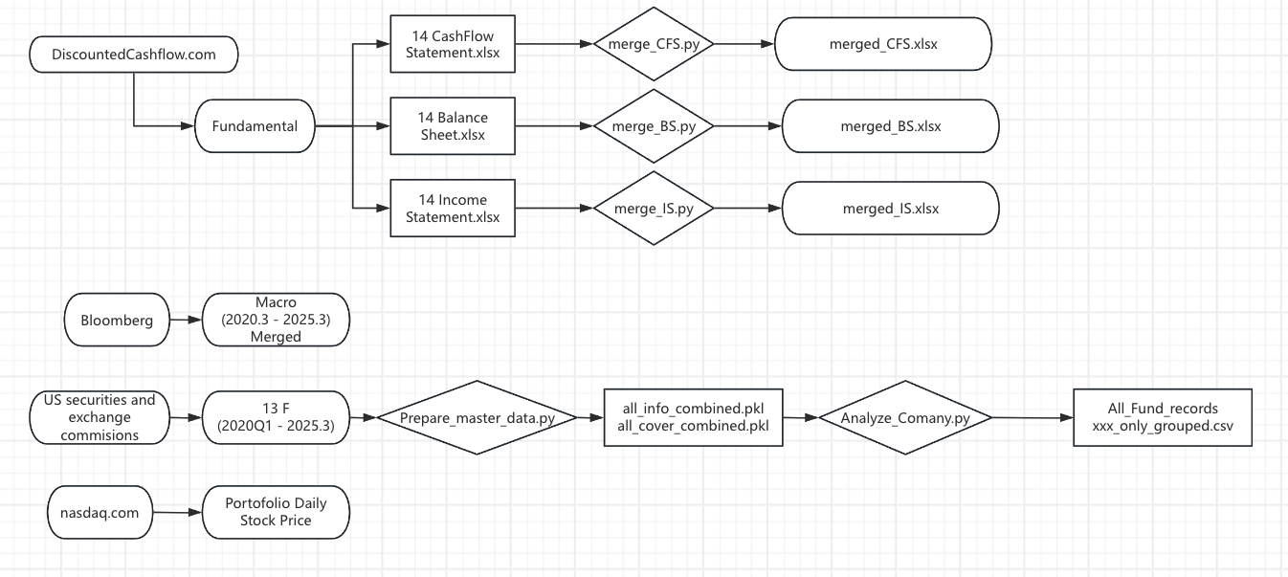
Table of Content
Portfolio Selection
Data Cleaning
Macro - Quarterly
Fundamental - Yearly
13 F - Quarterly
Historical Stock Price - Daily
Variable dimension Breakdown
LaTeX Dissertation Progress
Timeline

Slide 3
Portofolio Selections (14 Tech sector stocks)
Return
Mega-cap tech: AAPL, MSFT(IaaS,SaaS), AMZN(IaaS), GOOGL, META(FB), NVDA
Stable Stocks
High-conviction growth: TSLA, AMD(Design CPUGPU), PLTR(AI Platform), SNOW(PaaS/SaaS), SHOP(Ecommerce)
Volatile stocks
Subsector representation: ASML (semicon equipment), CRM (SaaS), PANW (cybersecurity)
Other important Tech related stocks

Slide 4
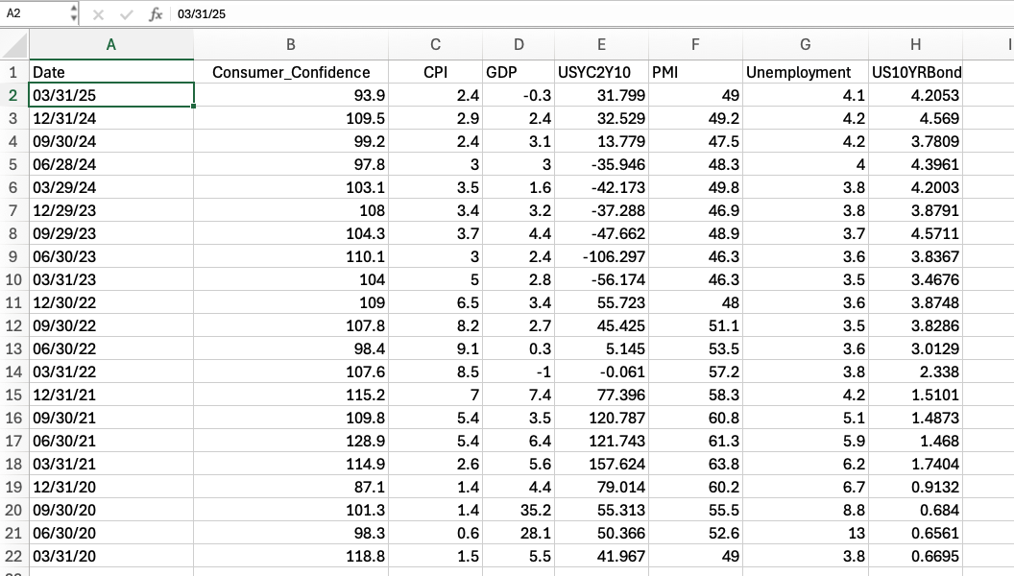
Data Cleaning – Macro
Return

Slide 5
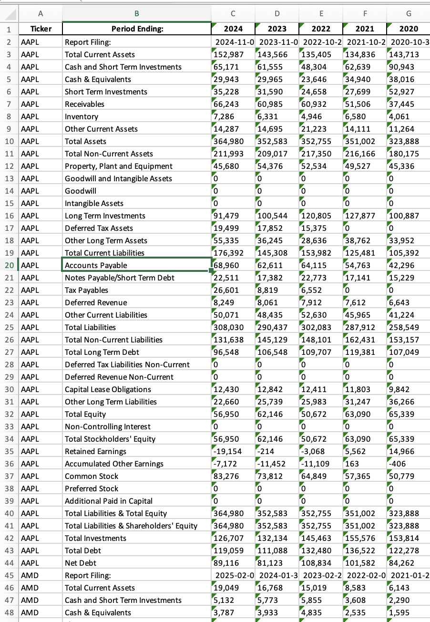
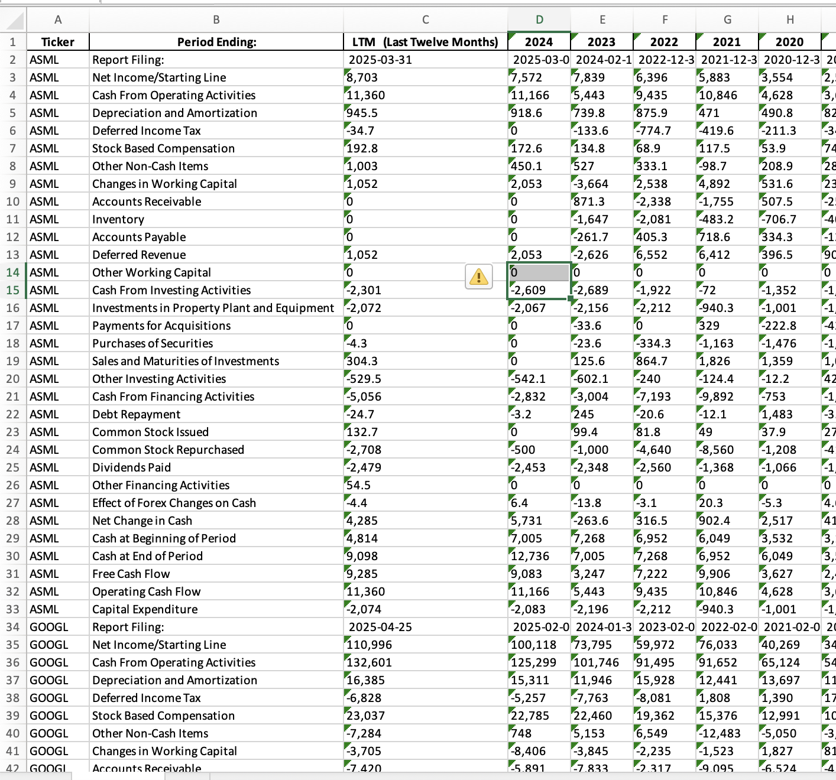
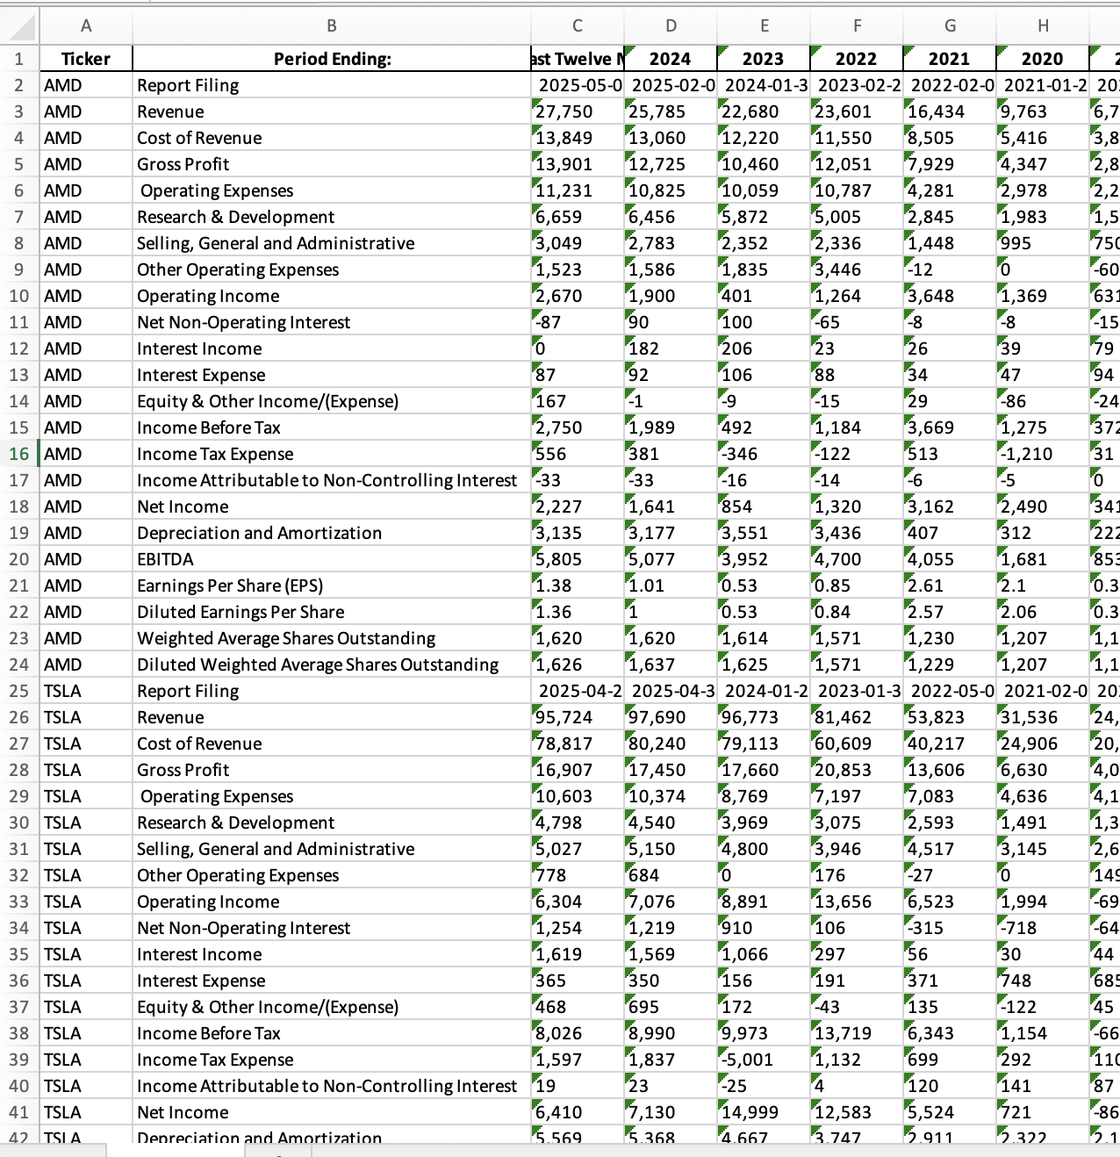
Data Cleaning - Fundamental Merged_BS, Merged_CFS, Merged_IS
Return

Slide 6
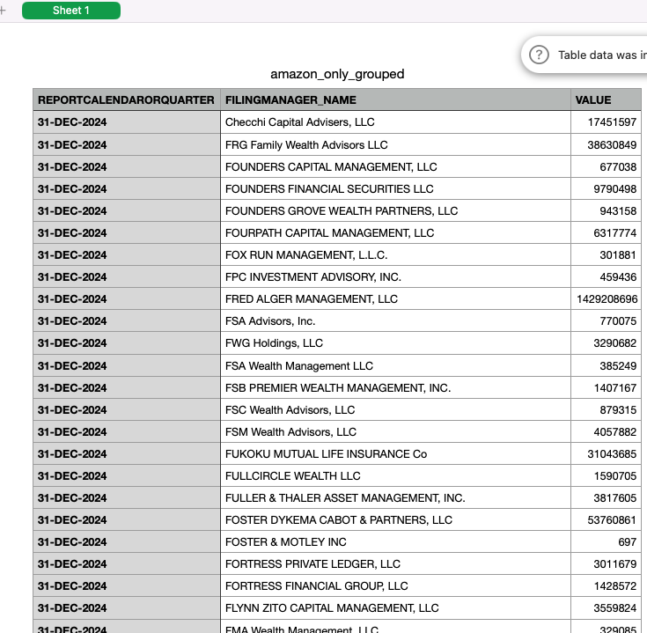
Data Cleaning 13 F
Return

Slide 7
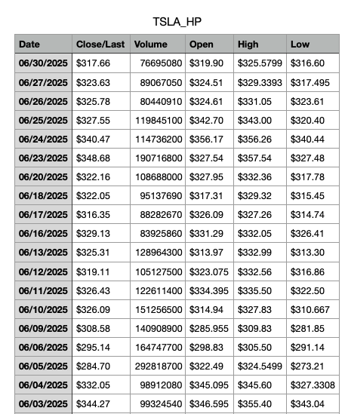
Data Cleaning Historical Stock Price
Return

Slide 8
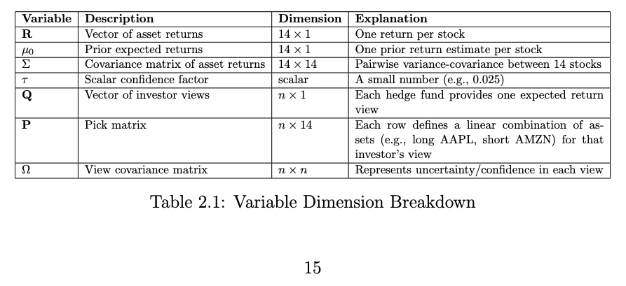
Variable Dimension Breakdown
Investor View

Slide 9
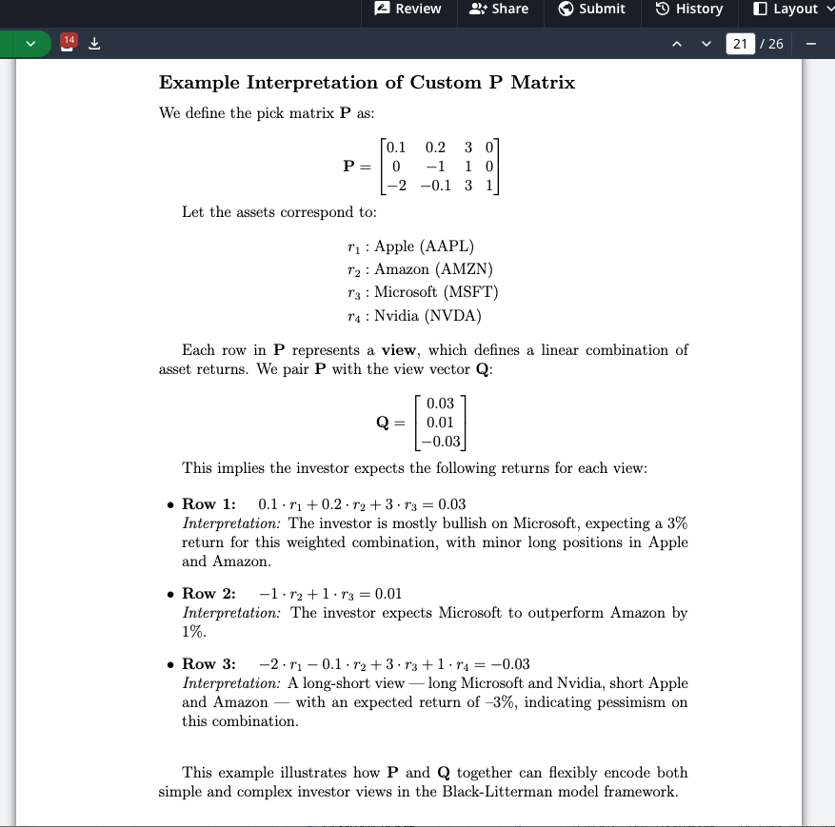
Which n hedge funds?
Select hedge funds that cumulatively account for the top 90% of portfolio holdings for each individual stock.Include them all into our P and Q
Take the union of these hedge funds across all 14 tech stocks, and include them in the construction of P and Q matrices.
For example, Hedge Fund A hold 30% holding in Apple but only 0.1% in Amazon
Then in the P matrix it will have higher weight to Apple and negligible weight to Amazon
The P matrix will likely be Sparse

Slide 10
How to get P, Q, Ω with 13F?
Return
P: Simply based on the weight of each portfolio
Q: Apply certain model to predict future holding, then use this prediction to construct this View vector Q
Ω: The more inaccurate a fund's past performance has been, the higher Omega it should be assigned

Slide 11
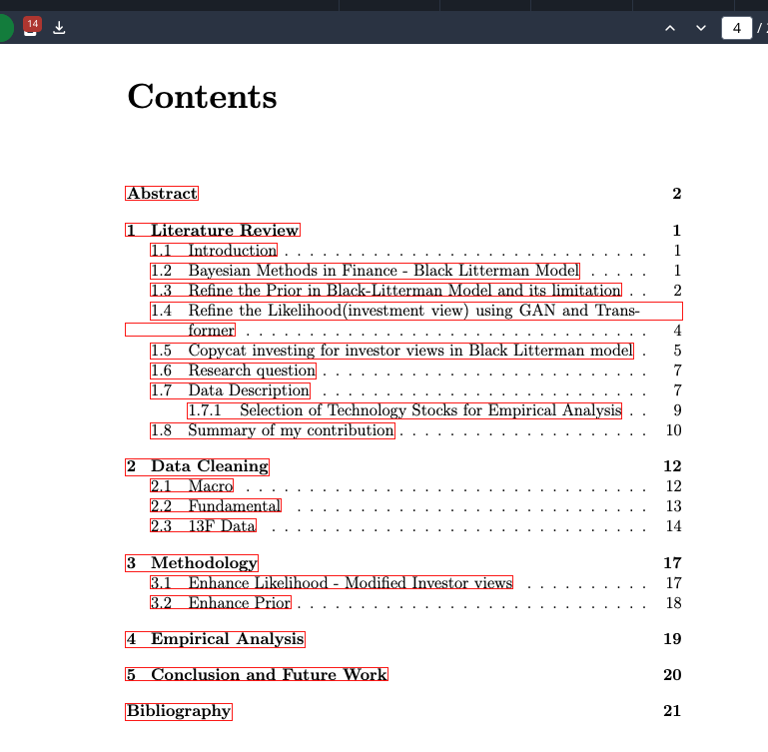
LaTeX Dissertation Progress
Return
Question1: Is this structure solid?
Question2: My Next step:
Write Empirical Analysis
Enhance Likelihood (Investor View Q)
Benchmark: TabPFN
Input: Macro + 13 F
Output: Predicted Future Asset HoldingFuture Holding
Other model/methods: GAN, Transformer, Bayesian emsemble models
Enhance Prior (Expected Market Return E[R])
Benchmark: TabPFN
Input: Macro + Fundamental
Output: Expected return metrics
Other model/methods: ???

Slide 12
Timeline
Return
June 26 | Supervisor meeting
June 27-July 3 | Data Cleaning | Today
July 4 – July 22 | Model Development
July 23 – August 4 | Model Development Writing main Chapters | Contact
August 5 – August 15 | Writing main chapters | Contact
August 16-August 22 | Polish draf, submit to supervisor
August 23- August 29 | Further polishing draft
September 1 – September 8 | Final Polish & Submit

