Slide 1

Dissertation Briefing
Liangxiao LI
7.11

Slide 2
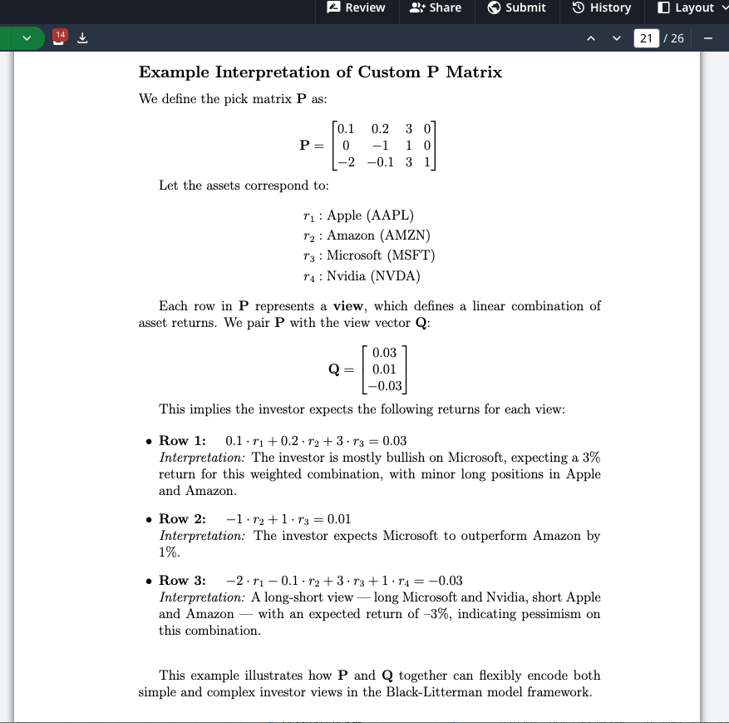
Quick Recap: How to get P, Q, Ω with 13F?
Return
P: Simply based on the weight of each portfolio
Q: Apply certain model to predict future holding, then use this prediction to construct this View vector Q
Ω: The more inaccurate a fund's past performance has been, the higher Omega it should be assigned

Slide 3
Table of Content
Model Pipeline Construction
LaTeX Dissertation Progress and my next steps
Timeline

Slide 4
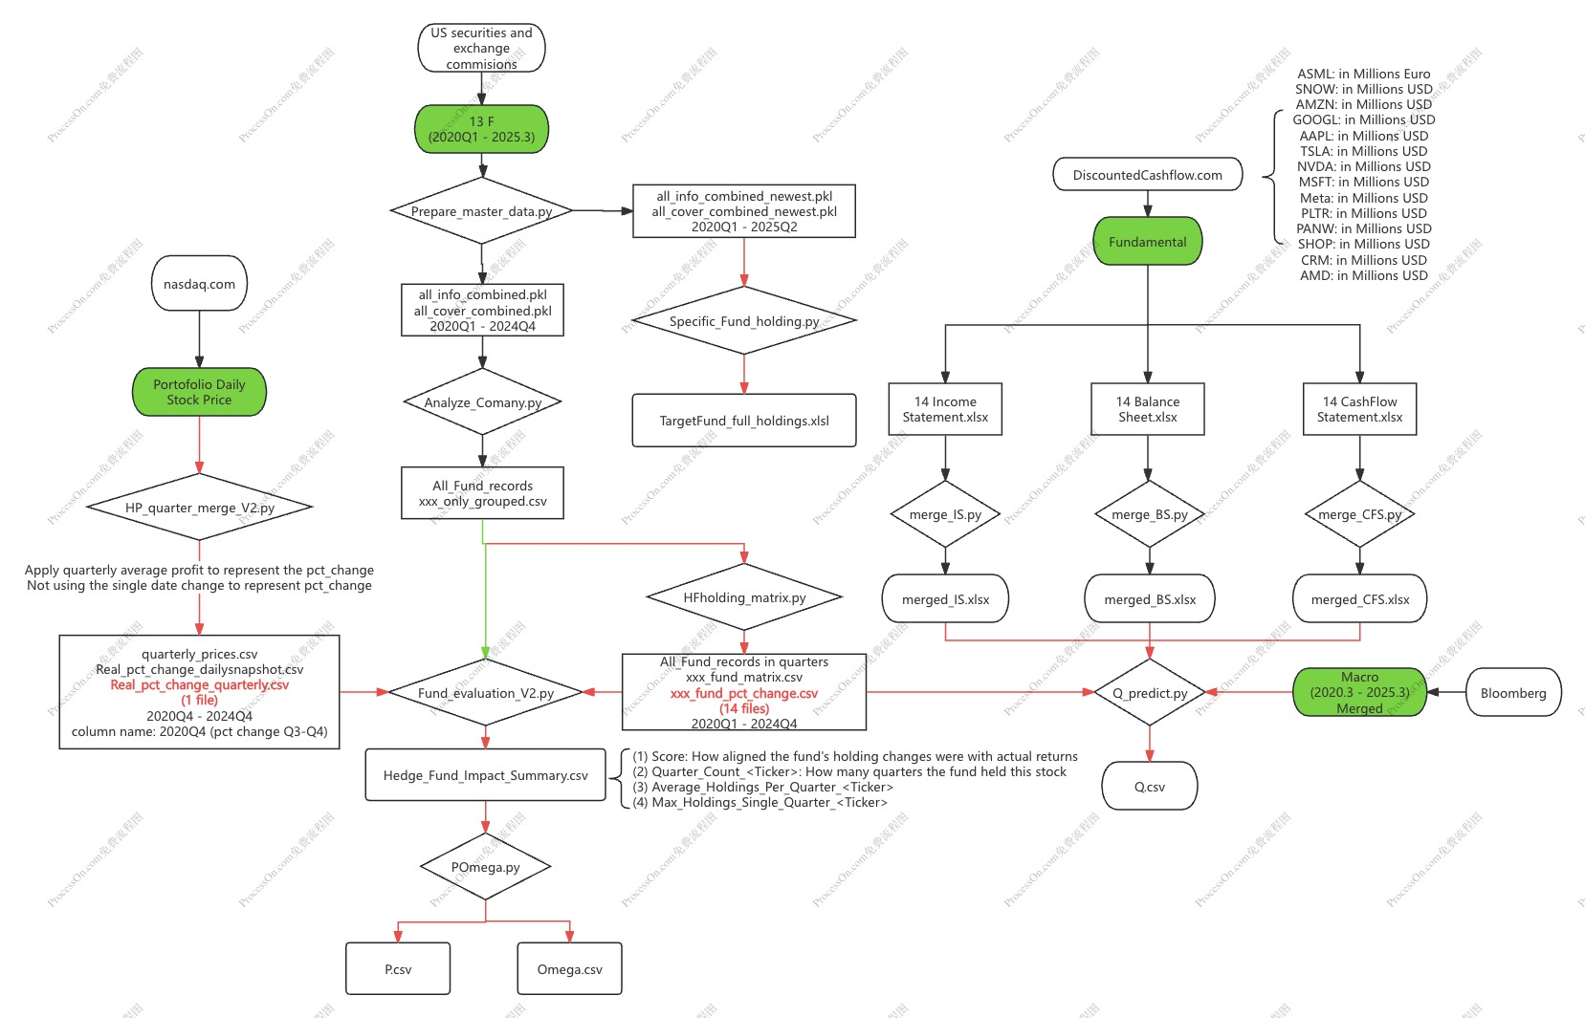
Model Pipeline Construction
(1)How 13 F Makes Money
(3)
(2)Real PCT Change
(6) Still in progress, aligning the dataset for quarterly
(4)
(5)

Slide 5
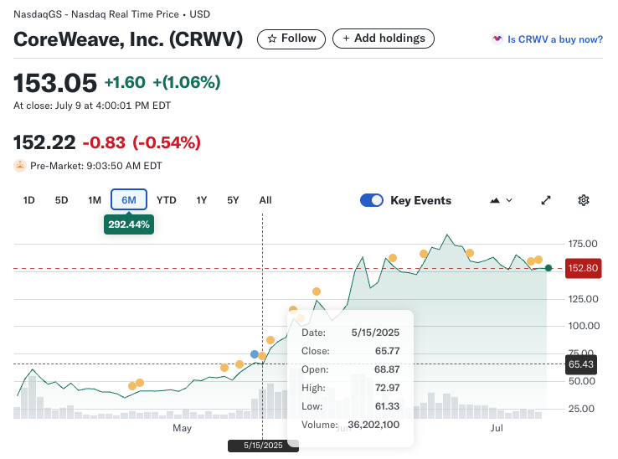
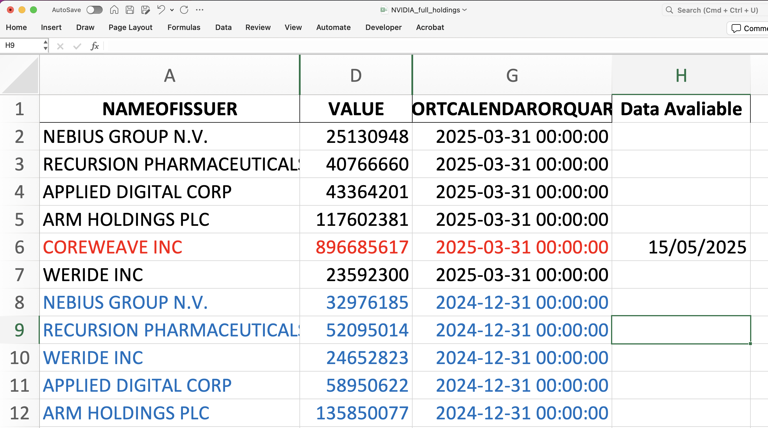
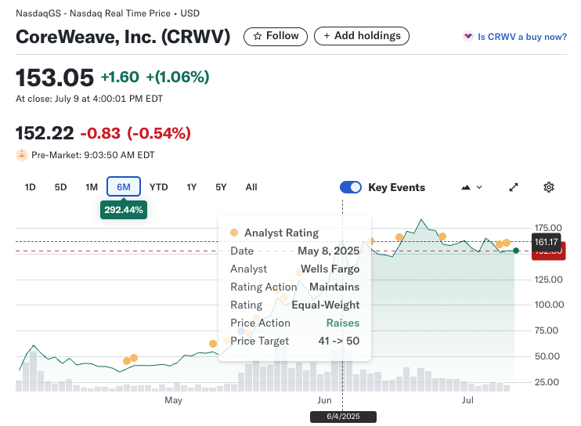
(1) How 13 F makes money
Return

Slide 6
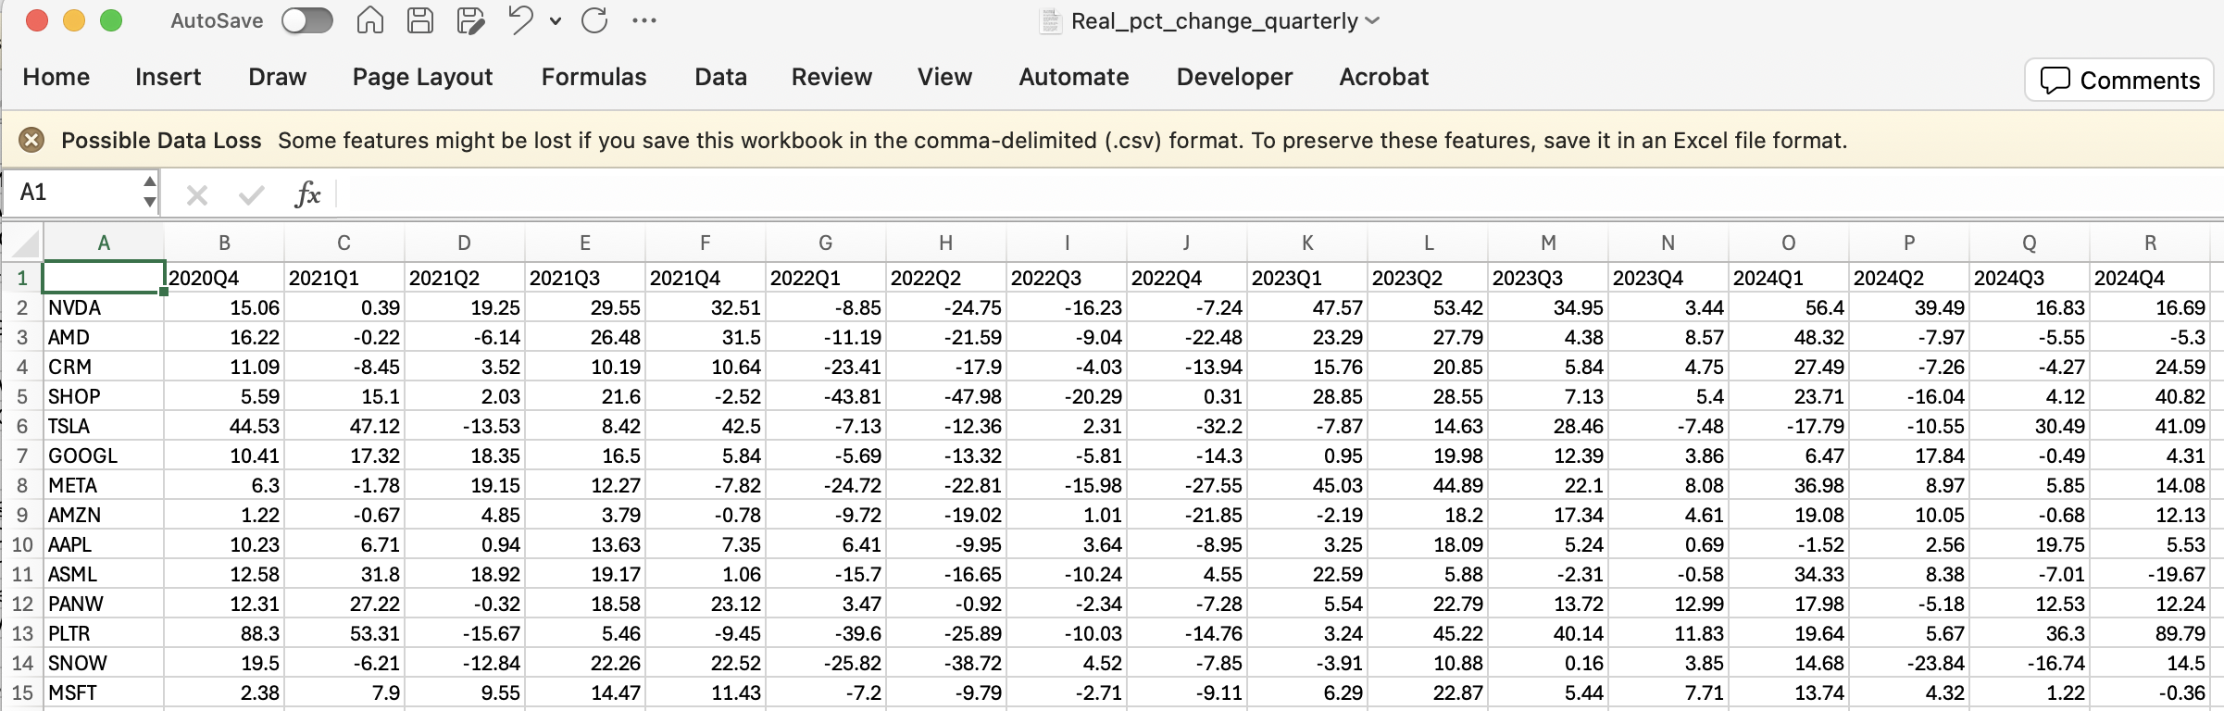
(2) Real_pct_change_quarterly
Return

Slide 7
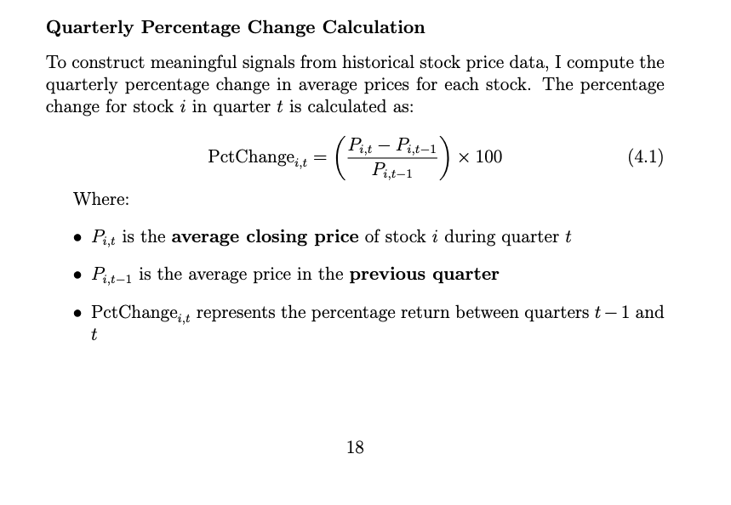
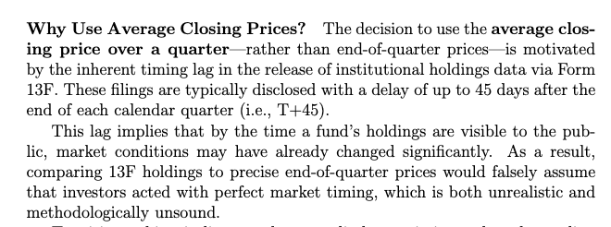
(2) Real_pct_change_quarterly Motivation
Return

Slide 8
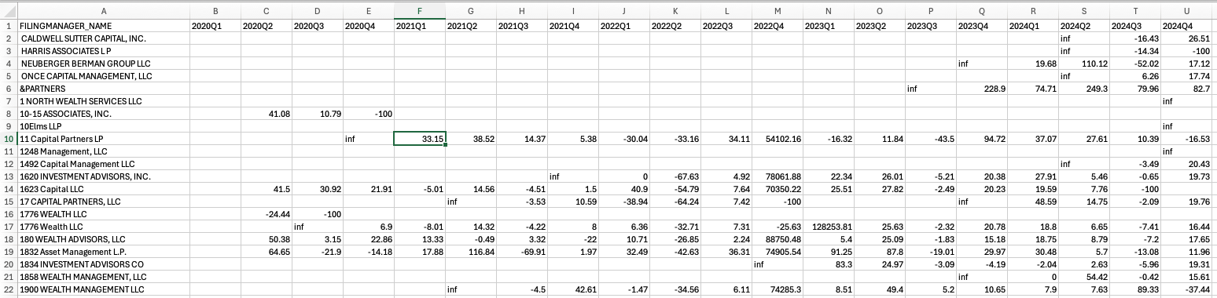
(3) Fund_pct_change (this example is AMZN)
Return

Slide 9
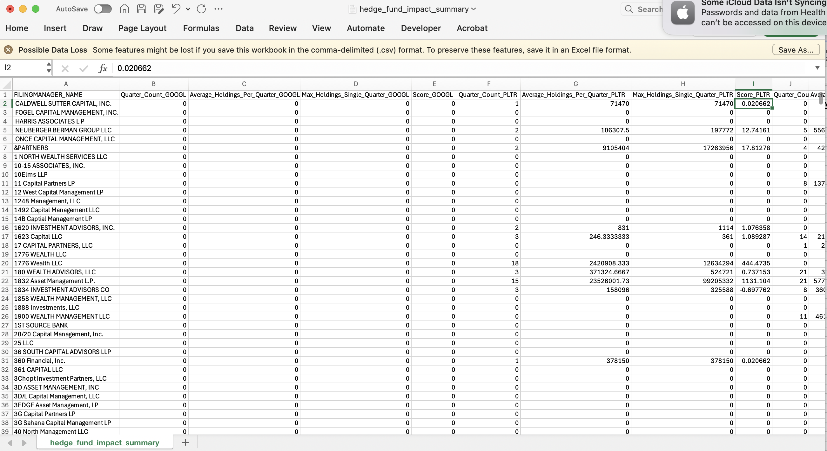
(4) Fund_Impact_Summary : n x(14 *4) matrix
Return

Slide 10
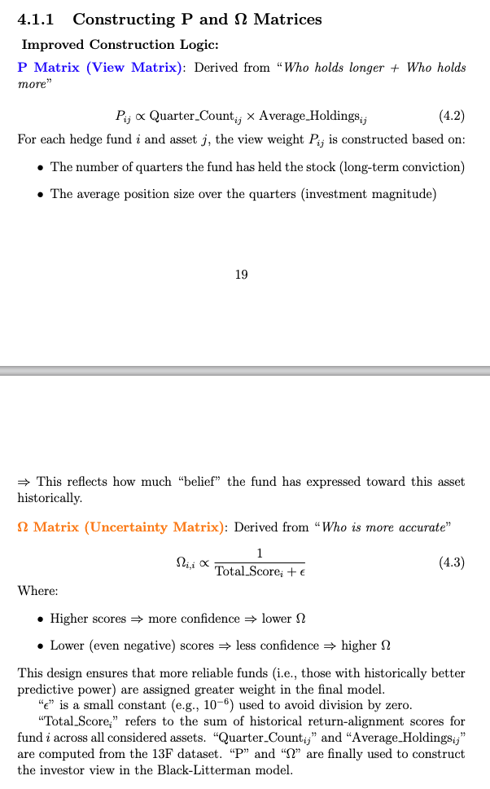
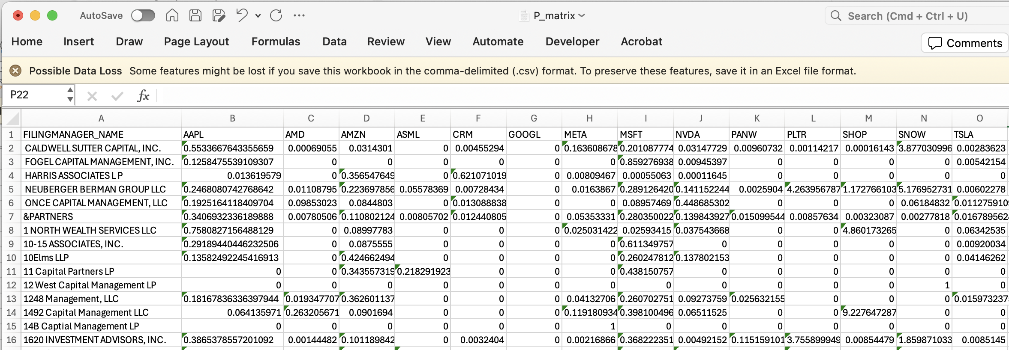
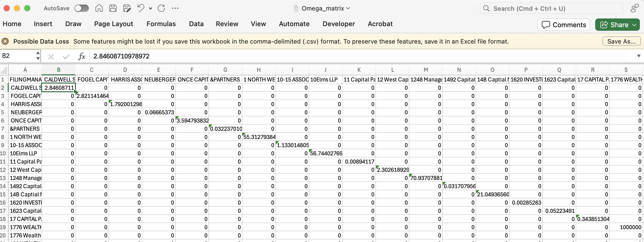
(5) Calculate P and Omega
Return

Slide 11
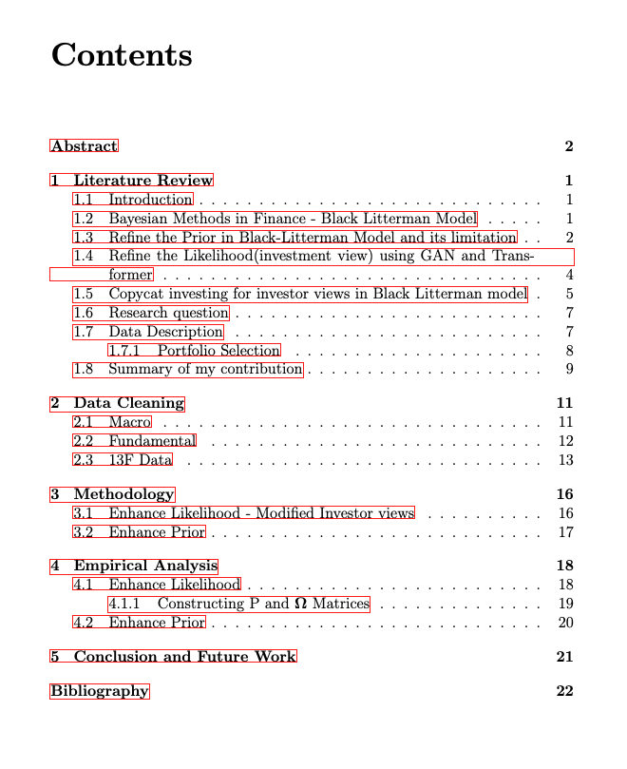
LaTeX Dissertation Progress

Slide 12
My Next Step:
Return
(1) Finish model pipeline
Finish the pipeline for getting Q
Build out the pipeline for getting Prior E[R]
(2) Perform more Literature review
How to deal with 13 F Dataset? (Get P and Omega)
Quarterly data, update slow
What models are used to get Q in the past?
What models are used to get Prior E[R]

Slide 13
My Question
Is my current working methodology correct?
What’s a typical research cycle for a statistician?
1 h Literature review
1 h coding
1 h writing
1 h presentation

Slide 14
Timeline
Return
June 26 | Supervisor meeting
June 27-July 3 | Data Cleaning
July 4 – July 22 | Model Development Part1: Enhance Likelihood PQR | Today, in progress
July 23 – August 4 | Model Development Writing main Chapters | Contact
August 5 – August 15 | Writing main chapters | Contact
August 16-August 22 | Polish draf, submit to supervisor
August 23- August 29 | Further polishing draft
September 1 – September 8 | Final Polish & Submit

