Slide 1

Dissertation Briefing
Liangxiao LI
7.18

Slide 2
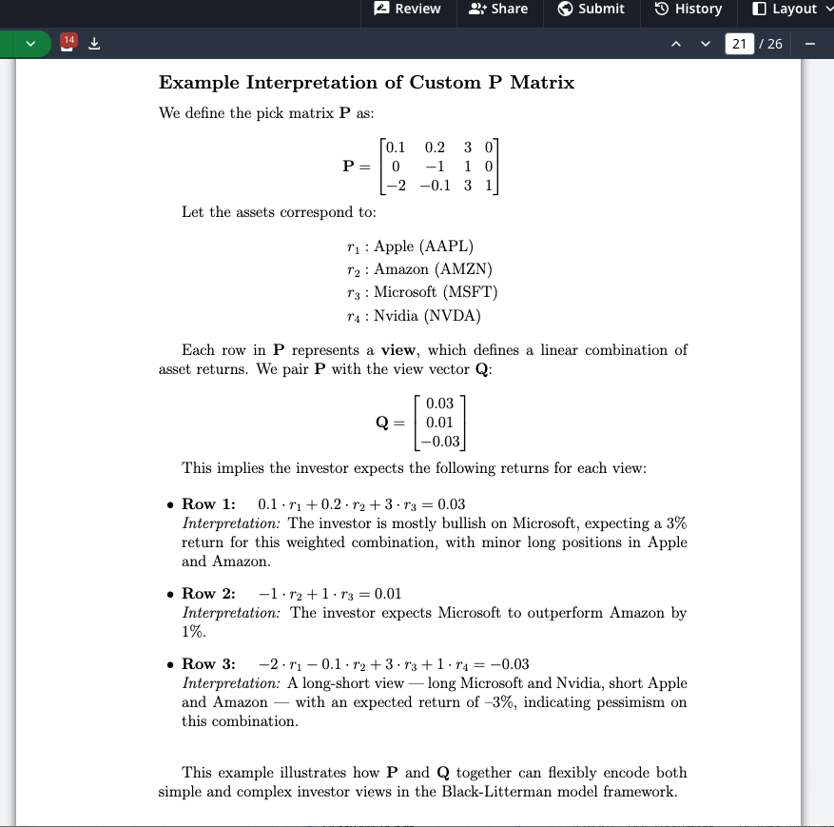
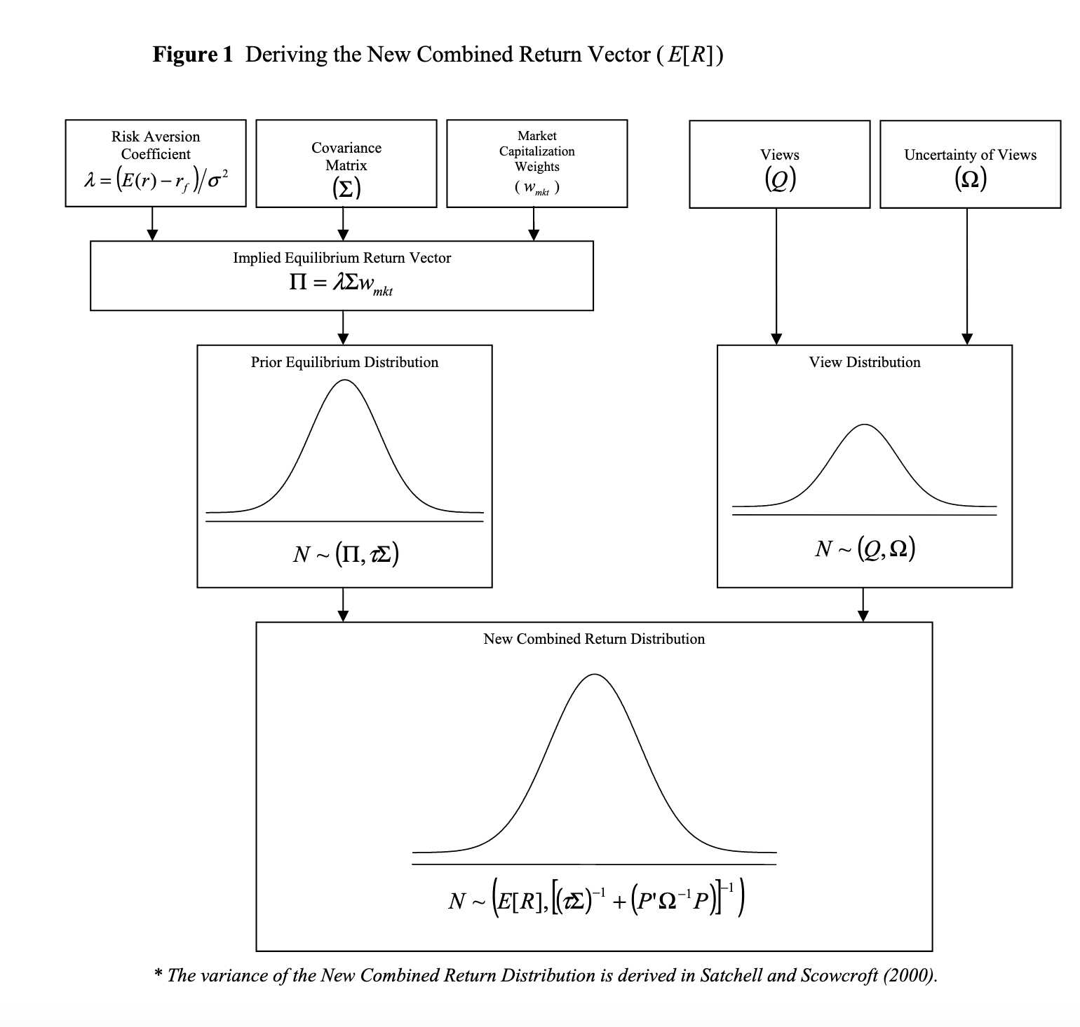
Quick Recap:
Return
Likelihood
Prior

Slide 3
Table of Content
Model Pipeline Construction
Update on dataset CRSP for historical data
Black-Litterman model library: PyPortfolioOpt
Literature reviews (What others do? What I’m gonna do)
Question 1: How to pick funds for analysis? – FEHF
Question 2: How to get P, Q, Ω?
Calculate P: Pick funds with highest tilts, assign P to “Best Ideas” based on money invested, other take 0.
Calculate Q: Prediction Model to predict Fund’s future implementation
Calculate Ω: Return of the fund’s past performance
Question 3: How to perform Benchmark testing?
47-day-lag
Farma French 3 Factor model
LaTeX Dissertation Progress and my next steps
Timeline

Slide 4
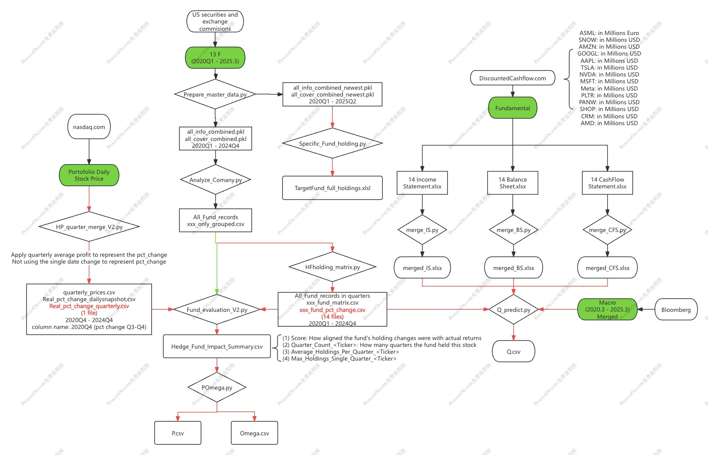
Model Pipeline Construction – Last time
(1)How 13 F Makes Money
(3)
(2)Real PCT Change
(6) Still in progress, aligning the dataset for quarterly
(4)
(5)

Slide 5
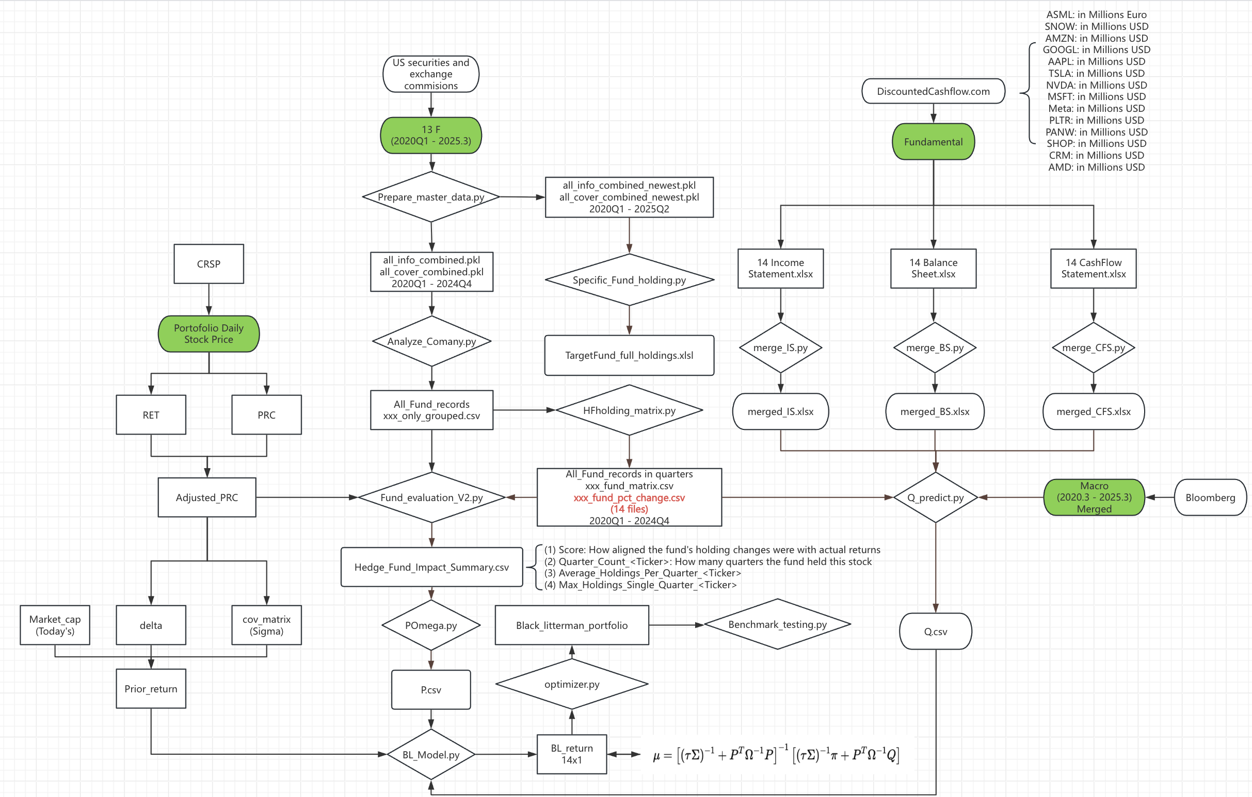
Model Pipeline Construction
Return

Slide 6
(0.1) CRSP

Slide 7
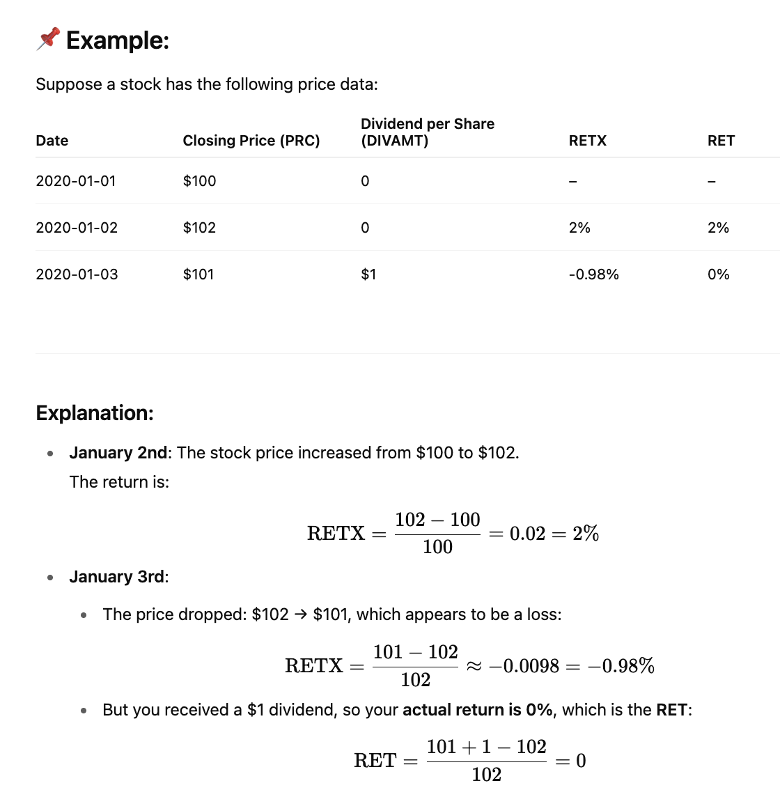
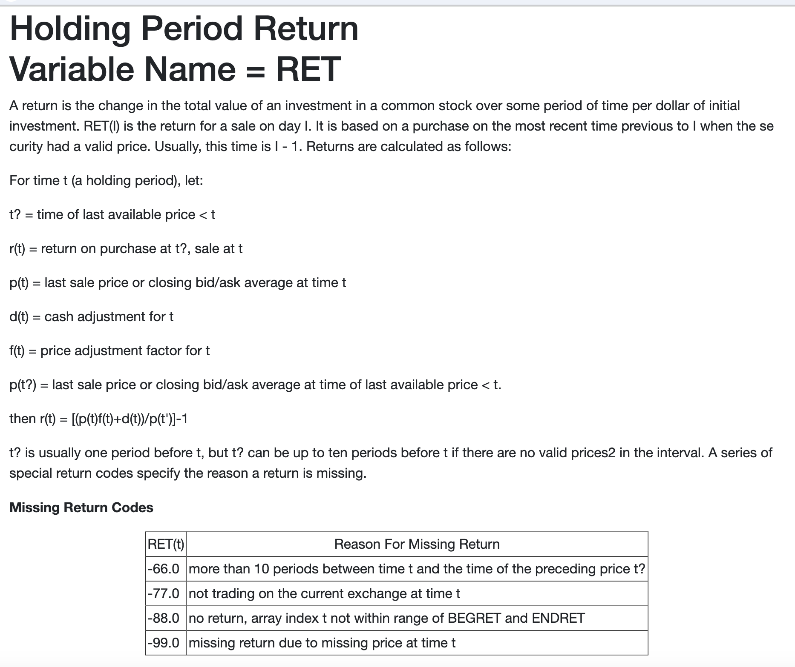
(0.1) CRSP: Apply RET
Return

Slide 8
(0.2) PyPortfolioOpt library

Slide 9
(0.2) PyPortfolioOpt library https://pyportfolioopt.readthedocs.io/en/latest/BlackLitterman.html

Slide 10
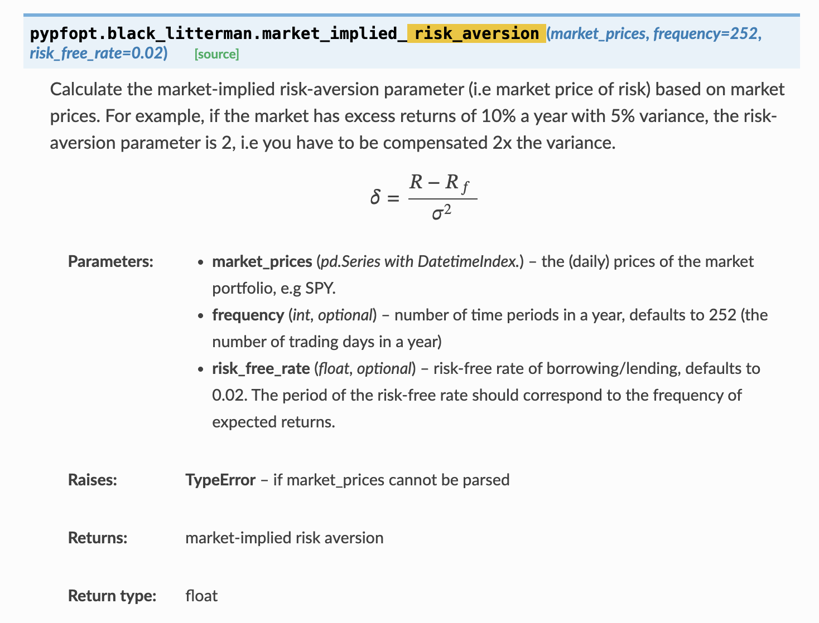
(0.2) PyPortfolioOpt library
Delta

Slide 11
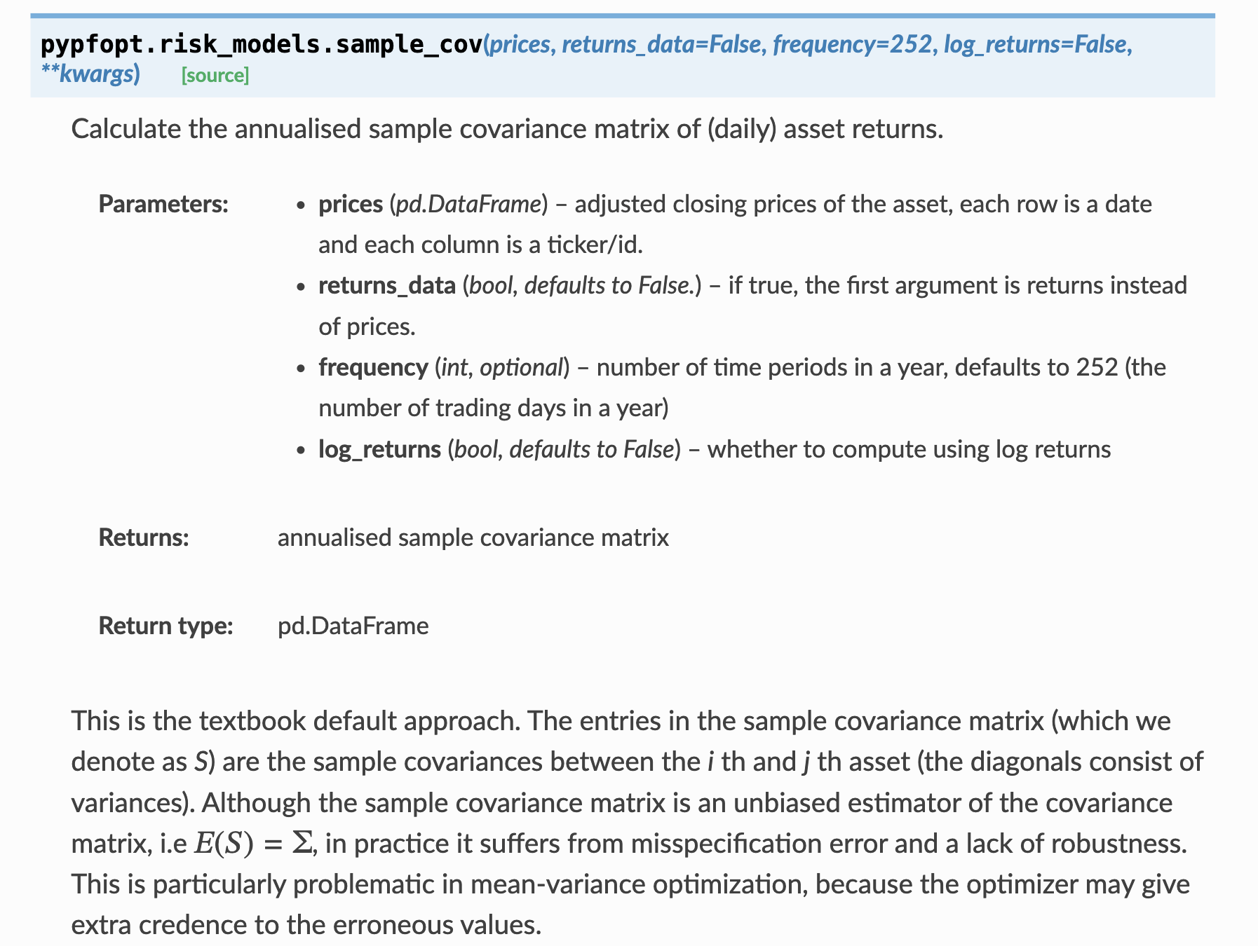
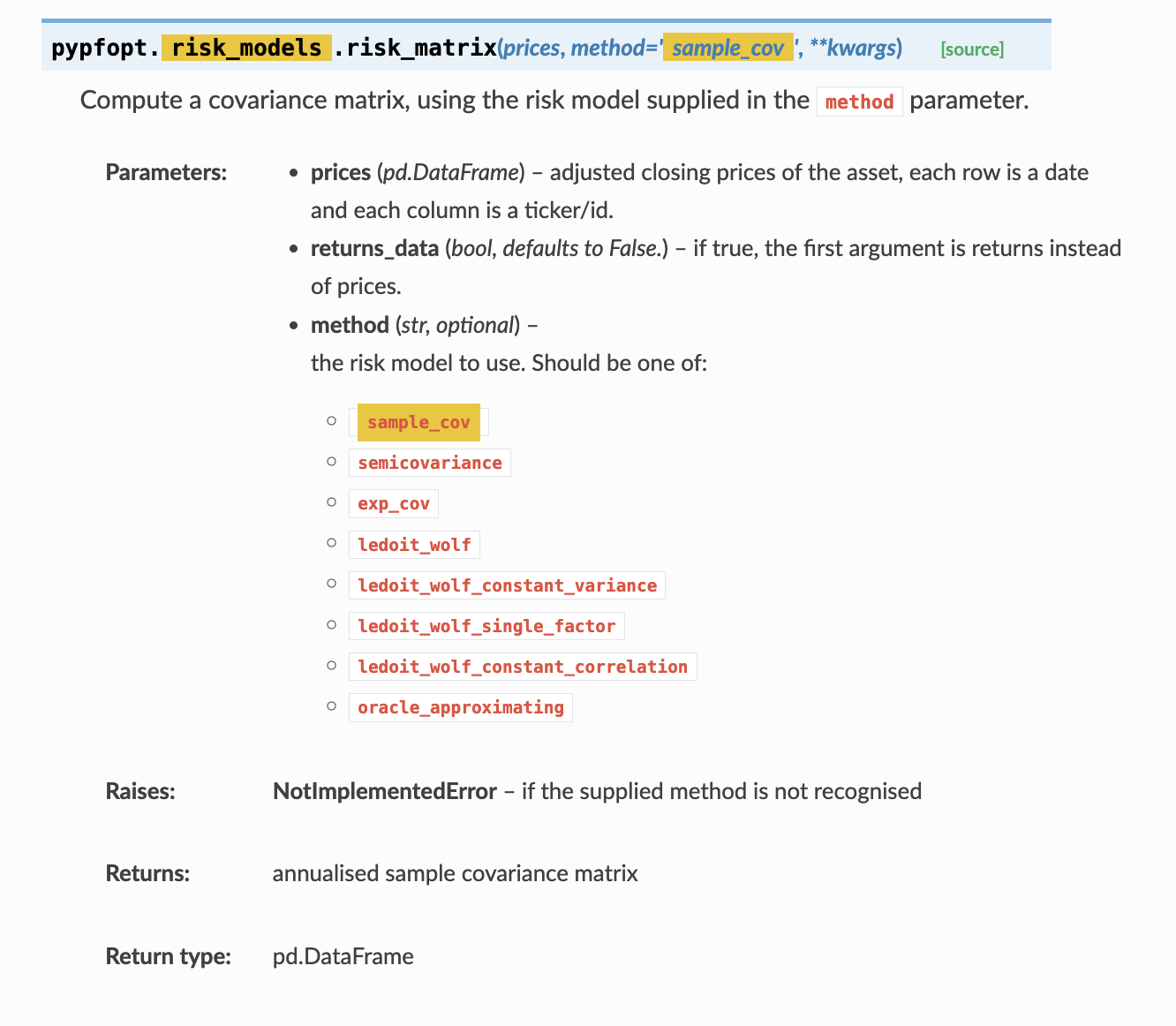
(0.2) PyPortfolioOpt library
Cov_Matrix

Slide 12
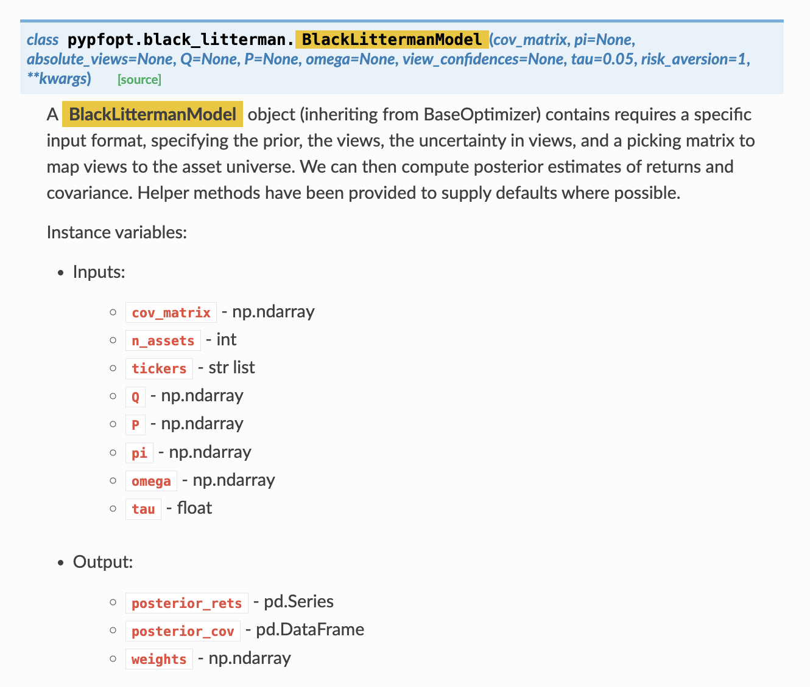
(0.2) PyPortfolioOpt library
Return

Slide 13
(1) Which Fund to pick?

Slide 14
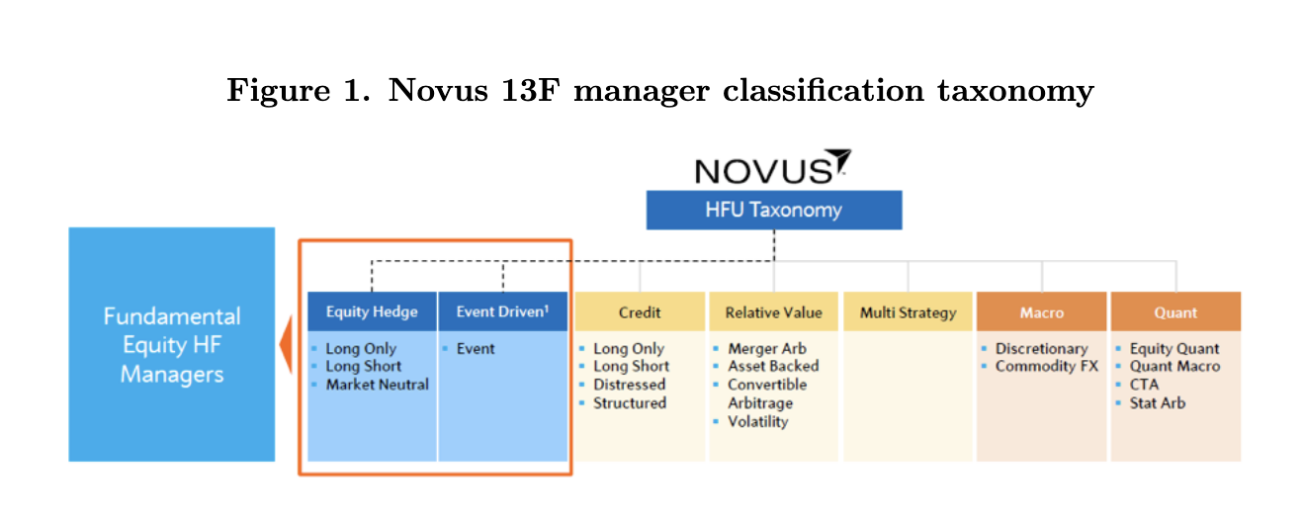
(1) Which Fund to pick? What others do? HFU = FEHF + Quantitative Fund
HFU: Hedge Fund Universe
All Hedge Fund in 13 F
FEHF: Fundamental Equity Hedge Fund
Hedge Funds that are more long-term focused

Slide 15
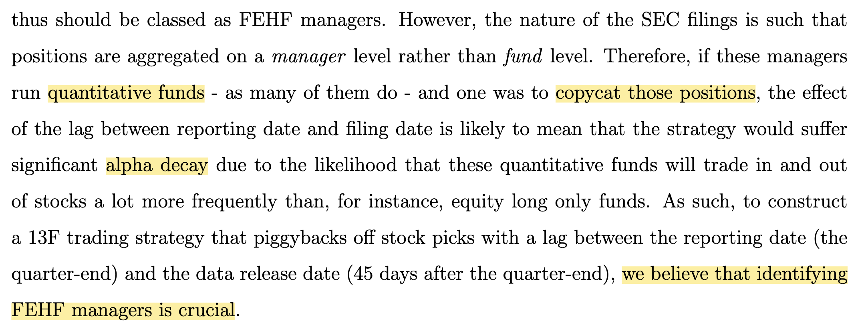
(1) Which fund to pick in 13 F (45 day lag)? What others do? Copycat Quantitative fund = alpha decay

Slide 16
(1) Which fund to pick in 13 F (45 day lag)? What I’m gonna do?
Return
Step1: Establish target stock universe (14 Tech stocks)
Step2: Filter out fund that invest in the stock universe
Step3: Quantify to find the ‘Expert Fund’ for my target stock universe
Coverage ratio: e.g. 9/14, 1/14, 14/14 of target universe
Average investment size:

Slide 17
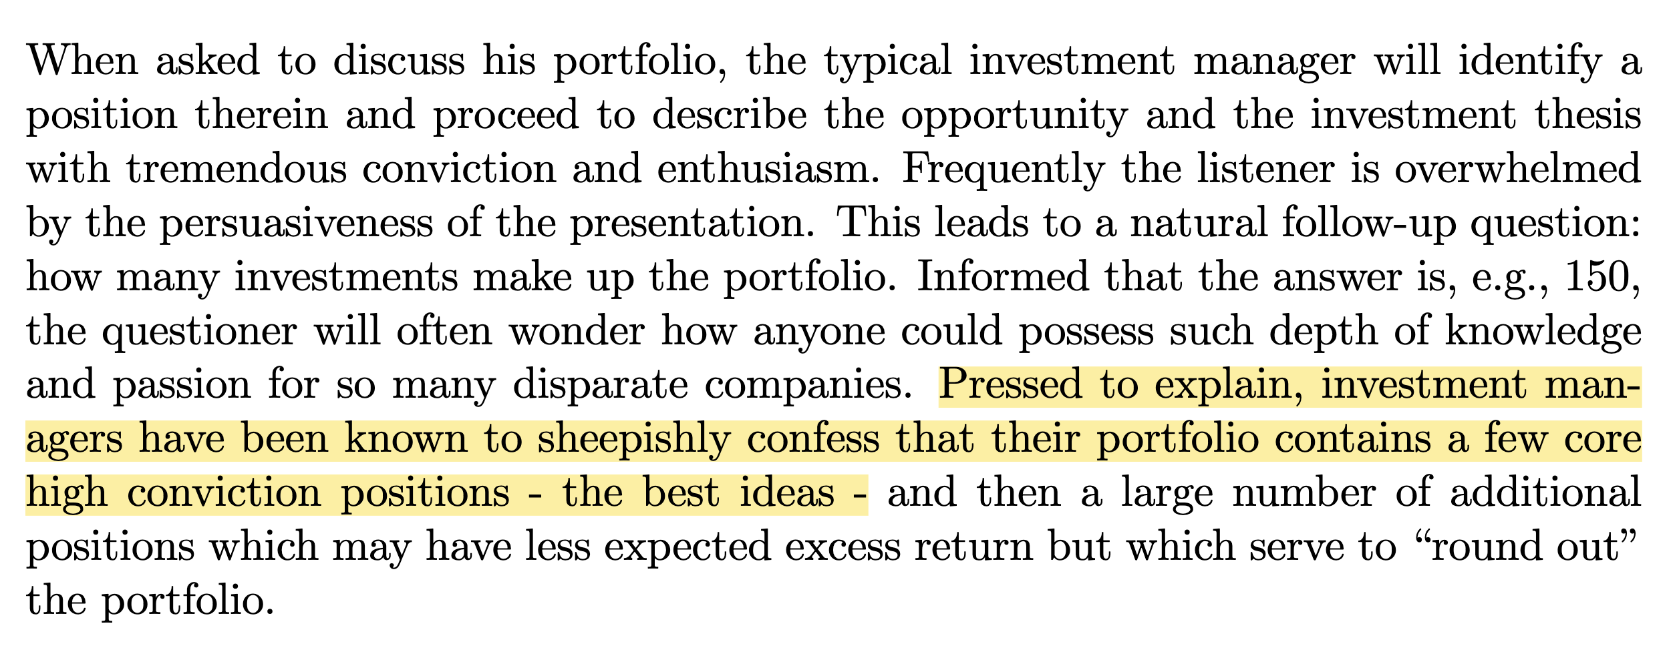
(2.1) Calculate P – Literature Review – Best Idea

Slide 18
(2.1) Calculate P – Literature Review – Best Idea

Slide 19
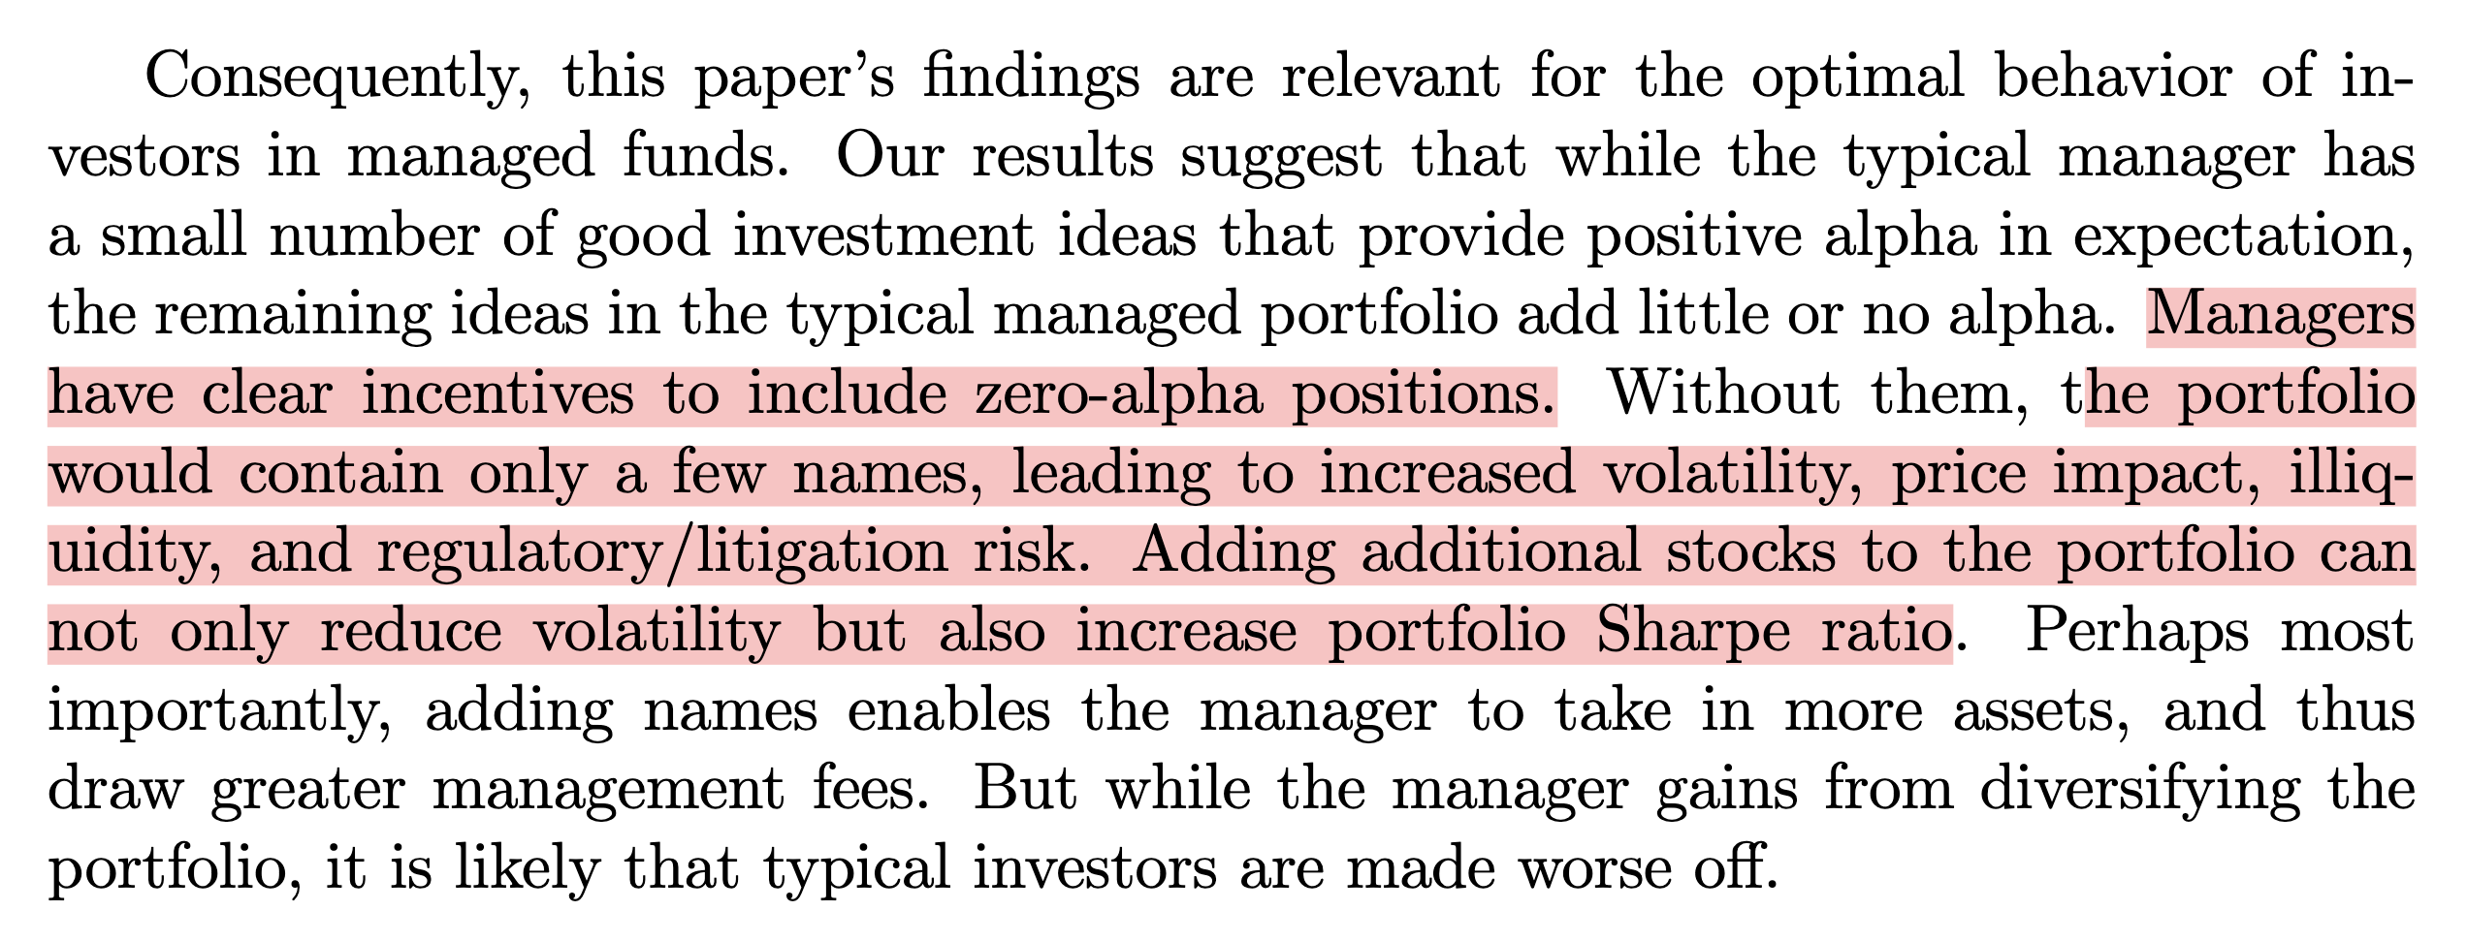
(2.1) Calculate P – Literature Review Portfolio = “Best Idea” + Other zero-alpha position

Slide 20
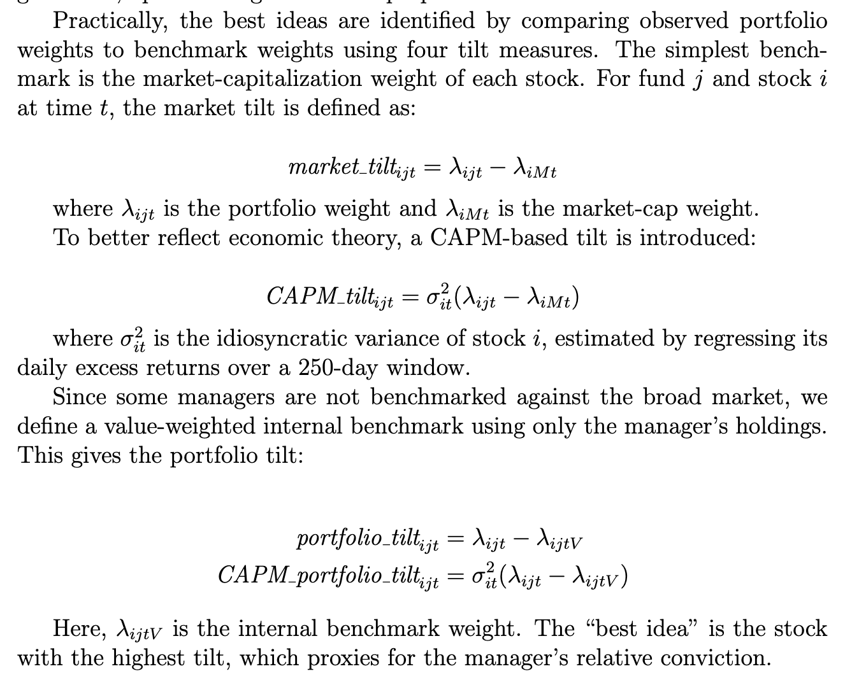
(2.1) Calculate P – Literature Review Tilt – Methodology for finding best ideas
Higher Tilts means higher conviction for certain stock
Market_Tilts
CAPM_Tilts:
Higher risk means higher conviction
Portfolio_Tilts:
Value-weighted internal benchmark is uniquely based on the market cap percentage for each fund manager
CAPM_Portfolio_Tilts

Slide 21
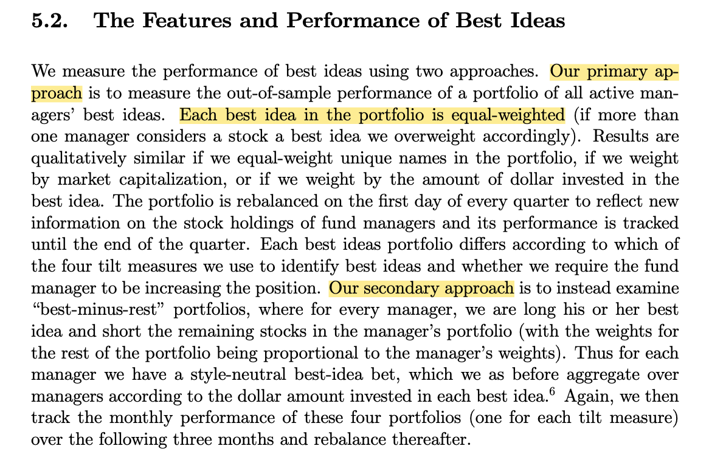
(2.1) After finding best idea, construct P What I’m gonna do?
Return
I don’t like equal-weighted portfolio.
I think for Black-litterman, the P matrix should be assign P to “Best Ideas”(based on market-tilt) based on money invested, other take 0.

Slide 22
(2.3) Calculate Ω

Slide 23
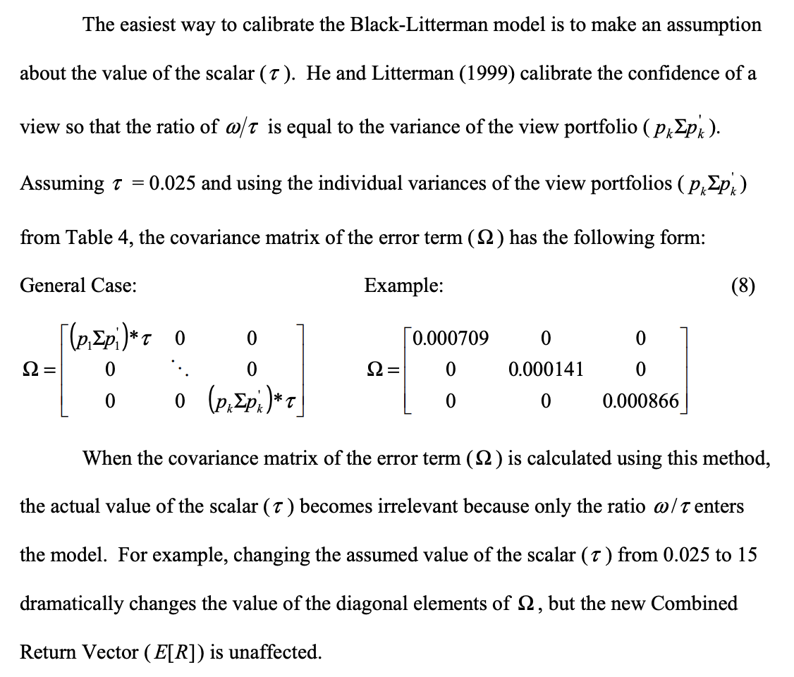
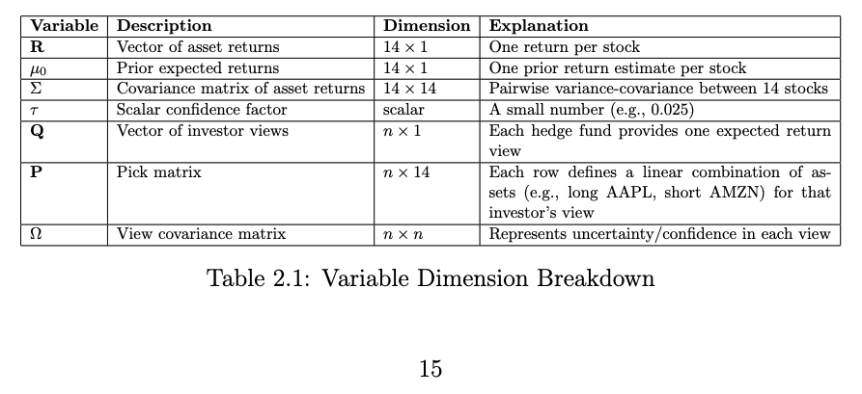
(2.3) Calculate Ω
He and Litterman (1999)

Slide 24
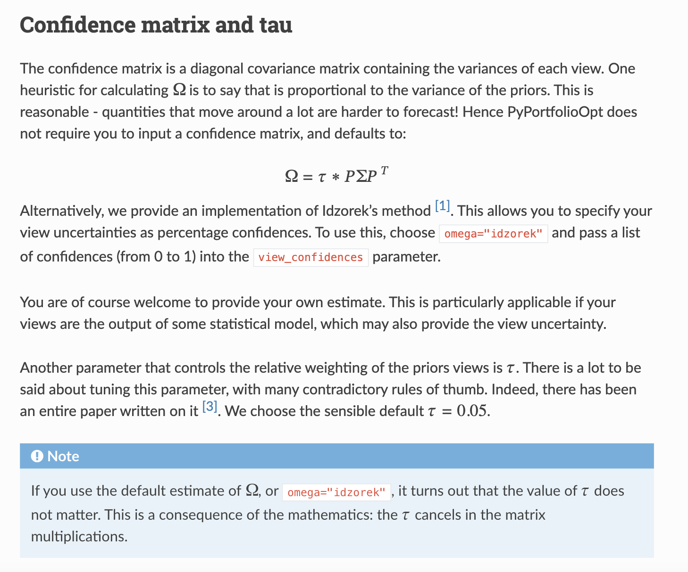
(2.3) Calculate Ω
Return
The Black-Litterman Model Library

Slide 25
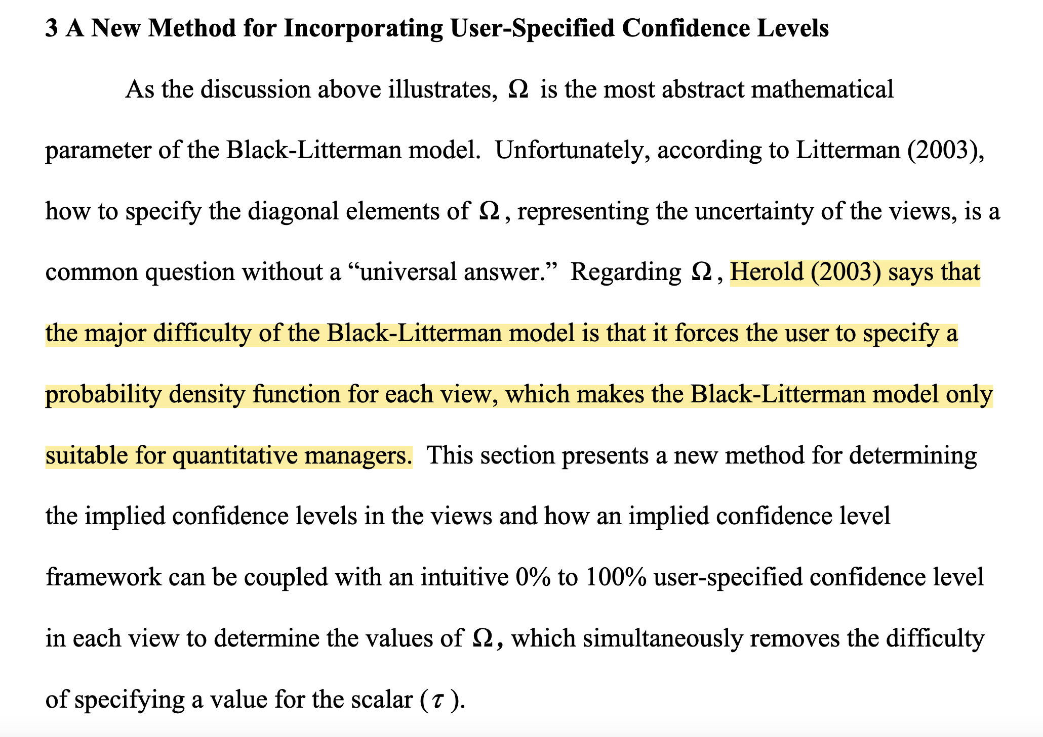
(2.3) Calculate Ω

Slide 26
(3) Benchmark Testing - 47 day lag
Return

Slide 27
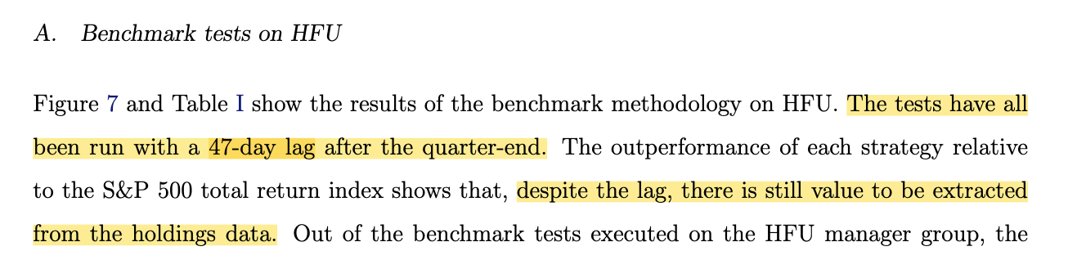
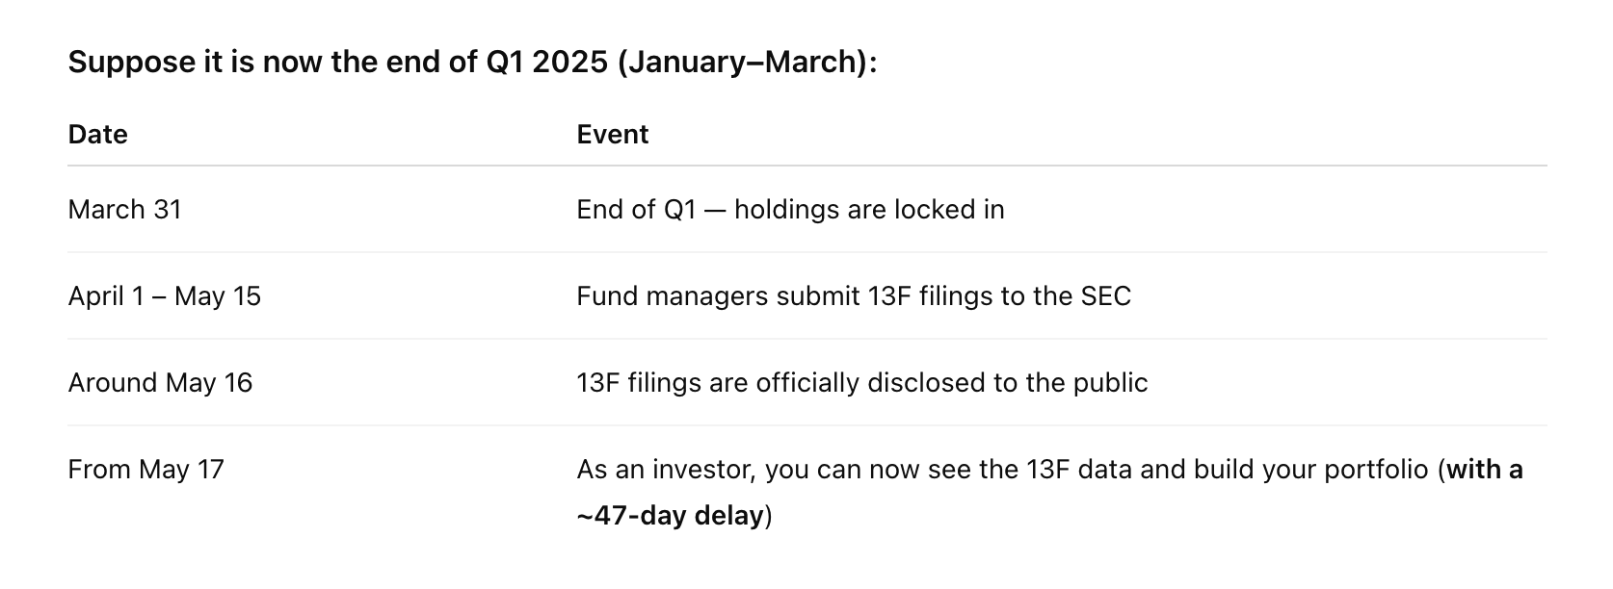
(3) Benchmark Testing - 47 day lag

Slide 28
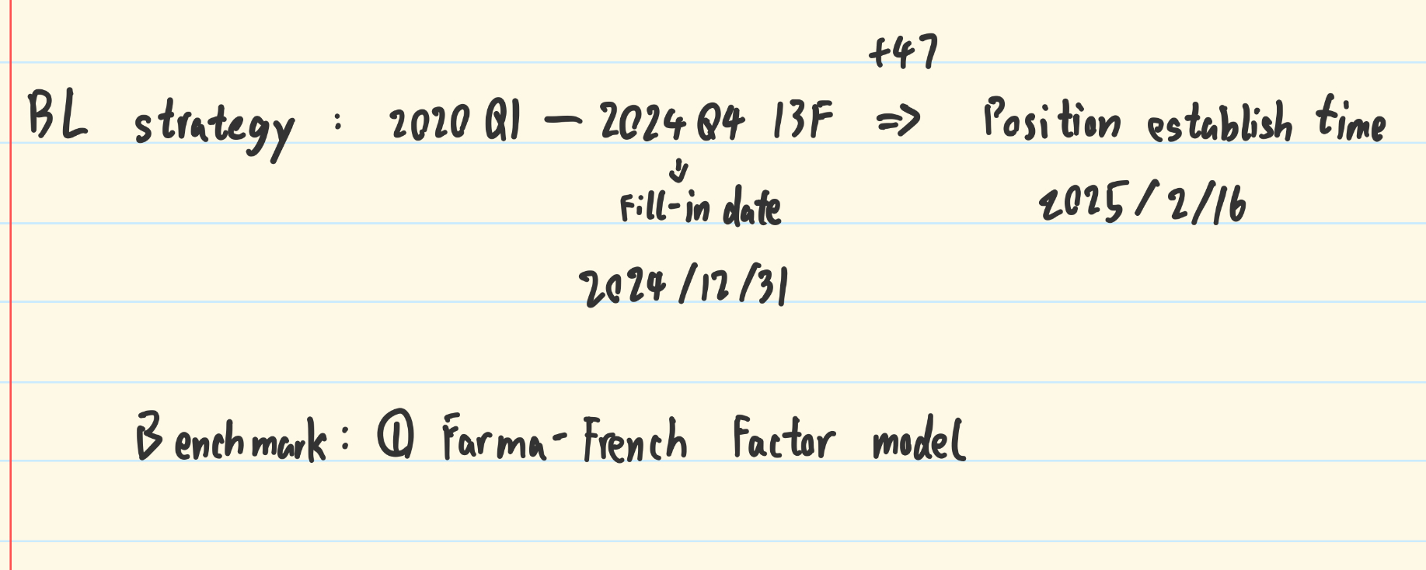
(3) Benchmark Testing - 47 day lag
Return

Slide 29
Timeline
Return
June 26 | Supervisor meeting
June 27-July 3 | Data Cleaning
July 4 – July 22 | Model Development Part1 Literature Review | Today, in progress
July 23 – August 4 | Model Development Writing main Chapters | Contact
August 5 – August 15 | Writing main chapters | Contact
August 16-August 22 | Polish draf, submit to supervisor
August 23- August 29 | Further polishing draft
September 1 – September 8 | Final Polish & Submit

