Slide 1

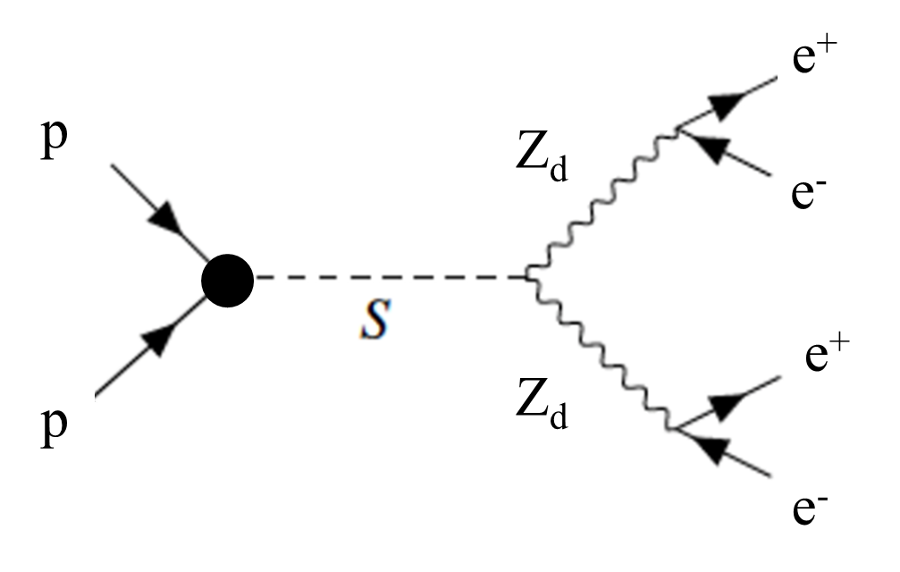
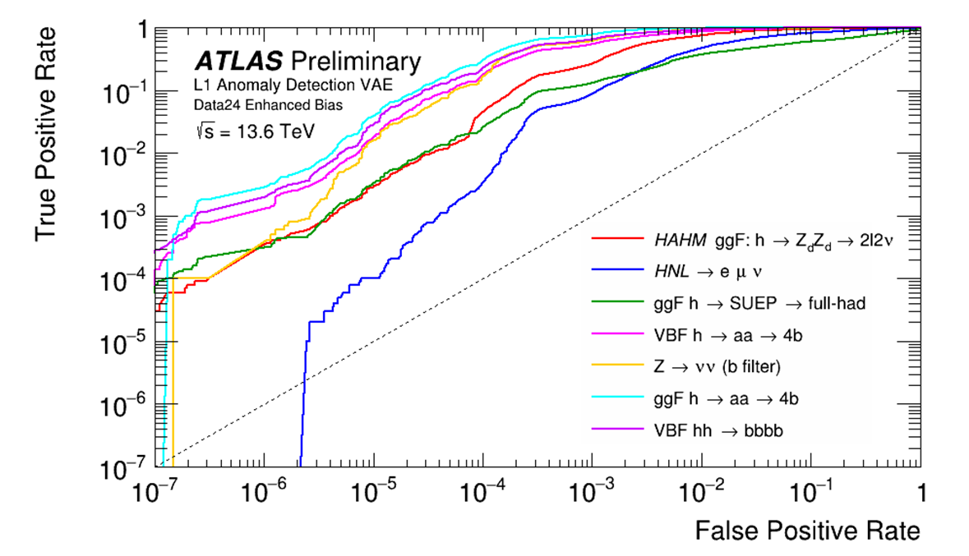
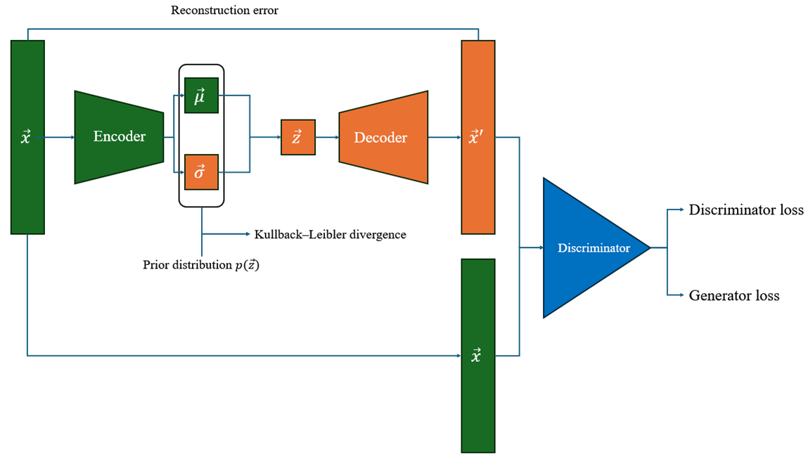
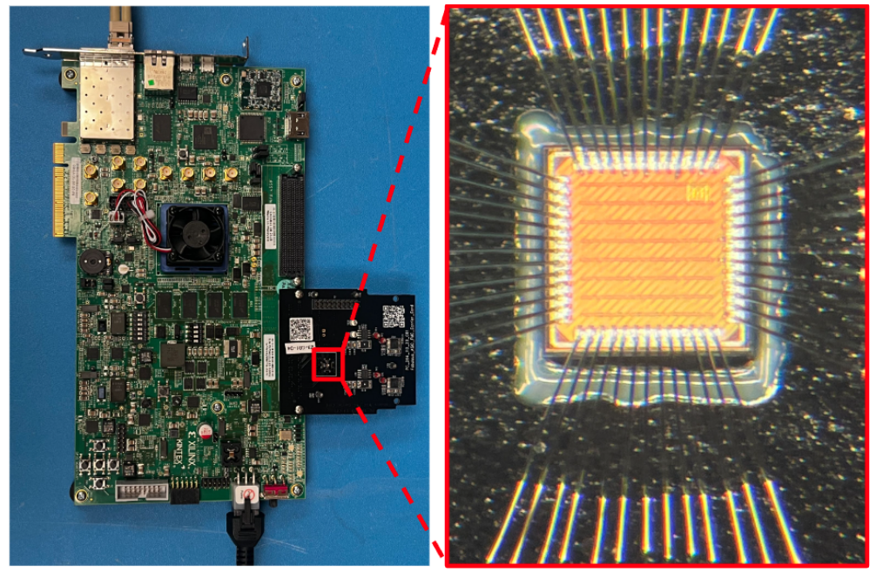
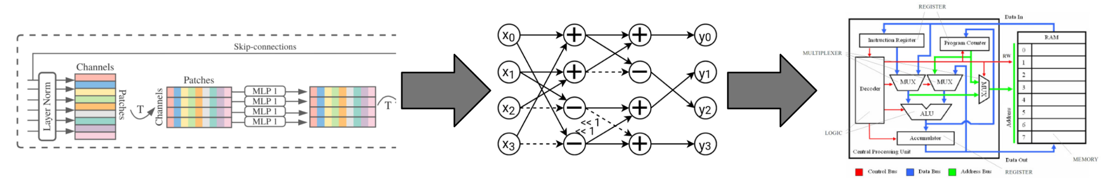
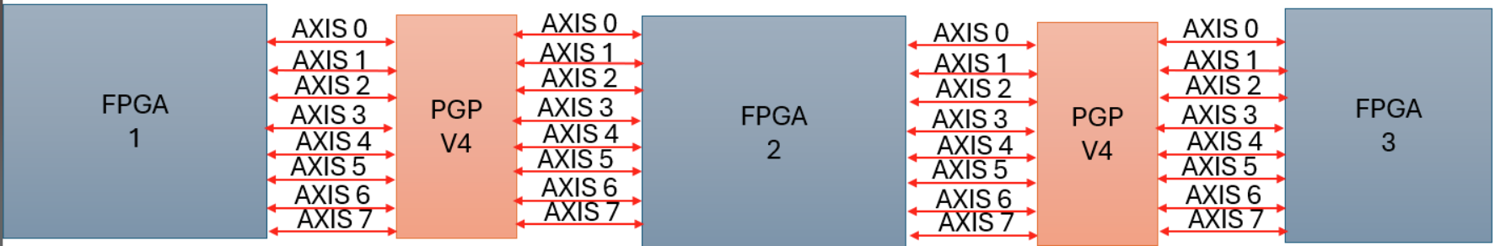
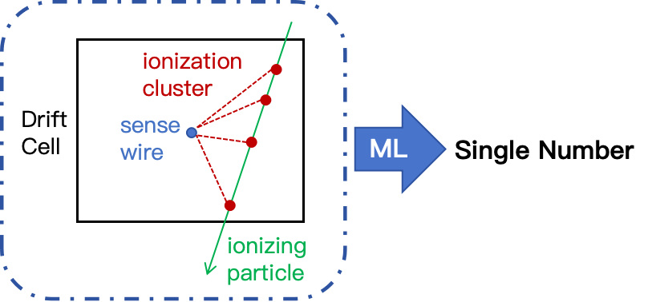
Machine Learning & Microelectronics for
New Physics Searches at Colliders
Searching for Dark Sector Mediators
Anomaly Detection in the ATLAS Trigger
Edge ML & Smart Detectors
Advancing ML on FPGAs & MLPMixers
PI: Julia Gonski
Postdocs: Sagar Addepalli, Qibin Liu
PhD: Kenny Jia, Liangyu Wu
UG: Gia Ancone, Deniz Yilmaz, Alexander Yue
Potential dark matter particle candidates can be produced in decays of heavy scalars. These dark matter particles can be long-lived and decay far away from the primary proton collision point, leading to displaced decay vertices.
Machine learning-based anomaly detection in offline ATLAS searches can enable broad sensitivity to any kind of new physics that is not Standard Model-like. Ultra-low latency anomaly detection could push this capability to the trigger level, with potential to write out never-before-seen events from the LHC.
Using new reconstruction techniques, we can identify these displaced vertices in the ATLAS inner tracker and the calorimeter decaying to pairs of electrons.
Anomaly detection is also used to look for signs of new physics which can decay into electron or photon final states with unusual topologies
We use a VAE-GAN trained over collision events modeled by the four-vectors of constituent particles.
To run anomaly detection algorithms in the low latency and limited resources of the ATLAS trigger, we employ “fast ML” techniques such as compression (i.e. truncating low-weight nodes), quantization, and reducing the loss terms.
ML at the
detector “edge” (the source of data) can reduce off-detector data rate and enable more efficient trigger and data acquisition.
The first ATLAS anomaly trigger is on track for data-taking in 2025, and studies for Run 4 anomaly triggers are ongoing!
Embedded field programmable gate arrays (eFPGAs) allow the design of an ASIC usable at the detector front-end with a reconfigurable digital logic fabric.
In collaboration with TID, we are exploring eFPGAs for ML-based signal processing, leveraging innovative data compression algorithms in advanced tracker and calorimeter concepts.
For example, detectors at next-generation colliders like CERN’s
Future Circular Collider are looking at drift chamber trackers;
we develop small compression models to perform key feature
extraction for deployment in front-end readout.
In collaboration with TID, we develop novel methods to implement the machine learning on FPGA, targeting ultra-fast ML inference and low power for applications like online data acquisition and processing. The MLP-Mixer architecture, promising for resource-limited transformer-like learning, has been successfully implemented, enabling the scaling up of edge/real-time ML to take advantage of state-of-the-art ML techniques.

