Slide 1
A Single ParT CVAE for HAXAD:
Embedding and Generation
Status: reconstruction, z–mγγ decorrelation, multi-seed baseline
Liangyu Wu
Stanford University
SLAC National Accelerator Laboratory
19 Oct 2026

Slide 2
Goal: One Latent Space for Embedding and Generation
Today: HAXAD uses a contrastive embedding model and a separate generative model, conditioned on mγγ, to build the signal-region (SR) background template from the sidebands (SB)
This work: a single conditional VAE with latent [z (16 free dims), mγγ (one fixed dim)]
encoder: event → z, plus one output that reproduces mγγ
decoder: (z, mγγ) → event, so events can be generated at a specified mγγ
Downstream use: the anomaly classifier runs on z; the SR background template is the SB z distribution
Requirements, in order of priority:
z independent of mγγ: a classifier on z cannot tell SR from SB (closure AUC → 0.5)
z keeps the event information (reconstruction R²), hence the signal information
only mγγ is fixed in the latent; nothing else has to be specified at generation
SB events (105–120, 130–145 GeV)
train the CVAE; z_SB
SR template
z_SB; valid in the SR only if z is independent of mγγ
Weakly supervised classifier on z
SR data vs template → anomaly score
Closure test: a BDT on z separates SR from SB background. Any AUC above 0.5 is a fake excess in the SR.

Slide 3
Model and Data
Inputs
11 object slots + 2 photon slots,
pair interactions, 7 high-level
ParT encoder
DPTModel (contrastive encoder)
4 self- + 2 class-attention blocks
Latent
z: μ, σ (16 dims)
m̂γγ (regressed, 1 dim)
Slot-query decoder
[z, MLP(mγγ)] → 13 slots +
high level (84 targets)
mγγ adversary
MLP on μ → 8 SB mγγ bins
Data: HAXAD pseudo-data from the demonstrator pipeline (data pool, unweighted, contrastive-encoder normalization); SB = 105–120 ∪ 130–145 GeV, SR = 120–130 GeV
Split: SB k-fold (5, seed): fold 0 test, fold 1 validation, rest training (958k); the SR is never trained on; SM Higgs removed in all tests
Loss: masked reconstruction (MSE, BCE for existence and b-tag) + 0.01·KL + 10·(m̂ − mγγ)² + λ·adversary term
Photon slots: pT, η, φ of both photons; the photon-pair mass in the interaction features equals mγγ, so the encoder reproduces it: m̂ R² 0.9995, rms 0.27 GeV
Adversary: own Adam optimizer, 20 inner steps per batch on detached μ; the encoder is penalized by KL(bin prior ‖ adversary output), switched on after 5 epochs, ramped over 10
Training: 400 epochs, AdamW, batch 16384, bf16; about 3.3 h on one A100

Slide 4
Study Plan and Where We Are
1 Reconstruction
1b Fixed mγγ dim
1c Decorrelate z
Multi-seed baseline
2 Weak-supervision test
3 Generation
Step | Question | Answer so far
1 Reconstruction | Can a ParT CVAE reconstruct the events? | yes: core R² 0.965 ± 0.004 (3 seeds); but z carries mγγ and the decoder ignores mγγ
1b Fixed mγγ dim | Can one latent dim be mγγ itself? | yes, with photon slots: m̂ R² 0.9995; the decoded photon pair follows the given mγγ
1c Decorrelate z | Can the rest of z be made mγγ-independent? | yes, with a strong adversary; GRL, DisCo and larger β do not work; price: R² 0.97 → 0.90–0.93
Baseline | Which configuration, and is the gain real? | λ = 0.05: closure SR/SB 0.518 ± 0.002 over 7 seeds vs 0.535 ± 0.004 (step 1)
2 Weak supervision | Does z find an injected signal in the SR? | next (to discuss)
3 Generation | Sample events at a given mγγ | later
Core R²: median R² over the jet1–4 and fatjet1 targets on the SB test fold. Closure AUCs: HistGradientBoosting on μ, 3-fold, event-weighted; SB-low vs SB-high on the SB test fold, SR vs SB test.

Slide 5
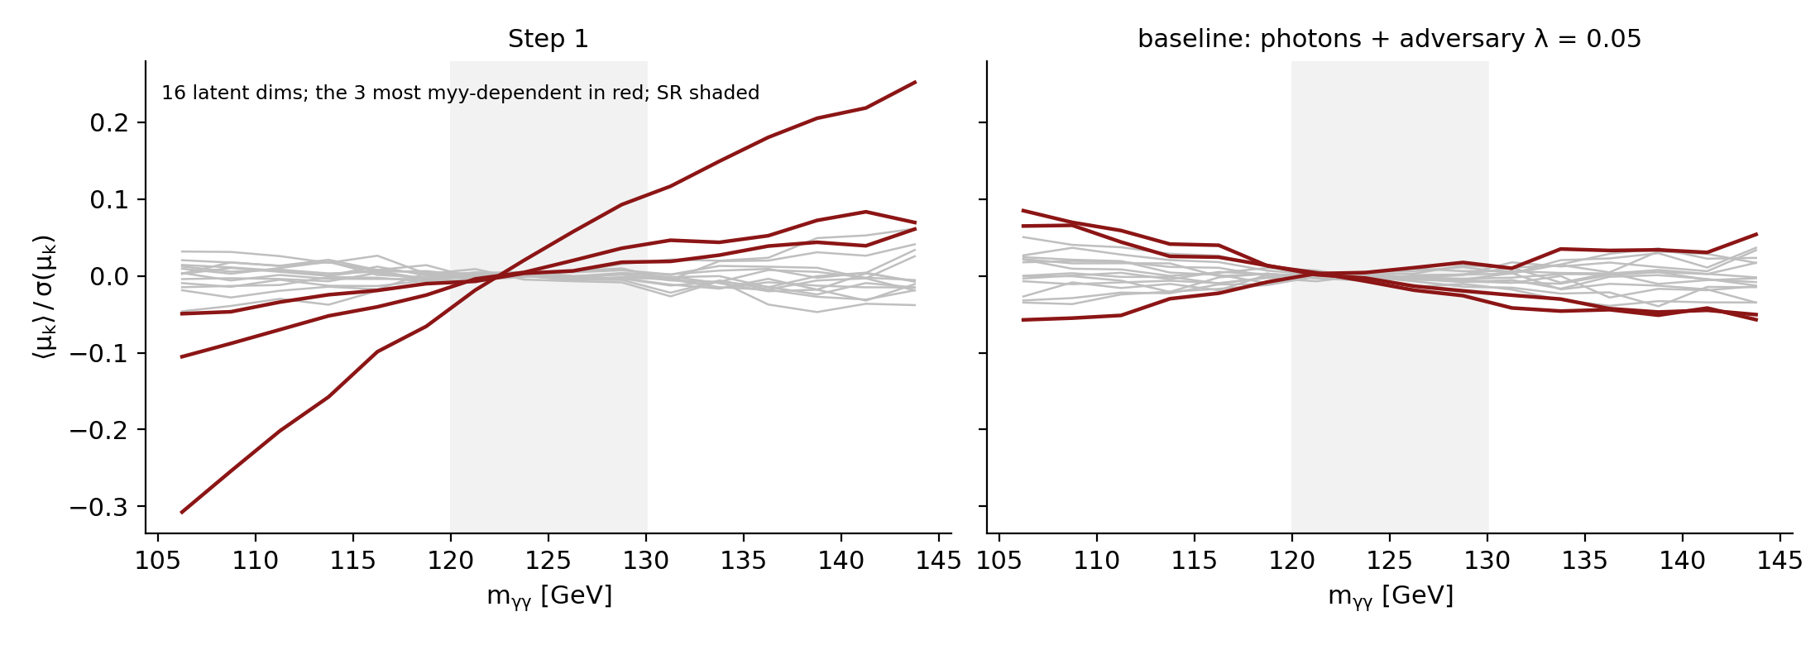
Step 1: Good Reconstruction, but z Carries mγγ
Reconstruction: core R² SB 0.965 ± 0.004, SR 0.966 ± 0.005; b-tag AUC 1.00; MET and high-level ≥ 0.99
z knows mγγ: closure AUC SB-low vs SB-high 0.648 ± 0.010, SR vs SB 0.535 ± 0.004 (raw inputs: 0.669 / 0.543)
left: one dim moves by about 0.55 σ across the SB
The decoder ignores mγγ: core R² 0.967 with the true mγγ, 0.966 with mγγ shuffled between events
everything mγγ-related travels through z, so SR recon = SB recon proved nothing
Cause: the encoder never saw the photons; the mγγ dependence it learns comes from correlated kinematics (diphoton pT, jets)
Mean of μ_k in mγγ bins (SB test + SR, SM Higgs removed), in units of the dim's standard deviation; right: the recommended baseline, same scale.
Core R² (step 1) | seed 0 | seed 1 | seed 2
SB test | 0.967 | 0.966 | 0.960
SR | 0.969 | 0.970 | 0.960
signal XHH_500 (never trained on) | 0.773 | 0.766 | 0.732
signal HVT_VcXjjHyy_2000_300 (never trained on) | 0.762 | 0.763 | 0.709
signal WN_HyyN_300 (never trained on) | 0.792 | 0.812 | 0.795
signal TT_tZNtHyyN_1000_205_60 (never trained on) | 0.275 | 0.451 | 0.366

Slide 6
Steps 1b–1c: Fix mγγ in the Latent, Remove It from z
Configuration (150 epochs, seed 0) | AUC lo/hi | AUC SR/SB | core R²
no photons, no adversary (step-1 recipe) | 0.641 | 0.532 | 0.927
+ photon slots + m̂ head | 0.864 | 0.657 | 0.871
+ β = 0.1 (stronger KL) | 0.898 | 0.807 | 0.564
+ adversary λ = 0.3 | 0.552 | 0.512 | 0.701
+ adversary λ = 1 | 0.554 | 0.513 | 0.317
+ adversary λ = 10 | 0.573 | 0.560 | 0.026
no photons + adversary λ = 1 | 0.567 | 0.515 | 0.627
Photon slots make mγγ explicit: the encoder reproduces it, but without a counter-force it also spreads it into z (AUC 0.64 → 0.86)
A larger β does not remove it: the KL term compresses z but keeps mγγ (AUC 0.90)
The adversary needs to be strong: with one-step gradient reversal the encoder dodges it (adversary at chance while a BDT still separates); own optimizer + 20 inner steps work
λ sets the trade-off: λ ≥ 1 reaches the closure floor but destroys the reconstruction; small λ over 400 epochs is the useful regime
Without photons the decoder ignores mγγ even with the adversary, so this branch was dropped
Adversary: 20 inner steps, hidden 256. 150-epoch R² is lower than at 400 epochs for every configuration.

Slide 7
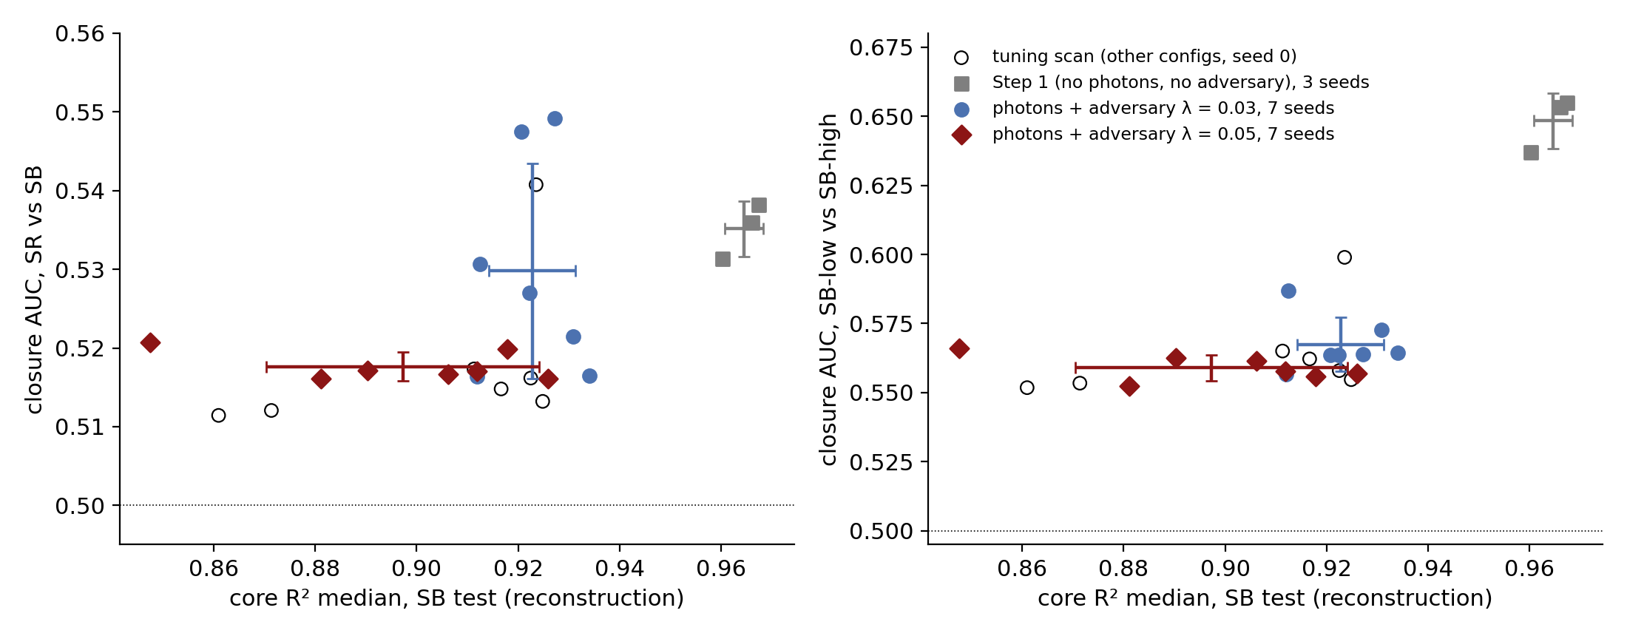
Multi-Seed Baseline: λ = 0.05 Gives Stable Closure
λ = 0.05: closure is seed-independent: SR/SB 0.516–0.521 for all 7 seeds, 0.017 below step 1 (≈ 4× its seed spread)
λ = 0.03 is bimodal: SR/SB 0.516–0.549; on average no better than step 1
mγγ leakage within the SB is cut: lo/hi 0.648 ± 0.010 → 0.559 ± 0.005
Price: reconstruction: R² 0.85–0.93, seed-dependent; the worst seeds lose R² without gaining closure
The tuning scan is a plateau (open circles): latent 32, KL 0.003, stronger or later adversary all fall inside the seed spread
Configuration (400 epochs) | seeds | AUC SR/SB | AUC lo/hi | core R² SB
Step 1 (no photons, no adversary) | 3 | 0.535 ± 0.004 | 0.648 ± 0.010 | 0.965 ± 0.004
photons + adversary λ = 0.03 | 7 | 0.530 ± 0.014 | 0.567 ± 0.010 | 0.923 ± 0.009
photons + adversary λ = 0.05 | 7 | 0.518 ± 0.002 | 0.559 ± 0.005 | 0.897 ± 0.027
Mean ± standard deviation over seeds (the seed also changes the k-fold split). The closure estimator itself repeats to ±0.001 (four repetitions).

Slide 8
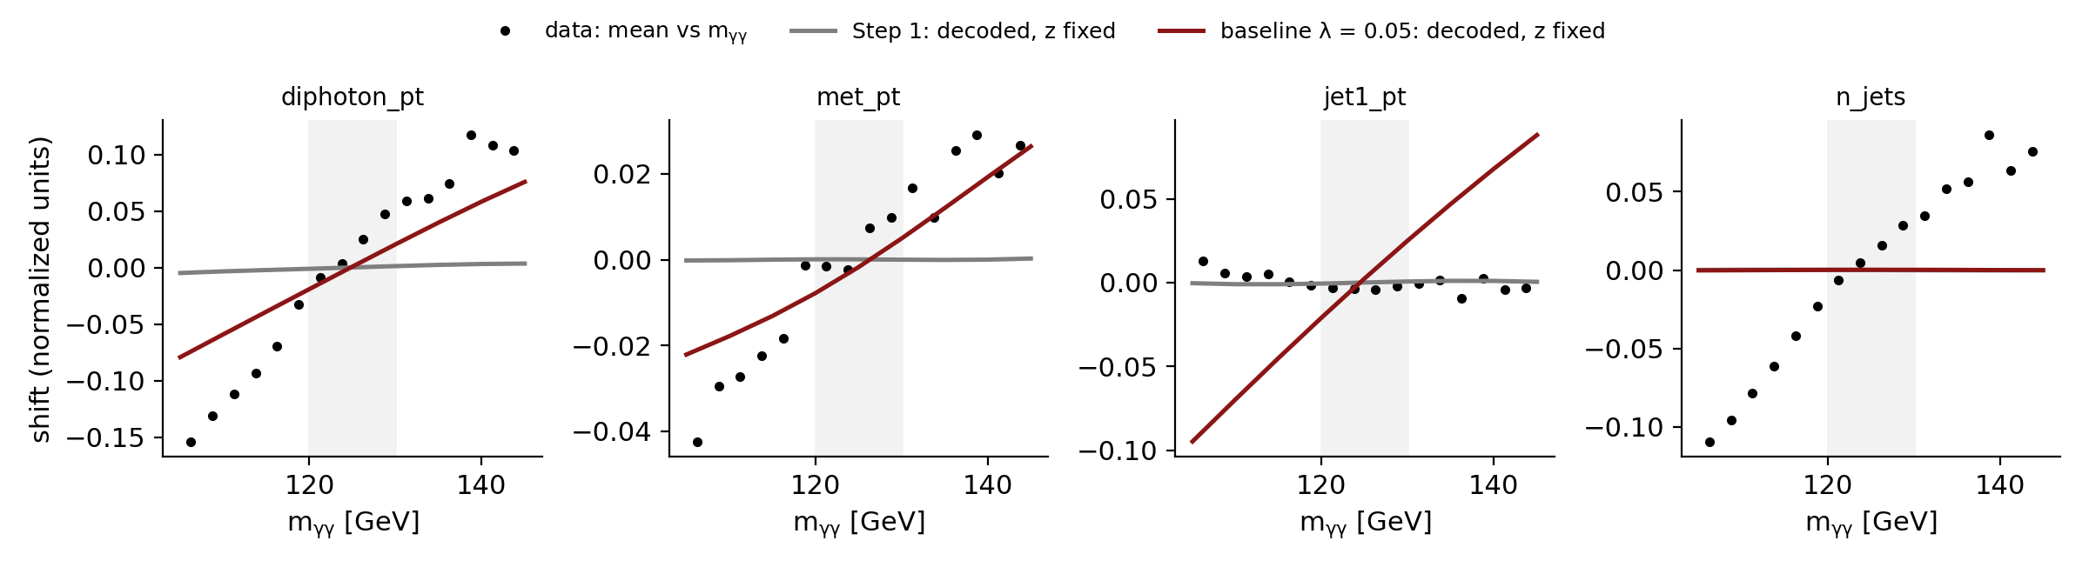
Recommended Baseline and What Its Decoder Does
Knob | Baseline value
Inputs | 11 object slots + 2 photon slots
Latent | z 16 dims + m̂γγ head (weight 10)
Decoder condition | MLP(mγγ) 1 → 32, concatenated with z
KL weight | 0.01
Adversary | λ = 0.05, 8 bins, hidden 256, 20 steps, lr 1e-3
Training | 400 epochs; pick the seed by SB validation loss
Mean shift vs mγγ at fixed z (lines) and in the data (dots); SB test events.
Decoded photons carry the given mγγ: corr(decoded, given) 0.989 when mγγ is shuffled, corr with the event's true mγγ -0.001; rms 1.9 GeV
Kinematics follow partly: at fixed z the decoder shifts diphoton pT and MET with mγγ, in the data's direction
Multiplicities do not: n_jets stays flat (data rises), and the jet-1 pT slope is not in the data
irrelevant for the z-based classifier; matters only if decoded events are used (step 3)
Seed choice: across the 7 λ = 0.05 seeds the validation reconstruction loss ranks the test R² with Spearman 0.96; it picks seed 0 (s1f_adv0p05): AUC SR/SB 0.516, lo/hi 0.557, core R² 0.926 (SB) / 0.915 (SR).

Slide 9
Status and Next Steps (for Discussion)
Item | Status | Content
Step 1 reconstruction | done | ParT encoder + slot-query decoder, R² 0.965 (3 seeds)
Steps 1b–1c | done | photon slots, m̂ head, multi-step adversary
Multi-seed baseline | done | λ = 0.05: closure SR/SB 0.518 ± 0.002, R² 0.90 ± 0.03 (7 seeds)
Signal information in z | open | supervised signal vs SR background saturates (AUC ≥ 0.994 for every model and raw inputs)
Weak-supervision test | next | injected signal in the SR, classifier on z (SR vs SB template)
Generation | later | p(z) sampling + decoder at a given mγγ
A Weak-supervision injection test (proposed next): signal at several strengths in the SR; CWoLa-style classifier on z; significance improvement vs strength, step 1 vs baseline vs raw inputs
B Recover reconstruction at λ = 0.05: longer training or a λ schedule; worth it only if A shows that R² limits the sensitivity
C Residual closure 0.518: measure the fake excess it causes in the weak-supervision test with no injected signal (the null of A)
D Generation (step 3): only after A; needs the multiplicity dependence

Slide 10
Back ups

Slide 11
Backup: Every Seed of the Baseline Study
Run | Config | seed | AUC SR/SB | AUC lo/hi | R² SB | R² SR | γγ rms [GeV]
step1_seed0 | step 1 | 0 | 0.538 | 0.655 | 0.967 | 0.969 | –
step1_seed1 | step 1 | 1 | 0.536 | 0.653 | 0.966 | 0.970 | –
base_step1_s2 | step 1 | 2 | 0.531 | 0.637 | 0.960 | 0.960 | –
s1e_ph_adv0p03 | λ 0.03 | 0 | 0.521 | 0.573 | 0.931 | 0.926 | 1.97
s1f_adv0p03_s1 | λ 0.03 | 1 | 0.549 | 0.564 | 0.927 | 0.928 | 1.97
base_adv0p03_s2 | λ 0.03 | 2 | 0.516 | 0.565 | 0.934 | 0.929 | 1.88
base_adv0p03_s3 | λ 0.03 | 3 | 0.547 | 0.564 | 0.921 | 0.926 | 1.84
base_adv0p03_s4 | λ 0.03 | 4 | 0.527 | 0.564 | 0.922 | 0.928 | 1.88
base_adv0p03_s5 | λ 0.03 | 5 | 0.516 | 0.557 | 0.912 | 0.892 | 1.76
base_adv0p03_s6 | λ 0.03 | 6 | 0.531 | 0.587 | 0.913 | 0.908 | 1.77
s1f_adv0p05 | λ 0.05 | 0 | 0.516 | 0.557 | 0.926 | 0.915 | 1.91
base_adv0p05_s1 | λ 0.05 | 1 | 0.517 | 0.558 | 0.912 | 0.916 | 1.99
base_adv0p05_s2 | λ 0.05 | 2 | 0.517 | 0.562 | 0.906 | 0.905 | 1.99
base_adv0p05_s3 | λ 0.05 | 3 | 0.520 | 0.556 | 0.918 | 0.912 | 1.77
base_adv0p05_s4 | λ 0.05 | 4 | 0.516 | 0.552 | 0.881 | 0.863 | 1.97
base_adv0p05_s5 | λ 0.05 | 5 | 0.517 | 0.563 | 0.890 | 0.871 | 2.23
base_adv0p05_s6 | λ 0.05 | 6 | 0.521 | 0.566 | 0.848 | 0.837 | 2.63
400 epochs each; the seed also sets the k-fold split
Runs s1e_*, s1f_* are from the tuning scan, base_* from the multi-seed study; same configuration
γγ rms: mγγ of the decoded photons vs the true mγγ, SB test
Spearman(val loss, test R²): λ 0.05 0.96, λ 0.03 0.18, step 1 0.50

Slide 12
Backup: Tuning Scan at 400 Epochs (Seed 0)
Configuration | AUC SR/SB | AUC lo/hi | R² SB | R² SR
λ = 0.03 (reference, 7 seeds) | 0.530 ± 0.014 | 0.567 ± 0.010 | 0.923 ± 0.009 | 0.919 ± 0.014
λ = 0.01 | 0.541 | 0.599 | 0.924 | 0.925
λ = 0.03, latent 32 | 0.516 | 0.558 | 0.922 | 0.924
λ = 0.03, KL 0.003 | 0.513 | 0.555 | 0.925 | 0.919
λ = 0.03, 40 adversary steps | 0.515 | 0.562 | 0.917 | 0.905
λ = 0.03, decoder 256 × 4 layers | 0.523 | 0.581 | 0.832 | 0.835
λ = 0.1, adversary from epoch 100 | 0.517 | 0.565 | 0.911 | 0.903
λ = 0.1 | 0.511 | 0.552 | 0.861 | 0.810
λ = 0.3 | 0.512 | 0.553 | 0.871 | 0.833
Everything except the decoder change lies inside the λ = 0.03 seed spread
λ ≥ 0.1 gives the lowest closure AUCs, but R² falls to 0.86–0.91 on one seed; λ = 0.05 is the compromise that was then run on 7 seeds
A larger decoder is worse (0.83): the loss is not decoder-capacity-limited

Slide 13
Backup: Options Tried and Rejected
Option | Result | Decision
DisCo: λ·dCor²(μ, mγγ) | unstable at λ ≥ 300 (KL explodes); with warm-up stable, closure 0.562 → 0.551 for 2× worse recon | dropped
mγγ as encoder input | mγγ leaks into z: SB-low vs SB-high AUC 0.85–0.93 | dropped
Learned-variance decoder | KL collapses to about 4 nats | dropped
β = 0.1 (step 1) | latent starved (about 11 nats), b-tag never learned | β = 0.01
Gradient-reversal adversary (one step) | encoder dodges it: adversary at chance while a BDT still separates the bins | own optimizer, 20 steps
Direct mγγ concatenation (no MLP) | same mγγ behaviour; recon 0.845 vs 0.871 (photons), 0.875 vs 0.927 (no photons), 150 epochs | keep MLP(1 → 32)
No photon slots + adversary | decoder still ignores mγγ (shuffle test, λ = 1: core R² 0.631 → 0.631) | dropped
Conditioning on multiplicities | would require specifying them at generation | rejected by design
DisCo, encoder-input, learned-variance and β numbers are from the step-1 development runs (README.md); the others are in figs/summary.json.

Slide 14
Backup: Transfer Test and Supervised Signal Sensitivity
Decode z_A at mγγ from B (A→B) | step 1 (seed 0) | λ = 0.03 (seed 0)
BDT AUC transfer vs recon B | 0.656 | 0.563
BDT AUC recon A vs recon B | 0.930 | 1.000
shift reproduced: diphoton pT / MET | 0.03 / 0.00 | 0.53 / 0.63
shift reproduced: jet1 / jet2 pT | 0.02 / 0.04 | 0.80 / 1.00
shift reproduced: n_jets / jet1 existence | 0.00 / 0.00 | 0.00 / 0.00
Signal vs SR background, BDT AUC | raw inputs | step 1 | λ = 0.03
XHH_500 | 0.994 | 0.994 | 0.994
HVT_VcXjjHyy_2000_300 | 1.000 | 0.999 | 1.000
WN_HyyN_300 | 0.998 | 0.998 | 0.998
TT_tZNtHyyN_1000_205_60 | 1.000 | 1.000 | 1.000
Fully supervised, 100k events per class: every representation separates every signal, so this test cannot rank models
Weak supervision at realistic signal fractions is the informative version (proposal A)
A = 105–120 GeV, B = 130–145 GeV (SB test). Shift reproduced = [mean(transfer) − mean(recon A)] / [mean(recon B) − mean(recon A)]. AUC 0.5 = perfect transfer. Recon A vs B is easy because the decoded photons carry mγγ.
The decoder moves kinematics with mγγ but not the existence logits, so decoded multiplicities do not change
Not needed for the z-based classifier; relevant again for generation

Slide 15
Backup: Closure Test Definition and Its Noise
Inputs: μ (16 dims) of events never used in training: the SB test fold and the SR; SM Higgs removed
Classifier: HistGradientBoosting (300 iterations, early stopping), 3-fold, at most 300k events per class, classes balanced in the fit, physical weights in the AUC
SB-low vs SB-high: 105–120 vs 130–145 GeV on the SB test fold; the strongest probe of mγγ in z
SR vs SB: SR vs SB test; the quantity that matters for the SR template
Estimator noise: four repetitions with different subsamples give ±0.001 or less; the 0.03 seed spread of λ = 0.03 is model variation
Run (4 repetitions) | lo/hi | SR/SB
step1_seed0 | 0.6550 ± 0.0003 | 0.5382 ± 0.0003
step1_seed1 | 0.6526 ± 0.0002 | 0.5366 ± 0.0004
s1e_ph_adv0p03 | 0.5709 ± 0.0007 | 0.5223 ± 0.0007
s1f_adv0p03_s1 | 0.5647 ± 0.0008 | 0.5472 ± 0.0014
From store/closure_noise.py (logs/closure_noise.log).

