Slide 1

移动开发个人项目——记账本
梁彧彧 201611680132

Slide 2
目 录
CONTENTS
01
03
项目难点
项目介绍
02
04
项目总结
代码分析

Slide 3
01
项目介绍
Introduction

Slide 4
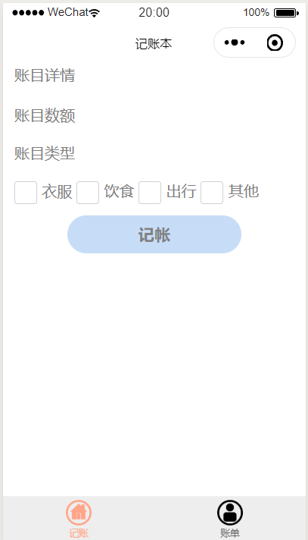
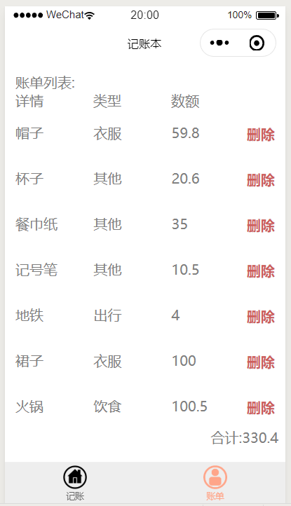
项目介绍
记账本

Slide 5
主要功能
01
增加账单（记账）
03
删除账单
02
计算账单总额

Slide 6
02
代码分析
Analysis

Slide 7
//表单提交
formSubmit: function (e) {
this.setData({
buttonLoading: true
});
var that = this;
setTimeout(function () {
var inDetail = e.detail.value.inputdetail;
var inAmount = e.detail.value.inputamount;
var inType = e.detail.value.inputtype;
if (inDetail.toString().length <= 0 || inAmount.toString().length <= 0) {
console.log("can not empty");
that.setData({
buttonLoading: false
});
return false;
}

Slide 8
//新增记录
var tempAccountData = wx.getStorageSync("accountData") || [];
tempAccountData.unshift({ detail: inDetail, amount: inAmount, type:inType });
wx.setStorageSync("accountData", tempAccountData);
that.caculateTotal(tempAccountData);
that.setData({
accountData: tempAccountData,
buttonLoading: false
});
}, 1000);
},
// 计算总额
caculateTotal: function (data) {
var tempTotal = 0;
for (var x in data) {
tempTotal += parseFloat(data[x].amount);
}
this.setData({
accountTotal: tempTotal
});
},

Slide 9
// 获取记录
onLoad: function () {
console.log('onLoad')
var that = this;
var tempAccountData = wx.getStorageSync("accountData") || [];
var accountTotal = wx.getStorageSync('accountTotal') || [];
this.setData({
accountData: tempAccountData
}); },
//删除行
deleteRow: function (e) {
var that = this;
var index = e.target.dataset.indexKey;
var tempAccountData = wx.getStorageSync("accountData") || [];
tempAccountData.splice(index, 1);
wx.setStorageSync("accountData", tempAccountData);
that.caculateTotal(tempAccountData);
that.setData({
accountData: tempAccountData,
});
}

Slide 10
03
项目难点
Difficulties

Slide 11
项目难点
微信小程序的页面间传递数据
使用本地缓存:
A页面js：
wx.setStorageSync('developer', developer);
B页面js：
var developer = (wx.getStorageSync('developer') || [])

Slide 12
04
项目总结
Summary

Slide 13
谢谢！
Thank you for watching!

