Slide 1
Application Acceleration with High-Level Synthesis
110062703 梁浩祥
LabB no.9 Sparse Matrix Multiplication

Slide 2
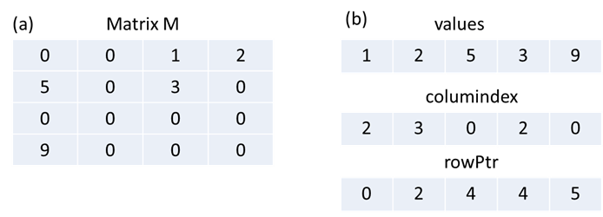
Overall system
Sparse matrix unlike usual matrix is mostly contains 0
Storing in standard data structure will have a lot of waste.
Hence, we use compressed row storage(CRS) for storing

Slide 3
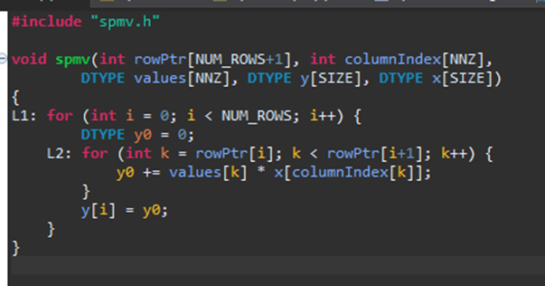
Implementation

Slide 4
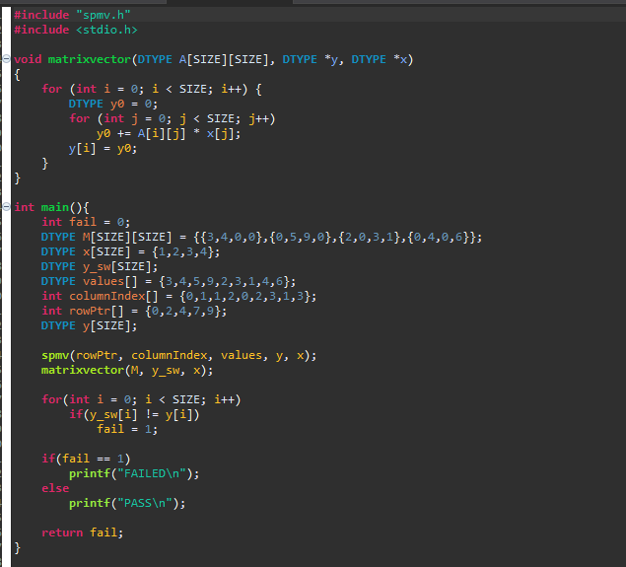
Implementation

Slide 5
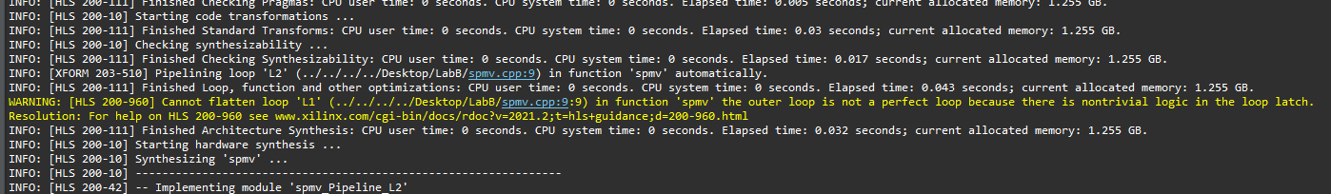
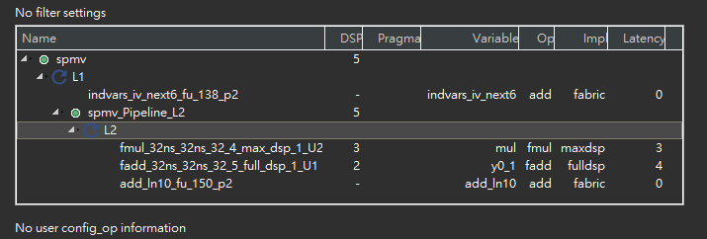
Analyze

Slide 6
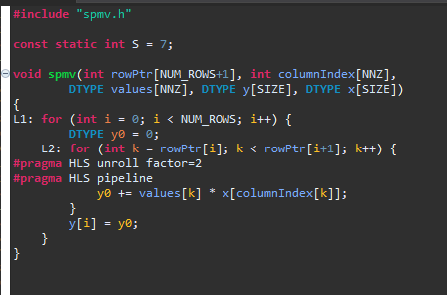
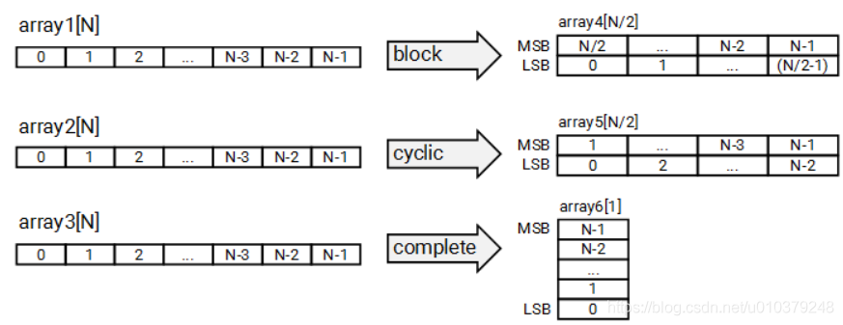
Optimization
Directives
Unroll
Pipeline
Cyclic
block

Slide 7
Optimization
case | L1 | L2 | time | Iteration latency | Interval | Trip count | DSP | DD | LUT
Baseline | x | x | 7.256 | 13 | 5 | 4 | 5 | 1165 | 1388
1 | x | pipeline | 7.256 | 13 | 5 | 4 | 5 | 1165 | 1388
2 | pipeline | x | 7.256 | 12 | 5 | 4 | 5 | 1165 | 1345
3 | Unroll 2 | x | 7.256 | 13 | 5 | 2 | 5 | 1466 | 1799
4 | x | pipeline Unroll 2 | 7.256 | 18 | 10 | 4 | 5 | 1466 | 1655
5 | x | pipeline Unroll 2 Cyclic 2 | 7.256 | 18 | 10 | 4 | 5 | 1660 | 1874
6 | x | pipeline Unroll 4 | 7.256 | 28 | 20 | 4 | 5 | 1677 | 2120
7 | X | pipeline Unroll 4 Cyclic 4 | 7.247 | 27 | 20 | 4 | 5 | 2285 | 2728
8 | X | pipeline Unroll 8 | 7.256 | 48 | 40 | 4 | 5 | 2065 | 2988
9 | X | pipeline Unroll 8 Cyclic 8 | 7.561 | 47 | 40 | 4 | 5 | 3399 | 4724
10 | x | pipeline Unroll 8 block 8 | 7.274 | 47 | 40 | 4 | 5 | 3969 | 4293

Slide 8
Observered and Learned
Set pipline II = 2 or 1 will cause violation, but don’t set anything won’t
Xilinx HLS is very easy to use compare with RTL
No worry for change of functionality after pipeline, unroll, data partition.
Compile time is negligible
Agile design space exploration
Many directives options.
And more open public information compare with Stratus HLS
A lot of documentation online
A lot of discussions/ tutorial online

