Slide 1
EE6470 Many Core System
Midterm presentation
HH Lian

Slide 2
Outline
The sharpen filter & algorithm
Overall schematic of the implementation
The results of HLS
Demo and conclusion

Slide 3
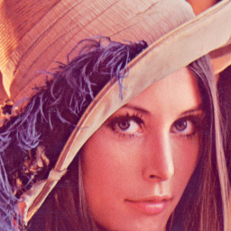

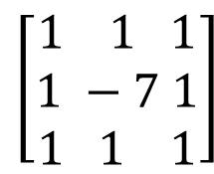
The sharpen filter & algorithm
$$\left[\begin{aligned}1 1 1 \\ 1 −7 1 \\ 1 1 1\end{aligned}\right]$$
X
=

Slide 4
The sharpen filter & algorithm
Data reuse
Data not reuse
Transfer 3 cols of data each time
Cold start (3 cols)
After cold start (1 col each time)

Slide 5
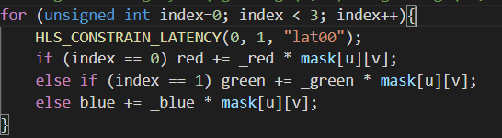
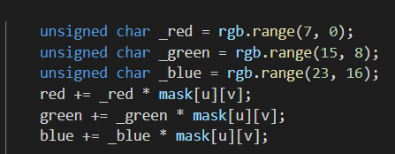
The sharpen filter & algorithm
Roll version
Unroll version

Slide 6
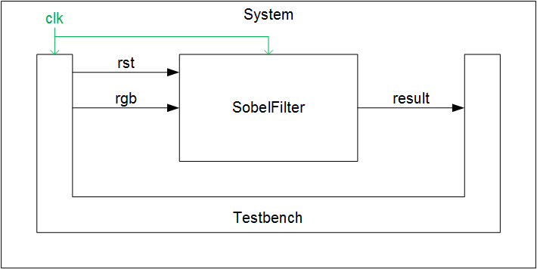
Overall schematic of the implementation
i_rgb
o_result
Sharpen filter

Slide 7
The results of HLS
BASIC/DPA (ns) | Data reuse | Data not reuse
Cold start | 210/210 | 190/190
Each col | 100/100 | 200/200
Transfer count | 591360 | 1769472
Difference of transfer | 1178112 (66%)

Slide 8
The results of HLS
BASIC/DPA (ns) | Data not reuse/ roll | Data not reuse/ unroll | Data reuse/ roll | Data reuse/ unroll
Stimulation time | 32112630 / 30801910 | 30801910 / 24903670 | 26257430 / 24926710 | 14440950 / 13130230
Cycle counts | 3211263 / 3080191 | 3080191 / 2490367 | 2625743 / 2492671 | 1444095 / 1313023
Total area | 6948/ 6481 | 3988/ 3677 | 15062/ 14221 | 14722/ 13647

Slide 9
Demo and conclusion
We discover that making calculation process unroll can reduce the cycle counts and maintain a reasonable area usage.
Implementing data reuse will increase area usage dramatically but decrease cycle counts by half.

