Slide 1
学生信息管理系统
THESIS DEFENSE POWERPOINT TEMPLATE
指导老师：沃焱
答辩人：陈明奕

Slide 2
目 录
CONTENTS
绪论
设计结构
功能实现
选题背景
类架构
程序架构
基本功能
扩展功能

Slide 3
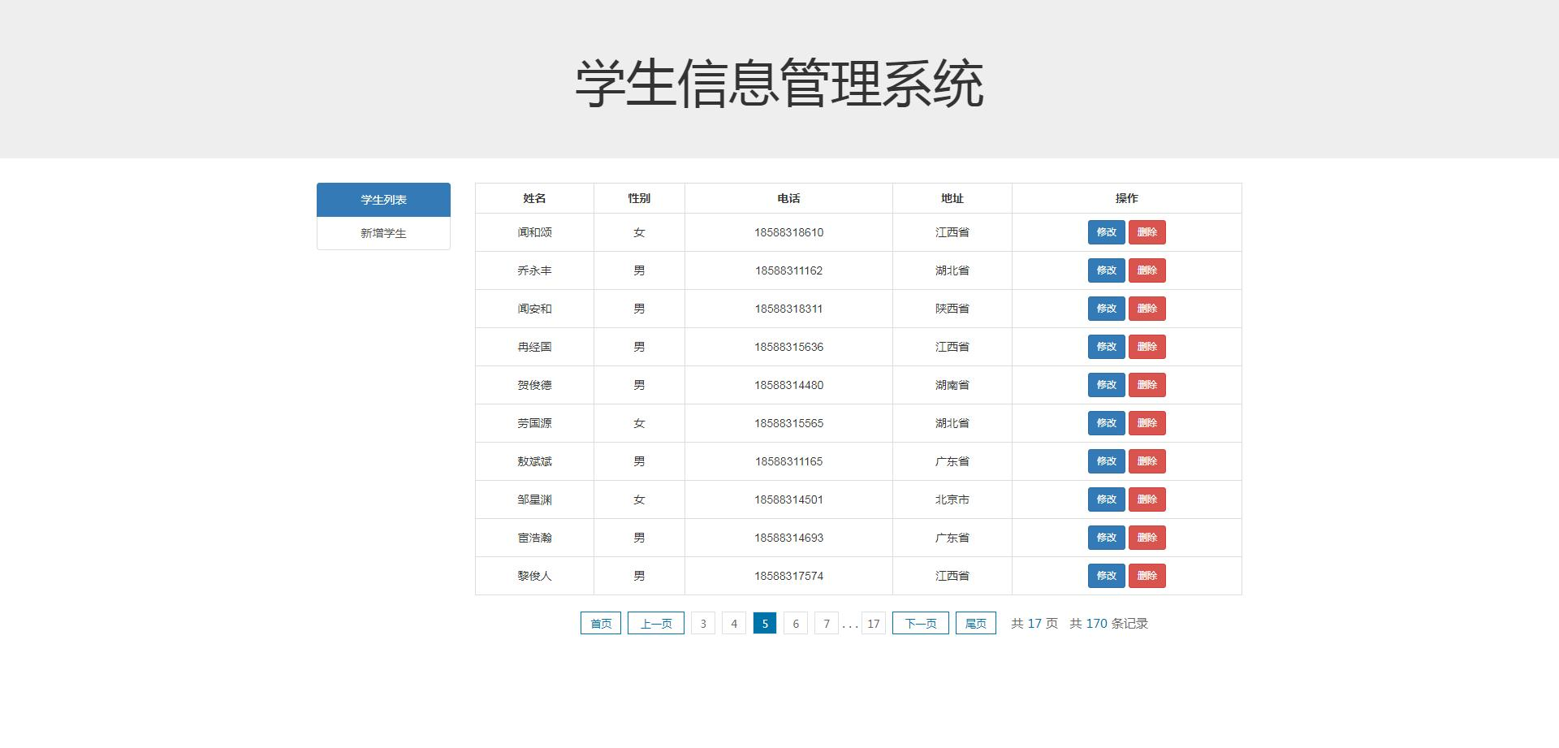
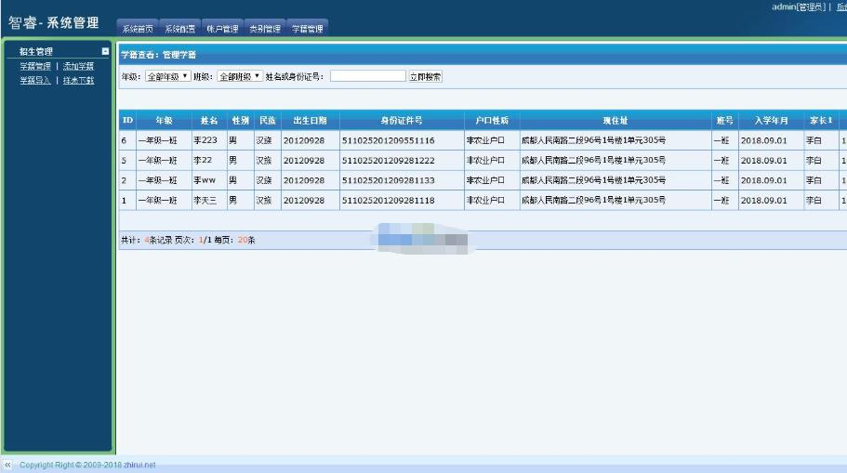
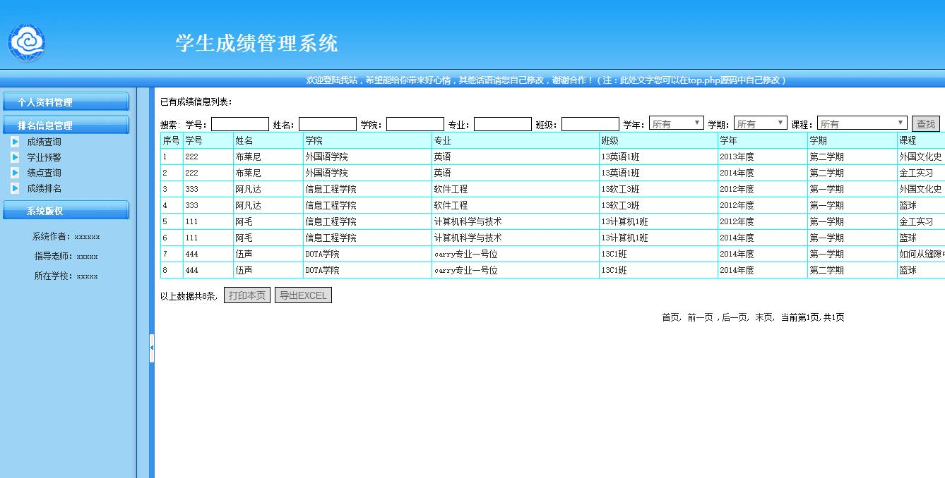
选题背景
TOPIC HEADER HERE
We have many PowerPoint templates that has been specifically designed to help anyone that is stepping into the world of PowerPoint for the very first time.

Slide 4
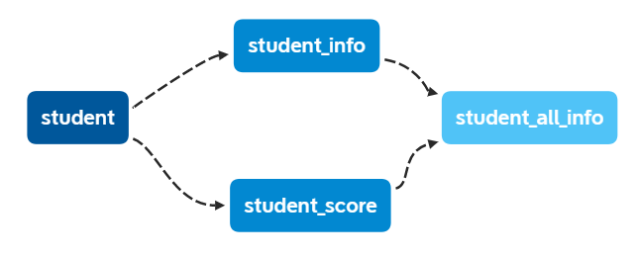
程序设计——类架构
TOPIC HEADER HERE
We have many PowerPoint templates that has been specifically designed to help anyone that is stepping into the world of PowerPoint for the very first time.

Slide 5
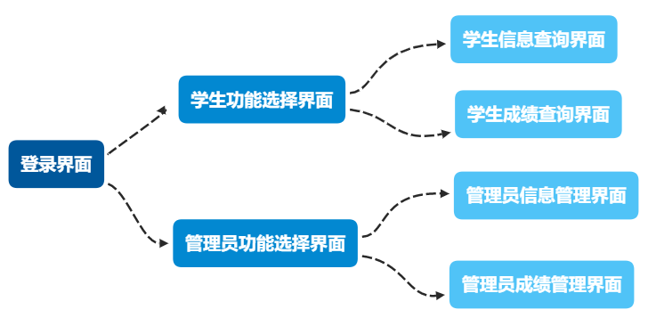
程序设计——程序架构
TOPIC HEADER HERE
We have many PowerPoint templates that has been specifically designed to help anyone that is stepping into the world of PowerPoint for the very first time.

Slide 6
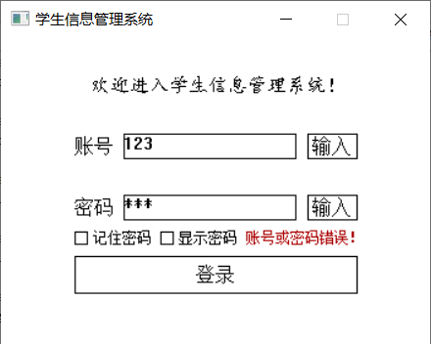
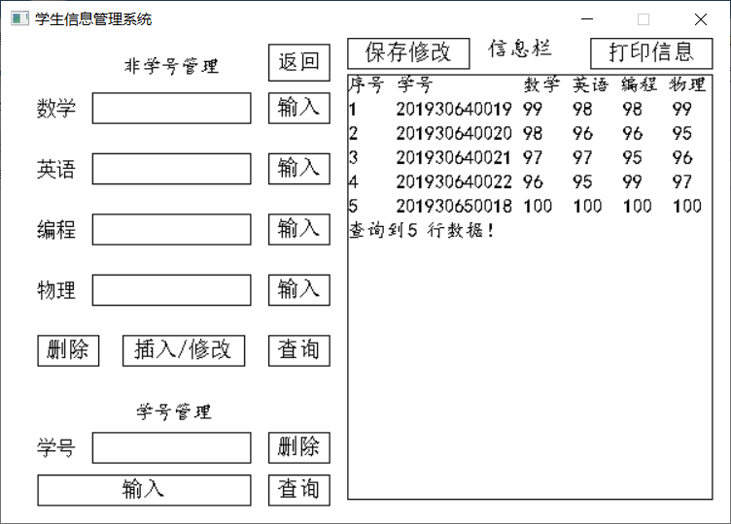
功能实现
基本功能：
1.完成数据的增删查改和储存功能
2.能够对查询到的数据进行排序
3.能够显示所存储的所有信息
扩展功能： 1.显示密码功能
2.记住密码功能
3.范围查找功能
4.多关键词查找功能
5.打印信息功能
TOPIC HEADER HERE
We have many PowerPoint templates that has been specifically designed to help anyone that is stepping into the world of PowerPoint for the very first time.

Slide 7
敬请批评指正
TAHNK YOU FOR WATCHING
指导老师：沃焱
答辩人：陈明奕

