Slide 1


EEL 6509 Wireless Communication Presentation
Study and Simulation of OFDM Systems
Jiajing Liao
UFID: 01469951

Slide 2
EEL 6509 Wireless Communication Presentation
Content
- Classic multiple access technology
- Principles of OFMD technology
- OFDM Transceiver system Simulation
- OFDM parameters
- Result and analysis
- Conclusion and Future

Slide 3
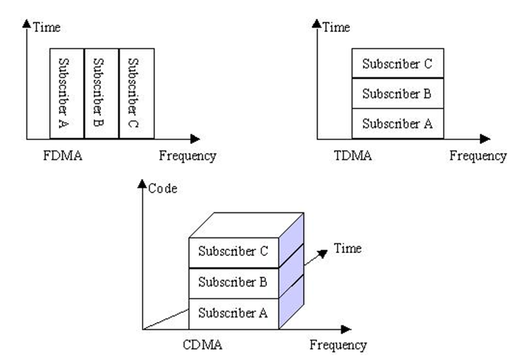
EEL 6509 Wireless Communication Presentation
Classic multiple access technology
- FDMA
- TDMA
- CDMA
Fig. 1. FDMA, TDMA, CDMA Comparison [2]

Slide 4
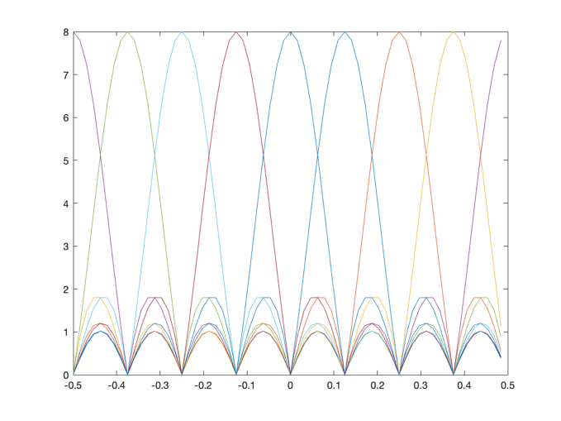
EEL 6509 Wireless Communication Presentation
OFDM
- Compact Frequency Utilization
Orthogonal for low ISI Interference
Used in WiFi 802.11ac, 4G, 5G cellular phone technologies, satellite and many others
Fig. 2. Orthogonal Signal in Frequency domain

Slide 5
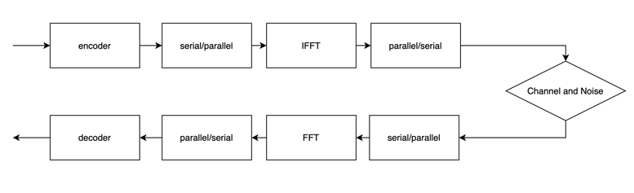
EEL 6509 Wireless Communication Presentation
OFDM Transceiver system
Fig. 3. OFDM Transceiver systems

Slide 6
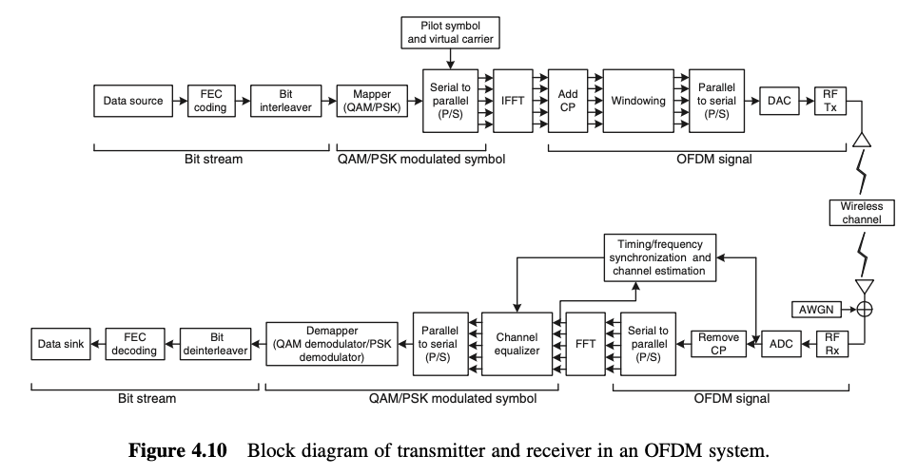
EEL 6509 Wireless Communication Presentation
OFDM Transceiver system
Related technology
Channel Coding
Interleaving
Pilot
Protection Interval
OFDM entire Transceiver systems [1]

Slide 7
EEL 6509 Wireless Communication Presentation
OFDM parameters selection example
Requirements :(1) a bit rate of 25Mbit/s (2) a time delay extension of 200ns (3) bandwidth less than 18MHz.
1) The protection interval is expanded from 200ns delay; to 800ns
2) Symbol cycle length 6*800ns=4.8us according to 800ns protection interval;
3) The interval of subcarriers is selected as the reciprocal of 4.8-0.8= 4US, i.e. 250KHz;
4) according to the ratio between the required bit rate and OFDM symbol rate, the bits to be transmitted for each symbol :(25Mbit/s)/(1/4.8us) =120bit.
5) To complete the above 120bit/ symbol, there are two choices: using 16QAM and code method with a code rate of 1/2, so that each subcarrier carries 2 bits of useful information, so 60 subcarriers are needed; The other is the use of QPSK and code rate of 3/4, each subcarrier carries 1.5bit information. Therefore, 80 subcarriers are needed. However, 80 subcarriers have unexpected bandwidth: 80*250KHz=20MHz, which is greater than the required bandwidth. Therefore, the first type, namely 60 subcarriers, is chosen. 64 IFFT can be used to achieve, the remaining 4 subcarrier complement 0.

Slide 8
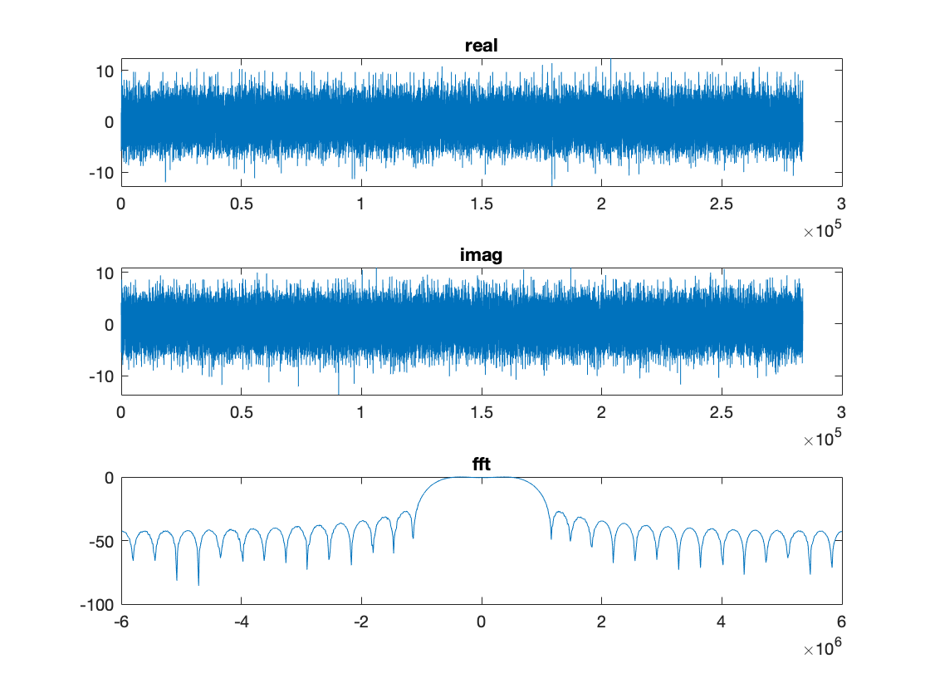
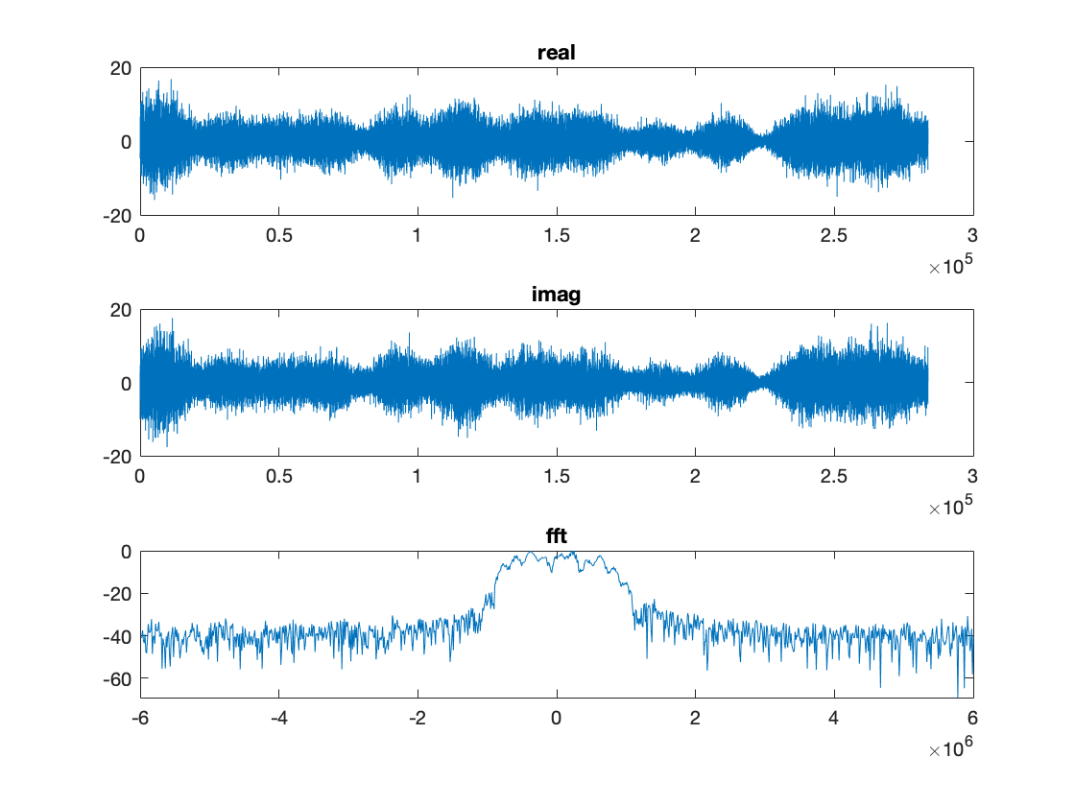
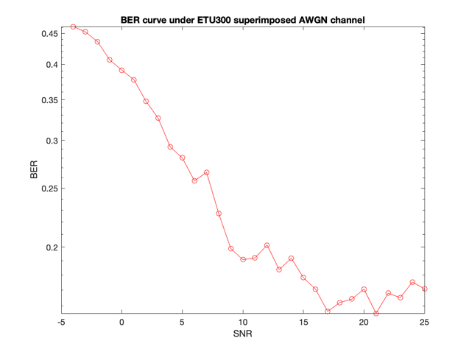
EEL 6509 Wireless Communication Presentation
Result and analysis
Fig. 5. time and frequency domain image through an ETU300 multipath channel
Fig. 6. BER v.s. SNR
Fig. 4. Time and frequency domain image of data sent

Slide 9
EEL 6509 Wireless Communication Presentation
Conclusion:
introduce the background and classic multiple access technology
analysis the principles of OFDM
Experiment and Simulation of OFDM transceiver system
Future Work
develop new method to further reduce ISI.
utilize Machine Learning technology to do the channel estimation
Thanks for your time!

