Slide 1
Phase congruency: A low-level image invariant:
Paper Reading
Speaker: Liao.L
Tutor: Bingjie Tao
IDIPLAB · UESTC

Slide 2
Introduction
Method
Experiment
Conclusion

Slide 3
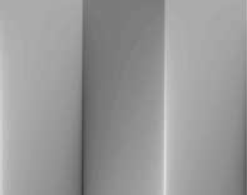
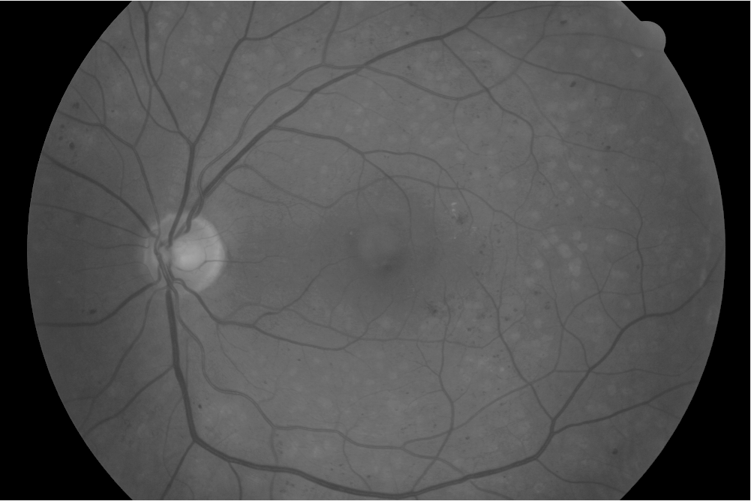
1 Introduction
The human visual system is able to reliably identify the significance of image features under widely varying conditions.
illumination changed
contrast changed

Slide 4
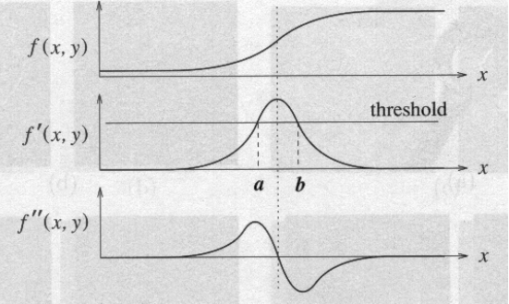

1 Introduction
Gradient based edge detection:
Sobel
Canny
Laplace
LoG
…
The threshold problem:
Intensity gradients
Illumination changed
Contrast levels
…
Edge representation in frequency domain.

Slide 5
Introduction
Method
Experiment
Conclusion

Slide 6
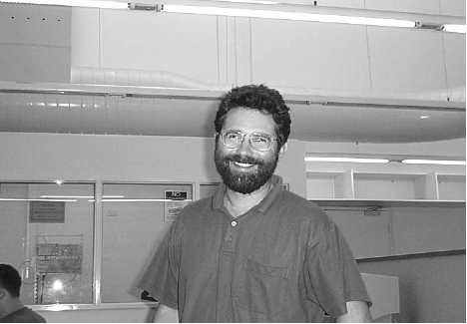
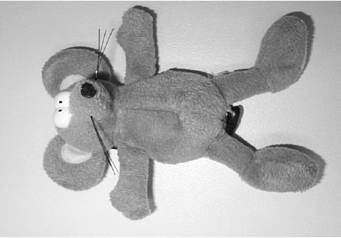
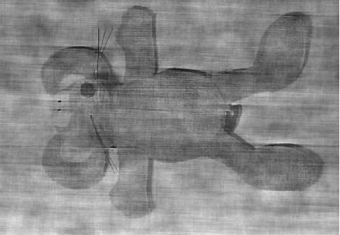
1.1 Phase is important
Amplitude of Peter, Phase of Mouse…

Slide 7
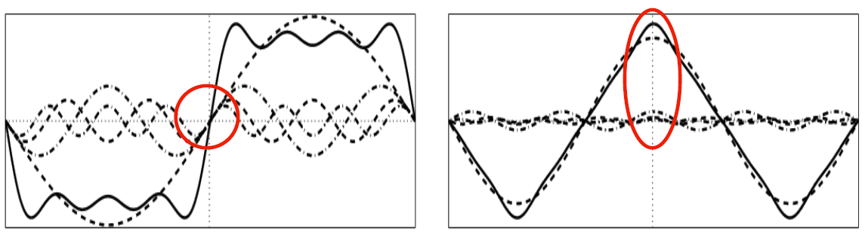
1.2 Local Energy Model
The Fourier components are all in phase at the point of the step in the square wave, and at the peaks and troughs of the triangular wave.
This property is stable over scale.

Slide 8
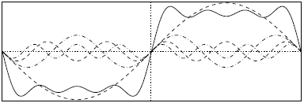
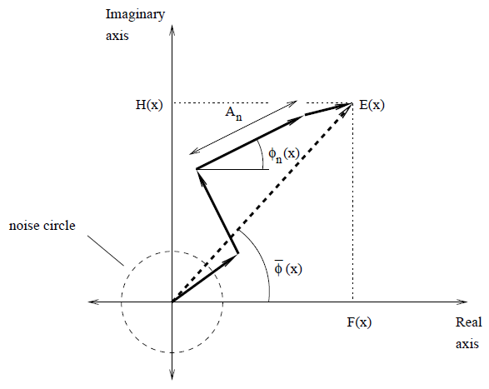

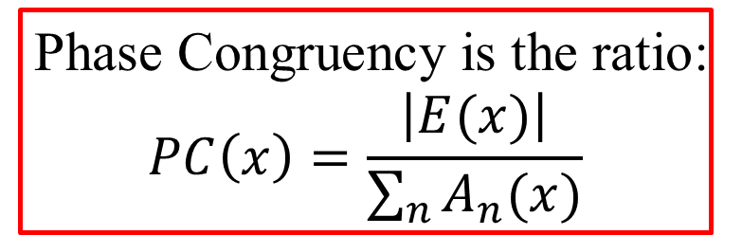
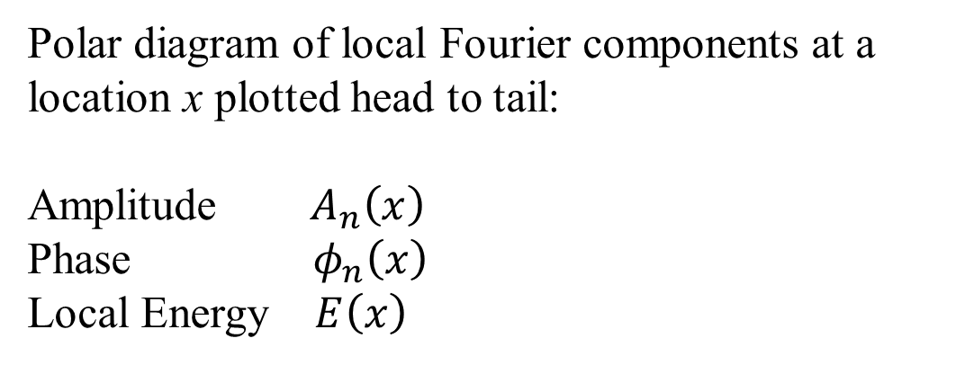
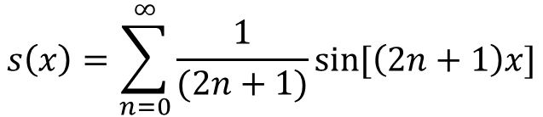
1.2 Local Energy Model
x
$$s\left(x\right)=\sum_{n=0}^{∞}{\frac{1}{(2n+1)}sin⁡[\left(2n+1\right)x]}$$
Phase Congruency is the ratio:
$$PC\left(x\right)=\frac{\left|E(x)\right|}{\sum_{n}{A_{n}(x)}}$$
Polar diagram of local Fourier components at a location x plotted head to tail:
Amplitude $A_{n}\left(x\right)$
Phase $φ_{n}\left(x\right)$
Local Energy $E\left(x\right)$
$$0≤PC\left(x\right)≤1$$

Slide 9
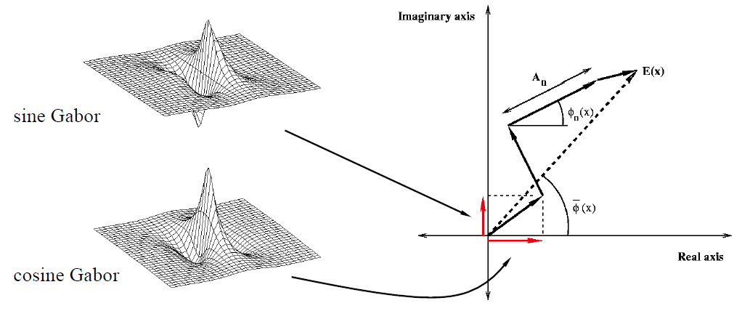
1.3 Log-Gabor filters
Local frequency information is obtained by applying quadrature pairs of log-Gabor filters over six orientations and 3-4 scales (typically).

Slide 10
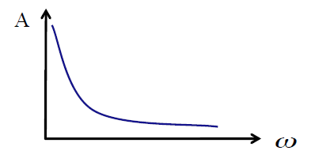
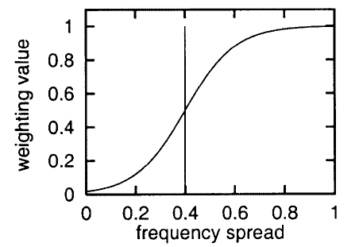
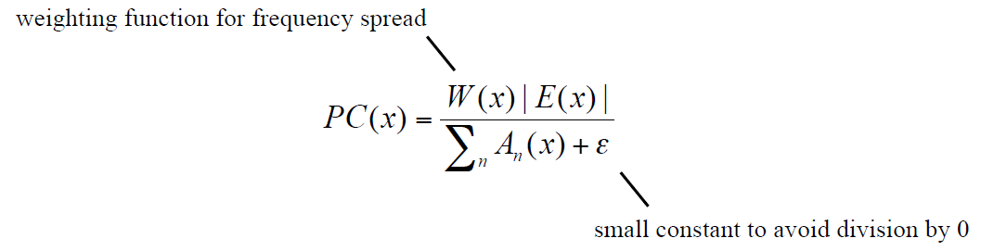
1.4 Frequency spread
Natural images have an amplitude spectrum that decay at $1/ω$^{[1]}.
[1] Field D J . Relations between the statistics of natural images and the response properties of cortical cells[J]. Journal of the Optical Society of America A-optics Image Science & Vision, 1987, 4(12):2379-2394.

Slide 11
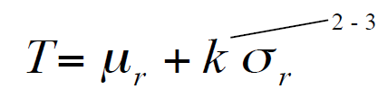
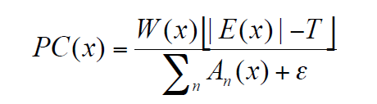
1.5 Noise compensation
Calculate Phase Congruency using the amount that |E(x) | exceeds the radius of the noise circle, T.

Slide 12
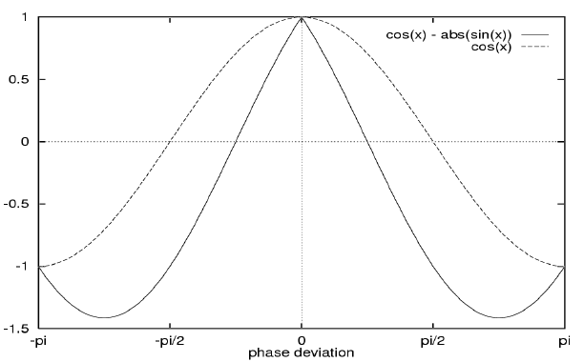
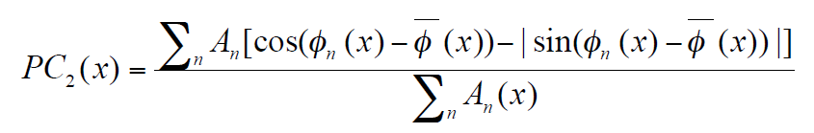
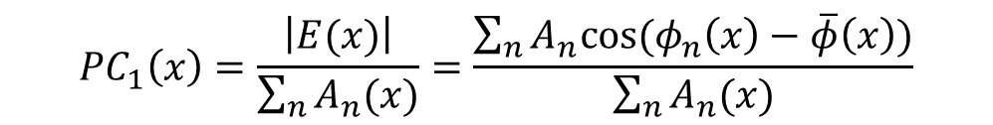
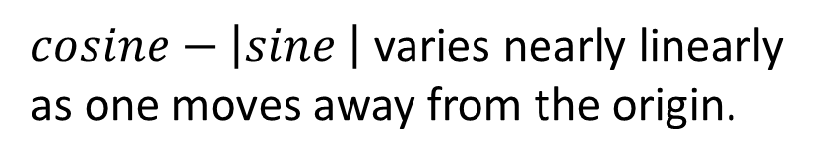
1.6 Localization
$cosine−\left|sine \right|$ varies nearly linearly as one moves away from the origin.
$${PC}_{1}\left(x\right)=\frac{\left|E(x)\right|}{\sum_{n}{A_{n}(x)}}=\frac{\sum_{n}{A_{n}cos⁡(φ_{n}\left(x\right)−\overline{φ}\left(x\right))}}{\sum_{n}{A_{n}(x)}}$$

Slide 13
Introduction
Method
Experiment
Conclusion

Slide 14
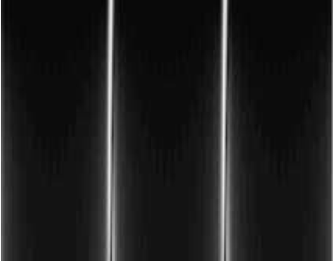
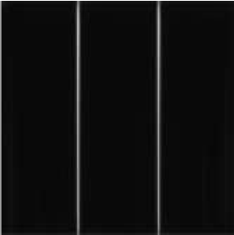
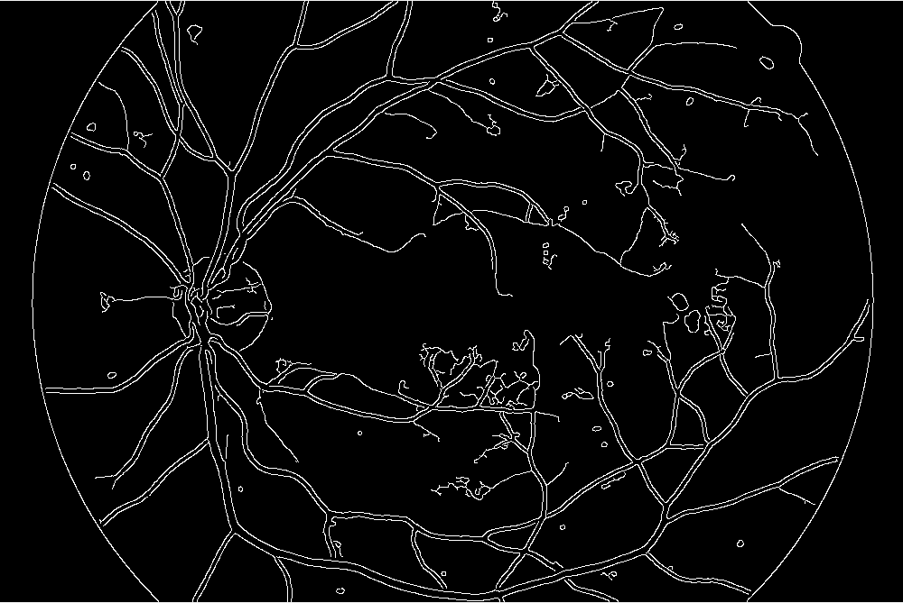
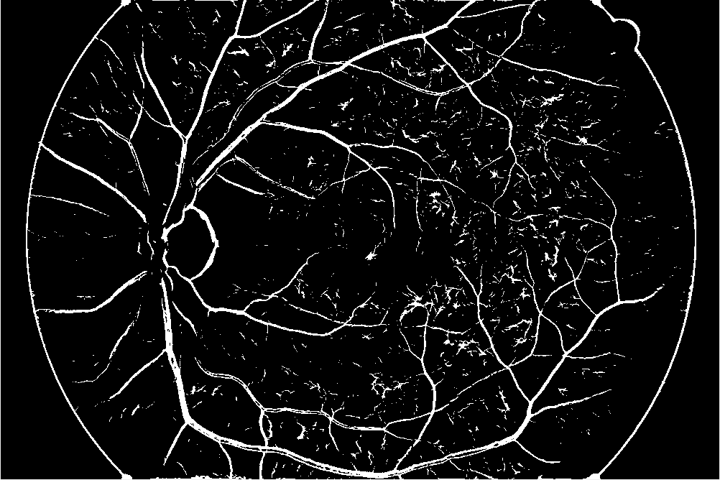
Original
Canny
PC

Slide 15
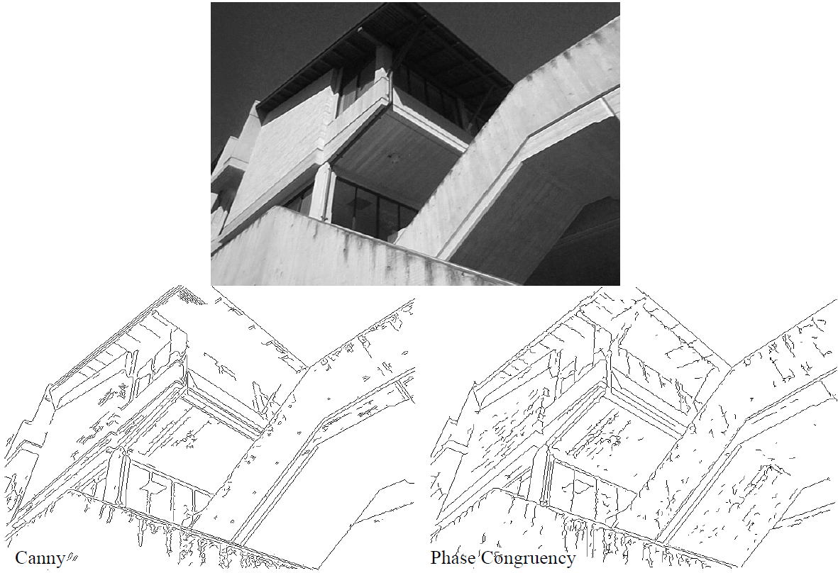

Slide 16
Introduction
Method
Experiment
Conclusion

Slide 17
4. Advantages
Phase Congruency is a dimensionless quantity.
Invariant to contrast and scale.
Value ranges between 0 and 1.
Threshold values can be fixed for wide classes of images.

Slide 18

THANKS
https://github.com/LiaoLIDIP/Slide-IDIPLab

