Slide 1
IVC Lab Optimization
Intra:
Applied on the still image encoding and the 1. frame of video encoding
Intra Coding
Inter :
Applied on the rest frame of video encoding
Half-sample-accurate MCP
Runan Lyu (03756583)
Qi Liao (03753836)

Slide 2
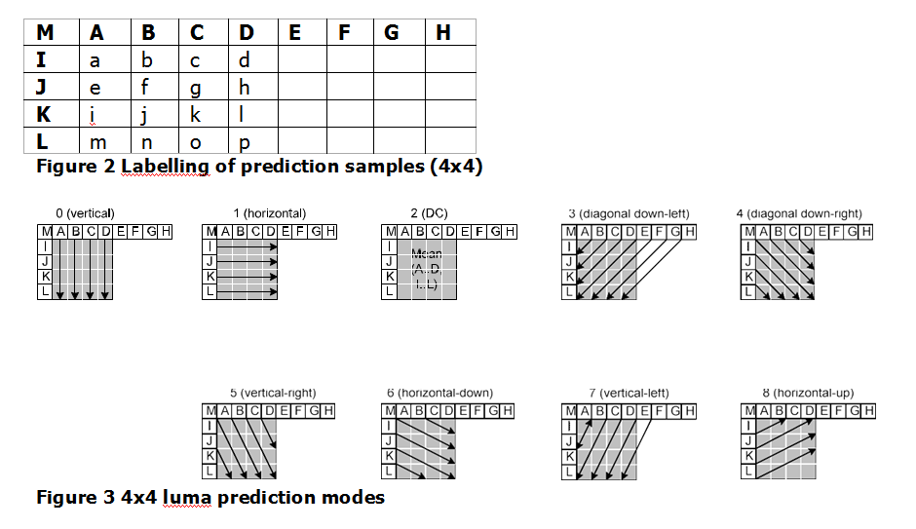
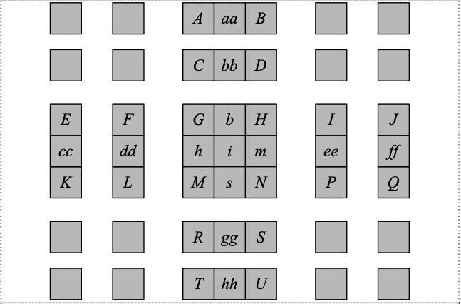
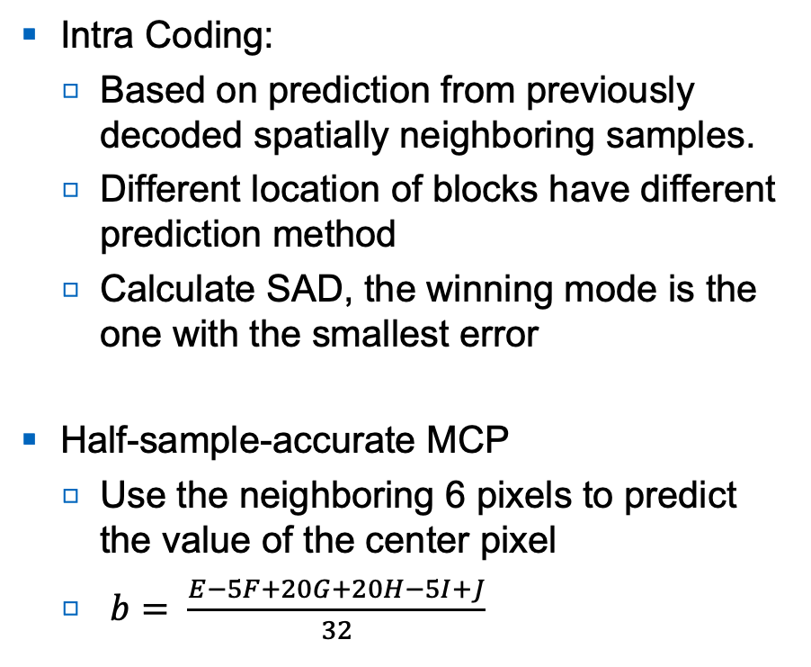
Details
Intra Coding:
Based on prediction from previously decoded spatially neighboring samples.
Different location of blocks have different prediction method
Calculate SAD, the winning mode is the one with the smallest error
Half-sample-accurate MCP
Use the neighboring 6 pixels to predict the value of the center pixel
$b= \frac{E−5F+20G+20H−5I+J}{32}$
Image1: Intra Coding [1]
Image2: Half-sample-accurate MCP [2]
[1] H.264/AVC Intra Prediction. https://www.vcodex.com/h264avc-intra-precition/
[2] Nan Wang, Ya-di Zhang . A method to remove image noise based on 6-tap Filter Interpolation.https://iopscience.iop.org/article/10.1088/1742-6596/1748/4/042003/pdf

Slide 3
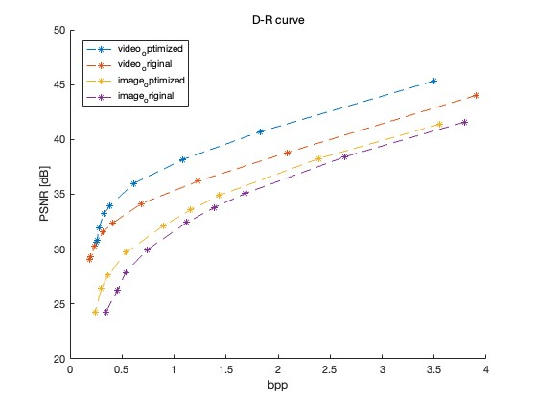
Result
Curve shift upwards
Bit-rate shift to the left
PSNR is a little bit larger
Runan Lyu (03756583)
Qi Liao (03753836)

