Slide 1



$$p\frac{∂}{x}\left(\frac{1}{q}\frac{∂}{x}\left(rΦ\right)\right)$$
$$x$$
$$p=1,q=1,r=1$$
$$\frac{∂}{x}\left(\frac{∂}{x}\left(Φ\right)\right)$$

Slide 2

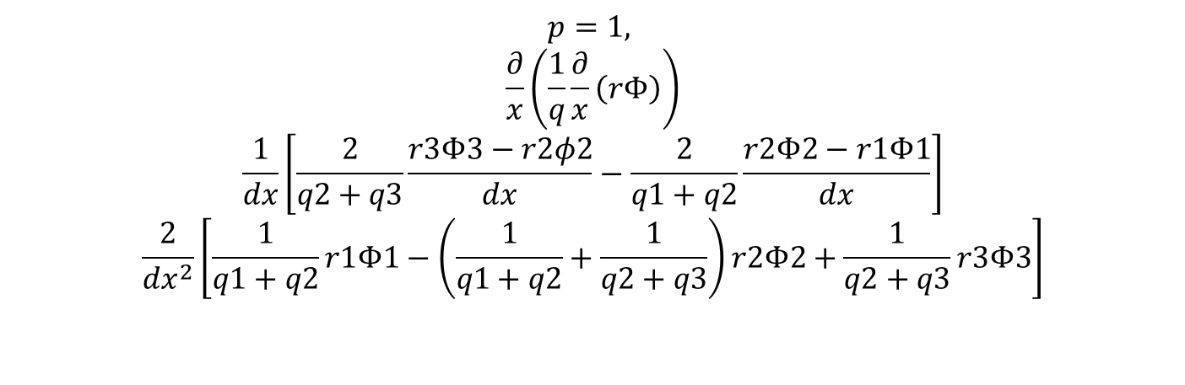



$$x$$
$$1$$
$$2$$
$$3$$
$$p=1,$$
$$\frac{∂}{x}\left(\frac{1}{q}\frac{∂}{x}\left(rΦ\right)\right)$$
$$\frac{1}{dx}\left[\frac{2}{q2+q3}\frac{r3Φ3−r2φ2}{dx}−\frac{2}{q1+q2}\frac{r2Φ2−r1Φ1}{dx}\right]$$
$$\frac{2}{dx^{2}}\left[\frac{1}{q1+q2}r1Φ1−\left(\frac{1}{q1+q2}+\frac{1}{q2+q3}\right)r2Φ2+\frac{1}{q2+q3}r3Φ3\right]$$

Slide 3
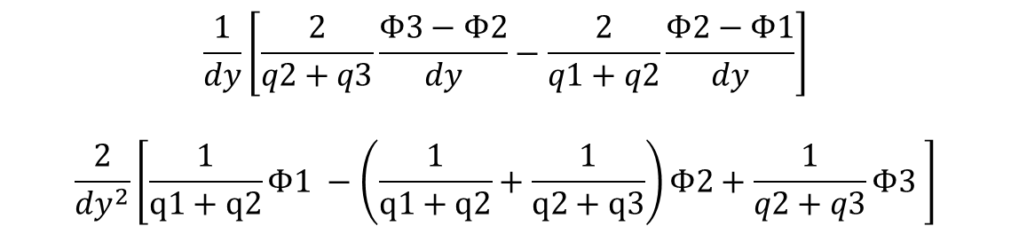
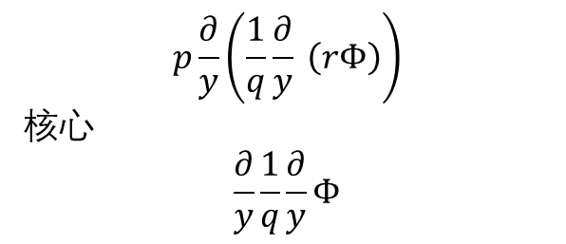
$$p\frac{∂}{y}\left(\frac{1}{q}\frac{∂}{y} \left(rΦ\right)\right)$$
核心
$$\frac{∂}{y}\frac{1}{q}\frac{∂}{y}Φ$$
3
2
$$\frac{1}{dy}\left[\frac{2}{q2+q3}\frac{Φ3−Φ2}{dy}−\frac{2}{q1+q2}\frac{Φ2−Φ1}{dy}\right]$$
$$\frac{2}{dy^{2}}\left[\frac{1}{q1+q2}Φ1 −\left(\frac{1}{q1+q2}+\frac{1}{q2+q3}\right)Φ2+\frac{1}{q2+q3}Φ3 \right]$$
1

Slide 4
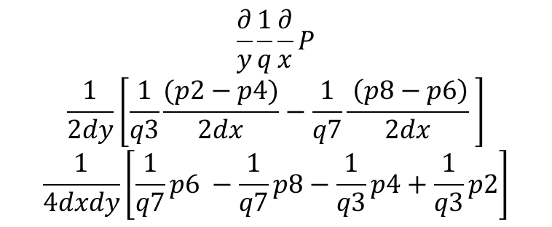
4
3
2
c
d
$$\frac{∂}{y}\frac{1}{q}\frac{∂}{x}P$$
$$\frac{1}{2dy}\left[\frac{1}{q3}\frac{(p2−p4)}{2dx}−\frac{1}{q7}\frac{ \left(p8−p6\right)}{2dx} \right]$$
$$\frac{1}{4dxdy}\left[\frac{1}{q7}p6 −\frac{1}{q7}p8−\frac{1}{q3}p4+\frac{1}{q3}p2\right]$$
5
0
1
6
a
7
8
b
d
c
Nx-1
Nx+1
b
a

Slide 5
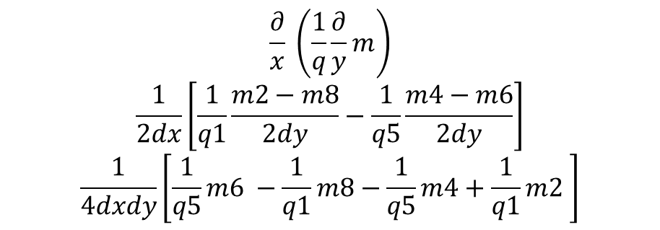
4
3
2
c
d
5
0
1
$$\frac{∂}{x} \left(\frac{1}{q}\frac{∂}{y}m\right)$$
$$\frac{1}{2dx}\left[\frac{1}{q1}\frac{m2−m8}{2dy}−\frac{1}{q5}\frac{m4−m6}{2dy}\right]$$
$$\frac{1}{4dxdy}\left[\frac{1}{q5}m6 −\frac{1}{q1}m8−\frac{1}{q5}m4+\frac{1}{q1}m2 \right]$$
6
a
7
8
b
c
d
b
a

