Slide 1


Image Defogging
Reporter：王忠安
Date：2021.12.27
Group 14：王忠安 石帅 魏雪齐

Slide 2

Introduction
Defogging
Defogging is highly desired in consumer/computational photography and computer vision applications.
Removing fog can significantly increase the visibility of the scene and correct the color shift caused by the airlight.

Slide 3

Methods
1
Dark Channel Prior
2
Boundary Constraint and Contextual Regularization
3
Feature Fusion Attention Network

Slide 4


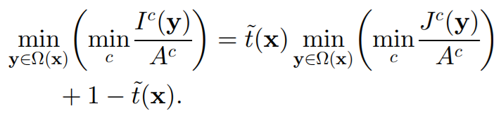

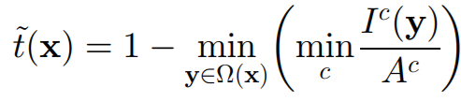

Dark Channel Prior
The model：
Assume that A is given and t(x) is constant：
Dark channel：
Put the minimum operators
Due to the dark channel prior
Dark channel prior：

Slide 5
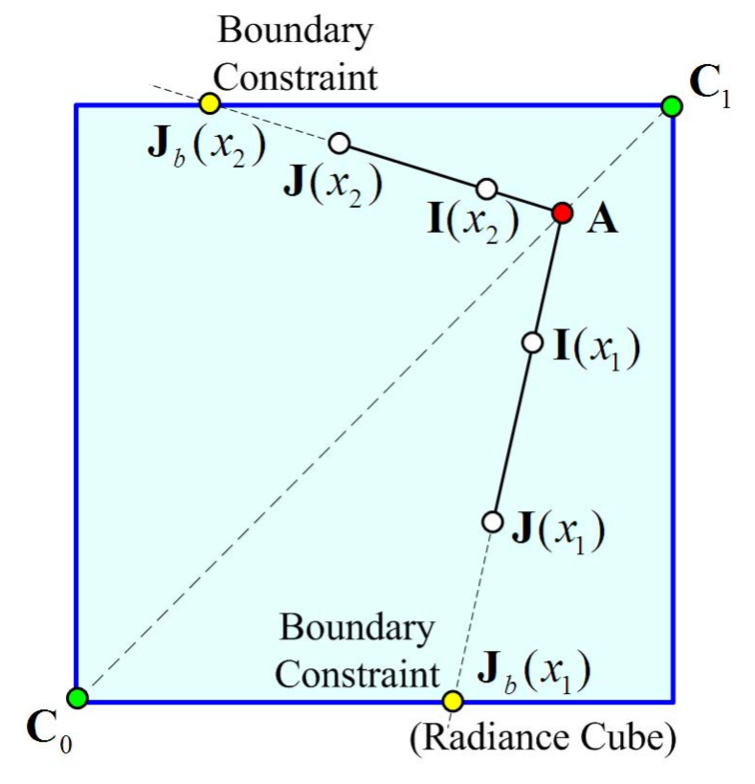
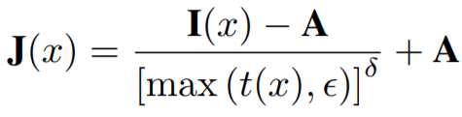




Boundary Constraint and Contextual Regularization
Boundary Constraint from Radiance Cube
Once t(x) and A are estimated:
Boundary constraint：
The new patch-wise transmission

Slide 6
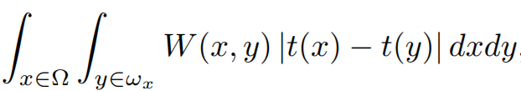



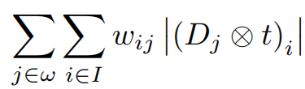


Boundary Constraint and Contextual Regularization
Weighted L1-norm based Contextual Regularization
Introduce a weighting function：
Integrating the weighted contextual constraints:
Two examples of the construction of such weighting functions：
discrete form
Based on the squared difference between the color vectors of two neighboring pixels
differential operators
Based on the luminance difference of neighboring pixels
more compactly

Slide 7
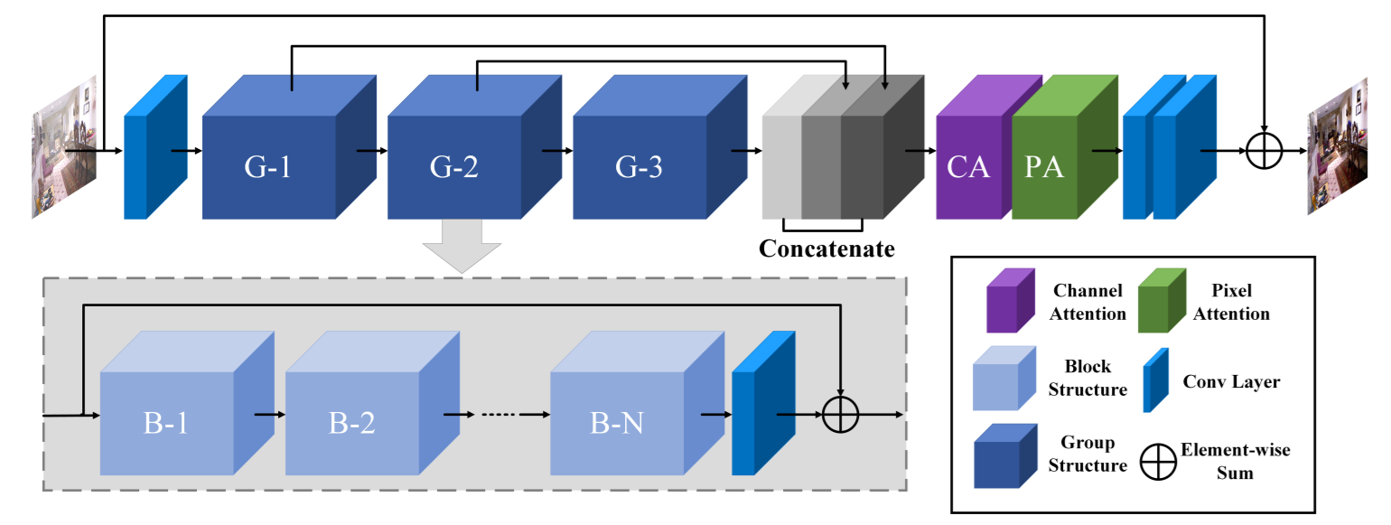
Feature Fusion Attention Network
FFA-Net architecture：

Slide 8


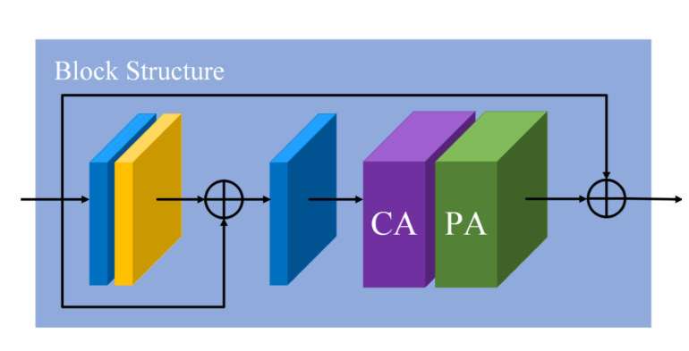
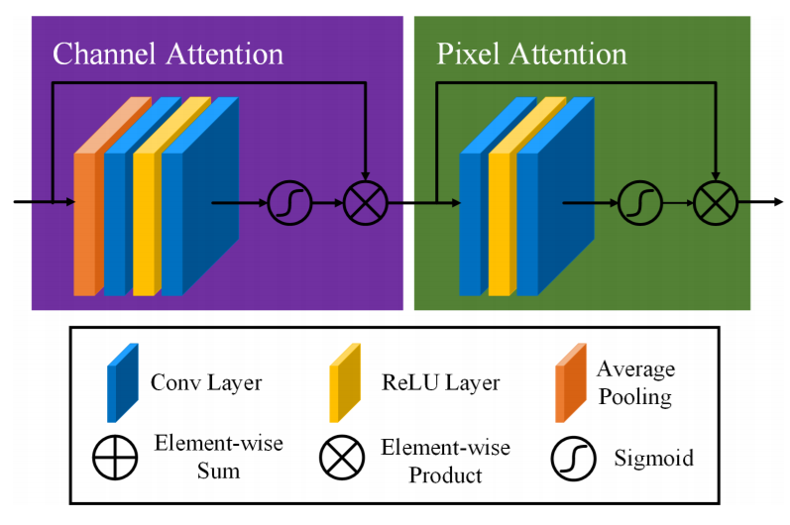
Feature Fusion Attention Network
Feature Attention module：
Basic Block Structure：

