Slide 1


Weekly meeting
Department of Physics, Shandong University
Chengxin Liao
liaocx@ihep.ac.cn
Wed, Nov 20, 2024

Slide 2
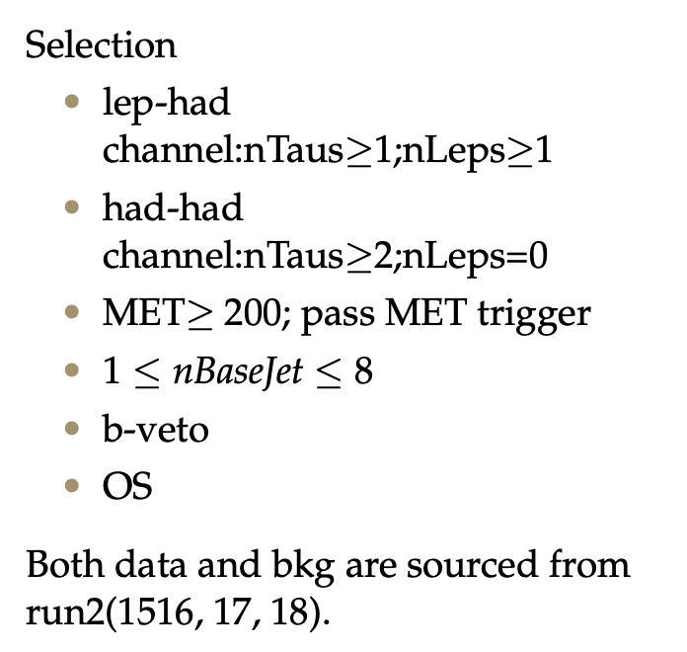
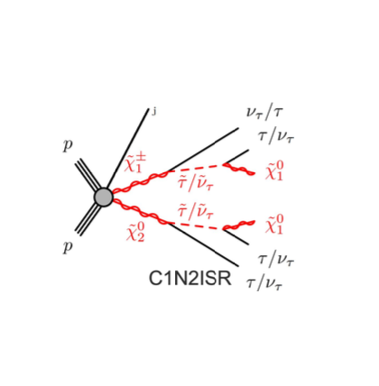
Pre-selection
1
Chengxin Liao
IHEP SUSY Meeting

Slide 3
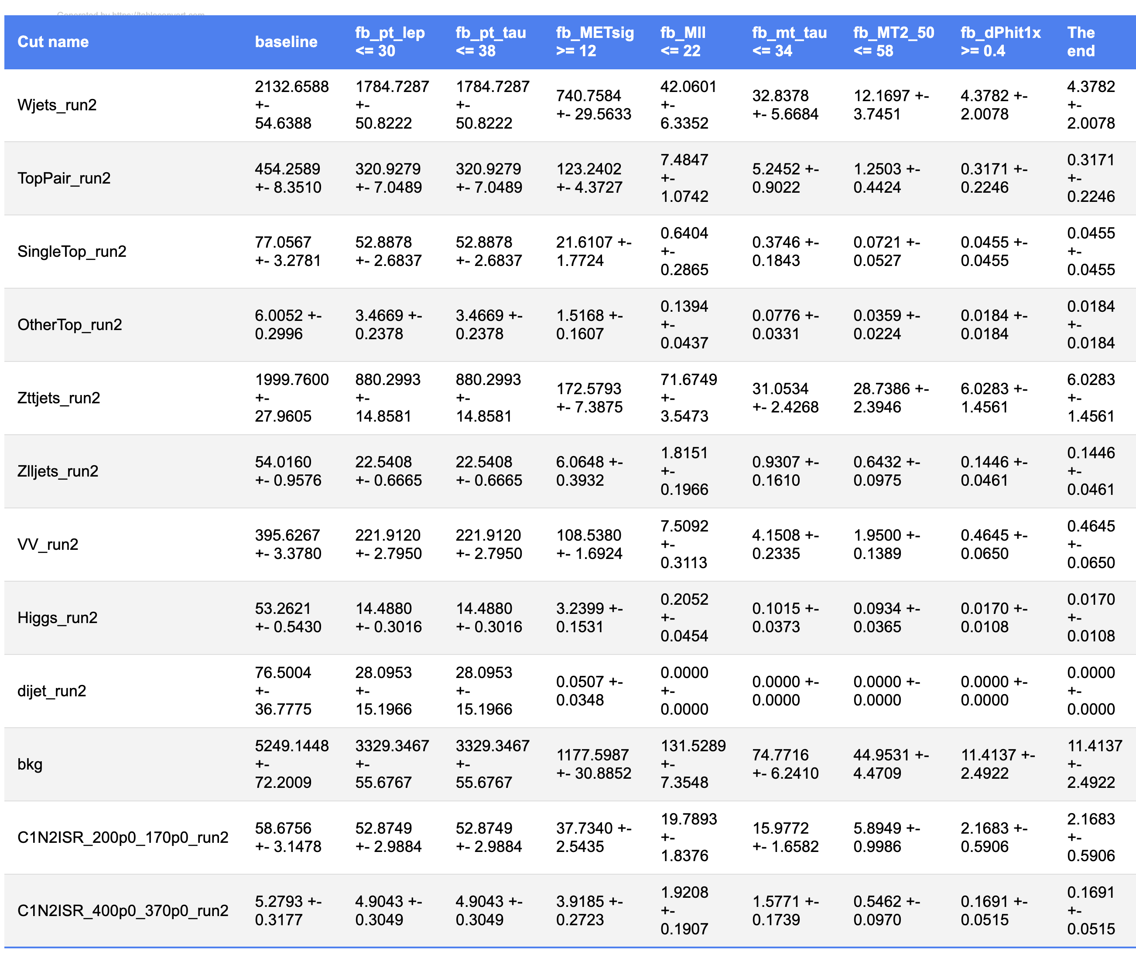
CutCount: HH
Pt_lep <= 24
Pt_tau <= 32
METsig >= 12
Mll <= 22
Mt_tau <= 32
MT2_50 <= 58
dPhit1x >= 0.4
Wjets and Zjets
dominate bkg
Inefficent cut
2
Chengxin Liao
IHEP SUSY Meeting

Slide 4
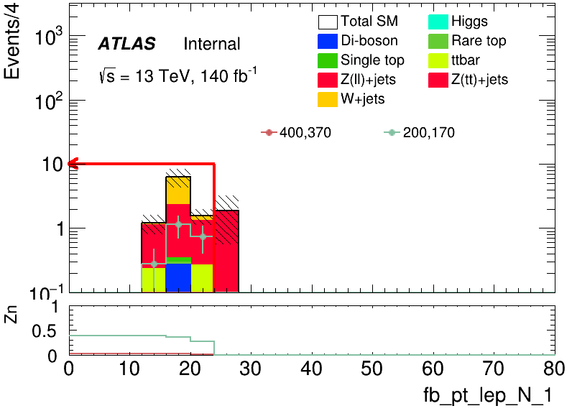
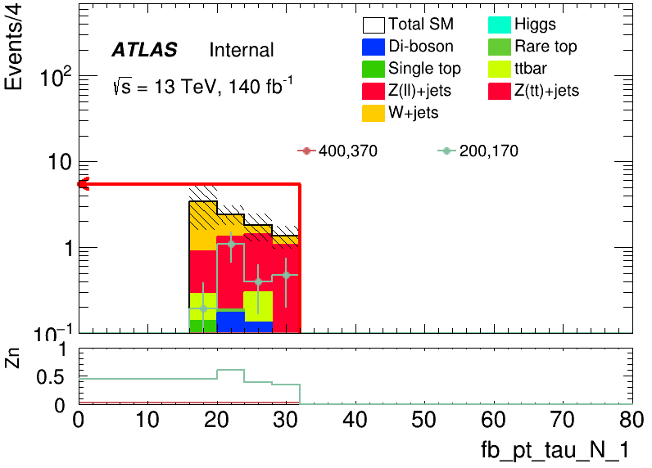
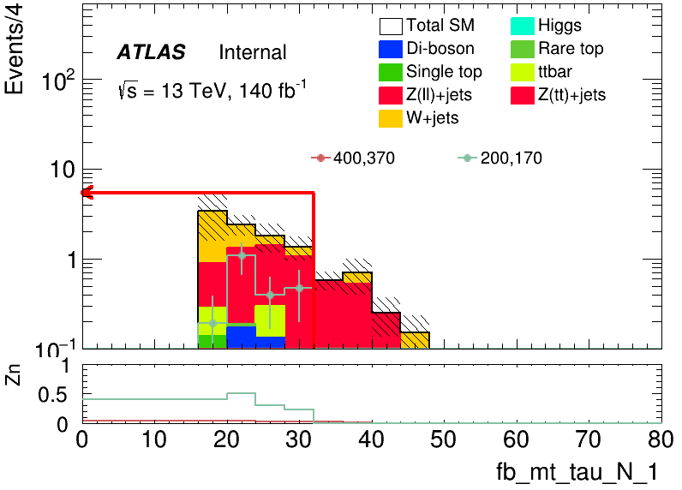
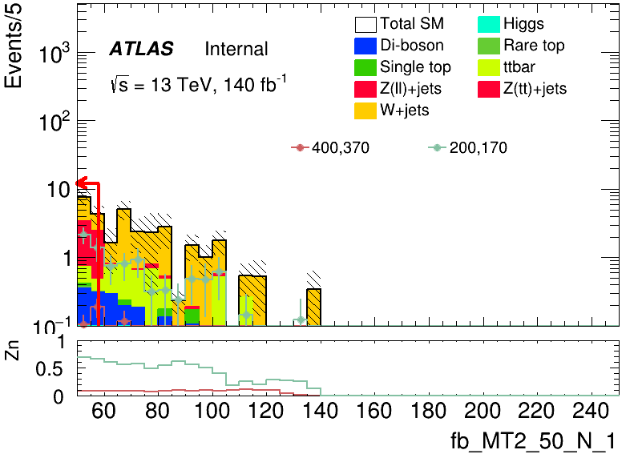
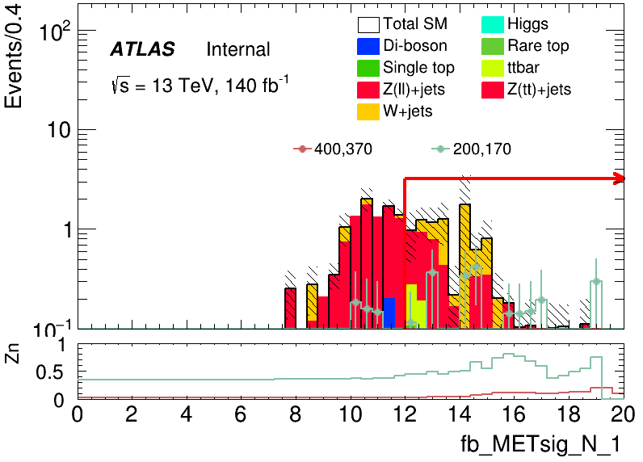
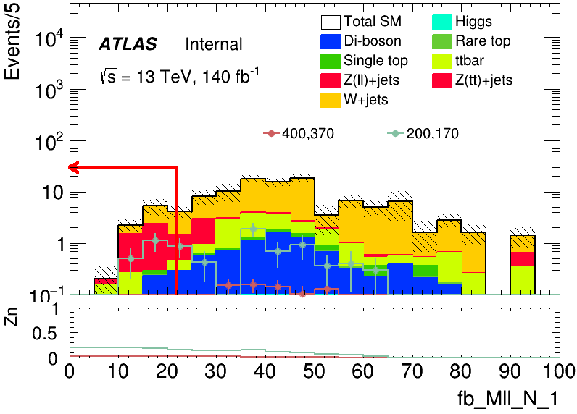
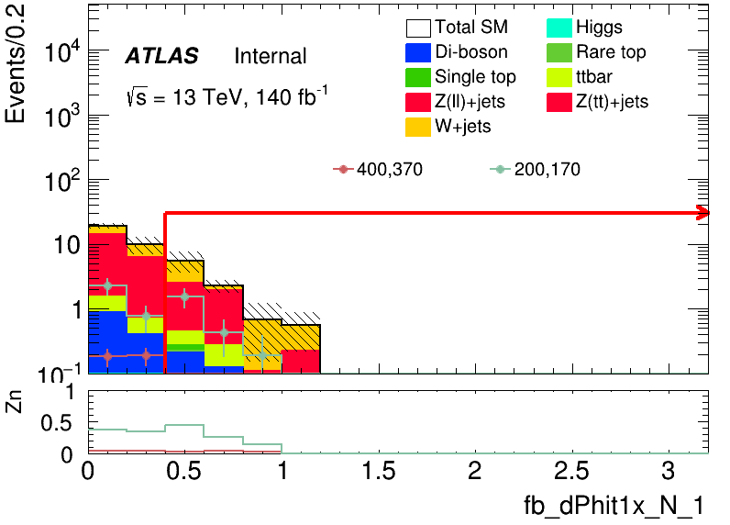
N-1 plot: HH
Pt_lep <= 24
Pt_tau <= 32
Mt_tau <= 32
MT2_50 <= 58
METsig >= 12
Mll <= 22
dPhit1x >= 0.4
3
Chengxin Liao
IHEP SUSY Meeting

Slide 5
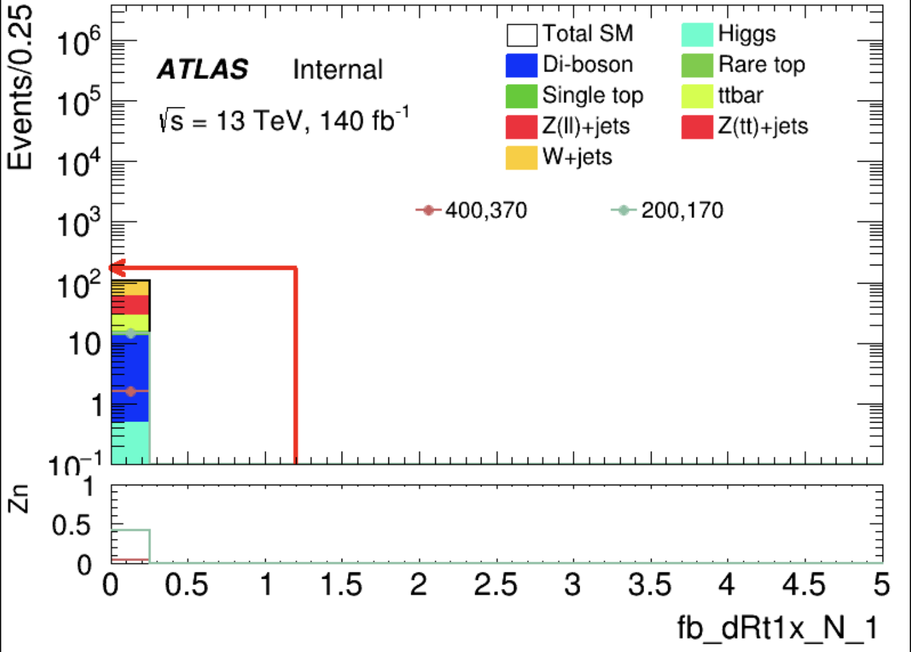
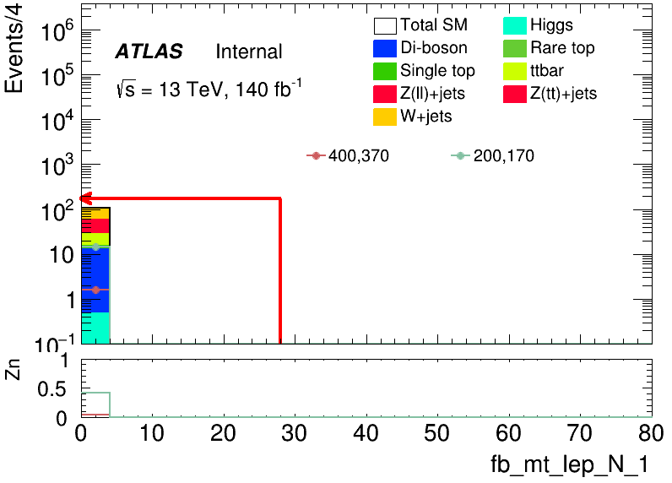
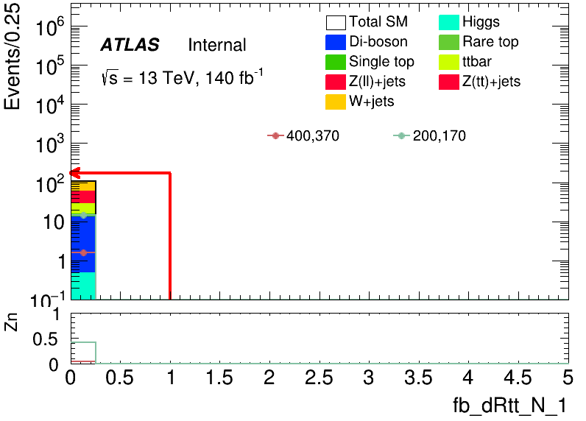
CutCount: LH
LH channel still have some problems, so I did not put result here
all bkg and sig contralize in the first bin
4
Chengxin Liao
IHEP SUSY Meeting

