Slide 1


Weekly meeting
Department of Physics, Shandong University
Chengxin Liao
liaocx@ihep.ac.cn
Wed, Nov 20, 2024

Slide 2
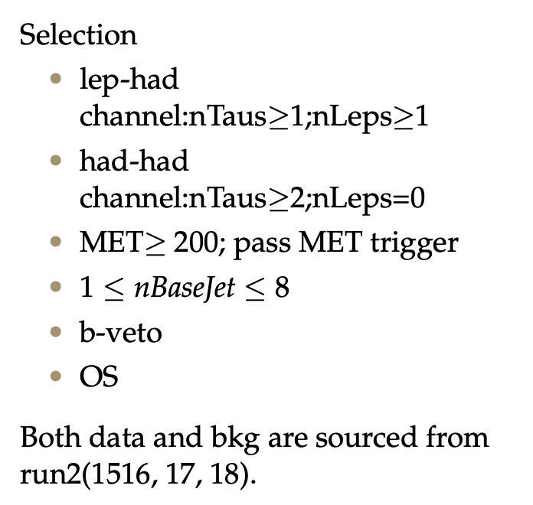
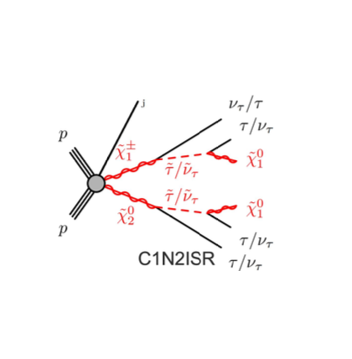
Pre-selection
1
Chengxin Liao
IHEP SUSY Meeting

Slide 3
CutCount result
Highlight line is the var combination I choose
Pt_lep <= 32
Pt_tau <= 48
METsig >= 16
Mll <= 60
20 <= Mt_tau <= 48
MT2_50 <= 60
0.2 <= dPhit1x <= 1.2
2
Chengxin Liao
IHEP SUSY Meeting

Slide 4
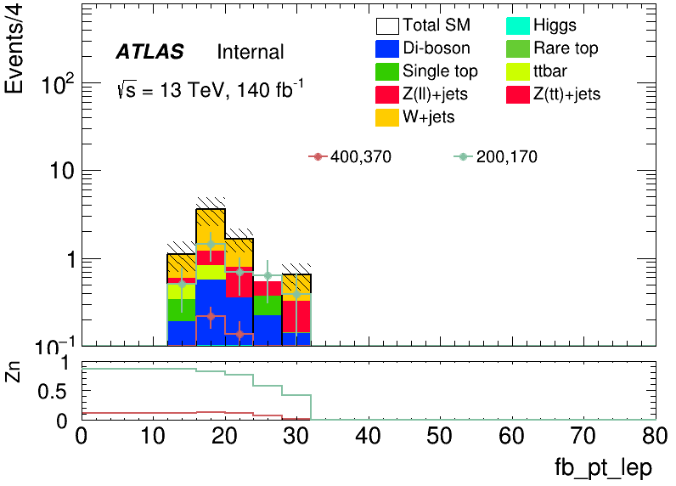
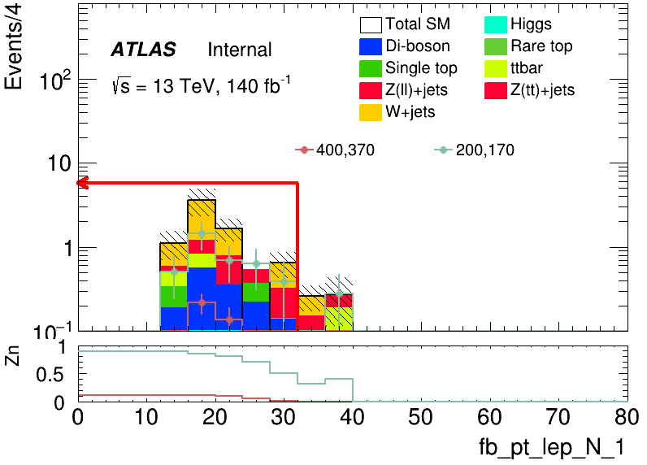
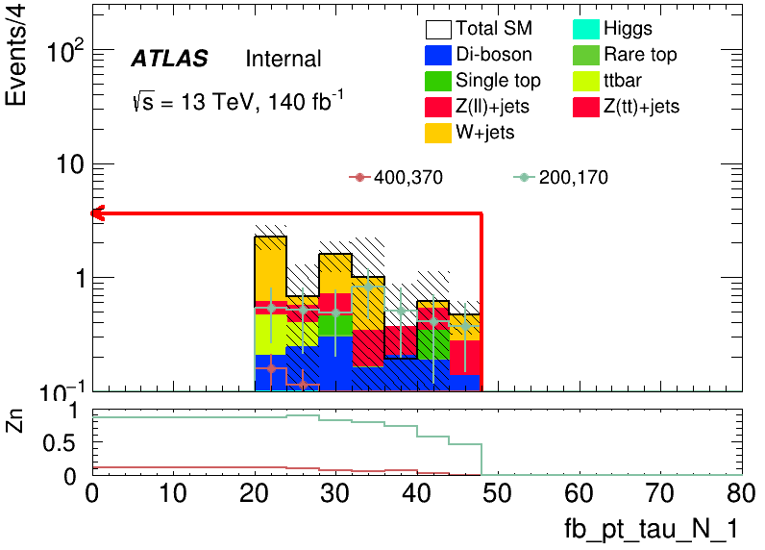
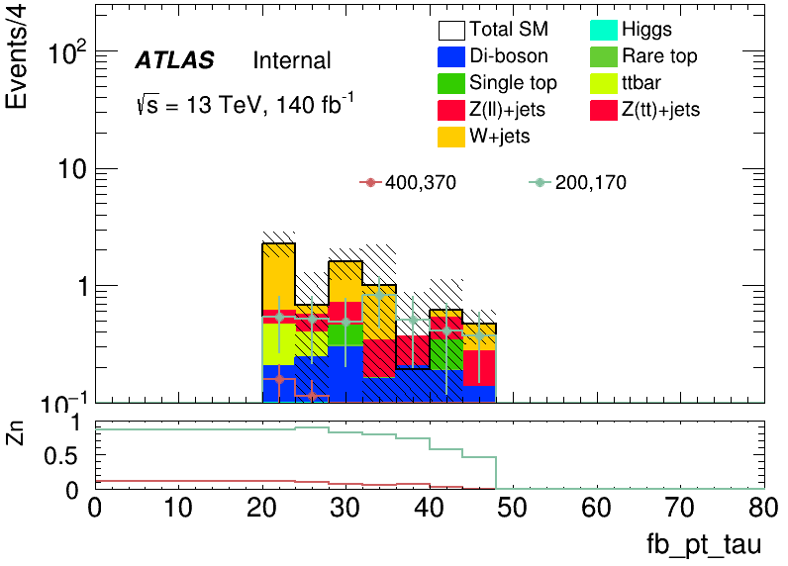
CutCount: HH
Pt_lep <= 32
Pt_tau <= 48
3
Chengxin Liao
IHEP SUSY Meeting

Slide 5
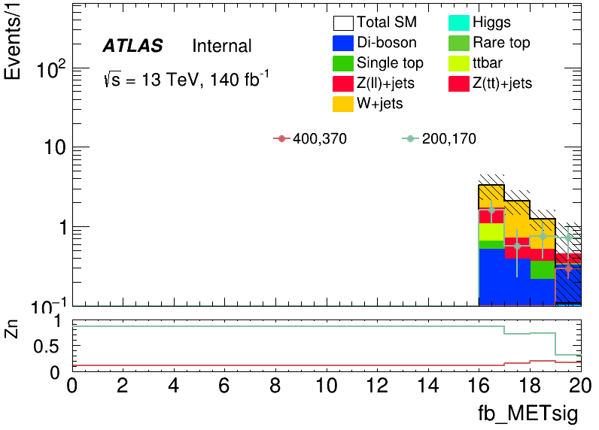
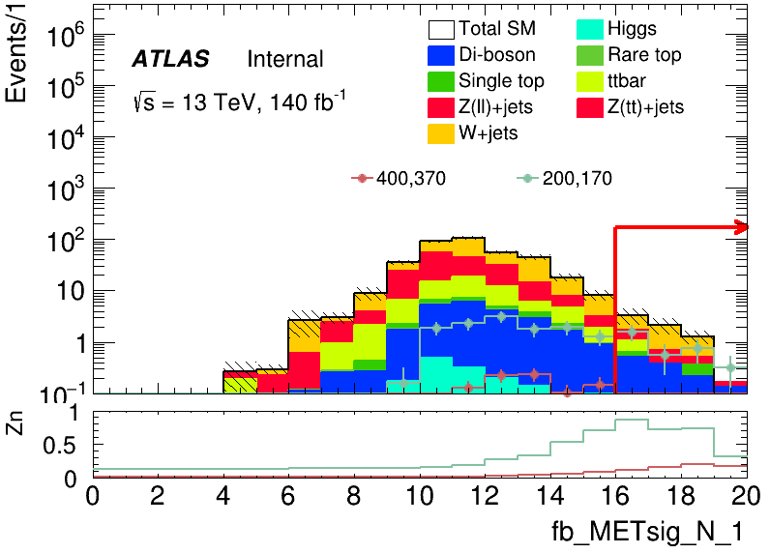
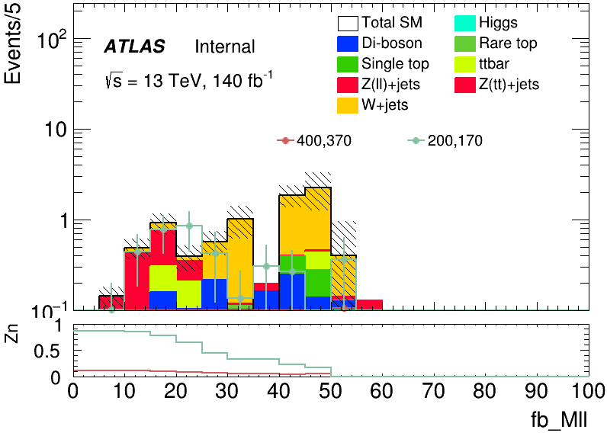
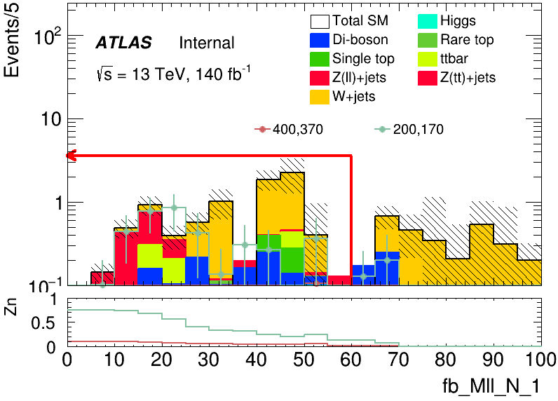
CutCount: HH
METsig >= 16
Pt_tau <= 60
4
Chengxin Liao
IHEP SUSY Meeting

Slide 6
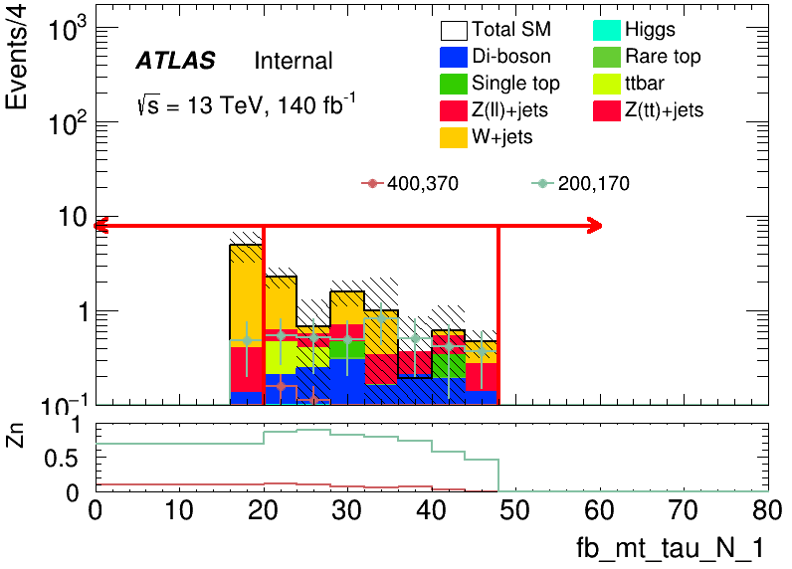

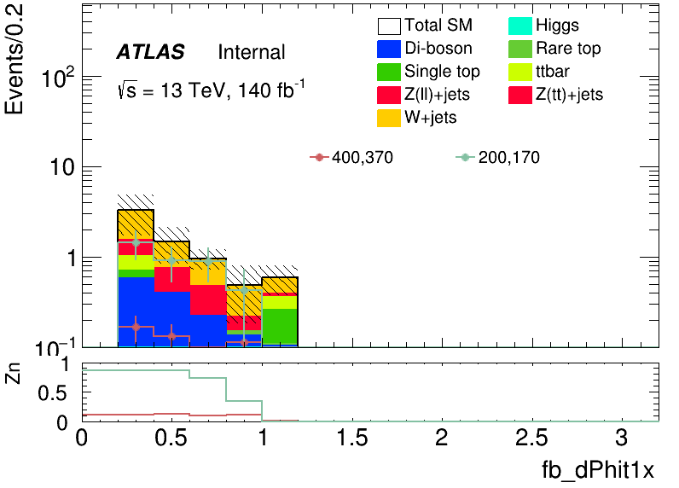
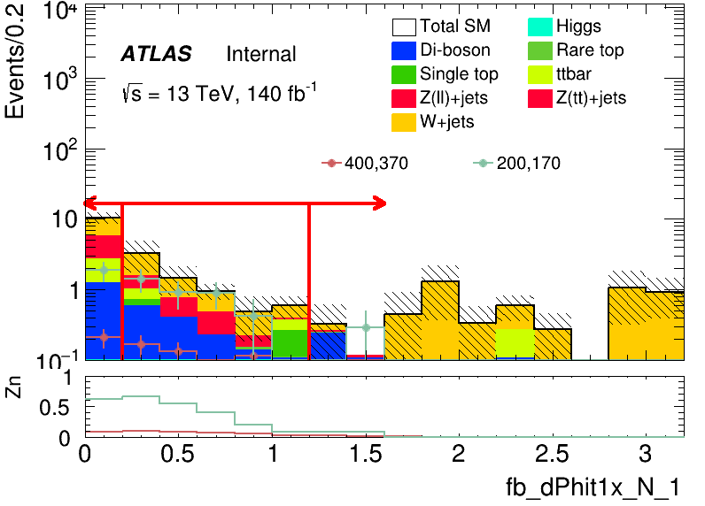
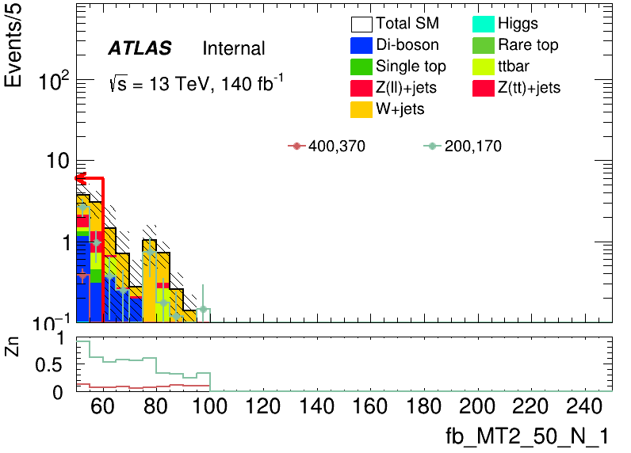
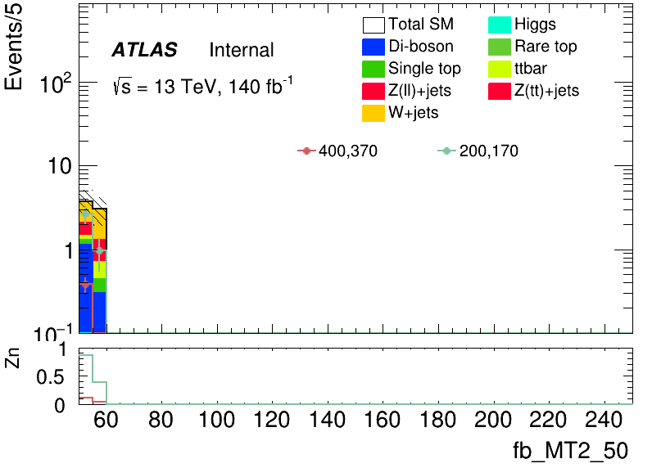
CutCount: HH
20 <= Mt_tau >= 50
MT2_50 <= 60
0.2 <= dPhit1x <= 1.2
t1x: Tau1 & MET
5
Chengxin Liao
IHEP SUSY Meeting

