Slide 1


Weekly meeting
Department of Physics, Shandong University
Chengxin LIAO
Wed, Sep 11, 2024

Slide 2
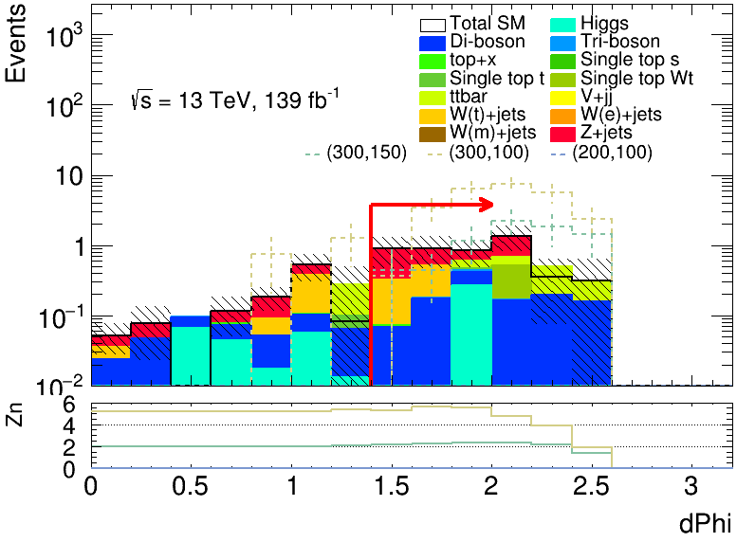
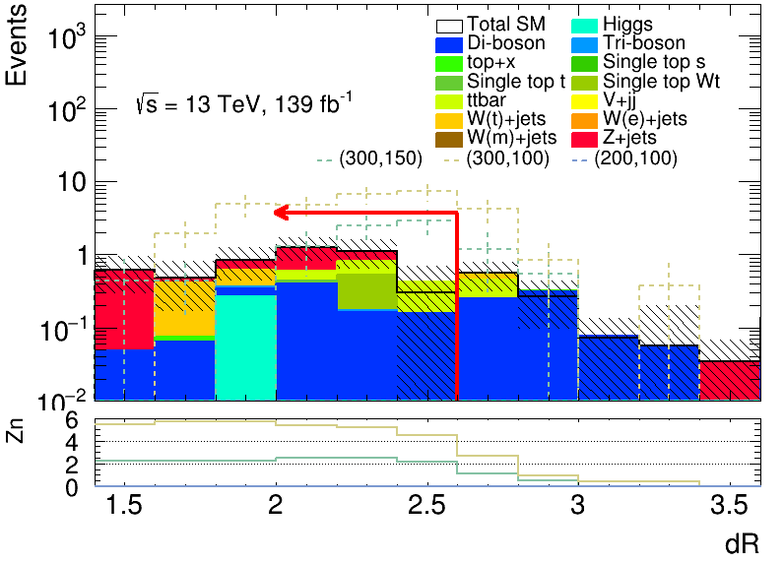
Adjust cut&count result
B-veto | MET | Minvtt | MT2 | 2 medium tau | OS | dPhitt | dRtt | baseline | trigpass
✔️ | [60,150] | > 125 | > 80 | ✔️ | ✔️ | > 1.4 | [0, 2.6] | ✔️ | ✔️
2.6
1.4
1

Slide 3
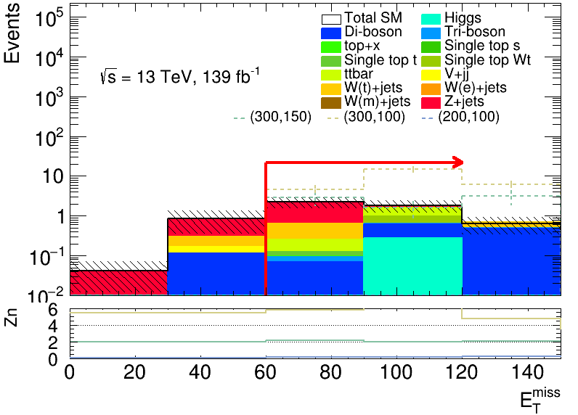
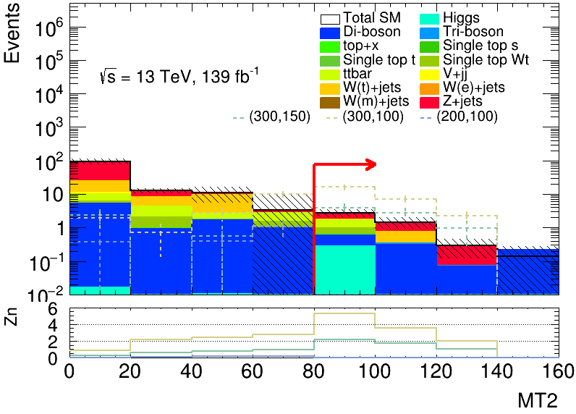
Adjust cut&count result
B-veto | MET | Minvtt | MT2 | 2 medium tau | OS | dPhitt | dRtt | baseline | trigpass
✔️ | [60,150] | >125 | >80 | ✔️ | ✔️ | >1.4 | [0,2.6] | ✔️ | ✔️
2

Slide 4
Event yields in SR
B-veto | MET | Minvtt | MT2 | 2 medium tau | OS | dPhitt | dRtt | baseline | trigpass
✔️ | [60,150] | >125 | >80 | ✔️ | ✔️ | >1.4 | [0,2.6] | ✔️ | ✔️
Process | SR-C1C1-LM
W+jets | 0.43+-0.49591087079902685
Z+jets | 1.92+-0.6085703690563284
MultiBoson | 0.94+-0.2367237000515398
TopQuark | 1.10+-0.47653763607698096
Higgs | 0.28+-0.26748083058129857
SM total | 4.67+-1.04142580775137
3

