Slide 1


Compressed EWK study(ISRC1N2)
Department of Physics, Shandong University
Chengxin Liao
liaocx@ihep.ac.cn
Wed, Jan 22, 2024

Slide 2
Outline
1. Hyperparameters optimization
2. Performance of Model
Chengxin Liao
IHEP SUSY Meeting

Slide 3
Task-list
Machine learning for HH channel
check more Variable and select significance var for ML(DONE)
BDTG hyperparameters optimization/ Setup a Grid Search framework (DONE)
Preliminary study on multibody quantum mechanics (In Progress) QFT Lecture (Peskin part I)
BSc thesis: https://www.overleaf.com/project/674e7119837a2580151a0868
CS61A (python): https://cs61a.vercel.app/index.html
1
Chengxin Liao
IHEP SUSY Meeting

Slide 4
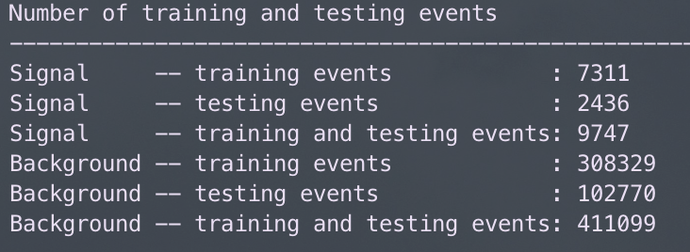
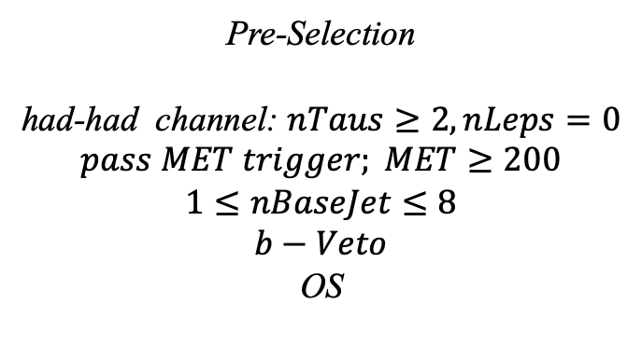
Hyperparameters optimization
Input(HH-Channel):
Sample:
Sig: ISRC1N2(mass_C1 = 100GeV, mass_N2 = 70GeV)->12180 entries
Bkg: 513850 entries
All input data(C1N2_100_70 and Bkg) already passed pre-selection
Pre-Selection
had-had channel: $nTaus≥2, nLeps=0$
$$pass MET trigger; MET≥200$$
$$1≤nBaseJet≤8$$
$$b−Veto$$
OS
Strategy:
method: BDTG Separate sig(bkg) into five folders, one for test, the other three for train, and last one for validation set,then traverse all possibilities.
2
Chengxin Liao
IHEP SUSY Meeting

Slide 5
Hyperparameters optimization
Variables:
Obj kinematics pt_lep pt_tau mt_tau e_lep(energy of tau2)
Angular correlations dPhit1x dRt1x dRtt dPhitt
Event kinematics
Mll(Invariant Mass of tau1 and tau2) METsig MT2_50 Mwh(Invariant Mass of tau1 and MET) Mwl(Invariant Mass of tau2 and MET) MCT(Transverse Mass Squared) Proj_j(Projection of pt jet on zeta) Proj_tt(Projection of tau1+tau2 on zeta)
mt_quad_sum mt_sum frac_MET_tau1 frac_MET_tau2
frac_MET_sqrtHT_40
frac_jet_tau1
frac_jet_tau2 frac_jet_tt
Note:
zeta is bisector direction of tau1 and tau2[PhyUtils::bisector(tau1, tau2)]
3
Chengxin Liao
IHEP SUSY Meeting

Slide 6
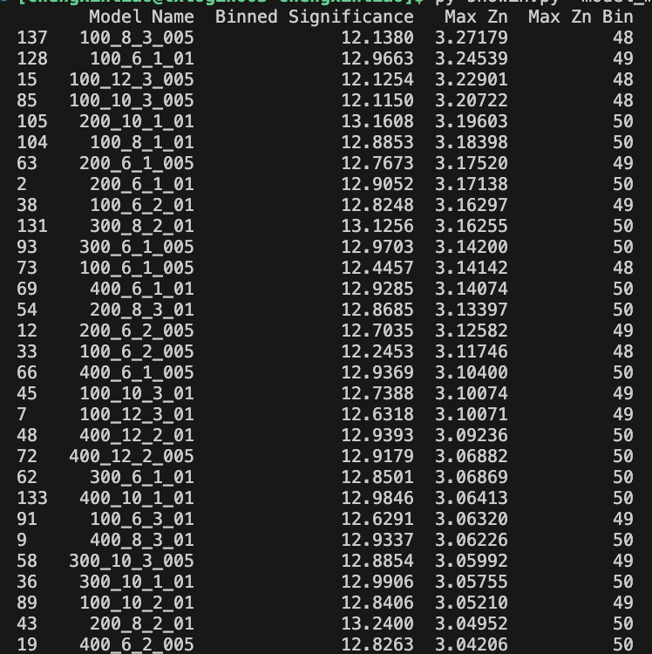
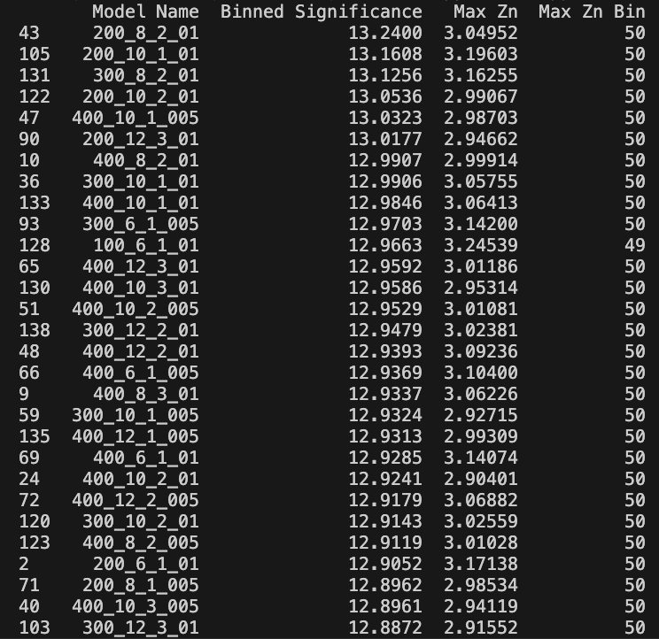
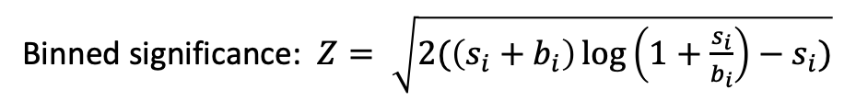
Hyperparameters optimization
Grid Search:
Binned significance: $Z= \sqrt{2(\left(s_{i}+b_{i}\right)\log\left(1+\frac{s_{i}}{b_{i}}\right)−s_{i})}$
Ntrees: 200, 300, 400
Max Depth: 6, 8, 10, 12 MinNodeSize: 1%, 2%, 3% Learning Rate: 0.01, 0.05, 0.1
Show top Zn
Show top binned significance
300_8_2_01 300_6_1_005
4
Chengxin Liao
IHEP SUSY Meeting

Slide 7
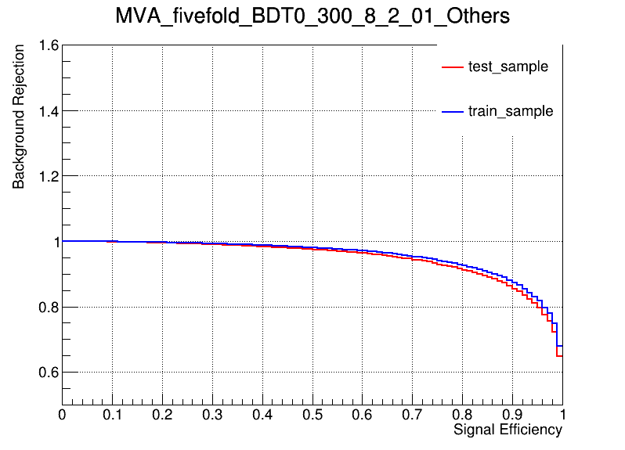
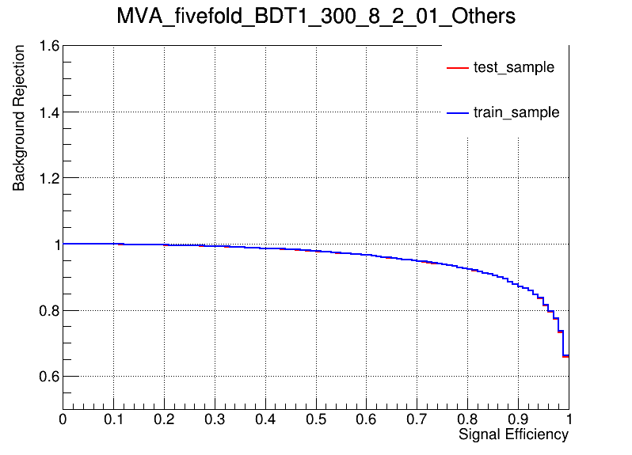
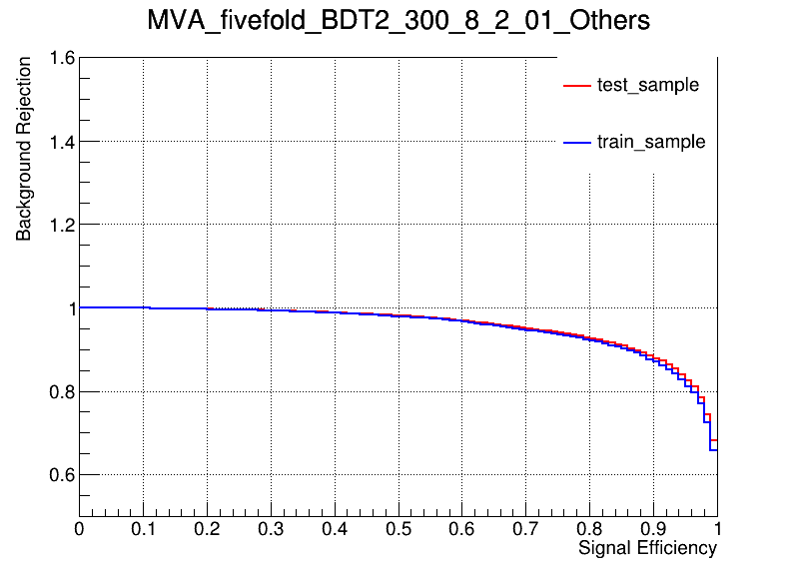
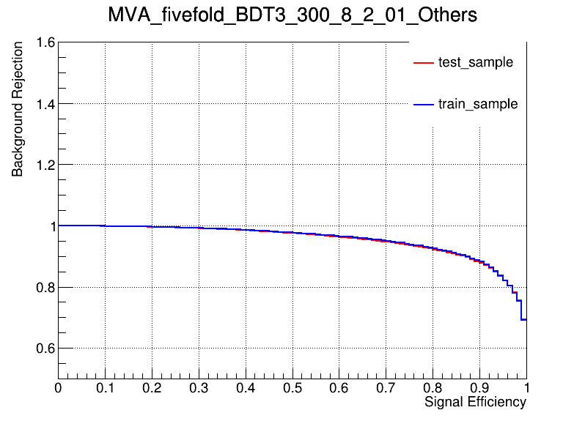
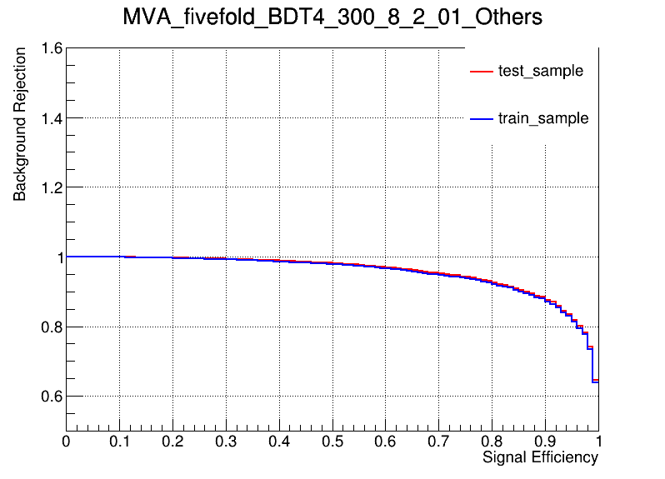
Performance of Model
Model
hyper parameter: NTrees=300, learning rate=0.1, max depth=8, MinNodeSize=2%(default)
ROC Curve
AUC: 0.949 sig eff from test(train) @B = 0.01 0.308(0.363) @B = 0.10 0.834(0.866) @B = 0.30 0.988(0.992)
AUC: 0.954 sig eff from test(train) @B = 0.01 0.345(0.350) @B = 0.10 0.863(0.863) @B = 0.30 0.989(0.990)
AUC: 0.957 sig eff from test(train) @B = 0.01 0.366(0.350) @B = 0.10 0.871(0.858) @B = 0.30 0.992(0.989)
AUC: 0.954 sig eff from test(train) @B = 0.01 0.321(0.343) @B = 0.10 0.866(0.873) @B = 0.30 0.994(0.994)
AUC: 0.956 sig eff from test(train) @B = 0.01 0.382(0.341) @B = 0.10 0.864(0.855) @B = 0.30 0.989(0.989)
Conlusion: seems no overtraining in 300_8_2_01
5
Chengxin Liao
IHEP SUSY Meeting

Slide 8

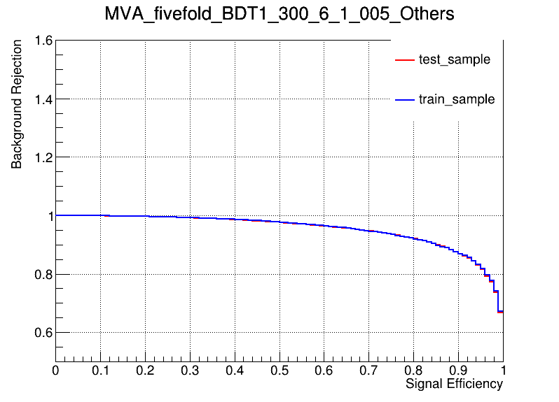
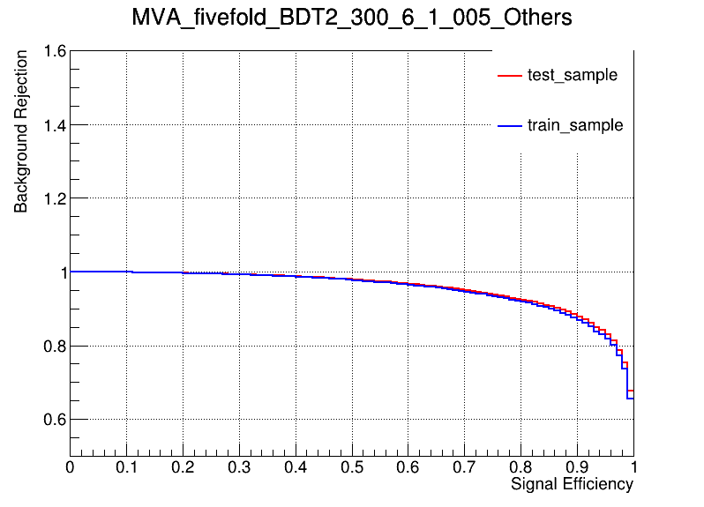
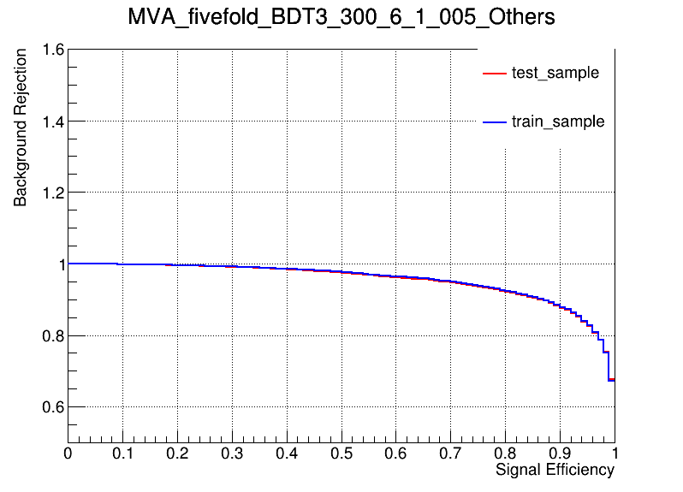
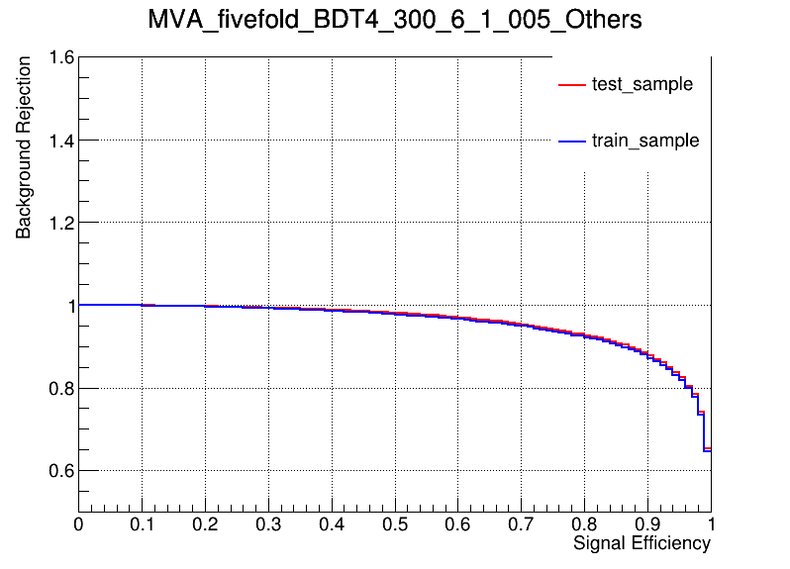
Performance of Model
Model
hyper parameter: NTrees=300, learning rate=0.05, max depth=6, MinNodeSize=1%(default)
ROC Curve
AUC: 0.949 sig eff from test(train) @B = 0.01 0.305(0.349) @B = 0.10 0.834(0.861) @B = 0.30 0.988(0.992)
AUC: 0.953 sig eff from test(train) @B = 0.01 0.341(0.343) @B = 0.10 0.852(0.851) @B = 0.30 0.990(0.991)
AUC: 0.956 sig eff from test(train) @B = 0.01 0.358(0.349) @B = 0.10 0.867(0.855) @B = 0.30 0.992(0.990)
AUC: 0.954 sig eff from test(train) @B = 0.01 0.321(0.339) @B = 0.10 0.865(0.871) @B = 0.30 0.992(0.992)
AUC: 0.957 sig eff from test(train) @B = 0.01 0.376(0.337) @B = 0.10 0.870(0.860) @B = 0.30 0.990(0.989)
Conlusion: seems no overtraining in 300_6_1_005
6
Chengxin Liao
IHEP SUSY Meeting

Slide 9
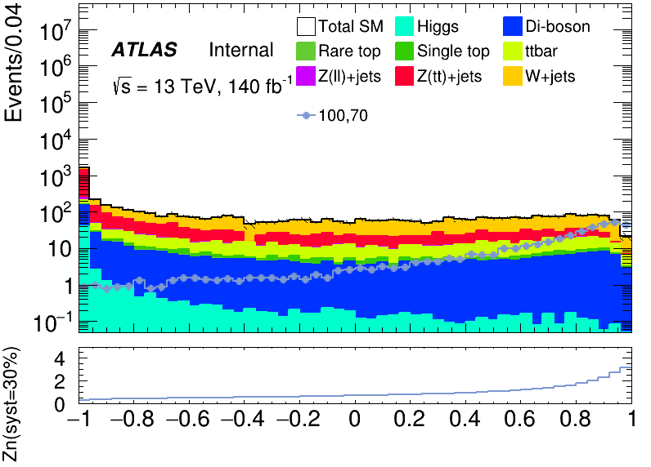
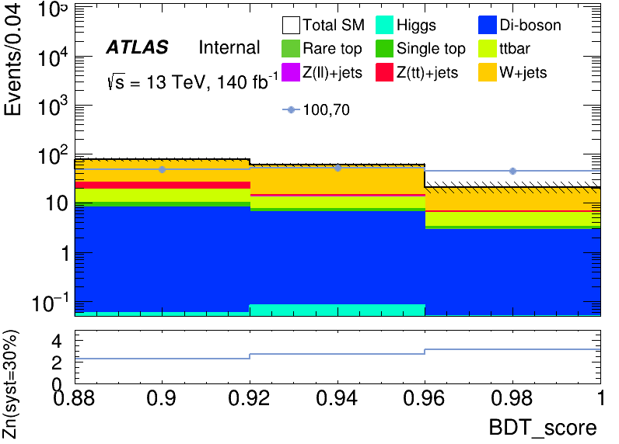
Performance of Model
BDT distribution
300_8_2_01
Apply BDT score cut > 0.88
C1N2ISR (100,70) | bkg | Higgs | OtherTop | SingleTop | TopPair | VV | Wjets | Zlljets | Zttjets
145.4848+-2.3131 | 157.261+- 14.7159 | 0.1491+- 0.0407 | 0.1557+- 0.0524 | 3.088+- 0.6327 | 17.2339+-1.6324 | 17.4035+- 0.6829 | 109.5969+- 11.3263 | 0.4297+-0.1394 | 9.2042+- 1.7708
7
Chengxin Liao
IHEP SUSY Meeting

Slide 10
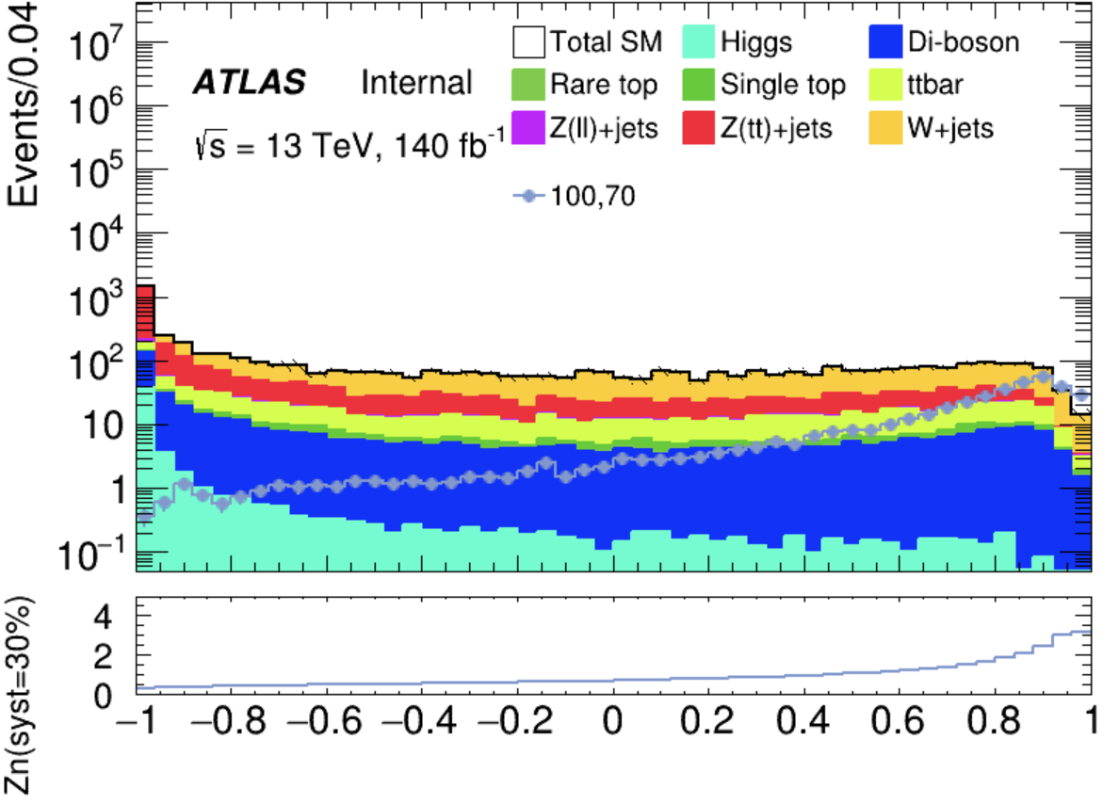
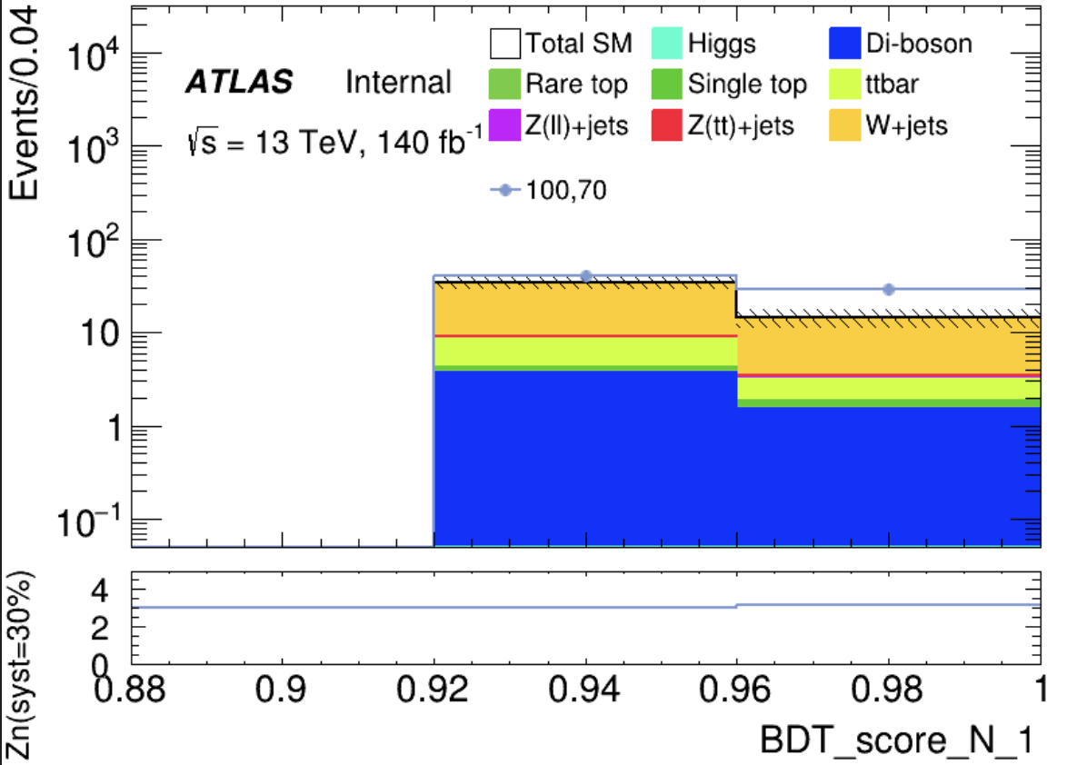
Performance of Model
BDT distribution
Apply BDT score cut > 0.90
300_6_1_005
C1N2ISR (100,70) | bkg | Higgs | OtherTop | SingleTop | TopPair | VV | Wjets | Zlljets | Zttjets
69.3519 +- 1.6014 | 48.4064+- 5.9886 | 0.0353 +- 0.0168 | 0.0656 +- 0.0274 | 0.7116 +- 0.3145 | 5.4903 +- 0.9186 | 5.2399 +- 0.2973 | 35.7085 +- 5.8902 | 0.2026 +- 0.1229 | 0.9527 +- 0.1545
8
Chengxin Liao
IHEP SUSY Meeting

Slide 11
TODO
1. Optimize ML model and try other method
2. Completing the theoretical section of the my thesis
9
Chengxin Liao
IHEP SUSY Meeting

