Slide 1


Compressed EWK study(ISRC1N2)
Department of Physics, Shandong University
Chengxin Liao
liaocx@ihep.ac.cn
Wed, Fri 19, 2024

Slide 2
Outline
1. Hyperparameters optimization
2. Performance of Model
Chengxin Liao
IHEP SUSY Meeting

Slide 3
Task-list
Machine learning for LH channel
check more Variable and select significance var for ML(DONE)
BDTG hyperparameters optimization/ Setup a Grid Search framework (DONE)
Preliminary study on multibody quantum mechanics (In Progress) QFT Lecture (Peskin part I)
BSc thesis: https://www.overleaf.com/project/674e7119837a2580151a0868
CS61A (python): https://cs61a.vercel.app/index.html
1
Chengxin Liao
IHEP SUSY Meeting

Slide 4
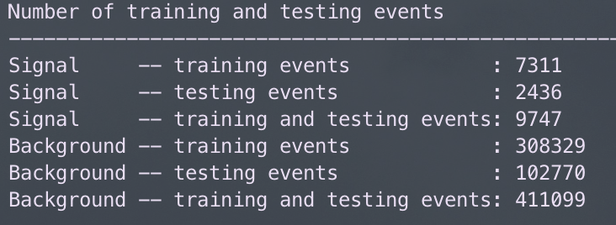
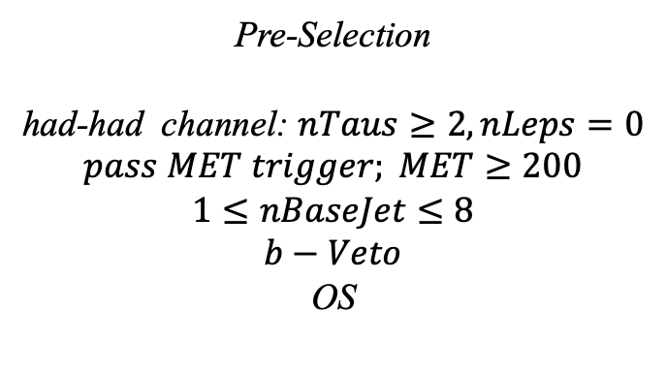
Hyperparameters optimization(HH)
Input(HH-Channel):
Sample:
Sig: ISRC1N2(mass_C1 = 100GeV, mass_N2 = 70GeV)->12180 entries
Bkg: 513850 entries
All input data(C1N2_100_70 and Bkg) already passed pre-selection
Pre-Selection
had-had channel: $nTaus≥2, nLeps=0$
$$pass MET trigger; MET≥200$$
$$1≤nBaseJet≤8$$
$$b−Veto$$
OS
Strategy:
method: BDTG Separate sig(bkg) into five folders, one for test, the other three for train, and last one for validation set,then traverse all possibilities.
2
Chengxin Liao
IHEP SUSY Meeting

Slide 5
Hyperparameters optimization(HH)
Variables:
Obj kinematics Pt_tt
Angular correlations dPhit1x dEtatt dPhiMax_xt
dPhiztt
dPhitt
dPhizxe
dPhiMin_xt
dPhit2x
dPhiMin_tj1
dRt2x
dRMax_xt
dRMin_tj
dRtt
sum_cos_dphi
Event kinematics
Mll(Invariant Mass of tau1 and tau2) MIA MT2_150 MET_Tau Proj_tt MstauA MCT frac_MET_tt frac_MET_tau1
frac_MET_MeffInc_40
frac_MET_Meff
These vars are selected based on the importance
3
Chengxin Liao
IHEP SUSY Meeting

Slide 6
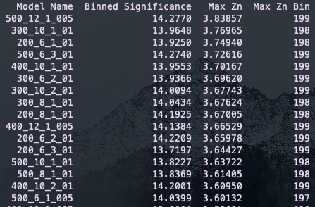
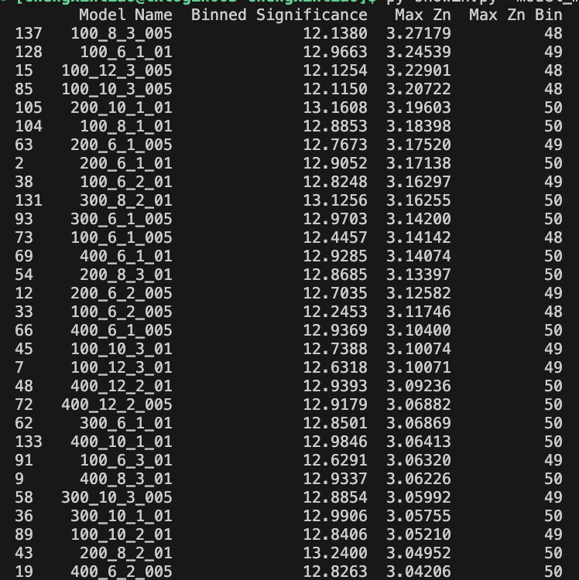
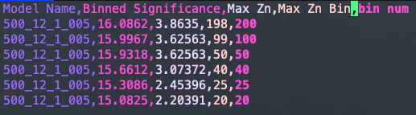
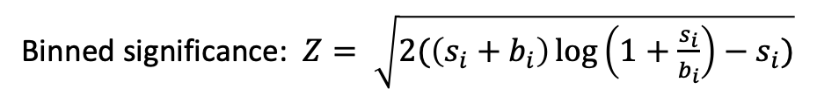
Hyperparameters optimization(HH)
Grid Search:
Binned significance: $Z= \sqrt{2(\left(s_{i}+b_{i}\right)\log\left(1+\frac{s_{i}}{b_{i}}\right)−s_{i})}$
Ntrees: 200, 300, 400, 500
Max Depth: 6, 8, 10, 12 MinNodeSize: 1%, 2%, 3% Learning Rate: 0.01, 0.05, 0.1
Show top Zn
Compared with form result, there has a significant improvement in Zn
Rebin result
4
Chengxin Liao
IHEP SUSY Meeting

Slide 7
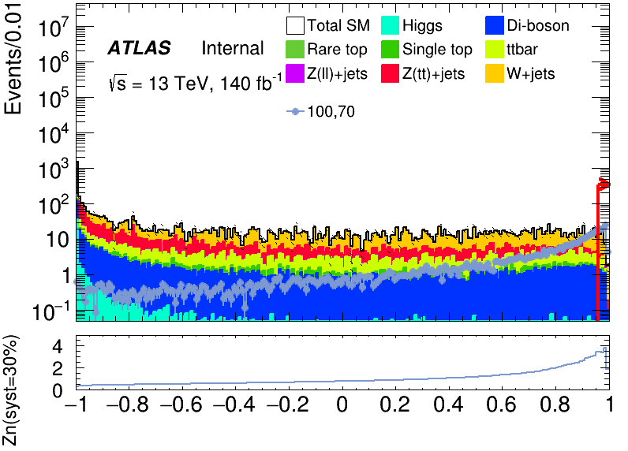
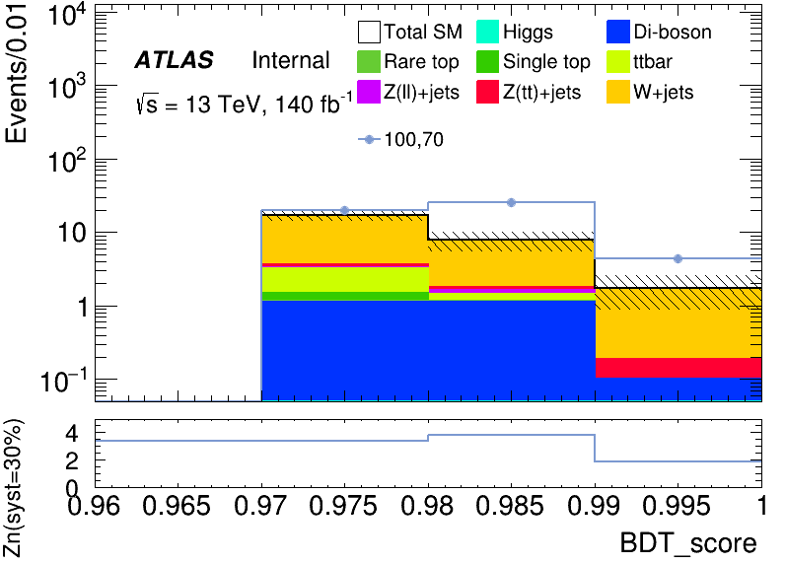
Performance of Model(HH)
Apply cut at BDT = 0.97
hyper parameter: NTrees=500, learning rate=0.05, max depth=12, MinNodeSize=1%(default)
bin | max Zn | C1N2ISR (100,70) | bkg | Higgs | OtherTop | SingleTop | TopPair | VV | Wjets | Zlljets | Zttjets
198(0.97) | 3.4089 | 19.929+-0.858 | 17.186+- 3.007(17.4%) | 0.007+-0.007 | 0.025+-0.014 | 0.345+-0.184 | 1.748+-0.528 | 1.125+-0.132 | 13.445+-2.950 | 0.180+-0.055 | 0.311+-0.085
199(0.98) | 3.83857 | 25.232+-1.287 | 7.805+- 3.807(54.3%) | 0.000+- 0.000 | 0.009+-0.017 | 0.003+-0.184 | 0.302+-0.570 | 1.138+-0.187 | 6.034+-3.753 | 0.116+- 0.084 | 0.203+-0.114
200(0.99) | 1.86049 | 4.390+-1.350 |  | 0.000+- 0.000 | 0.000+-0.017 | 0.000+-0.184 | 0.000+-0.570 | 0.100+-0.189 | 1.562+-3.850 | 0.132+- 0.139 | 0.086+-0.129
4
Chengxin Liao
IHEP SUSY Meeting

Slide 8
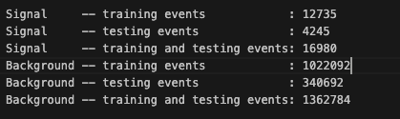
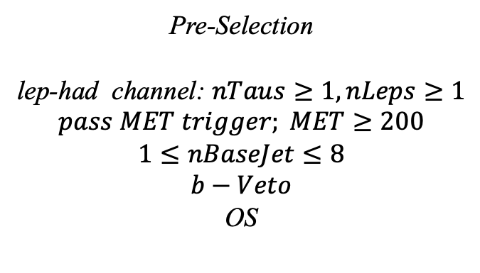
Hyperparameters optimization(LH)
Input(LH-Channel):
Sample:
Sig: ISRC1N2(mass_C1 = 100GeV, mass_N2 = 70GeV)->21225 entries
Bkg: 1703476 entries
All input data(C1N2_100_70 and Bkg) already passed pre-selection
Pre-Selection
lep-had channel: $nTaus≥1, nLeps≥1$
$$pass MET trigger; MET≥200$$
$$1≤nBaseJet≤8$$
$$b−Veto$$
OS
Strategy:
method: BDTG Separate sig(bkg) into five folders, one for test, the other three for train, and last one for validation set,then traverse all possibilities.
5
Chengxin Liao
IHEP SUSY Meeting

Slide 9
Hyperparameters optimization(LH)
Variables:
Obj kinematics nBase_Jet mt_lep e_lep(energy of tau2)
Angular correlations dPhitt dRtt dRt1x
dPhiMin_xj
dPhiMax_tj
Event kinematics
Mll(Invariant Mass of tau1 and tau2) METsig MT2_50 Mwh(Invariant Mass of tau1 and MET) Mwl(Invariant Mass of tau2 and MET) MCT(Transverse Mass Squared) Proj_j(Projection of pt jet on zeta) Proj_tt(Projection of tau1+tau2 on zeta) mtx_tau
Mtx_lep
ht_tau mt_quad_sum mt_sum frac_MET_tau1 frac_MET_tau2 frac_MET_tt
frac_MET_sqrtHT_40
frac_jet_tau1
frac_jet_tau2 frac_jet_tt
MT_taumin pt_Vframe
High importance at shiyi’s feature
Note:
zeta is bisector direction of tau1 and tau2[PhyUtils::bisector(tau1, tau2)]
6
Chengxin Liao
IHEP SUSY Meeting

Slide 10
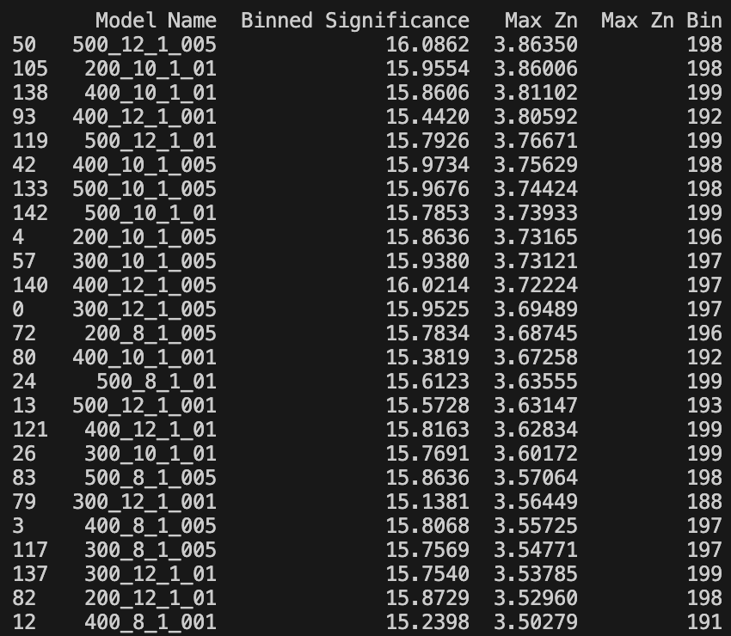
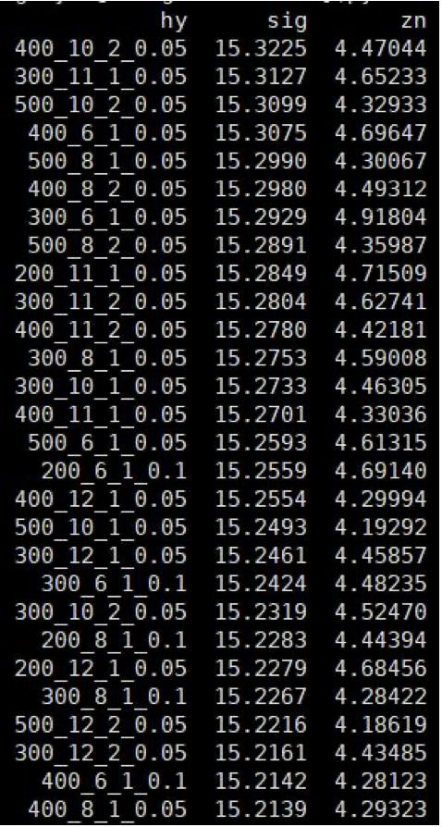
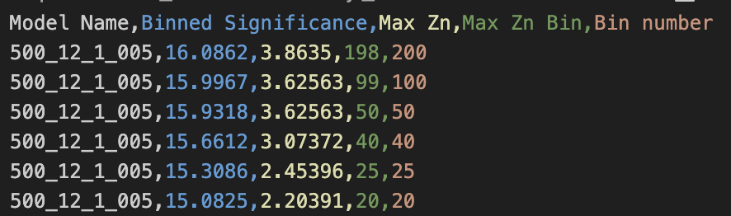
Hyperparameters optimization(LH)
Grid Search:
Binned significance: $Z= \sqrt{2(\left(s_{i}+b_{i}\right)\log\left(1+\frac{s_{i}}{b_{i}}\right)−s_{i})}$
Ntrees: 200, 300, 400, 500
Max Depth: 6, 8, 10, 12 MinNodeSize: 1%, 2%, 3% Learning Rate: 0.01, 0.05, 0.1
Show top Zn
Shiyi’s result of LH channel
Rebin result
7
Chengxin Liao
IHEP SUSY Meeting

Slide 11
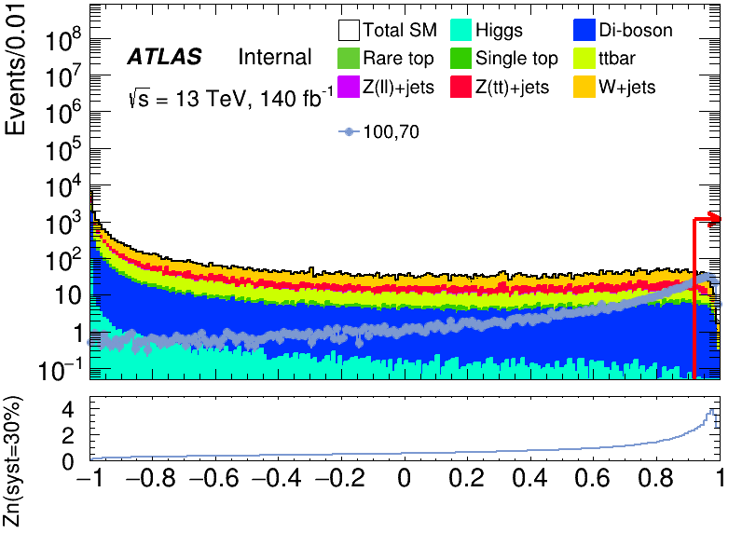
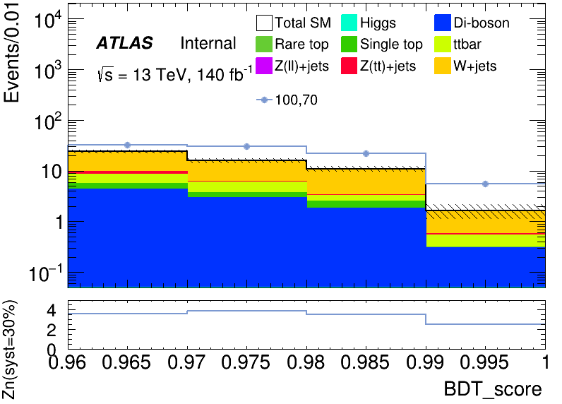
Performance of Model(LH)
Apply cut at BDT = 0.97
hyper parameter: NTrees=500, learning rate=0.05, max depth=12, MinNodeSize=1%(default)
bin | max Zn | C1N2ISR (100,70) | bkg | Higgs | OtherTop | SingleTop | TopPair | VV | Wjets | Zlljets | Zttjets
197 0.96-0.97 | 3.62563 | 32.151+-1.083 | 24.064+- 2.244(9.32%) | 0.038+-0.020 | 0.046+-0.023 | 1.325+-0.388 | 2.877+-0.663 | 4.210+-0.340 | 14.541+-2.075 | -0.012+-0.044 | 1.049+-0.154
198 0.97-0.98 | 3.8635 | 30.244+-1.512 | 15.848+- 2.885(18.2%) | 0.006+-0.021 | 0.006+-0.023 | 0.801+-0.497 | 2.214+-0.875 | 2.911+-0.423 | 9.635+-2.663 | 0.051+-0.052 | 0.224+-0.196
199 0.98-0.99 | 3.53666 | 21.783+-1.754 | 11.019+- 3.228(29.3%) | 0.000+-0.021 | -0.007+-0.026 | 0.731+-0.573 | 0.660+-0.937 | 1.811+-0.488 | 7.668+-2.988 | 0.012+-0.052 | 0.144+-0.222
8
Chengxin Liao
IHEP SUSY Meeting

Slide 12
TODO
1. add Mttau_min and pt_Vframe into ML
2. find a better way to select vars
9
Chengxin Liao
IHEP SUSY Meeting

