Slide 1


Compressed EWK study(ISRC1N2)
Department of Physics, Shandong University
Chengxin Liao
liaocx@ihep.ac.cn
Feb, Mon 24, 2024

Slide 2
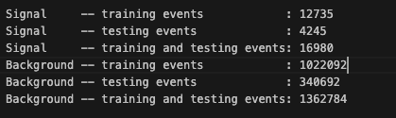
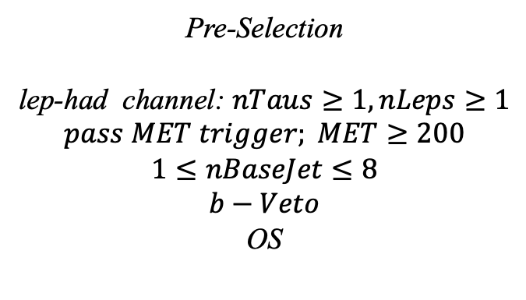
Hyperparameters optimization(LH)
Input(LH-Channel):
Sample:
Sig: ISRC1N2(mass_C1 = 100GeV, mass_N2 = 70GeV)->21225 entries
Bkg: 1703476 entries
All input data(C1N2_100_70 and Bkg) already passed pre-selection
Pre-Selection
lep-had channel: $nTaus≥1, nLeps≥1$
$$pass MET trigger; MET≥200$$
$$1≤nBaseJet≤8$$
$$b−Veto$$
OS
Strategy:
method: BDTG Separate sig(bkg) into five folders, one for test, the other three for train, and last one for validation set,then traverse all possibilities.
1
Chengxin Liao
IHEP SUSY Meeting

Slide 3
Hyperparameters optimization(LH)
Variables(30):
Obj kinematics nBase_Jet mt_lep e_lep(energy of tau2)
Angular correlations dPhitt dRtt dRt1x
dPhiMin_xj
dPhiMax_tj
Event kinematics
Mll(Invariant Mass of tau1 and tau2) METsig MT2_50 Mwh(Invariant Mass of tau1 and MET) Mwl(Invariant Mass of tau2 and MET) MCT(Transverse Mass Squared) Proj_j(Projection of pt jet on zeta) Proj_tt(Projection of tau1+tau2 on zeta) mtx_tau
Mtx_lep
ht_tau mt_quad_sum mt_sum frac_MET_tau1 frac_MET_tau2 frac_MET_tt
frac_MET_sqrtHT_40
frac_jet_tau1
frac_jet_tau2 frac_jet_tt
MT_taumin pt_Vframe
High importance at shiyi’s feature
Note:
zeta is bisector direction of tau1 and tau2[PhyUtils::bisector(tau1, tau2)]
2
Chengxin Liao
IHEP SUSY Meeting

Slide 4
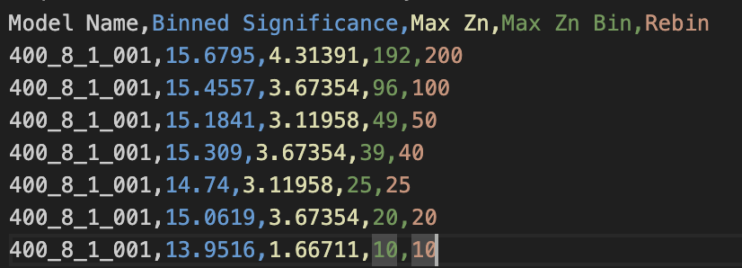
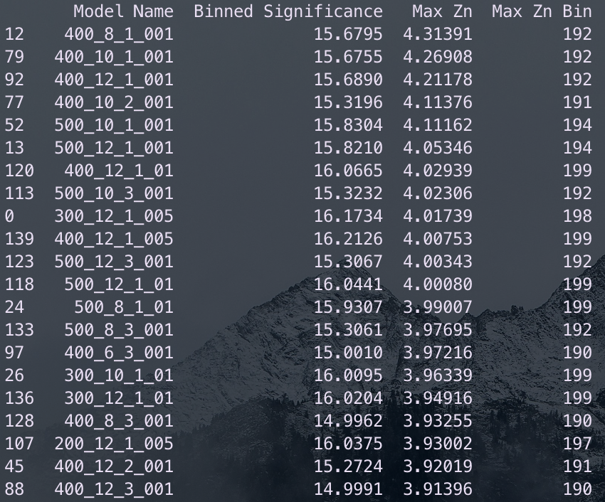
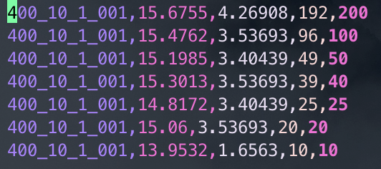
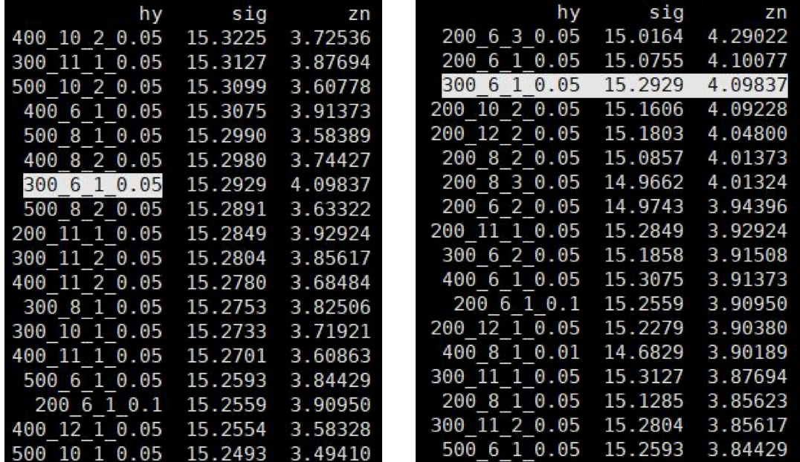
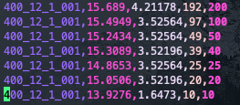
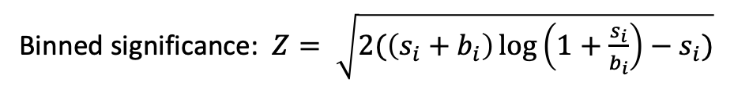
Hyperparameters optimization(LH)
Grid Search:
Binned significance: $Z= \sqrt{2(\left(s_{i}+b_{i}\right)\log\left(1+\frac{s_{i}}{b_{i}}\right)−s_{i})}$
Ntrees: 200, 300, 400, 500
Max Depth: 6, 8, 10, 12 MinNodeSize: 1%, 2%, 3% Learning Rate: 0.01, 0.05, 0.1
Show top Zn
Shiyi’s result of LH channel
Top Sig
Top Zn
3
Chengxin Liao
IHEP SUSY Meeting

Slide 5
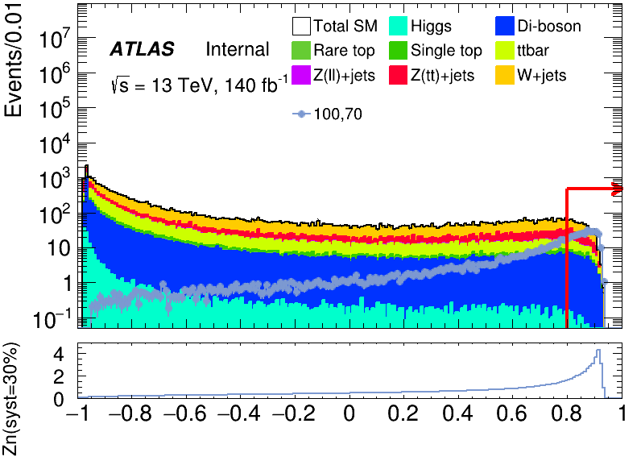
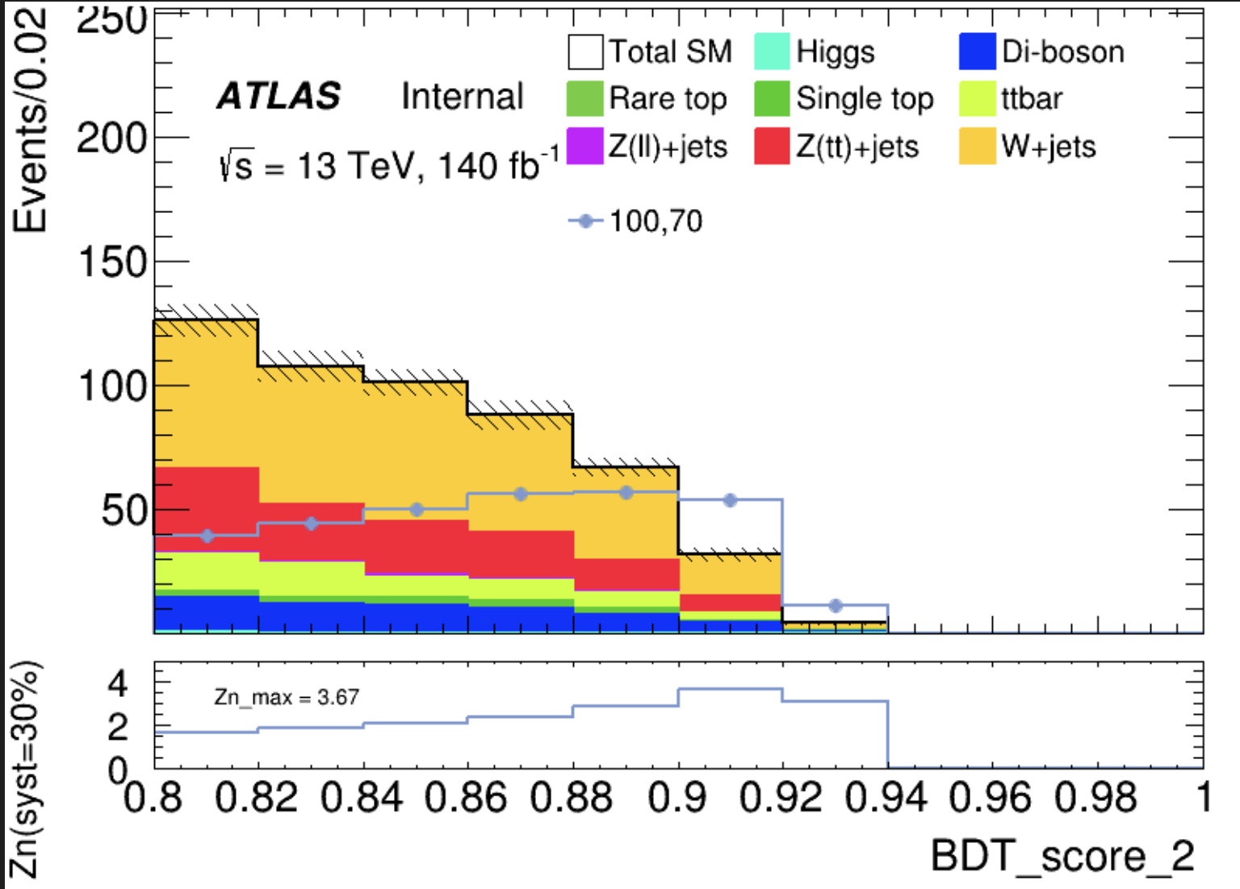
Performance of Model(LH)
hyper parameter: NTrees=400, learning rate=0.01, max depth=8, MinNodeSize=1%(default)
Cut at BDT_score = 0.8, rebin to 100 bins
Notice there is a gap at the edge
3 bins
bin | max Zn | C1N2ISR (100,70) | bkg | Higgs | OtherTop | SingleTop | TopPair | VV | Wjets | Zlljets | Zttjets
94 (0.86-0.88) | 2.39932 | 55.995+-1.433 | 87.737+- 5.078(5.78%) | 0.127+-0.034 | 0.027+-0.018 | 2.737+-0.600 | 8.356+-1.136 | 10.027+-0.535 | 46.913+-5.404 | 0.629+-0.128 | 18.921+-1.943
95 (0.88-0.90) | 2.85787 | 56.966+-1.438 | 66.750+- 5.910(8.85%) | 0.069+-0.023 | 0.071+-0.029 | 2.058+-0.482 | 6.606+-1.013 | 7.540+-0.405 | 37.355+-3.540 | 0.619+-0.127 | 12.433+-1.240
96 (0.90-0.92) | 3.67354 | 53.908+-1.411 | 31.481+- 2.782(8.83%) | 0.021+-0.011 | 0.025+-0.016 | 0.621+-0.196 | 2.791+-0.663 | 4.435+-0.322 | 16.842+-2.246 | 0.150+-0.082 | 6.597+-1.453
4
Chengxin Liao
IHEP SUSY Meeting

Slide 6
Performance of Model(LH)
hyper parameter: NTrees=400, learning rate=0.01, max depth=10, MinNodeSize=1%(default)
Cut at BDT_score = 0.8, rebin to 100 bins
4
Chengxin Liao
IHEP SUSY Meeting

