Slide 1


Compressed EWK study(ISRC1N2)
Department of Physics, Shandong University
Chengxin Liao
liaocx@ihep.ac.cn
Feb, Wed 26, 2025

Slide 2
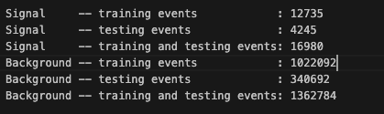
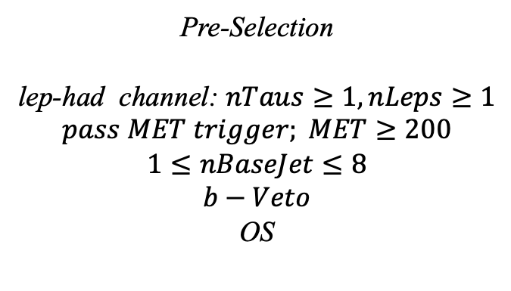
Hyperparameters optimization(LH)
Input(LH-Channel):
Sample:
Sig: ISRC1N2(mass_C1 = 100GeV, mass_N2 = 70GeV)->21225 entries
Bkg: 1703476 entries
All input data(C1N2_100_70 and Bkg) already passed pre-selection
Pre-Selection
lep-had channel: $nTaus≥1, nLeps≥1$
$$pass MET trigger; MET≥200$$
$$1≤nBaseJet≤8$$
$$b−Veto$$
OS
Strategy:
method: BDTG Separate sig(bkg) into five folders, one for test, the other three for train, and last one for validation set,then traverse all possibilities.
1
Chengxin Liao
IHEP SUSY Meeting

Slide 3
Hyperparameters optimization(LH)
Variables(30):
Obj kinematics nBase_Jet mt_lep e_lep(energy of tau2)
Angular correlations dPhitt dRtt dRt1x
dPhiMin_xj
dPhiMax_tj
Event kinematics
Mll(Invariant Mass of tau1 and tau2) METsig MT2_50 Mwh(Invariant Mass of tau1 and MET) Mwl(Invariant Mass of tau2 and MET) MCT(Transverse Mass Squared) Proj_j(Projection of pt jet on zeta) Proj_tt(Projection of tau1+tau2 on zeta) mtx_tau
Mtx_lep
ht_tau mt_quad_sum mt_sum frac_MET_tau1 frac_MET_tau2 frac_MET_tt
frac_MET_sqrtHT_40
frac_jet_tau1
frac_jet_tau2 frac_jet_tt
MT_taumin pt_Vframe
High importance at shiyi’s feature
Note:
zeta is bisector direction of tau1 and tau2[PhyUtils::bisector(tau1, tau2)]
2
Chengxin Liao
IHEP SUSY Meeting

Slide 4
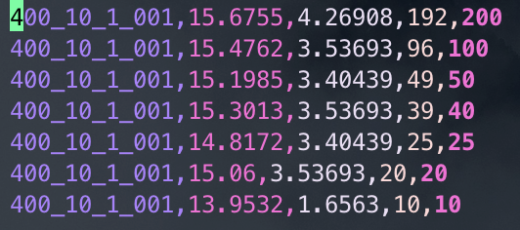
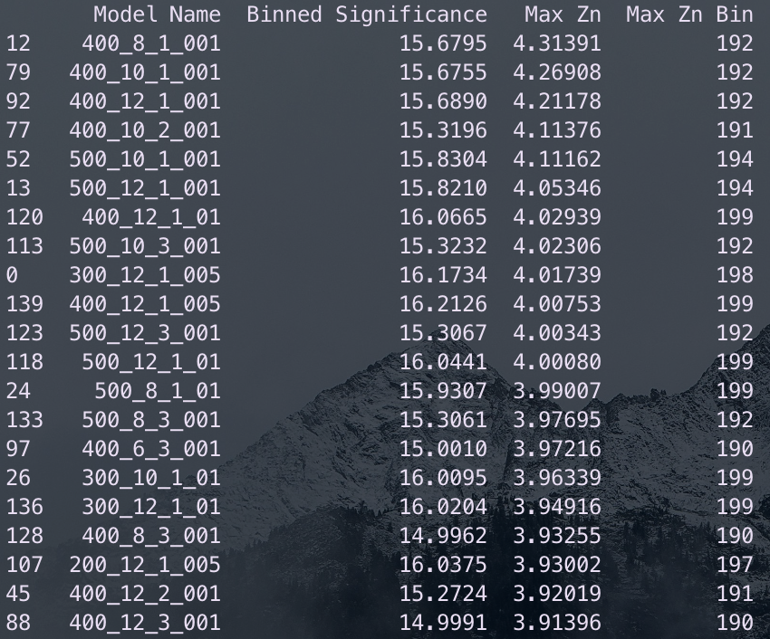
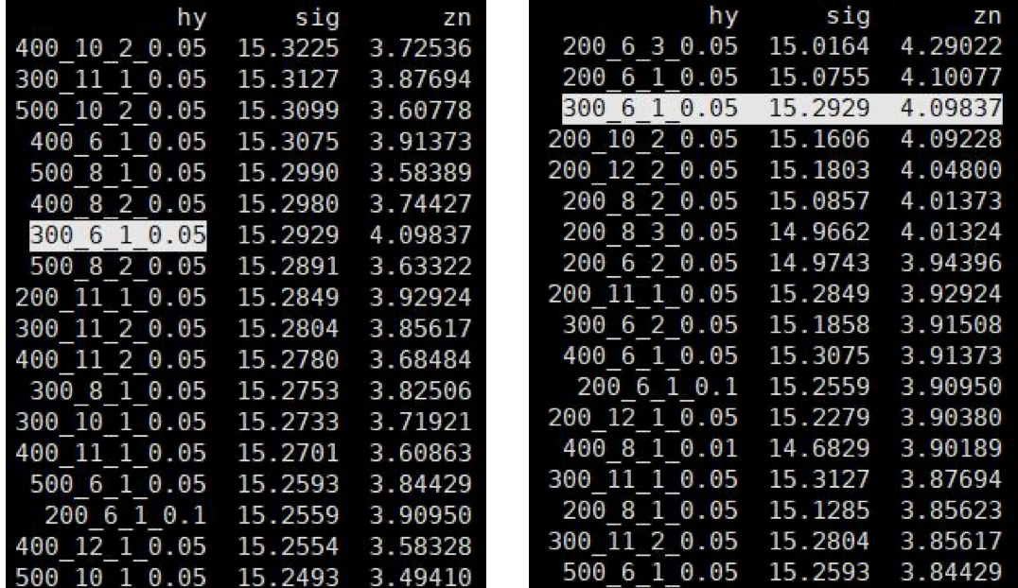
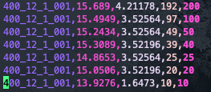
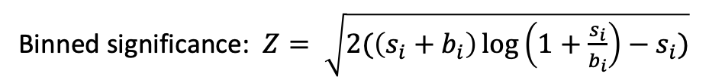
Hyperparameters optimization(LH)
Grid Search:
Binned significance: $Z= \sqrt{2(\left(s_{i}+b_{i}\right)\log\left(1+\frac{s_{i}}{b_{i}}\right)−s_{i})}$
Ntrees: 200, 300, 400, 500
Max Depth: 6, 8, 10, 12 MinNodeSize: 1%, 2%, 3% Learning Rate: 0.01, 0.05, 0.1
Show top Zn
Shiyi’s result of LH channel
Top Sig
Top Zn
3
Chengxin Liao
IHEP SUSY Meeting

Slide 5
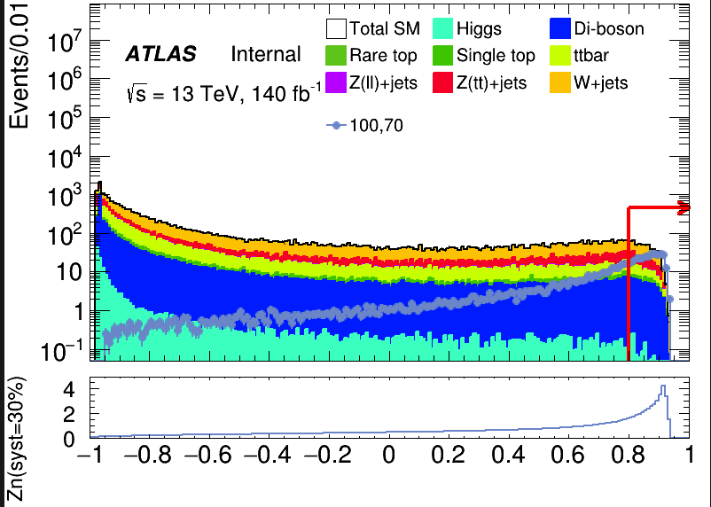
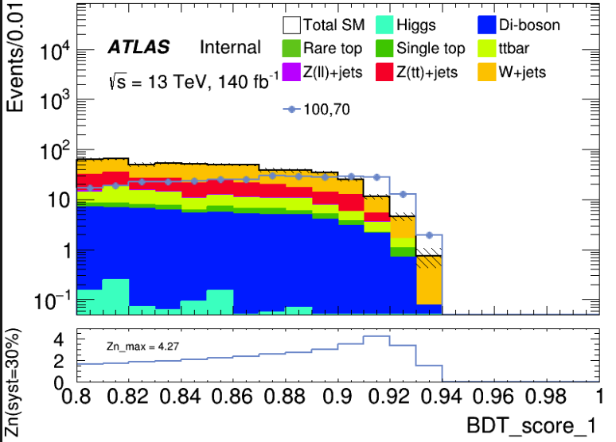

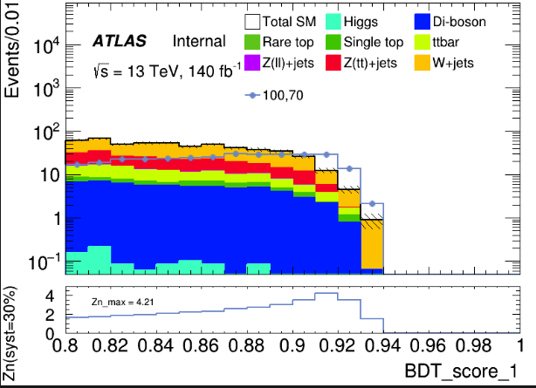
Performance of Model(LH)
hyper parameter: NTrees=400, learning rate=0.01, max depth=10, MinNodeSize=1%(default)
Cut at BDT_score = 0.8
hyper parameter: NTrees=400, learning rate=0.01, max depth=12, MinNodeSize=1%(default)
4
Chengxin Liao
IHEP SUSY Meeting

Slide 6
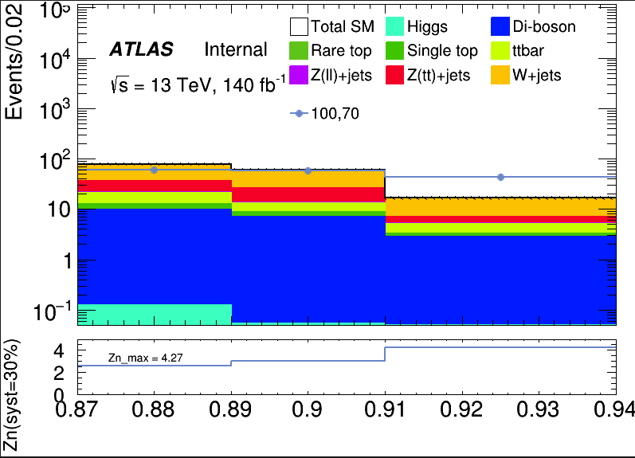
Performance of Model(LH)
hyper parameter: NTrees=400, learning rate=0.01, max depth=10, MinNodeSize=1%(default)
Apply BDT score cut at 0.87
Root of square sum of Zn of each bin: 5.8479
bin | max Zn | C1N2ISR (100,70) | bkg | Higgs | OtherTop | SingleTop | TopPair | VV | Wjets | Zlljets | Zttjets
(0.87-0.89) | 2.59868 | 59.238+-1.484 | 76.648+- 5.530(7.21%) | 0.126+-0.034 | 0.033+-0.021 | 2.619+-0.548 | 8.311+-1.141 | 9.569+-0.520 | 39.971+-5.074 | 0.760+-0.130 | 15.259+-1.718
(0.89-0.91) | 3.03656 | 57.663+-1.447 | 59.803+- 3.946(6.59%) | 0.053+-0.020 | 0.078+-0.030 | 1.761+-0.420 | 4.401+-0.823 | 6.851+-0.399 | 33.586+-3.367 | 0.453+-0.128 | 12.620+-1.792
(0.91-0.94) | 4.26908 | 42.715+-1.251 | 16.632+- 1.683(10.11%) | 0.005+-0.004 | 0.006+-0.004 | 0.450+-0.202 | 1.819+-0.532 | 2.858+-0.249 | 9.733+-1.536 | 0.039+-0.020 | 1.722+-0.298
5
Chengxin Liao
IHEP SUSY Meeting

Slide 7

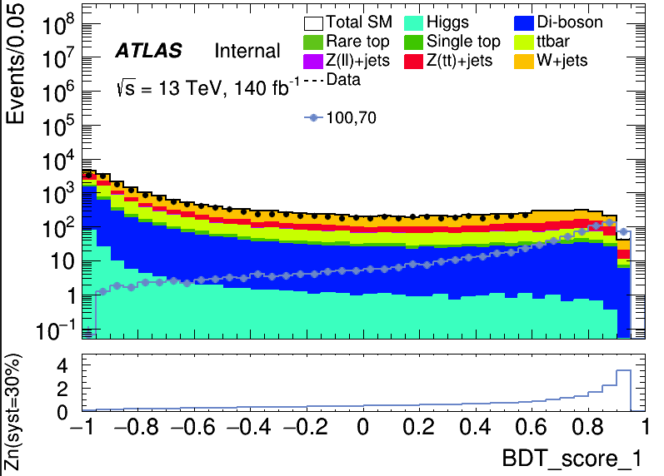
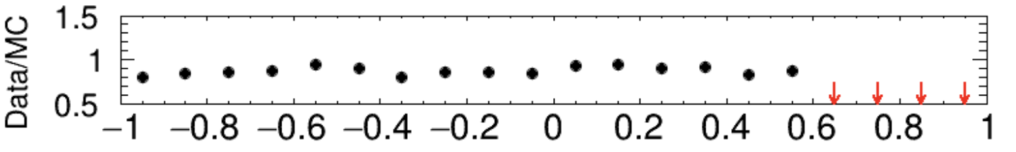
Performance of Model(LH)
hyper parameter: NTrees=400, learning rate=0.01, max depth=10, MinNodeSize=1%(default)
BDT score distribution of Validation set
BDT score distribution of test set and data (Blind with events with score > 0.6)
6
Chengxin Liao
IHEP SUSY Meeting

