Slide 1


Compressed EWK study(ISRC1N2)
Department of Physics, Shandong University
Chengxin Liao
liaocx@ihep.ac.cn
Wed, Feb 5, 2024

Slide 2
Outline
1. Hyperparameters optimization
2. Performance of Model
Chengxin Liao
IHEP SUSY Meeting

Slide 3
Task-list
Machine learning for LH channel
check more Variable and select significance var for ML(DONE)
BDTG hyperparameters optimization/ Setup a Grid Search framework (DONE)
Preliminary study on multibody quantum mechanics (In Progress) QFT Lecture (Peskin part I)
BSc thesis: https://www.overleaf.com/project/674e7119837a2580151a0868
CS61A (python): https://cs61a.vercel.app/index.html
1
Chengxin Liao
IHEP SUSY Meeting

Slide 4
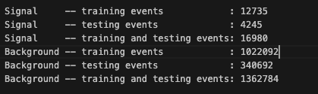
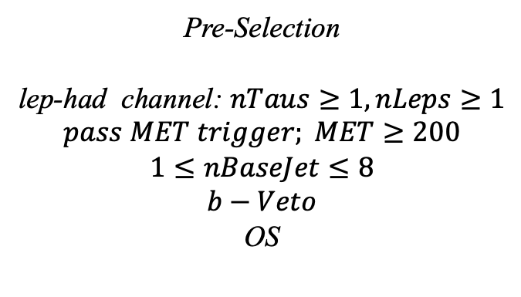
Hyperparameters optimization
Input(LH-Channel):
Sample:
Sig: ISRC1N2(mass_C1 = 100GeV, mass_N2 = 70GeV)->21225 entries
Bkg: 1703476 entries
All input data(C1N2_100_70 and Bkg) already passed pre-selection
Pre-Selection
lep-had channel: $nTaus≥1, nLeps≥1$
$$pass MET trigger; MET≥200$$
$$1≤nBaseJet≤8$$
$$b−Veto$$
OS
Strategy:
method: BDTG Separate sig(bkg) into five folders, one for test, the other three for train, and last one for validation set,then traverse all possibilities.
2
Chengxin Liao
IHEP SUSY Meeting

Slide 5
Hyperparameters optimization
Variables:
Obj kinematics pt_lep pt_tau mt_tau e_lep(energy of tau2)
Angular correlations dPhit1x dRt1x dRtt dPhitt
Event kinematics
Mll(Invariant Mass of tau1 and tau2) METsig MT2_50 Mwh(Invariant Mass of tau1 and MET) Mwl(Invariant Mass of tau2 and MET) MCT(Transverse Mass Squared) Proj_j(Projection of pt jet on zeta) Proj_tt(Projection of tau1+tau2 on zeta)
mt_quad_sum mt_sum frac_MET_tau1 frac_MET_tau2
frac_MET_sqrtHT_40
frac_jet_tau1
frac_jet_tau2 frac_jet_tt
Note:
zeta is bisector direction of tau1 and tau2[PhyUtils::bisector(tau1, tau2)]
3
Chengxin Liao
IHEP SUSY Meeting

Slide 6
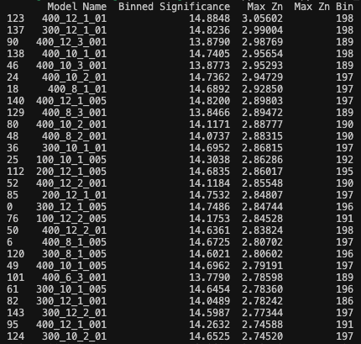
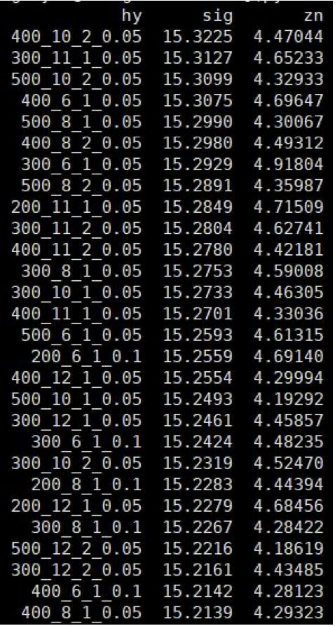
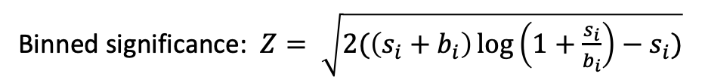
Hyperparameters optimization
Grid Search:
Binned significance: $Z= \sqrt{2(\left(s_{i}+b_{i}\right)\log\left(1+\frac{s_{i}}{b_{i}}\right)−s_{i})}$
Ntrees: 200, 300, 400
Max Depth: 6, 8, 10, 12 MinNodeSize: 1%, 2%, 3% Learning Rate: 0.01, 0.05, 0.1
Show top Zn
Shiyi’s result of LH channel
Comment:
compare with shiyi’s result, my Max Zn is still quite low and even lower than HH-channel
4
Chengxin Liao
IHEP SUSY Meeting

Slide 7
TODO
1. check more vars and try other method
9
Chengxin Liao
IHEP SUSY Meeting

