Slide 1


Compressed EWK study(ISRC1N2)
Department of Physics, Shandong University
Chengxin Liao
liaocx@ihep.ac.cn
Mar, Wed 19, 2025

Slide 2
Tasklist
Obtain (120,90), (140,90) in ML result
Significance map in HH&LH channel
Bkg estimation(Top CR&VR on going)
BSc thesis: https://www.overleaf.com/project/674e7119837a2580151a0868
Chengxin Liao
IHEP SUSY Meeting

Slide 3
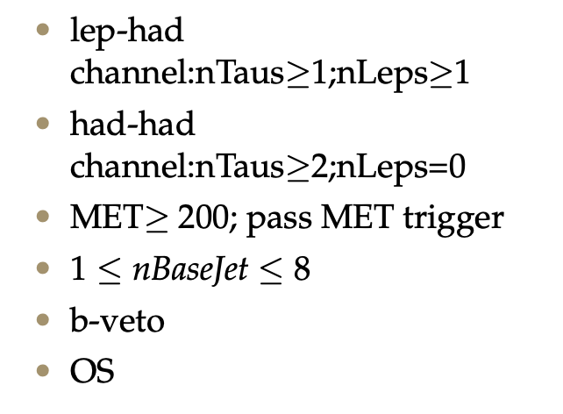
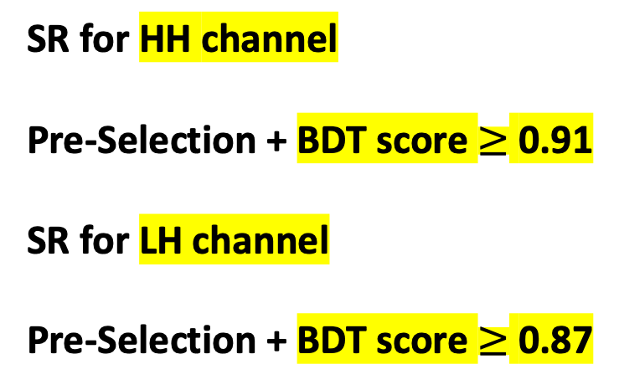
SR definition
Pre-Selection
SR for HH channel Pre-Selection + BDT score $≥$ 0.91 SR for LH channel Pre-Selection + BDT score $≥$ 0.87
hyper parameter: NTrees=500, learning rate=0.05, max depth=12, MinNodeSize=1%(default)
hyper parameter: NTrees=400, learning rate=0.01, max depth=10, MinNodeSize=1%(default)
Cut off some of the background tail without cut the signal but I will remove the upper cut later
1
Chengxin Liao
IHEP SUSY Meeting

Slide 4
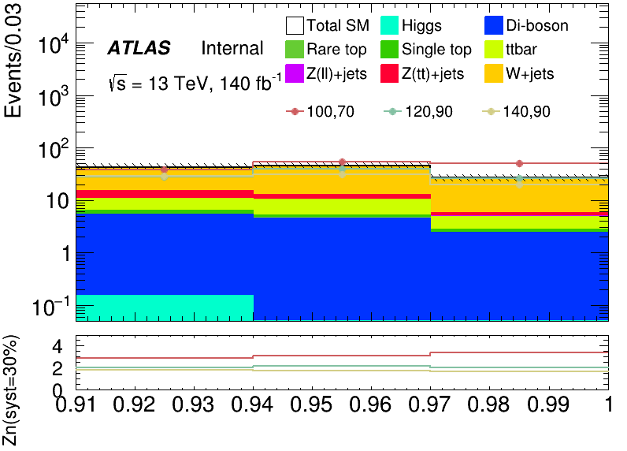
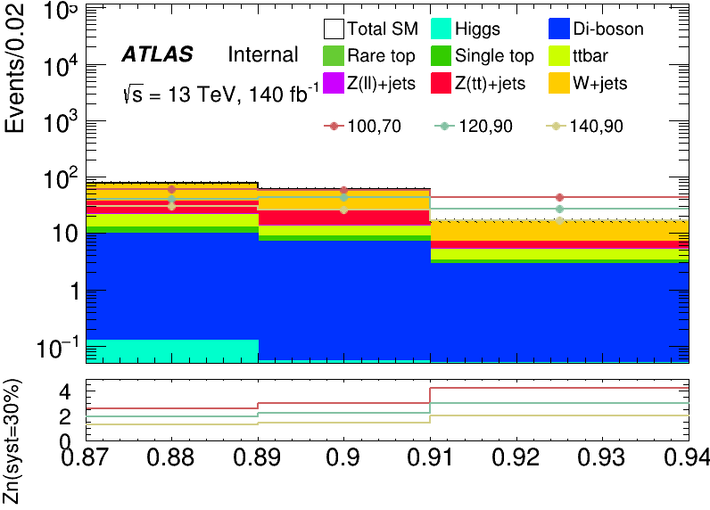
Performance of Model(LH, HH)
HH channel
LH channel
Expand range to 1
The trend in these three signal are close
2
Chengxin Liao
IHEP SUSY Meeting
Notes:
总分布 ZCR dR<1.0 kinematic distribution Data&sig significance map only contain 1.64 line

Slide 5
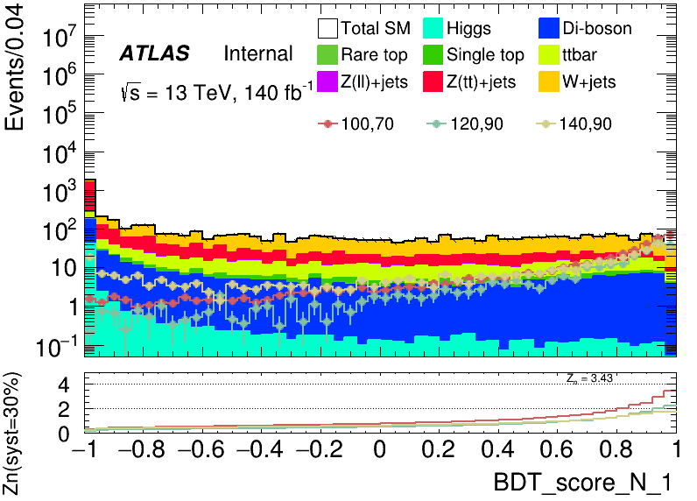
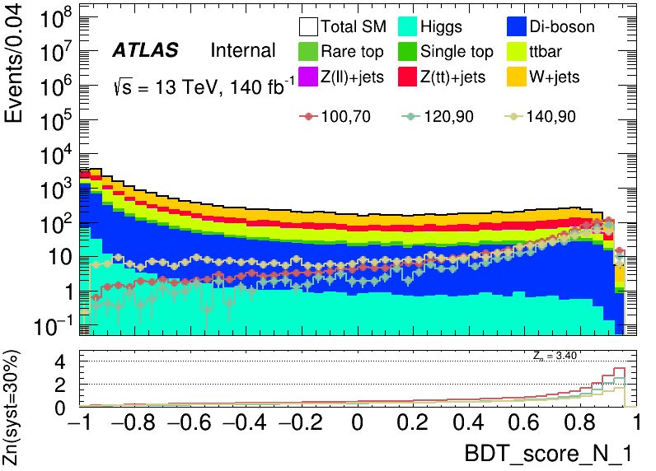
Performance of Model(LH, HH)
HH channel
LH channel
Merge the empty bin into last bin
3
Chengxin Liao
IHEP SUSY Meeting

Slide 6
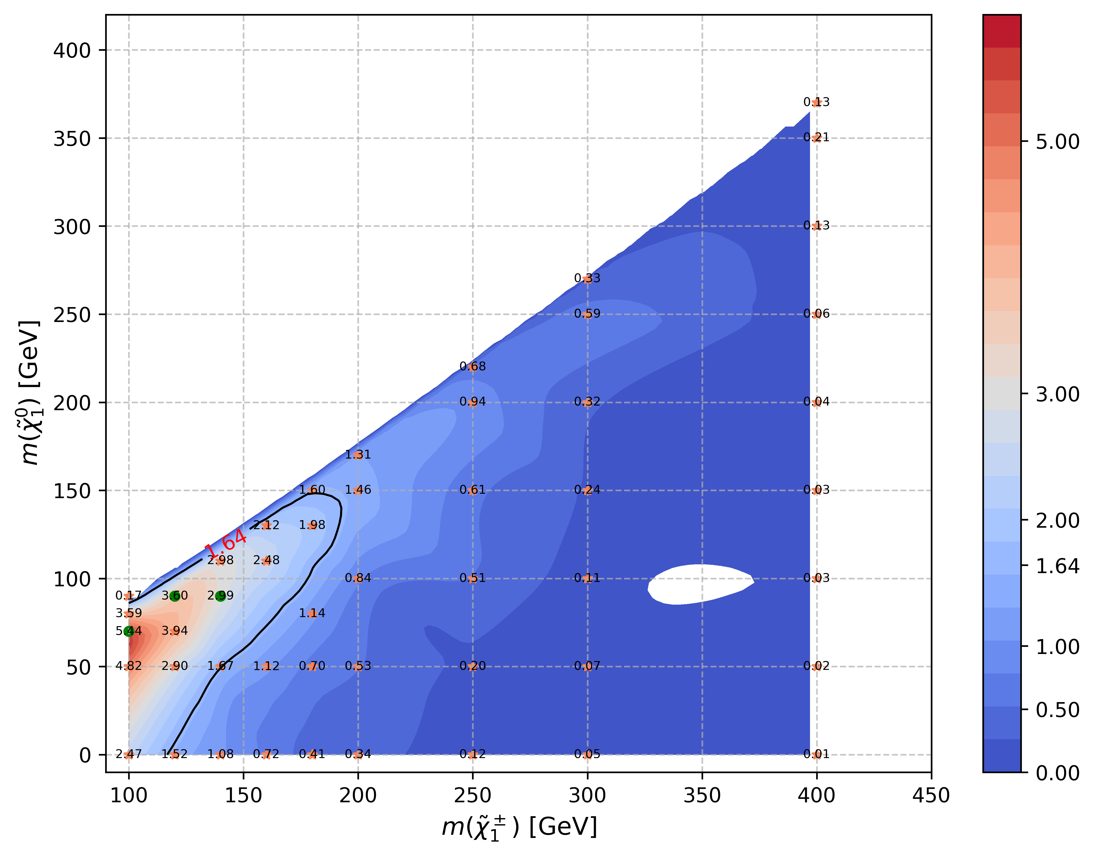
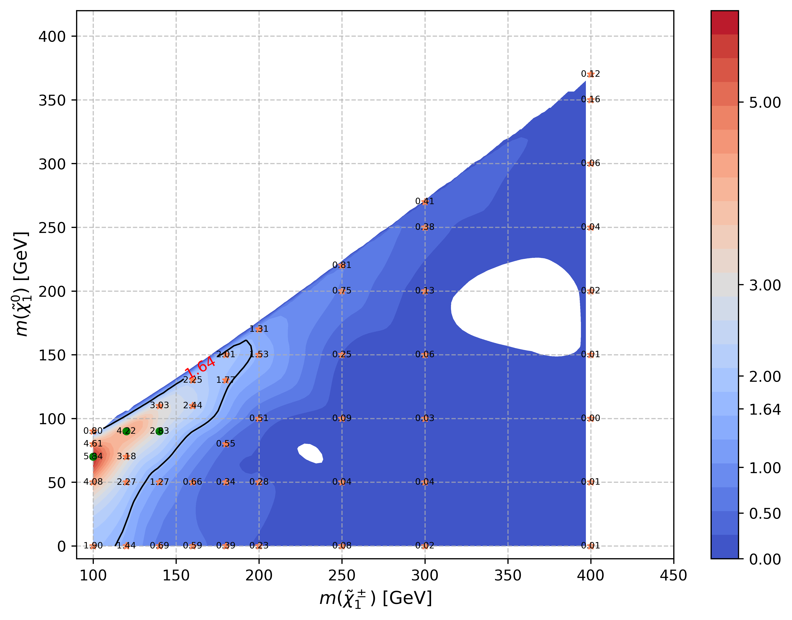
Significance Map(LH)
Cubic method to interpolation
HH channel
Cubic method to interpolation
LH channel
4
Chengxin Liao
IHEP SUSY Meeting

Slide 7
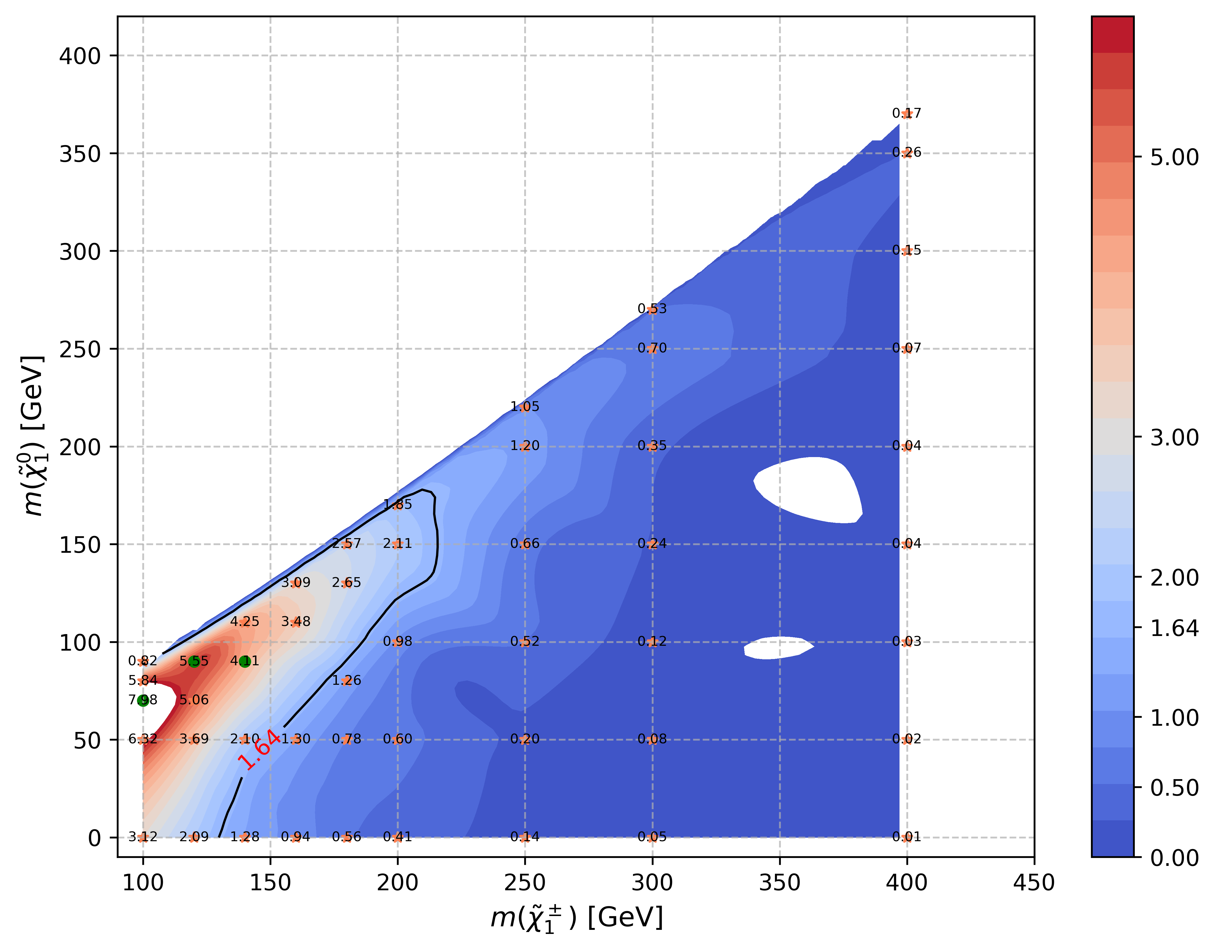

Significance Map(combine)
Cubic method to interpolation
Zn_combine = $\sqrt{Zn_{HH}^{2}+Zn_{LH}^{2}}$
TODO:
1. find a better way to interpolation 2. seems 1.64 can’t cover sig with delta_mass = 10 maybe I should include more signal here
5
Chengxin Liao
IHEP SUSY Meeting

Slide 8
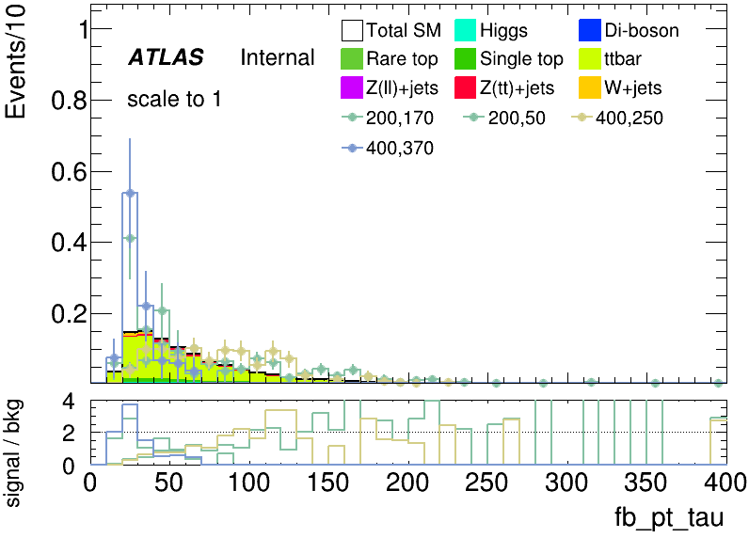
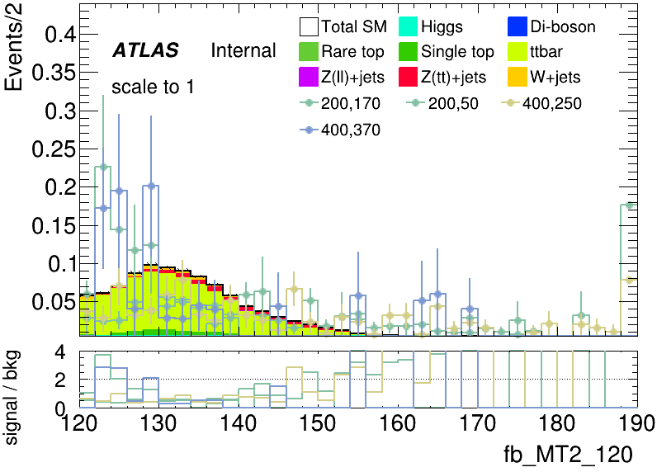
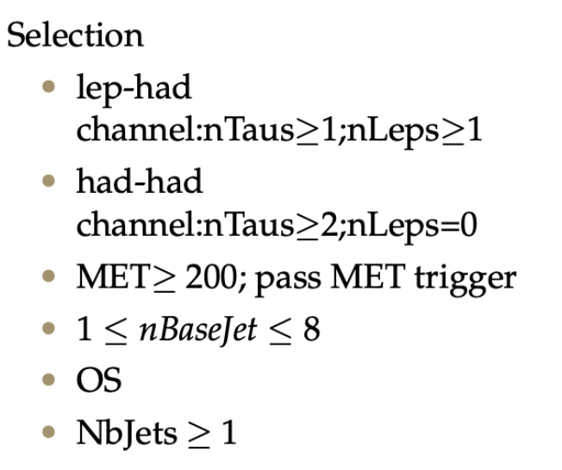
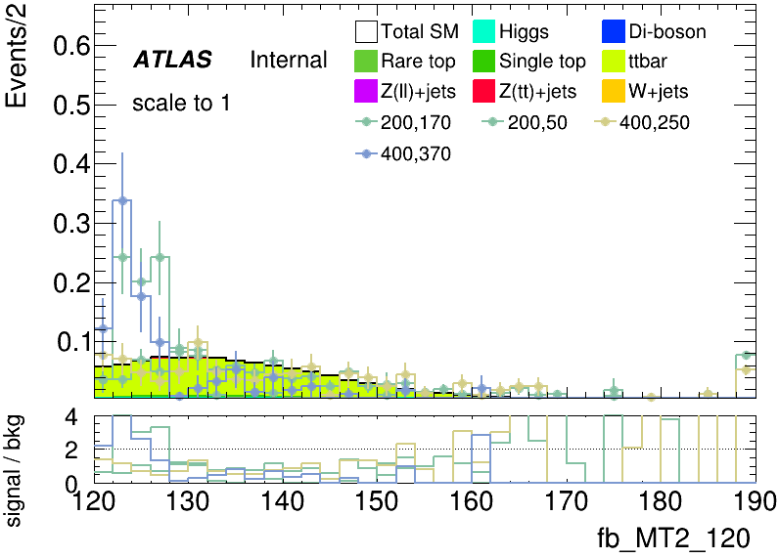
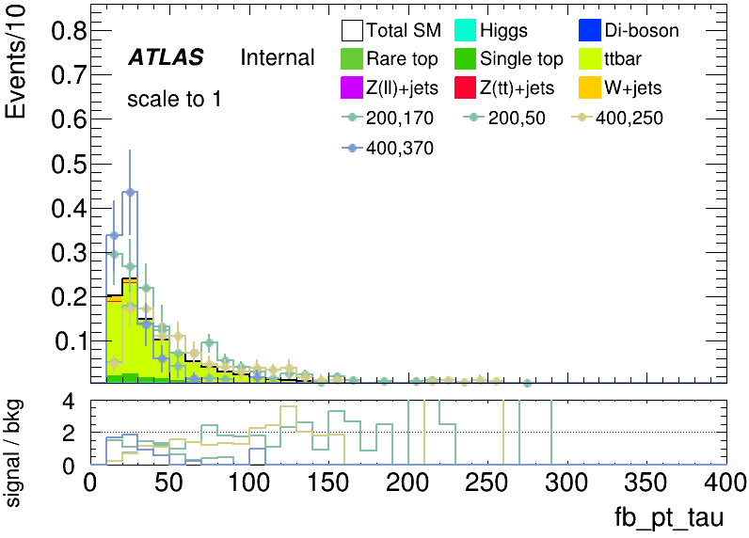
Bkg Estimation(combine)
Top CR & VR
HH channel
LH channel
6
Chengxin Liao
IHEP SUSY Meeting

Slide 9
Backup

Slide 10
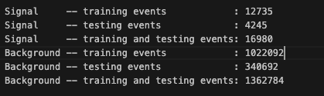
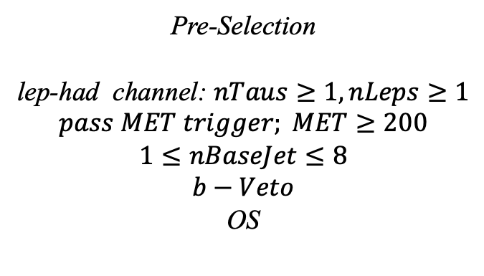
Hyperparameters optimization(LH)
Input(LH-Channel):
Sample:
Sig: ISRC1N2(mass_C1 = 100GeV, mass_N2 = 70GeV)->21225 entries
Bkg: 1703476 entries
All input data(C1N2_100_70 and Bkg) already passed pre-selection
Pre-Selection
lep-had channel: $nTaus≥1, nLeps≥1$
$$pass MET trigger; MET≥200$$
$$1≤nBaseJet≤8$$
$$b−Veto$$
OS
Strategy:
method: BDTG Separate sig(bkg) into five folders, one for test, the other three for train, and last one for validation set,then traverse all possibilities.
1
Chengxin Liao
IHEP SUSY Meeting

Slide 11
Hyperparameters optimization(LH)
Variables(30):
Obj kinematics nBase_Jet mt_lep e_lep(energy of tau2)
Angular correlations dPhitt dRtt dRt1x
dPhiMin_xj
dPhiMax_tj
Event kinematics
Mll(Invariant Mass of tau1 and tau2) METsig MT2_50 Mwh(Invariant Mass of tau1 and MET) Mwl(Invariant Mass of tau2 and MET) MCT(Transverse Mass Squared) Proj_j(Projection of pt jet on zeta) Proj_tt(Projection of tau1+tau2 on zeta) mtx_tau
Mtx_lep
ht_tau mt_quad_sum mt_sum frac_MET_tau1 frac_MET_tau2 frac_MET_tt
frac_MET_sqrtHT_40
frac_jet_tau1
frac_jet_tau2 frac_jet_tt
MT_taumin pt_Vframe
High importance at shiyi’s feature
Note:
zeta is bisector direction of tau1 and tau2[PhyUtils::bisector(tau1, tau2)]
2
Chengxin Liao
IHEP SUSY Meeting

Slide 12
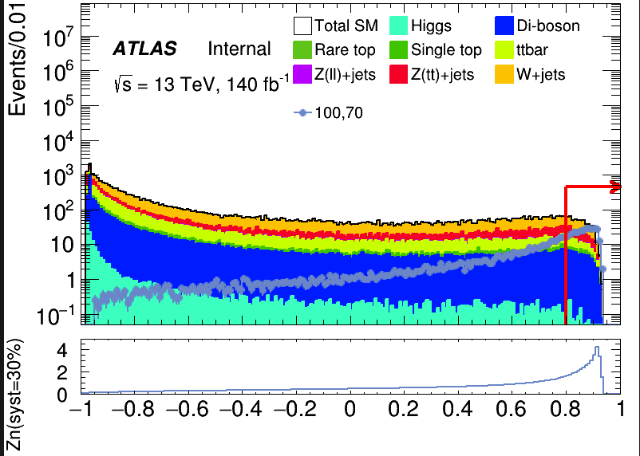
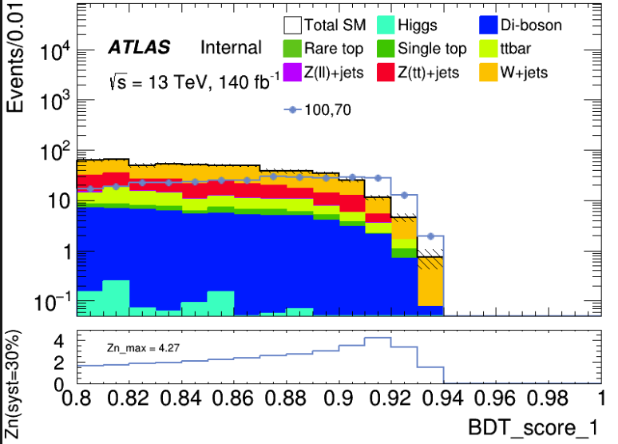

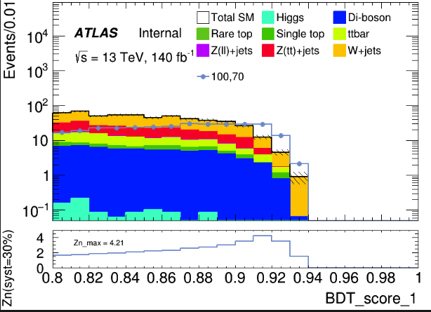
Hyperparameters optimization(LH)
hyper parameter: NTrees=400, learning rate=0.01, max depth=10, MinNodeSize=1%(default)
Cut at BDT_score = 0.8
hyper parameter: NTrees=400, learning rate=0.01, max depth=12, MinNodeSize=1%(default)
4
Chengxin Liao
IHEP SUSY Meeting

Slide 13
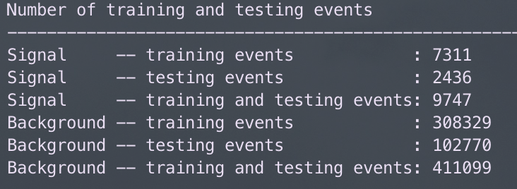
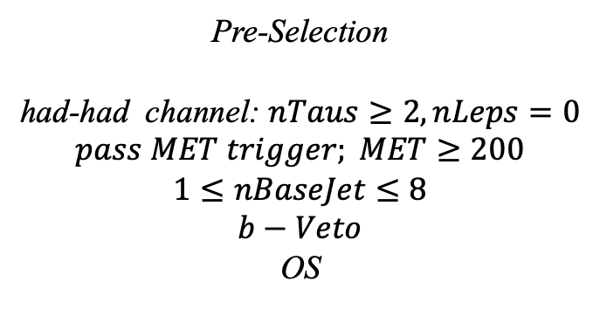
Hyperparameters optimization(HH)
Input(HH-Channel):
Sample:
Sig: ISRC1N2(mass_C1 = 100GeV, mass_N2 = 70GeV)->12180 entries
Bkg: 513850 entries
All input data(C1N2_100_70 and Bkg) already passed pre-selection
Pre-Selection
had-had channel: $nTaus≥2, nLeps=0$
$$pass MET trigger; MET≥200$$
$$1≤nBaseJet≤8$$
$$b−Veto$$
OS
Strategy:
method: BDTG Separate sig(bkg) into five folders, one for test, the other three for train, and last one for validation set,then traverse all possibilities.
5
Chengxin Liao
IHEP SUSY Meeting

Slide 14
Hyperparameters optimization(HH)
Variables(26):
Obj kinematics Pt_tt
Angular correlations dPhit1x dEtatt dPhiMax_xt
dPhiztt
dPhitt
dPhizxe
dPhiMin_xt
dPhit2x
dPhiMin_tj1
dRt2x
dRMax_xt
dRMin_tj
dRtt
sum_cos_dphi
Event kinematics
Mll(Invariant Mass of tau1 and tau2) MIA MT2_150 MET_Tau Proj_tt MstauA MCT frac_MET_tt frac_MET_tau1
frac_MET_MeffInc_40
frac_MET_Meff
These vars are selected based on the importance
6
Chengxin Liao
IHEP SUSY Meeting

Slide 15
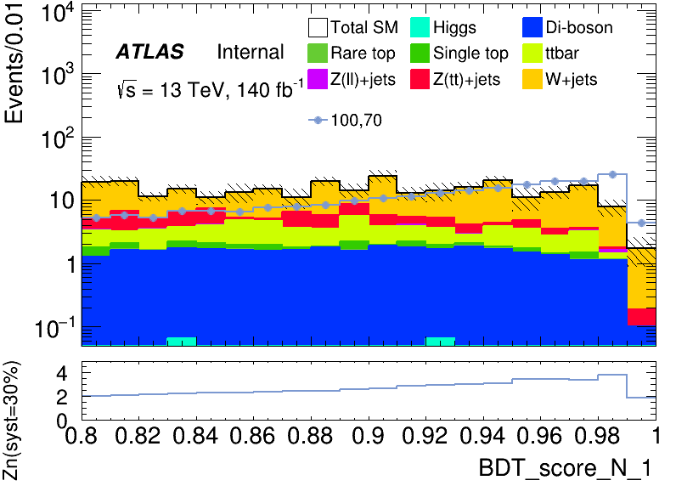
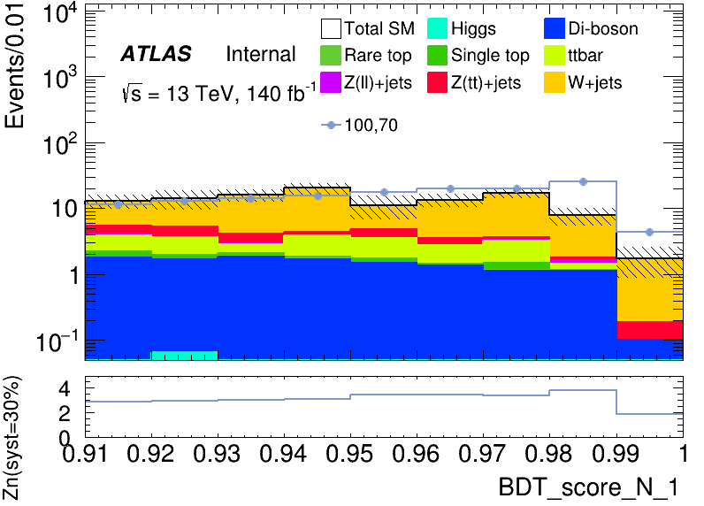
Hyperparameters optimization(HH)
hyper parameter: NTrees=500, learning rate=0.05, max depth=12, MinNodeSize=1%(default)
Apply a rough cut at 0.80 to check the distribution
It has a wider peak than LH signal region
Precise cut at 0.91 to define signal region
Rebin to: [0.91, 0.94, 0.97, 1.00]
8
Chengxin Liao
IHEP SUSY Meeting

Slide 16

Performance of Model(LH)
hyper parameter: NTrees=400, learning rate=0.01, max depth=10, MinNodeSize=1%(default)
Apply BDT score cut at 0.87
Root of square sum of Zn of each bin: 5.8479
Rebin to: [0.87, 0.89, 0.91, 0.94]
bin | max Zn | C1N2ISR (100,70) | bkg | Higgs | OtherTop | SingleTop | TopPair | VV | Wjets | Zlljets | Zttjets
(0.87-0.89) | 2.59868 | 59.238+-1.484 | 76.648+- 5.530(7.21%) | 0.126+-0.034 | 0.033+-0.021 | 2.619+-0.548 | 8.311+-1.141 | 9.569+-0.520 | 39.971+-5.074 | 0.760+-0.130 | 15.259+-1.718
(0.89-0.91) | 3.03656 | 57.663+-1.447 | 59.803+- 3.946(6.59%) | 0.053+-0.020 | 0.078+-0.030 | 1.761+-0.420 | 4.401+-0.823 | 6.851+-0.399 | 33.586+-3.367 | 0.453+-0.128 | 12.620+-1.792
(0.91-0.94) | 4.26908 | 42.715+-1.251 | 16.632+- 1.683(10.11%) | 0.005+-0.004 | 0.006+-0.004 | 0.450+-0.202 | 1.819+-0.532 | 2.858+-0.249 | 9.733+-1.536 | 0.039+-0.020 | 1.722+-0.298
9
Chengxin Liao
IHEP SUSY Meeting

Slide 17
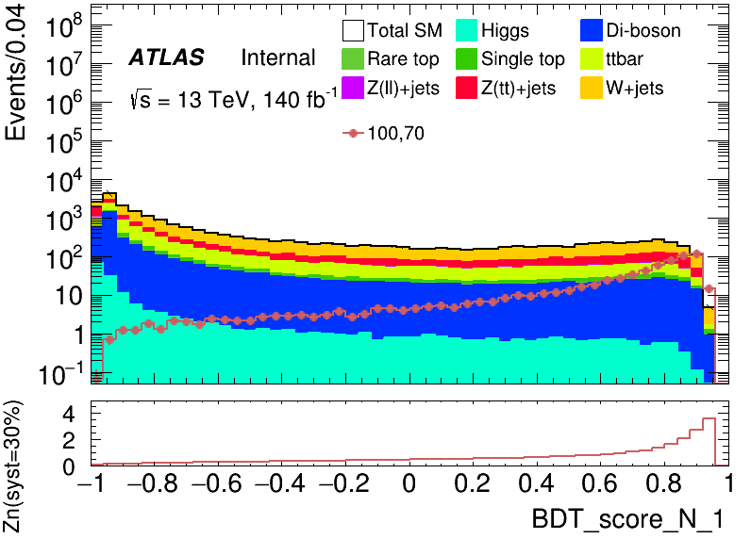
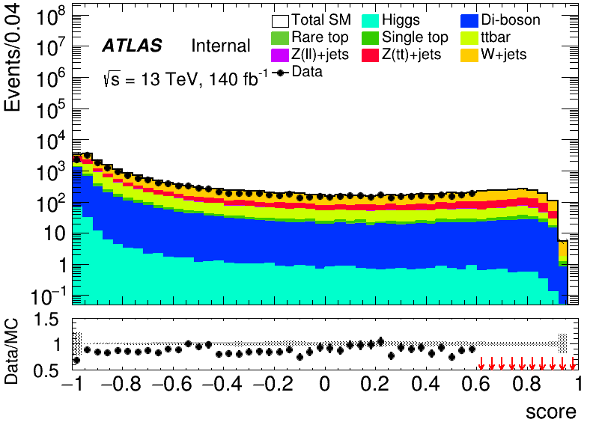
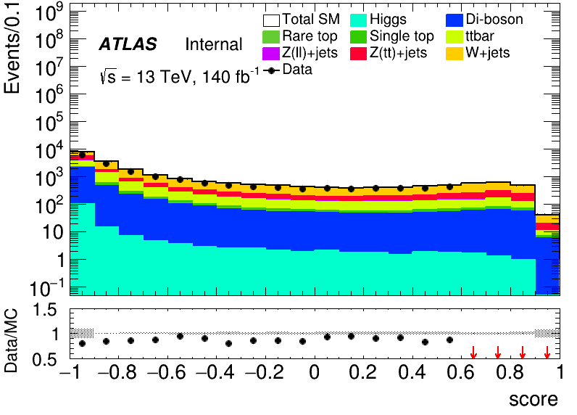
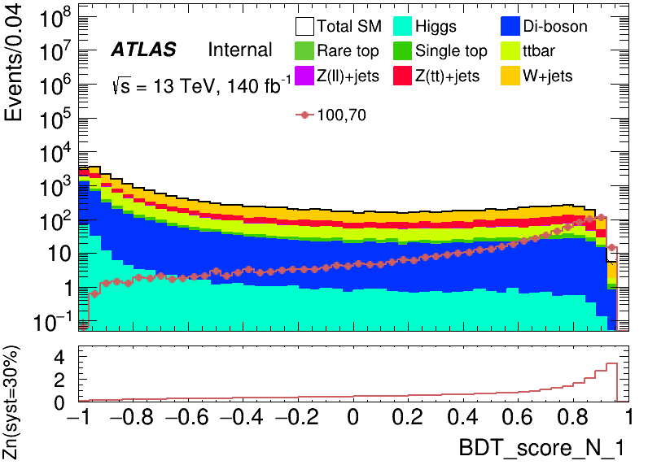
Performance of Model(LH)
hyper parameter: NTrees=400, learning rate=0.01, max depth=10, MinNodeSize=1%(default)
50 bins
20 bins
BDT score distribution of Validation set
BDT score distribution of test set and data (Blind with events with score > 0.6)
BDT score distribution of Test set
10
Chengxin Liao
IHEP SUSY Meeting

Slide 18
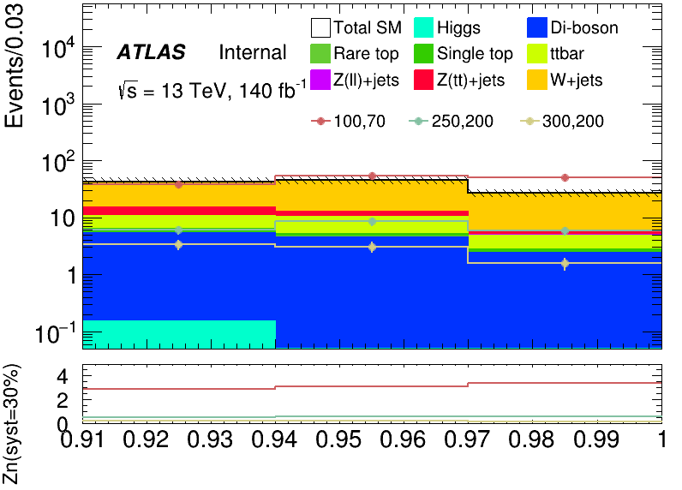
Performance of Model(HH)
hyper parameter: NTrees=500, learning rate=0.05, max depth=12, MinNodeSize=1%(default)
Root of quadratic sum of Zn = 5.3163
Rebin to: [0.91, 0.94, 0.97, 1.00]
bin | Zn | C1N2ISR (100,70) | bkg | SingleTop | Zttjets | Wjets | OtherTop | VV | Zlljets | TopPair | Higgs
bin1 | 2.8678146 | 38.472+-1.192 | 42.986+-6.490(15.09%) | 0.958+-0.303 | 4.090+-0.675 | 28.198+-6.388 | 0.026+-0.020 | 5.144+-0.289 | 0.265+-0.185 | 4.156+-0.802 | 0.150+-0.041
bin2 | 3.1193828 | 53.206+-1.399 | 44.788+-6.647(14.86%) | 0.473+-0.239 | 2.435+-0.612 | 32.118+-6.547 | 0.033+-0.022 | 4.512+-0.303 | 0.040+-0.026 | 5.158+-0.888 | 0.019+-0.014
bin3 | 3.4088980 | 49.550+-1.350 | 26.640+-3.905(14.65%) | 0.348+-0.184 | 0.600+-0.129 | 21.041+-3.850 | 0.034+-0.017 | 2.363+-0.189 | 0.196+-0.123 | 2.050+-0.570 | 0.007+-0.007
11
Chengxin Liao
IHEP SUSY Meeting

Slide 19
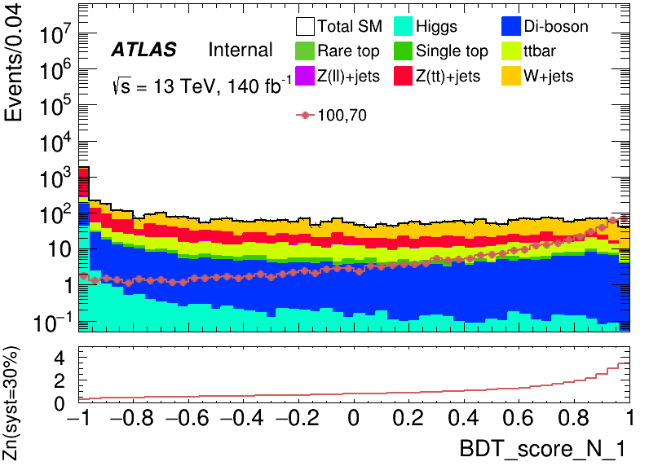
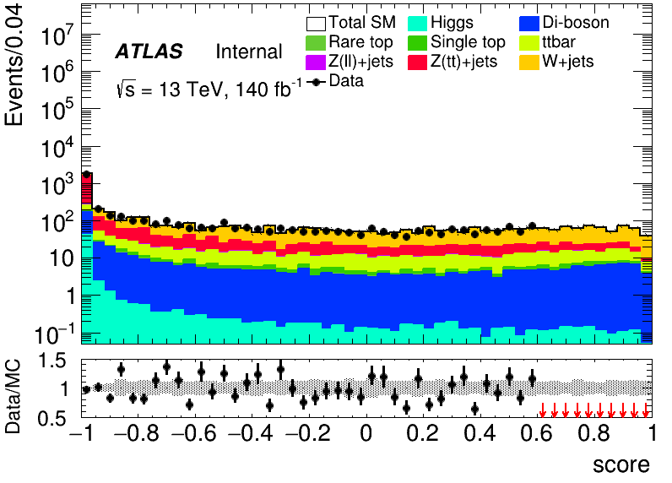
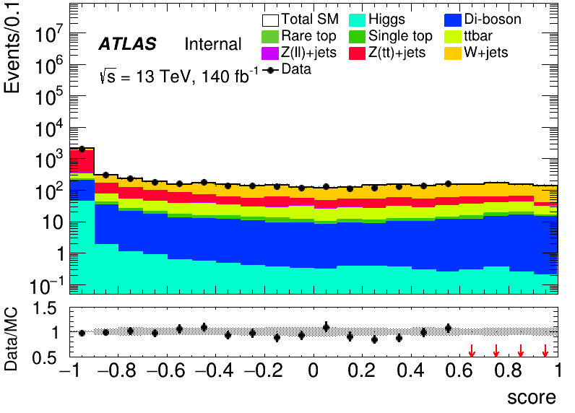
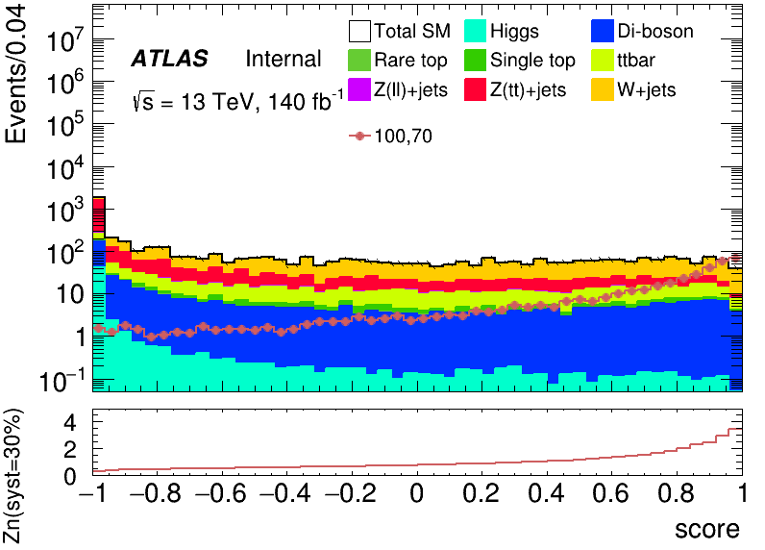
Performance of Model(HH)
hyper parameter: NTrees=500, learning rate=0.05, max depth=12, MinNodeSize=1%(default)
50 bins
20 bins
BDT score distribution of Validation set
BDT score distribution of test set and data (Blind with events with score > 0.6)
BDT score distribution of Test set
12
Chengxin Liao
IHEP SUSY Meeting

