Slide 1


Compressed EWK study(ISRC1N2)
Department of Physics, Shandong University
Chengxin Liao
liaocx@ihep.ac.cn
Mar, Wed 19, 2025

Slide 2
Tasklist
Bkg estimation for C1N2ISR
BSc thesis: https://www.overleaf.com/project/674e7119837a2580151a0868
Chengxin Liao
IHEP SUSY Meeting

Slide 3
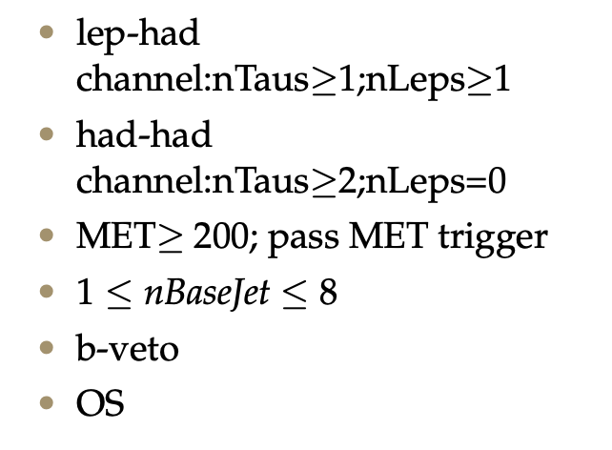
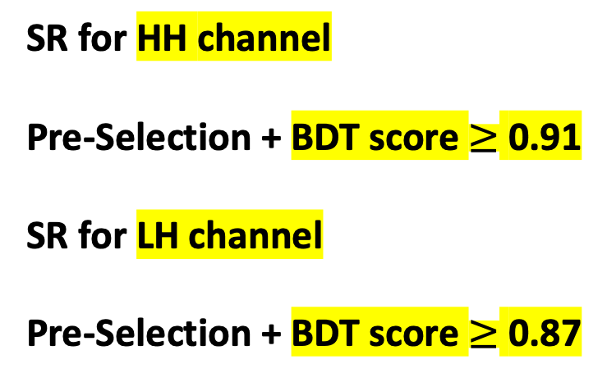
SR definition
Pre-Selection
SR for HH channel Pre-Selection + BDT score $≥$ 0.91 SR for LH channel Pre-Selection + BDT score $≥$ 0.87
hyper parameter: NTrees=500, learning rate=0.05, max depth=12, MinNodeSize=1%(default)
Nbjets > 0
hyper parameter: NTrees=400, learning rate=0.01, max depth=10, MinNodeSize=1%(default)
For Top estimation
1
Chengxin Liao
IHEP SUSY Meeting

Slide 4
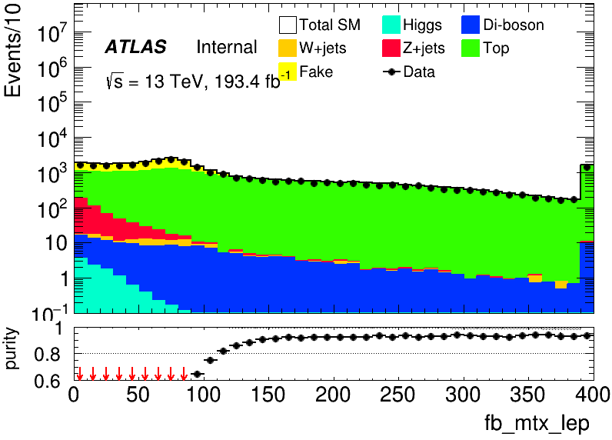
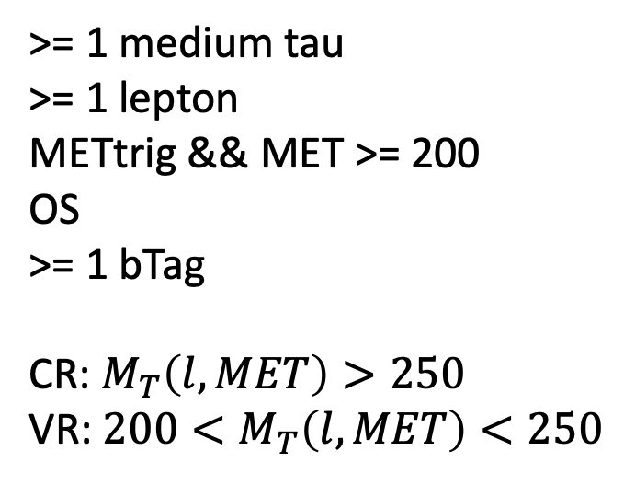
Top(LH)
>= 1 medium tau >= 1 lepton METtrig && MET >= 200 OS >= 1 bTag CR: $M_{T}\left(l,MET\right)>250$ VR: $200<M_{T}\left(l, MET\right)<250$
CR: TOP 5480.93, MC: 5884.94, purity: 0.931349 VR: TOP 5044.15, MC: 5471.2, purity: 0.921946
Top CR N_1
2
Chengxin Liao
IHEP SUSY Meeting
Notes:
总分布 ZCR dR<1.0 kinematic distribution Data&sig significance map only contain 1.64 line

Slide 5
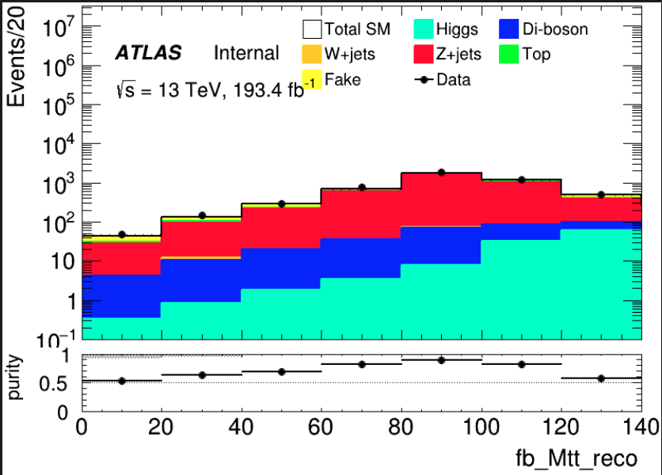
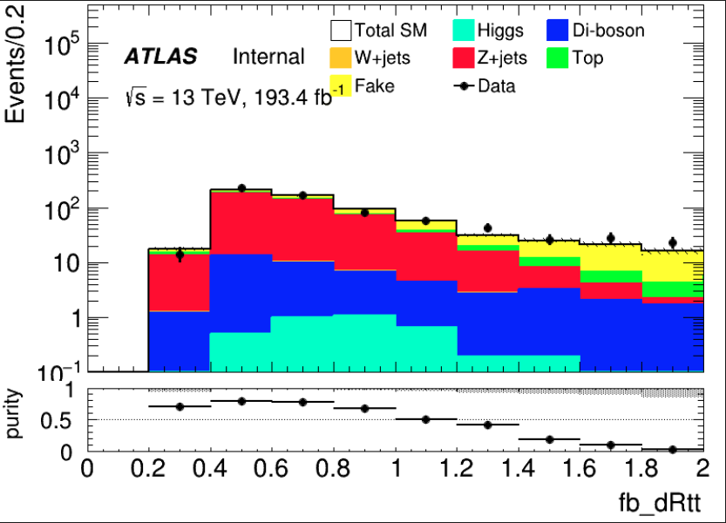
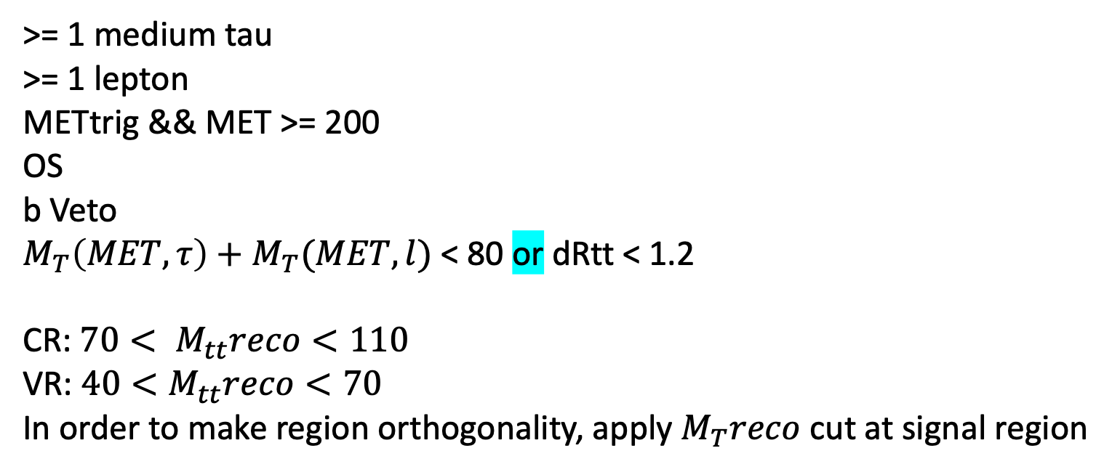
Zjets(LH)
>= 1 medium tau >= 1 lepton METtrig && MET >= 200 OS b Veto $M_{T}\left(MET,τ\right)+M_{T}(MET,l)$ < 80 or dRtt < 1.2 CR: $70< M_{tt}reco<110$ VR: $40<M_{tt}reco<70$ In order to make region orthogonality, apply $M_{T}reco$ cut at signal region
I’m not sure after apply MT sum cut if CR&VR can othogonalize with SR
CR: Zjets: 3780.25, MC: 5458.11, purity: 0.887756 VR: Zjets:379.093, MC: 486.911, purity: 0.778568 CR: Zjets:2555.77, MC:2905.17, purity:0.879732 VR: Zjets:402.205, MC:548.51, purity:0.73327
Yellow one corrspond to MT sum cut Green one corrspond to dRtt cut
3
Chengxin Liao
IHEP SUSY Meeting

Slide 6
VV
4
Chengxin Liao
IHEP SUSY Meeting

Slide 7
Backup

Slide 8
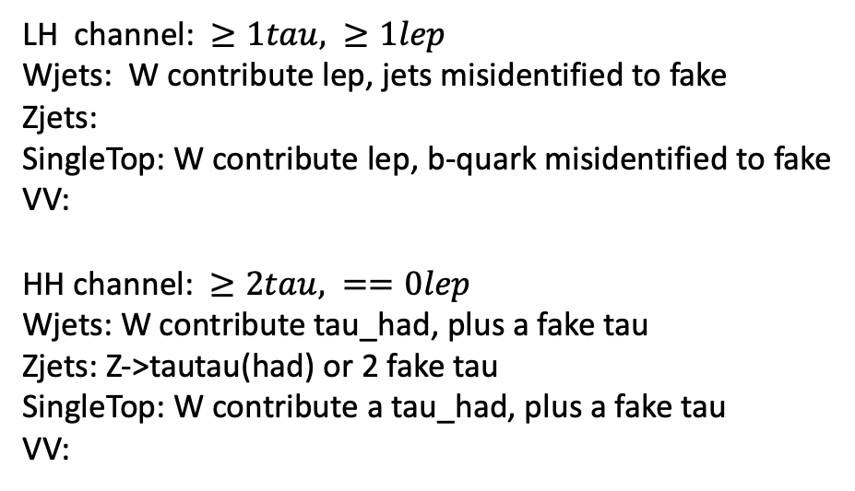
Bkg decay mode
LH channel: $≥1tau, ≥1lep$ Wjets: W contribute lep, jets misidentified to fake Zjets:
SingleTop: W contribute lep, b-quark misidentified to fake
VV: HH channel: $≥2tau, ==0lep$ Wjets: W contribute tau_had, plus a fake tau Zjets: Z->tautau(had) or 2 fake tau SingleTop: W contribute a tau_had, plus a fake tau VV:
Wjets: W->e/muon + nu W->tau+nu(can contribute true tau_had) jet misidentified to a fake tau Zjets: Z->ll/tautau jet misindentified to fake tau Top: top->W+b, W can contribute a true tau_had b-quark is a source of fake VV: W/Z
12
Chengxin Liao
IHEP SUSY Meeting

