Slide 1


Compressed EWK study(ISRC1N2)
Department of Physics, Shandong University
Chengxin Liao
liaocx@ihep.ac.cn
Mar, Wed 5, 2025

Slide 2
Outline
1. Hyperparameters optimization
2. Performance of Model 3. Backup
1
Chengxin Liao
IHEP SUSY Meeting

Slide 3
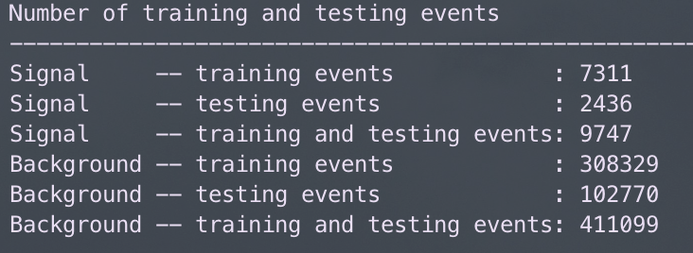
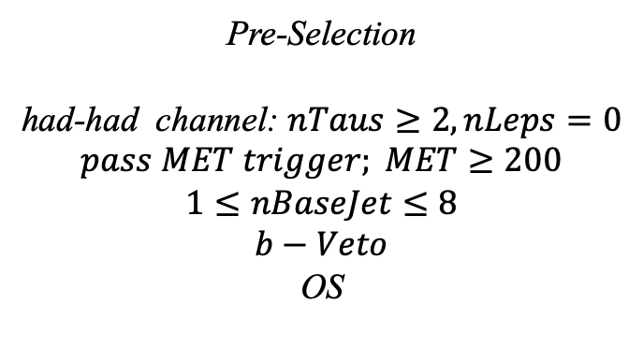
Hyperparameters optimization(HH)
Input(HH-Channel):
Sample:
Sig: ISRC1N2(mass_C1 = 100GeV, mass_N2 = 70GeV)->12180 entries
Bkg: 513850 entries
All input data(C1N2_100_70 and Bkg) already passed pre-selection
Pre-Selection
had-had channel: $nTaus≥2, nLeps=0$
$$pass MET trigger; MET≥200$$
$$1≤nBaseJet≤8$$
$$b−Veto$$
OS
Strategy:
method: BDTG Separate sig(bkg) into five folders, one for test, the other three for train, and last one for validation set,then traverse all possibilities.
2
Chengxin Liao
IHEP SUSY Meeting

Slide 4
Hyperparameters optimization(HH)
Variables(26):
Obj kinematics Pt_tt
Angular correlations dPhit1x dEtatt dPhiMax_xt
dPhiztt
dPhitt
dPhizxe
dPhiMin_xt
dPhit2x
dPhiMin_tj1
dRt2x
dRMax_xt
dRMin_tj
dRtt
sum_cos_dphi
Event kinematics
Mll(Invariant Mass of tau1 and tau2) MIA MT2_150 MET_Tau Proj_tt MstauA MCT frac_MET_tt frac_MET_tau1
frac_MET_MeffInc_40
frac_MET_Meff
These vars are selected based on the importance
3
Chengxin Liao
IHEP SUSY Meeting

Slide 5
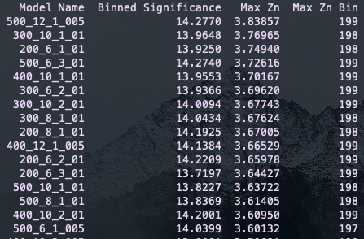
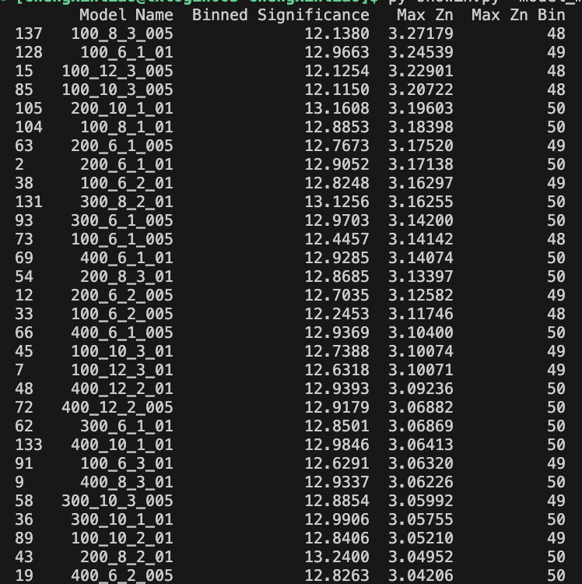
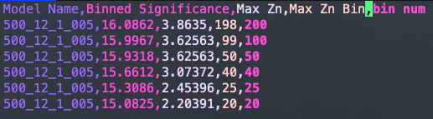
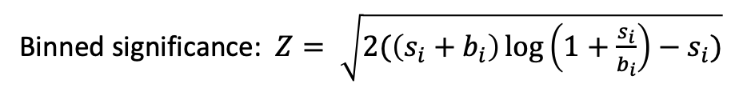
Hyperparameters optimization(HH)
Grid Search:
Binned significance: $Z= \sqrt{2(\left(s_{i}+b_{i}\right)\log\left(1+\frac{s_{i}}{b_{i}}\right)−s_{i})}$
Ntrees: 200, 300, 400, 500
Max Depth: 6, 8, 10, 12 MinNodeSize: 1%, 2%, 3% Learning Rate: 0.01, 0.05, 0.1
Show top Zn
Compared with form result, there has a significant improvement in Zn
Rebin result
4
Chengxin Liao
IHEP SUSY Meeting

Slide 6
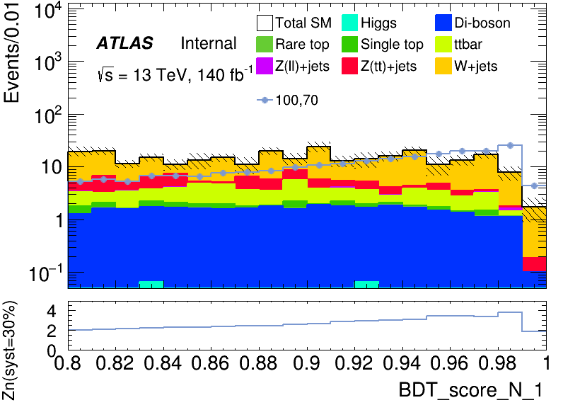
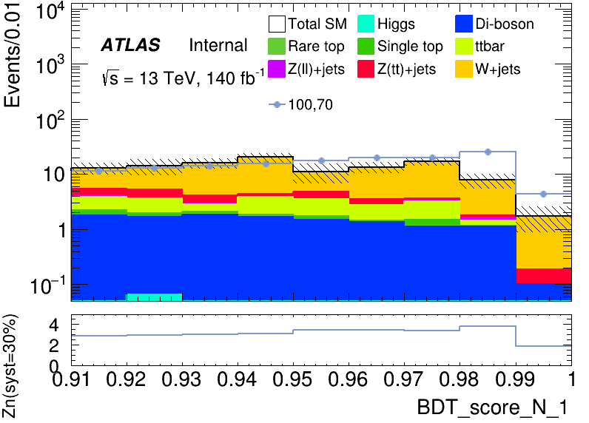
Performance of Model(HH)
hyper parameter: NTrees=500, learning rate=0.05, max depth=12, MinNodeSize=1%(default)
Apply a rough cut at 0.80 to check the distribution
It has a wider peak than LH signal region
Precise cut at 0.91 to define signal region
Rebin to: [0.91, 0.94, 0.97, 1.00]
5
Chengxin Liao
IHEP SUSY Meeting

Slide 7
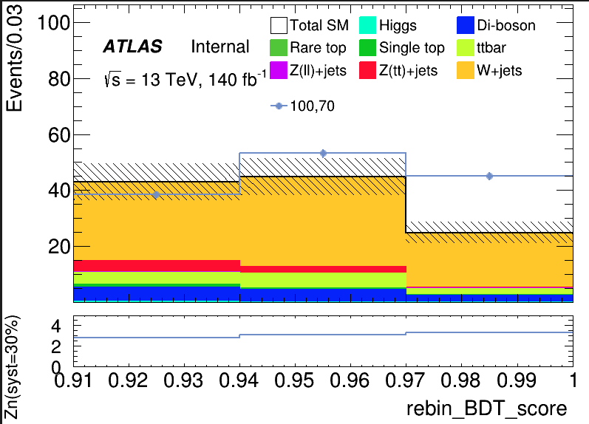
Performance of Model(HH)
hyper parameter: NTrees=500, learning rate=0.05, max depth=12, MinNodeSize=1%(default)
Root of quadratic sum of Zn = 5.3163
bin | max Zn | C1N2ISR (100,70) | bkg | Higgs | OtherTop | SingleTop | TopPair | VV | Wjets | Zlljets | Zttjets
(0.91-0.94) | 2.8271 | 38.472+-1.192 | 42.987+- 6.489(15.09%) | 0.150+-0.041 | 0.026+-0.020 | 0.958+-0.303 | 4.156+-0.802 | 5.144+-0.289 | 28.198+-6.388 | 0.265+-0.185 | 4.090+-0.675
(0.94-0.97) | 3.0639 | 53.206+-1.399 | 44.788+- 6.645(14.83%) | 0.019+-0.014 | 0.026+-0.020 | 0.473+-0.239 | 5.158+-0.888 | 4.512+-0.303 | 32.118+-6.547 | 0.040+-0.026 | 2.435+-0.612
(0.97-1.00) | 3.29906 | 45.161+-1.287 | 24.891+- 3.088(12.40%) | 0.007+-0.007 | 0.034+-0.017 | 0.348+-0.184 | 2.050+-0.570 | 2.263+-0.187 | 19.479+-3.753 | 0.196+-0.123 | 2.435+-0.612
6
Chengxin Liao
IHEP SUSY Meeting

Slide 8
TODO
1. BDT distribution of Validation Set & Binned BDT distribution of Data and Test Set
2. Finish Rebin Code
3. Summary of HH&LH channel ML results and the definition of SR 4. arrange the old code and optimize them(add README.md)
7
Chengxin Liao
IHEP SUSY Meeting

Slide 9
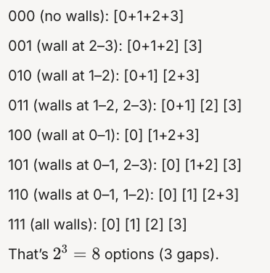
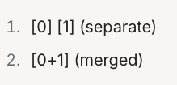
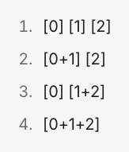
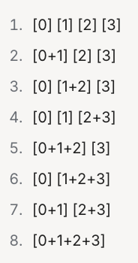

BackUp
An Interesting Method to Rebin
Example in 4 bins
It can be proved that there are $2^{n−1}$ ways to rebin if histgram have n bins except 2 bins
2 bins
Oredered the method and trun into binary number
Based on Mathmatical Induction
3 bins
$2^{n−1}$ ways to rebin
4 bins
8
Chengxin Liao
IHEP SUSY Meeting

