Slide 1


Compressed EWK study(ISRC1N2)
Department of Physics, Shandong University
Chengxin Liao
liaocx@ihep.ac.cn
Apr, Tue 1, 2025

Slide 2
Tasklist
Bkg estimation for C1N2ISR
BSc thesis: https://www.overleaf.com/project/674e7119837a2580151a0868
Chengxin Liao
IHEP SUSY Meeting

Slide 3
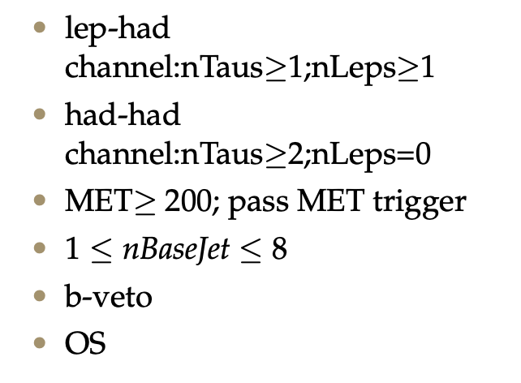
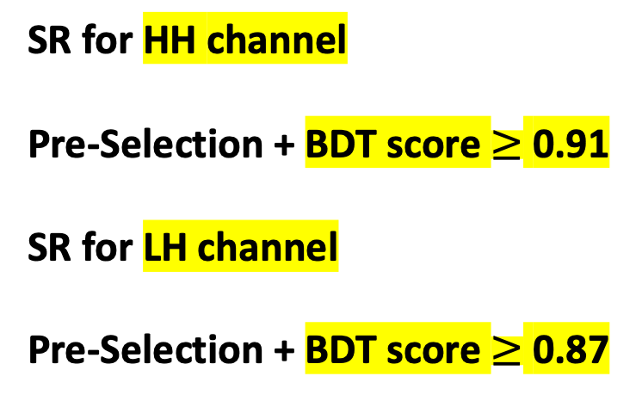
SR definition
Pre-Selection
SR for HH channel Pre-Selection + BDT score $≥$ 0.91 SR for LH channel Pre-Selection + BDT score $≥$ 0.87
hyper parameter: NTrees=500, learning rate=0.05, max depth=12, MinNodeSize=1%(default)
Nbjets > 0
hyper parameter: NTrees=400, learning rate=0.01, max depth=10, MinNodeSize=1%(default)
For Top estimation
1
Chengxin Liao
IHEP SUSY Meeting

Slide 4
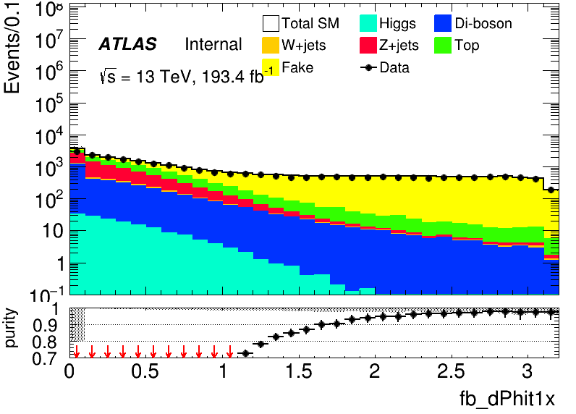
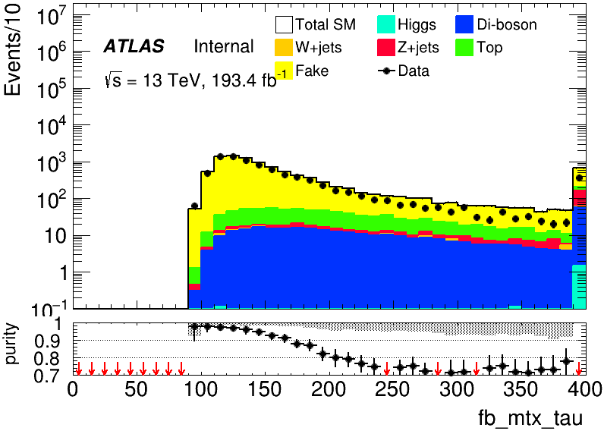
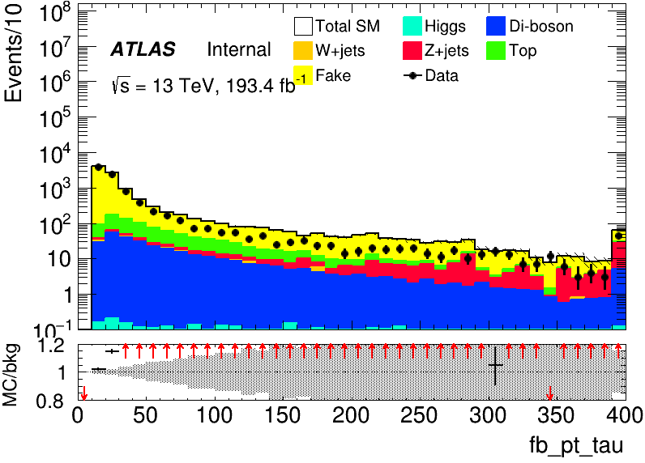
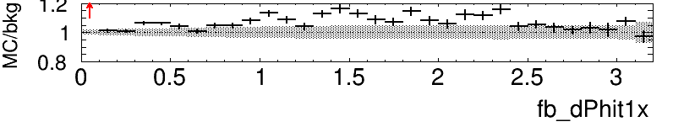
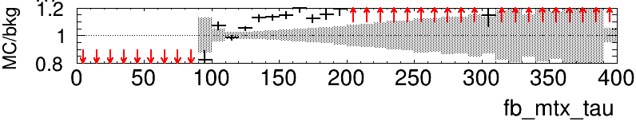
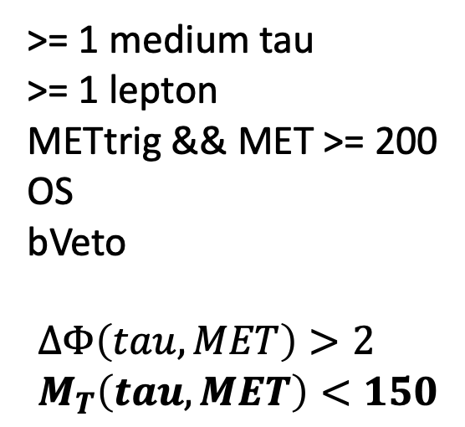
Fake CRID(LH)
>= 1 medium tau >= 1 lepton METtrig && MET >= 200 OS bVeto $$∆Φ\left(tau, MET\right)>2 \\ M_{T}\left(tau, MET\right)<150$$
Data/MC
MT disagreement basic come from pt can fix by apply fake method
Remove next time
CRID:
Fake : 5332.71+-12.118, MC: 5530.2+-12.1666 purity: 0.964289
2
Chengxin Liao
IHEP SUSY Meeting
Notes:
总分布 ZCR dR<1.0 kinematic distribution Data&sig significance map only contain 1.64 line

Slide 5
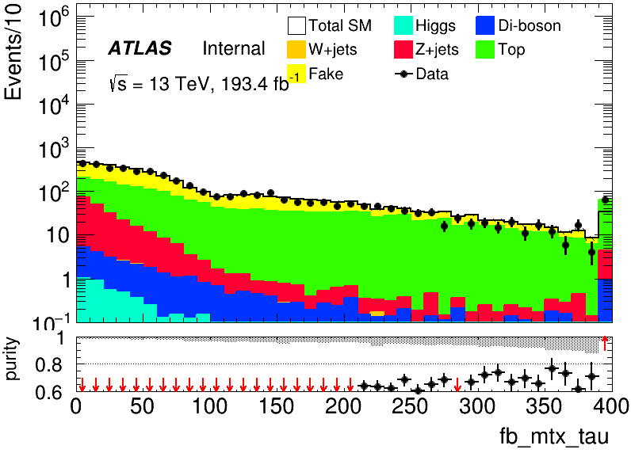
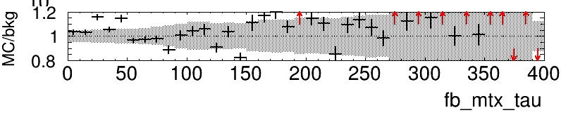
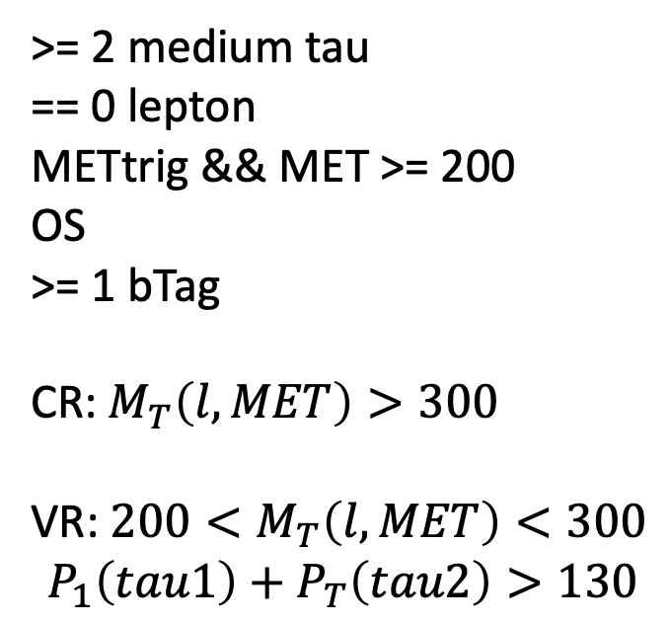
Top(HH)
>= 2 medium tau == 0 lepton METtrig && MET >= 200 OS >= 1 bTag CR: $M_{T}\left(l,MET\right)>300$ VR: $200<M_{T}\left(l, MET\right)<300$ $$P_{1}\left(tau1\right)+P_{T}\left(tau2\right)>130$$
CR: TOP 160.201+-3.13218, MC: 179.424+-4.37706, purity: 0.892863 VR: TOP 60.8234+-2.09314, MC: 81.6181+-2.40428, purity: 0.74522
3
Chengxin Liao
IHEP SUSY Meeting
Notes:
总分布 ZCR dR<1.0 kinematic distribution Data&sig significance map only contain 1.64 line

Slide 6
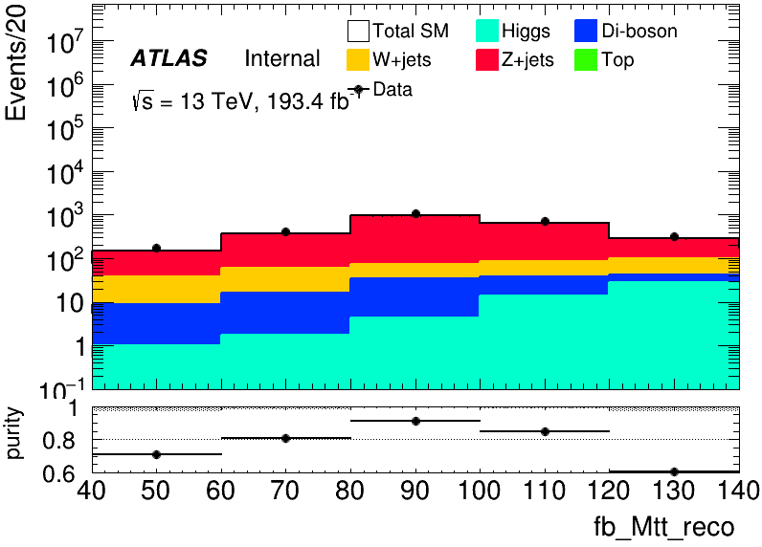
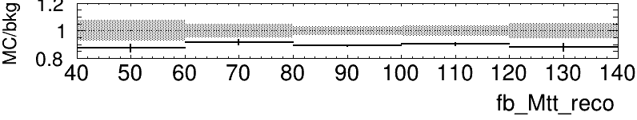
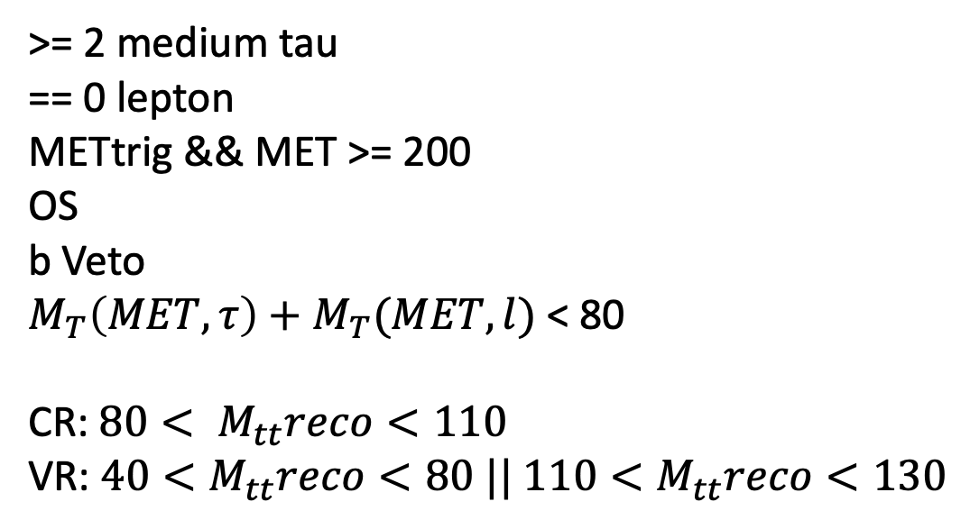
Zjets(HH)
>= 2 medium tau == 0 lepton METtrig && MET >= 200 OS b Veto $M_{T}\left(MET,τ\right)+M_{T}(MET,l)$ < 80 CR: $80< M_{tt}reco<110$ VR: $40<M_{tt}reco<80 || 110<M_{tt}reco<130$
CR: Zjets: 1222.78 +- 5.51281, MC: 1353.18 +- 8.55008, purity: 0.903629 VR: Zjets: 716.519 +- 4.33741, MC: 941.069+-12.0672, purity: 0.761388
4
Chengxin Liao
IHEP SUSY Meeting

Slide 7
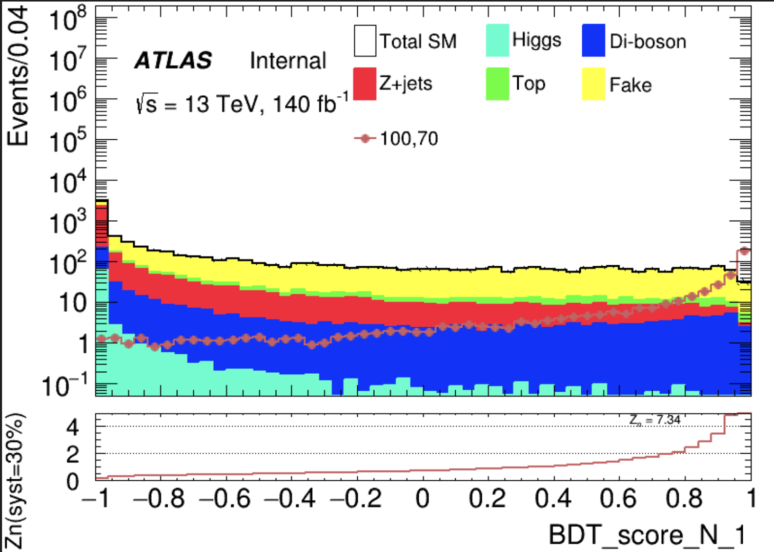
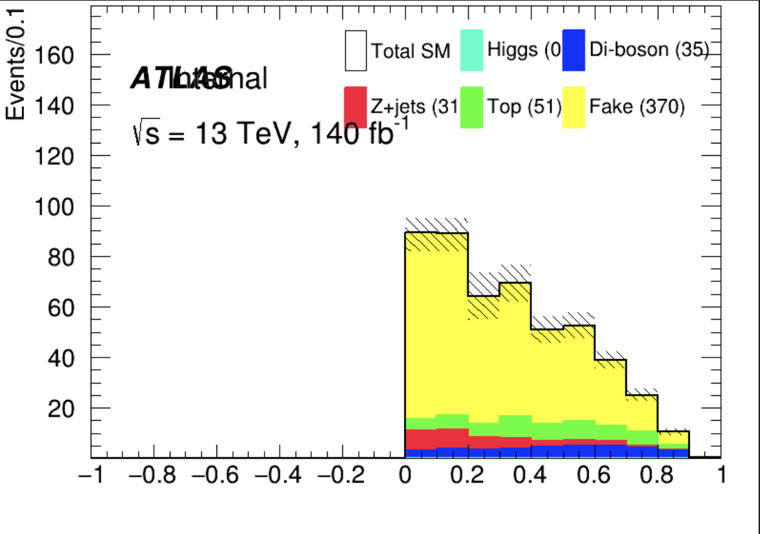
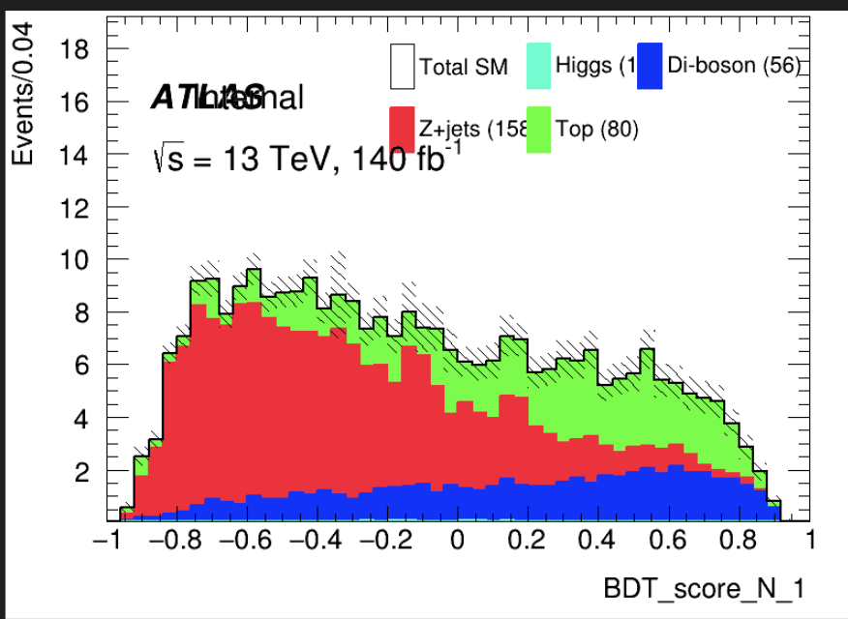
VV
Higgs: 0.74755 VV: 35.618 Zjets: 31.702 Top: 51.8255 fake: 370.709
VV_score
BDT_score : [-0.3, 0.6]
CR
VV_score
4
Chengxin Liao
IHEP SUSY Meeting

Slide 8
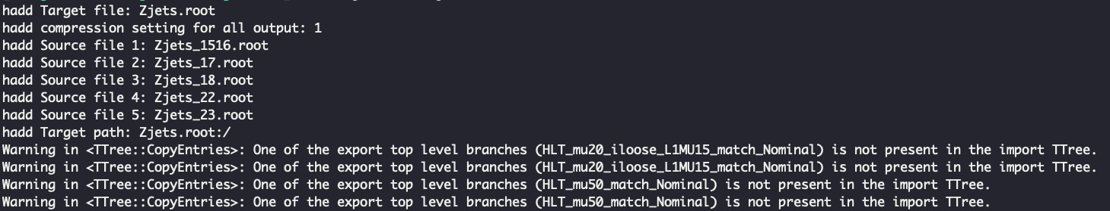
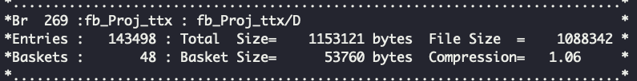
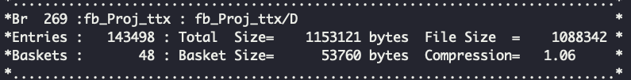
ML for Bkg estimation
All ML code is ready, something happened in file perpared
Hadd Zjets.root Zjets*
In Zjets_1516.root
In Zjets.root
Still try to find the reason for that
6
Chengxin Liao
IHEP SUSY Meeting

Slide 9
TODO
Solve merge problem and Start to ML for background estimation
Calculate FF by using jiarong’s sample(familiar with steps of FF method)
5
Chengxin Liao
IHEP SUSY Meeting

Slide 10
Backup

Slide 11
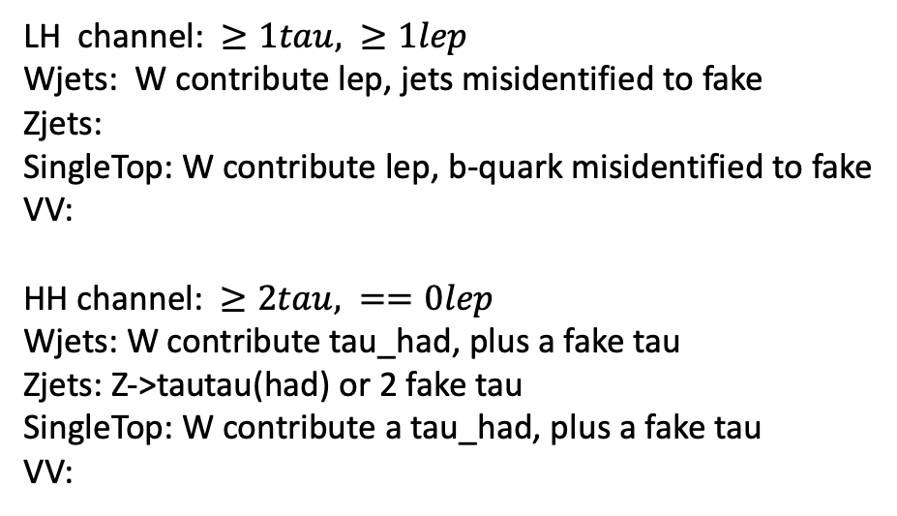
Bkg decay mode
LH channel: $≥1tau, ≥1lep$ Wjets: W contribute lep, jets misidentified to fake Zjets:
SingleTop: W contribute lep, b-quark misidentified to fake
VV: HH channel: $≥2tau, ==0lep$ Wjets: W contribute tau_had, plus a fake tau Zjets: Z->tautau(had) or 2 fake tau SingleTop: W contribute a tau_had, plus a fake tau VV:
Wjets: W->e/muon + nu W->tau+nu(can contribute true tau_had) jet misidentified to a fake tau Zjets: Z->ll/tautau jet misindentified to fake tau Top: top->W+b, W can contribute a true tau_had b-quark is a source of fake VV: W/Z
Chengxin Liao
IHEP SUSY Meeting

