Slide 1


Compressed EWK study(ISRC1N2)
Department of Physics, Shandong University
Chengxin Liao
liaocx@ihep.ac.cn
Apr, Tue 1, 2025

Slide 2
Tasklist
Bkg estimation for C1N2ISR
BSc thesis: https://www.overleaf.com/project/674e7119837a2580151a0868
Chengxin Liao
IHEP SUSY Meeting

Slide 3
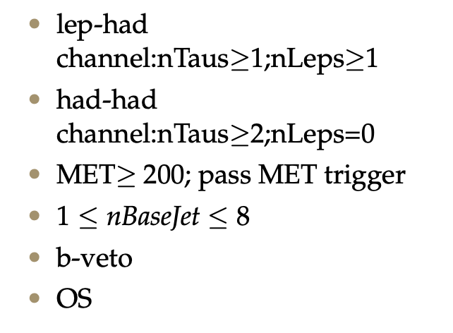
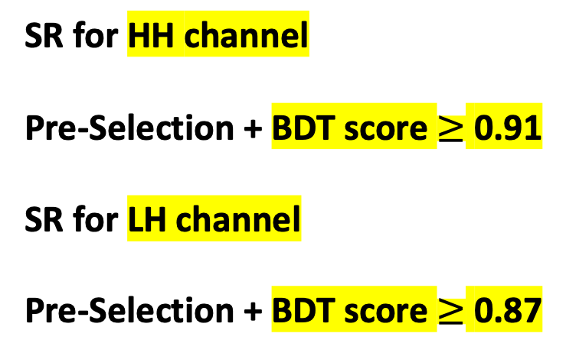
SR definition
Pre-Selection
SR for HH channel Pre-Selection + BDT score $≥$ 0.91 SR for LH channel Pre-Selection + BDT score $≥$ 0.87
hyper parameter: NTrees=500, learning rate=0.05, max depth=12, MinNodeSize=1%(default)
Nbjets > 0
hyper parameter: NTrees=400, learning rate=0.01, max depth=10, MinNodeSize=1%(default)
For Top estimation
1
Chengxin Liao
IHEP SUSY Meeting

Slide 4
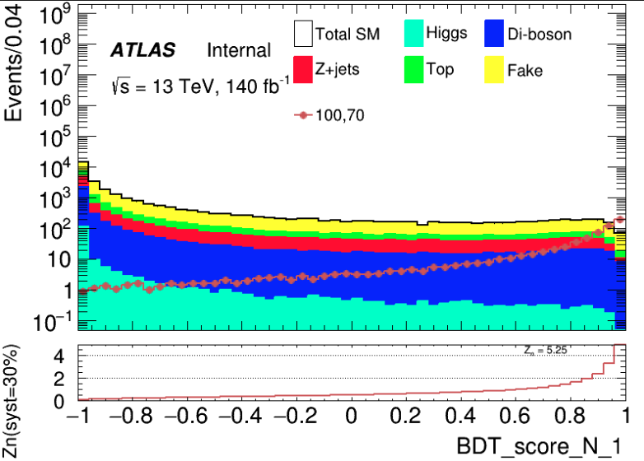
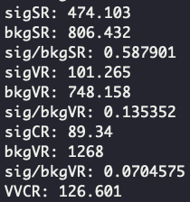
Bkg Est ML(LH)
CR: [0.4, 0.7]
VR: [0.7, 0.8]
SR: [0.8, 1.0]
CR
VR
SR
4
Chengxin Liao
IHEP SUSY Meeting

Slide 5
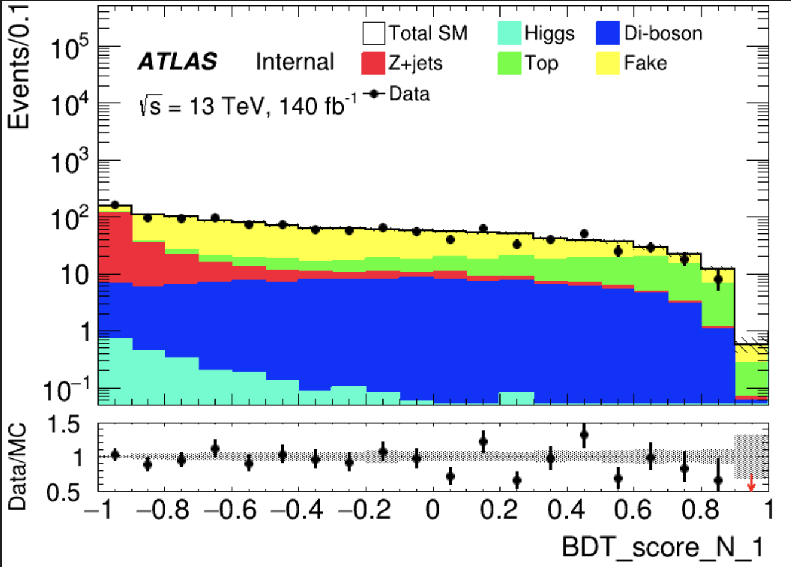
Top
VV_score cut at 0.5 purity: 0.44041 VV: 44.1305 TotalBkg: 100.203
FF method to correct that
4
Chengxin Liao
IHEP SUSY Meeting

Slide 6
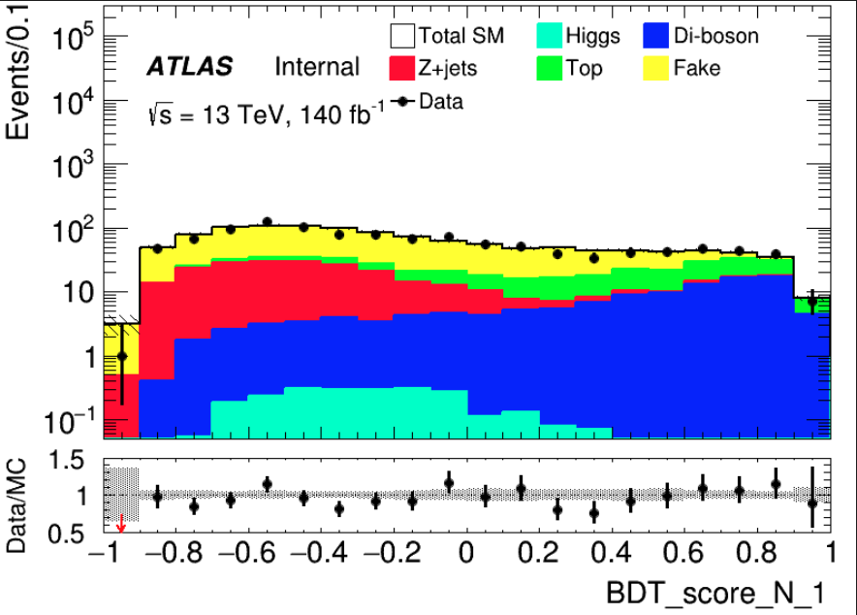
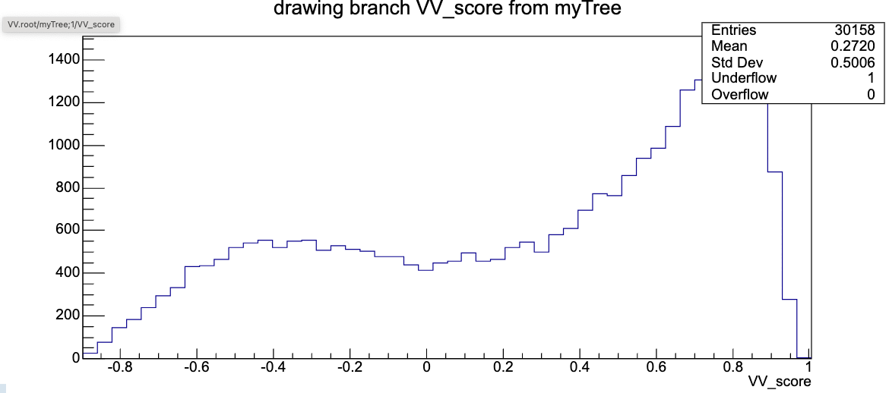
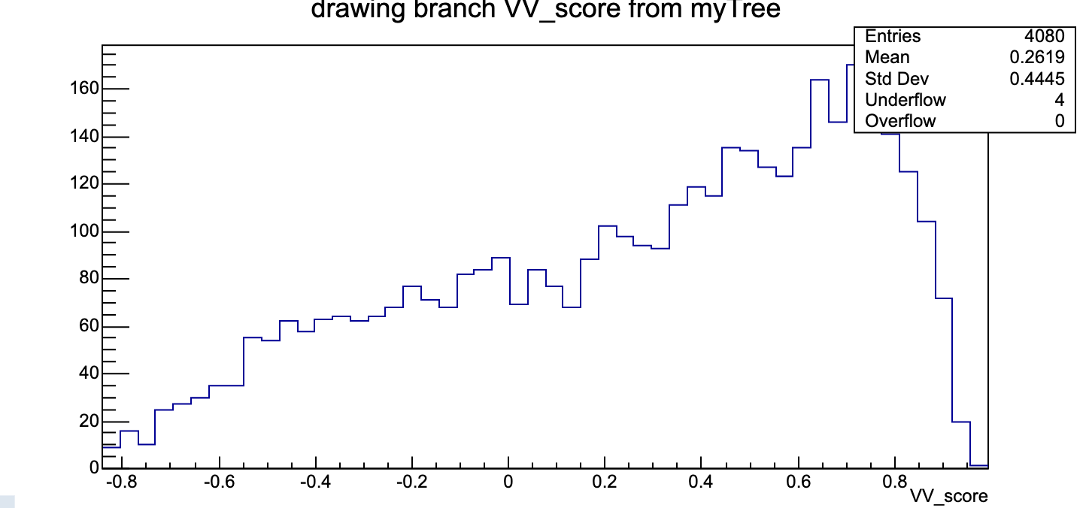
VV
VV
VV_score cut at 0.6 purity: 0.40509 VV: 51.4569 TotalBkg: 127.025
Top
VV_score
Top probably contaminate VV ? VV and Top have similar distribution
4
Chengxin Liao
IHEP SUSY Meeting

Slide 7
TODO
Solve merge problem and Start to ML for background estimation
Calculate FF by using jiarong’s sample(familiar with steps of FF method)
5
Chengxin Liao
IHEP SUSY Meeting

Slide 8
Backup

Slide 9
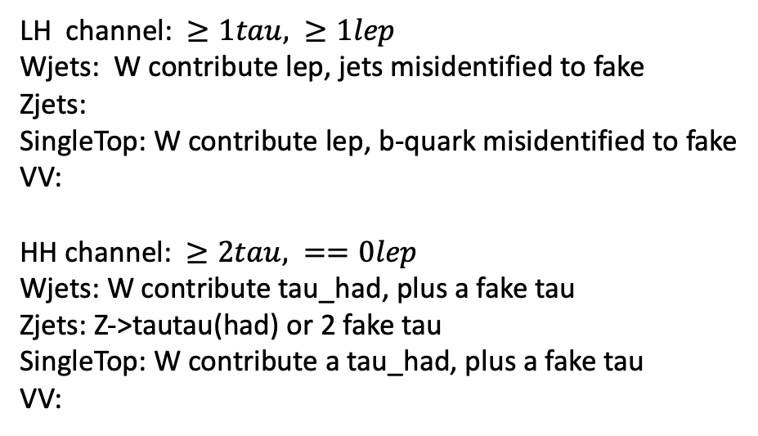
Bkg decay mode
LH channel: $≥1tau, ≥1lep$ Wjets: W contribute lep, jets misidentified to fake Zjets:
SingleTop: W contribute lep, b-quark misidentified to fake
VV: HH channel: $≥2tau, ==0lep$ Wjets: W contribute tau_had, plus a fake tau Zjets: Z->tautau(had) or 2 fake tau SingleTop: W contribute a tau_had, plus a fake tau VV:
Wjets: W->e/muon + nu W->tau+nu(can contribute true tau_had) jet misidentified to a fake tau Zjets: Z->ll/tautau jet misindentified to fake tau Top: top->W+b, W can contribute a true tau_had b-quark is a source of fake VV: W/Z
Chengxin Liao
IHEP SUSY Meeting

