Slide 1


Compressed EWK study(ISRC1N2)
Department of Physics, Shandong University
Chengxin Liao
liaocx@ihep.ac.cn
Apr, Wed 16, 2025

Slide 2
Tasklist
FF method var distribution check
Multiclass result(failed)
BSc thesis: https://www.overleaf.com/project/674e7119837a2580151a0868 (need to submit before the end of Apr)
Chengxin Liao
IHEP SUSY Meeting

Slide 3
FF method
Pre-Selection
SR(2ID):
nBaseTau == 2, medium tau == 2
nBaseJets >= 1 MET trigger & MET >= 200 OS bVeto Mtt_reco <=40 && Mtt_reco >= 130
CR(ID): nBaseTau == 1, medium tau == 1
nLeps >= 1 MET trigger & MET >= 200
bVeto
1
Chengxin Liao
IHEP SUSY Meeting

Slide 4
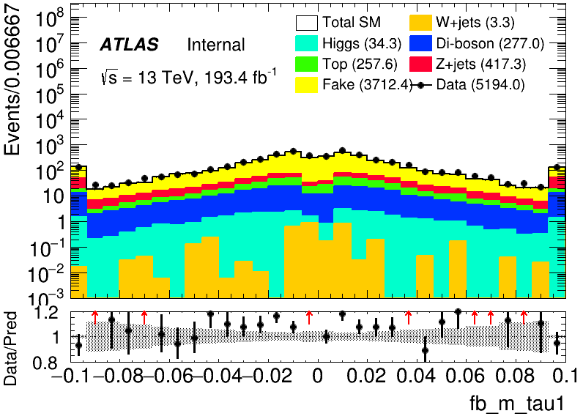
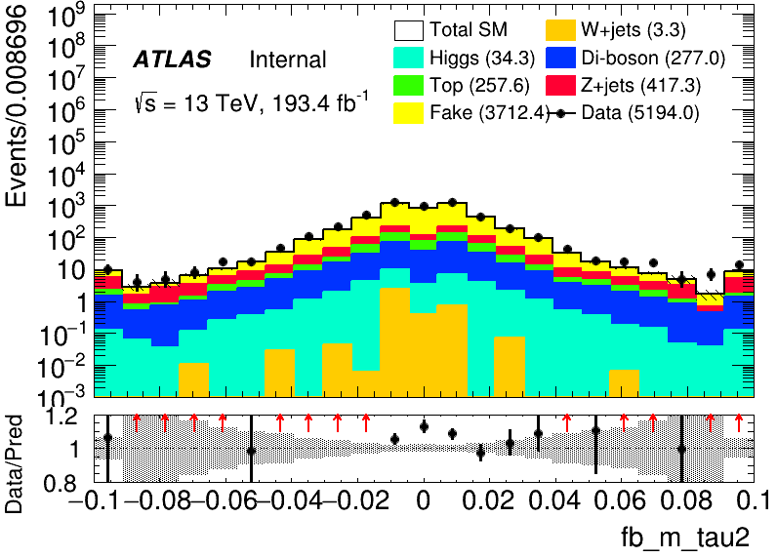
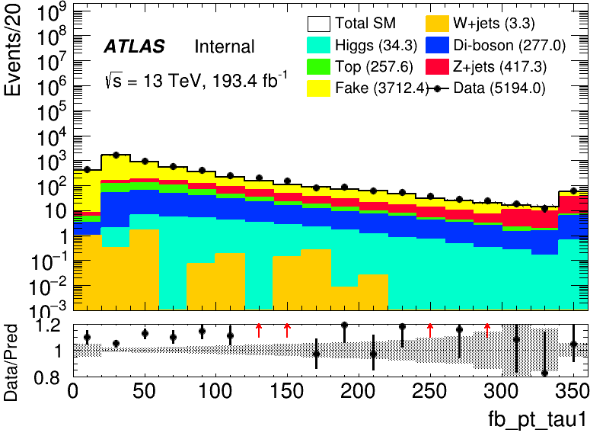
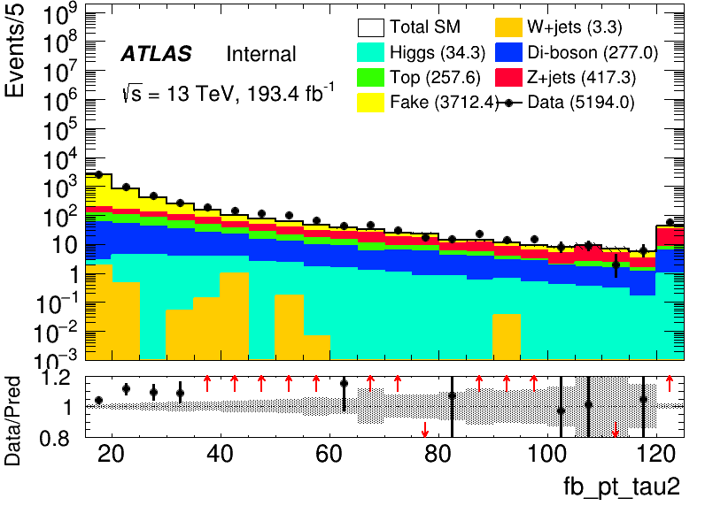
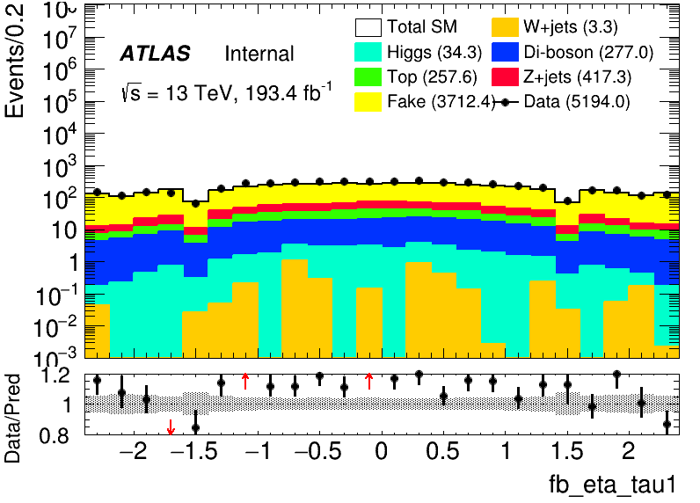
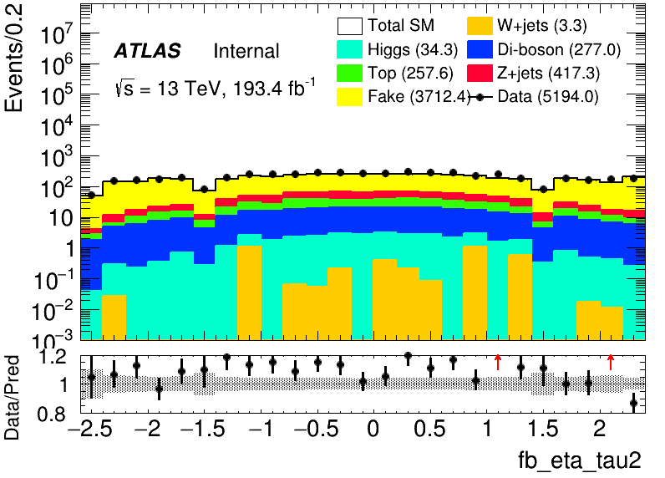
FF method
2
Chengxin Liao
IHEP SUSY Meeting

Slide 5
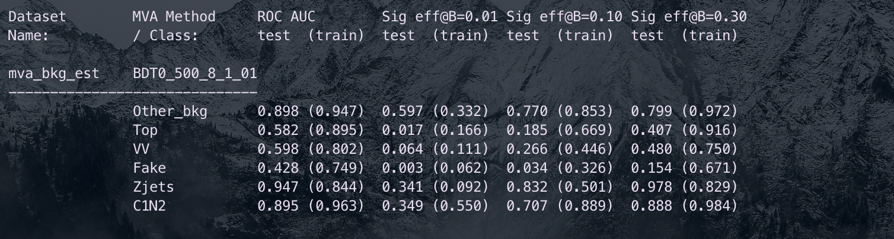
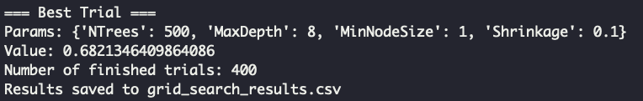
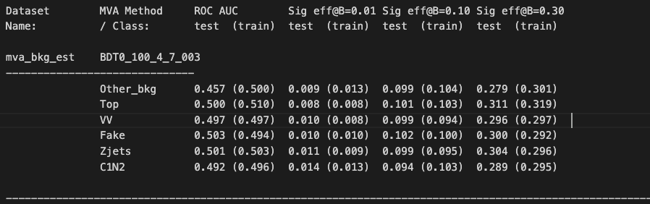
Multiclass
Try to use optuna to auto-optimize, but also failed constraint: average of AUC need to >= 0.6 penalty function: score = test_auc – 0.3*auc_gap (auc_gap = abs(train_auc- test_auc)) maximum(score)
hyperparameter setting(Grid Search)
Test_auc = \sum{Test_auc_class} Train_auc = \sum{Train_auc_class}
Severe overfit
Ntrees: [100, 200, 300, 400, 500]
MaxDepth: [4, 6, 8, 10] MinNode: [1, 3, 5, 7]
Learning rate: [0.01, 0.03, 0.05, 0.8, 0.1] 400 models
If we don’t require AUC constraint, so model will be like this the accuracy for that even lower than threw coin
3
Chengxin Liao
IHEP SUSY Meeting

Slide 6
Backup

Slide 7
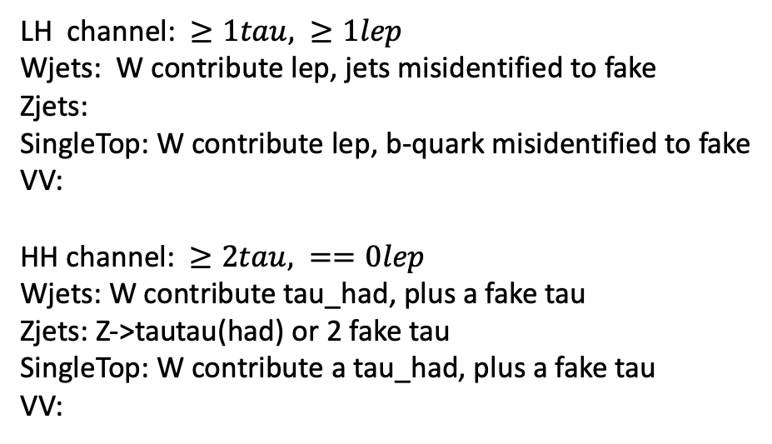
Bkg decay mode
LH channel: $≥1tau, ≥1lep$ Wjets: W contribute lep, jets misidentified to fake Zjets:
SingleTop: W contribute lep, b-quark misidentified to fake
VV: HH channel: $≥2tau, ==0lep$ Wjets: W contribute tau_had, plus a fake tau Zjets: Z->tautau(had) or 2 fake tau SingleTop: W contribute a tau_had, plus a fake tau VV:
Wjets: W->e/muon + nu W->tau+nu(can contribute true tau_had) jet misidentified to a fake tau Zjets: Z->ll/tautau jet misindentified to fake tau Top: top->W+b, W can contribute a true tau_had b-quark is a source of fake VV: W/Z
Chengxin Liao
IHEP SUSY Meeting

