Slide 1


Compressed EWK study(ISRC1N2)
Department of Physics, Shandong University
Chengxin Liao
liaocx@ihep.ac.cn
May, Wed 28, 2025

Slide 2
Tasklist
Technical tool
Git and Docker(Pro Git, Docker Docs)
With a few cpp assignments to practice https://github.com/courseworks
Update FF method with SS selection
Include more signal in ML to expand exclusion limit(Ongoing)
Chengxin Liao
IHEP SUSY Meeting

Slide 3
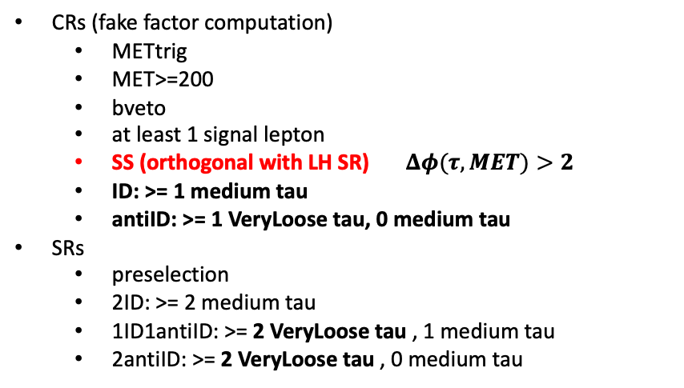
FF method
CRs (fake factor computation)
METtrig
MET>=200
bveto
at least 1 signal lepton
SS (orthogonal with LH SR) $Δφ(τ,MET)>2$
ID: >= 1 medium tau
antiID: >= 1 VeryLoose tau, 0 medium tau
SRs
preselection
2ID: >= 2 medium tau
1ID1antiID: >= 2 VeryLoose tau , 1 medium tau
2antiID: >= 2 VeryLoose tau , 0 medium tau
FF determination
Data
FF determination
Data
Use this before
CR
Pass ID
SR
Pass ID
SR
but
1 tau Fail ID
CR
Fail ID
Binned in prongness, tau eta, tau pT
Eta bins
2 bins: central [0,1.37], forward [1.52,2.5]
3 bins: eta0,1,2 for [0,1), [1, 1.37], [1.52,2.5]
Auto binning:
> 10% of events in nominator and denominator
Add bins to bin i until it is not consistent anymore with bin i - 1
Relative stat uncertainty on ratio smaller than 50%
>10% events in nominator and denominator
SR
but
2 tau Fail ID
1
Chengxin Liao
IHEP SUSY Meeting

Slide 4
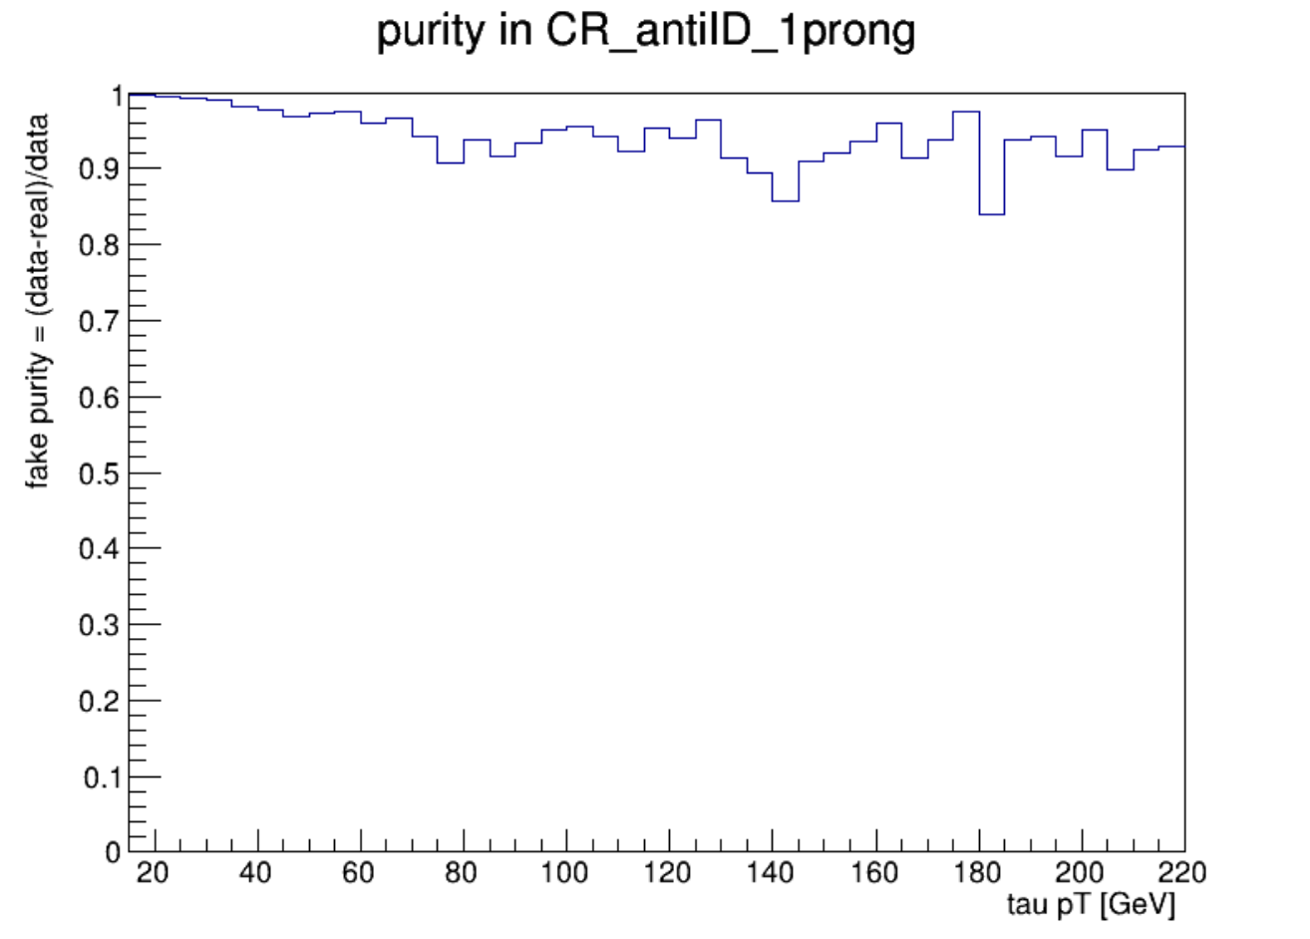
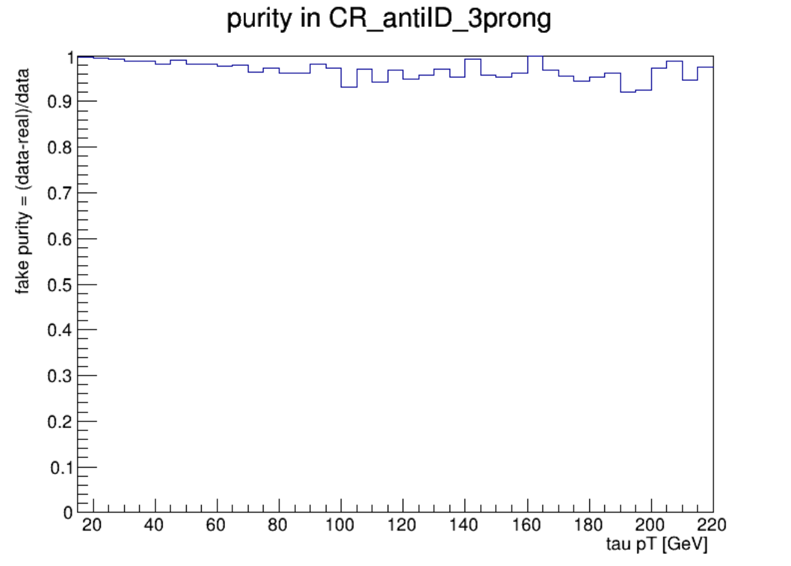
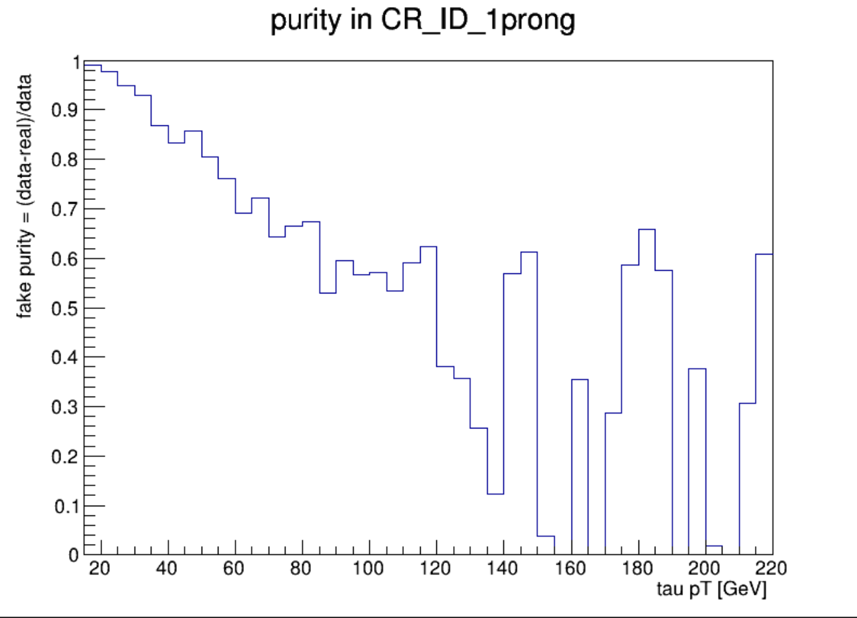
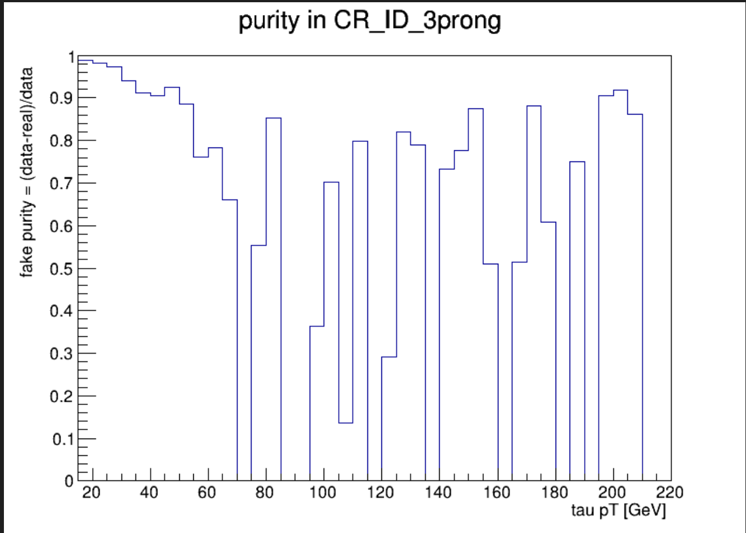
FF method
2
Chengxin Liao
IHEP SUSY Meeting

Slide 5
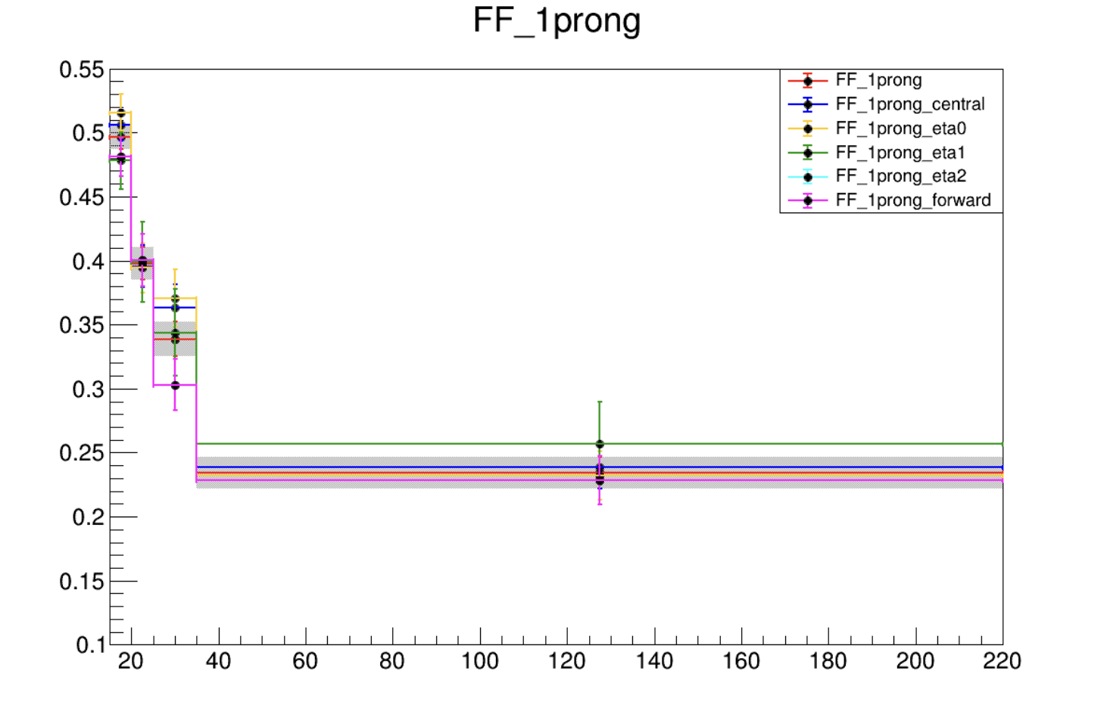
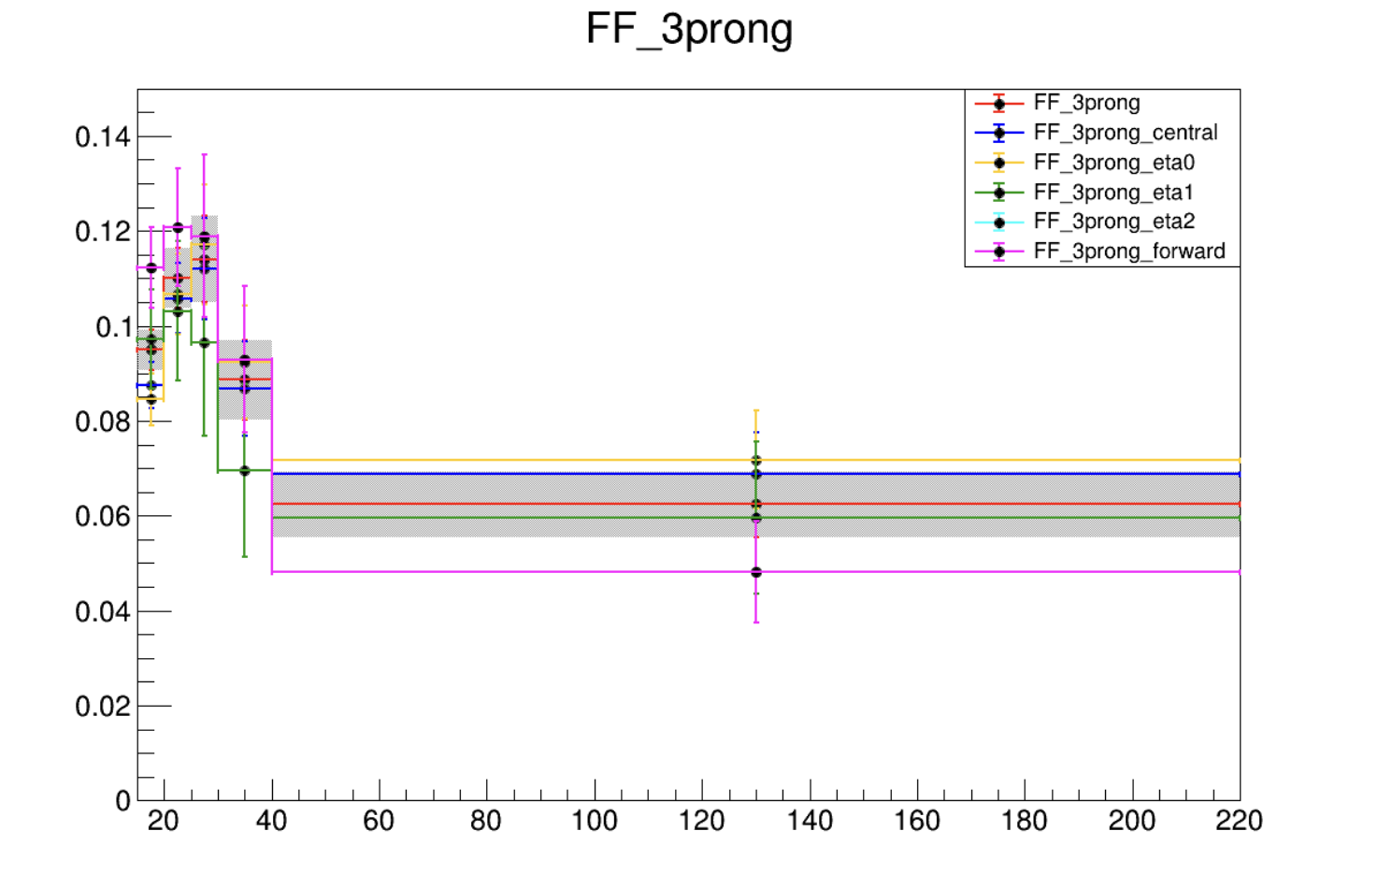
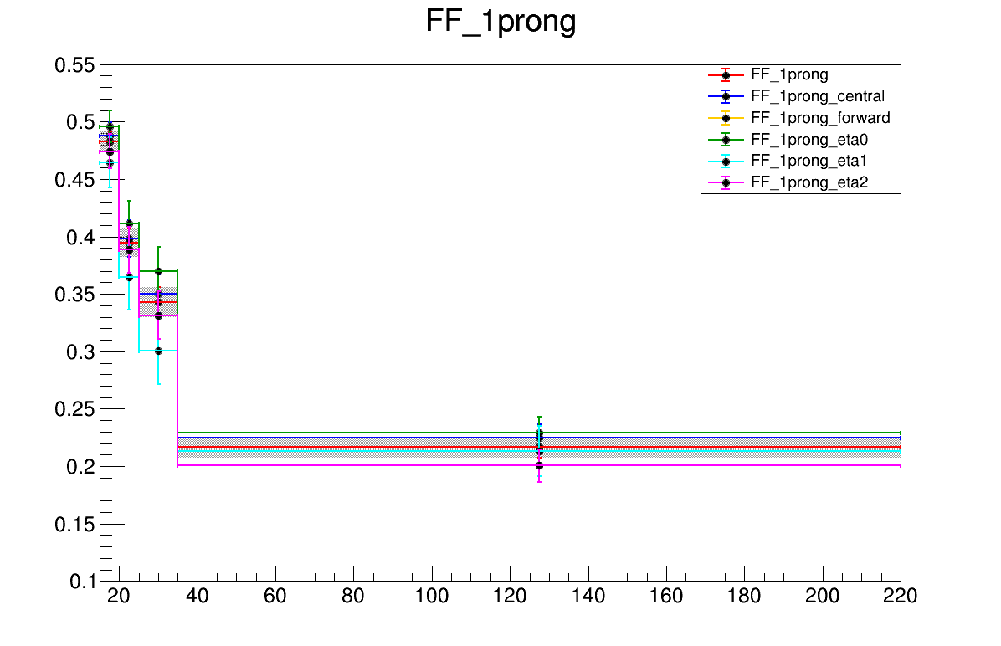
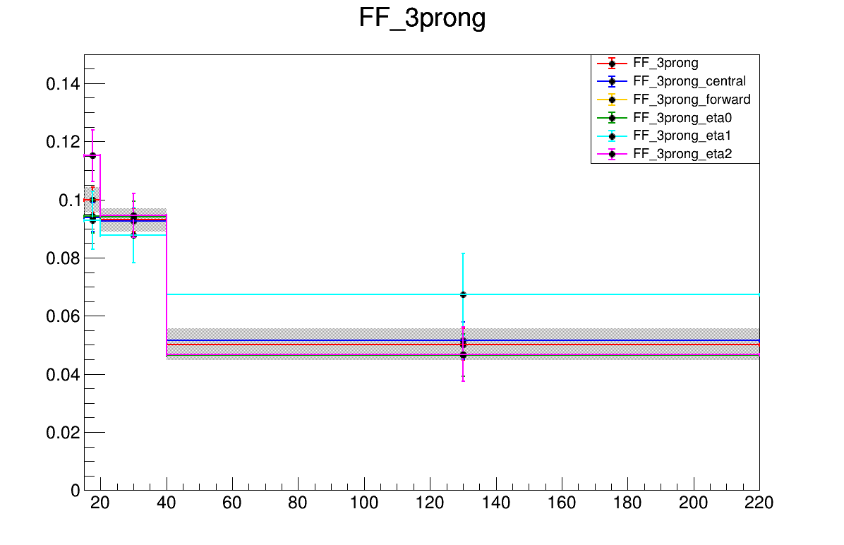
FF method
Updated result
Previous result
3
Chengxin Liao
IHEP SUSY Meeting

Slide 6
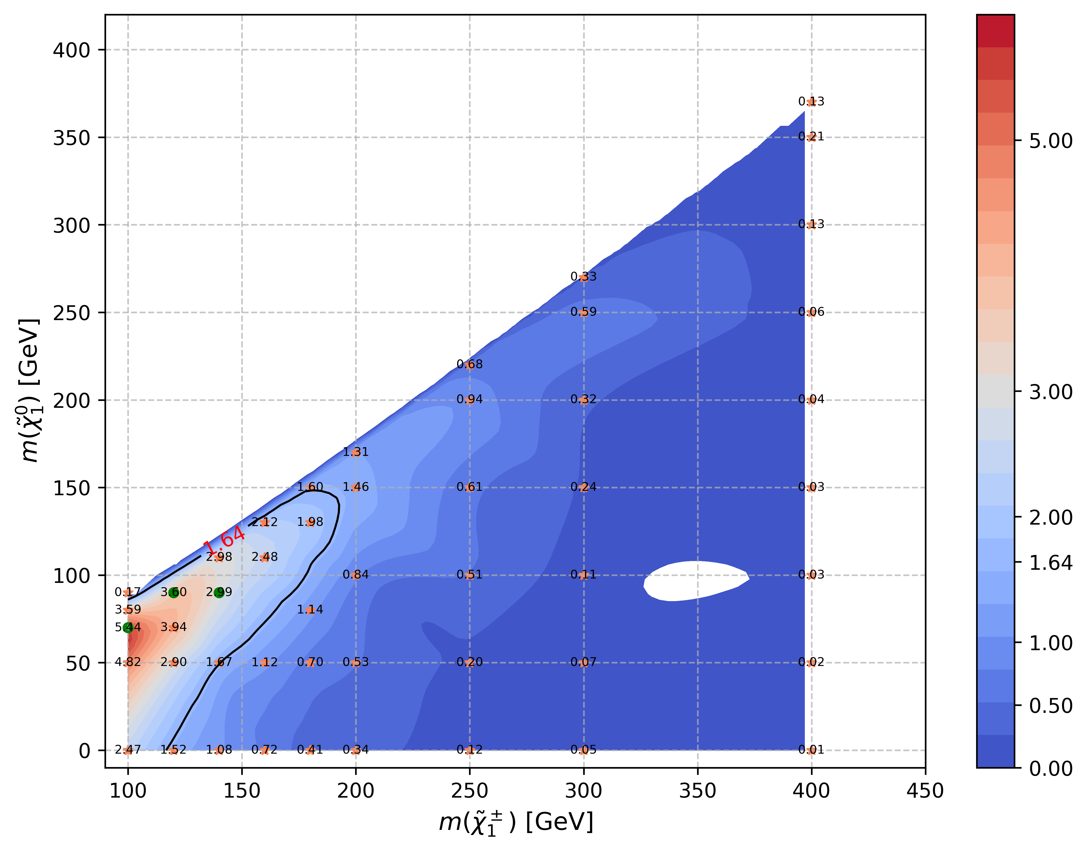
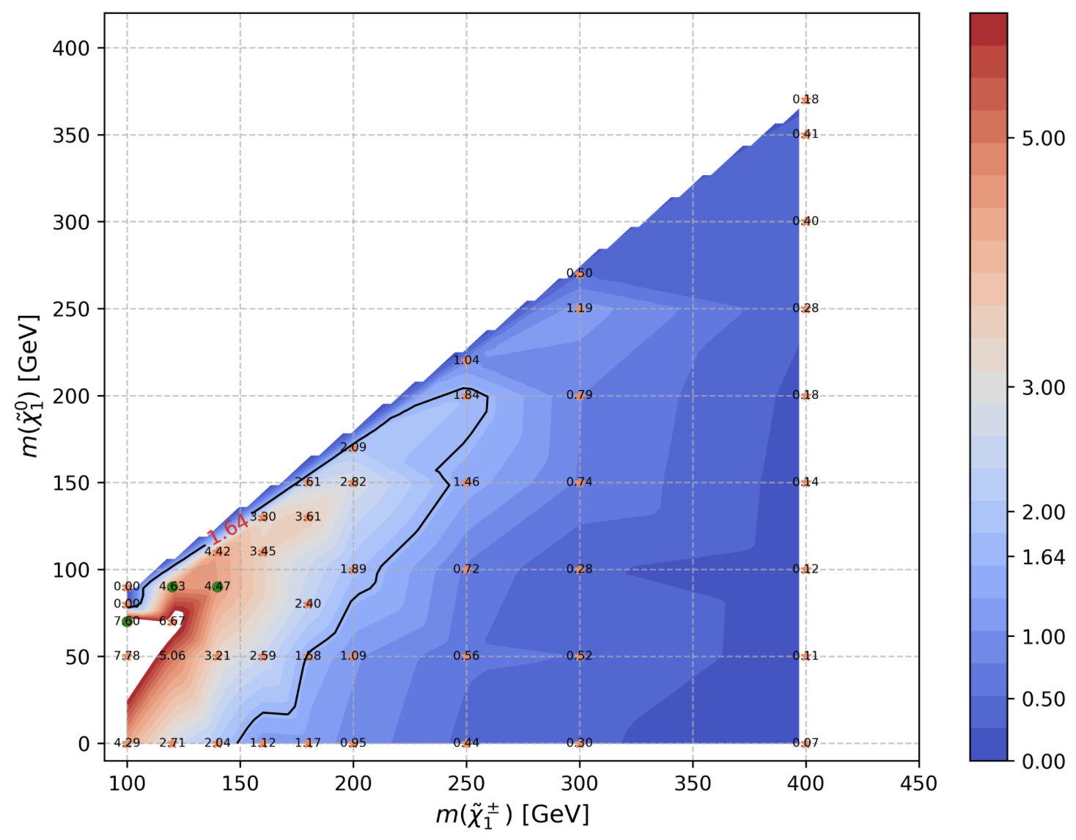
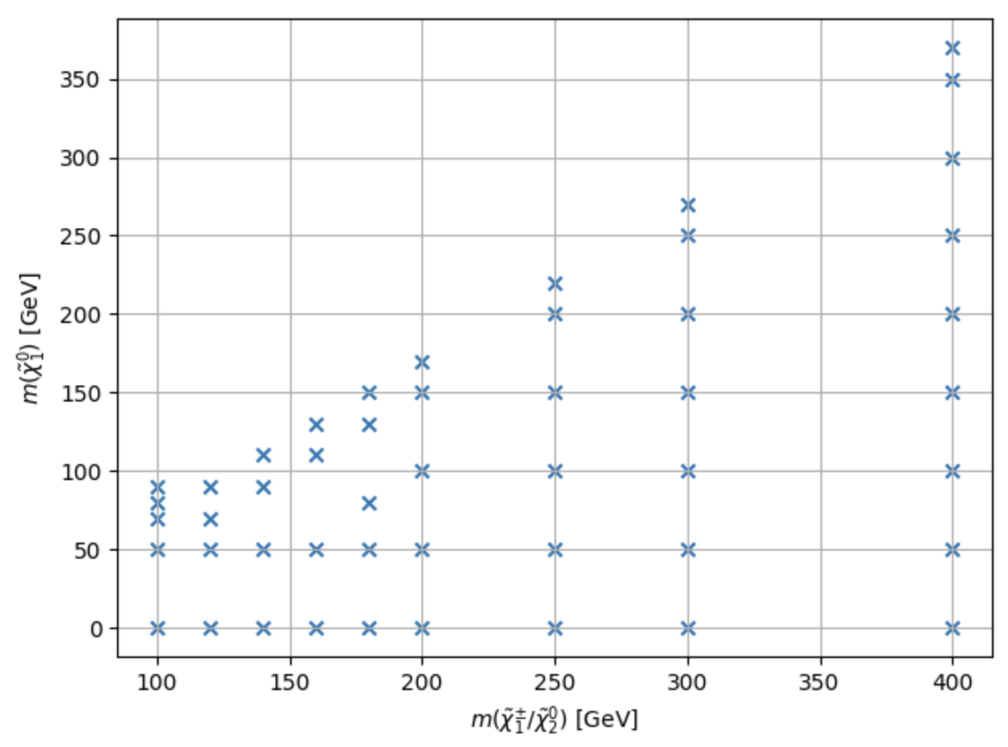
SR(HH)
Include signal: 100_70, 120_90, 140_90
Previous result(Run2 only with 100_70)
Run2+partial Run3 and with more signal points
For now, signal only include 2TFilter
include more signal to see if it can expand the limit
4
Chengxin Liao
IHEP SUSY Meeting

Slide 7
TODO
1. include 1TFilter signal in the sensitivity map
2. apply the same process in the LH channel
3. compare the Run2+partial Run3 result with only Run2 result
5
Chengxin Liao
IHEP SUSY Meeting

Slide 8
Backup

Slide 9
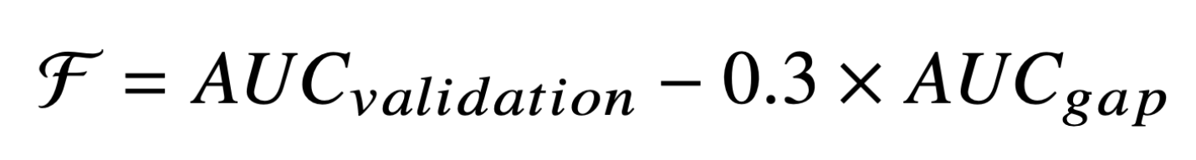
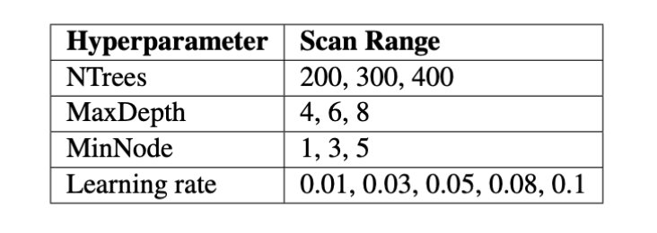
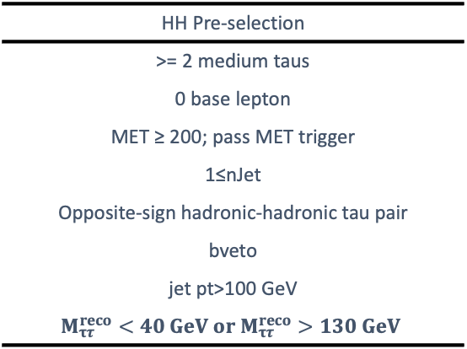
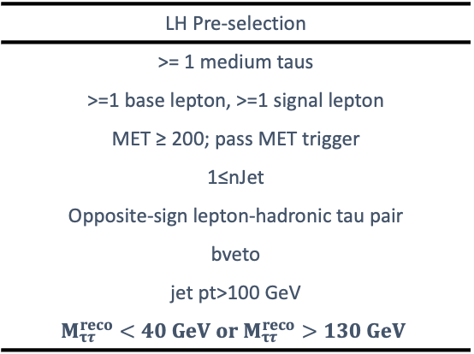
C1N2 ISR signal region optimization
Preselection for HH and LH channel
BDT method for signal region optimization
Figure of merit: AUC
5-fold Cross-Validation
HH Pre-selection
>= 2 medium taus
0 base lepton
MET ≥ 200; pass MET trigger
1≤nJet
Opposite-sign hadronic-hadronic tau pair
bveto
jet pt>100 GeV
$$M_{ττ}^{reco}<40 GeV or M_{ττ}^{reco}>130 GeV$$
LH Pre-selection
>= 1 medium taus
>=1 base lepton, >=1 signal lepton
MET ≥ 200; pass MET trigger
1≤nJet
Opposite-sign lepton-hadronic tau pair
bveto
jet pt>100 GeV
$$M_{ττ}^{reco}<40 GeV or M_{ττ}^{reco}>130 GeV$$
Penalty function to balance the AUC and overfit
Grid Search for the best model

