Slide 1
Compressed EWK study(ISRC1N2)
Chengxin Liao
liaocx@ihep.ac.cn
Jun, Wed 11, 2025

Slide 2
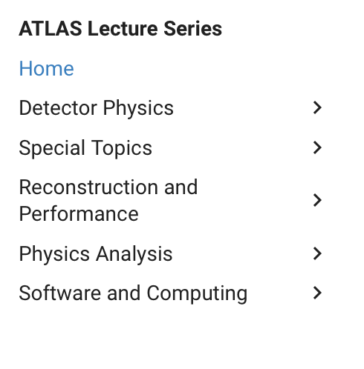
Tasklist
Technical tool
Git and Docker(Pro Git, Docker Docs)
With a few cpp assignments to practice https://github.com/courseworks(Done) APU1400-2
Next Step: GNU make & CMake, follow how to write makefile and Official CMake Tutorial
Follow ATLAS Lecture Seriers and ATLAS Software Tutorial to get more fundamental analysis knowledge
Compare CR and VR key parameters/distribution between run2 and run2+partial run3 sample(ongoing)

