Slide 1
Compressed EWK study(ISRC1N2)
Chengxin Liao
liaocx@ihep.ac.cn
Jun, Wed 25, 2025

Slide 2
Tasklist
Technical tool
Git and Docker(Pro Git, Docker Docs)
GNU make & CMake, follow how to write makefile and Official CMake Tutorial
Update the FF and correct some bug after double check with wenyi(About Systematic error for FF?)
Analysis the Run 2 and Run 3 samples separately and check the modeling in SR

Slide 3
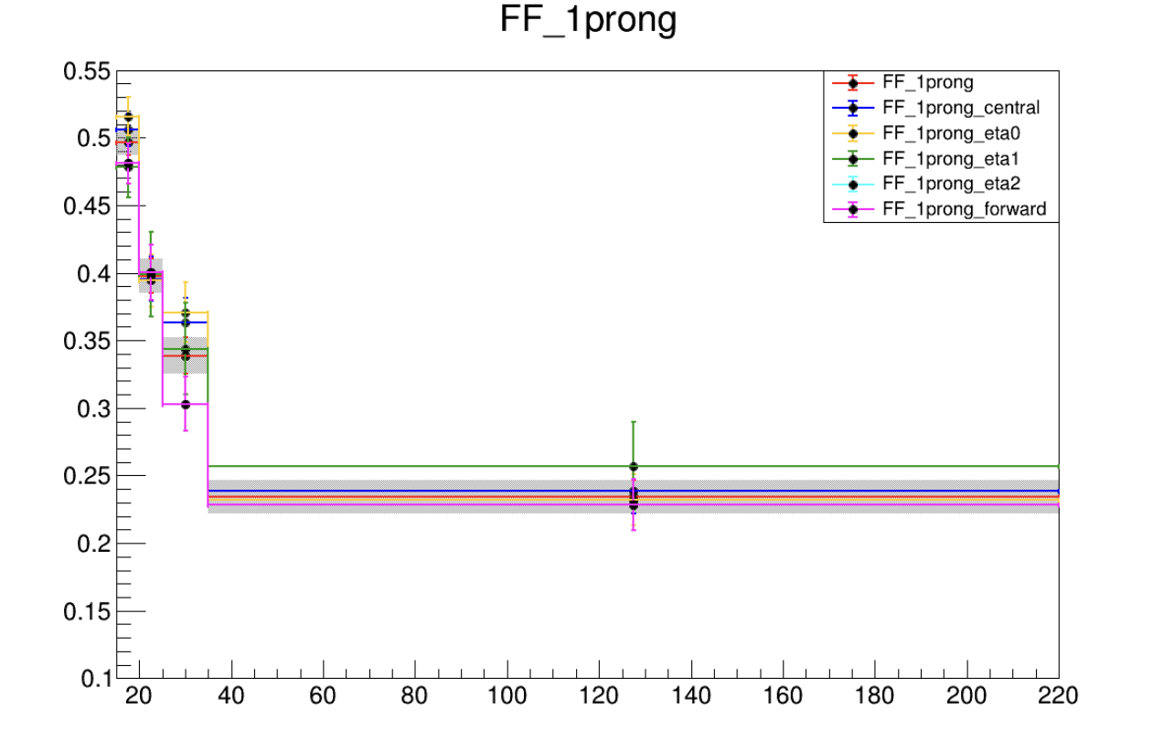
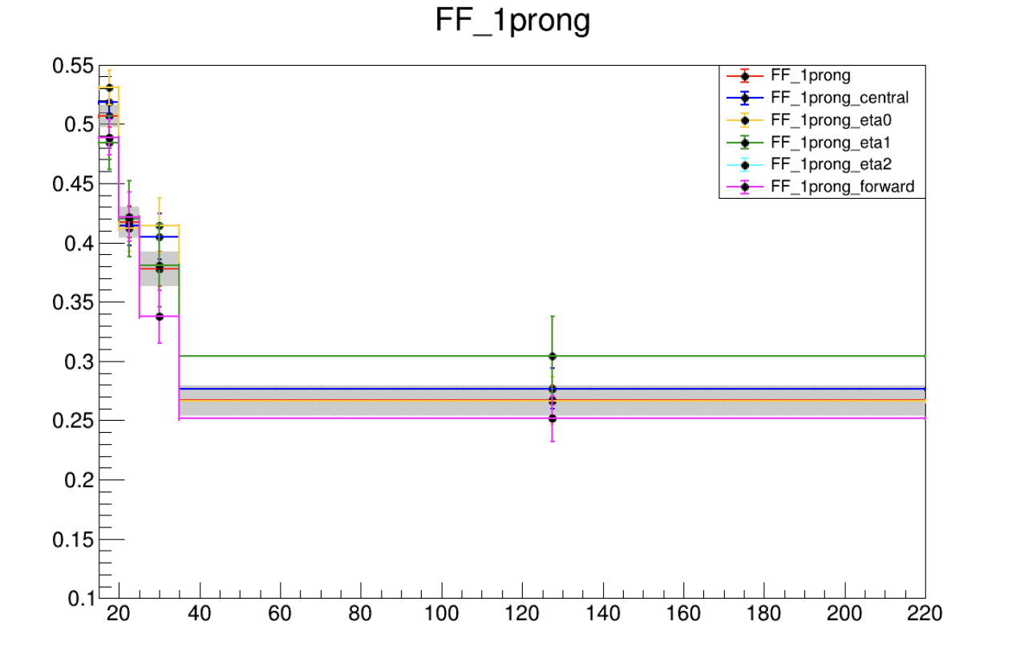
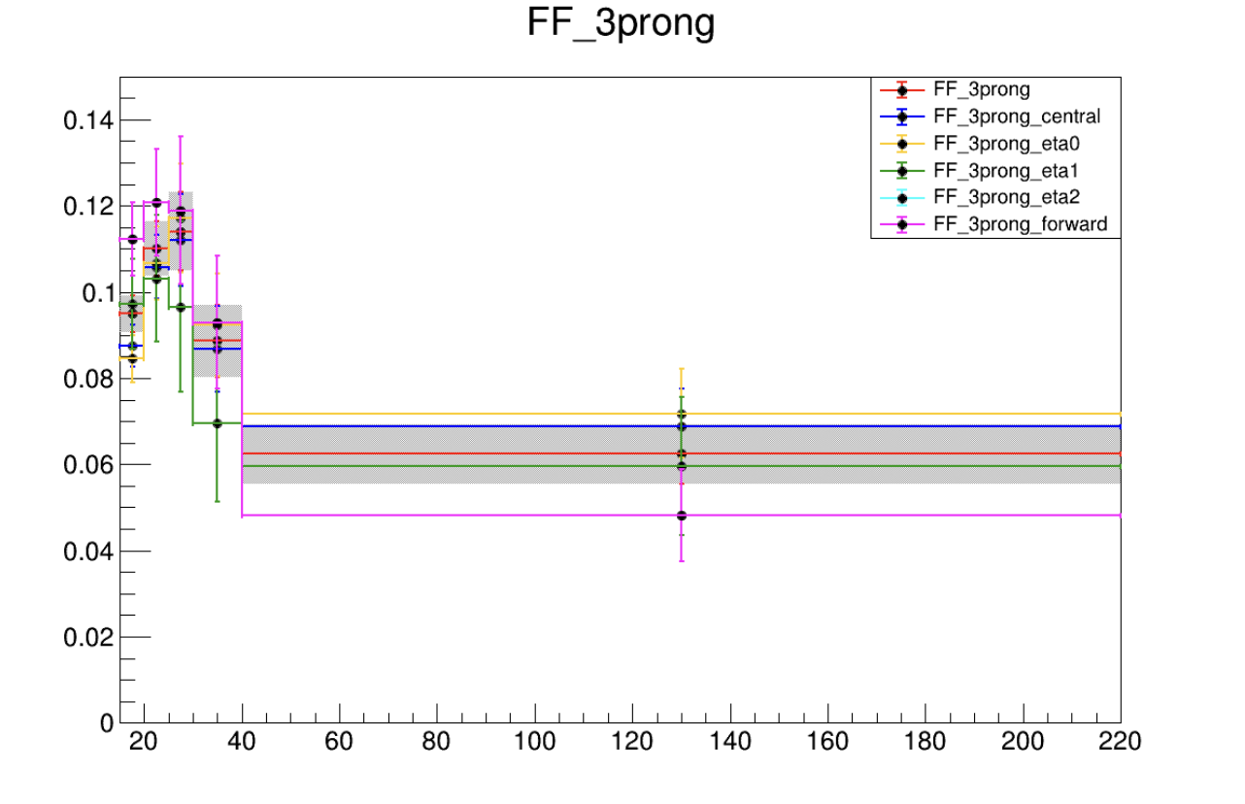
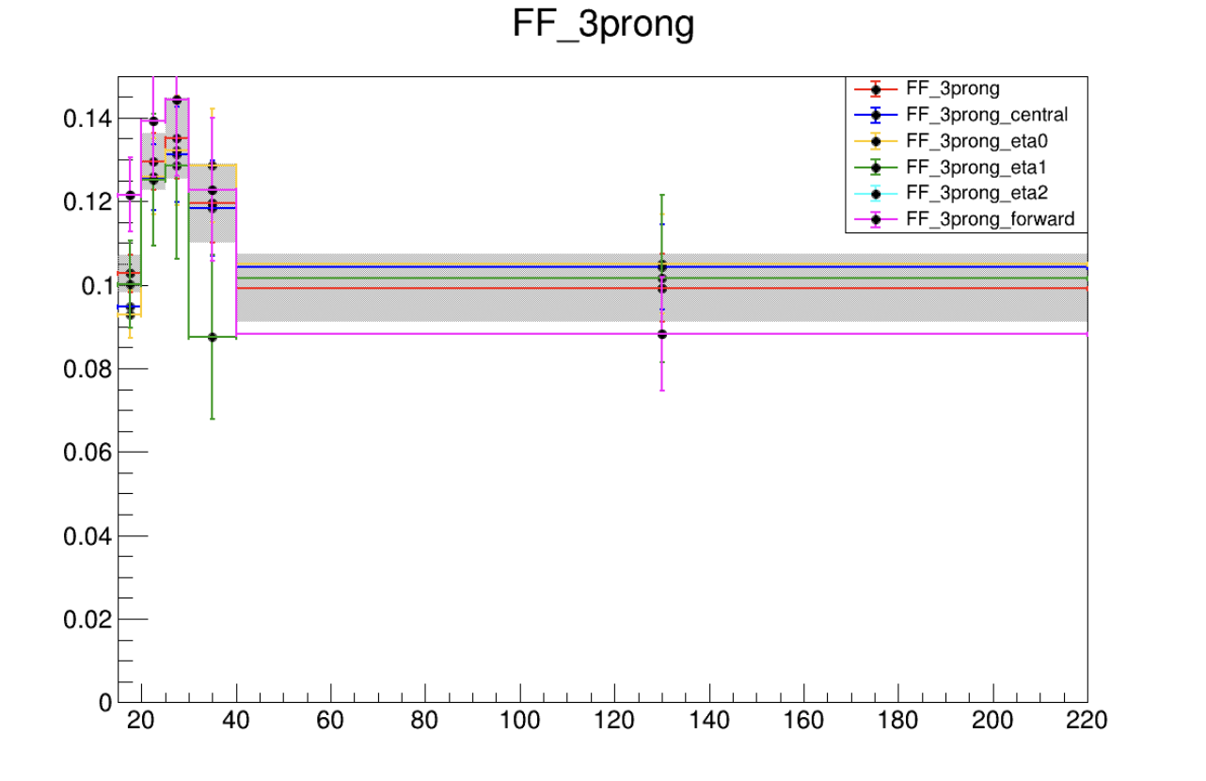
Fake Factor Update
Prev
New
Same setting but different result
Don’t know why for now

Slide 4
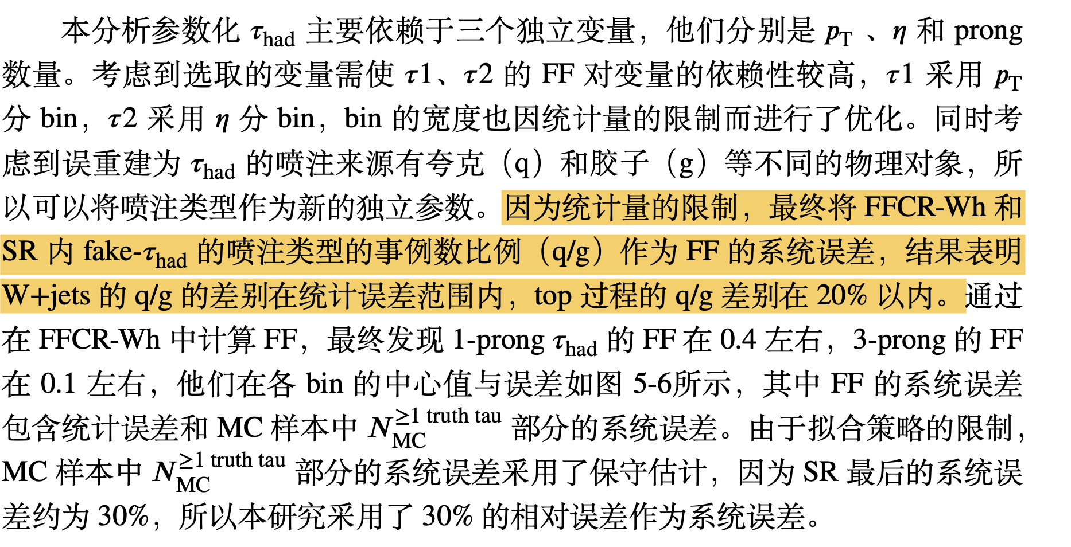
Fake Factor Update
Cite from yuchen’s thesis, so what’s systematic error for our case?

