Slide 1
IHEP SUSY Group Meeting
Chengxin Liao
Institute of High Energy Physics Chinese Academy of Sciences Jul 13, 2025

Slide 2
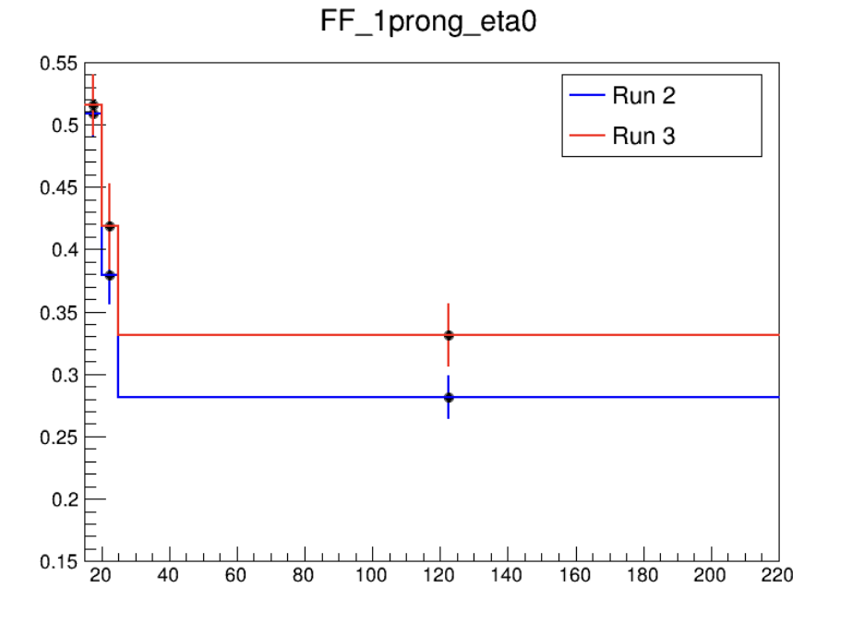
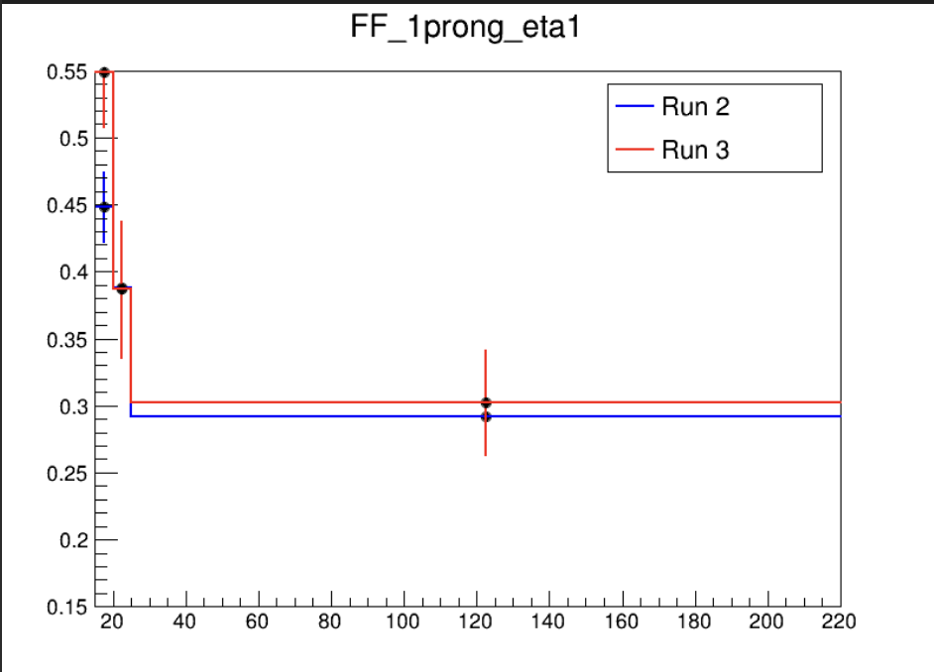
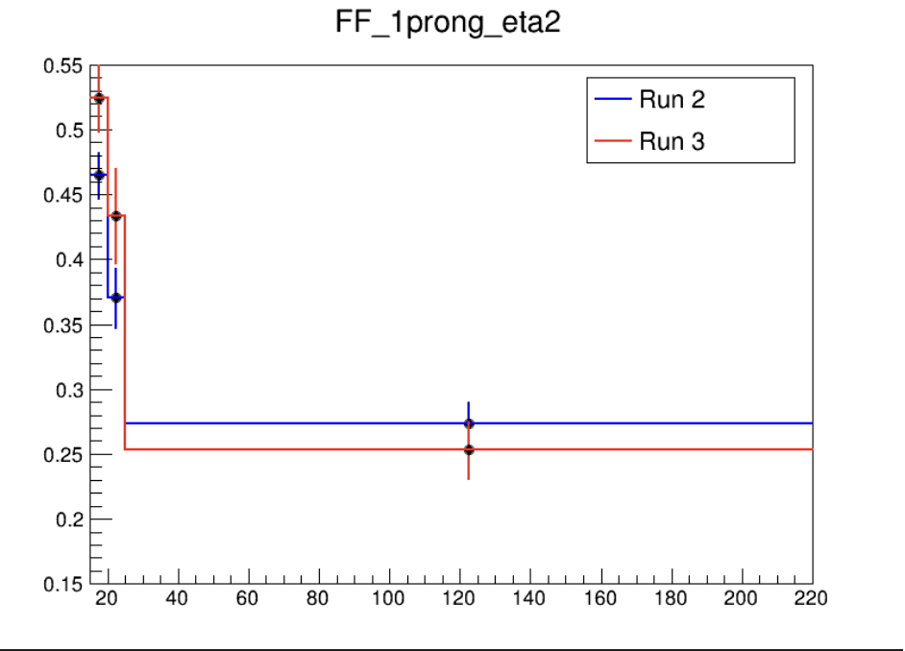
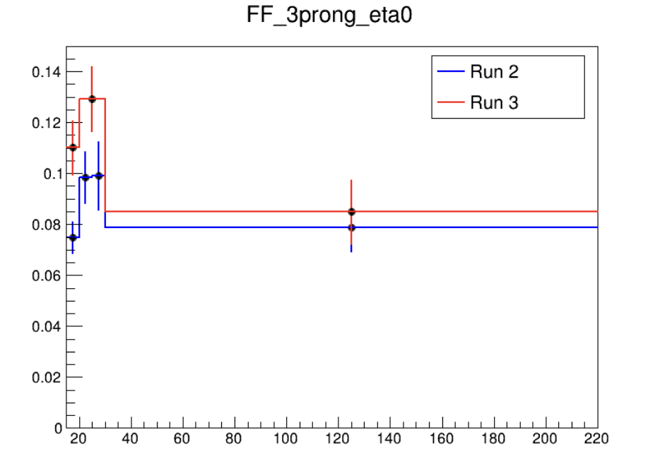
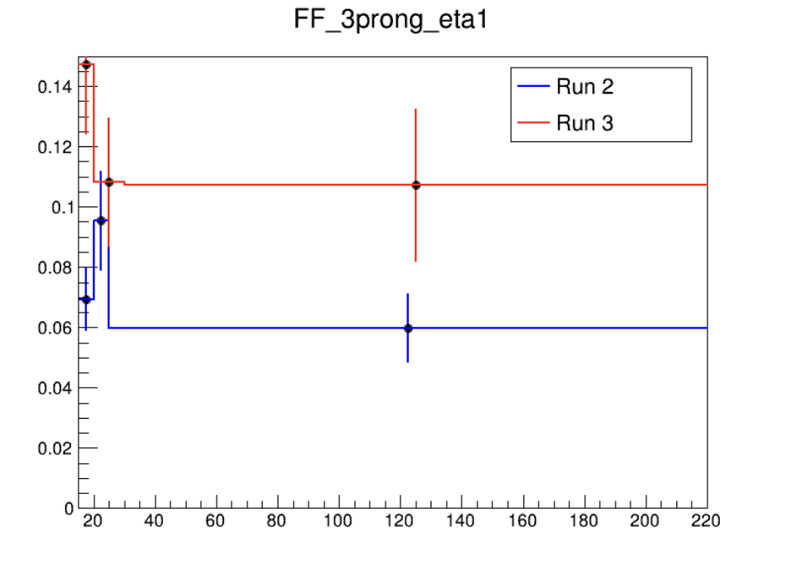
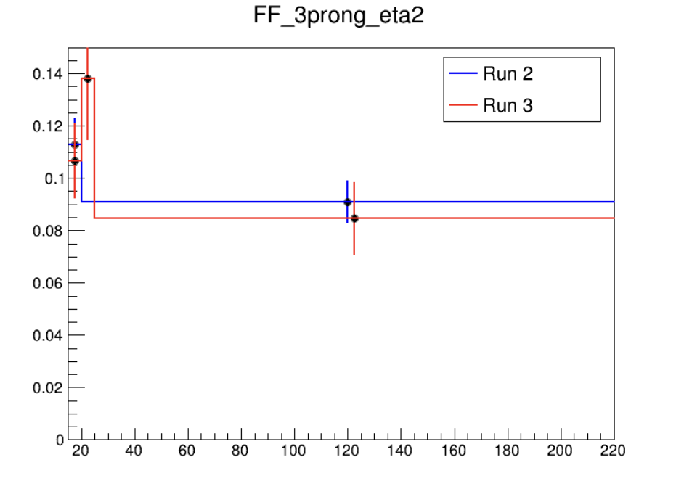



Fake Factor for Run2 and Run3
$0<|η|<1$
$1<|η|<1.37$
$1.52<|η|<2.5$
Selection:
nBaseTau == 1
nBaseLep >= 1, SigLep >= 1 MET trigger, MET >= 200
Same-Signal(Orthogonal with SR) bVeto ID: nMediumTau == 1 antiID: nMediumTau < 1
Wait for wenyi’s result to cross-check

