Slide 1
IHEP SUSY Group Meeting
Chengxin Liao
Institute of High Energy Physics Chinese Academy of Sciences Jul 16, 2025

Slide 2
C1N2 Status
FF already cross-check with wenyi and result can be matched
BDT training for run2 already finished and apply the model to run2 sample and run3 sample
Update LCG version and test code(Ongoing)
Update support-note(Ongoing)

Slide 3
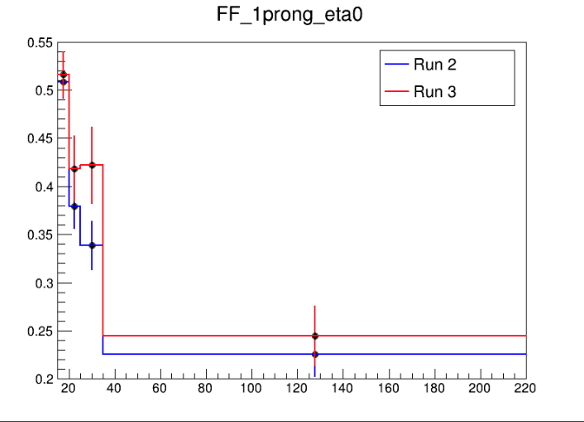
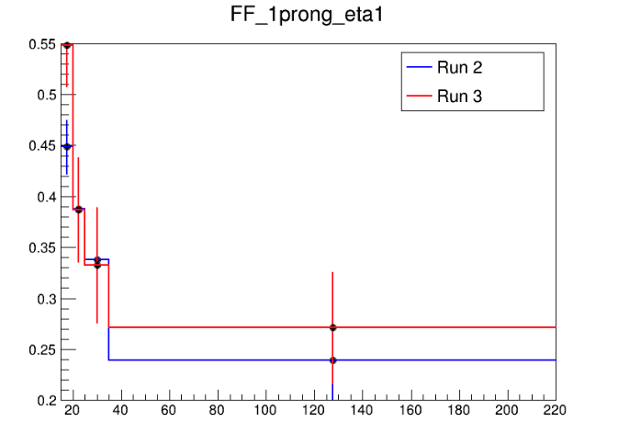



Fake Factor for Run2 and Run3
$0<|η|<1$
$1<|η|<1.37$
$1.52<|η|<2.5$
Selection:
nBaseTau == 1
nBaseLep >= 1, SigLep >= 1 MET trigger, MET >= 200
Same-Signal(Orthogonal with SR) bVeto ID: nMediumTau == 1 antiID: nMediumTau < 1
A small bump show in the last bin

Slide 4
Pre-Selection
HH Pre-selection
>= 2 medium taus
0 base lepton
MET ≥ 200; pass MET trigger
1≤nJet
Opposite-sign hadronic-hadronic tau pair
bveto
jet pt>100 GeV
Mtt_reco <= 40 GeV || Mtt_reco >= 130GeV
LH Pre-selection
>= 1 medium taus
1 base lepton, 1 signal lepton
MET ≥ 200; pass MET trigger
1≤nJet
Opposite-sign lepton-hadronic tau pair
bveto
jet pt>100 GeV
Mtt_reco <= 40 GeV || Mtt_reco >= 130GeV

Slide 5
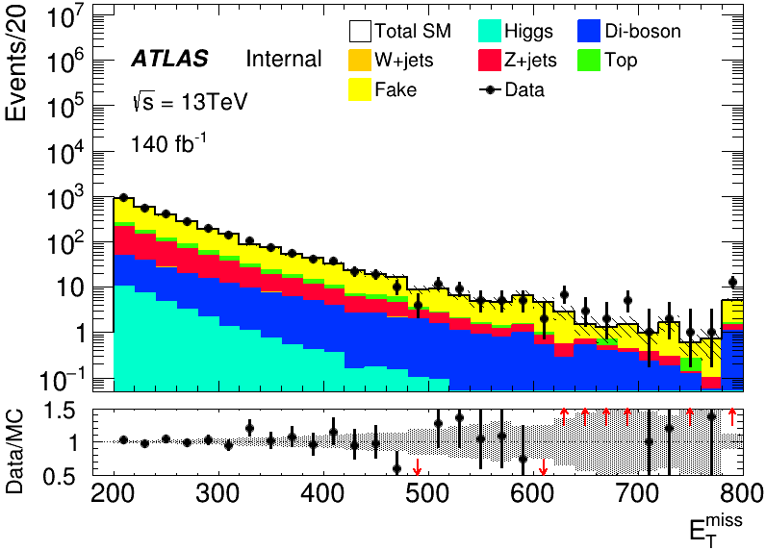
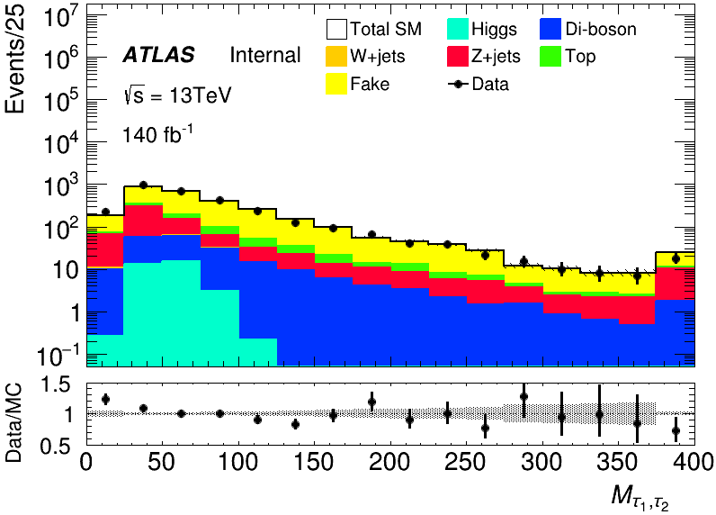
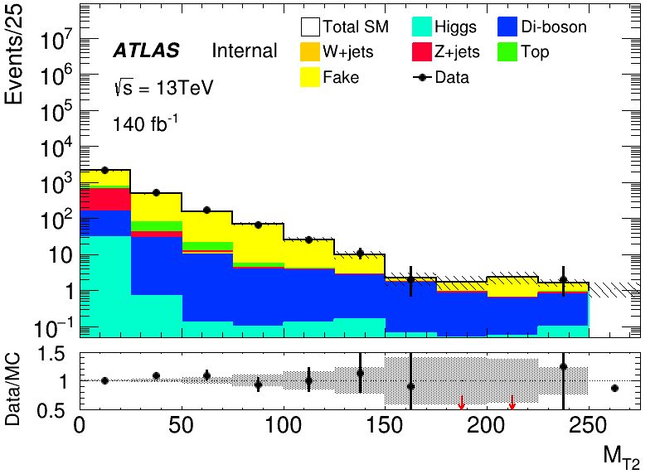
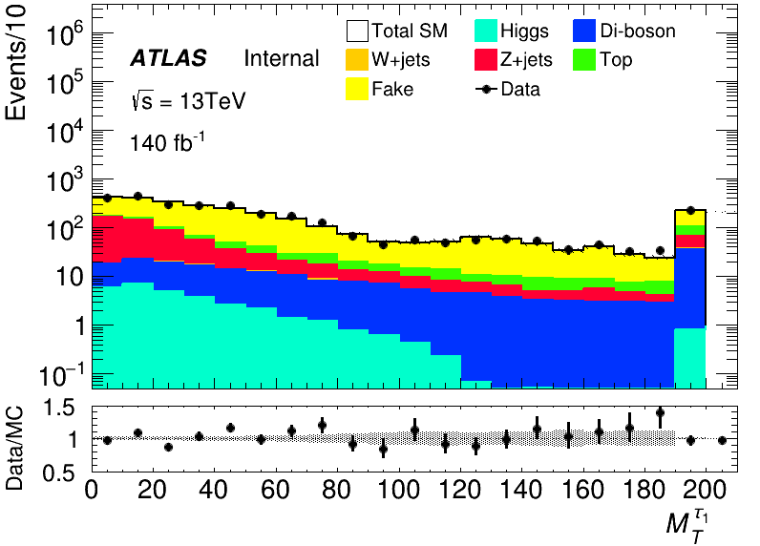
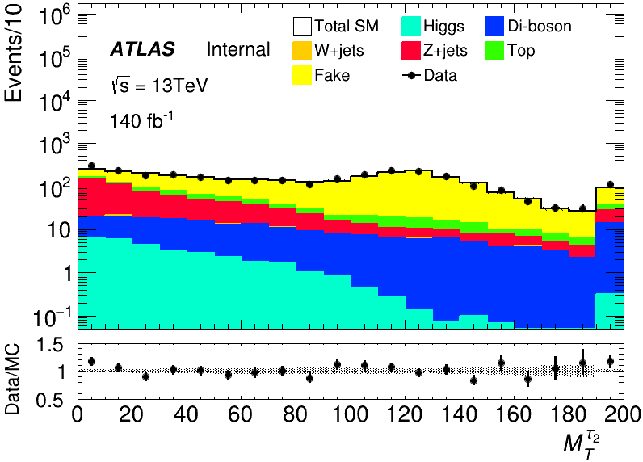
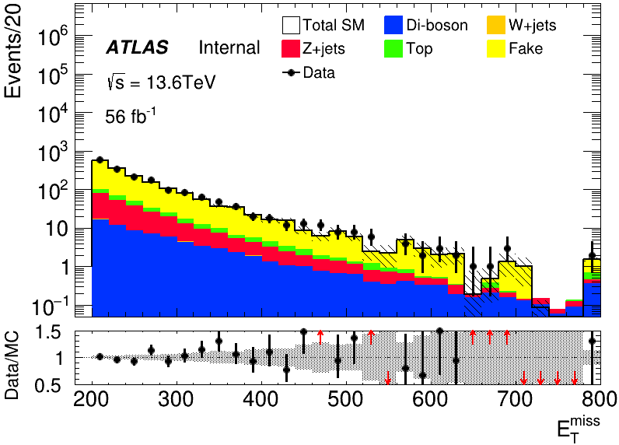
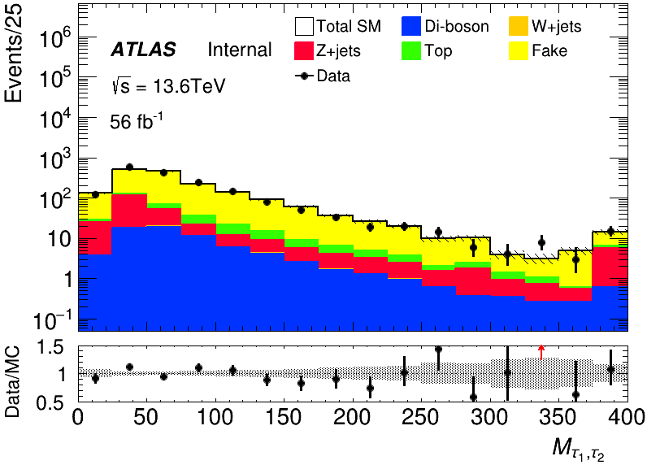
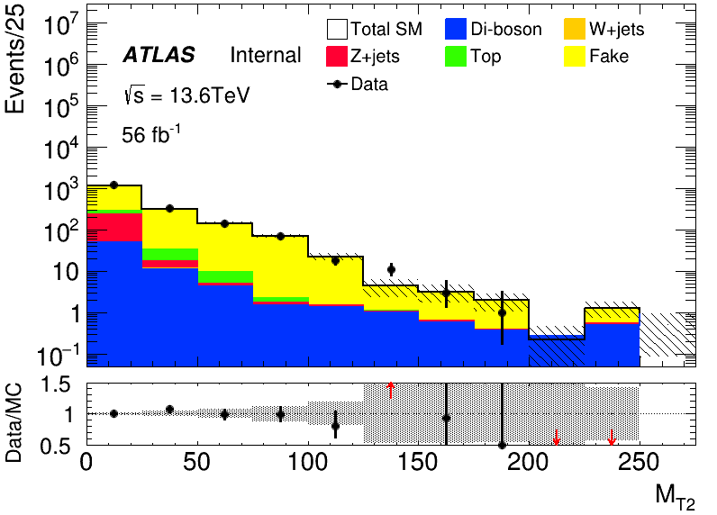
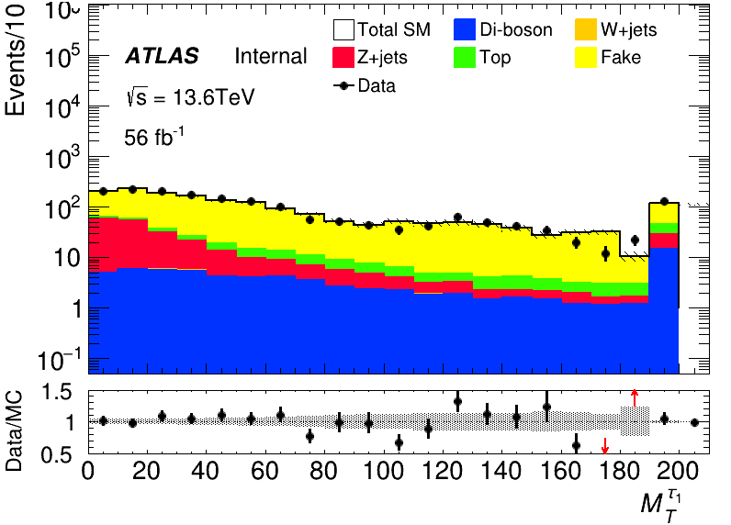
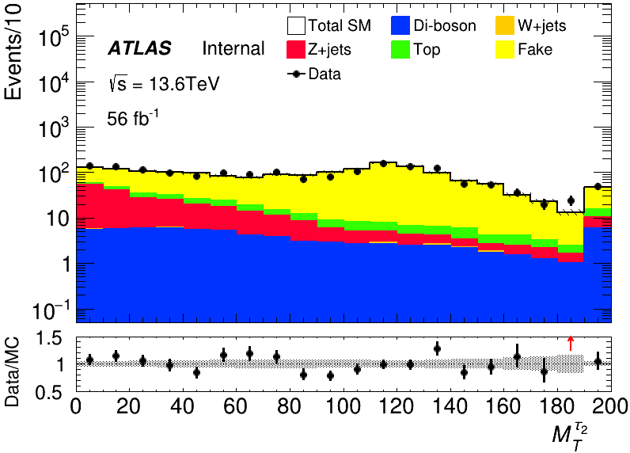
MC modeling in Pre-Selection(HH)
run2
run3

Slide 6
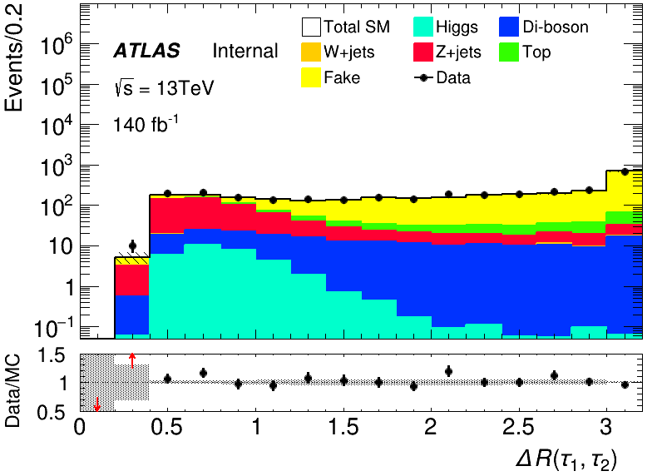
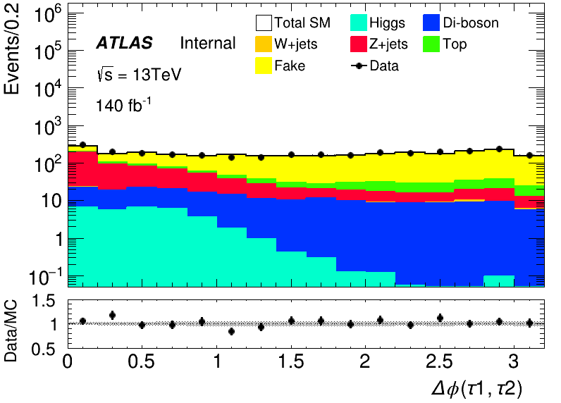
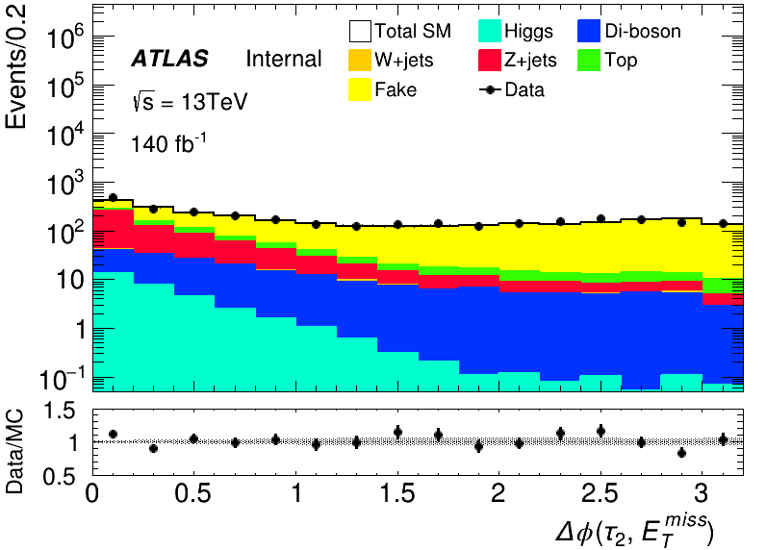
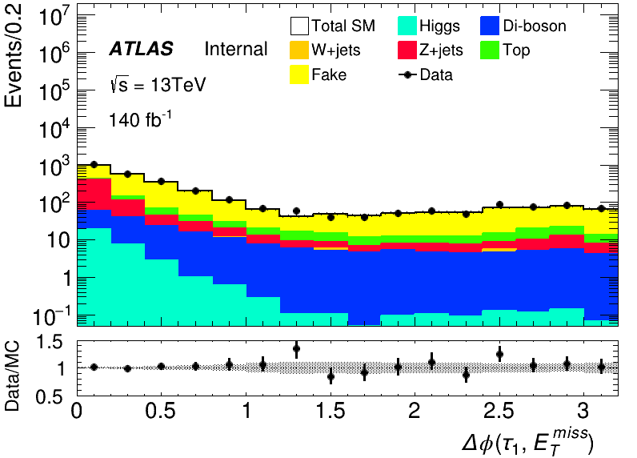
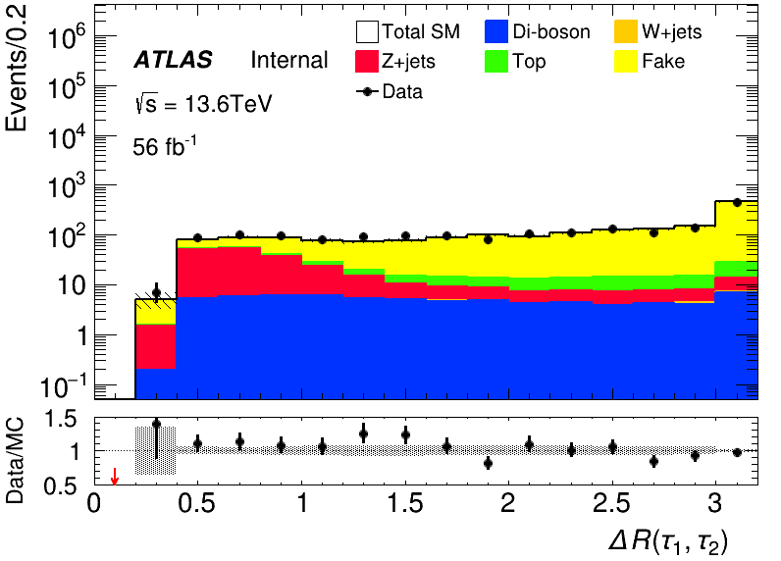
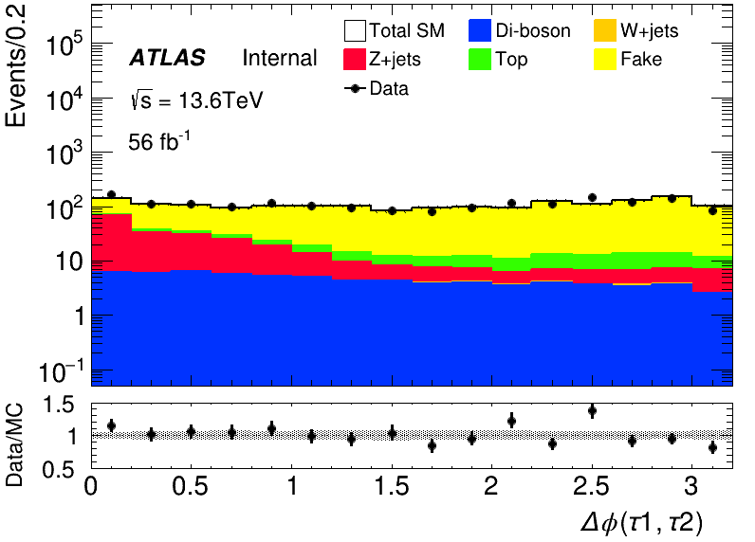
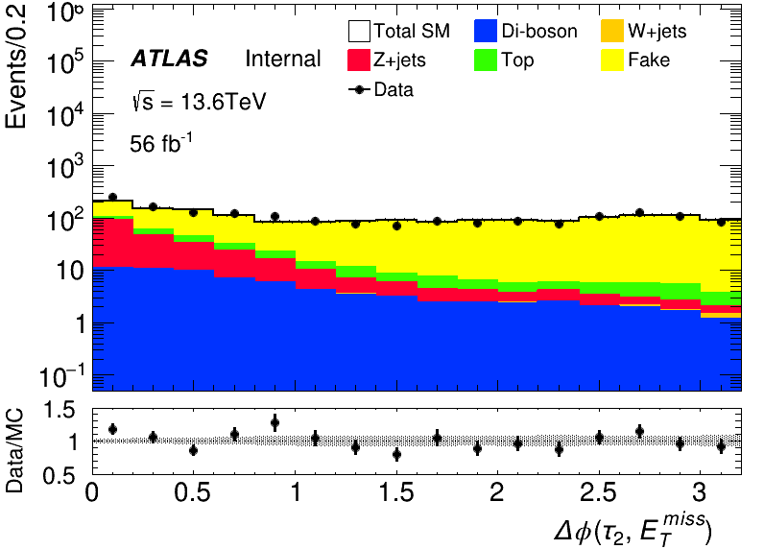
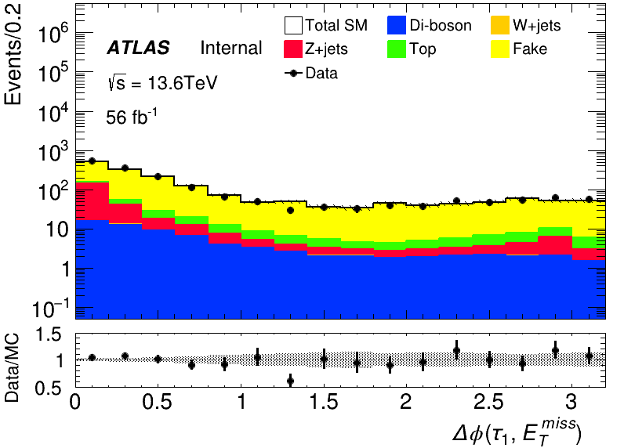
MC modeling in Pre-Selection(HH)
run2
run3

Slide 7
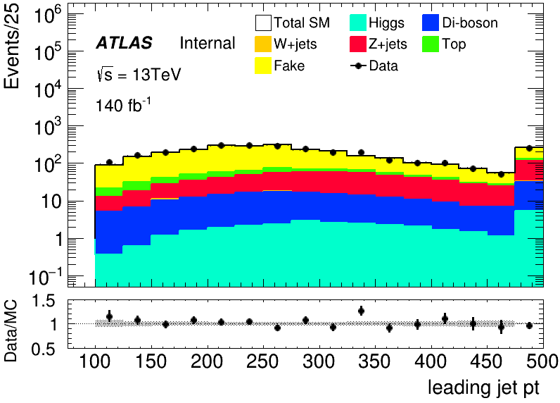
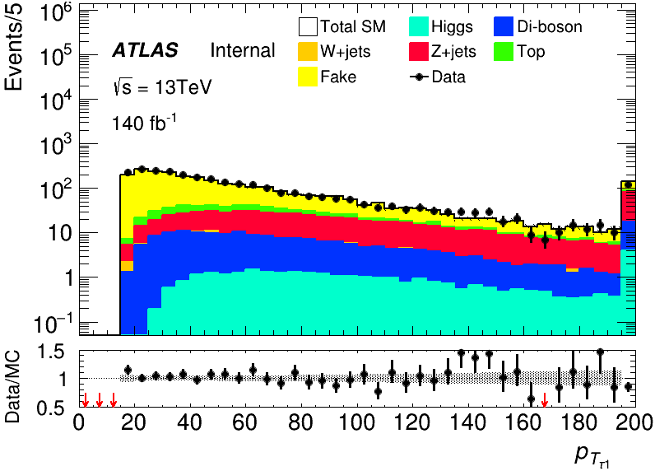
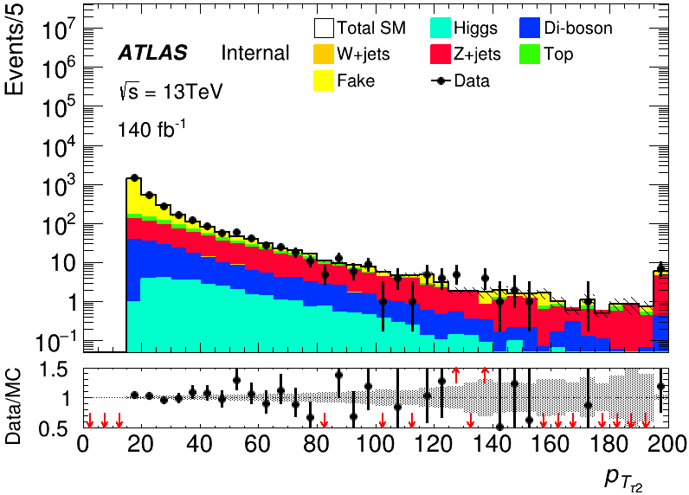
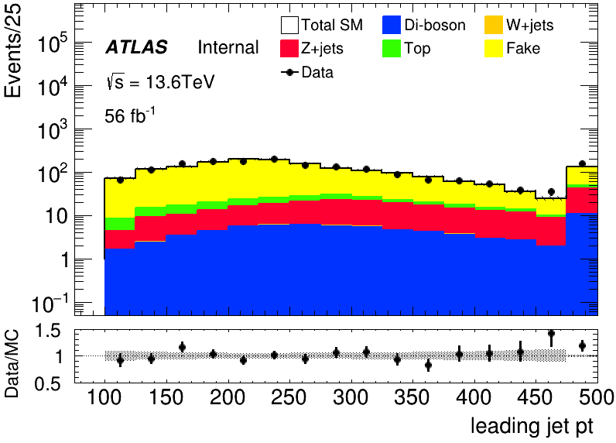
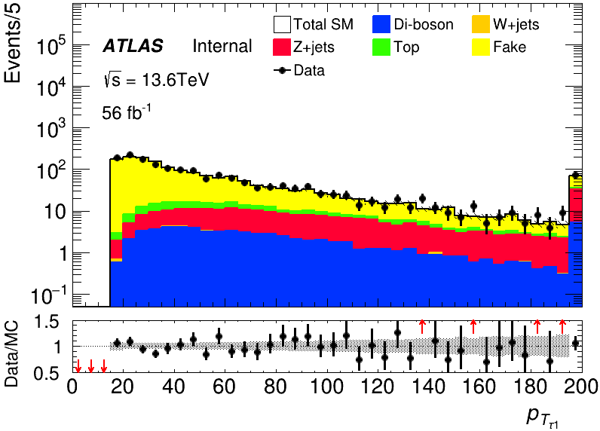
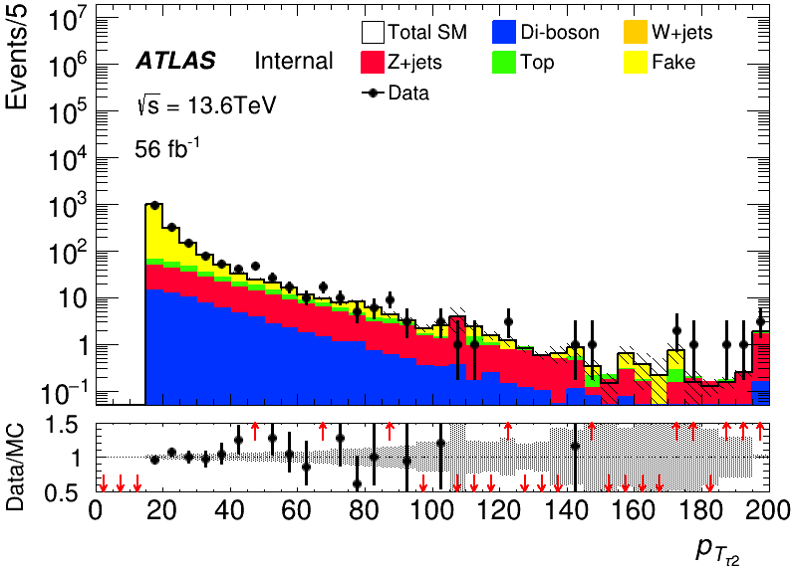
MC modeling in Pre-Selection(HH)
run2
run3

Slide 8
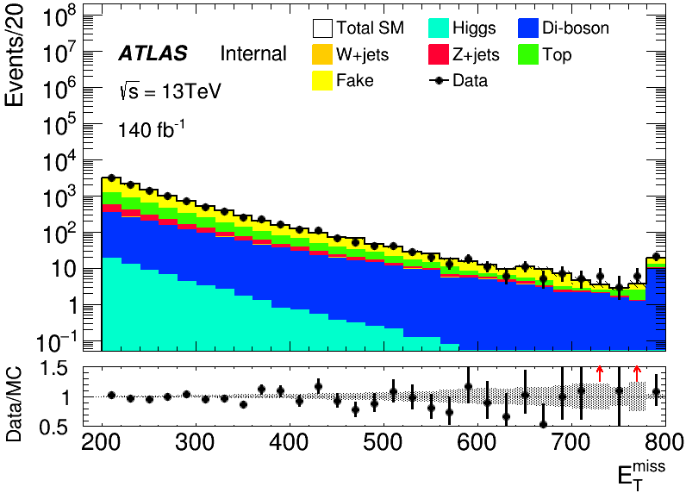
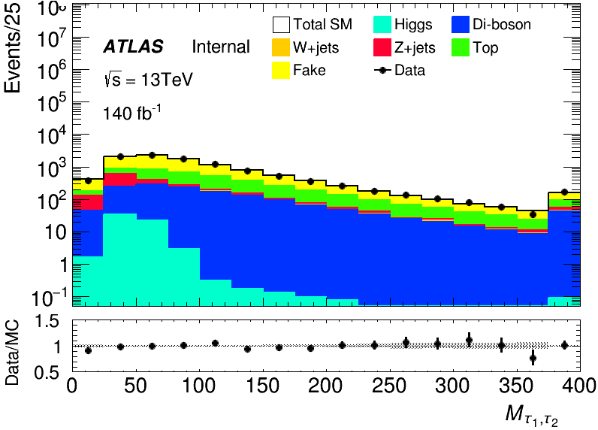
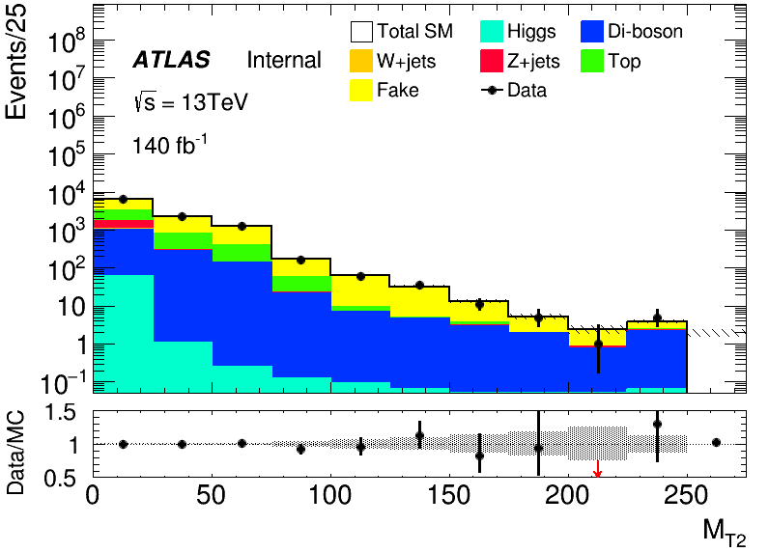
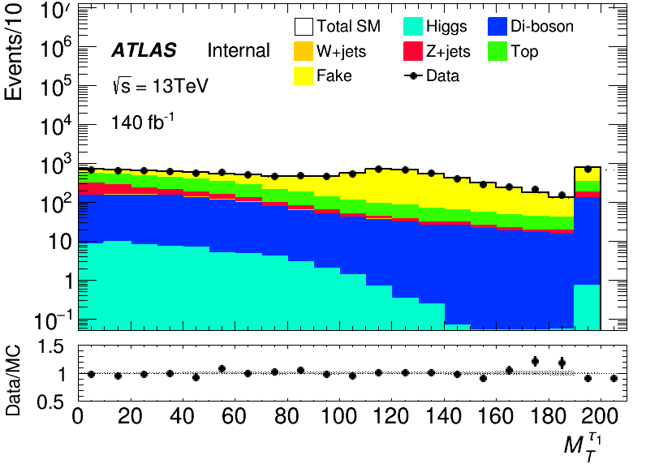
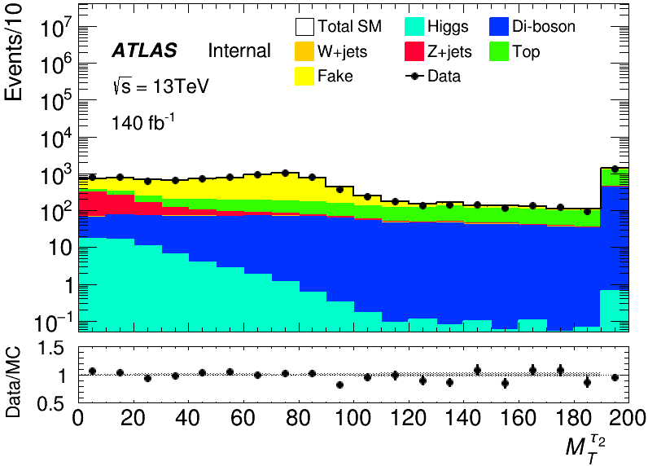
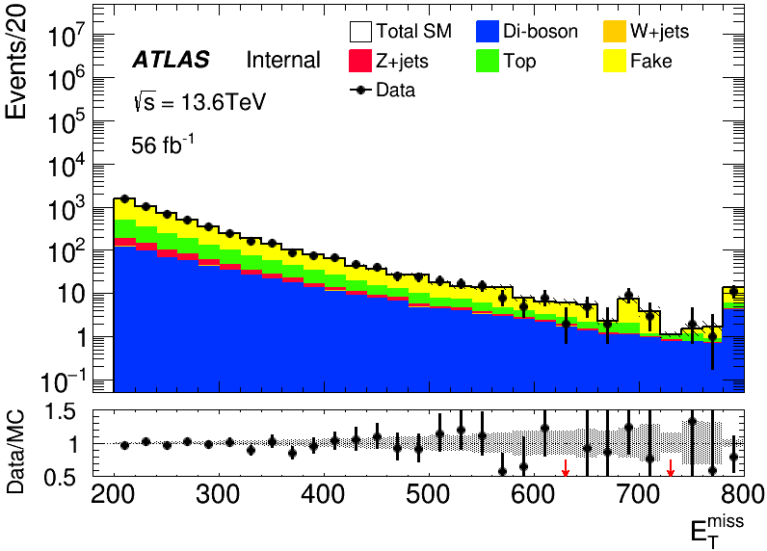
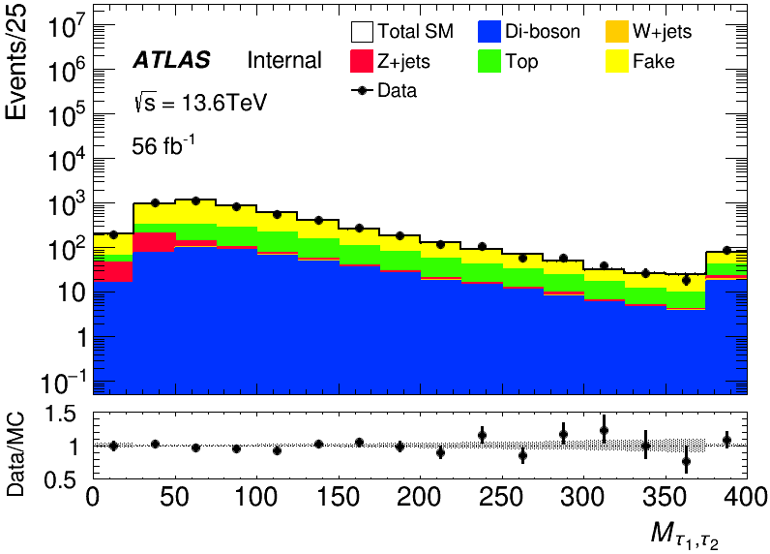
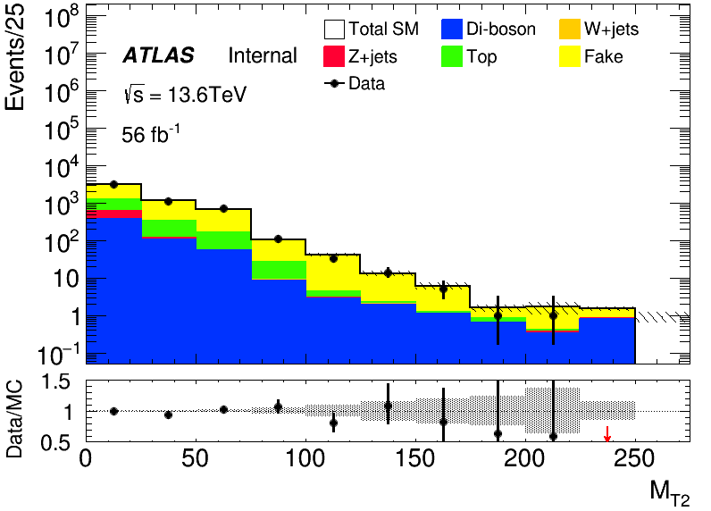
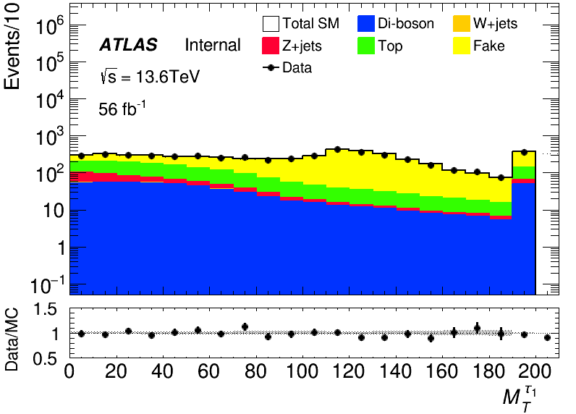
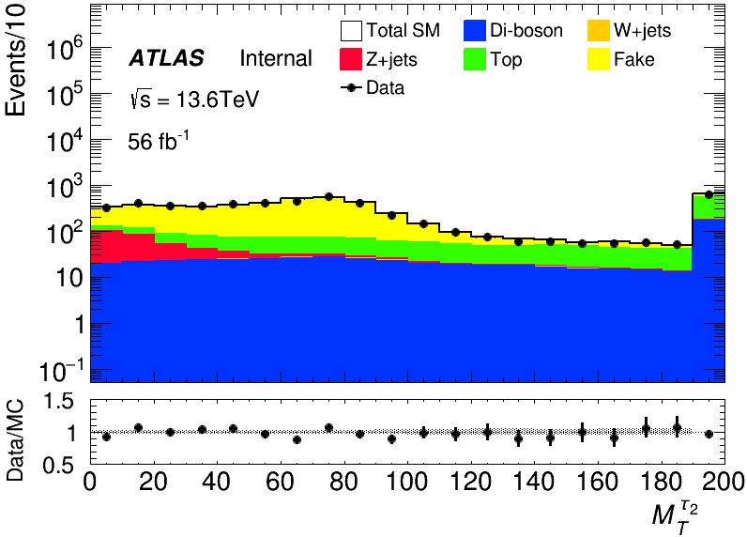
MC modeling in Pre-Selection(LH)
run2
run3

Slide 9
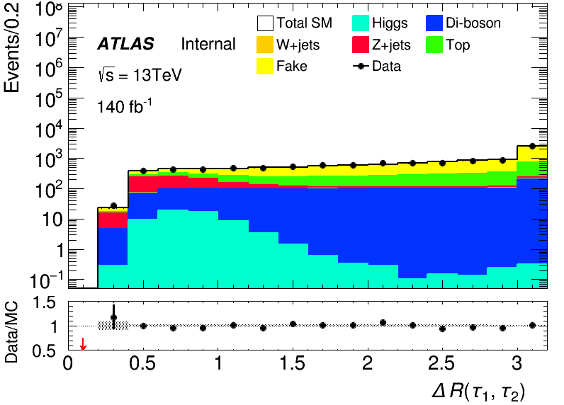
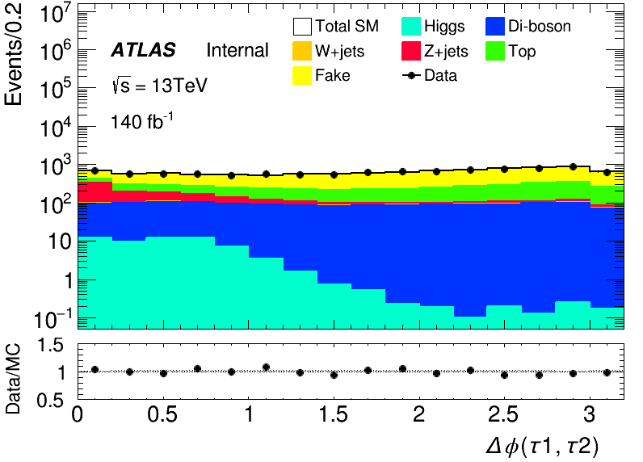
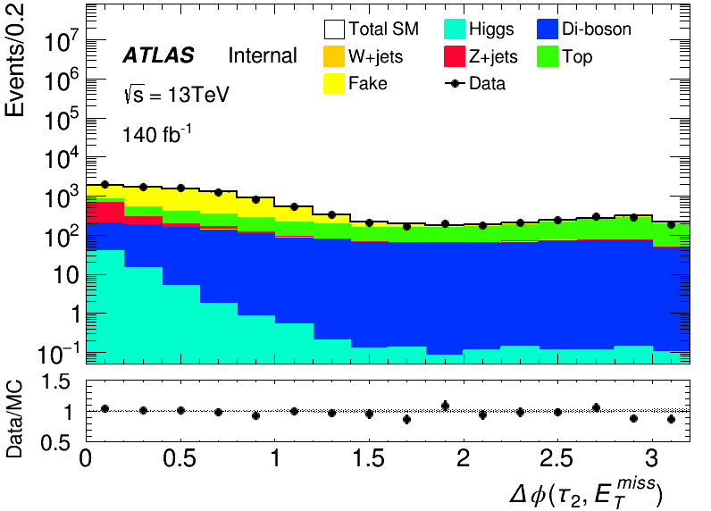
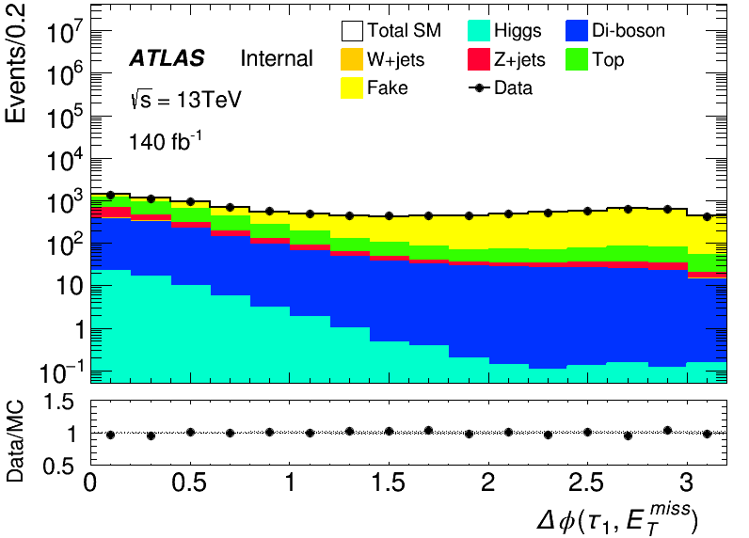
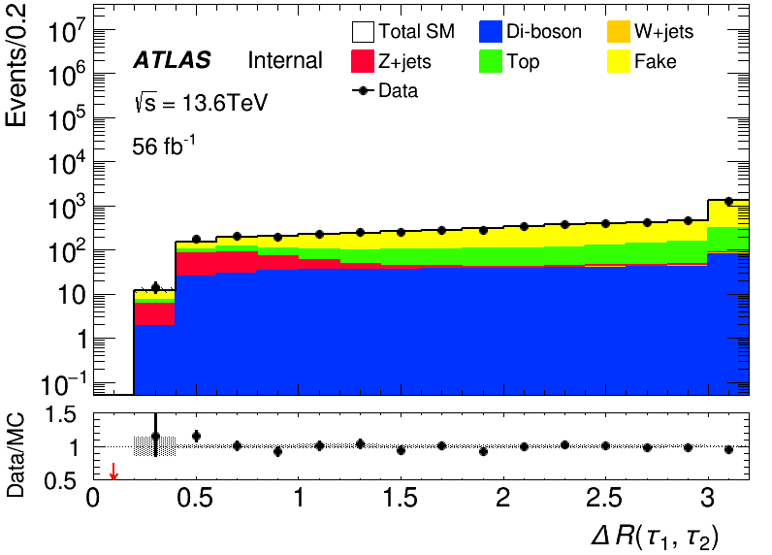
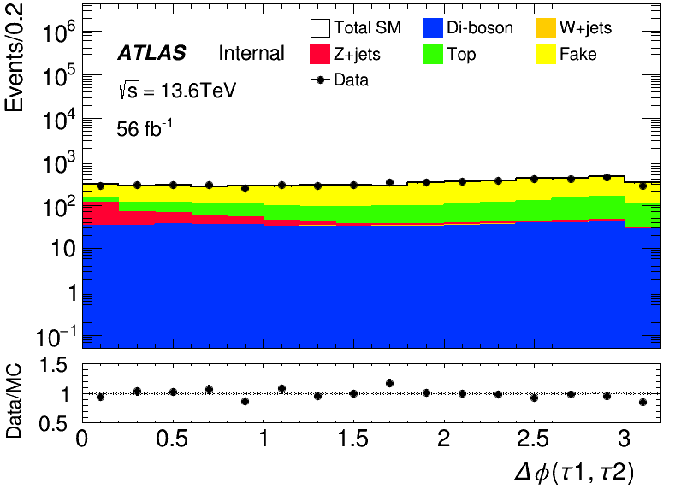
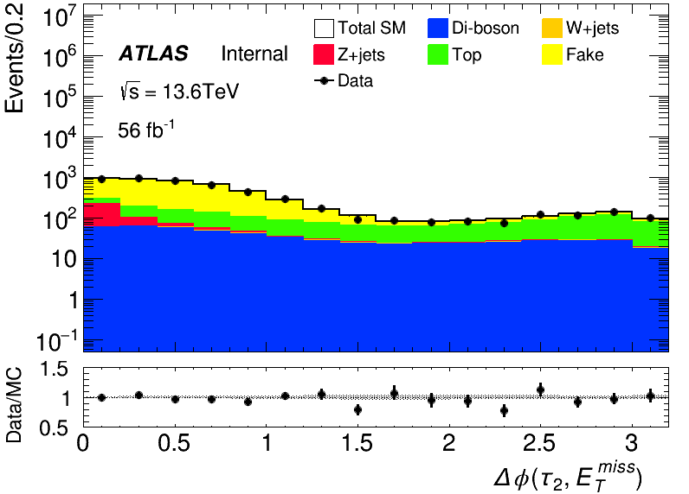
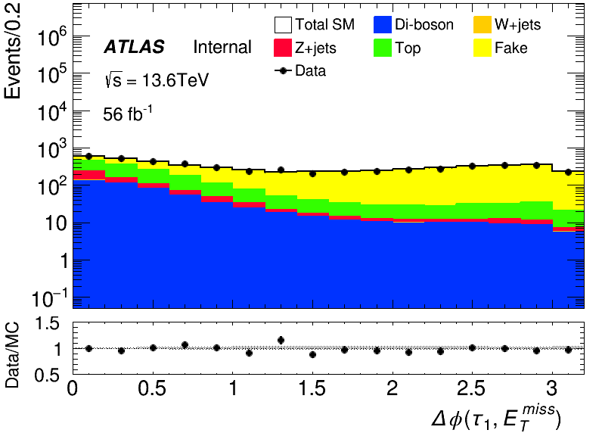
MC modeling in Pre-Selection(LH)
run2
run3

Slide 10
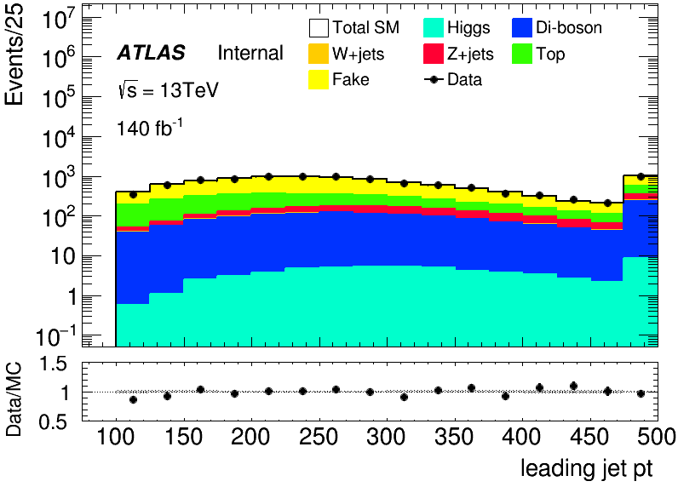
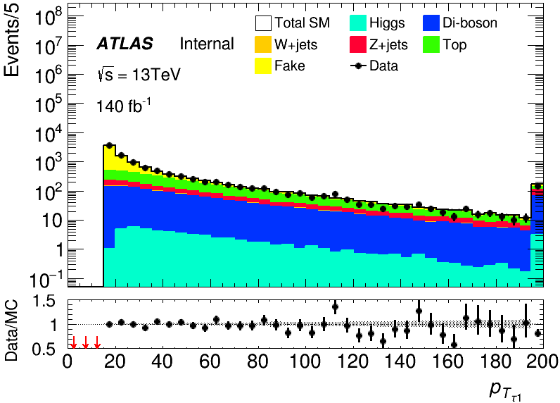
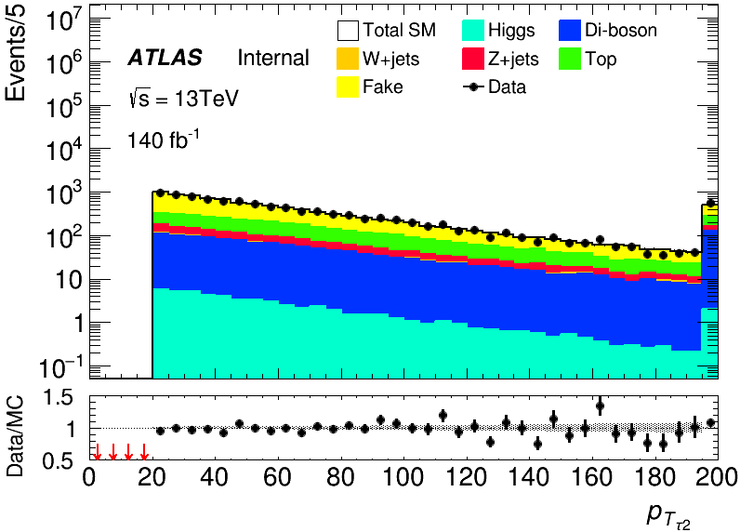
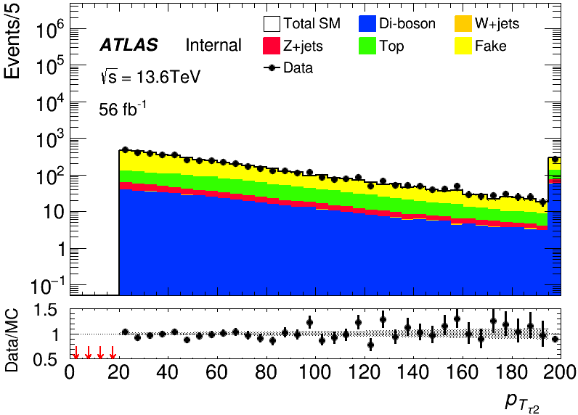
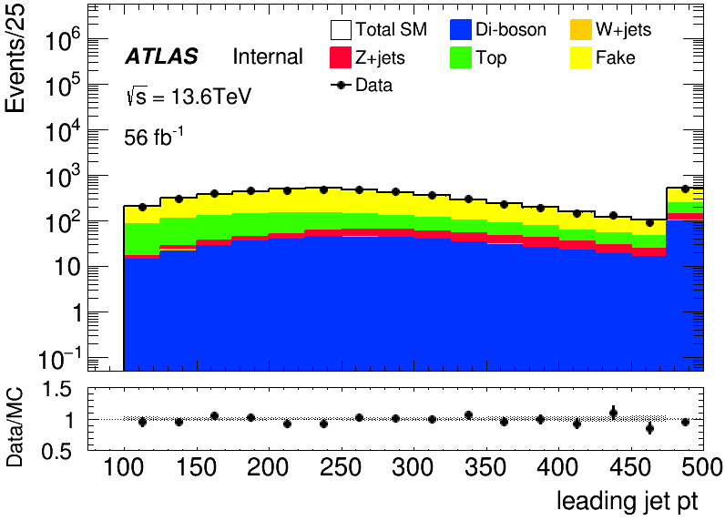
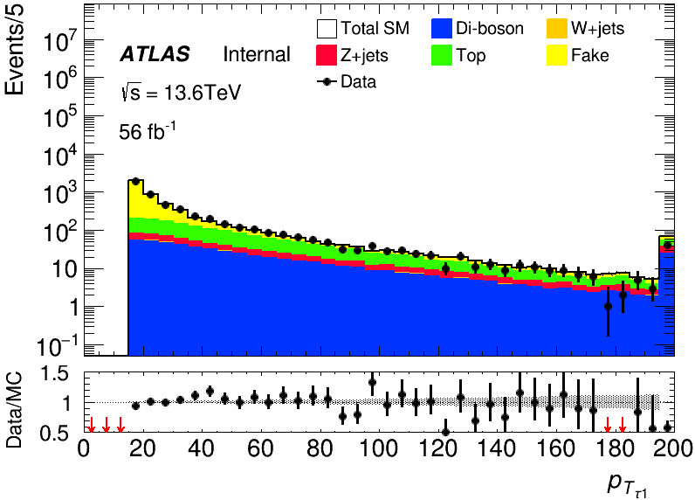
MC modeling in Pre-Selection(LH)
run2
run3

Slide 11
C1N2 SR(HH and LH)
Input sample:
bkg: run2 bkg sample passed pre-selection(HH/LH) sig: 100_70, 120_90, 140_90(only run2)
Hyperparameters: HH: Ntrees = 300, MaxDepth = 6, MinNodeSize = 1%, Learning rate = 0.05
LH: Ntrees = 200, MaxDepth = 6, MinNodeSize = 1%, Learning rate = 0.05
Weight choose: abs(physics weight)
Split strategy: Separate entries by using mod 5, for Fake bkg, if separate follow sequence, all weighted entry will split into first fold

Slide 12




BDT distribution for LH and HH
HH
LH
run2
run3

Slide 13
Backup

Slide 14



Cross-Check FF
$0<|η|<1$
$1<|η|<1.37$
$1.52<|η|<2.5$
My result
Wenyi’s result
Same value for first two bins and different in last bin for different rebin strategy I check FF with same rebin method in case, it turns out we are the same

