Slide 1
Data processing process
数据处理进程
Liao jiajia
2023/06/19
Notes:
Good afternoon, next I will report on mobile data processing in Sapporo.
下午好,接下来我将汇报札幌移动数据处理的情况。

Slide 2
Data Base
Data base: Sapporo City Agoop cell phone signaling data for July 21-22, 2019
Study area: 29 Sapporo City parks and green spaces were selected as the basis for the study based on the Sapporo s City Green Association website
websit: https://www.sapporo-park.or.jp/map/
Research dependent software: Python / R
Data analysis proposed to solve the problem:
What types of urban parks and green spaces are visited more frequently?
Re:More intensive visits to urban parks in urban areas
What are the trends in the timing of visits to urban parks and green spaces?
Re:Peak time zone for visits from 12:00-18:00
Notes:
First of all the data was used two-day dataset of XXX 2019, as well as I selected 29 urban parks and green spaces in Sapporo as the study area. The main software used was python,because I also continued to try again with R language in the past two days. Based on this dataset, the two main points I analyzed were:
首先数据是采用2019年XXX的两天数据集，以及我选取了札幌市29个城市公园及绿地作为研究区。主要的软件是使用了python,因为这两天也继续在用R语言再试着做了一遍。根据这份数据集，我主要分析的两点：

Slide 3
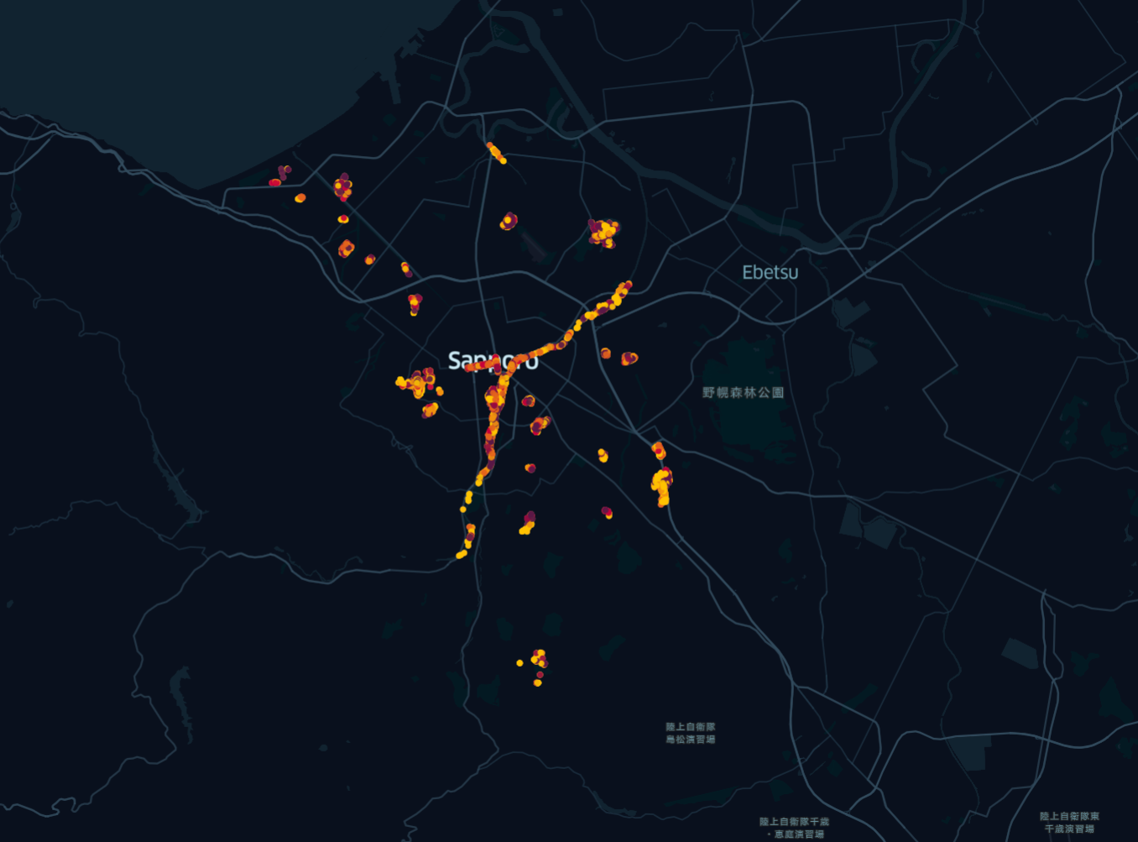
Data processing steps
See website for details ：
CODE_sapporo_jiajia
Notes:
Next I will mainly introduce the main process of my data processing, and after the data code session, I will upload it to github
接下来我将主要介绍我数据处理的主要流程，数据代码会议结束后，我会上传至github

Slide 4
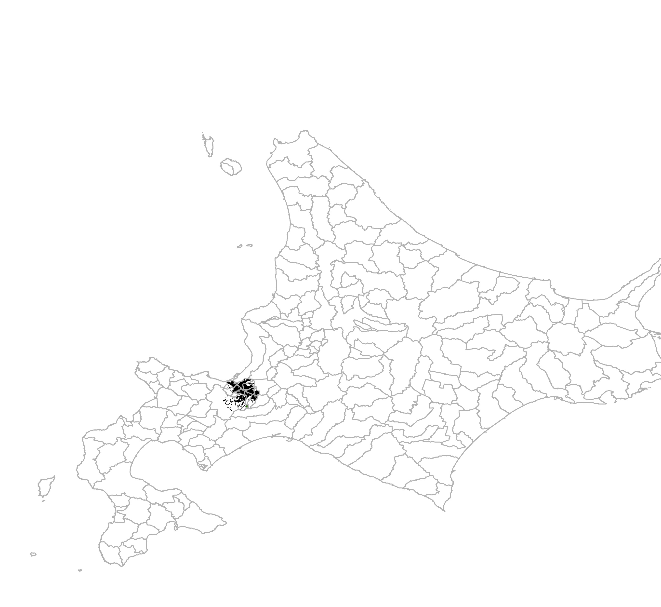
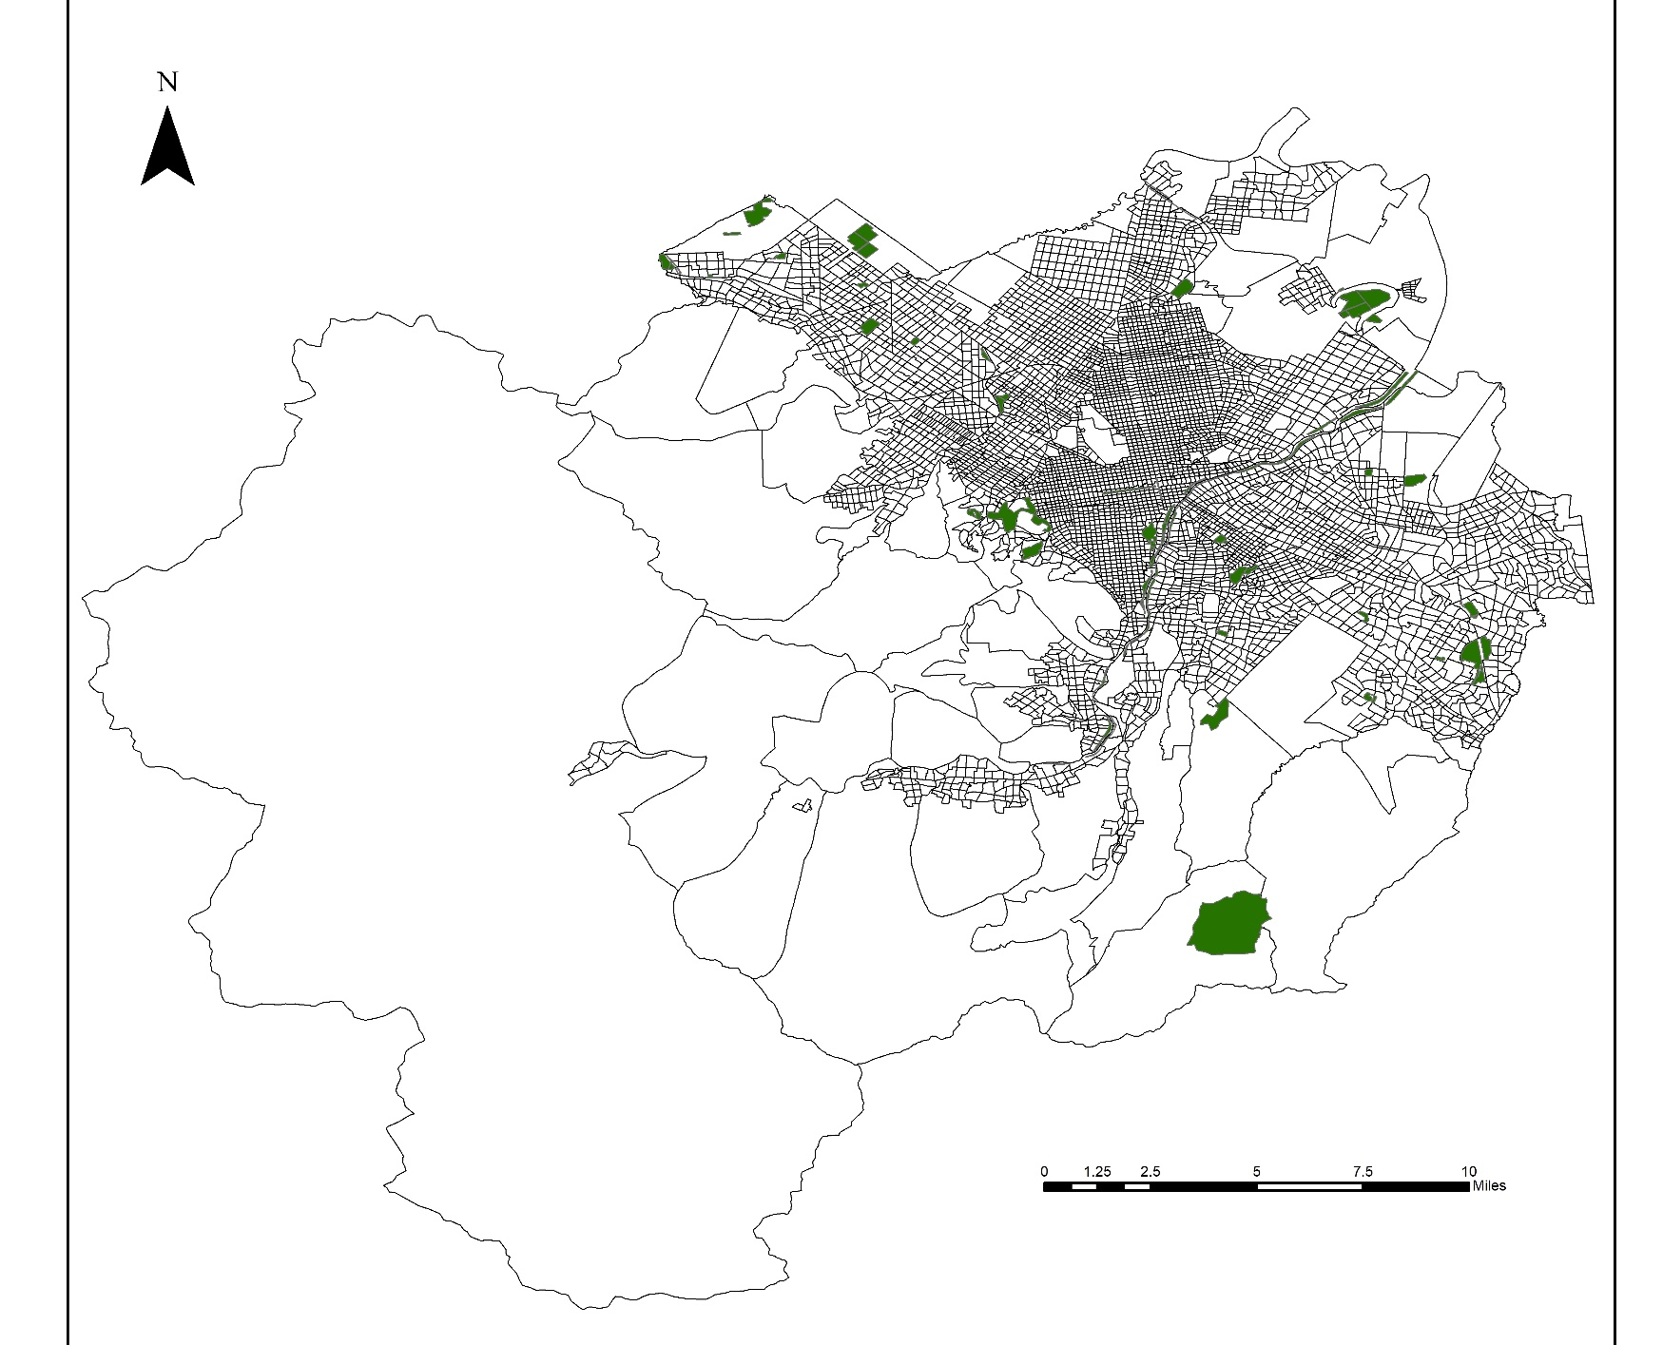
Research Area
Sapporo
Notes:
Vector image of urban green space
城市绿地的矢量图

Slide 5
City Parks and Green Spaces
FID | 公園名 | 種別 | 区 | 告示面 | x | y | area | number_all | number_21 | number_22
0 | 中島公園 | 総合公園 | 中央区 | 236295 | 141.354387 | 43.044358 | 228568 | 99 | 25 | 74
1 | 円山公園 | 総合公園 | 中央区 | 691028 | 141.308889 | 43.050861 | 723939 | 155 | 40 | 115
2 | 百合が原公園 | 総合公園 | 北区 | 253140 | 141.365391 | 43.128422 | 240934 | 16 | 3 | 13
3 | 月寒公園 | 総合公園 | 豊平区 | 220661 | 141.385183 | 43.031264 | 221748 | 43 | 8 | 35
4 | 前田森林公園 | 総合公園 | 手稲区 | 597258 | 141.256641 | 43.144734 | 596068 | 16 | 4 | 12
5 | 平岡公園 | 総合公園 | 清田区 | 663200 | 141.465704 | 43.003116 | 687830 | 21 | 3 | 18
6 | モエレ沼公園 | 総合公園 | 東区 | 1043496 | 141.427001 | 43.123481 | 1034710 | 51 | 10 | 41
7 | 川下公園 | 総合公園 | 白石区 | 194560 | 141.44424 | 43.063204 | 194564 | 19 | 3 | 16
8 | 農試公園 | 運動公園 | 西区 | 123667 | 141.303771 | 43.090022 | 123637 | 22 | 1 | 21
9 | 厚別公園 | 運動公園 | 厚別区 | 131332 | 141.463646 | 43.019187 | 131640 | 16 | 9 | 7
10 | 手稲稲積公園 | 運動公園 | 手稲区 | 181503 | 141.258647 | 43.115571 | 181477 | 27 | 6 | 21
11 | 旭山記念公園 | 特殊公園 | 中央区 | 202760 | 141.314082 | 43.039093 | 208492 | 15 | 4 | 11
12 | 西岡公園 | 特殊公園 | 豊平区 | 408961 | 141.377132 | 42.983052 | 409264 | 4 | 2 | 2
13 | 大通公園 | 特殊公園 | 中央区 | 78901 | 141.346856 | 43.05981 | 78094.9 | 690 | 319 | 371
14 | 創成川公園 | 特殊公園 | 中央区 | 18245 | 141.357332 | 43.060192 | 18519.4 | 60 | 34 | 26
15 | 豊平川緑地 | 都市緑地 | 中央区 | 1237932 | 141.386721 | 43.053274 | 1251180 | 127 | 47 | 80
16 | 荒井山緑地 | 都市緑地 | 中央区 | 88306 | 141.294453 | 43.0518 | 88304.7 | 3 | 1 | 2
17 | 伏籠川緑地 | 都市緑地 | 北区 | 29982 | 141.360189 | 43.158948 | 29544 | 2 | 1 | 1
18 | 山口緑地 | 都市緑地 | 手稲区 | 441425 | 141.219831 | 43.153405 | 445540 | 2 | 2 | 0
19 | 北郷公園 | 地区公園 | 白石区 | 47786 | 141.428764 | 43.065817 | 47789.8 | 11 | 2 | 9
20 | 豊平公園 | 地区公園 | 豊平区 | 73667 | 141.378368 | 43.042963 | 73175.7 | 19 | 5 | 14
21 | 吉田川公園 | 地区公園 | 豊平区 | 56508 | 141.427208 | 43.01681 | 56538.3 | 7 | 1 | 6
22 | 西岡中央公園 | 地区公園 | 豊平区 | 46815 | 141.378927 | 43.01113 | 46802.8 | 5 | 0 | 5
23 | 清田南公園 | 地区公園 | 清田区 | 69705 | 141.42913 | 42.989083 | 70060 | 6 | 0 | 6
24 | 発寒西陵公園 | 地区公園 | 西区 | 42225 | 141.298015 | 43.10574 | 40939 | 1 | 0 | 1
25 | 北発寒公園 | 地区公園 | 手稲区 | 41737 | 141.274207 | 43.11043 | 41733.5 | 5 | 1 | 4
26 | 前田公園 | 地区公園 | 手稲区 | 38790 | 141.256506 | 43.129641 | 38796.2 | 1 | 0 | 1
27 | 明日風公園 | 地区公園 | 手稲区 | 47569 | 141.228439 | 43.139398 | 47646.7 | 1 | 1 | 0
28 | 滝野すずらん丘陵公園 | 広域公園 | 南区 | 3957000 | 141.381601 | 42.911716 | 3924540 | 6 | 4 | 2
Notes:
and this is a selection of urban parks and green spaces in Sapporo City
以及这是选取的札幌市城市公园及绿地

Slide 6
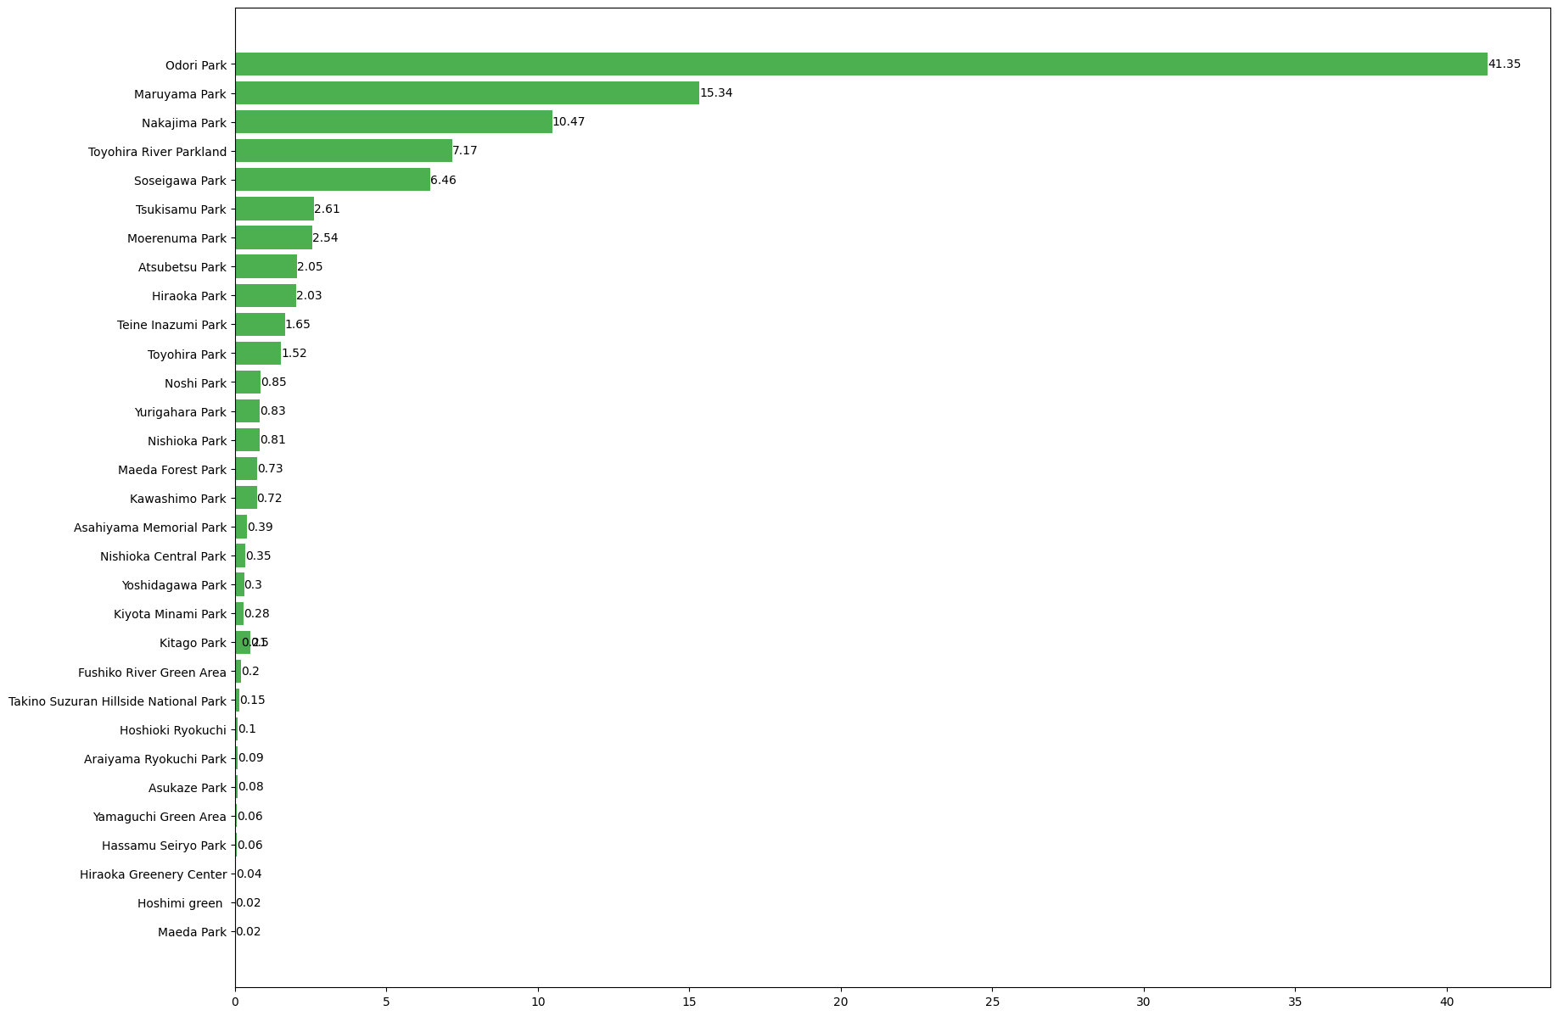
Visiting ratio of urban park green space
The main city parks that are visited in high are
Odori Park, Toyohira River Green Space, Tsuburayama Park, and Nakajima Park;
The parks are mainly concentrated in the central part of Sapporo City.
%
Notes:
This bar graph focuses on the ratio of the number of visitors to the total number of visitors in each park. Among them, Odori Park is the park with the largest percentage, and Tweed is also a very popular park. The rest of the XXXX, too, are basically gathered in Chuo-ku and Nohira-ku. It is also the area where Sapporo is the most crowded.
这个条形图，主要是各公园访客人数占总人数的比率。其中，Odori Park是占比最多的公园，雀氏也是非常受欢迎的公园。而其余的XXXX，也基本聚集在中央区和农平区。也是札幌是人流量最多的区域。

Slide 7
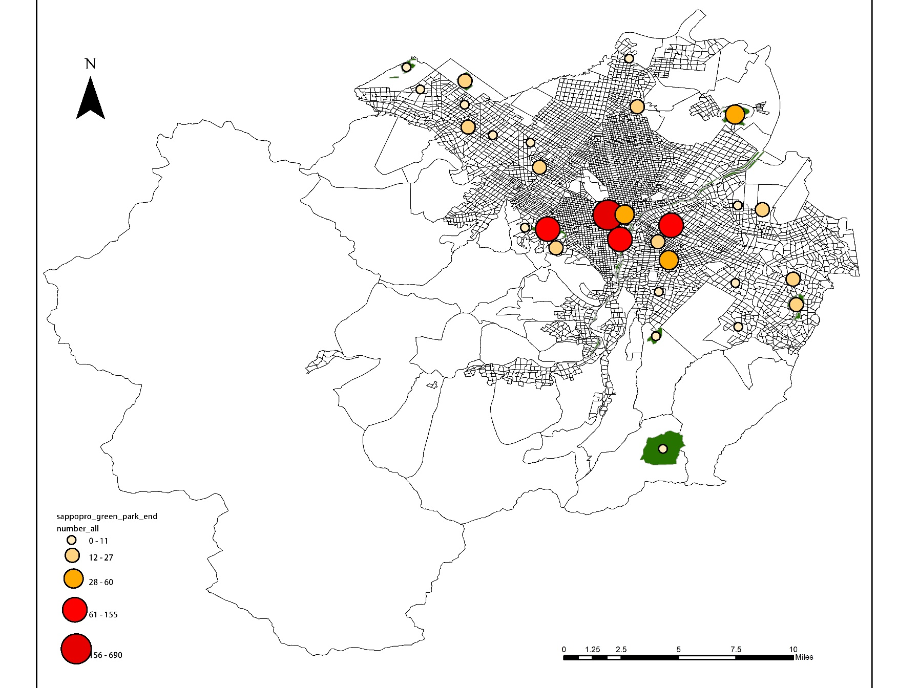
Changing spatial patterns of urban park green space access
大通公園
円山公園
創成川公園
豊平川緑地
2_days
Notes:
This is a combination of two days of data analysis XXX: the more red the color of the circle represents the more people, the highest rate of visitors to the park are basically in the central city. Of course, there are also some people who choose green areas and parks in the suburbs, but they are relatively few.
这是将两天的数据结合分析XXX：圆圈的的颜色越红代表人数越多，访客率最高的公园基本都在中心城区。当然也会有部分人选择城郊的绿地及公园，不过比较少数

Slide 8

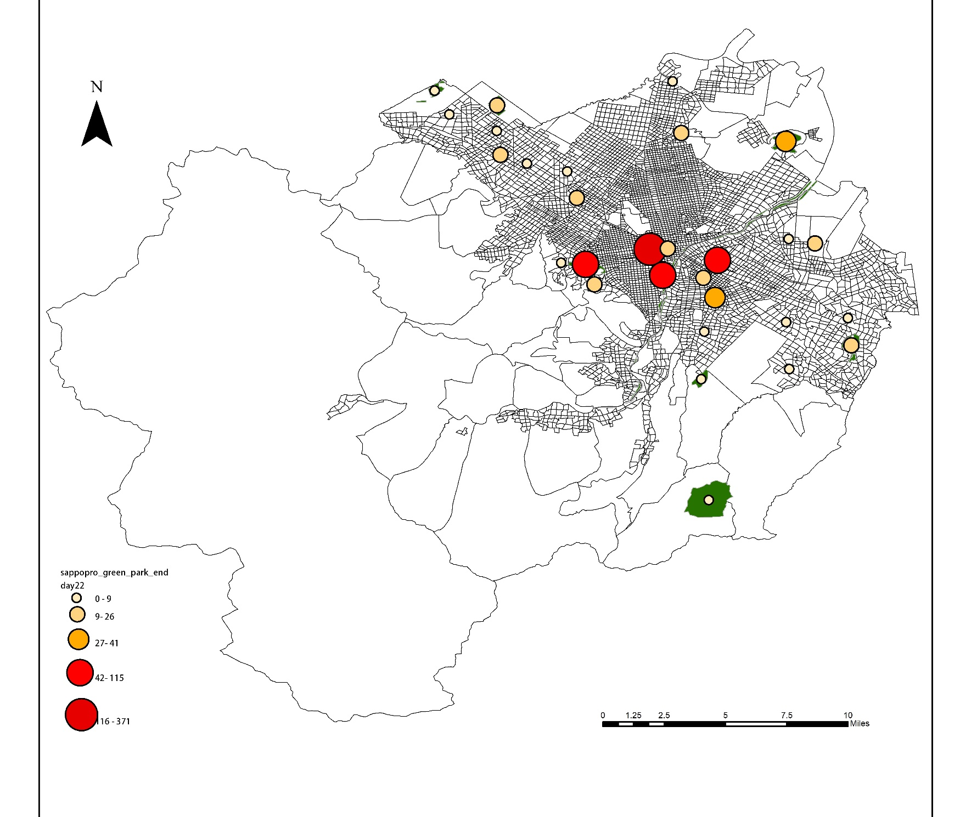
Changing spatial patterns of urban park green space access
21_day
22_day
Notes:
This is a separate comparison of the data from the 21st and 22nd, which shows that in addition to the decrease in the number of people in the central city, the number of people in the suburbs has also decreased
这是将21号和22号数据分开对比，可以看出，除了中心城区的人数减少以外，郊区的人数也减少了

Slide 9
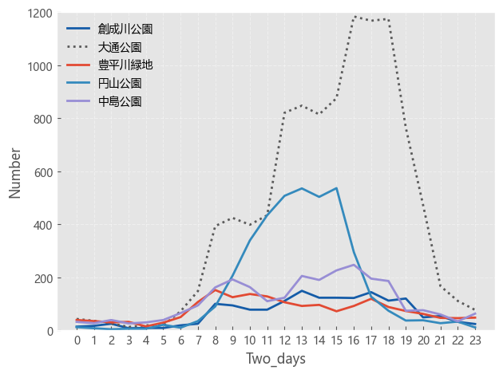
Changing Temporal Patterns of Urban Park Green Space Access
Notes:
I selected the five most visited gardens and green areas to analyze their visitors in the visit and stay in the park time, can be found from 12 noon to 18:00 this interval, is the most favorite time to visit the interval.
我选取的参观人数最多的五个花园及绿地进行分析其游客在参观并滞留在公园时间，可以发现从中午12带你到18点这个区间，是人们最喜欢参观的时间区间。

Slide 10
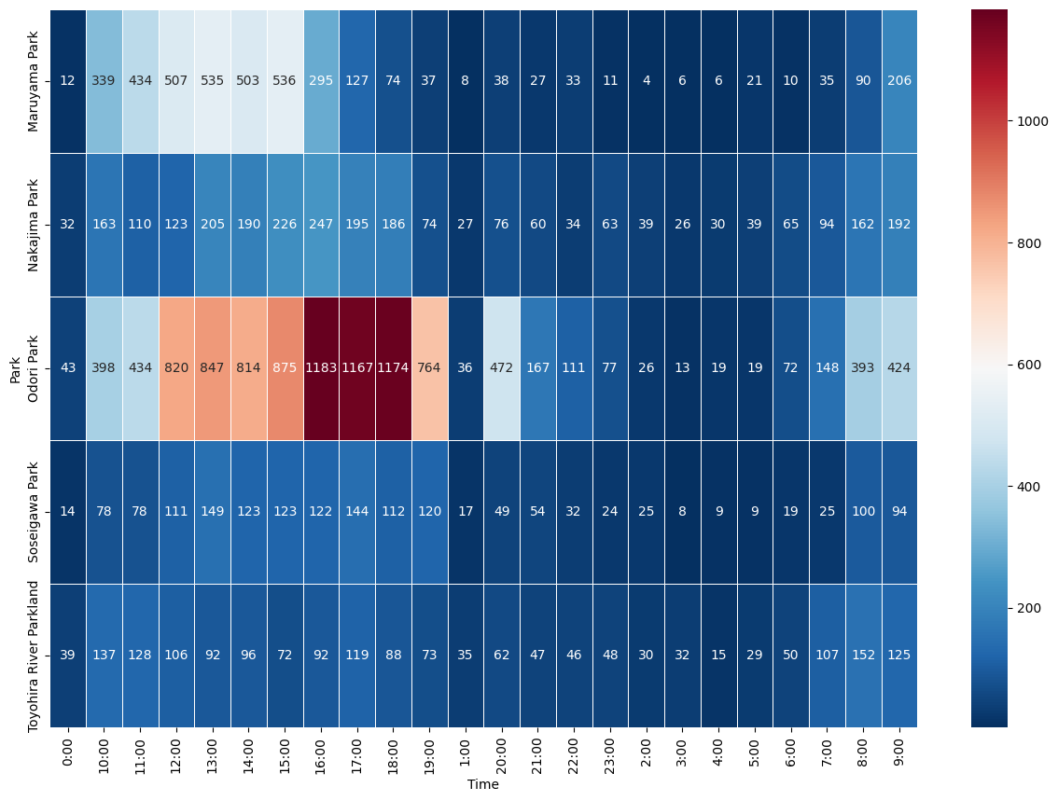
Changing Temporal Patterns of Urban Park Green Space Access
2_days
Notes:
It is clear that Chase Park has the largest and longest overall gathering of people
很明显，大通公园的整体聚集人数最多也是最长

Slide 11
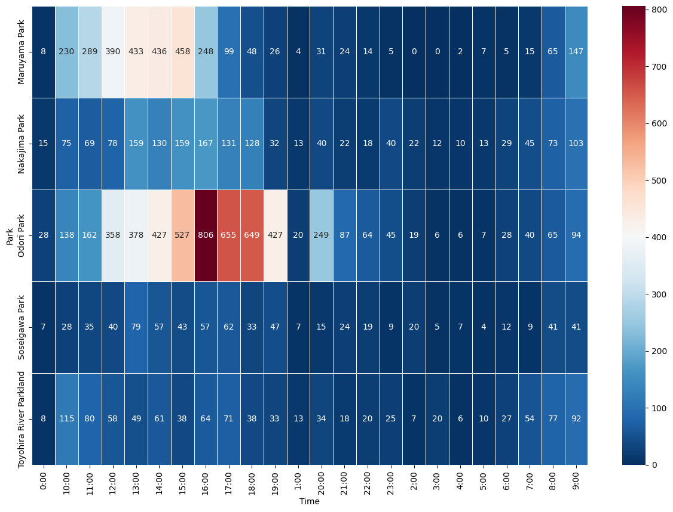
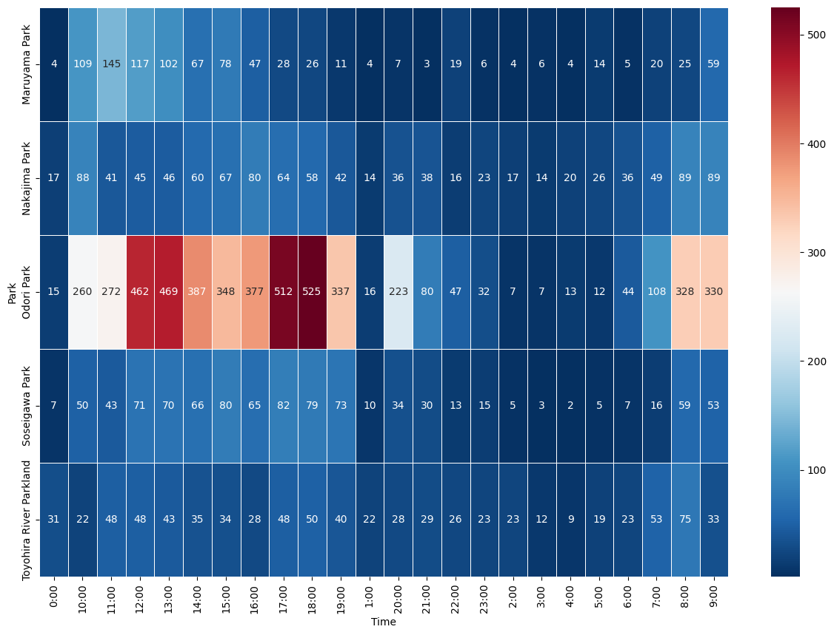
Changing Temporal Patterns of Urban Park Green Space Access
2019/7/21
2019/7/22
Small error: heat map time sorting disorder, the cause of time character type error, has not yet been processed successfully
Notes:
This data, I have not yet had time to add the comparison of the length of time people stay between different parks, I will add further later这份数据，我还没来得及补充不同公园之间人们滞留时间长短的对比，我后边会进一步补上

Slide 12
Next step
Questions not yet considered:
Technical problem: How do you define which park/parks an "individual" visits when he/she makes multiple trips to different parks and does not receive all the return signals?
Additional questions:
How do the types of activities people do in the park vary?
Add the importance of environmental and socioeconomic variables on the length of park visits
Notes:
Finally, there was a discussion with kang about a possible problem: XXXXX. kang shared with me the code that was used to solve this problem in R. I myself was interested in whether there was any other way to solve such a problem.
最后，是之前和kang讨论存在可能的问题：XXXXX。康给我分享了在用R解决这个问题的代码，我自己也很感兴趣还有没有其他方式可以解决这样的问题。

