Slide 1

Lab_2_DSA
Submitted to: Sir Ghafoor

Slide 2
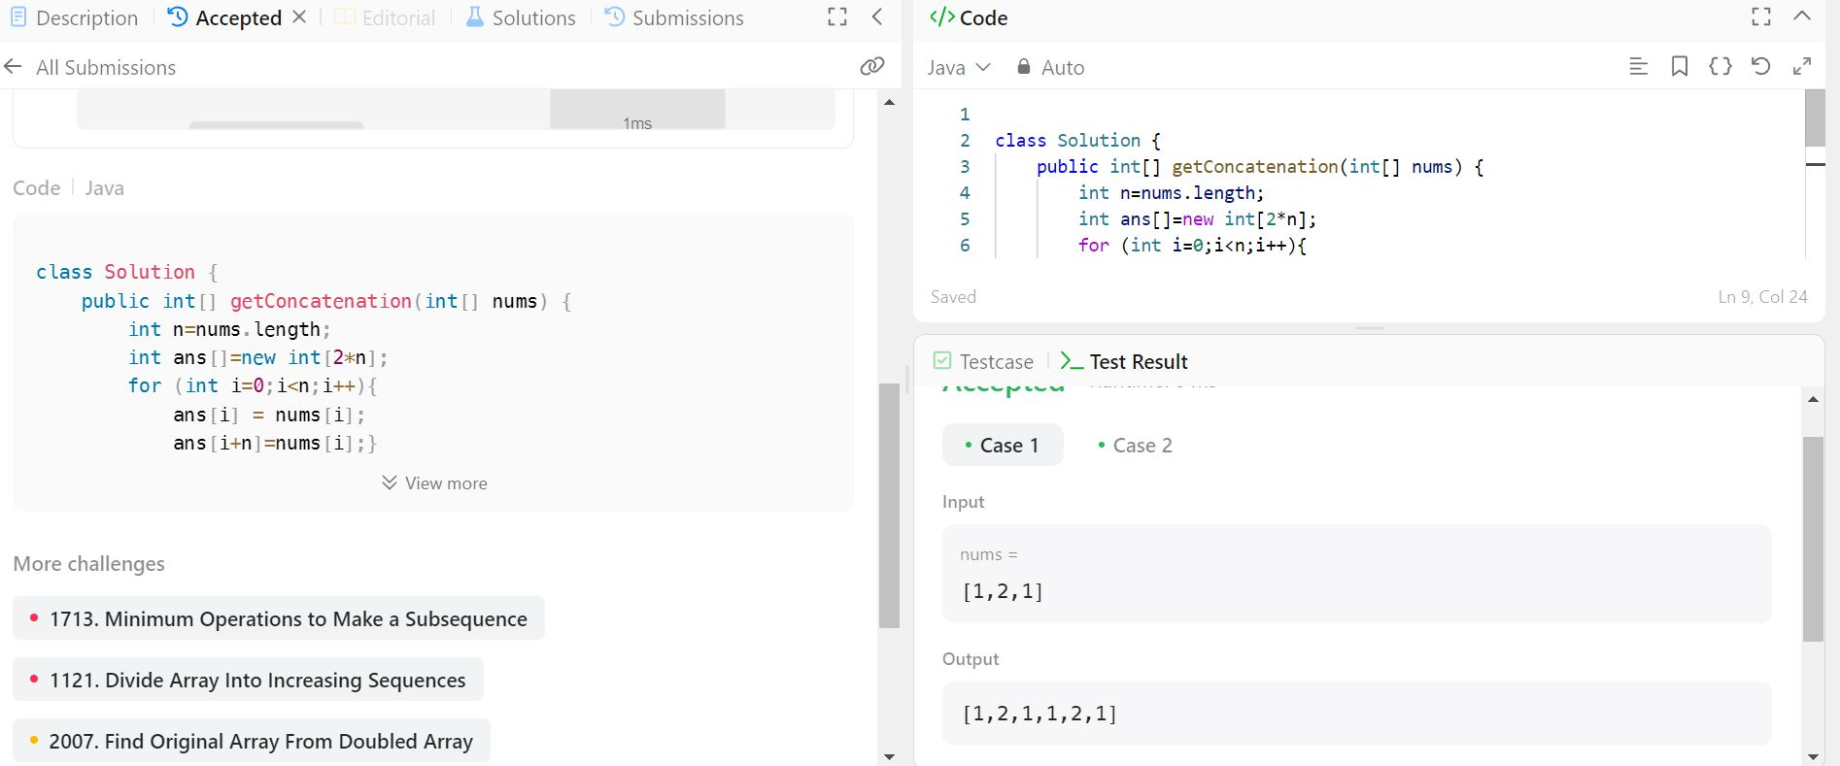
Task_01

Slide 3
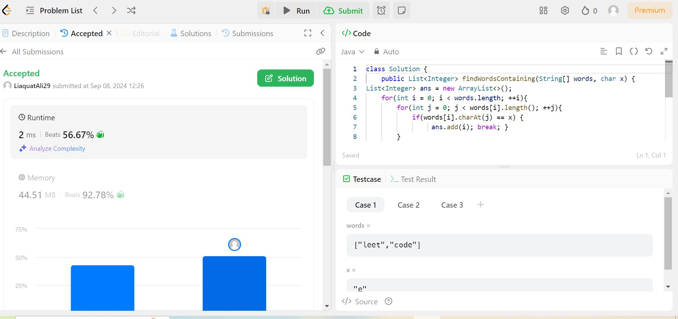
Task_02

Slide 4
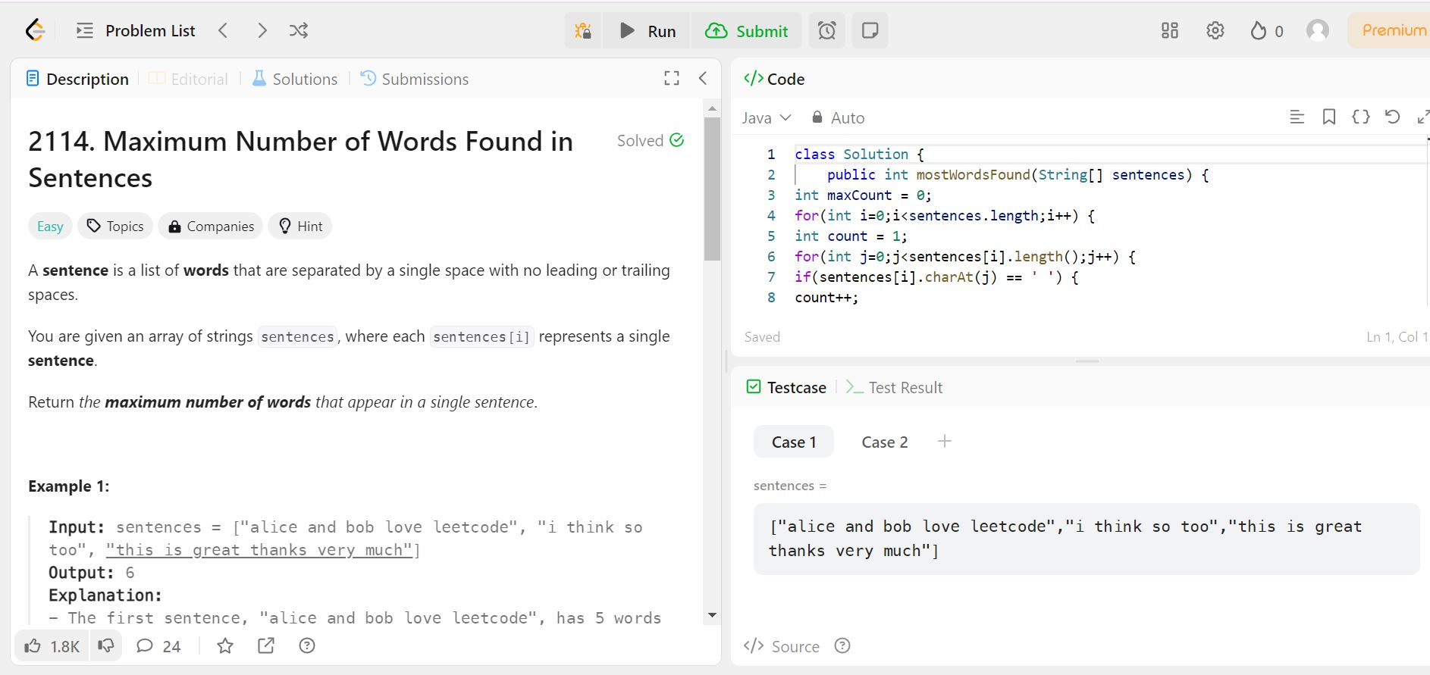
Task_03

Slide 5
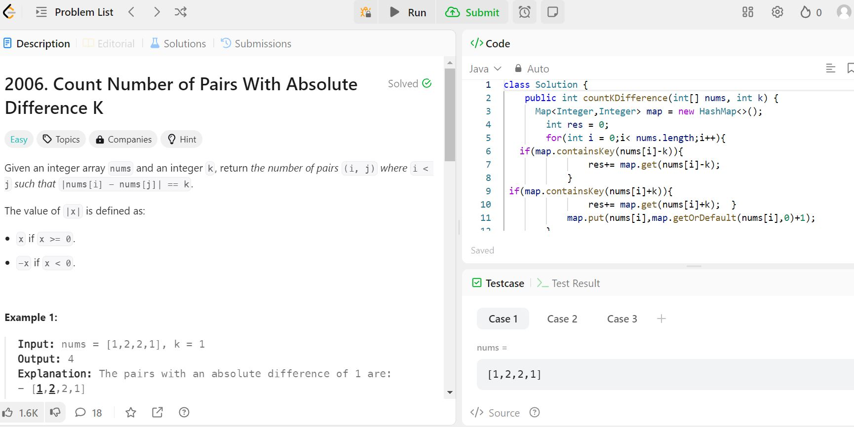
Task_4

Slide 6
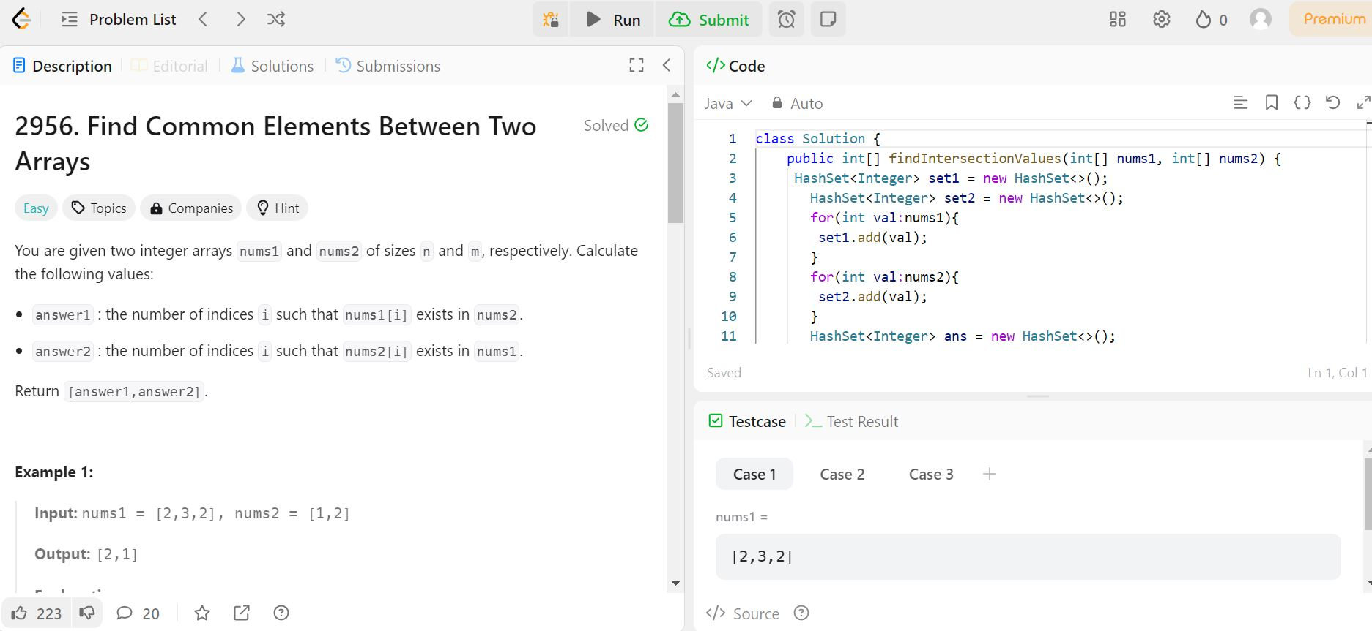
Task 5

Slide 7
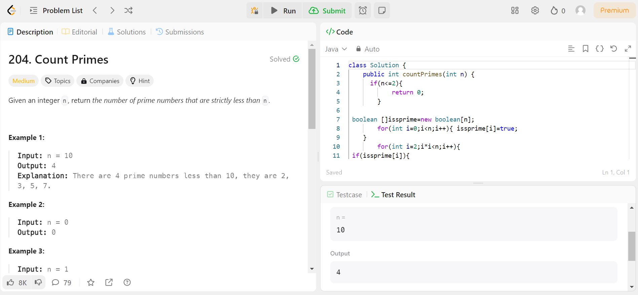
Task_6

