Slide 1
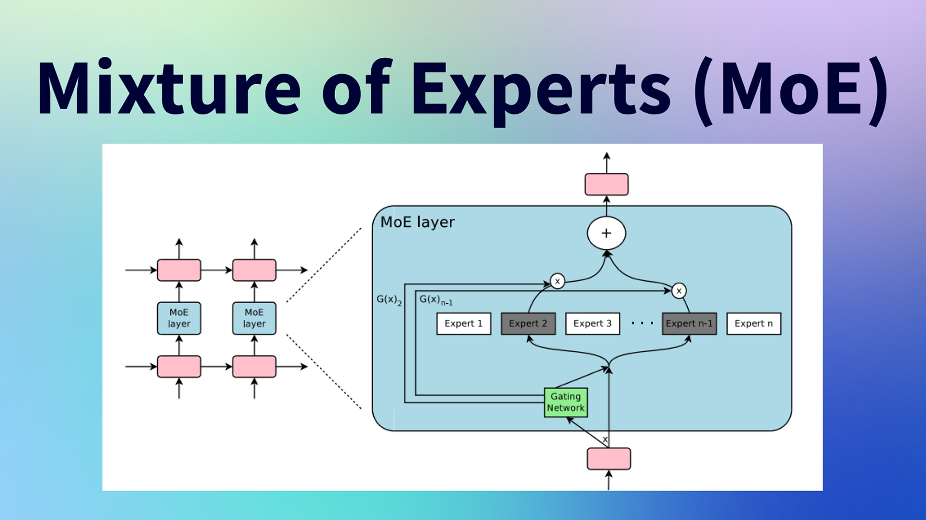

昇腾手撕
MOE 代码
ZOMI

Slide 2

视频目录大纲
单卡版 MoE
单机八卡版 MoE
Profiling MoE 看计算 & 通信耗时

Slide 3
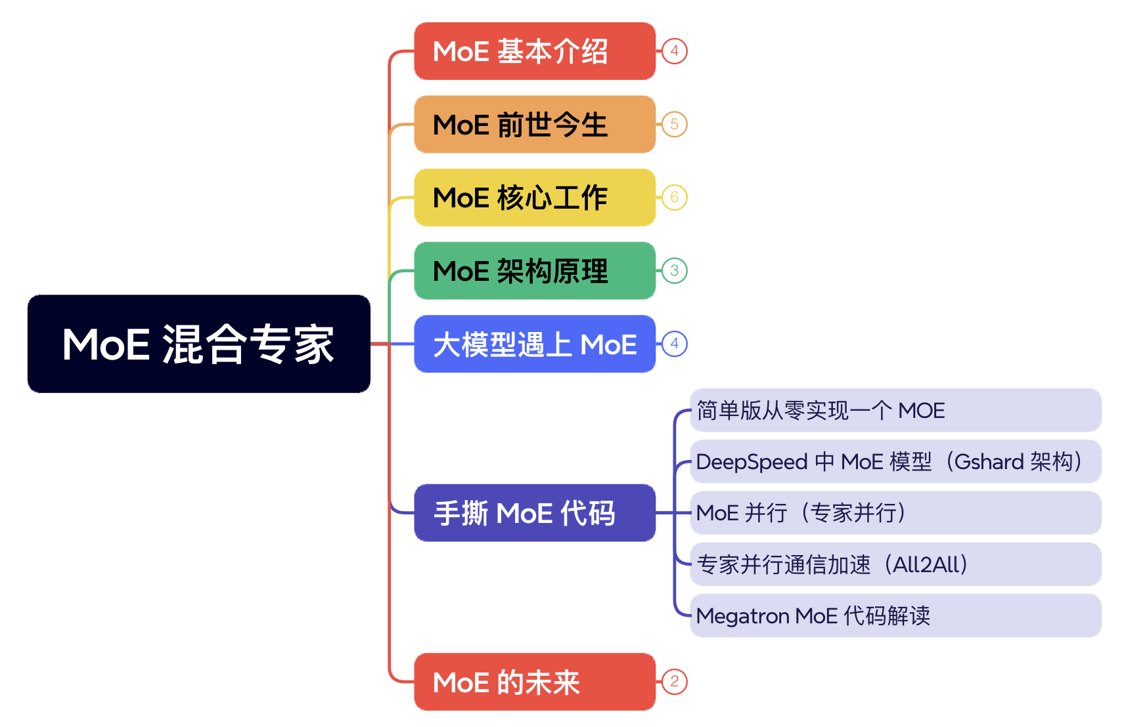
视频目录大纲

Slide 4
01
单卡版 MoE 实现

Slide 6
02
单机八卡版 MoE

Slide 8
03
Profiling MoE

Slide 9
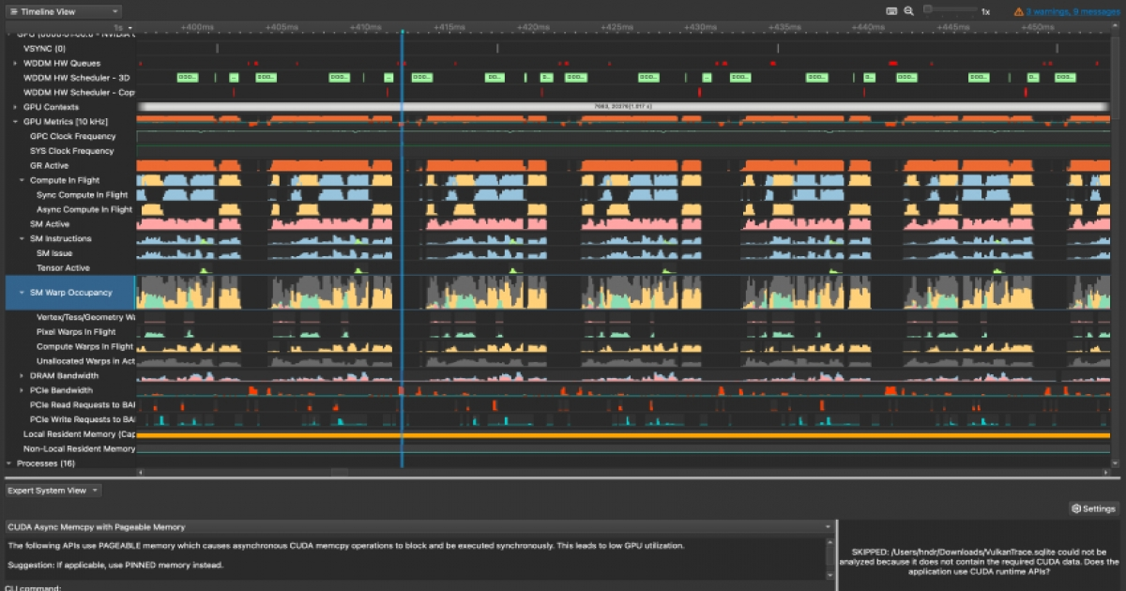
NVIDIA Nsight Systems

Slide 10
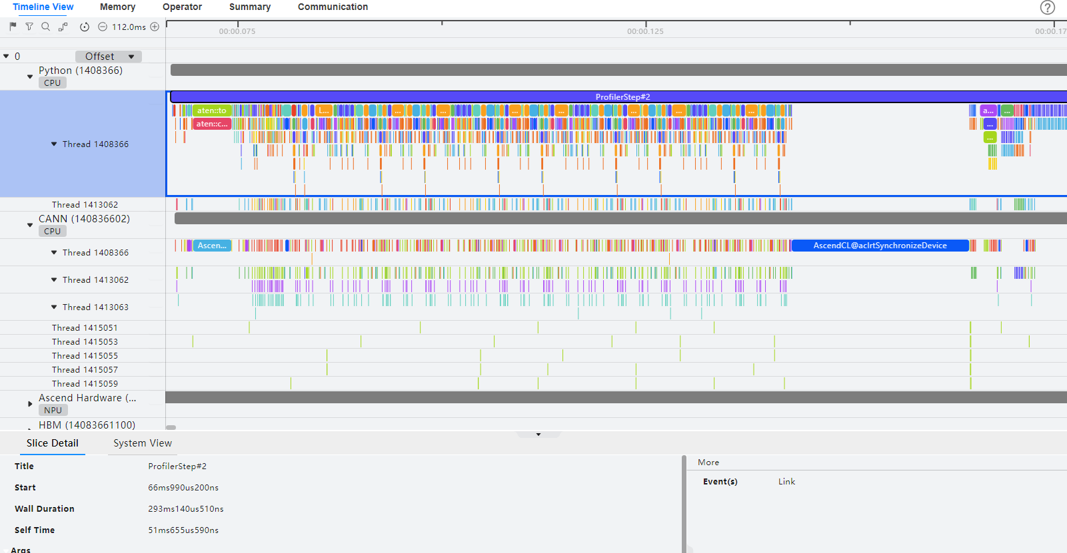
Ascend MindStudio

Slide 12
引用与参考
https://mp.weixin.qq.com/s/6kzCMsJuavkZPG0YCKgeig
https://www.zhihu.com/tardis/zm/art/677638939?source_id=1003
https://huggingface.co/blog/zh/moe
https://mp.weixin.qq.com/s/mOrAYo3qEACjSwcRPG7fWw
https://mp.weixin.qq.com/s/x39hqf8xn1cUlnxEIM0_ww
https://mp.weixin.qq.com/s/ZXjwnO103e-wXJGmmKi-Pw
https://mp.weixin.qq.com/s/8Y281VYaLu5jHoAvQVvVJg
https://blog.csdn.net/weixin_43013480/article/details/139301000
https://developer.nvidia.com/zh-cn/blog/applying-mixture-of-experts-in-llm-architectures/
https://www.zair.top/post/mixture-of-experts/
https://my.oschina.net/IDP/blog/16513157
PPT 开源在：
https://github.com/chenzomi12/AIInfra

