Slide 1
GGR: Superfast Full-Scale GPU-Accelerated Global Routing
2024/12/11
Group1-demo4
code
paper

Slide 2
Outline
Introduction
Parallel L-Shape Routing
Parallel Z-Shape Routing
Two-Level Maze Routing
Build
Experiment on ICCAD 2019 Benchmark

Slide 3
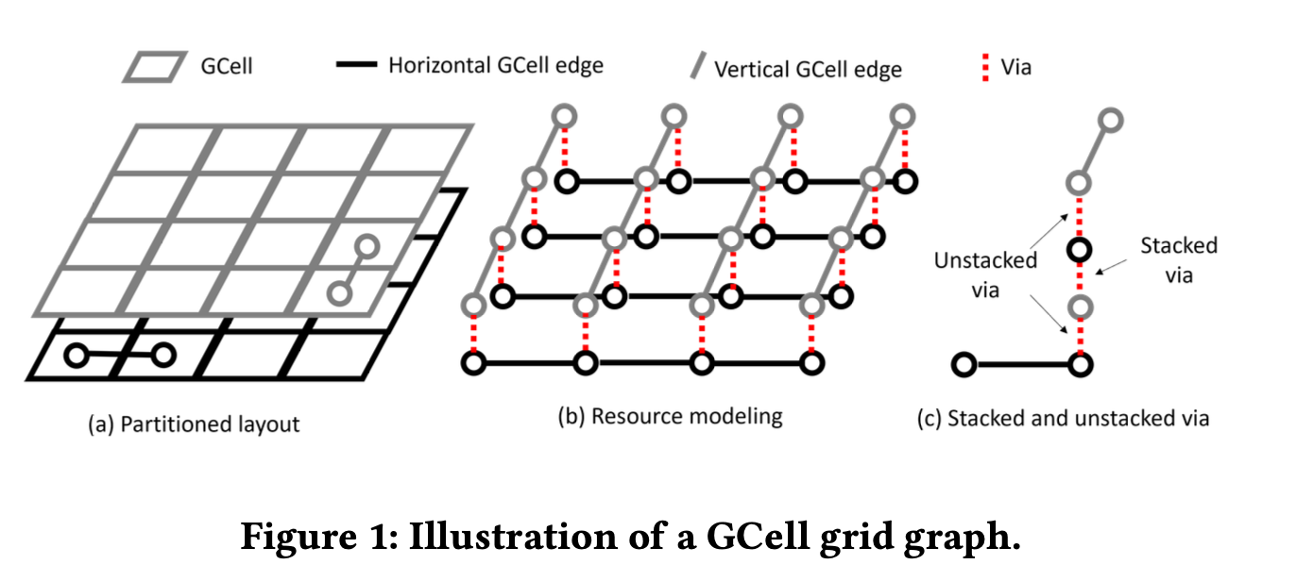
Introduction - 3D global routing problem
Routing topology generation
G-cells
Multi-layer grid graph
edges
capacity
via
Minimized overflows and total wirelength
figure source

Slide 4
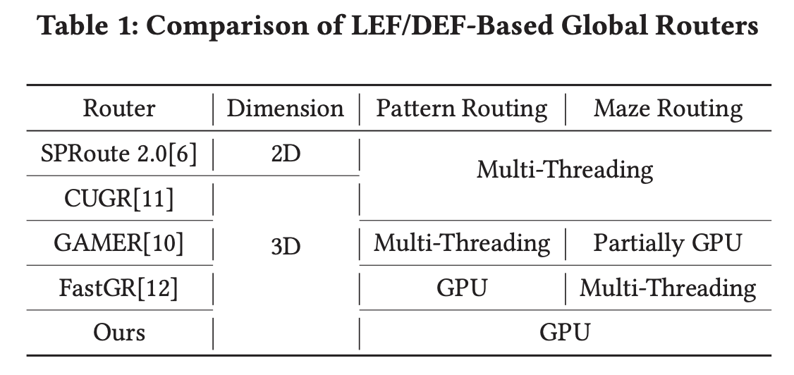
Introduction - 3D global routing problem
Pattern routing
L-shape,
Z-shape
3-bend routing
Ripped up and Re-Routed(RRR)
maze routing
2d routing, layer assignment
3d two-level maze routing

Slide 5
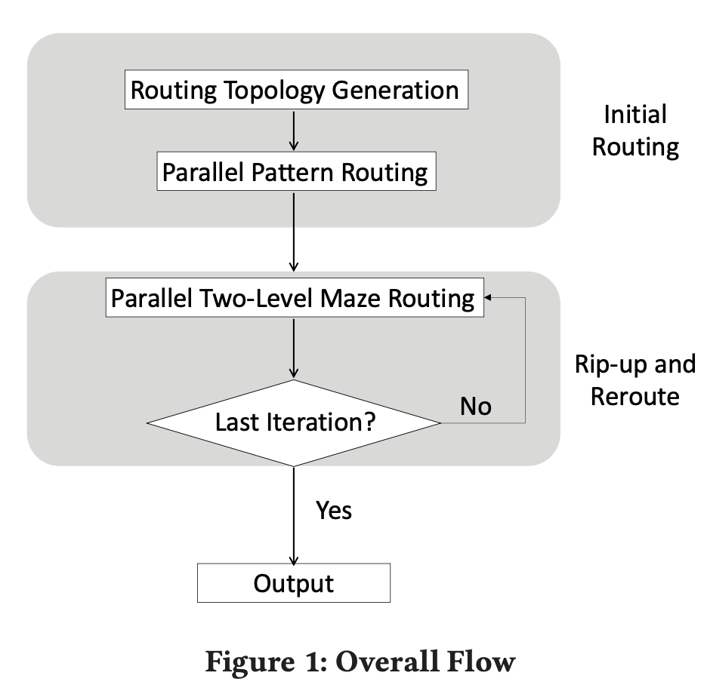
Introduction - Overview
LEF/DEF based global routing
In our 3D pattern routing, a 2D routing topology of a multi-pin net is first generated using FLUTE.
two-pin nets ordering(CUGR)
GPU- accelerated L/Z-shape routing
net-level parallelism
Parallel two-level maze routing
coarse-grained
fine-grained
Results are evaluated by the official evaluator Innovus v18.12-s106

Slide 6
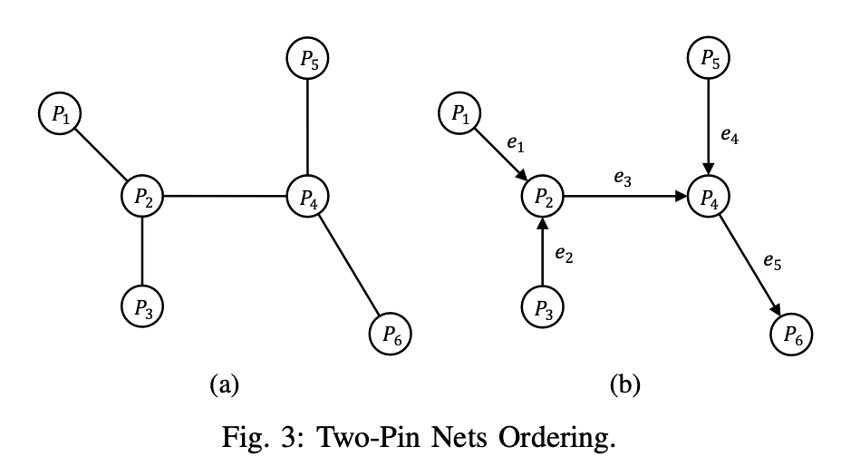
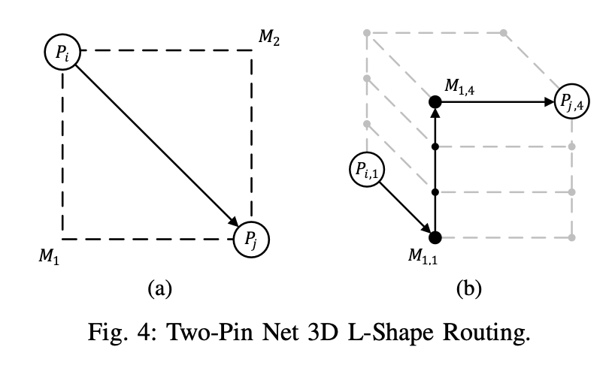
Introduction - Overview
source

Slide 7
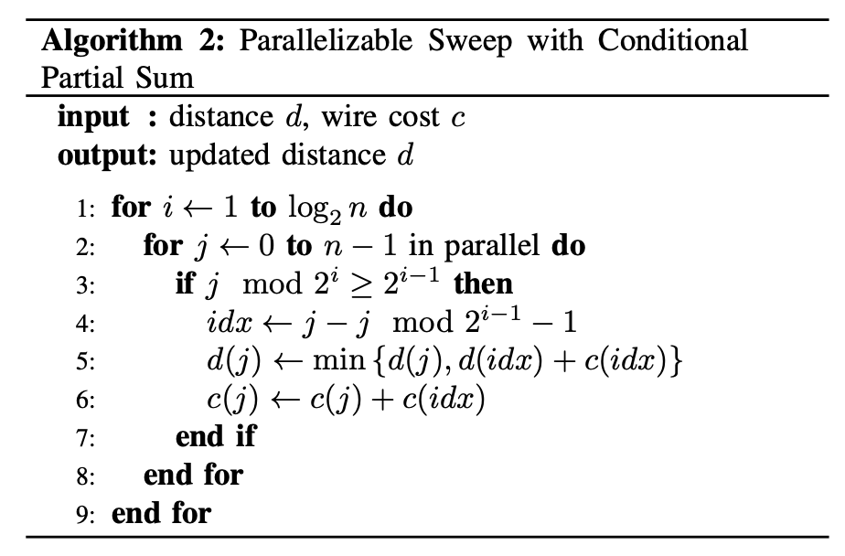
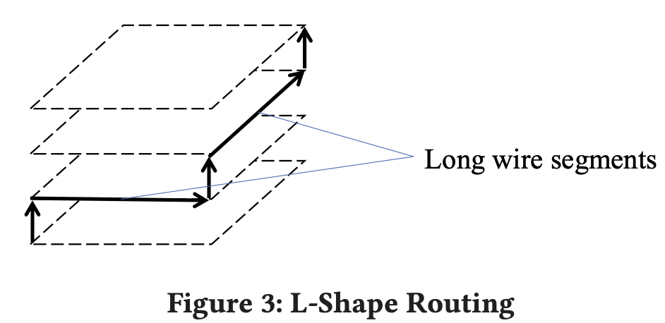
Parallel L-Shape Routing - Prefix sum
The most time-consuming step in L-shape routing is computing the total cost of a long wire segment.
In a bounding box has 2xLxL possible, (hv, vh) x (0~L) x (0~L).
Calculate the total cost of a long wire segment is to use prefix sum, which can be parallized.(ref)

Slide 8
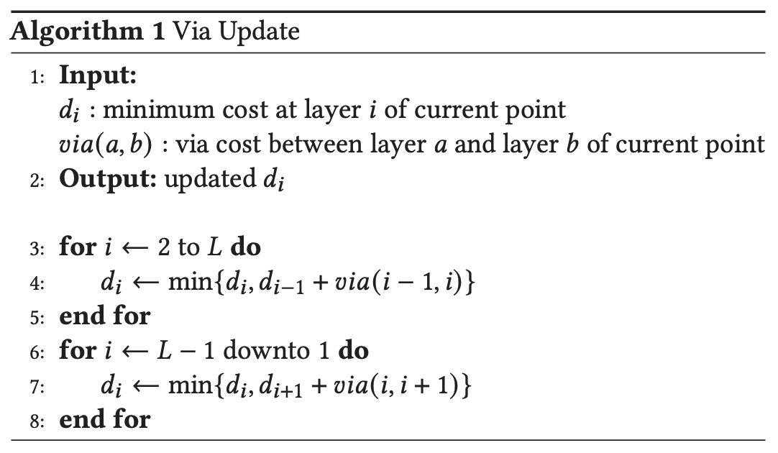
Parallel L-Shape Routing - Via update

Slide 9
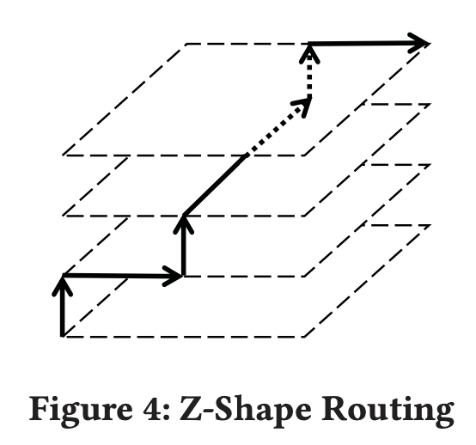
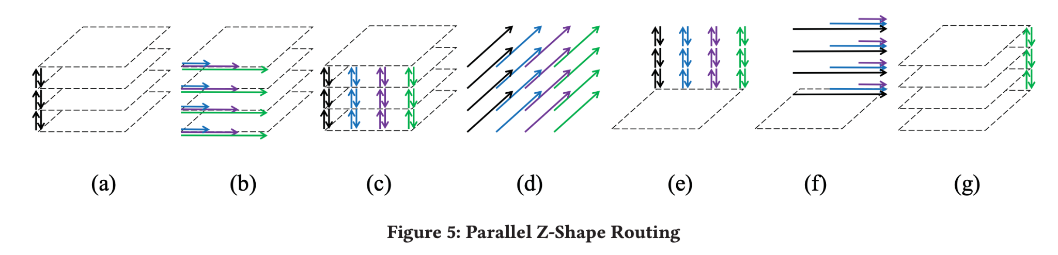
Parallel Z-Shape Routing
Z-shape routing has L^3 × (n+m) possible paths.
Using pre-computing prefix sum for fast long wire cost queries
Each net in a batch of non-overlapping nets occupies a block in CUDA, and multiple threads are allocated for every block.
chooses 32 as the unified number of threads for the nets.

Slide 10
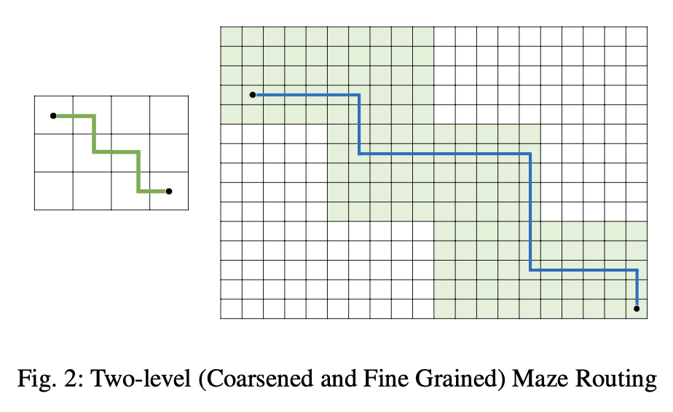
Two-Level Maze Routing
source

Slide 11
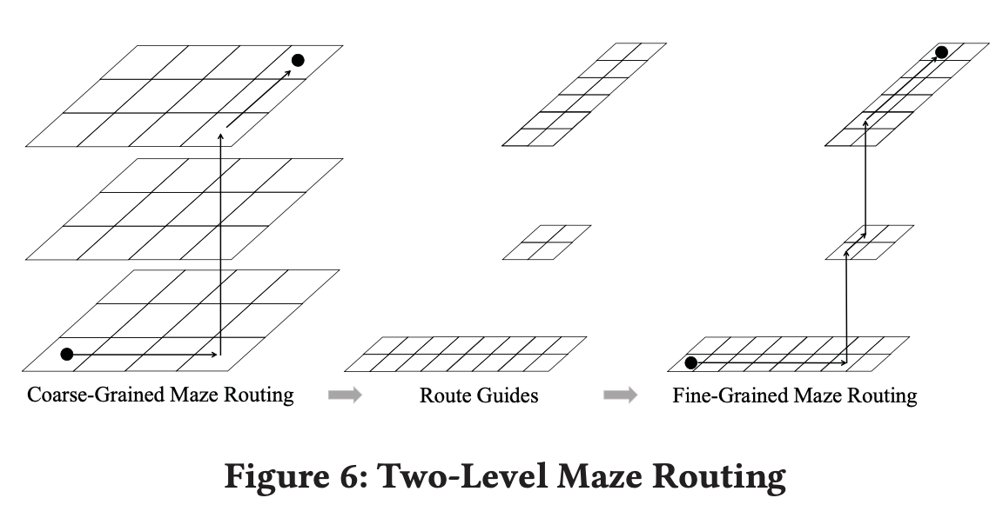
Two-Level Maze Routing - Coarse-grained routing
Two-level maze routing is a useful technique to reduce running time.
Coarse-grained routing
G-cells are merged to a coarse-grained G-cell.
Coarse-grained maze routing is first applied to find a path on the coarse grid graph.
All the coarse-grained G-cells on the path are used as route guides.
Only G-cells within the route guides will be considered in the fine-grained routing.

Slide 12
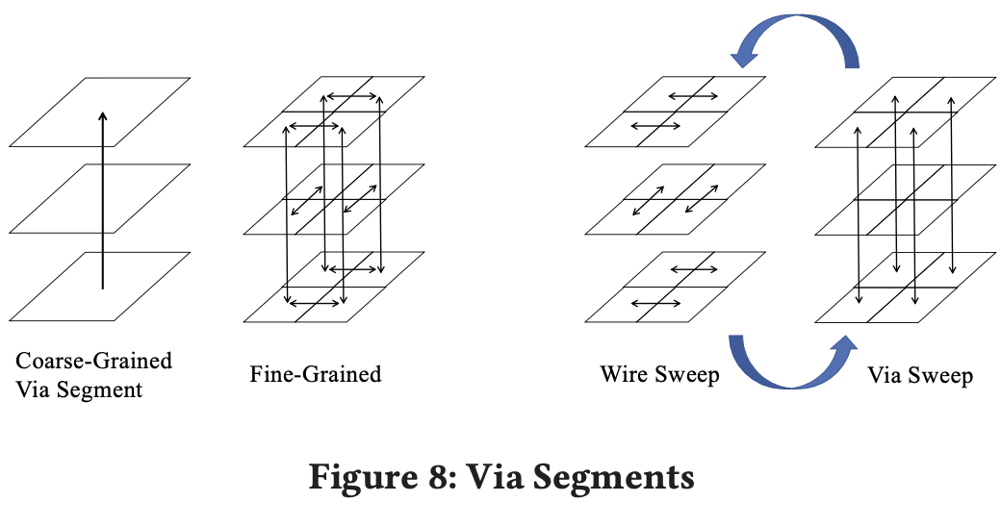
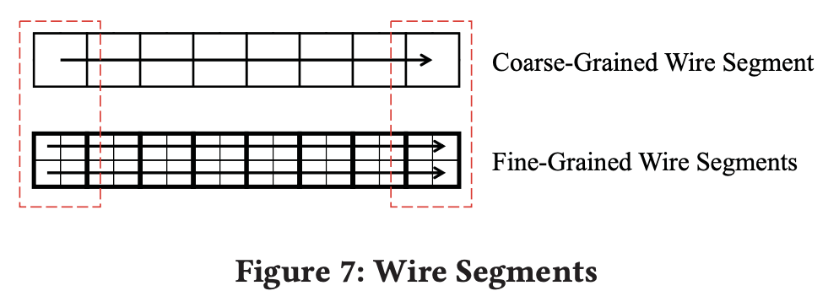
Two-Level Maze Routing - Parallel fine-grained maze routing
Decomposing Multi-Pin Nets into 2-Pin Nets.
Wire Segments: Continuous connections on the same layer.
Via Segments: Vertical connections between layers.
G-cell consists of 𝑐 × 𝑐 fine-grained G-cells and a coarse-grained via segment spans 𝐿 layers, 𝑐 × 𝐿 and 𝑐 × 𝑐 threads are needed for wire and via sweeps respectively.

Slide 13
Build
When Build Xplace, GGR will be installed.
Testcase called ispd19_test5 in ICCAD 2019 must be modified by program in ~/Xplace/data/remove_fence_in_ispd19_test5.py
How to run detail routing by using Innovus
modify source code and directory in ~/Xplace/tool/innovus_ispd2015_fix
cd ~/Xplace/tool/innovus_iccad2019 (I add this directory)
cp -r ~/Xplace/data/raw/iccad2019 .
python update_placement_def.py ~/Xplace/result/2024-12-09-15:24:14
the directory of iccad2019_xplace_route will be made
modify source code of run_all_route_xplace_route.tcl in ~/Xplace/tool/innovus_iccad2019/innovus_work
move innovus_iccad2019 to Innovus environment.
cd innovus_work
innovus -stylus -init run_all_route_xplace_route.tcl
Reference

Slide 14
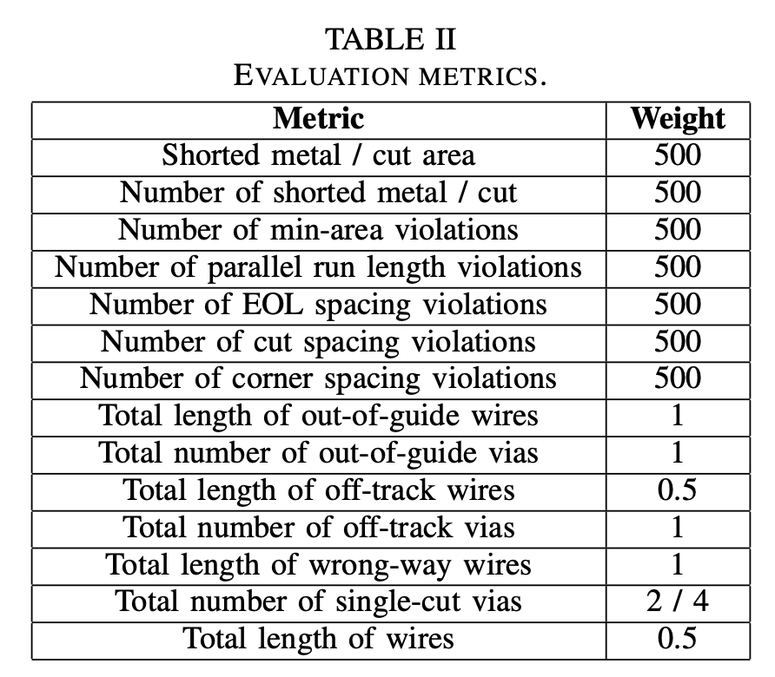
Experiment on ICCAD 2019 Benchmark : Introduction
2019 CAD Contest: LEF/DEF Based Global Routing
Inputs are placed DEF/LEF files.
Output file format follows the ISPD-2018/2019 route guide format.
Need to figure out pin accesses and blockage effects based on physical metal shapes and DRCs to achieve accurate resource modeling.
Using an academic detailed router(Dr.CU) as part of the evaluation process. Rather than comparing overflow metrics.

Slide 15
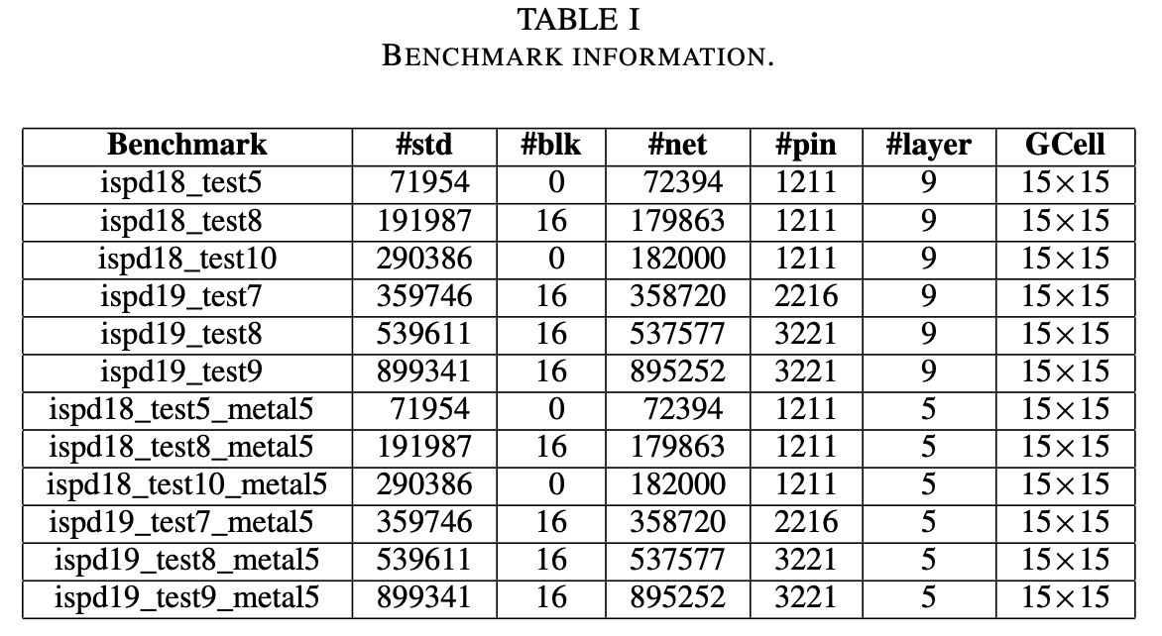
Experiment on ICCAD 2019 Benchmark : Introduction

Slide 16
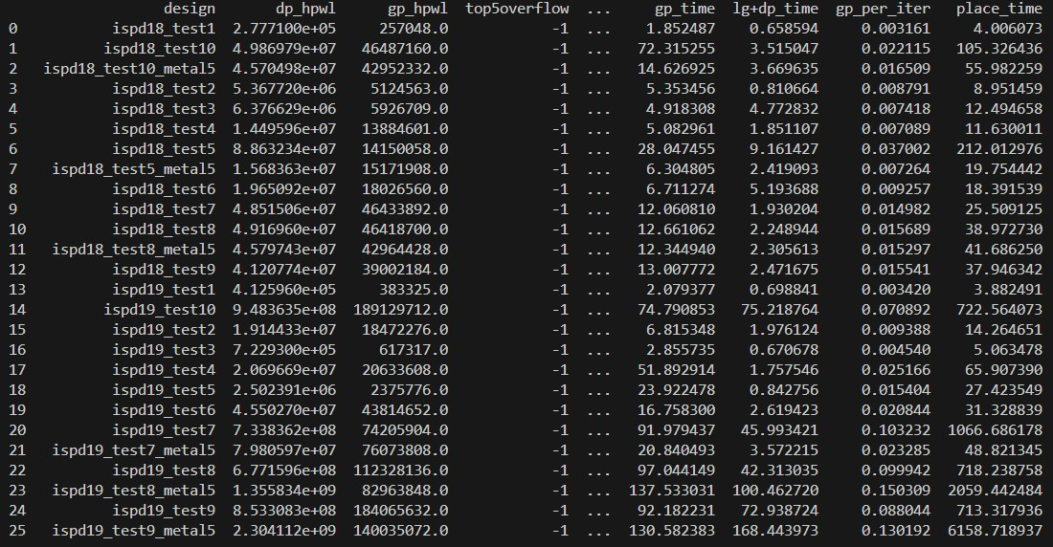
Experiment on ICCAD 2019 Benchmark : Result
the iccad 2019 result of GGR

Slide 17
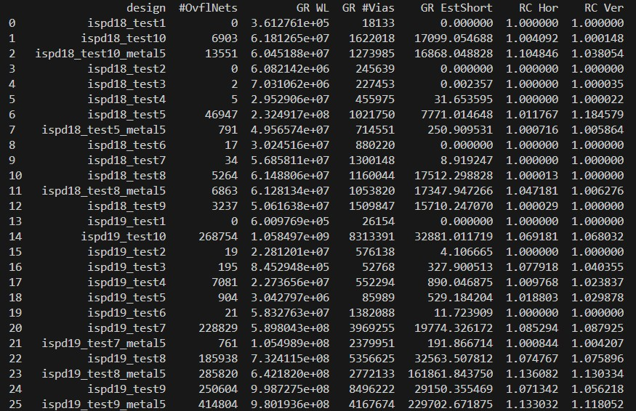
Experiment on ICCAD 2019 Benchmark : Result
the iccad 2019 result of GGR

Slide 18
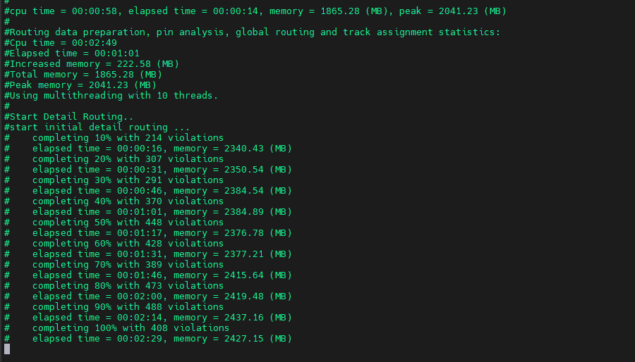
Experiment on ICCAD 2019 Benchmark : Result
the process of iccad 2019 Detail Routing on EE machine Innovus (need to run about two days)

Slide 19
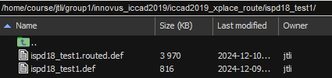
Experiment on ICCAD 2019 Benchmark : Result
the result of iccad 2019 Detail Routing (will get some xx.routed.def)
ispd18_test1, ispd18_test2, ispd18_test3, ispd18_test4, have already been successfully executed.

Slide 20
Experiment on ICCAD 2019 Benchmark : Result
command: see some detail routing result
innovus
read_physical -lefs /home/course/jtli/group1/innovus_iccad2019/iccad2019/ispd18_test1/ispd18_test1.input.lef
read_netlist /home/course/jtli/group1/innovus_iccad2019/innovus_work/ispd18_test1.def.v
read_def /home/course/jtli/group1/innovus_iccad2019/iccad2019_xplace_route/ispd18_test1/ispd18_test1.routed.def

Slide 21
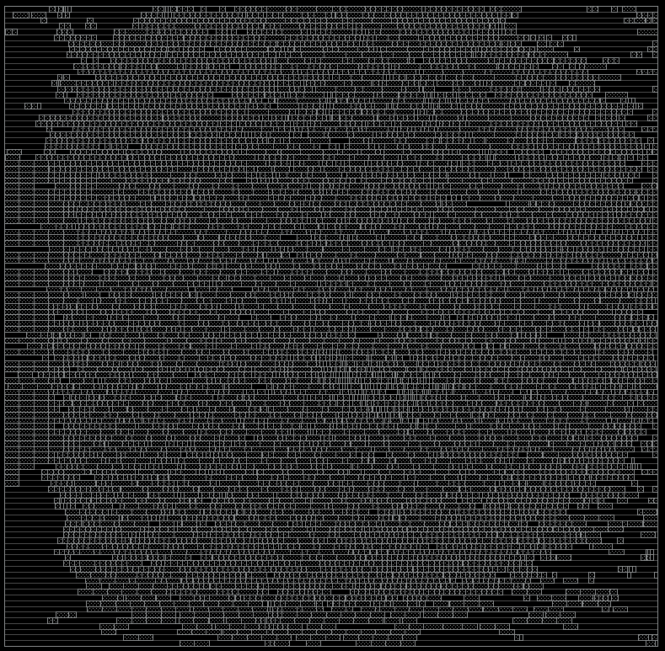
Experiment on ICCAD 2019 Benchmark : Result
the iccad2019 result of Xplace’ s placement
ispd_test1

Slide 22
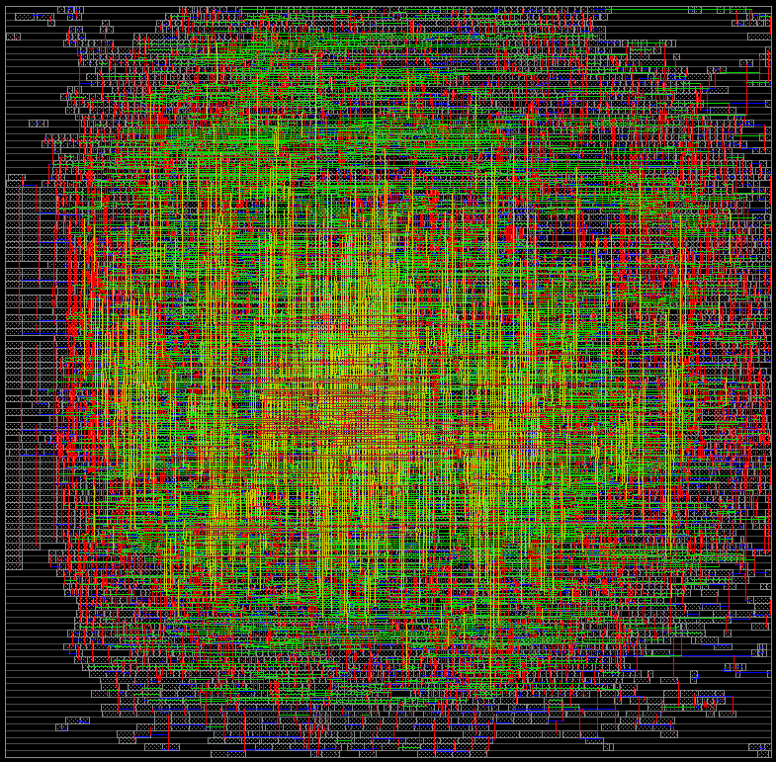
Experiment on ICCAD 2019 Benchmark : Result
the iccad2019 result of detail route
ispd_test1

