Slide 1
ABCDPlace: Accelerated Batch-Based Concurrent Detailed Placement on Multithreaded CPUs and GPUs
2024/11/13
Group1

Slide 2
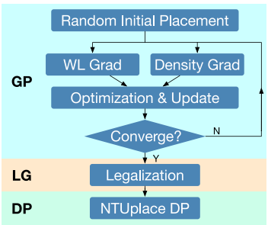
Introduction
Experiments of DreamPlace have shown that, after accelerated global placement with GPU, detailed placement will become bottleneck of performance.
While ABCDPlace is not directly related to ML or DL, it is integrated into DreamPlace as a GPU-accelerated detailed placement component. We present this paper to facilitate further discussion on DreamPlace.

Slide 3
Introduction
As an important part of modern very-large-scale intergrated (VLSI) designs, many effective sequential detail placement algorithm already exist.
Including independent set matching, global swap, and local reordering
ABCDPlace intorduces batch-based parallel algorithm for these widely adopted techniques, leveraging multithreading and GPU acceleration to significantly improve runtime.

Slide 4
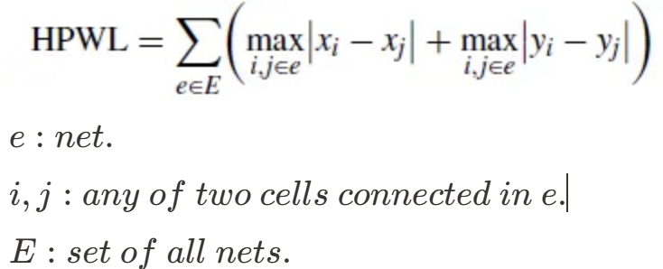
Objective
HPWL (Half-Perimeter wirelength)

Slide 5
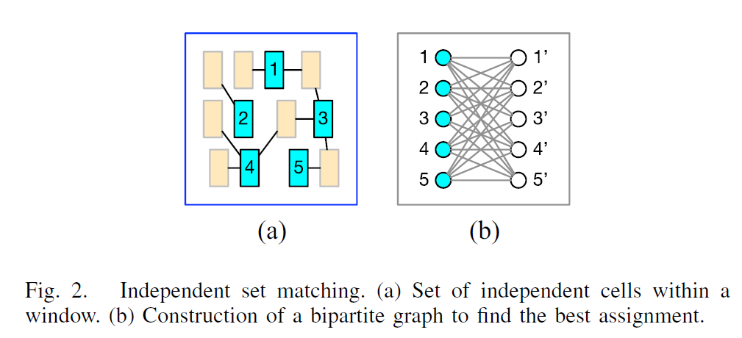
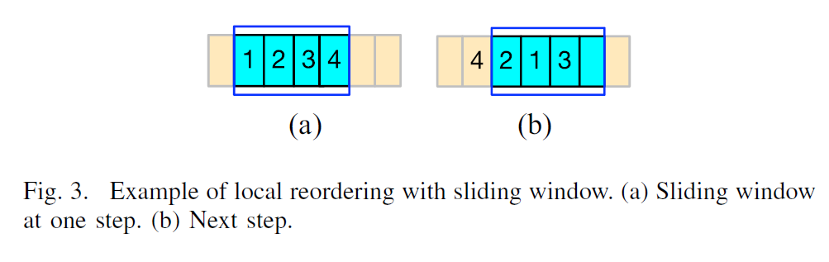
Original Algorithms
Independent Set Matching (Fig. 2)
Global Swap
Local Reordering (Fig. 3)

Slide 6
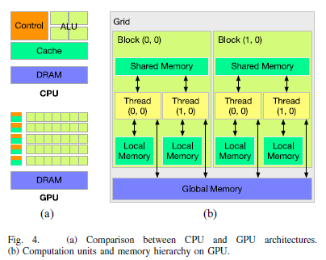

Slide 7
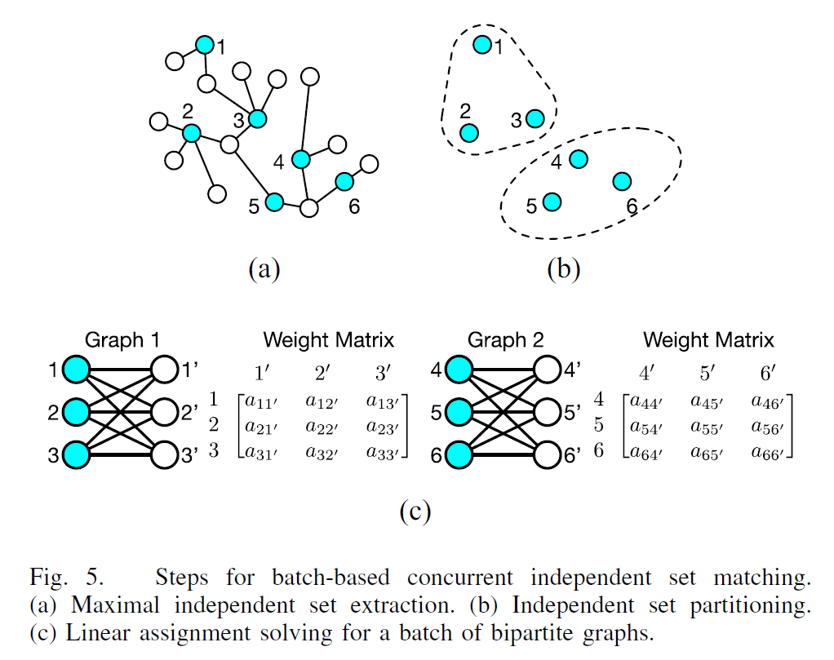
Concurrent Independent Set Matching
Extracts a maximal independent set with given seed.
Partitions the maximal independent set into many subsets. (The cells with sames sizes and physically close will be allocated to tho same subset.)
Solves LAP for all subsets in the batch independently.

Slide 8
Concurrent Independent Set Matching -
1. Parallel Maximal Independent Set Extraction
Blelloch’s algorithm :
Creates a random order: Assign a random order value to all cells.
Parallel check: Check all cells in parallel, incorprating a cell into the independent set if and only if it has minimum order value among its neighbors.
Iterative update: In each iteration, the algorithm ensure adds at least one cell into the independent set.

Slide 9
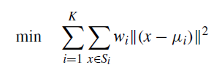

Concurrent Independent Set Matching -
2. Parallel Partitioning with Balanced K-Means Clustering

Slide 10
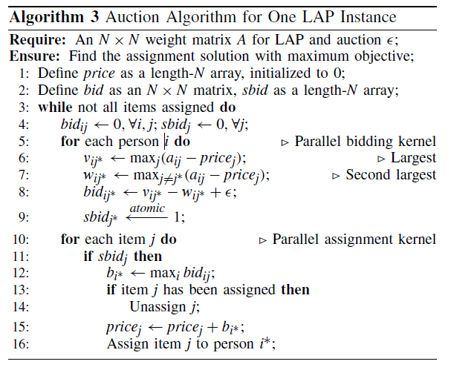
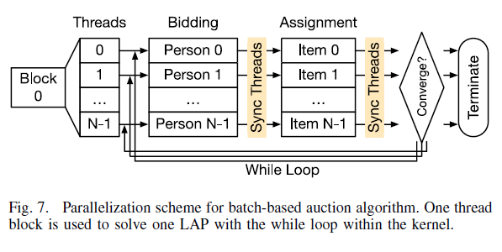
Concurrent Independent Set Matching -
3. Batch Solving for Linear Assignment Problems

Slide 11
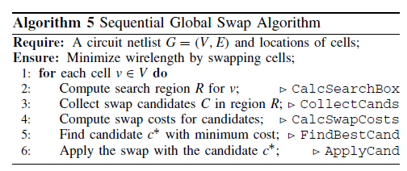
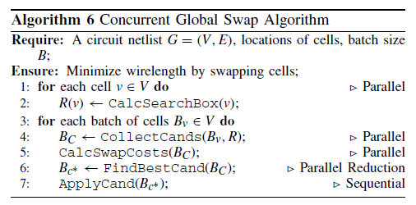
Concurrent Independent Set Matching
Calculates the search region.
Collects candidates.
Calculates the swapping cost for each candidate.
Selects the best candidate.
Apply swapping.

Slide 12
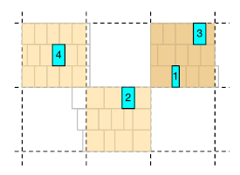
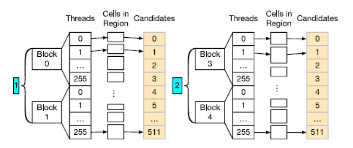
Concurrent Independent Set Matching

Slide 13
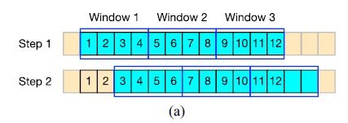
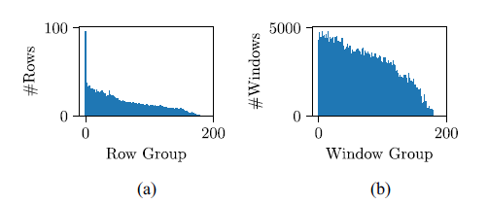
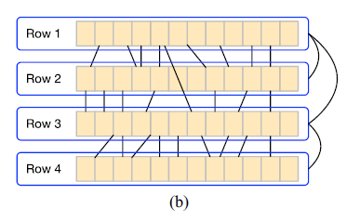
Concurrent Local Reordering
Parallel Sliding Windows
Independent Rows Assumpt the most connections are local in the detailed placement.

Slide 14
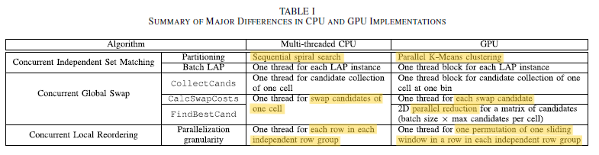
Summary of Parallel CPU and GPU Implementations

Slide 15
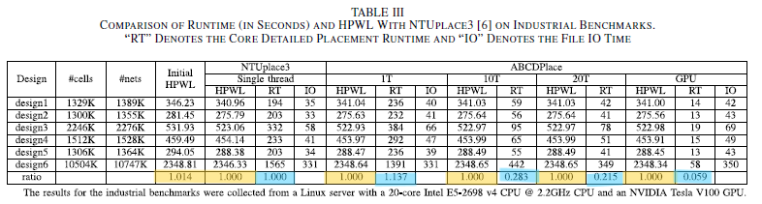
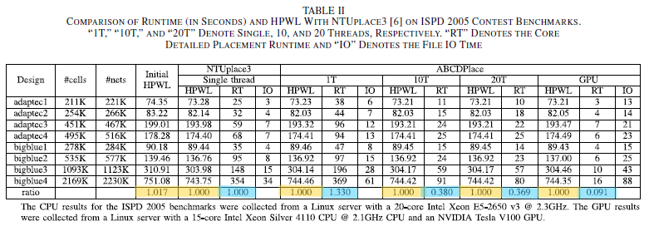
Experiment results on each Benchmark

Slide 16
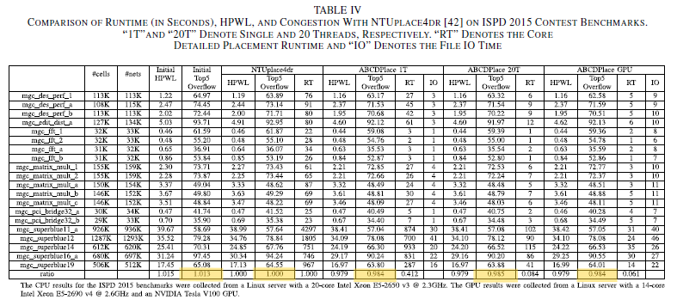
Experiment results on each Benchmark

Slide 17
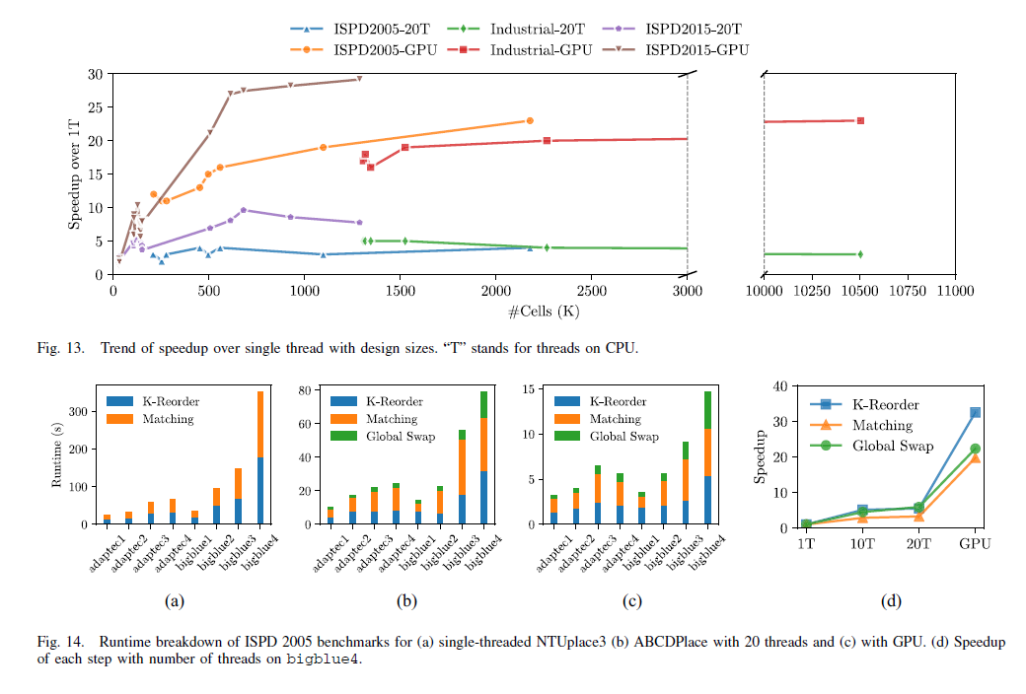
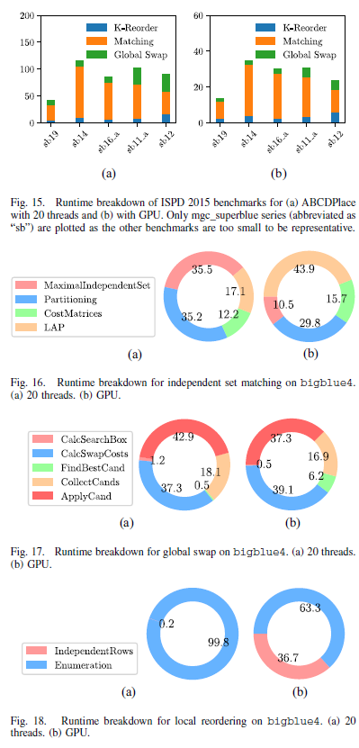
Speedup

Slide 18
Runtime breakdown for each algorithms

Slide 19
Thank you !

