Slide 1
Xplace: An Extremely Fast and Extensible Placement Framework
2024/12/04
Group1
Paper link
code : https://github.com/cuhk-eda/Xplace
‹#›

Slide 2
Outline
Introduction
Operator-Level Optimization
Stage-Aware Parameters Scheduling
Fourier-Neural-Operator (FNO)
Detailed-Routability Optimization
Experiment Results
Conculsion

Slide 3
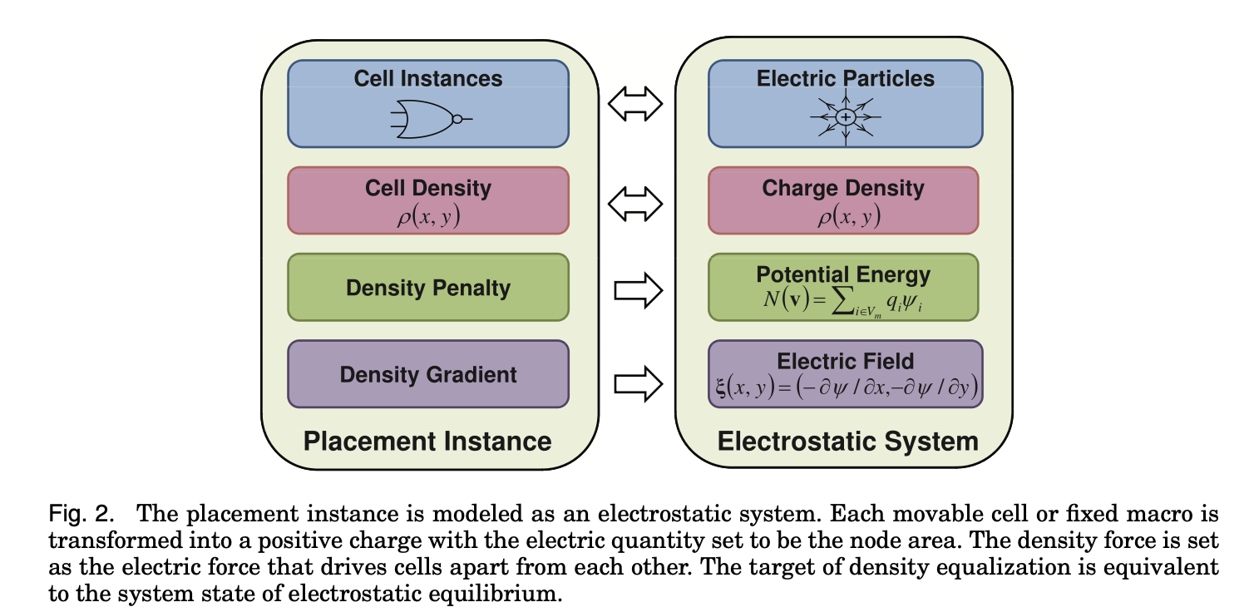
Introduction - Review Electrostatics-Based Placement

Slide 4
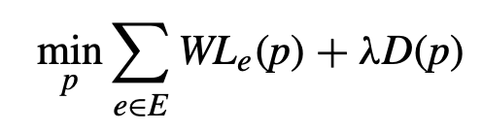
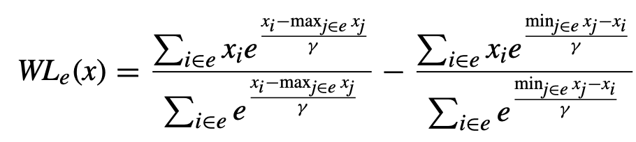
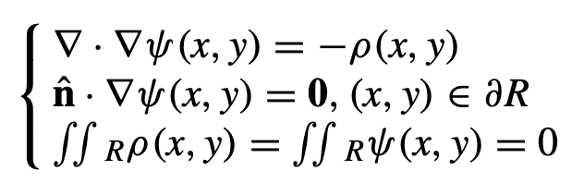
Introduction - Objective
Weighted average (WA) numerically stable version
Poisson’s equation (solved by DCT)

Slide 5
Introduction - Overview
Xplace-Route
“Upgrade” version of DREAMPlace
Routability-Driven placement flow to optimize the detailed routability.
Operator-Level optimization techniques to achieve effective parallelization.
Stage-Aware parameters scheduling to improve the solution.
Fourier-Neural-Operator (FNO), solving Poisson equation.
DreamPlace
ePlace/RePlace
ABCDPlace
ePlace/RePlace
ABCDPlace
Routability Optimization

Slide 6
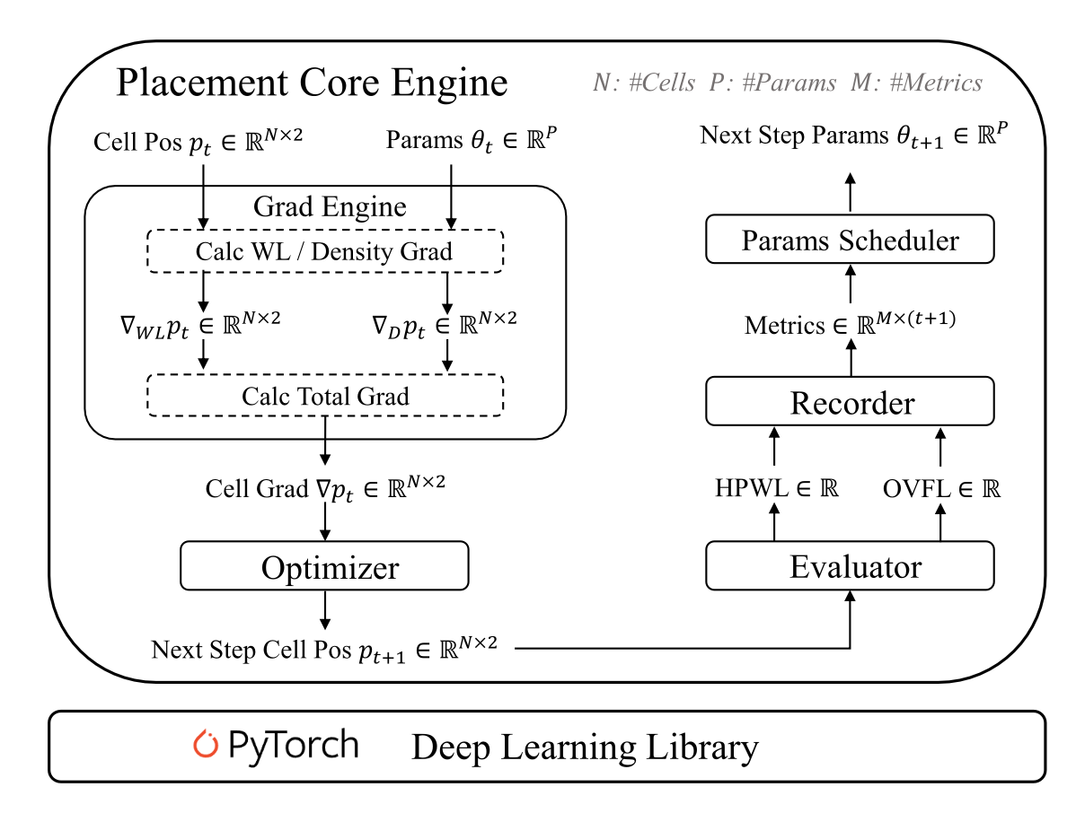
Introduction - Placement Core Engine
Placement- Stage-Aware parameters scheduler
Operator-Level optimization
Fourier-Neural-Operator (FNO)
Routability evaluation and optimization (GGR <- our demo 4)

Slide 7
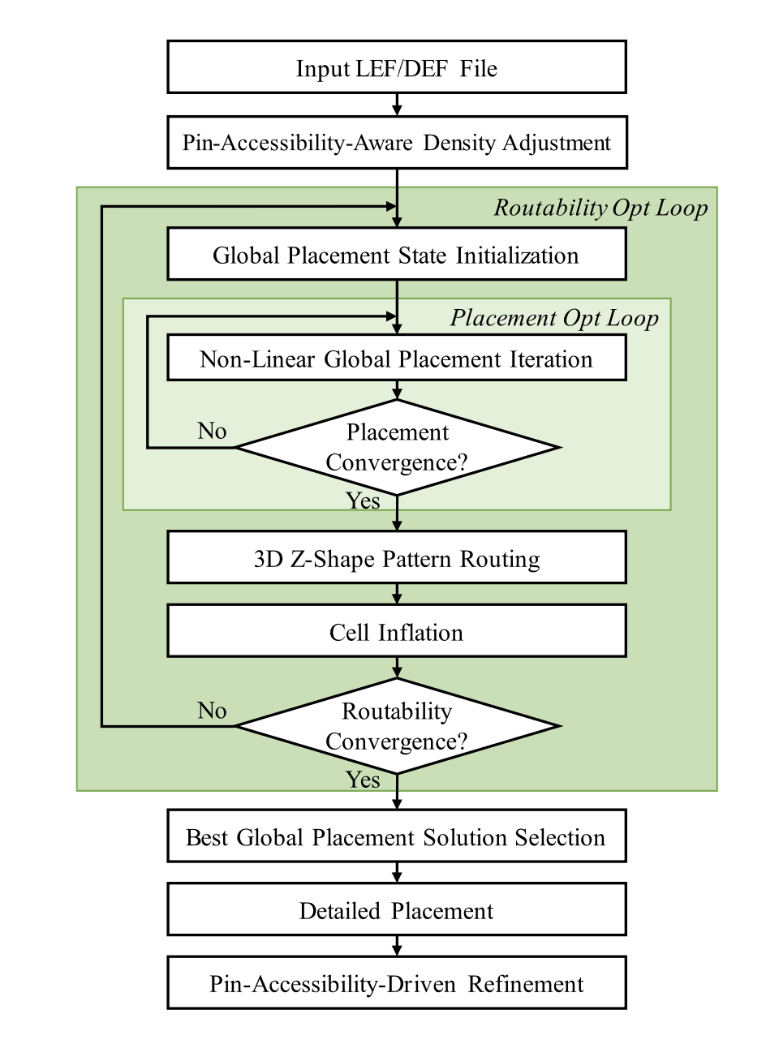
Introduction - System Flow
Routability-Driven Placement Flow
Pin-Accessibility-Aware Density Adjustment
Placement Core
Routing Congestion Map (3D Z-Shape)
Cell Inflation
Selects the solution with the smallest routing cost
Legalization and Detailed Placement (use ABCDPlace)
Pin-Accessibility-Driven Refinement

Slide 8

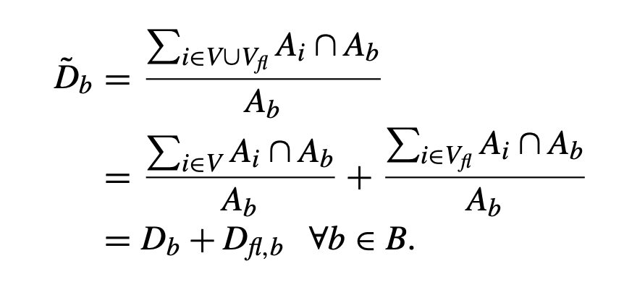
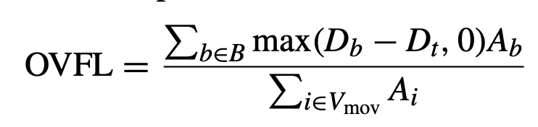
Operator-Level Optimization
Operator extraction
Db is bin b’s cell density
overflow ratio OVFL
total density map

Slide 9
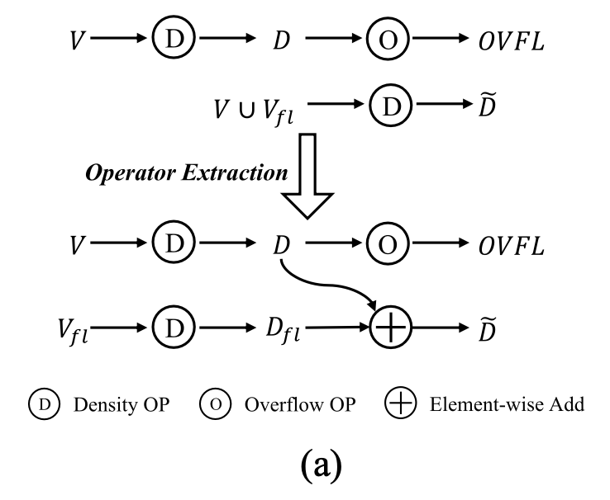
Operator-Level Optimization
Element- wise add operator to compute density map.
Overflow operator to calculate OVFL.

Slide 10
Operator-Level Optimization
Kernel launching overheads may be much larger than their GPU execution overheads when their computation workloads are small.
Kernel launching overheads of most placement operators are much larger than their GPU execution overheads. (except for wirelength and density computations)
Operator Reduction
Avoid invoking the heavy autograd engine.
PyTorch in-place operators
Operator Skipping

Slide 11
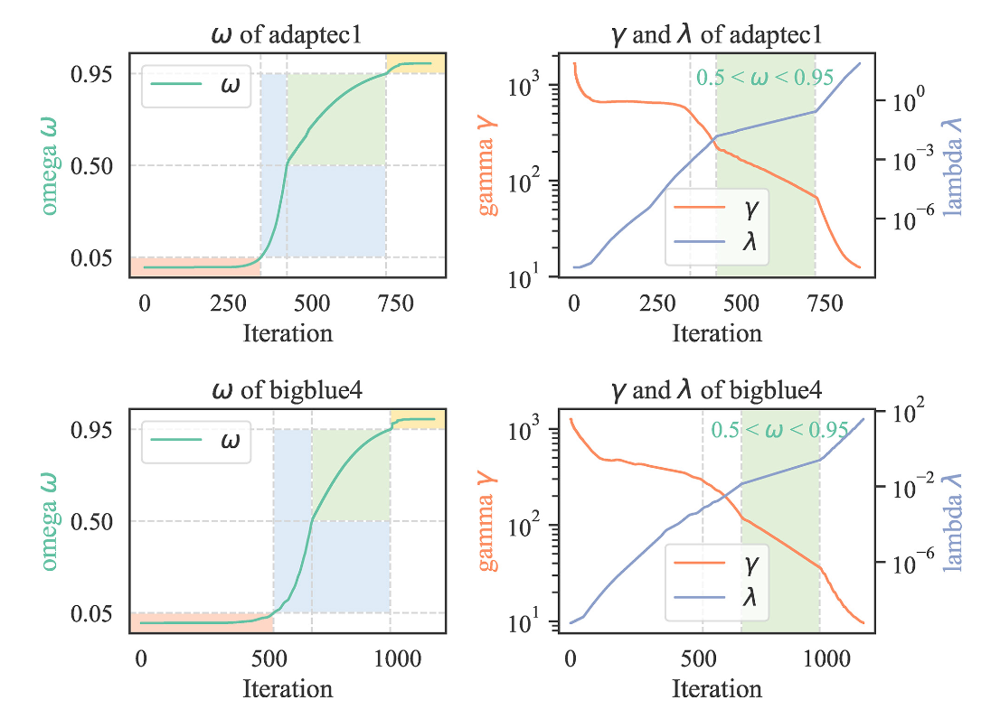
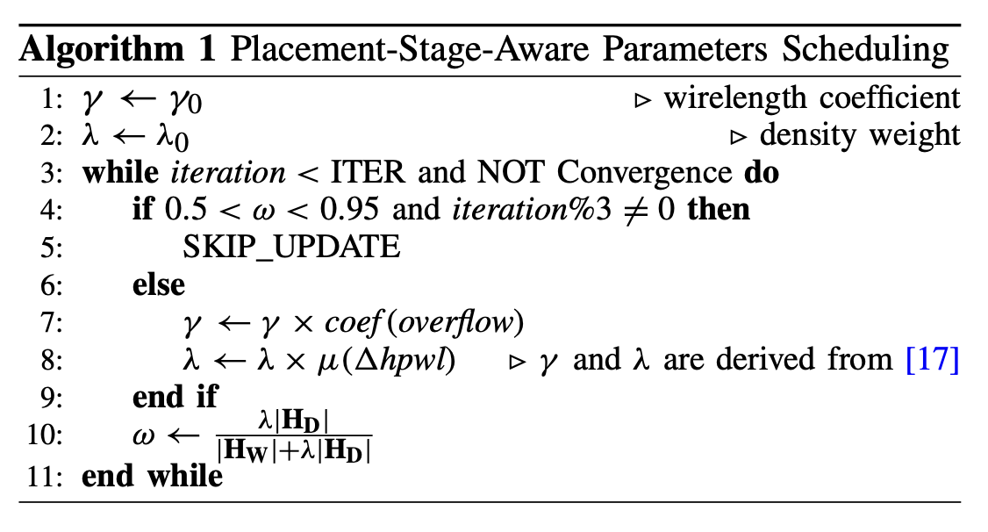
Stage-Aware Parameters Scheduling
Search the solution spaces more fine-grained, and the quality of the final solution will become better.

Slide 12
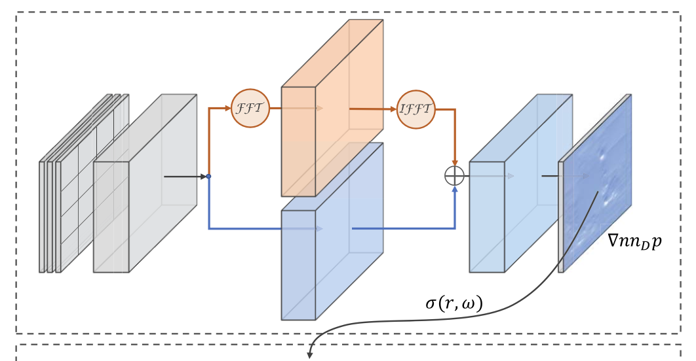




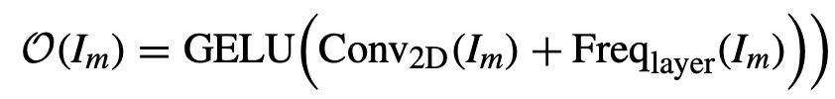
Fourier-Neural-Operator (FNO)
Neural networks have shown great potential on mapping between dynamic systems defined by partial differential equations (PDEs).
FNO is used to solve Poisson equation here.
Input : I={D, Mx, My}

Slide 13
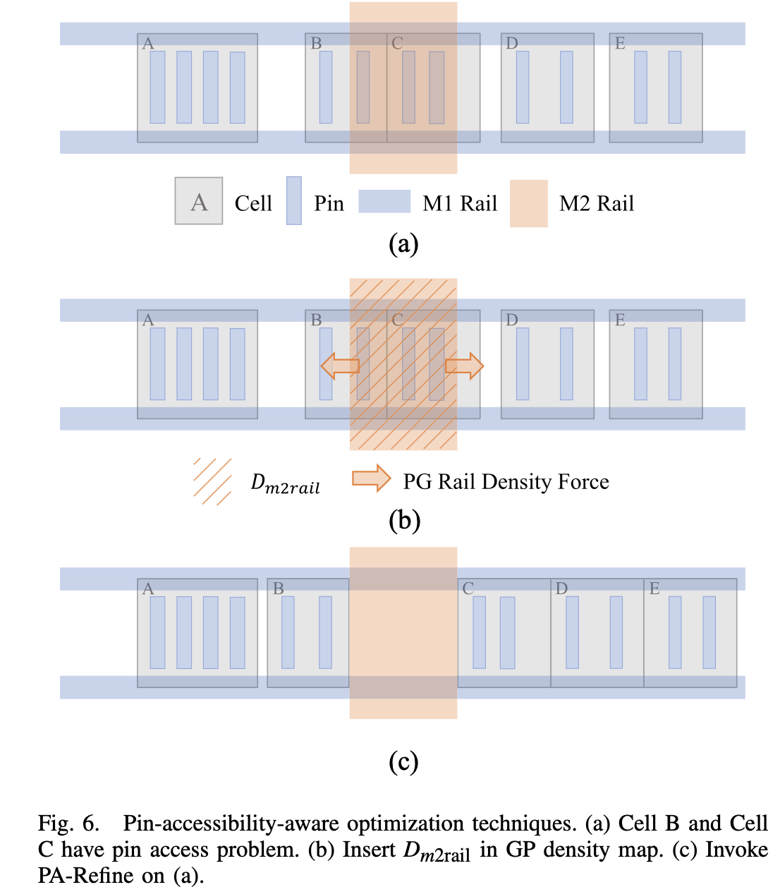
Detailed-Routability Optimization
Pin-Accessibility-Aware Density Adjustment
insert PG rail density as penalty
Pin-Accessibility-Driven Refinement
search horizontal neighborhoods for movement

Slide 14
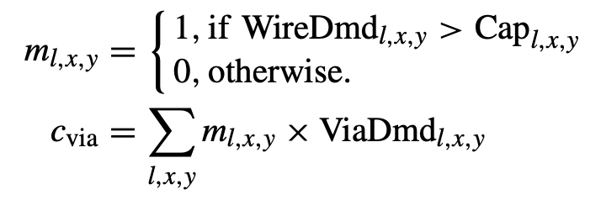
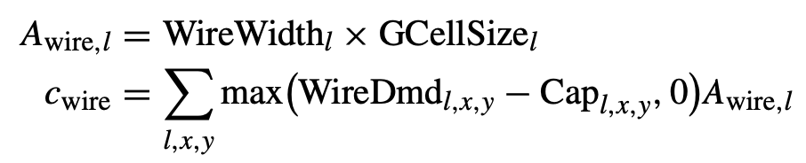

Detailed-Routability Optimization
Routing Congestion Map
GPU-accelerated 3-D Z- shape pattern routing algorithm (GGR: Superfast Full-Scale GPU-Accelerated Global Routing)
Cell Inflation
a cell in a more congested area will be much more inflated than one in a noncongested area.
Solution Selection Criteria
smallest routing cost among all the converged placement solutions
Routing Cost

Slide 15
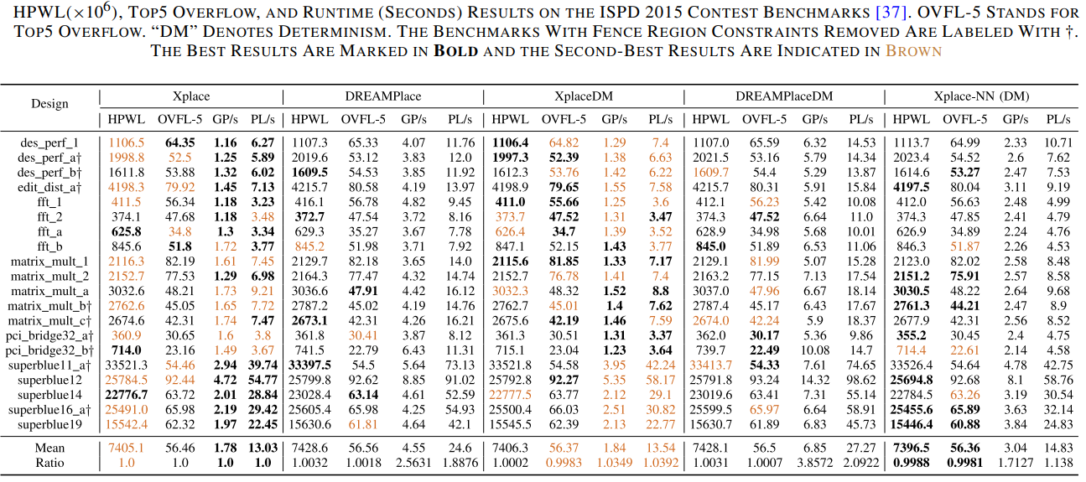
Experiment Results

Slide 16
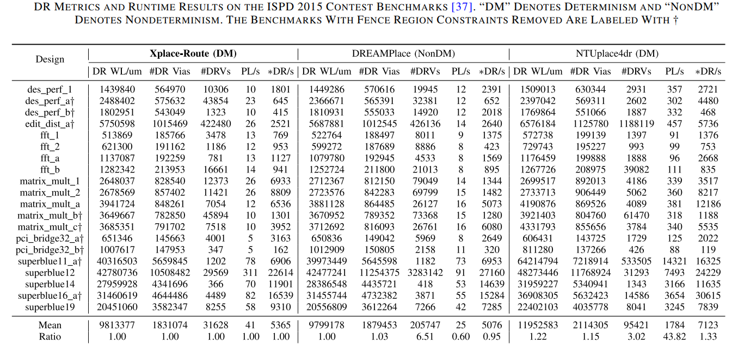
Experiment Results

Slide 17
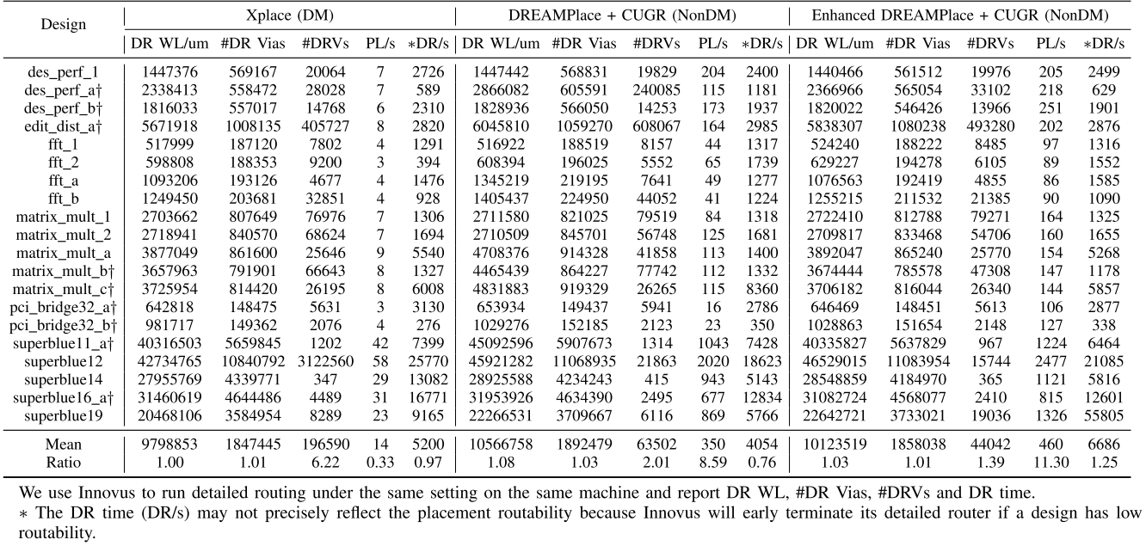
Experiment Results

Slide 18
Conculsion
Xplace is a open-source GPU-accelerated placement framework.
Xplace’s extensibility in integrating with neural networks to solve Poisson equation.
Xplace can handle the detailed-routability-driven placement problem.
Xplace-Route, a GPU-accelerated routing engine effectively improves detailed routability and reduces the number of violations.

