Slide 1

Driftwood Self-Regulating Access to Natural Resources
Modeling and Simulation of Complex Systems
Lecturer: Prof Alexis Drogoul, Arnaud Grinard, Athur Bulgiere
By: Phạm Gia Phúc

Slide 2
Contents
Introduction
Mechanisms - Environment
Extension 1 - Self-Regulation and Pile Ownership
Extension 2 - External Enforcement
Extension 3 - Group Dynamics
Conclusion

Slide 3
Introduction
Problem Statement
Resource competition for driftwood collection on coastal shores
Ownership marked by stone placement
Theft possible when unobserved
Need for effective self-regulation
Key Research Question
Is it possible to achieve a stable resource management system through:
Peer pressure regulation
External enforcement
Group dynamics
Notes:
The Driftwood project explores self-regulating access to natural resources in a coastal environment, focusing on how social dynamics, enforcement mechanisms, and group behaviors influence resource management, where collectors compete for resources while navigating complex social and environmental constraints.

Slide 4
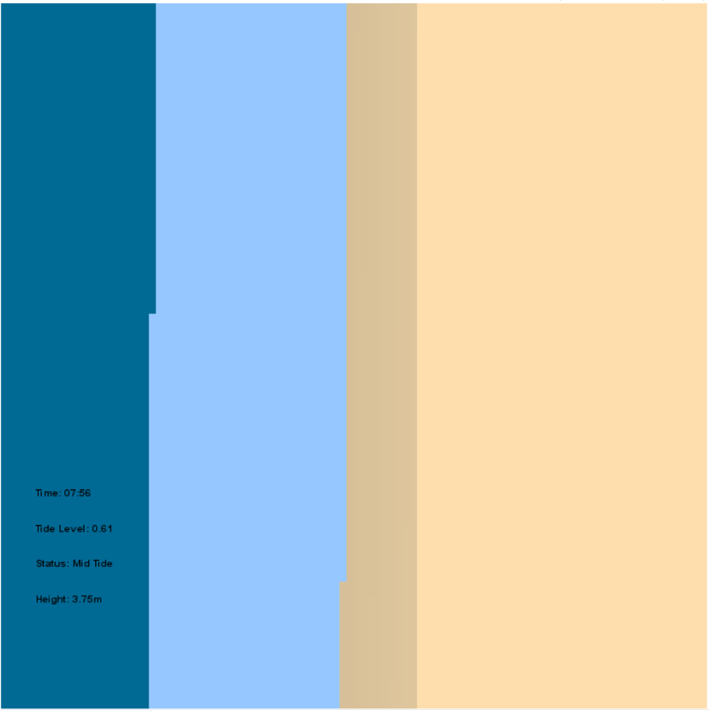


Mechanisms - Environment
Spatial Organization
Deep Sea Zone (20% width)
Tidal Zone (20-65%)
Sandy Beach Zone (65-100%)
Dynamic Systems
24-hour day/night cycle
Synchronized tidal system
Rising: 0:00–6:00 and 12:00–18:00
Falling: 6:00–12:00 and 18:00–24:00
Wave dynamics with parametric control
Water depth calculations and beach topography
Notes:
The simulation environment represents a coastal area with three distinct zones:
Deep Sea Zone (20%): The primary source of driftwood, characterized by deep water and constant movement
Tidal Zone (20-65%): The transitional area where driftwood accumulates and moves with tides
Sandy Beach (65-100%): The collection area where piles are formed and maintained

Slide 5
Mechanisms - Environment
Driftwood
3 sizes:
Large: 5
Medium: 3
Small: 1
Tide influenced movement
Wave influenced movement

Slide 6
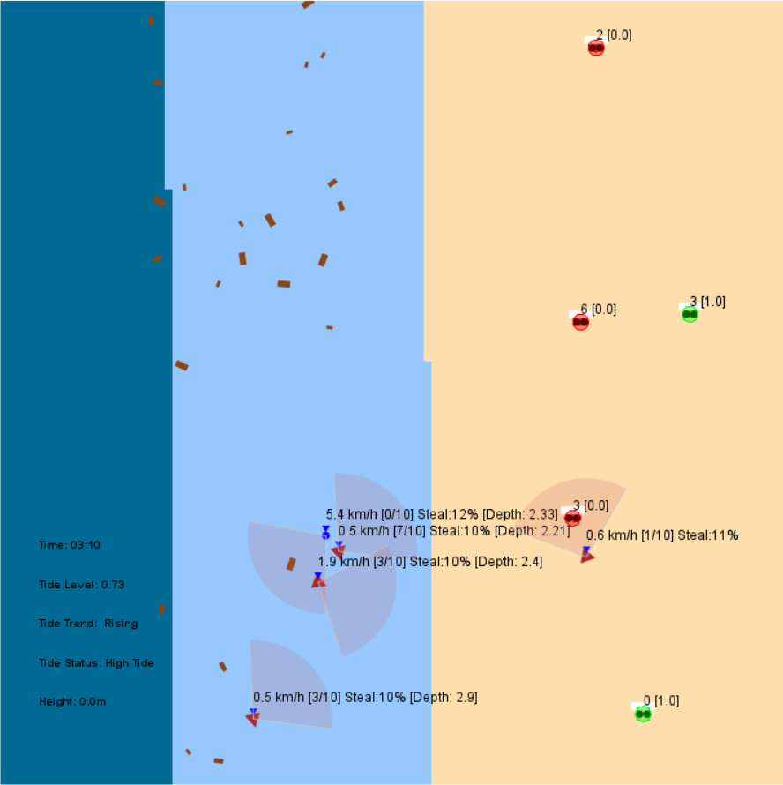
Extension 1: Self-Regulation and Pile Ownership
Collector Behavior
Speed: 0-8 km/h
Carrying capacity: 10 units
Field of view: 100 degrees, 10m range
Greediness factor: 0.3-0.8
Theft Mechanics
Initial steal chance: 10%
Maximum: 20%
Success-based increase: 1%

Slide 7
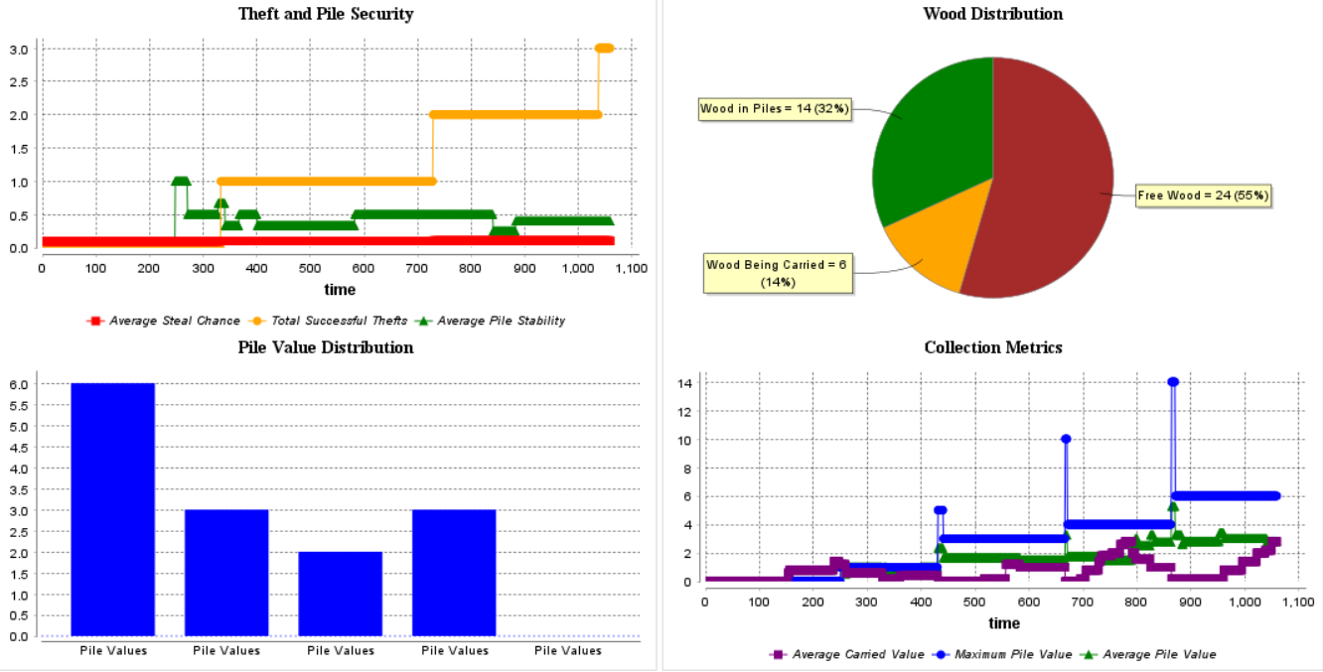
Ext1: Self-Regulation and Pile Ownership – Analysis

Slide 8
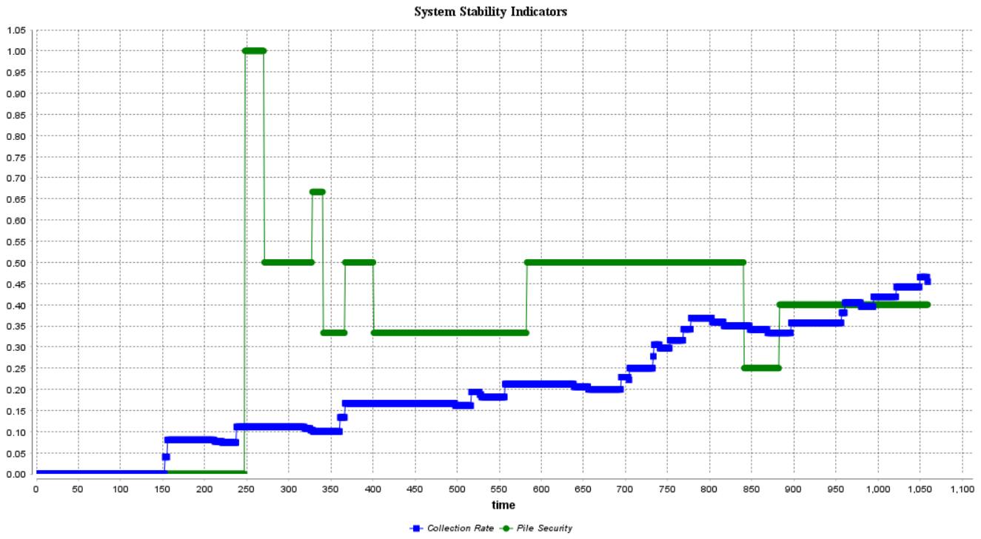
Ext1: Self-Regulation and Pile Ownership – Analysis

Slide 9
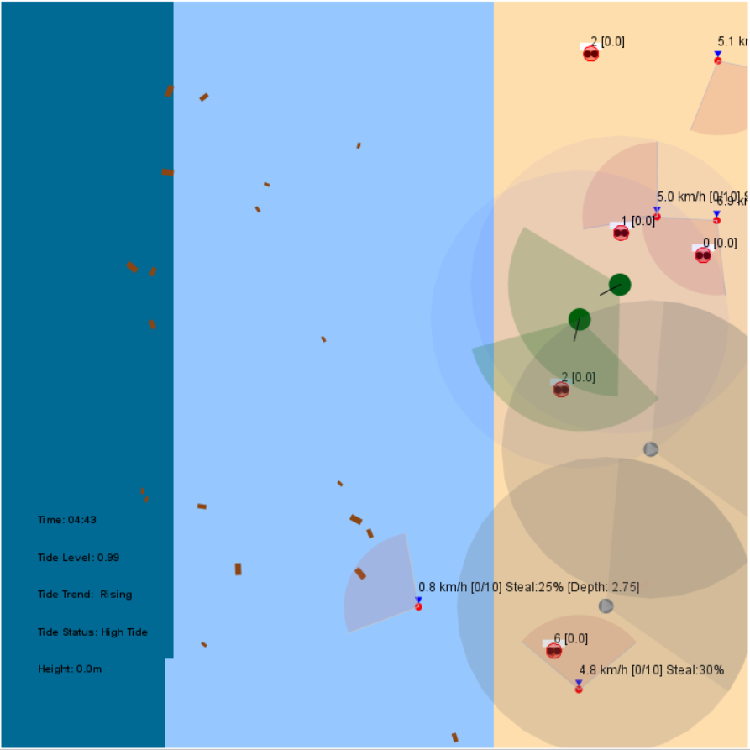
Extension 2: External Enforcement
Enforcement Mechanisms
Authority agents with enhanced FOV
Security cameras
Active pursuit system
Punishment mechanics
Impact Analysis
Catch rates
System stability
Resource security
Theft deterrence

Slide 10
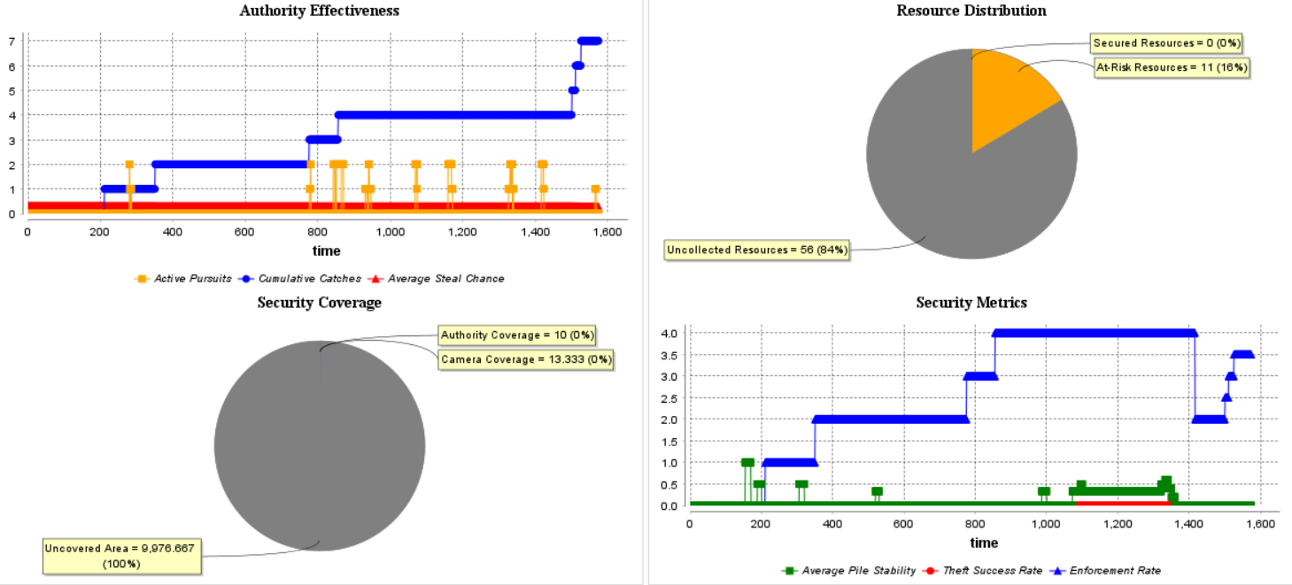
Ext2: External Enforcement – Analysis

Slide 11
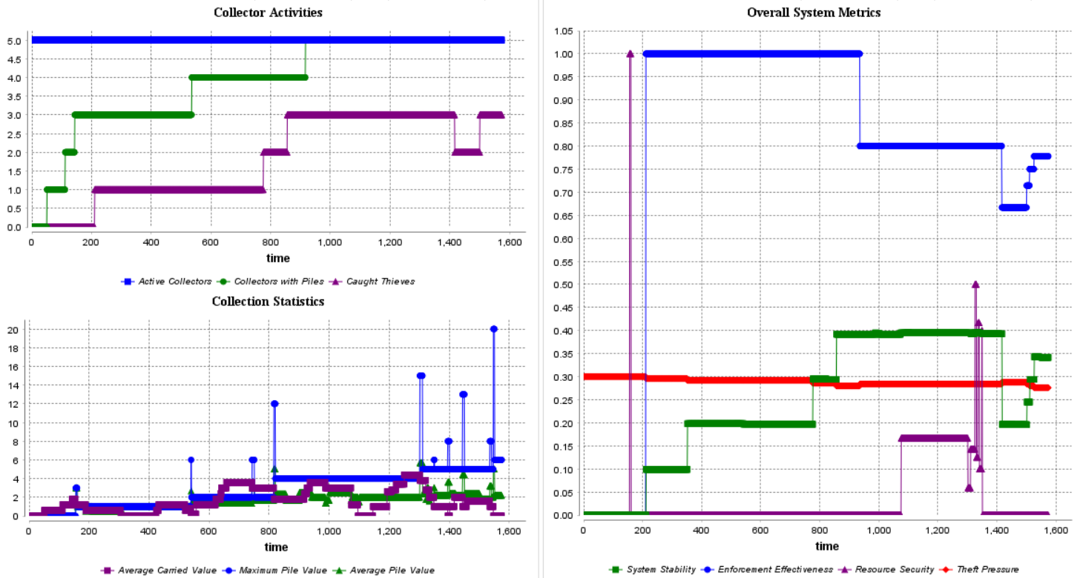
Ext2: External Enforcement – Analysis

Slide 12
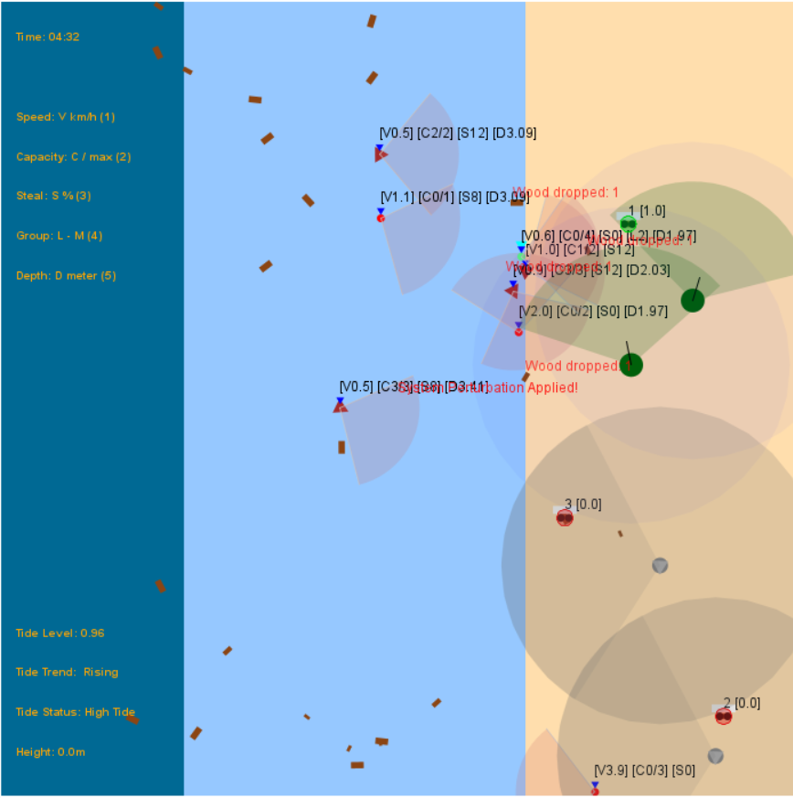
Extension 3: Group Dynamics
Group Formation
Size: 2-4 members
Formation chance: 30%
Breakup chance: 10%
Cooperation bonus: 20%
System Resilience
Regular system disruptions (every 500 cycles)
20% impact strength
Recovery period: 500 cycles
Affects speed, capacity, and efficiency

Slide 13
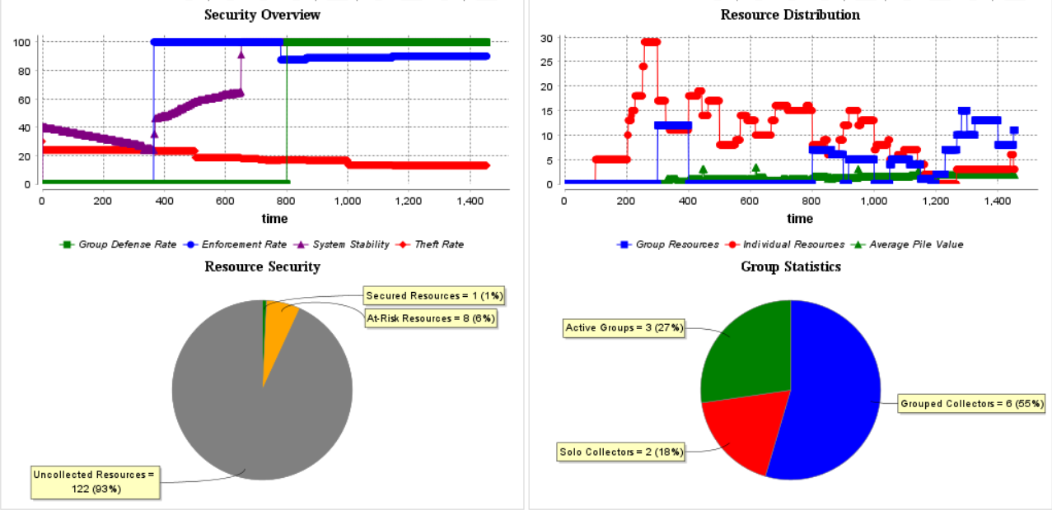
Ext3: Group Dynamics – Analysis

Slide 14
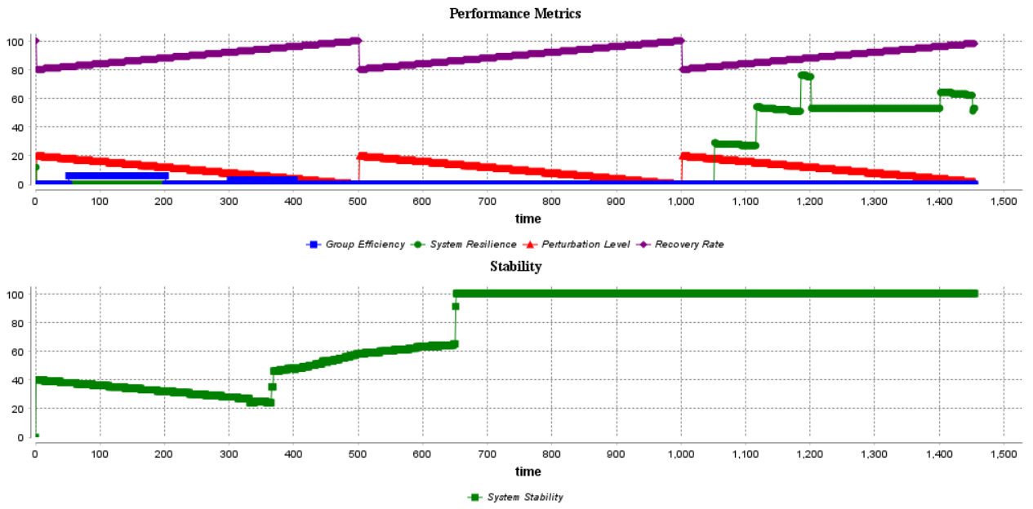
Ext3: Group Dynamics – Analysis

Slide 15
Conclusion
System Stability Achieved Through:
Peer pressure mechanisms
External enforcement
Group cooperation
Key Contributions
Demonstrated emergence of stable resource management
Identified optimal enforcement strategies
Validated group-based resilience

Slide 16
Thank you!

