Slide 1

New Lib4RI Web Search
frank.hoesli@lib4ri.ch
User’s outgoing search term
Incoming results from search sites
Unless otherwise noted, this work is licensed under a Creative Commons Attribution 4.0 License, which means that it can be freely copied, redistributed and adapted as long as appropriate attribution is given.

Slide 2
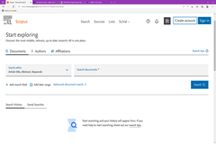
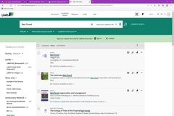
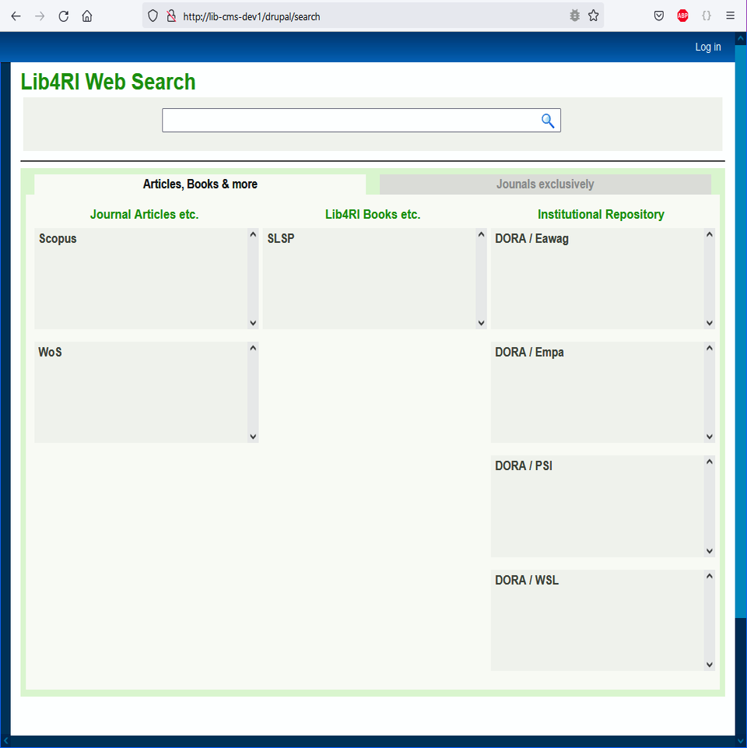

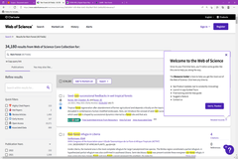
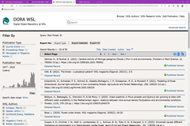
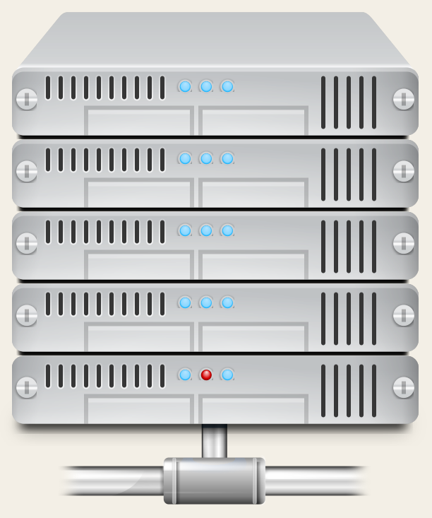
Lib4RI Web Search – the journey of a search term
Bento box tool to relay search term
w
water
wa
water|
wate
wat
API-optimized Search Handler
APIs to search
Prototype web page with result ‘Bento’ boxes for each site to search
Web server lib-cms-dev1

Slide 3
Lib4RI Web Search – the processing of search results
API-optimized Search Handler
Web server lib-cms-dev1

Slide 4



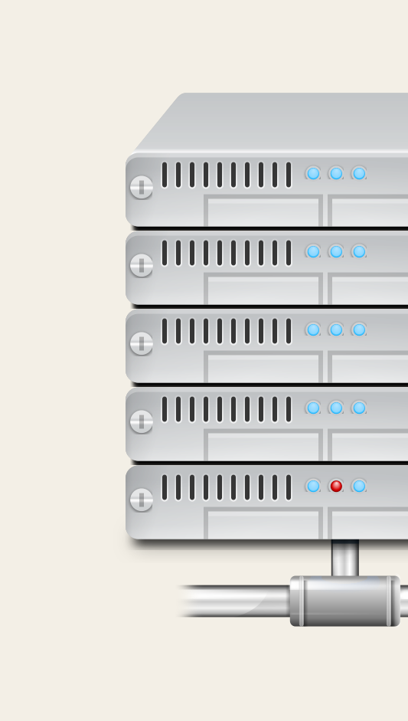
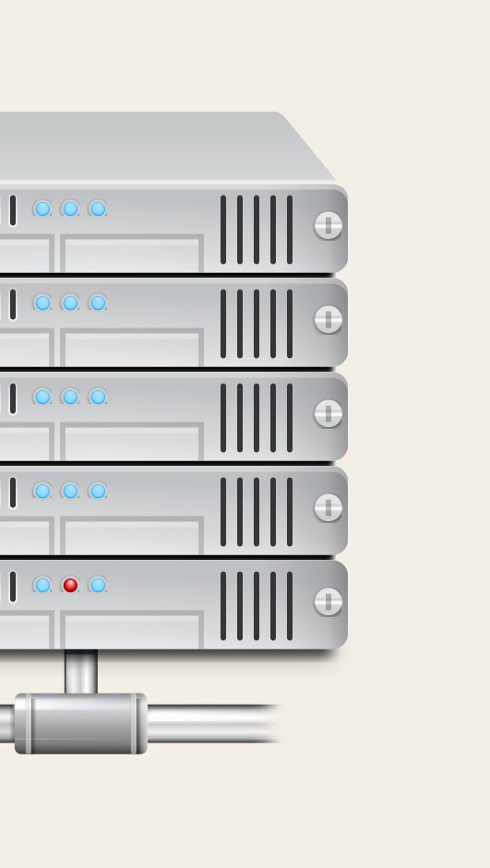
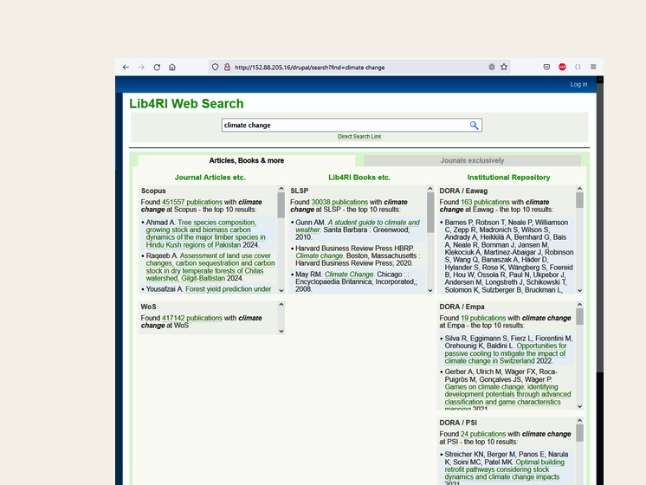
Lib4RI Web Search – the processing of search results
Bento box tool to fill in results for each search site
API-optimized Search Handler
API-optimized Search Handler
Web server lib-cms-
server lib-cms-dev1

