Slide 1




A Brief Introduction of LibEpidemic
BRICS-STI
EpiModeing Project
Jingyuan Wang, Honghao Shi, Qijian Tian
School of Computer Science and Engineering
Beihang University, Beijing, China
Chinese Center for Disease Control and Prevention, Beijing, China

Slide 2
Contents
01
Research Purpose and
Overall Structure
CONTENTS
02
LibEpidemic
APIs and Engine
03
LibEpidemic
Models and Applications

Slide 3




Research Purpose
LibEpidemic is an open source modeling framework, built in python, designed to help researchers, epidemiologists, teachers, and students whose research and learn related to infectious disease modeling.
LibEpidemic
API
Engine
Models
Application

Slide 4
Target Users - Researcher
Researchers can use the framework to build any compartment model simply and quickly, and execute it with arbitrary parameters to obtain results.
User Purpose:
Build compartment model
Execute model
Visualization results
Need to Learn:
Python (as basic)
API
Engine
Models
Can Use:
Everything in LibEpidemic
Customization at any Level
LibEpidemic
API
Engine
Models
Application

Slide 5
Target Users - Epidemiologist
Epidemiologists need to use the existing mature infectious disease models, make a small amount of expansion according to the actual situation, and then complete the model execution by adjusting the no-code method of the configuration file, and obtain the visualization results.
User Purpose:
Use compartment model
Solve Problem in Epidemiology
Fine-tune model if necessary
Need to Learn:
The Principal of Engine (with no code)
How to execute python file
Can Use:
All Existing Models in LibEpidemic
API with GUI to fine-tune (in the future)
LibEpidemic
API
Engine
Models
Application

Slide 6
Target Users - Educator
Researchers The construction and improvement of this framework can promote the integration of teaching and scientific research in related majors. The framework development team has cooperated with the School of Computer Science and Engineering, Beihang University to carry out the experimental course “scientific research classroom”, using the framework to carry out the teaching work.
User Purpose:
Teaching the Principal of Epidemic Modeling
Experimental Teaching of Epidemic Modeling
Can Use:
Learn Epidemic Modeling
Learn How to Constuct Model with python
Learn How to Improve Model after COVID-19 outbreaking
Learn How to Construct Open-source Framework

Slide 7
Overall Structure
In order to achieve the above goals, LibEpidemic has built an engine-function-model/application three-level framework, which provides users with different levels of freedom and support for different purposes.
Model/Application
Basic Model
Preset Complex Model
NPI applications
Examples/
Compartment/
Compiler/
Function
Visualization
Docs
No-code GUI (future)
Visual/
Parameters/
Executor/
Docs/
Engine
API to construct model
Executor to execute model
Supported tools
Utils/
Settings/

Slide 8
Contents
01
Research Purpose and
Overall Structure
CONTENTS
02
LibEpidemic
APIs and Engine
03
LibEpidemic
Models and Applications

Slide 9
Engine - Node and Edge
In compartment models (dynamic models), the “dynamic” part is the process by which a certain number of individuals move from one group to another. This process can be modeled using a directed graph. Therefore, the bottom layer of this engine is the nodes and edges of the directed graph. Each node models a compartment, and each edge models a term of a differential equation.
S
E
I
R
S
E
I
R
concrete and specific
->
abstract and broad
S
Node
Edge

Slide 10
Engine - Node and Edge (2)
We use the adjacency list data structure to model and store Node and Edge.
S
Attribute:
Name
Suffix-list
Function:
Add-suffix
Example:
S->E in SEIR model
Init 2 Nodes with Name S and E.
Node named S add a suffix E, then the Suffix-list of S is [E].
P->A & P -> I in SEPIAR model
Init 3 Nodes with Name P, A and I.
Node named P add a suffix A, then the Suffix-list of S is [A].
Node named P add a suffix I, then the Suffix-list of S is [A, I].
Node
Edge

Slide 11
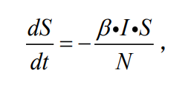
Engine – Compartment and Transmission
In order to move from node-edge to a real compartment model, a higher-level class containing node-edge and additional information is needed to model the “node” and “edge” in compartment models.
In the compartment model, the node function is carried by the compartment, and the edge function is carried by the transmission.
S
X
Node
Edge
Compartment
Transmission
X:X(t), the number of individuals in compartment X at time t

Slide 12
Engine – Compartment and Transmission (2)
X
Attribute:
Node
Value
Function:
Ø
Example:
S in SEIR model
Init 4 Nodes with Name S, E, I and R.
Construct the graph of Node and Edge. (Detail in next Slide)
Init 1 Compartment from Node S.
Fill the default value of S with 10000.
Compartment

Slide 13
Engine – Compartment and Transmission (3)
Attribute:
Expression
Parameter-values
Function:
Set-Exp
Set-Param
Example:
S->E in SEIR model
Init Graph, finish Compartment.
Set the Expression with Set-Exp: beta * S * I * popuinv
Set the Parameter-values with Set-Param: {beta: 0.3}
Add the value of popuinv with 1.0/popu,
Parameter-values:{beta:0.3, popuinv:0.0001}
Transmission

Slide 14
Engine – Graph and Model
The graph and model integrate the various parts of the compartment model. Graph integrates node and path at the level of directed graph, while model integrates compartment and transmission at the level of infectious disease.
S
S
E
I
R
Node
Edge
Graph
X
S
E
I
R
Compartment
Transmission
Model

Slide 15

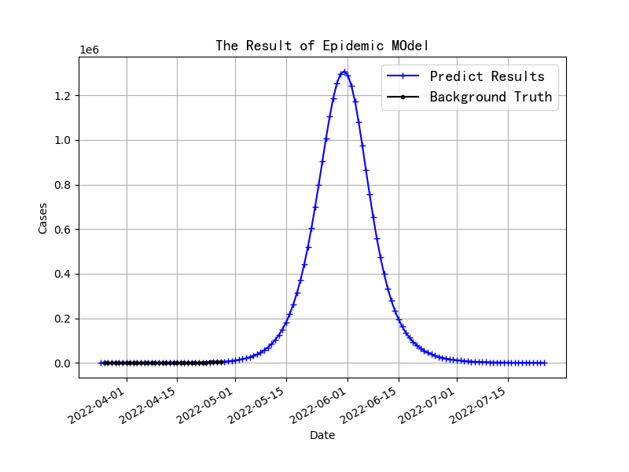
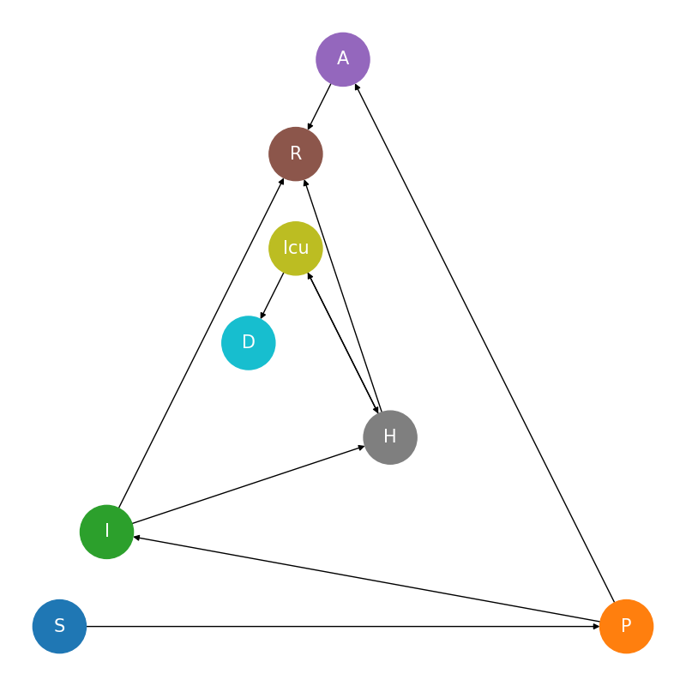
API User Guide – SEIR for Example
LibEpidemic provides 4 types of APIs for building a compartment model:
Structure
Formula and Parameters
Executor
Results and Visualization
Here we use the built and simulated SEIR as an example to introduce these APIs
S
E
I
R
Structure
Executor
S
E
I
R
Formula and Parameters
Results and Visualization

Slide 16
API User Guide – Determine Structure
You can build a compartment model structure of any shape through the following three APIs:
Vertical Divide
Horizontal Divide
Add Path
These APIs can not only build a compartment model of arbitrary structure, but also have specific epidemiological significance, which is one of the research points in the field of infectious disease modeling after the outbreak of COVID-19
S
E
I
R
S
E
I
R
Model
Structure

Slide 17
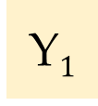
API User Guide – Determine Structure (2)
Vertical Divide can subdivide compartments by information relevant to the epidemiological process, such as asymptomatic, pre-symptomatic, confirmed, isolated, etc.
Such subdivide supports the modeling of individual differences within the same compartment
New compartment 1
X
X
Y$1$
Origin
compartment
New compartment 2
Y
Y₂
Y_{n}
New compartment 3
Z
Z
Local
Global

Slide 18
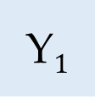
API User Guide – Determine Structure (3)
Horizontal Divide can subdivide compartments by information not relevant to the epidemiological process, such as age, gender, country, etc.
Such subdivide supports the modeling of individual differences within the same compartment
X
X
New compartment 1
Origin
compartment
New compartment 2
Y
Y$1$
Y₂
Y_{n}
New compartment 3
Z
Z
Local
Global

Slide 19
API User Guide – Determine Structure (4)
Add Path can add an transmission, give it formula and parameters.
Usually used in combination with the first two methods
Origin
compartment 1
X
U
X
U
Y
V
Y
V
Origin compartment 2
Z
W
Z
W
Local
Global

Slide 20
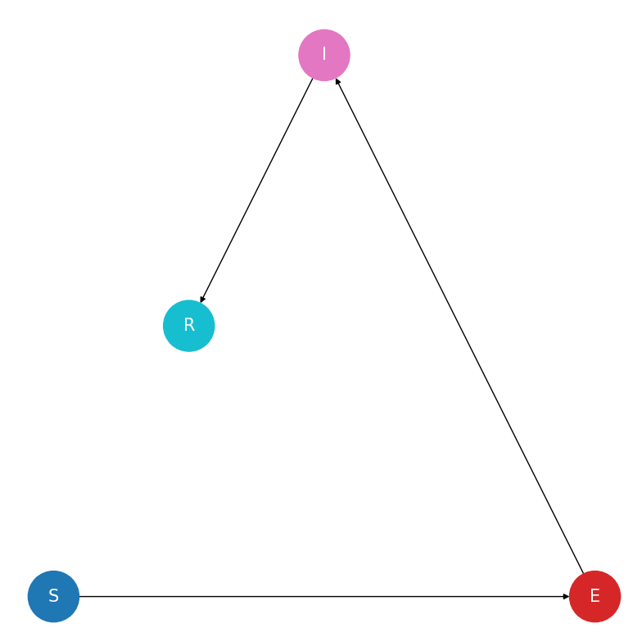
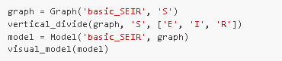
API User Guide – Determine Structure (4)
Determine the structure of SEIR model with these API:
Initializes a graph containing the S compartment and names it basic_SEIR.
Uses vertical_divide to subdivide the initial S into S, E, I and R, which corresponds to the SEIR model.
Converts the diagram used to describe the abstract structure into a model in LibEpidemic after determining the structure of the compartment model, providing support for subsequent work.
Calls the visualization API and prints the structure diagram that builds this model.
Python Code
in LibEpidemic
Visualization of SEIR
in LibEpidemic

Slide 21
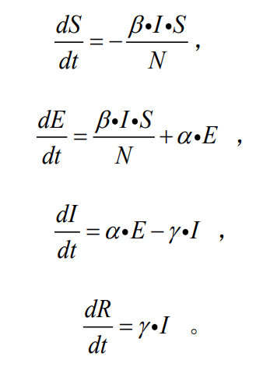
API User Guide – Formula and Parameters
After create the strcture of model, you can use the following APIs to dealing with parameters(or formula).
Set Path Exp
Set Path Parameters
Reset Parameters
It is worth noting that only the parameters in the formula need to be considered here. The current compartment value involved in the formula and how to calculate the formula are all functions of the executor.
Parameter | Value
β | 0.5
α | 1.0/10.0
γ | 1.0/10.0
N | 10000
S
E
I
R
Model
Formula and Parameters

Slide 22



API User Guide – Formula and Parameters (2)
Determine the Formula and Parameters of SEIR model with these API:
Give a set of value
Set formula
Fill Parameters into formula
Parameter | Value
β | 0.5
α | 1.0/10.0
γ | 1.0/10.0
N | 10000

Slide 23
API User Guide – Executor
Executor can use the model and all the methods of each class, and use the expression analysis system to complete the simulation of the compartment model.
The function of executor contains:
Parse the expression like the string ‘beta*S*I*popu’.
Calculate the expression to simulate the model.
S
E
I
R
Parameter | Value
β | 0.5
α | 1.0/10.0
γ | 1.0/10.0
N | 10000

Slide 24
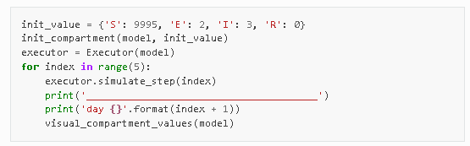
API User Guide – Executor (2)
Executing the SEIR model can be done with only 2 APIs, without programming the principles of infectious disease dynamics models, and without manually writing complex model extensions. In fact, executing steps is the same to every model, not only SEIR.
Use init_compartment to set the init value of each compartment.
Use Executor() to init a executor
Use simulate_step to finish all parsing and calculating

Slide 25
API and Engine - Conclusion
In LibEpidemic, you can:
Build the structure of model with 3 APIs:
Vertical Divide
Horizontal Divide
Add Path
Fill with formula and parameters with 3 APIs:
Set Path Exp
Set Path Parameters
Reset Parameters
Execute the model with 2 APIs:
init_compartment
simulate_step
Visualizing the results with 4 APIs or matplotlib:
visual_graph
visual_model
visual_compartment_values
plot_line
Import matplotlib as plt (*)

Slide 26
API and Engine – Conclusion (2)
In LibEpidemic, you can build a model like SEIR in 4 steps:
1
S
E
I
R
4
1. Determine Structure
S
E
I
R
3
Parameter | Value
β | 0.5
α | 1.0/10.0
γ | 1.0/10.0
N | 10000
2
Model to be built
4. Visualization
3. Executing
2. Fill Formula and Parameters

Slide 27
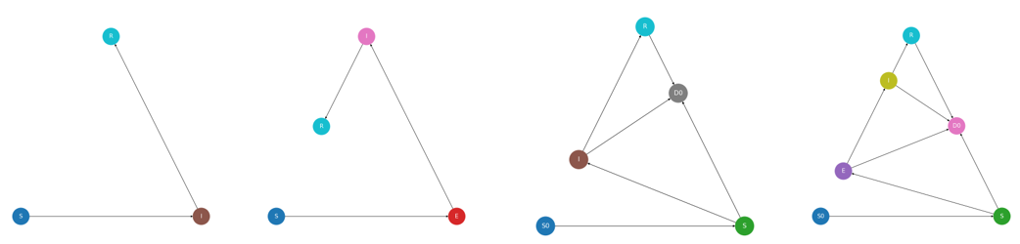
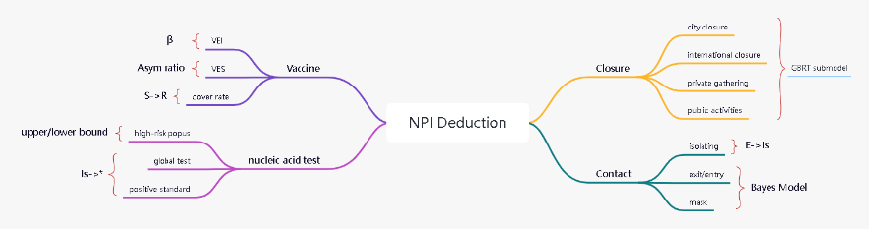
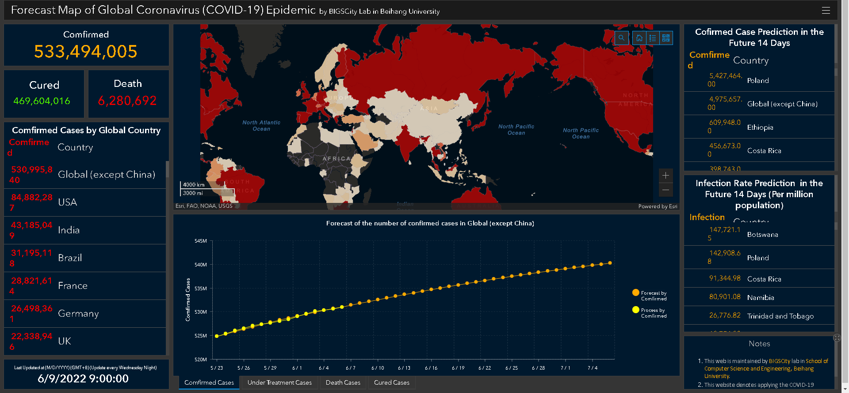
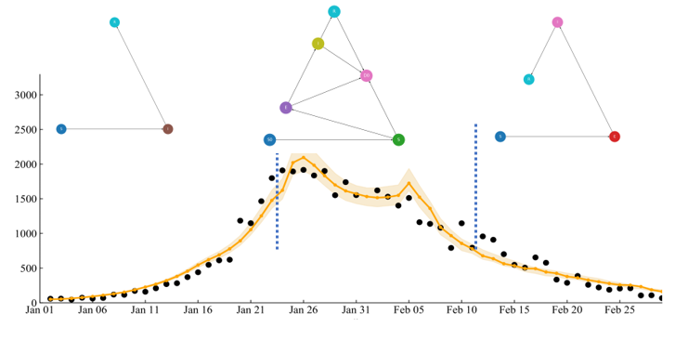
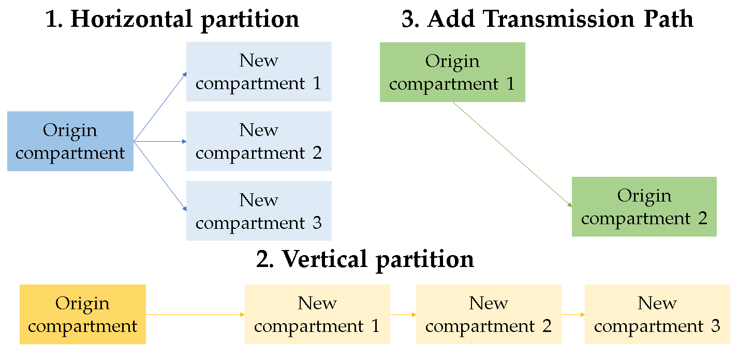

API and Engine – Conclusion (2)
Data
Models
Applications
Users
Case Data
Confirmed
Recovered
Death
Non-case Data
Mobility
NPI
Climate
Classical
SIR\SEIR\SEPIR
Complex
Meta-population
Subdivided
Multi-stage
Dynamic parameters
NPI Deduction
SEPAIR + No-code settings
One-fit-all Model
SIR/SEIR/SEPIR/birth/death
Multi-stage + Auto search
Researchers
build any warehouse model simply and quickly, and execute it with arbitrary parameters to obtain results
Support
Support
Epidemiologists
use the existing mature infectious disease models, make a small amount of expansion according to the actual situation, and then complete the model execution
by adjusting the no-code method of the configuration file, and obtain the visualization results
Support
Executor
generate
serve
extract
Support
Utils and Visualization
Engine and APIs
Educators
The construction and improvement of this framework can promote the integration of teaching and scientific research in related majors

Slide 28
Contents
01
Research Purpose and
Overall Structure
CONTENTS
02
LibEpidemic
APIs and Engine
03
LibEpidemic
Models and Applications

Slide 29
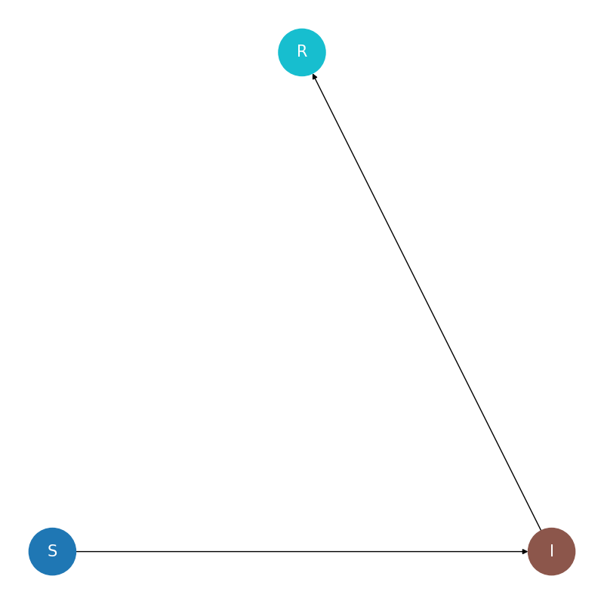
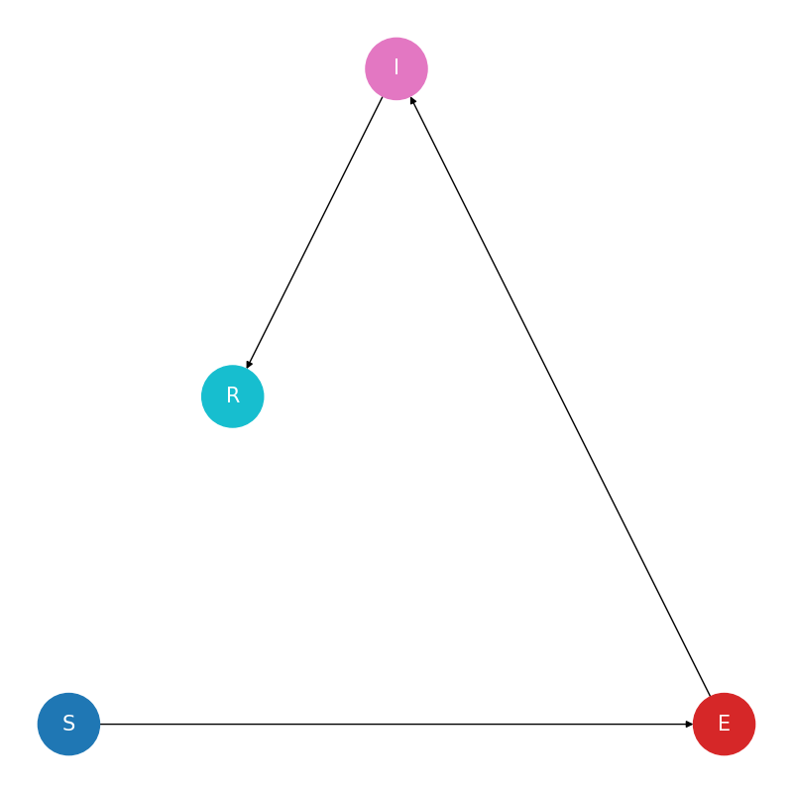
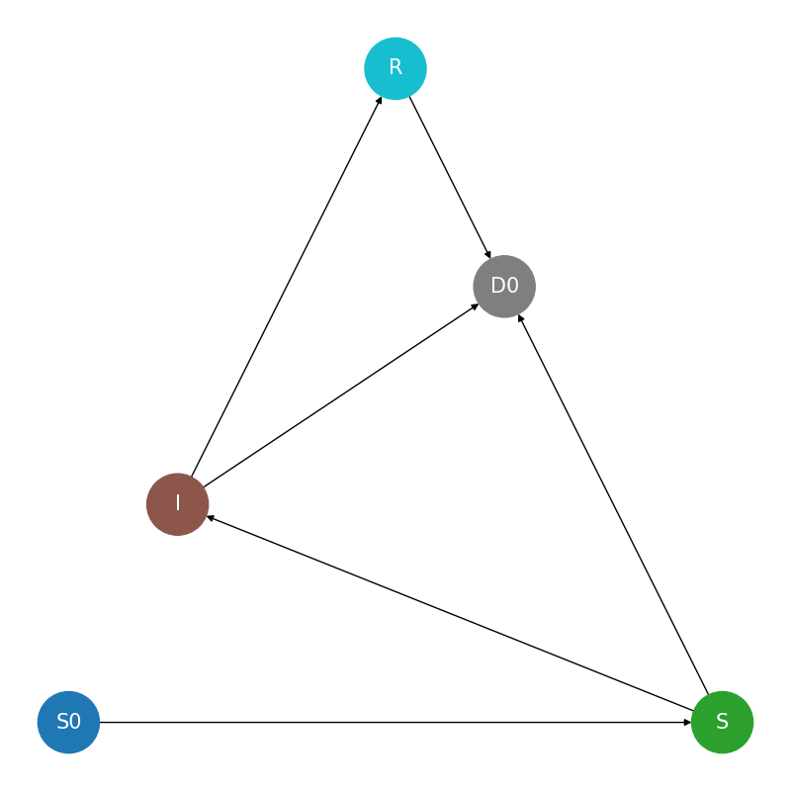
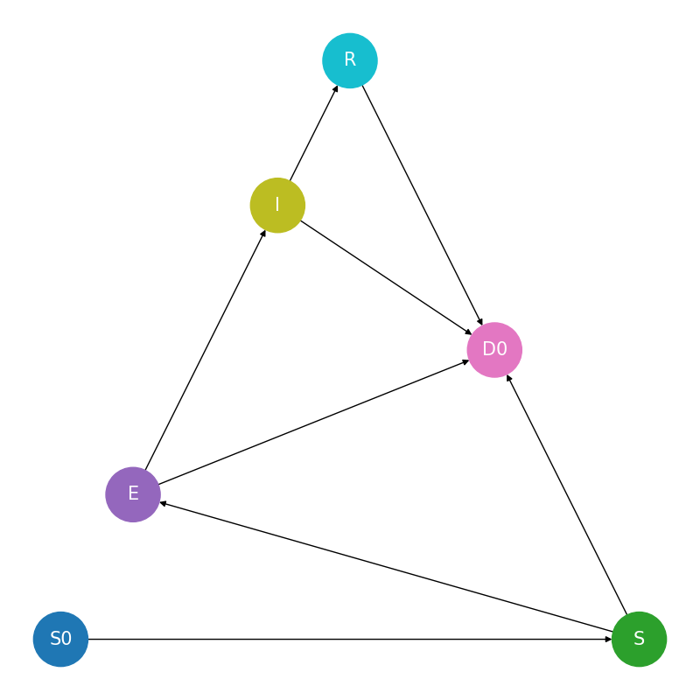
Base Model - SEIR-class
LibEpidemic has 5 complete basic models built in:
SIR
SEIR
SIR + natural birth/death
SEIR + natural birth/death
SEPIR
They come from textbooks or cups for early COVID-19 predictions
Users can view and modify the code of these basic models, fill in any parameter settings, complete the model simulation, and view the results

Slide 30
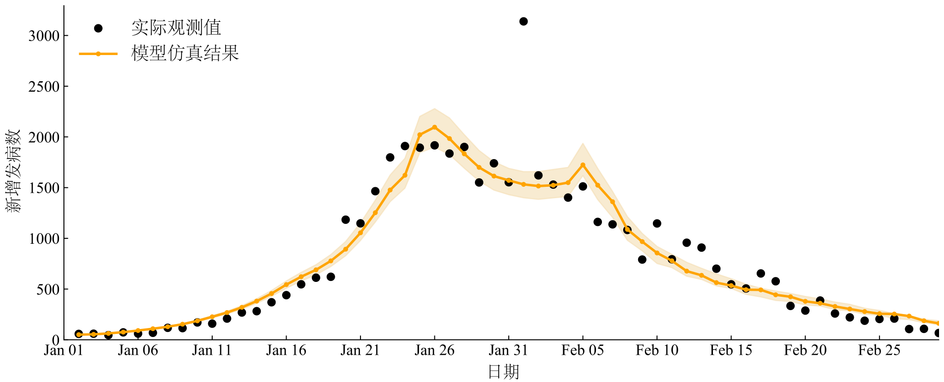
Base Model - SEIR-class (2)
Every models in LibEpidemic can use multi-stage or dynamic-parameters strategy
Multi-stage means change the whole model in different time part
Dynamic-parameters means only the parameters can change with time, not the structure
Model 1
Model 2
Model 3

Slide 31
Base Model - SEIR-class (3)
Considering that the inputs to the underlying SEIR model are similar, LibEpidemic provide Mixed-strategy Model to Epidemiologists . The mixed-strategy model is used with the multi-stage method, and the optimal model in the model library is automatically selected through the given loss function in each stage.
Model Library
Select Result

Slide 32
Base Model - SEIR-class (3)
Mixed-strategy models can be used to build a "one fits all model“. Using this model, combined with multi-stage global predictions (tests), the total error is less than or equal to any single model.
Model Library
Select Result

Slide 33
Base Model – Metapopulation Model
In the SEIR model, ”transmission” occurs uniformly between susceptible and infected compartments. But actually, in human society, this process goes along social networks.
The metapopulation model regards each node on the social network as a population, and the transmission of infectious diseases within the population is uniform, which is in line with the SEIR model. Between populations, along every edge on a social network, there is flow of individuals.
LibEpidemic provide a complete example of building a metapopulation model
SEIR-based
Model
SEIR-based
Model
SEIR-based
Model
SEIR-based
Model
SEIR-based
Model
SEIR-based
Model
SEIR-based
Model
SEIR-based
Model
SEIR-based
Model

Slide 34
Applications – Complex Model from Paper

Slide 35
Applications – Complex Model from Paper (2)

Slide 36
Applications – Complex Model from Paper (3)

Slide 37
Applications – Complex Model from Paper (4)

Slide 38
Applications – Complex Model from Paper (5)

Slide 39
Applications - NPIs

Slide 40
Thanks for Listening!
王静远，北京航空航天大学
Jingyuan Wang, Beihang University, Beijing, China
jywang@buaa.edu.cn，http://www.bigcity.ai

